Slide 1
Lecture 4:
Introduction to Proofs
Section 1.7

Slide 2
Section Summary
Mathematical Proofs
Forms of Theorems
Direct Proofs
Indirect Proofs
Proof by Contraposition
Proof by Contradiction

Slide 3
Proofs of Mathematical Statements
A proof is a valid argument that establishes the truth of a statement.
Proofs have many practical applications:
verification that computer programs are correct
establishing that operating systems are secure
enabling programs to make inferences in artificial intelligence
showing that system specifications are consistent

Slide 4
Definitions
A theorem is a statement that can be shown to be true using:
definitions
other theorems
axioms (statements which are given as true)
rules of inference
A lemma is a ‘helping theorem’ or a result which is needed to prove a theorem.
A corollary is a result which follows directly from a theorem.
Less important theorems are sometimes called propositions.
A conjecture is a statement that is being proposed to be true. Once a proof of a conjecture is found, it becomes a theorem. It may turn out to be false.

Slide 5
Forms of Theorems
Many theorems assert that a property holds for all elements in a domain, such as the integers, the real numbers, or some of the discrete structures that we will study in this class.
Often the universal quantifier (needed for a precise statement of a theorem) is omitted by standard mathematical convention.
For example, the statement:
“If x > y, where x and y are positive real numbers, then x² > y² ”
really means
“For all positive real numbers x and y, if x > y, then x² > y² .”

Slide 6
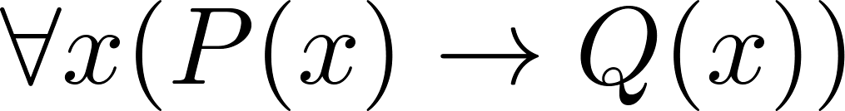
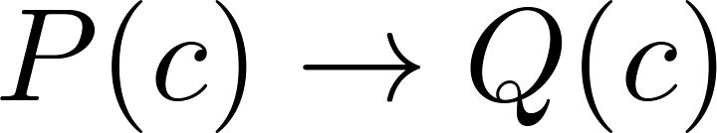

Proving Theorems
Many theorems have the form:
To prove them, we show that: where c is an arbitrary element of the domain,
By universal generalization the truth of the original formula follows.
So, we must prove something of the form:

Slide 7
Proving Conditional Statements: p → q
Trivial Proof: If we know q is true, then
p → q is true as well.
“If it is raining then 1=1.”
Vacuous Proof: If we know p is false then
p → q is true as well.
“If I am both rich and poor then 2 + 2 = 5.”
[ Even though these examples seem silly, both trivial and vacuous proofs are often used in mathematical induction, as we will see in Chapter 5) ]

Slide 8
Even and Odd Integers
Definition: The integer n is even if there exists an integer k such that n = 2k, and n is odd if there exists an integer k, such that n = 2k + 1. Note that every integer is either even or odd and no integer is both even and odd.
We will need this basic fact about the integers in some of the example proofs to follow. We will learn more about the integers in Chapter 4.

Slide 9
Proving Conditional Statements: p → q
Direct Proof: Assume that p is true. Use rules of inference, axioms, and logical equivalences to show that q must also be true.
Example: Give a direct proof of the theorem “If n is an odd integer, then n² is odd.”
Solution: Assume that n is odd. Then n = 2k + 1 for an integer k. Squaring both sides of the equation, we get:
n² = (2k + 1)² = 4k² + 4k +1 = 2(2k² + 2k) + 1= 2r + 1,
where r = 2k² + 2k , an integer.
We have proved that if n is an odd integer, then n² is an odd integer.

Slide 10
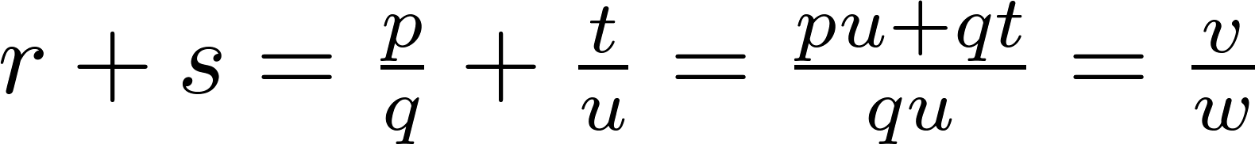
Proving Conditional Statements: p → q
Definition: The real number r is rational if there exist integers p and q such that r = p/q, where q≠0.
Example: Prove that the sum of two rational numbers is rational.
Solution: Assume r and s are two rational numbers. Then there must be integers p, q and also t, u such that
Thus the sum is rational.
where v = pu + qt
w = qu ≠ 0

Slide 11
Proof by Contraposition
Proof by Contraposition: Assume ¬q and show ¬p is true also. This is sometimes called an indirect proof method. If we give a direct proof of ¬q → ¬p then we have a proof of p → q.
Why does this work?
Example: Prove that if n is an integer and 3n + 2 is odd, then n is odd.
Solution: Assume n is even. So, n = 2k for some integer k. Thus,
3n + 2 = 3(2k) + 2 =6k +2 = 2(3k + 1) = 2j for j = 3k +1
Therefore 3n + 2 is even. Since we have shown ¬q → ¬p , p → q must hold as well. If n is an integer and 3n + 2 is odd (not even) , then n is odd (not even).

Slide 12
Proof by Contraposition
Example: Prove that for an integer n, if n² is odd, then n is odd.
Solution: Use proof by contraposition. Assume n is even (i.e., not odd). Therefore, there exists an integer k such that n = 2k. Hence,
n² = 4k² = 2 (2k²)
and n² is even(i.e., not odd).
We have shown that if n is an even integer, then n² is even. Therefore by contraposition, for an integer n, if n² is odd, then n is odd.

Slide 13
Proof by Contradiction
Proof by Contradiction: (AKA reductio ad absurdum).
To prove p (the theorem), assume ¬p and derive a contradiction (such as p ∧ ¬p).
Since we have shown that ¬p →F is true, it follows that the contrapositive T→p also holds.
Example: Prove that if you pick 22 days from the calendar, at least 4 must fall on the same day of the week.
Solution: Assume that no more than 3 of the 22 days fall on the same day of the week. Because there are 7 days of the week, we could only have picked 21 days. This contradicts the assumption that we have picked 22 days.

Slide 14
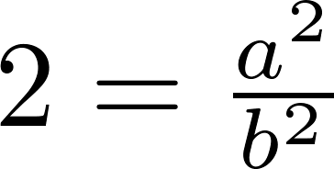
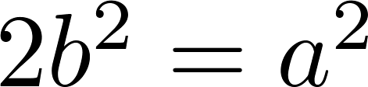
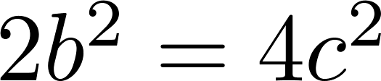
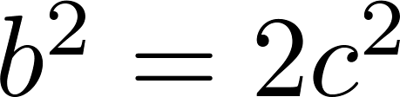
Proof by Contradiction
Example-1: Use a proof by contradiction to give a proof that √2 is irrational.
Solution: Suppose √2 is rational. Then there exists integers a and b with √2 = a/b, where b≠ 0 and a and b have no common factors (see Chapter 4). Then
Therefore a² must be even. If a² is even then a must be even (an exercise). Since a is even, a = 2c for some integer c. Thus,
Therefore b² is even. Again then b must be even as well.
But then 2 must divide both a and b. This contradicts our assumption that a and b have no common factors. We have proved by contradiction that our initial assumption must be false and therefore √2 is irrational .

Slide 15
Proof by Contradiction
Example-2: Give a proof by contradiction of the statement: “If 3n + 2 is odd, then n is odd.”
Solution: Let p be “3n + 2 is odd” and q be “n is odd.” To construct a proof by contradiction, assume that both p and ¬q are true. That is, assume that 3n + 2 is odd and that n is not odd. Because n is not odd, we know that it is even. -> Because n is even, there is an integer k such that n = 2k. This implies that 3n + 2 = 3(2k) + 2 = 6k + 2 = 2(3k + 1). -> Because 3n + 2 is 2t, where t = 3k + 1, 3n + 2 is even. Note that the statement “3n + 2 is even” is equivalent to the statement ¬p, because an integer is even if and only if it is not odd. -> Because both p and ¬p are true, we have a contradiction. This completes the proof by contradiction, proving that if 3n + 2 is odd, then n is odd.

Slide 16
Theorems that are Biconditional Statements
To prove a theorem that is a biconditional statement, that is, a statement of the form p ↔ q, we show that p → q and q →p are both true.
Example: Prove the theorem: “If n is an integer, then n is odd if and only if n² is odd.”
Solution: We have already shown (previous slides) that both p →q and q →p. Therefore we can conclude p ↔ q.
Sometimes iff is used as an abbreviation for “if and only if,” as in
“If n is an integer, then n is odd iff n² is odd.”

Slide 17
Biconditional Statements are useful for proving equivalence
Example: Show that these statements about the integer x are equivalent: (i) 3x + 2 is even, (ii) x + 5 is odd, (iii) x² is even. [Ch 1.7, Exercise 33]
Solution: Let, p = “3x + 2 is even”, q = “x + 5 is odd”, and r = “x² is even”.
Assume, 3x + 2 is even. Therefore, 3x is even. [even – even = even]
Since, 3 is odd, x must be even.
Then, x + 5 must be odd. [even + odd = odd] (proved p → q)
Also, x can be written as 2k, where k is an integer.
Then x² = (2k)² = 4k². Thus, x² is even. (proved p → r)
Now, we must prove the converse, r → p and q → p. Complete it yourself.
Then we will have, p ↔ q and p ↔ r. Therefore, p ≡ q and p ≡ r.
In other words, p ≡ q ≡ r .

Slide 18
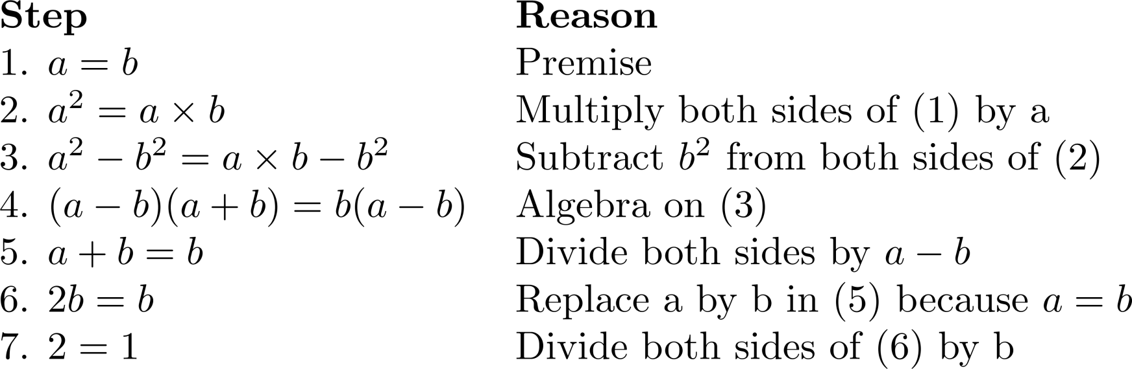
What is wrong with this?
“Proof” that 1 = 2
Solution: Step 5. a - b = 0 by the premise and division by 0 is undefined.

Slide 19
Assumptions are important.
What should be the assumption when we try to prove these statements?
“if x is an irrational number and x > 0, then √x is also irrational.”
for direct proof: Assume x cannot be written as p/q, where q ≠ 0. (Difficult to prove the statement, as we cannot explicitly represent irrationality in algebra)
for contraposition: Assume √x is rational, therefore √x = p/q, where q ≠ 0. (easier to proof for x from √x)

Slide 20
Assumptions are important.
What should be the assumption when we try to prove these statements?
“If x, y, and z are integers and all three are even, then x +y +z is even,”
for direct proof: Assume x, y and z are evens, therefore, x = 2a, y = 2b and z = 2c. (Easier to find x+y+z)
for contraposition: Assume x+y+z = 2k + 1. (Relatively Lengthy, have to separately consider x, y and z and their cases)
“if m and n are integers and mn is even, then m is even or n is even.”
for direct proof: Assume mn is even, therefore mn = 2k. (Relatively Difficult, have to consider all cases of m and n)
for contraposition: Assume m is odd and n is odd, therefore m = 2a+1, n = 2b+1. (Easier to find mn)

Slide 21
Looking Ahead
If direct methods of proof do not work:
We may need a clever use of a proof by contraposition.
Or a proof by contradiction.
In Chapter 5, we will see mathematical induction and related techniques.

