Slide 1
Lecture 5:
Mathematical Induction
Section 5.1

Slide 2
Section Summary
Mathematical Induction
Examples of Proof by Mathematical Induction
Mistaken Proofs by Mathematical Induction
Guidelines for Proofs by Mathematical Induction

Slide 3
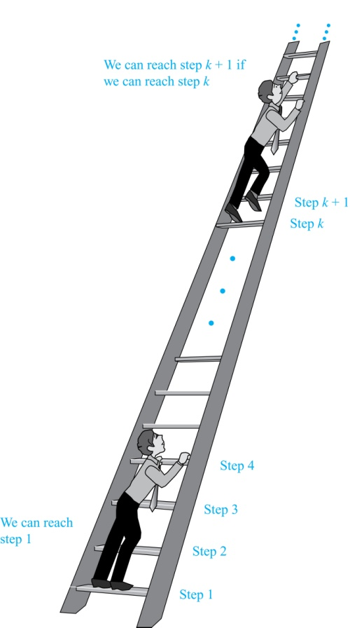
Climbing an Infinite Ladder
Suppose we have an infinite ladder:
We can reach the first rung of the ladder.
If we can reach a particular rung of the ladder, then we can reach the next rung.
From (1), we can reach the first rung. Then by applying (2), we can reach the second rung. Applying (2) again, the third rung. And so on. We can apply (2) any number of times to reach any particular rung, no matter how high up.
This example motivates proof by mathematical induction.

Slide 4
Principle of Mathematical Induction
Principle of Mathematical Induction: To prove that P(n) is true for all positive integers n, we complete these steps:
Basis Step: Show that P(1) is true.
Inductive Step: Show that P(k) → P(k + 1) is true for all positive integers k.
To complete the inductive step, assuming the inductive hypothesis that P(k) holds for an arbitrary integer k, show that must P(k + 1) be true.
Climbing an Infinite Ladder Example:
BASIS STEP: By (1), we can reach rung 1.
INDUCTIVE STEP: Assume the inductive hypothesis that we can reach rung k. Then by (2), we can reach rung k + 1.
Hence, P(k) → P(k + 1) is true for all positive integers k. We can reach every rung on the ladder.

Slide 5
Important Points About Using Mathematical Induction
Mathematical induction can be expressed as :
where the domain is the set of positive integers.
In a proof by mathematical induction, we don’t prove that P(k) is true for all positive integers! We show that if we assume that P(k) is true, then P(k + 1) must also be true.
Proofs by mathematical induction do not always start at the integer 1. In such a case, the basis step begins at a starting point b where b is an integer. We will see examples of this soon.
(P(1) ∧ ∀k (P(k) → P(k + 1))) → ∀n P(n),

Slide 6
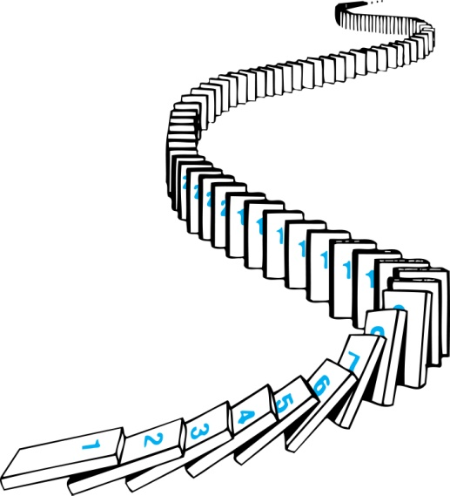
How Mathematical Induction Works
Consider an infinite sequence of dominoes, labeled 1,2,3, …, where each domino is standing.
We know that the first domino is knocked down, i.e., P(1) is true .
We also know that if whenever the k^{th} domino is knocked over, it knocks over the (k + 1)^{st} domino, i.e, P(k) → P(k + 1) is true for all positive integers k.
Let P(n) be the proposition that the nth domino is knocked over.
Hence, all dominos are knocked over.
P(n) is true for all positive integers n.

Slide 7
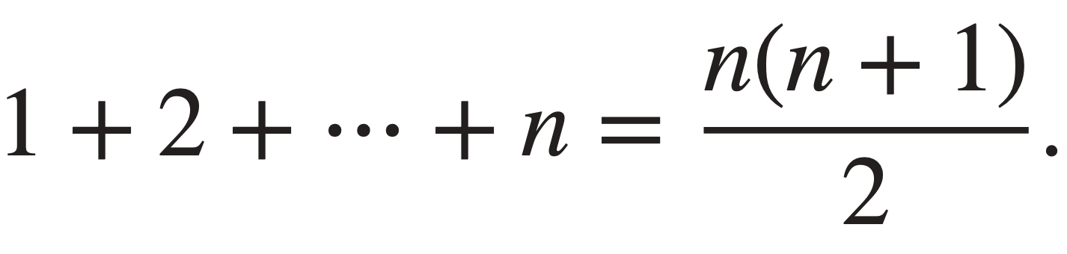
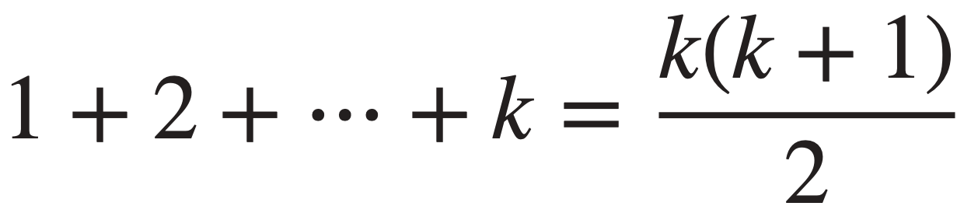
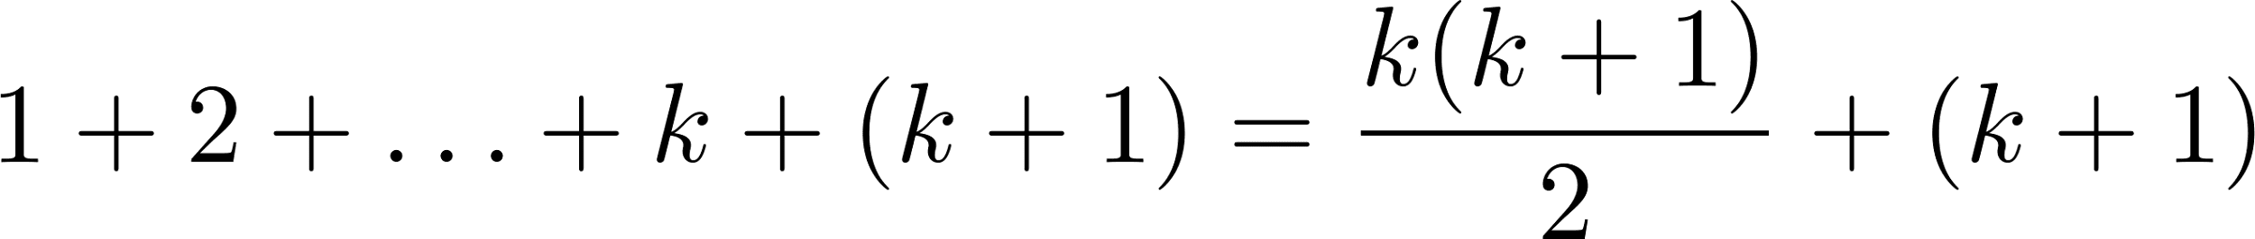
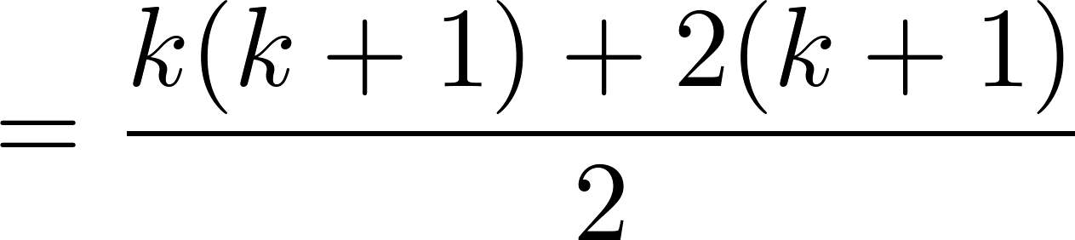
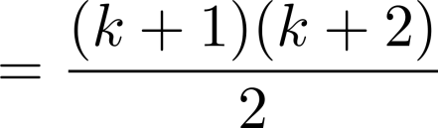
Proving a Summation Formula by Mathematical Induction
Example: Show that if n is a positive integer, then:
Solution:
BASIS STEP: P(1) is true since 1 = 1(1 + 1)/2.
INDUCTIVE STEP: Assume P(k) holds.
Then, the inductive hypothesis is:
Under this assumption,

Slide 8
Conjecturing and Proving Correct a Summation Formula
Example: Conjecture and prove correct a formula for the sum of the first n positive odd integers. Then prove your conjecture.
Solution: We have: 1= 1, 1 + 3 = 4, 1 + 3 + 5 = 9, 1 + 3 + 5 + 7 = 16,
1 + 3 + 5 + 7 + 9 = 25.
We can conjecture that the sum of the first n positive odd integers is n²,
We prove that the conjecture is correct with mathematical induction.
BASIS STEP: P(1) is true since 1² = 1.
INDUCTIVE STEP: We have to show that, for every positive integer k,
P(k) → P(k + 1).
Assume the inductive hypothesis P(k) is True and then show that P(k + 1) holds has well.
(continued →) .
1 + 3 + 5 + ∙∙∙+ (2n − 1) =n² .

Slide 9
Conjecturing and Proving Correct a Summation Formula
Inductive Hypothesis: P(k) ≡ “1 + 3 + 5 + ∙∙∙+ (2k − 1) = k² ”
So, assuming P(k), it follows that:
Hence, we have shown that P(k + 1) follows from P(k). Therefore the sum of the first n positive odd integers is n².
1 + 3 + 5 + ∙∙∙+ (2k − 1) + (2k + 1)
= [1 + 3 + 5 + ∙∙∙+ (2k − 1)] + (2k + 1)
= k² + (2k + 1) [by the inductive hypothesis]
= k² + 2k + 1 = (k + 1) ²

Slide 10
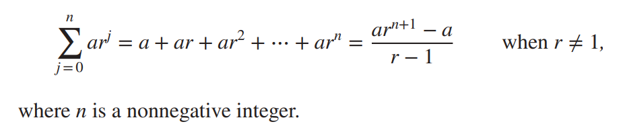
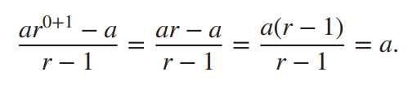
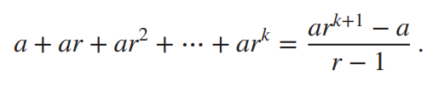
More Summation Proof by Induction
Example:
Show that: Sum of a finite number of terms in a geometric progression with initial term a and common ratio r is
Solution:
BASIS STEP: P(0) is true since
INDUCTIVE STEP: Assume true for P(k). So the inductive hypothesis would be:
Under such assumption, we add ar^{k+1} to both sides of the equality above.

Slide 11
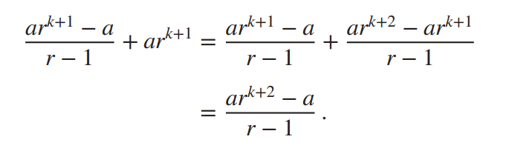
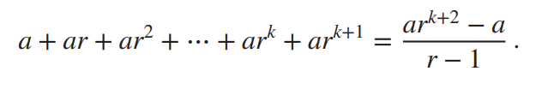
More Summation Proof by Induction (contd.)
Rewriting the R.H.S of the equation gives
which implies-
Conclusion: If the inductive hypothesis P(k) is true, then P(k+1) must be true. Proof by induction done!

Slide 12
Proving Divisibility Results
Example: Use mathematical induction to prove that n³ − n is divisible by 3, for every positive integer n.
Solution: Let P(n) be the proposition that n³ − n is divisible by 3.
BASIS STEP: P(1) is true since 1³ − 1 = 0, which is divisible by 3.
INDUCTIVE STEP: Assume P(k) holds, i.e., k³ − k is divisible by 3, for an arbitrary positive integer k. To show that P(k + 1) follows:
(k + 1)³ − (k + 1) = (k³ + 3k² + 3k + 1) − (k + 1)
= (k³ − k) + 3(k² + k)
By the inductive hypothesis, the first term (k³ − k) is divisible by 3 and the second term is divisible by 3 since it is an integer multiplied by 3. So by part (i) of Theorem 1 in Section 4.1 , (k + 1)³ − (k + 1) is divisible by 3.
Therefore, n³ − n is divisible by 3, for every integer positive integer n.

Slide 13
Proving More Divisibility
Example: Use mathematical induction to prove that 7^{n+2} +8^{2n+1} is divisible by 57 for every nonnegative integer n.
Solution: Let P(n) denote the proposition: “7^{n+2} +8^{2n+1} is divisible by 57.”
BASIS STEP: P(0) is true since 7⁰⁺² +8^{2⋅0+1} = 7² +8¹ = 57 is divisible by 57.
INDUCTIVE STEP: Assume P(k) holds, that is, we assume that
7^{k+2} +8^{2k+1} is divisible by 57. So we can write: 7^{k+2} +8^{2k+1} = 57x,
where x is an integer.
Then, we must show that P(k +1), the statement that
“7^{(k+1)+2} +8^{2(k+1)+1} is divisible by 57”, is also true. We find that,
7^{(k+1)+2} +8^{2(k+1)+1} = 7^{k+3} +8^{2k+3} = 7 ⋅ 7^{k+2} +8² ⋅ 8^{2k+1} = 7 ⋅ 7^{k+2} +64 ⋅ 8^{2k+1}
= 7(7^{k+2} +8^{2k+1}) +57⋅ 8^{2k+1} = 7(57x) +57⋅ 8^{2k+1} = 57(7x + 8^{2k+1}).
Therefore, 7^{(k+1)+2} +8^{2(k+1)+1} is divisible by 57.

Slide 14
An Incorrect “Proof” by Mathematical Induction (Cont.)
Example: Let P(n) be the statement that “Every set of n lines in the plane, no two of which are parallel, meet in a common point.” Here is a “proof” that P(n) is true for all positive integers n ≥ 2.
BASIS STEP: The statement P(2) is true because any two lines in the plane that are not parallel meet in a common point.
INDUCTIVE STEP: The inductive hypothesis is the statement that P(k) is true for the positive integer k ≥ 2, i.e., every set of k lines in the plane, no two of which are parallel, meet in a common point.
We must show that if P(k) holds, then P(k + 1) holds,
i.e., if every set of k lines in the plane, no two of which are parallel, k ≥ 2, meet in a common point,
then every set of k + 1 lines in the plane, no two of which are parallel, meet in a common point.
continued →

Slide 15
An Incorrect “Proof” by Mathematical Induction (Cont.)
Consider a set of k + 1 distinct lines in the plane, no two parallel. By the inductive hypothesis, the first k of these lines must meet in a common point p₁. By the inductive hypothesis, the last k of these lines meet in a common point p₂.
If p₁ and p₂ are different points, all lines containing both of them must be the same line since two points determine a line. This contradicts the assumption that the lines are distinct. Hence, p₁ = p₂ lies on all k + 1 distinct lines, and therefore P(k + 1) holds. Assuming that k ≥2, distinct lines meet in a common point, then every k + 1 lines meet in a common point.
There must be an error in this proof since the conclusion is absurd. But where is the error?
Answer: P(k)→ P(k + 1) only holds for k ≥3. It is not the case that P(2) implies P(3). The first two lines must meet in a common point p₁ and the second two must meet in a common point p₂. They do not have to be the same point since only the second line is common to both sets of lines.
Inductive Hypothesis: Every set of k lines in the plane, where k ≥ 2, no two of which are parallel, meet in a common point.

Slide 16
