Slide 1
Lecture 6:
Sets
Section 2.1

Slide 2
Section Summary
Definition of sets
Describing Sets
Roster Method
Set-Builder Notation
Some Important Sets in Mathematics
Empty Set and Universal Set
Subsets and Set Equality
Cardinality of Sets
Tuples
Cartesian Product

Slide 3
Sets
A set is an unordered collection of objects.
the students in this class
the chairs in this room
The objects in a set are called the elements, or members of the set. A set is said to contain its elements.
The notation a ∈ A denotes that a is an element of the set A.
If a is not a member of A, write a ∉ A

Slide 4
Describing a Set: Roster Method
S = {a,b,c,d}
Order not important
S = {a,b,c,d} = {b,c,a,d}
Each distinct object is either a member or not; listing more than once does not change the set.
S = {a,b,c,d} = {a,b,c,b,c,d}
Elipses (…) may be used to describe a set without listing all of the members when the pattern is clear.
S = {a,b,c,d, ……,z }

Slide 5
Roster Method
Set of all vowels in the English alphabet:
V = {a,e,i,o,u}
Set of all odd positive integers less than 10:
O = {1,3,5,7,9}
Set of all positive integers less than 100:
S = {1,2,3,……..,99}
Set of all integers less than 0:
S = {…., -3,-2,-1}

Slide 6
Some Important Sets
N = natural numbers = {1,2,3….}
Z = integers = {…,-3,-2,-1,0,1,2,3,…}
Z⁺ = positive integers = {1,2,3,…..}
R = set of real numbers
R⁺ = set of positive real numbers
C = set of complex numbers.
Q = set of rational numbers

Slide 7
Set-Builder Notation
Specify the property or properties that all members must satisfy:
S = {x | x is a positive integer less than 100}
O = {x | x is an odd positive integer less than 10}
O = {x ∈ Z⁺ | x is odd and x < 10}
A predicate may be used:
S = {x | P(x)}
Example: S = {x | Prime(x)}
Positive rational numbers:
Q⁺ = {x ∈ R | x = p/q, for some positive integers p,q}

Slide 8
Interval Notation
[a,b] = {x | a ≤ x ≤ b}
[a,b) = {x | a ≤ x < b}
(a,b] = {x | a < x ≤ b}
(a,b) = {x | a < x < b}
closed interval [a,b]
open interval (a,b)

Slide 9
Universal Set and Empty Set
The universal set U is the set containing everything currently under consideration.
Sometimes implicit
Sometimes explicitly stated.
Contents depend on the context.
The empty set is the set with no elements.
Symbolized as ∅ or, {} .

Slide 10
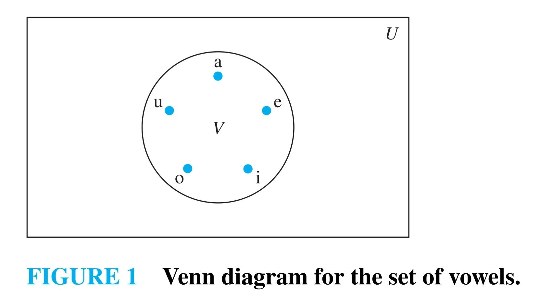
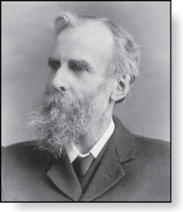
Venn Diagrams
The universal set is represented by a rectangle.
Sets are shown as ovals, circles or other geometric shapes.
Sometimes points are used to represent the particular elements of the set.
John Venn (1834-1923)
Cambridge, UK

Slide 11
Some things to remember
Sets can be elements of sets.
{{1,2,3},a, {b,c}}
{N,Z,Q,R}
The empty set is different from a set containing the empty set.
∅ ≠ { ∅ }

Slide 12
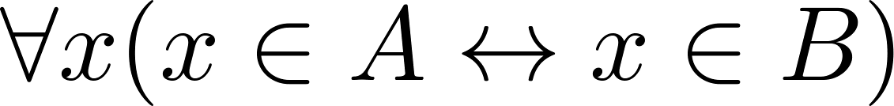
Set Equality
Definition: Two sets are equal if and only if they have the same elements.
Therefore if A and B are sets, then A and B are equal if and only if .
We write A = B if A and B are equal sets.
{1,3,5} = {3, 5, 1}
{1,5,5,5,3,3,1} = {1,3,5}

Slide 13
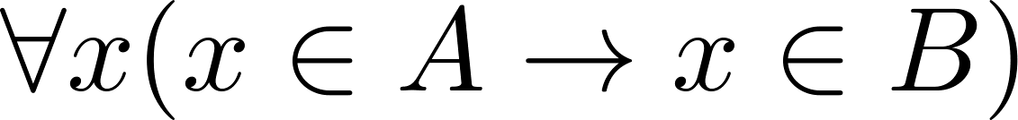
Subsets
Definition: The set A is a subset of B, if and only if every element of A is also an element of B.
The notation A ⊆ B is used to indicate that A is a subset of the set B.
A ⊆ B holds if and only if is true.
∅ ⊆ S , for every set S (Because a ∈ ∅ is always false).
S ⊆ S, for every set S (Because a ∈ S → a ∈ S).

Slide 14
Showing a Set is or is not a Subset of Another Set
Showing that A is a Subset of B: To show that A ⊆ B, show that if x belongs to A, then x also belongs to B.
Showing that A is not a Subset of B: To show that A is not a subset of B, A ⊈ B, find an element x ∈ A with x ∉ B. (Such an x is a counterexample to the claim that x ∈ A implies x ∈ B.)
Examples:
The set of all computer science majors at your school is a subset of all students at your school.
The set of integers with squares less than 100 is not a subset of the set of nonnegative integers.

Slide 15
Another look at Equality of Sets
Recall that two sets A and B are equal, denoted by A = B, iff
Using logical equivalences we have that A = B iff
This is equivalent to
A ⊆ B and B ⊆ A

Slide 16
Proper Subsets
Definition: If A ⊆ B, but A ≠B, then we say A is a proper subset of B, denoted by A ⊂ B. If A ⊂ B, then
is true.
Venn Diagram:
U
B
A

Slide 17
Set Cardinality
If there are exactly n distinct elements in S where n is a nonnegative integer, we say that S is finite. Otherwise it is infinite.
Definition: The cardinality of a finite set A, denoted by |A|, is the number of (distinct) elements of A.
Examples:
|ø| = 0
Let S be the letters of the English alphabet. Then |S| = 26
|{1,2,3}| = 3
|{ø}| = 1
The set of integers is infinite.

Slide 18
Power Sets
Definition: The set of all subsets of a set A, denoted P(A), is called the power set of A.
Example: If A = {a, b} then
P(A) = {ø, {a}, {b}, {a, b}}
Example: If A = {ø, {a, b}} then
P(A) = {ø, {ø}, {{a, b}}, {ø, {a, b}}}
If a set has n elements, then the cardinality of the power set is 2ⁿ.

Slide 19
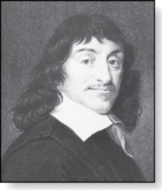
Cartesian Product
René Descartes (1596-1650)
Definition: The Cartesian Product of two sets A and B, denoted by A × B is the set of ordered pairs (a,b) where a ∈ A and b ∈ B.
Example:
A = {a,b} B = {1,2,3}
A × B = {(a,1),(a,2),(a,3), (b,1),(b,2),(b,3)}
Definition: A subset R of the Cartesian product A × B is called a relation from the set A to the set B.

Slide 20
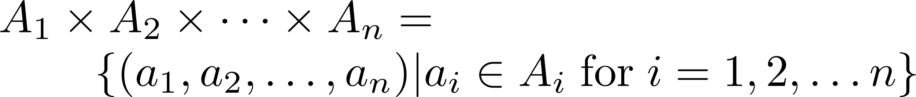
Cartesian Product
Definition: The cartesian products of the sets A₁,A₂,……,A_{n} denoted by A₁ × A₂ × …… × A_{n} , is the set of ordered n-tuples (a₁,a₂,……,a_{n}) where a_{i} belongs to A_{i} for i = 1, … n.
Example: What is A × B × C where A = {0,1}, B = {1,2} and C = {0,1,2}
Solution: A × B × C = {(0,1,0), (0,1,1), (0,1,2),(0,2,0), (0,2,1), (0,2,2),(1,1,0), (1,1,1), (1,1,2), (1,2,0), (1,2,1), (1,2,2)}

