Slide 1
Lecture 7:
Set Operations
Section 2.2

Slide 2
Section Summary
Set Operations
Union
Intersection
Complementation
Difference
Set Cardinality: Inclusion, Exclusion
Set Identities
Proving Identities

Slide 3

Union
Definition: Let A and B be sets. The union of the sets A and B, denoted by A ∪ B, is the set:
Example: What is {1,2,3} ∪ {3, 4, 5}?
Solution: {1,2,3,4,5}
Venn Diagram for A ∪ B
U
A
B

Slide 4

Intersection
Definition: The intersection of sets A and B, denoted by A ∩ B, is
Note if the intersection is empty, then A and B are said to be disjoint.
Example: What is {1,2,3} ∩ {3,4,5} ?
Solution: {3}
Example:What is {1,2,3} ∩ {4,5,6} ?
Solution: ∅
Venn Diagram for A ∩B
U
A
B

Slide 5
Complement
Definition: If A is a set, then the complement of the A (with respect to U), denoted by Ā is the set U – A.
Ā = {x ∈ U | x ∉ A}
(The complement of A is sometimes denoted by A^{c} .)
Example: If U is the positive integers less than 100, what is the complement of {x | x > 70} ?
Solution: {x | x ≤ 70}
Venn Diagram for Complement
U
Ā
A

Slide 6
Difference
Definition: Let A and B be sets. The difference of A and B, denoted by A – B, is the set containing the elements of A that are not in B. The difference of A and B is also called the complement of B with respect to A.
A – B = {x | x ∈ A ∧ x ∉ B} = A∩B^{c}
Venn Diagram for A − B
U
A
B

Slide 7
Review Questions
Example: U = {0,1,2,3,4,5,6,7,8,9,10} A = {1,2,3,4,5}, B ={4,5,6,7,8}
A ∪ B
Solution: {1,2,3,4,5,6,7,8}
A ∩ B
Solution: {4,5}
Ā
Solution: {0,6,7,8,9,10}
Solution: {0,1,2,3,9,10}
A – B
Solution: {1,2,3}
B – A
Solution: {6,7,8}

Slide 8
The Cardinality of the Union of Two Sets
Inclusion-Exclusion Principle
|A ∪ B| = |A| + | B| − |A ∩ B|
Example: Let A be the math majors in your class and B be the CS majors. To count the number of students who are either math majors or CS majors:
Add the number of math majors and the number of CS majors.
Then subtract the number of joint CS/math majors.
U
A
B

Slide 9
Inclusion-Exclusion Principle
Example: A restaurant served 50 guests one day. At the end, there was 37 orders of burgers and 29 orders of smoothies. If everyone ordered a burger or a smoothie that day, how many people ordered both?
Solution:
Let A and B be the sets of people who ordered burgers and smoothies respectively. Then, |A| = 37 and |B| = 29.
Since, |A ∪ B| = 50
=> |A| + |B| − |A ∩ B| = 50
=> |A ∩ B| = |A| + |B| − 50
=> |A ∩ B| = 37 + 29 − 50 = 16.
U
A
B

Slide 10
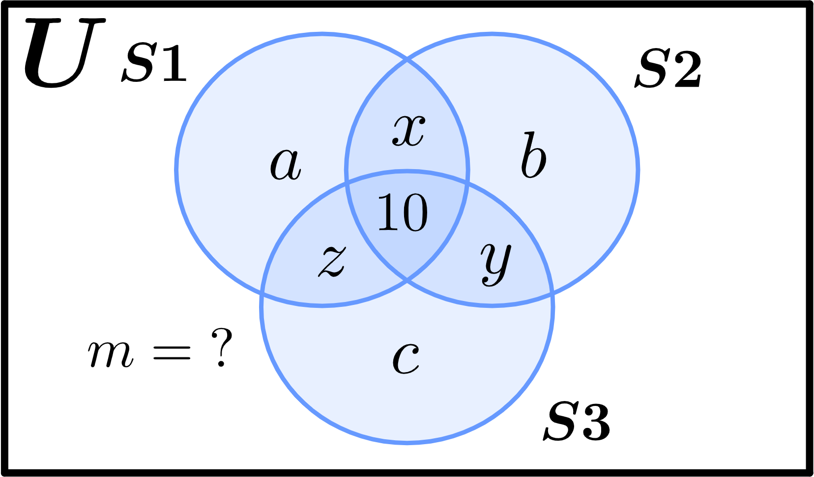
Inclusion-Exclusion Principle
Example: A coding competition had 100 students participating. 50 of the participants were able to solve the first problem. However, for the second and third problem, 39 and 23 students were able to solve them, respectively. If 10 students solved all three problems and 12 solved any 2, how many students solved none?
Solution: Let, S1, S2 and S3 be the sets
of students who answered the first,
second and third set respectively, and
U be the universal set of all participants.
Then, |S1| = 50 = a+x+z+10,
|S2| = 39 = b+x+y+10, |S3| = 23 = c+y+z+10 and |U| = 100.
Inferring from the Venn Diagram,
Number of students that solved zero problems = m,
Number of students that solved 1 problem = a+b+c,
Number of students that solved 2 problems = x+y+z = 12 (given),
Number of students that solved all 3 problems = 10.

Slide 11
Inclusion-Exclusion Principle
Example: A coding competition had 100 students participating. 50 of the participants were able to solve the first problem. However, for the second and third problem, 39 and 23 students were able to solve them, respectively. If 10 students solved all three problems and 12 solved any 2, how many students solved none?
Solution (continued):
Here, |S1|+|S2|+|S3| = 50+39+23
=> (a+x+z+10)+(b+x+y+10)+
(c+y+z+10) = 112
=> a+b+c+2x+2y+2z = 82
=> a+b+c = 82 – 2(x+y+z)
=> a+b+c = 82 – 2*12 = 58
So, 58 students solved exactly 1 problem.
Also, |U| = m+(a+b+c)+(x+y+z)+10 = 100.
=> m+58+12+10=100 => m = 100–80 = 20.
Thus, 20 students solved zero problems.

Slide 12
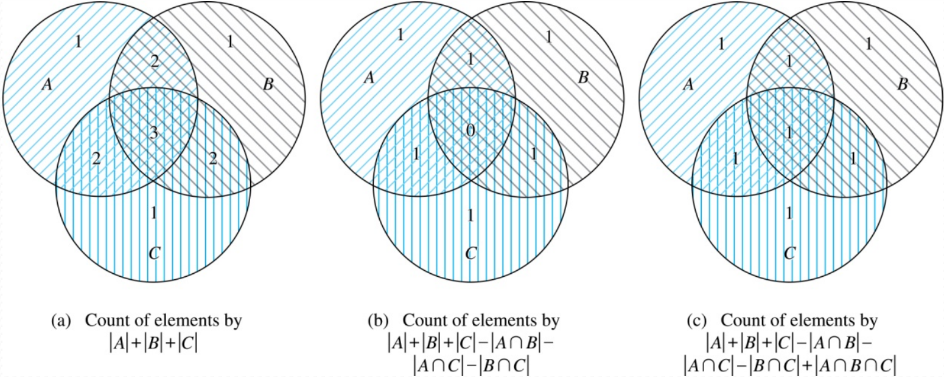
Inclusion-Exclusion Principle for 3 Sets
For 3 sets, the Inclusion-Exclusion Principle becomes:
|A ∪ B ∪ C| = |A| + |B| + |C| − |A ∩ B| − |B ∩ C| − |C ∩ A| + |A ∩ B ∩ C|

Slide 13
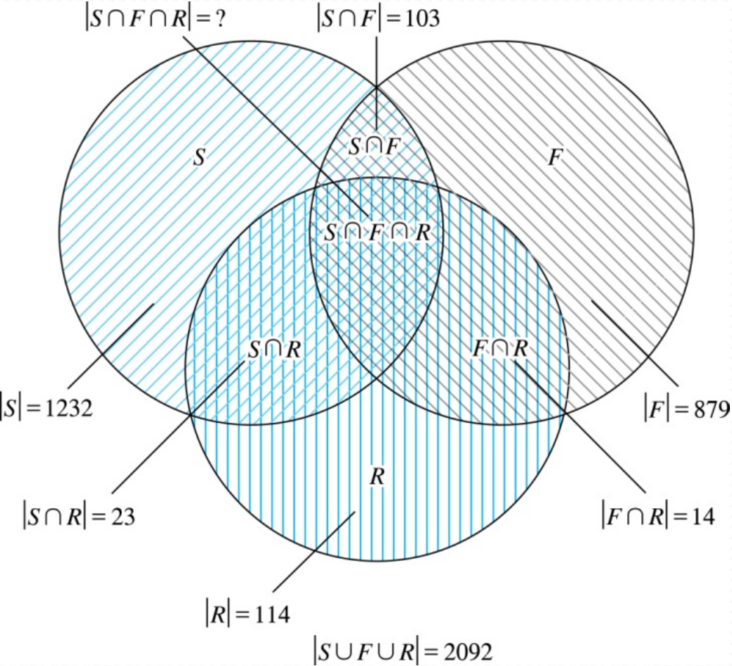
Inclusion-Exclusion Principle for 3 Sets
Example: In a class,
1232 students have taken a course in Spanish,
879 have taken a course in French, and
114 have taken a course in Russian. Further,
103 have taken courses in both
Spanish and French,
23 have taken courses in both
Spanish and Russian, and
14 have taken courses in both
French and Russian.
If 2092 students have taken a course in
at least one of Spanish, French and Russian,
how many students have taken a course in all 3 languages?

Slide 14
Inclusion-Exclusion Principle for 3 Sets
Example (Cont.):
Here, |S∪F∪R| = |S|+ |F|+ |R| − |S∩F| − |S∩R| − |F∩R| + |S∩F∩R|
=> 2092 = 1232 + 879 + 114 −103 −23 −14 + |S∩F∩R|.
=> |S∩F∩R| = 7.

Slide 15
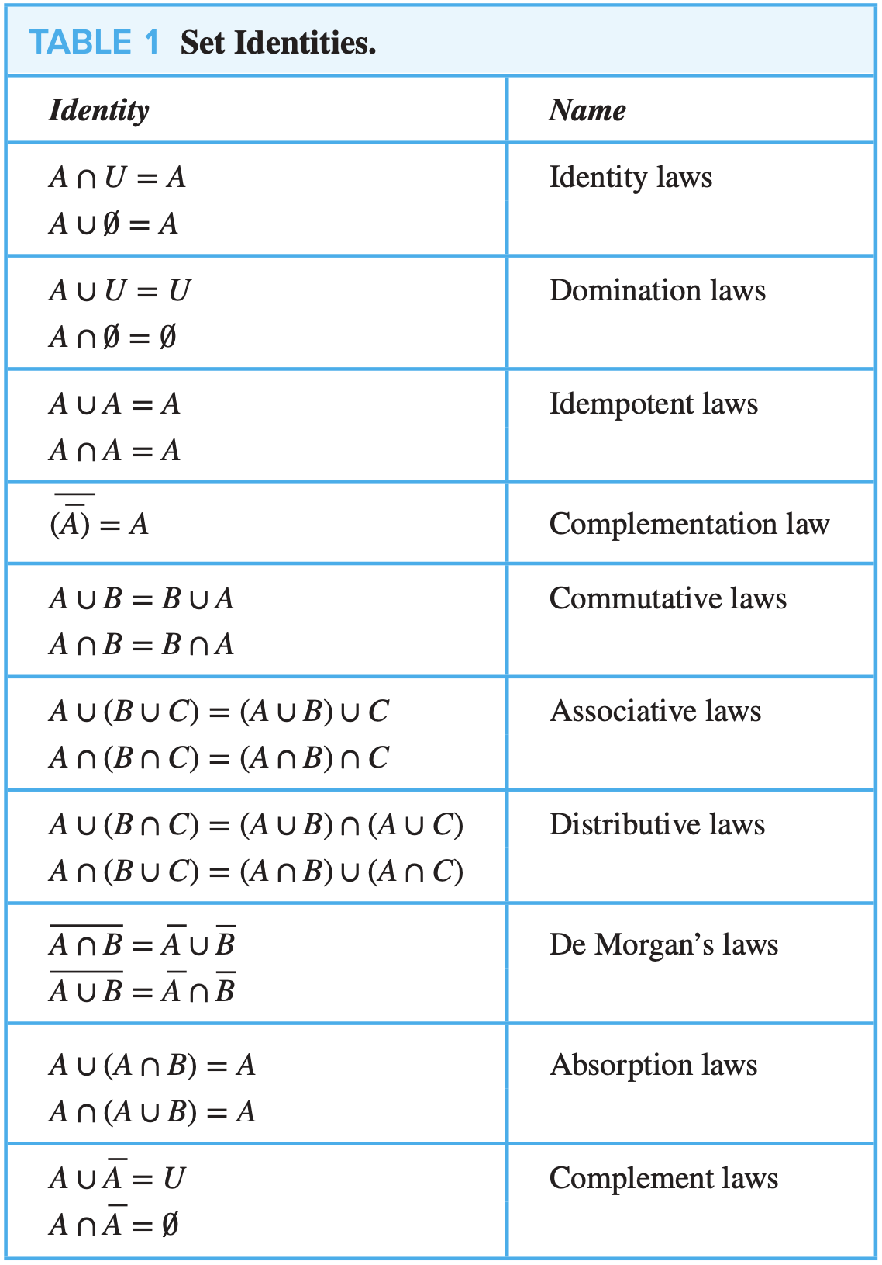
Set Identities

Slide 16
Proving Set Identities
Different ways to prove set identities:
Prove that each set (side of the identity) is a subset of the other.
Use set builder notation and propositional logic.
Membership Tables: Verify that elements in the same combination of sets always either belong or do not belong to the same side of the identity. Use 1 to indicate it is in the set and a 0 to indicate that it is not.

Slide 17



Proving Set Identities: Second De Morgan Law
Example: Prove that
Solution: We prove this identity by showing that:
1) and
2)
Continued on next slide 🡪

Slide 18
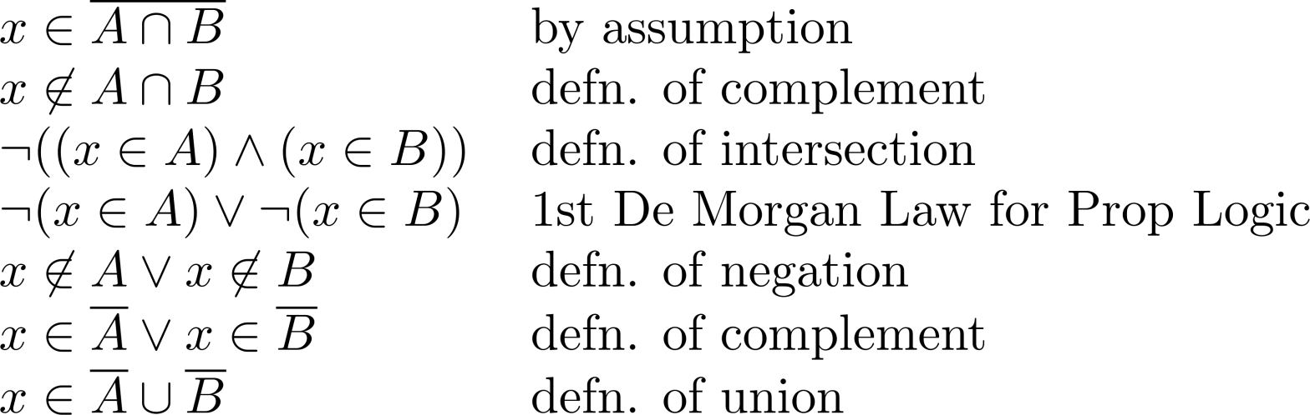
Proving Set Identities: Second De Morgan Law (Cont.)
1) Show that:
Continued on next slide →

Slide 19
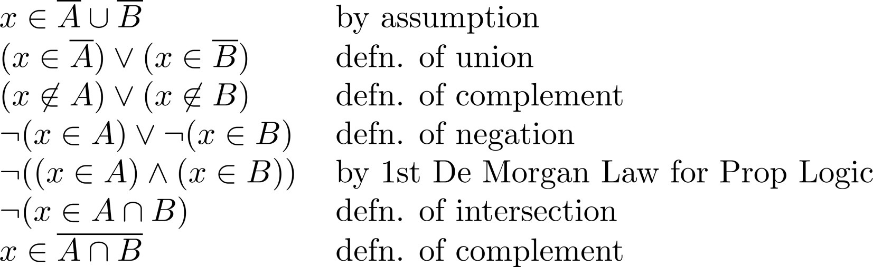
Proving Set Identities: Second De Morgan Law (Cont.)
2) Show that:

Slide 20
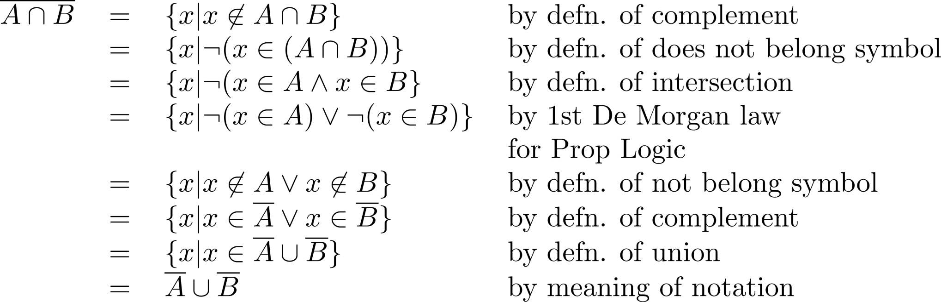
Proving Set Identities with Propositional Logic
We can also prove the second De Morgan’s law by the following process with propositional logic on Set Builder Notation:
Therefore, .

Slide 21
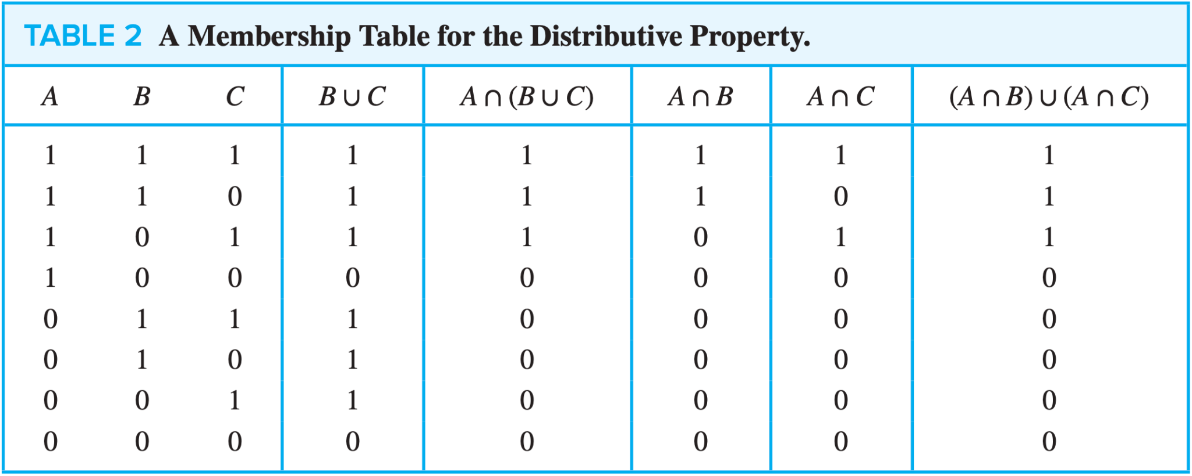
Proving Set Identities with Membership Tables
We can use a membership table to show that A∩(B∪C) = (A∩B)∪(A∩C):

