Slide 1
Lecture 8:
Sequences & Summations
Section 2.4

Slide 2
Section Summary
Sequences.
Examples: Geometric Progression, Arithmetic Progression
Recurrence Relations
Example: Fibonacci Sequence
Summations

Slide 3
Functions
Definition: Let A and B be nonempty sets. A function f from A to B, denoted f : A → B is an assignment of each element of A to exactly one element of B. We write f(a) = b if b is the unique element of B assigned by the function f to the element a of A.
Functions are sometimes
called mappings or
transformations.
Students
Grades
A
Carl
B
Sandeep
C
Williams
D
Scott
F

Slide 4
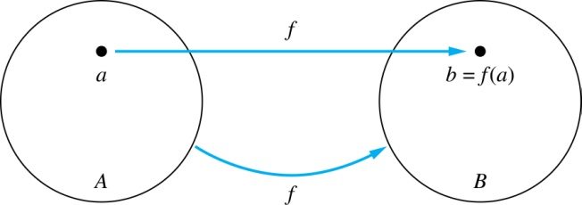
Functions
Given a function f : A → B :
We say f maps A to B or
f is a mapping from A to B.
A is called the domain of f.
B is called the codomain of f.
If f (a) = b,
then b is called the image of a under f.
a is called the preimage of b.
The range of f is the set of all images of points in A under f.
We denote it by f (A).

Slide 5
Sequences
Sequences are ordered lists of elements.
1, 2, 3, 5, 8 (finite)
1, 3, 9, 27, 81, ……. (infinite)
Definition: A sequence is a function from a subset of the integers (usually either the set {0, 1, 2, 3, 4, …} or {1, 2, 3, 4, …} ) to a set S.
The notation a_{n} is used to denote the image of the integer n.
We can think of a_{n} as the equivalent of f(n) where f is a function from {0, 1, 2, …} to S. We call a_{n} a term of the sequence.

Slide 6
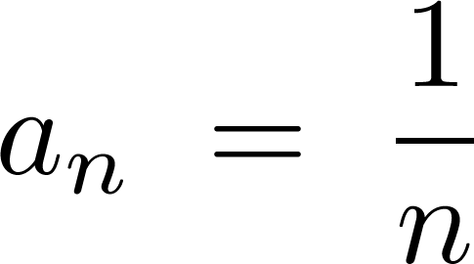
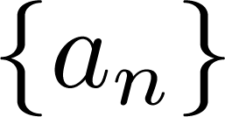
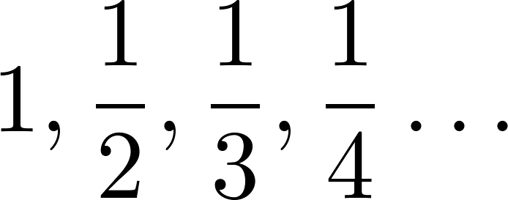
Sequences
Example: Consider the sequence where

Slide 7
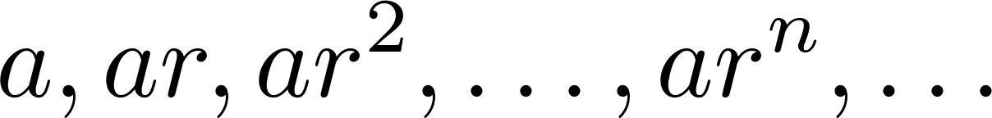
Geometric Progression
Definition: A geometric progression is a sequence of the form:
where the initial term a and the common ratio r are real numbers.
Examples:
Let a = 1 and r = −1. Then:
Let a = 2 and r = 5. Then:
Let a = 6 and r = 1/3. Then:

Slide 8
Arithmetic Progression
Definition: A arithmetic progression is a sequence of the form:
where the initial term a and the common difference d are real numbers.
Examples:
Let a = −1 and d = 4:
Let a = 7 and d = −3:
Let a = 1 and d = 2:

Slide 9
Recurrence Relations
Definition: A recurrence relation for the sequence {a_{n}} is an equation that expresses a_{n} in terms of one or more of the previous terms of the sequence, namely, a₀, a₁, …, a_{n-1}, for all integers n with n ≥ n₀, where n₀ is a nonnegative integer.
A sequence is called a solution of a recurrence relation if its terms satisfy the recurrence relation.
The initial conditions for a sequence specify the terms that precede the first term where the recurrence relation takes effect.

Slide 10
Recurrence Relations
Example 1: Let {a_{n}} be a sequence that satisfies the recurrence relation
a_{n} = a_{n-1} + 3 for n = 1,2,3,4,…. and suppose that a₀ = 2.
What are a₁ , a₂ and a₃?
[Here a₀ = 2 is the initial condition.]
Solution: We see from the recurrence relation that
a₁ = a₀ + 3 = 2 + 3 = 5
a₂ = 5 + 3 = 8
a₃ = 8 + 3 = 11

Slide 11
Recurrence Relations
Example 2: Let {a_{n}} be a sequence that satisfies the recurrence relation
a_{n} = a_{n-1} – a_{n-2} for n = 2,3,4,…. and suppose that a₀ = 3 and a₁ = 5.
What are a₂ and a₃?
[Here the initial conditions are a₀ = 3 and a₁ = 5. ]
Solution: We see from the recurrence relation that
a₂ = a₁ – a₀ = 5 – 3 = 2
a₃ = a₂ – a₁ = 2 – 5 = –3

Slide 12
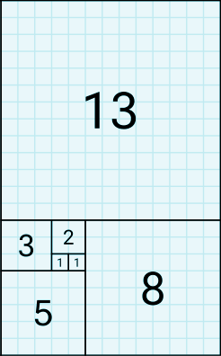
Fibonacci Sequence
Definition: We define the Fibonacci sequence,
f₀ , f₁ , f₂, … , by:
Initial Conditions: f₀ = 0, f₁ = 1
Recurrence Relation: f_{n} = f_{n-1} + f_{n-2}
Example: Find f₂ , f₃ , f₄ , f₅ and f₆ .
Answer:
f₂ = f₁ + f₀ = 1 + 0 = 1,
f₃ = f₂ + f₁ = 1 + 1 = 2,
f₄ = f₃ + f₂ = 2 + 1 = 3,
f₅ = f₄ + f₃ = 3 + 2 = 5,
f₆ = f₅ + f₄ = 5 + 3 = 8.

Slide 13
Solving Recurrence Relations
Finding a formula for the n^{th} term of the sequence generated by a recurrence relation is called solving the recurrence relation.
Such a formula is called a closed formula.
Various methods for solving recurrence relations will be covered in next lectures (Chapter 8) where recurrence relations will be studied in greater depth.
For now, we illustrate by example the method of iteration in which we need to guess the formula. The guess can be proved correct by the method of induction.

Slide 14
Iterative Solution Example
Method 1: Working upward, forward substitution
Let {a_{n}} be a sequence that satisfies the recurrence relation a_{n} = a_{n-1} + 3 for n = 2, 3, 4, …. and suppose that a₁ = 2.
a₂ = 2 + 3
a₃ = (2 + 3) + 3 = 2 + 3 ∙ 2
a₄ = (2 + 2 ∙ 3) + 3 = 2 + 3 ∙ 3
.
.
.
a_{n} = a_{n-1} + 3 = (2 + 3 ∙ (n – 2)) + 3 = 2 + 3(n – 1)

Slide 15
Iterative Solution Example
Method 2: Working downward, backward substitution
Let {a_{n}} be a sequence that satisfies the recurrence relation a_{n} = a_{n-1} + 3 for n = 2, 3, 4, …. and suppose that a₁ = 2.
a_{n} = a_{n-1} + 3
= (a_{n-2} + 3) + 3 = a_{n-2} + 3 ∙ 2
= (a_{n-3} + 3)+ 3 ∙ 2 = a_{n-3} + 3 ∙ 3
.
.
.
= a₂ + 3(n – 2) = (a₁ + 3) + 3(n – 2) = 2 + 3(n – 1)

Slide 16
Real World Application
Example: Suppose that a person deposits $10,000.00 in a savings account at a bank yielding 11% per year with interest compounded annually. How much will be in the account after 30 years?
Solution:
Let P_{n} denote the amount in the account after n years.
Then, P_{n} satisfies the following recurrence relation:
P_{n} = P_{n-1} + 0.11P_{n-1} = (1.11) P_{n-1}
with the initial condition P₀ = 10,000.
Continued on next slide ⇒

Slide 17
Real World Application
P_{n} = P_{n-1} + 0.11P_{n-1} = (1.11) P_{n-1}
with the initial condition P₀ = 10,000
Solving the recurrence with Forward Substitution:
P₁ = (1.11)P₀
P₂ = (1.11)P₁ = (1.11)²P₀
P₃ = (1.11)P₂ = (1.11)³P₀
:
P_{n} = (1.11)P_{n-1} = (1.11)^{n}P₀ = (1.11)^{n} 10,000
Since, P_{n} = (1.11)^{n} 10,000 , P₃₀ = (1.11)³⁰ 10,000 = $228,992.97.

Slide 18
Identifying Integer Sequences
Given a few terms of a sequence, try to identify the sequence. Conjecture a formula, recurrence relation, or some other rule.
Some questions to ask?
Are there repeated terms of the same value?
Can you obtain a term from the previous term by adding an amount or multiplying by an amount?
Can you obtain a term by combining the previous terms in some way?
Are there cycles among the terms?
Do the terms match those of a well known sequence?

Slide 19
Identifying Integer Sequences
Find formulae for the sequences with the following first five terms:
Example 1: 1, 1/2, 1/4, 1/8, 1/16, ….
Solution: Note that the denominators are powers of 2.
The sequence with a_{n} = 1/2^{n} is a possible match.
This is a geometric progression with a = 1 and r = 1/2.
Example 2: 1,3,5,7,9
Solution: Note that each term is obtained by adding 2 to the previous term. A possible formula is a_{n} = 2n + 1.
This is an arithmetic progression with a =1 and d = 2.
Example 3: 1, –1, 1, –1,1
Solution: The terms alternate between 1 and -1.
A possible sequence is a_{n} = (−1)^{n} .
This is a geometric progression with a = 1 and r = −1.

Slide 20
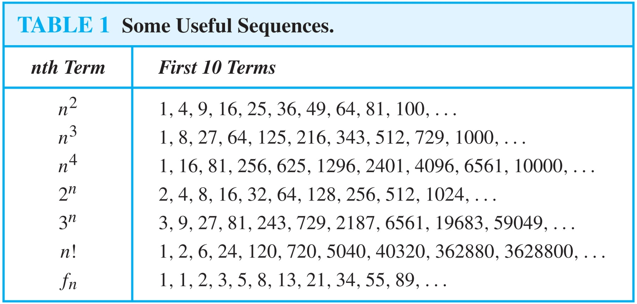
Useful Sequences

Slide 21
Guessing Sequences
Example: Conjecture a simple formula for a_{n} if the first 10 terms of the sequence {a_{n}} are
1, 7, 25, 79, 241, 727, 2185, 6559, 19681, 59047.
Solution: Note the ratio of each term to the previous approximates 3. So now compare with the sequence 3^{n} .
{3^{n}} = 1, 3, 9, 27, 81, 243, 729, 2187, 6561, 19683, 59049, ...
We notice that the nth term is 2 less than the corresponding power of 3. So a good conjecture is that a_{n} = 3^{n} − 2.

Slide 22
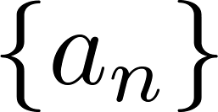
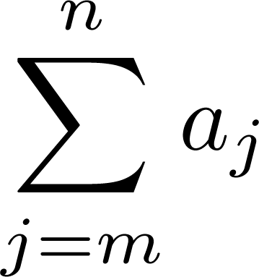
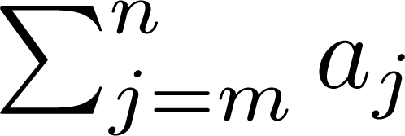
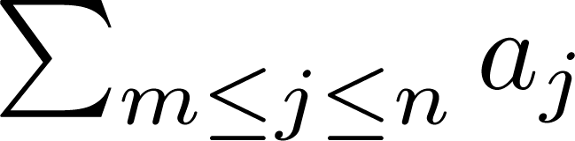
Summations
Sum of the terms from the sequence
The notations:
or, or,
represents
The variable j is called the index of summation.
It runs through all the integers starting with its lower limit, m and ending with its upper limit, n.

Slide 23
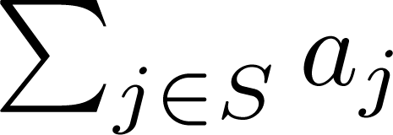
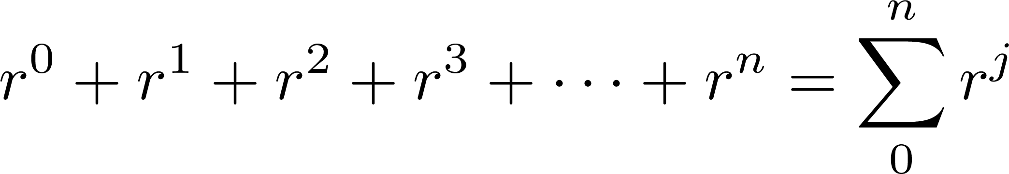
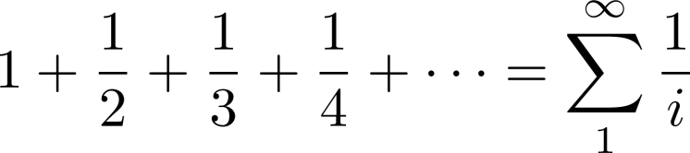
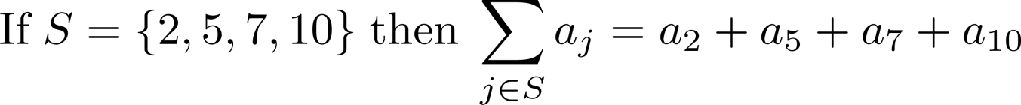
Summations
More generally for a set S:
Examples:

Slide 24
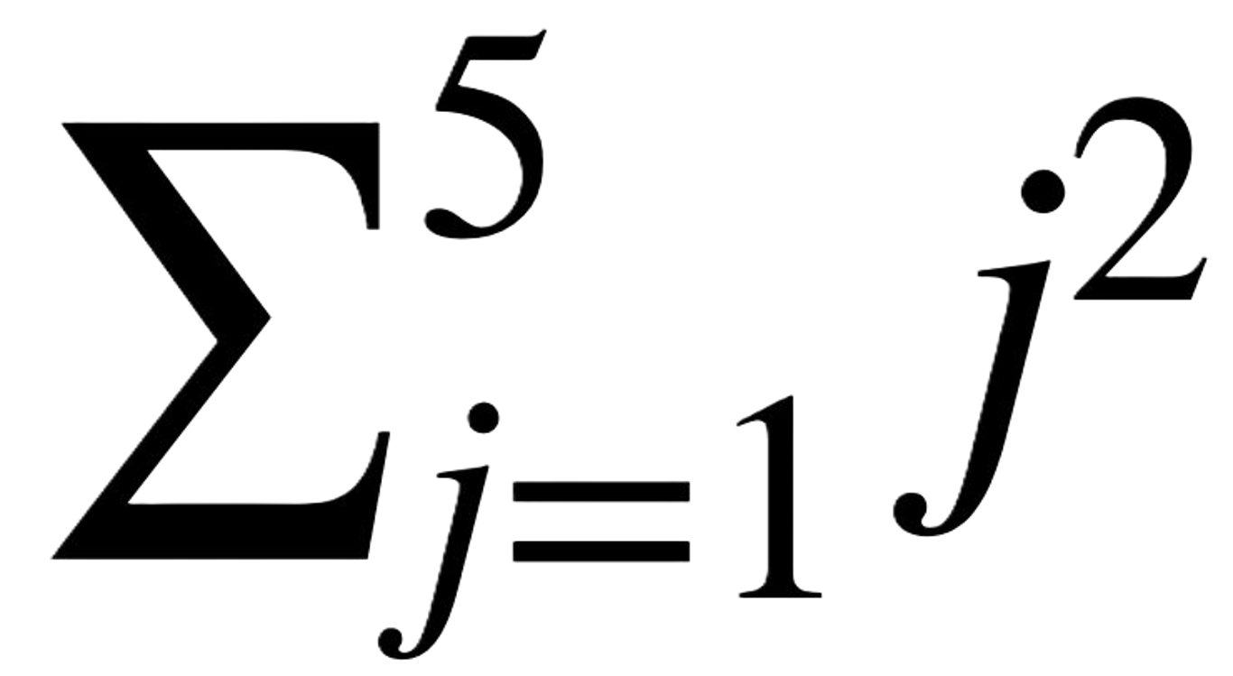
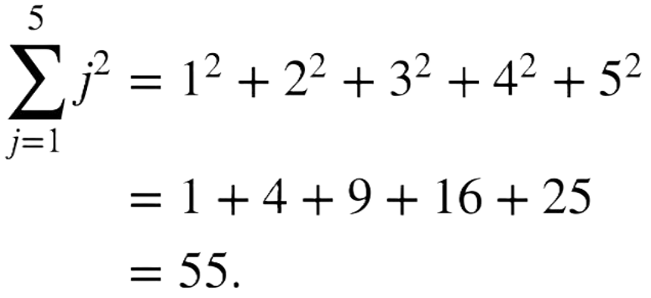

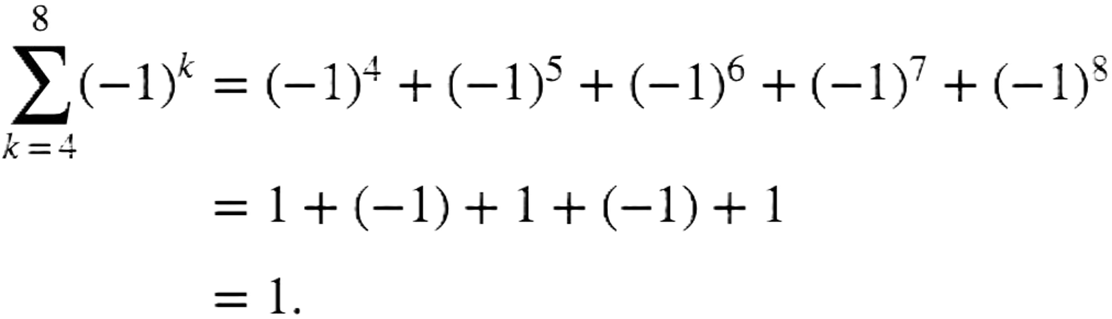
Summations Examples
What is the value of ?
Solution:
What is the value of ?
Solution:

Slide 25
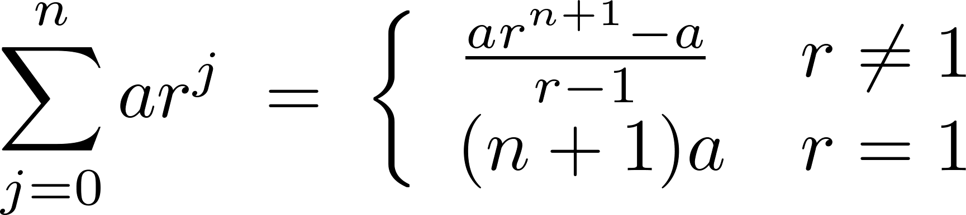
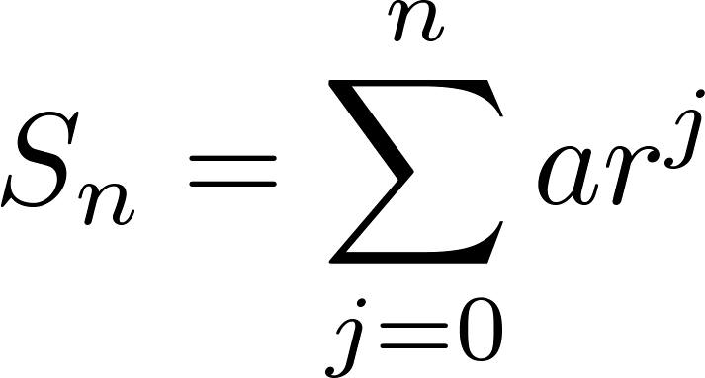
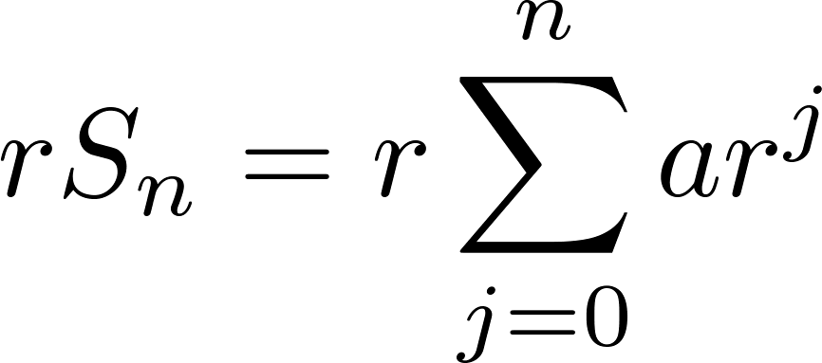
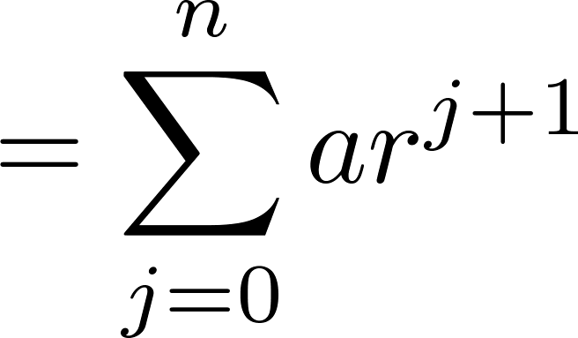
Summation of Series Formula
Sums of terms of geometric progressions
Proof:
Let
To compute S_{n} , first multiply both sides of the equality by r and then manipulate the resulting sum:
Continued on next slide ⇒

Slide 26
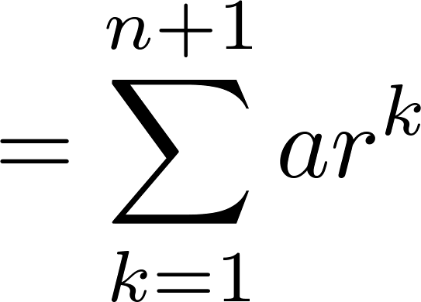
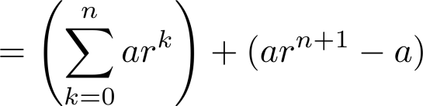
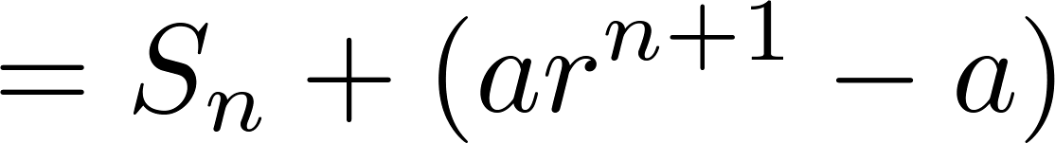
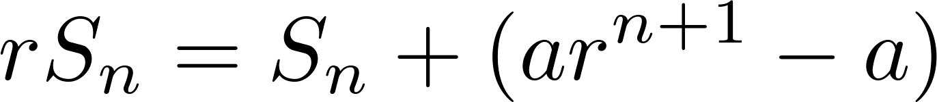
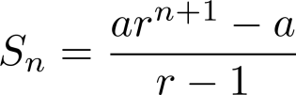
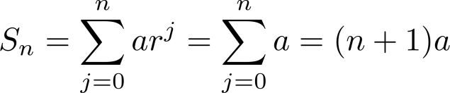
Summation of Series Formula
From previous slide.
Shifting the index of summation with k = j + 1.
Removing k = n + 1 term and
adding k = 0 term.
Substituting S for summation formula
∴
if r ≠1
if r = 1

Slide 27
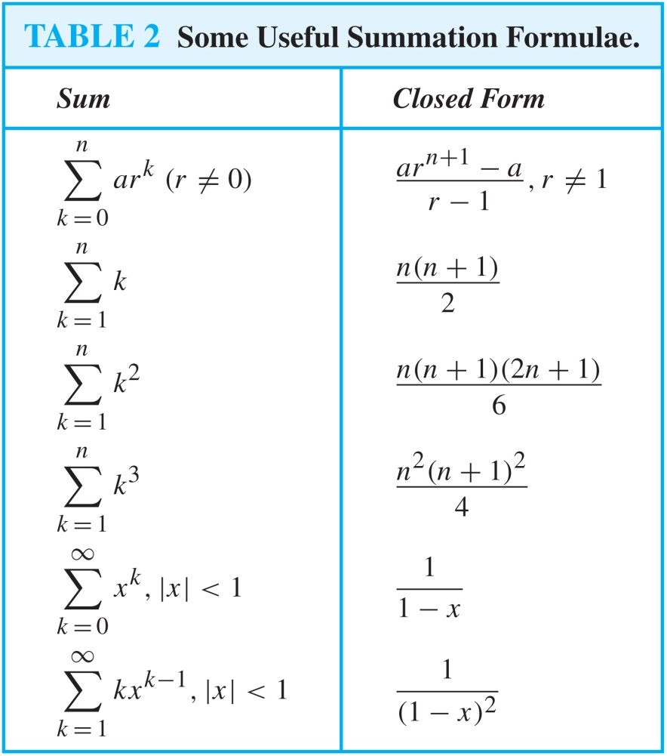
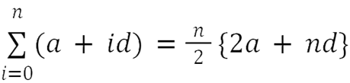
Some Useful Summation Formulae
for Arithmetic Series,
We can prove these by induction, also.
Proof requires calculus

