Slide 1
Lecture 13: Primes and Greatest Common Divisors
Section 4.3

Slide 2
Section Summary
Prime Numbers and their Properties
Conjectures and Open Problems About Primes
Greatest Common Divisors and Least Common Multiples
The Euclidian Algorithm
gcds as Linear Combinations

Slide 3
Primes
Definition: A positive integer p greater than 1 is called prime if the only positive factors of p are 1 and p. A positive integer that is greater than 1 and is not prime is called composite.
Example: The integer 7 is prime because its only positive factors are 1 and 7, but 9 is composite because it is divisible by 3.

Slide 4
The Fundamental Theorem of Arithmetic
Theorem: Every positive integer greater than 1 can be written uniquely as a prime or as the product of two or more primes where the prime factors are written in order of nondecreasing size.
Examples:
100 = 2 ∙ 2 ∙ 5 ∙ 5 = 2² ∙ 5²
641 = 641
999 = 3 ∙ 3 ∙ 3 ∙ 37 = 3³ ∙ 37
1024 = 2 ∙ 2 ∙ 2 ∙ 2 ∙ 2 ∙ 2 ∙ 2 ∙ 2 ∙ 2 ∙ 2 = 2¹⁰

Slide 5
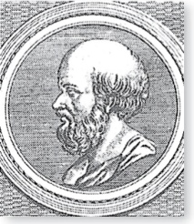
The Sieve of Eratosthenes
Eratosthenes
(276-194 B.C.)
The Sieve of Eratosthenes can be used to find all primes not exceeding a specified positive integer. For example, begin with the list of integers between 1 and 100.
Delete all the integers, other than 2, divisible by 2.
Delete all the integers, other than 3, divisible by 3.
Next, delete all the integers, other than 5, divisible by 5.
Next, delete all the integers, other than 7, divisible by 7.
Since all the remaining integers are not divisible by any of the previous integers, other than 1, the primes are:
{2,3,5,7,11,15,1719,23,29,31,37,41,43,47,53,
59,61,67,71,73,79,83,89, 97}
continued →

Slide 6
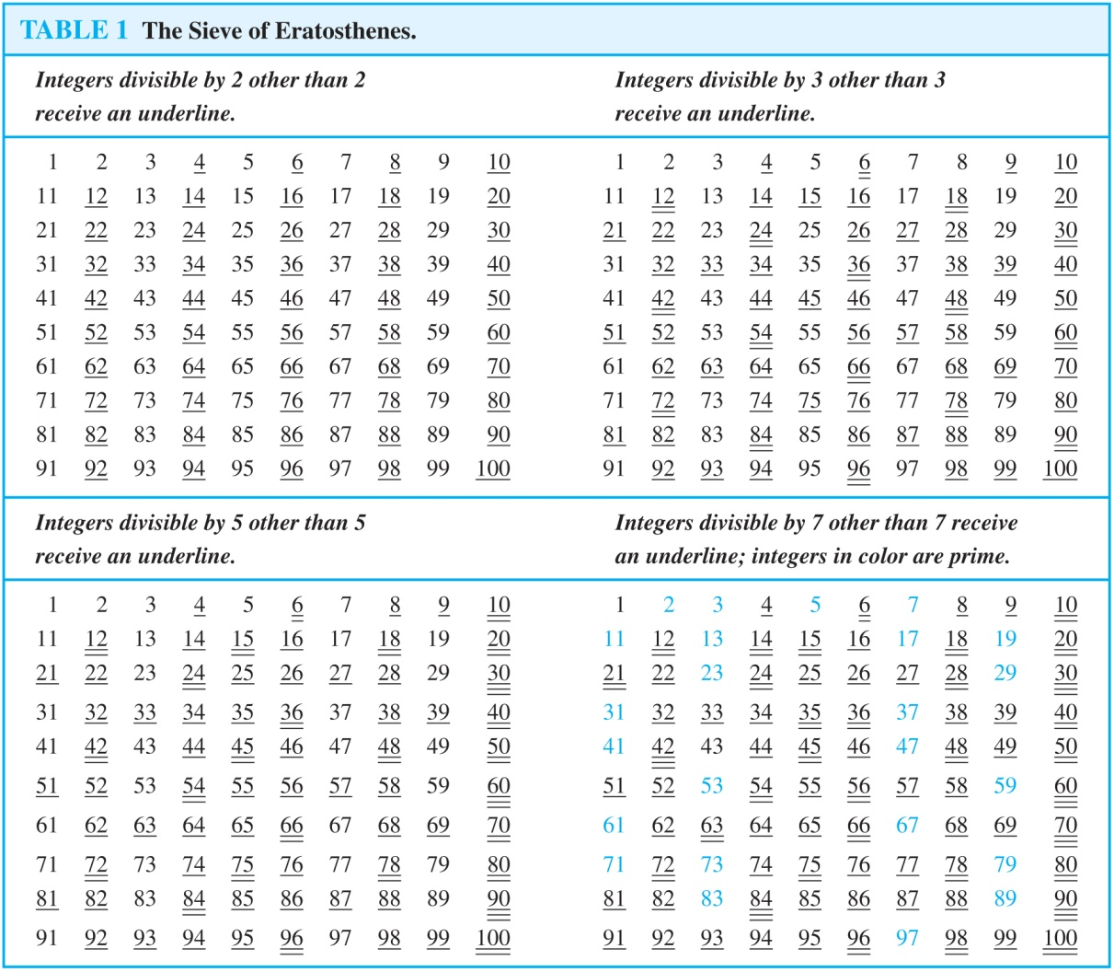
The Sieve of Eratosthenes
If an integer n is a composite integer, then it has a prime divisor less than or equal to √n.
To see this, note that if n = ab, then a ≤ √n or b ≤√n.
Trial division, a very inefficient method of determining if a number n is prime, is to try every integer i ≤√n and see if n is divisible by i.

Slide 7
Distribution of Primes
Mathematicians have been interested in the distribution of prime numbers among the positive integers. In the nineteenth century, the prime number theorem was proved which gives an asymptotic estimate for the number of primes not exceeding x.
Prime Number Theorem: The ratio of the number of primes not exceeding x and x/ln x approaches 1 as x grows without bound. (ln x is the natural logarithm of x)
The theorem tells us that the number of primes not exceeding x, can be approximated by x/ln x.
The odds that a randomly selected positive integer less than n is prime are approximately (n/ln n)/n = 1/ln n.

Slide 8
Generating Primes
The problem of generating large primes is of both theoretical and practical interest.
So far, no useful closed formula that always produces primes has been found. There is no simple function f (n) such that f (n) is prime for all positive integers n.
But f (n) = n² − n + 41 is prime for all integers 1,2,…, 40. Because of this, we might conjecture that f (n) is prime for all positive integers n. But f (41) = 41² is not prime.
More generally, there is no polynomial with integer coefficients such that f (n) is prime for all positive integers n. (See supplementary Exercise 23.)

Slide 9
Conjectures about Primes
Even though primes have been studied extensively for centuries, many conjectures about them are unresolved, including:
Goldbach’s Conjecture: Every even integer n, n > 2, is the sum of two primes. It has been verified by computer for all positive even integers up to 1.6 ∙10¹⁸. The conjecture is believed to be true by most mathematicians.
There are infinitely many primes of the form n² + 1, where n is a positive integer. But it has been shown that there are infinitely many primes of the form n² + 1, where n is a positive integer or the product of at most two primes.
The Twin Prime Conjecture: The twin prime conjecture is that there are infinitely many pairs of twin primes. Twin primes are pairs of primes that differ by 2. Examples are 3 and 5, 5 and 7, 11 and 13, etc. The current world’s record for twin primes (as of mid 2011) consists of numbers 65,516,468,355∙23^{33,333} ±1, which have 100,355 decimal digits.

Slide 10
Greatest Common Divisor
Definition: Let a and b be integers, not both zero. The largest integer d such that d | a and also d | b is called the greatest common divisor of a and b. The greatest common divisor of a and b is denoted by gcd(a,b).
One can find greatest common divisors of small numbers by inspection.
Example:What is the greatest common divisor of 24 and 36?
Solution: gcd(24, 36) = 12
Example:What is the greatest common divisor of 17 and 22?
Solution: gcd(17,22) = 1

Slide 11
Greatest Common Divisor
Definition: The integers a and b are relatively prime if their greatest common divisor is 1.
Example: 17 and 22
Definition: The integers a₁, a₂, …, a_{n} are pairwise relatively prime if gcd(a_{i}, a_{j})= 1 whenever 1 ≤ i<j ≤n.
Example: Determine whether the integers 10, 17 and 21 are pairwise relatively prime.
Solution: Because gcd(10,17) = 1, gcd(10,21) = 1, and gcd(17,21) = 1, 10, 17, and 21 are pairwise relatively prime.
Example: Determine whether the integers 10, 19, and 24 are pairwise relatively prime.
Solution: Because gcd(10,24) = 2, 10, 19, and 24 are not pairwise relatively prime.

Slide 12
Greatest Common Divisor
Definition: The integers a and b are relatively prime if their greatest common divisor is 1.
Example: 17 and 22
Definition: The integers a₁, a₂, …, a_{n} are pairwise relatively prime if gcd(a_{i}, a_{j})= 1 whenever 1 ≤ i<j ≤n.
Example: Determine whether the integers 10, 17 and 21 are pairwise relatively prime.
Solution: Because gcd(10,17) = 1, gcd(10,21) = 1, and gcd(17,21) = 1, 10, 17, and 21 are pairwise relatively prime.
Example: Determine whether the integers 10, 19, and 24 are pairwise relatively prime.
Solution: Because gcd(10,24) = 2, 10, 19, and 24 are not pairwise relatively prime.

Slide 13
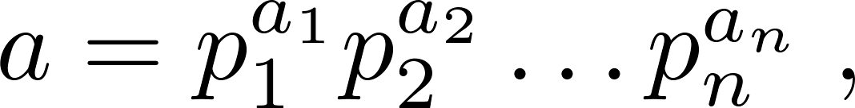
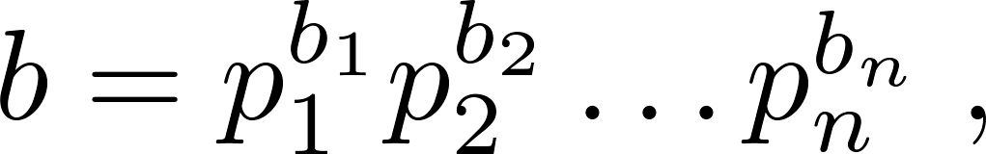
Finding the Greatest Common Divisor Using Prime Factorizations
Suppose the prime factorizations of a and b are:
where each exponent is a nonnegative integer, and where all primes occurring in either prime factorization are included in both. Then:
This formula is valid since the integer on the right (of the equals sign) divides both a and b. No larger integer can divide both a and b.
Example: 120 = 2³ ∙3 ∙5 500 = 2² ∙5³
gcd(120,500) = 2^{min(3,2)} ∙3^{min(1,0)} ∙5^{min(1,3)} = 2² ∙3⁰ ∙5¹ = 20
Finding the gcd of two positive integers using their prime factorizations is not efficient because there is no efficient algorithm for finding the prime factorization of a positive integer.

Slide 14
Least Common Multiple
Definition: The least common multiple of the positive integers a and b is the smallest positive integer that is divisible by both a and b. It is denoted by lcm(a,b).
The least common multiple can also be computed from the prime factorizations.
This number is divided by both a and b and no smaller number is divided by a and b.
Example: lcm(2³3⁵7², 2⁴3³) = 2^{max(3,4)} 3^{max(5,3)} 7^{max(2,0)} = 2⁴ 3⁵ 7²
The greatest common divisor and the least common multiple of two integers are related by:
Theorem 5: Let a and b be positive integers. Then
ab = gcd(a,b) ∙lcm(a,b)
(proof is Exercise 31)

Slide 15
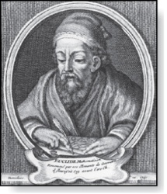
Euclidean Algorithm
Euclid
(325 B.C.E. – 265 B.C.E.)
The Euclidean algorithm is an efficient method for computing the greatest common divisor of two integers. It is based on the idea that gcd(a,b) is equal to gcd(a,c) when a > b and c is the remainder when a is divided by b.
Example: Find gcd(91, 287):
287 = 91 ∙ 3 + 14
91 = 14 ∙ 6 + 7
14 = 7 ∙ 2 + 0
gcd(287, 91) = gcd(91, 14) = gcd(14, 7) = 7
Divide 287 by 91
Divide 91 by 14
Divide 14 by 7
Stopping condition
continued →

Slide 16
Correctness of Euclidean Algorithm
Lemma 1: Let a = bq + r, where a, b, q, and r are integers. Then gcd(a,b) = gcd(b,r).
Proof:
Suppose that d divides both a and b. Then d also divides a − bq = r (by Theorem 1 of Section 4.1). Hence, any common divisor of a and b must also be any common divisor of b and r.
Suppose that d divides both b and r. Then d also divides bq + r = a. Hence, any common divisor of a and b must also be a common divisor of b and r.
Therefore, gcd(a,b) = gcd(b,r).

Slide 17
Correctness of Euclidean Algorithm
r₀ = r₁q₁ + r₂ 0 ≤ r₂ < r₁,
r₁ = r₂q₂ + r₃ 0 ≤ r₃ < r₂,
∙
∙
∙
r_{n-2} = r_{n-1}q_{n-1} + r₂ 0 ≤ r_{n} < r_{n-1},
r_{n-1} = r_{n}q_{n} .
Suppose that a and b are positive
integers with a ≥ b.
Let r₀ = a and r₁ = b.
Successive applications of the division
algorithm yields:
Eventually, a remainder of zero occurs in the sequence of terms: a = r₀ > r₁ > r₂ > ∙ ∙ ∙ ≥ 0. The sequence can’t contain more than a terms.
By Lemma 1, gcd(a,b) = gcd(r₀,r₁) = ∙ ∙ ∙ = gcd(r_{n-1},r_{n}) = gcd(r_{n} , 0) = r_{n}.
Hence the greatest common divisor is the last nonzero remainder in the sequence of divisions.

Slide 18


Uniqueness of Prime Factorization
We will prove that a prime factorization of a positive integer where the primes are in nondecreasing order is unique.
Proof: (by contradiction) Suppose that the positive integer n can be written as a product of primes in two distinct ways:
n = p₁p₂ ∙∙∙ p_{s} and n = q₁q₂ ∙∙∙ p_{t}.
Remove all common primes from the factorizations to get
By Lemma 3, it follows that divides , for some k, contradicting the assumption that and are distinct primes.
Hence, there can be at most one factorization of n into primes in nondecreasing order.

Slide 19
Dividing Congruences by an Integer
Dividing both sides of a valid congruence by an integer does not always produce a valid congruence (see Section 4.1).
But dividing by an integer relatively prime to the modulus does produce a valid congruence:
Theorem 7: Let m be a positive integer and let a, b, and c be integers. If ac ≡ bc (mod m) and gcd(c,m) = 1, then a ≡ b (mod m).
Proof: Since ac ≡ bc (mod m), m | ac − bc = c(a − b) by Lemma 2 and the fact that gcd(c,m) = 1, it follows that m | a − b. Hence, a ≡ b (mod m).

