Slide 1
Lecture 14: The Basic Rules of Counting
Section 6.1

Slide 2
Lecture Summary
The Product Rule
The Sum Rule
The Subtraction Rule

Slide 3
Basic Counting Principles: The Product Rule
The Product Rule: A procedure can be broken down into a sequence of two tasks. There are n₁ ways to do the first task and n₂ ways to do the second task. Then there are n₁∙n₂ ways to do the procedure.
Example: How many bit strings of length seven are there?
Solution: Since each of the seven bits is either a 0 or a 1, the answer is 2⁷ = 128.

Slide 4
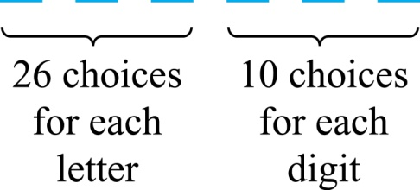
The Product Rule
Example: How many different license plates can be made if each plate contains a sequence of three uppercase English letters followed by three digits?
Solution: By the product rule,
there are 26 ∙ 26 ∙ 26 ∙ 10 ∙ 10 ∙ 10 = 17,576,000 different possible license plates.

Slide 5

Seating Arrangement
Example: We have 5 students, how many different seating arrangements are possible if we have 3 seats available?
Possible solution:
For the first chair, we have 5
students available to choose from
For the third chair, we have
remaining 3 students to choose from
For the second chair, we have 4
students available now to choose from
and all three events have to occur all at once, so we can use product rule.
And possible arrangement would be (5×4×3) = 60
We can later try to solve the same problem with permutation or combination concept.

Slide 6
Telephone Numbering Plan
Example: The North American numbering plan (NANP) specifies that a telephone number consists of 10 digits, consisting of a three-digit area code, a three-digit office code, and a four-digit station code. There are some restrictions on the digits.
Let X denote a digit from 0 through 9.
Let N denote a digit from 2 through 9.
Let Y denote a digit that is 0 or 1.
In the old plan (in use in the 1960s) the format was NYX-NNX-XXXX.
In the new plan, the format is NXX-NXX-XXXX.
How many different telephone numbers are possible under the old plan and the new plan?
Solution: Use the Product Rule.
There are 8 ∙2 ∙10 = 160 area codes with the format NYX.
There are 8 ∙10 ∙10 = 800 area codes with the format NXX.
There are 8 ∙8 ∙10 = 640 office codes with the format NNX.
There are 10 ∙10 ∙10 ∙10 = 10,000 station codes with the format XXXX.
Number of old plan telephone numbers: 160 ∙ 640 ∙ 10,000 = 1,024,000,000.
Number of new plan telephone numbers: 800 ∙ 800 ∙ 10,000 = 6,400,000,000.

Slide 7
Counting Subsets of a Finite Set
Counting Subsets of a Finite Set: Use the product rule to show that the number of different subsets of a finite set S is 2^{|S|}.
Solution:
When the elements of S are listed in an arbitrary order,
there is a one-to-one correspondence between subsets of S and bit strings of length |S|, when the i th element is in the subset, the bit string has a 1 in the i th position and a 0 otherwise.
By the product rule, there are 2^{|S|} such bit strings, and therefore 2^{|S|} subsets.

Slide 8
Product Rule in Terms of Sets
If A₁, A₂, … , A_{m} are finite sets, then the number of elements in the Cartesian product of these sets is the product of the number of elements of each set.
The task of choosing an element in the Cartesian product A₁ ⨉ A₂ ⨉ ∙∙∙ ⨉ A_{m} is done by choosing an element in A₁, an element in A₂ , …, and an element in A_{m}.
By the product rule, it follows that:
|A₁ ⨉ A₂ ⨉ ∙∙∙ ⨉ A_{m} |= |A₁| ∙ |A₂| ∙ ∙∙∙ ∙ |A_{m}|.

Slide 9
Basic Counting Principles: The Sum Rule
The Sum Rule: If a task can be done either in one of n₁ ways or in one of n₂, where none of the set of n₁ ways is the same as any of the n₂ ways, then there are n₁ + n₂ ways to do the task.
Example: The mathematics department must choose either a student or a faculty member as a representative for a university committee. How many choices are there for this representative if there are 37 members of the mathematics faculty and 83 mathematics majors and no one is both a faculty member and a student.
Solution: By the sum rule it follows that there are
37 + 83 = 120 possible ways to pick a representative.

Slide 10
The Sum Rule in terms of sets
The sum rule can be phrased in terms of sets.
|A ∪ B|= |A| + |B| as long as A and B are disjoint sets.
Or more generally,
The case where the sets have elements in common will be discussed when we consider the subtraction rule (remember inclusion-exclusion principle?)
|A₁ ∪ A₂ ∪ ∙∙∙ ∪ A_{m} |= |A₁| + |A₂| + ∙∙∙ + |A_{m}|
when A_{i} ∩ A_{j} = ∅ for all i, j.

Slide 11
Combining the Sum and Product Rule
Example: Suppose statement labels in a programming language can be either a single letter or a letter followed by a digit. Find the number of possible labels.
Solution: Two ways to make a label.
Only one letter = 26,
1 Letter followed by a digit = 26*10 = 260 [product rule]
Total labels = 26 + 260 = 286 [sum rule]

Slide 12
Counting Passwords
Example: Each user on a computer system has a password, which is six to eight characters long, where each character is an uppercase letter or a digit. Each password must contain at least one digit. How many possible passwords are there?
Solution: Let P be the total number of passwords, and let P₆, P₇, and P₈ be the passwords of length 6, 7, and 8.
By the sum rule P = P₆ + P₇ +P₈.
To find each of P₆, P₇, and P₈ , we find the number of passwords of the specified length composed of letters and digits and subtract the number composed only of letters. We find that:
P₆ = 36⁶ − 26⁶ = 2,176,782,336 − 308,915,776 = 1,867,866,560.
P₇ = 36⁷ − 26⁷ = 78,364,164,096 − 8,031,810,176 = 70,332,353,920.
P₈ = 36⁸ − 26⁸ = 2,821,109,907,456 − 208,827,064,576
= 2,612,282,842,880.
Consequently, P = P₆ + P₇ +P₈ = 2,684,483,063,360.

Slide 13
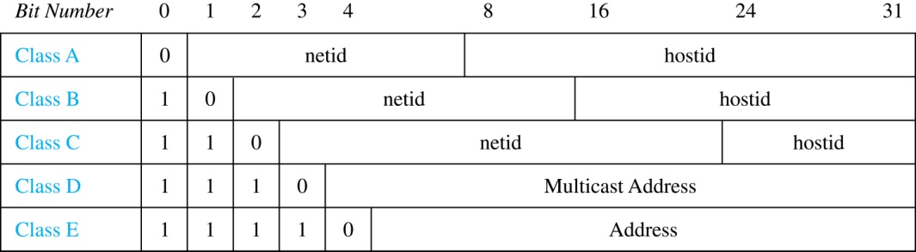
Internet Addresses
Version 4 of the Internet Protocol (IPv4) uses 32 bits.
Class A Addresses: used for the largest networks, a 0, followed by a 7-bit net_id and a 24-bit host_id.
Class B Addresses: used for the medium-sized networks, a 10, followed by a 14-bit net_id and a 16-bit host_id.
Class C Addresses: used for the smallest networks, a 110, followed by a 21-bit net_id and a 8-bit host_id.
Neither Class D nor Class E addresses are assigned as the address of a computer on the internet. Only Classes A, B, and C are available.
1111111 is not available as the net_id of a Class A network.
Host_ids consisting of all 0s and all 1s are not available in any network.

Slide 14
Counting Internet Addresses
Example: How many different IPv4 addresses are available for computers on the internet?
Solution: Use both the sum and the product rule. Let x be the number of available addresses, and let x_{A}, x_{B}, and x_{C} denote the number of addresses for the respective classes.
To find, x_{A}: 2⁷ − 1 = 127 net_ids. 2²⁴ − 2 = 16,777,214 host_ids.
x_{A} = 127∙ 16,777,214 = 2,130,706,178.
To find, x_{B}: 2¹⁴ = 16,384 net_ids. 2¹⁶ − 2 = 16,534 host_ids.
x_{B} = 16,384 ∙ 16, 534 = 1,073,709,056.
To find, x_{C}: 2²¹ = 2,097,152 net_ids. 2⁸ − 2 = 254 host_ids.
x_{C} = 2,097,152 ∙ 254 = 532,676,608.
Hence, the total number of available IPv4 addresses is
x = x_{A} + x_{B} + x_{C}
= 2,130,706,178 + 1,073,709,056 + 532,676,608
= 3, 737,091,842.
Not Enough Today !!
The newer IPv6 protocol solves the problem of too few addresses.

Slide 15
Basic Counting Principles: Subtraction Rule
Subtraction Rule: If a task can be done either in one of n₁ ways or in one of n₂ ways, then the total number of ways to do the task is n₁ + n₂ minus the number of ways to do the task that are common to the two different ways.
Also known as, the principle of inclusion-exclusion:

Slide 16
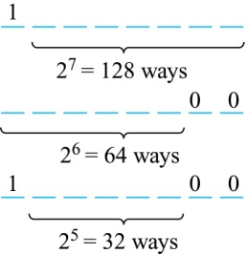
Counting Bit Strings
Example: How many bit strings of length eight either start with a 1 bit or end with the two bits 00?
Solution: Use the subtraction rule.
Number of bit strings of length eight that start with a 1 bit: 2⁷ = 128
Number of bit strings of length eight that end with bits 00: 2⁶ = 64
Number of bit strings of length eight that start with a 1 bit and end with bits 00 : 2⁵ = 32
Hence, the number is 128 + 64 − 32 = 160.

Slide 17
Lecture 15: The Pigeonhole Principle
Section 6.2

Slide 18
Lecture Summary
The Pigeonhole Principle
The Generalized Pigeonhole Principle

Slide 19
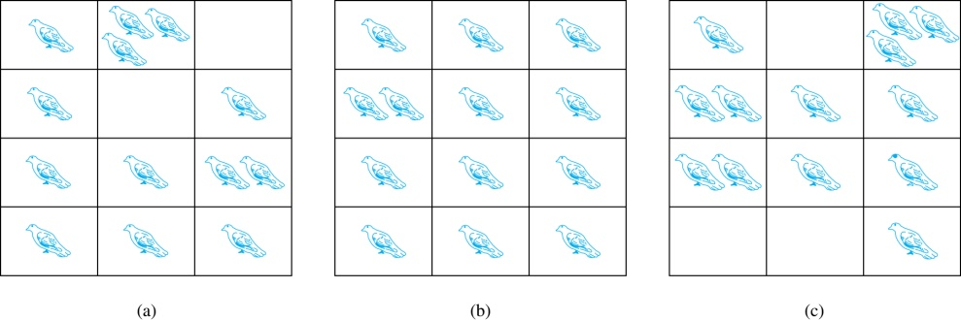
The Pigeonhole Principle
If a flock of 13 pigeons roosts in a set of 12 pigeonholes, one of the pigeonholes must have more than 1 pigeon.
Pigeonhole Principle: If k is a positive integer and k + 1 objects are placed into k boxes, then at least one box contains two or more objects.
Proof: We use a proof by contraposition. Suppose none of the k boxes has more than one object. Then the total number of objects would be at most k. This contradicts the statement that we have k + 1 objects.

Slide 20
Picking Object Blindfolded
Example: Suppose you are blindfolded and picking out balls from a box like below.
(a) Minimum how many balls to pick to get 2 balls of same color?
(b) Minimum how many balls to pick to get 2 red balls?
8 Red
5 blue
6 Black
(a) Worst case scenario would be, you pick 1 balls from each color = 3 balls. Then if you pick your 4th ball, it must match any of the color, and you will have your 2 same color balls.
So, solution is (1 Red+1 Blue + 1 Black) + 1 = 4 balls
(b) Worst case scenario would be, you pick all the blue and black balls. Then if you pick your next 2 balls, it must be of red color.
So, solution is (5 Blue + 6 Black + 1 Red) + 1 = 13 balls

Slide 21
Pigeonhole Principle
Example 1: Among any group of 367 people, there must be at least two with the same birthday, because there are only 366 possible birthdays.
Example 2: How many students must be in a class to guarantee that at least two students receive the same score on the final exam, if the exam is graded on a scale from 0 to 100 points?
Solution: There are 101 possible scores on the final. The pigeonhole principle shows that among any 102 students there must be at least 2 students with the same score.

Slide 22
Pigeonhole Principle
Example 3: Show that for every integer n there is a multiple of n that has only 0s and 1s in its decimal expansion.
Solution: Let n be a positive integer. Consider the n + 1 integers 1, 11, 111, …., 11…1 (where the last has n + 1 1s). There are n possible remainders when an integer is divided by n. By the pigeonhole principle, when each of the n + 1 integers is divided by n, at least two must have the same remainder. Subtract the smaller from the larger and the result is a multiple of n that has only 0s and 1s in its decimal expansion.

Slide 23
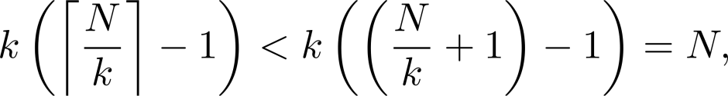
The Generalized Pigeonhole Principle
The Generalized Pigeonhole Principle: If N objects are placed into k boxes, then there is at least one box containing at least ⌈N/k⌉ objects.
Proof: We use a proof by contraposition. Suppose that none of the boxes contains more than ⌈N/k⌉ − 1 objects. Then the total number of objects is at most
where the inequality ⌈N/k⌉ < ⌈N/k⌉ + 1 has been used. This is a contradiction because there are a total of n objects.
Example: Among 100 people there are at least ⌈100/12⌉ = 9 who were born in the same month.

Slide 24
The Generalized Pigeonhole Principle
Example: a) How many cards must be selected from a standard deck of 52 cards to guarantee that at least three cards of the same suit are chosen?
b) How many must be selected to guarantee that at least three hearts are selected?
Solution: a) We assume four boxes; one for each suit. Using the generalized pigeonhole principle, at least one box contains at least ⌈N/4⌉ cards. At least three cards of one suit are selected if ⌈N/4⌉ ≥3. The smallest integer N such that ⌈N/4⌉ ≥3 is N = 2 ∙ 4 + 1 = 9.
b) A deck contains 13 hearts and 39 cards which are not hearts. So, if we select 41 cards, we may have 39 cards which are not hearts along with 2 hearts. However, when we select 42 cards, we must have at least three hearts. (Note that the generalized pigeonhole principle is not used here.)

Slide 25
Applications of Pigeonhole Principle
Example: During a month with 30 days, a baseball team plays at least one game a day, but no more than 45 games. Show that there must be a period of some number of consecutive days during which the team must play exactly 14 games.
Solution: : Let a_{j} be the number of games played on or before the j-th day of the month. Then a₁, a₂, … , a₃₀ is an increasing sequence of distinct positive integers, with 1 ≤ a_{j} ≤ 45. Moreover, a₁ + 14, a₂ + 14, … , a₃₀ + 14 is also an increasing sequence of distinct positive integers, with 15 ≤ a_{j} + 14 ≤ 59. The 60 positive integers a₁, a₂, … , a₃₀, a₁ + 14, a₂ + 14, … , a₃₀ + 14 are all less than or equal to 59.
Hence, by the pigeonhole principle two of these integers are equal. Because the integers a_{j} , j = 1, 2, … , 30 are all distinct and the integers a_{j} + 14, j = 1, 2, … , 30 are all distinct, there must be indices i and j with a_{i} = a_{j} + 14. This means that exactly 14 games were played from day j + 1 to day i.

