Slide 1

Nature-Based Solutions: A Path to a Sustainable Future
Nature-Based Solutions (NbS) offer a powerful approach to addressing global challenges by working with, rather than against, nature. This presentation explores what NbS are, why they matter, how they are implemented, and their impact worldwide.

Slide 2



What Are Nature-Based Solutions?
"NbS involve protecting, restoring, or sustainably managing ecosystems to address societal challenges." These solutions leverage natural processes to provide benefits for both people and the environment.
Reforestation
Wetland Restoration
Urban Green Spaces
Planting trees to restore degraded forests and absorb carbon.
Bringing back vital wetlands for water purification and flood control.
Creating parks and green areas in cities for well-being and climate resilience.

Slide 3




Why NbS Matter
Carbon Sequestration
Biodiversity Conservation
Natural ecosystems act as powerful carbon sinks, mitigating climate change.
Protecting and restoring habitats safeguards countless species.
Cost-Effectiveness
Community Benefits
Often more affordable and sustainable than engineered solutions.
Enhances human well-being, health, and economic opportunities.

Slide 4



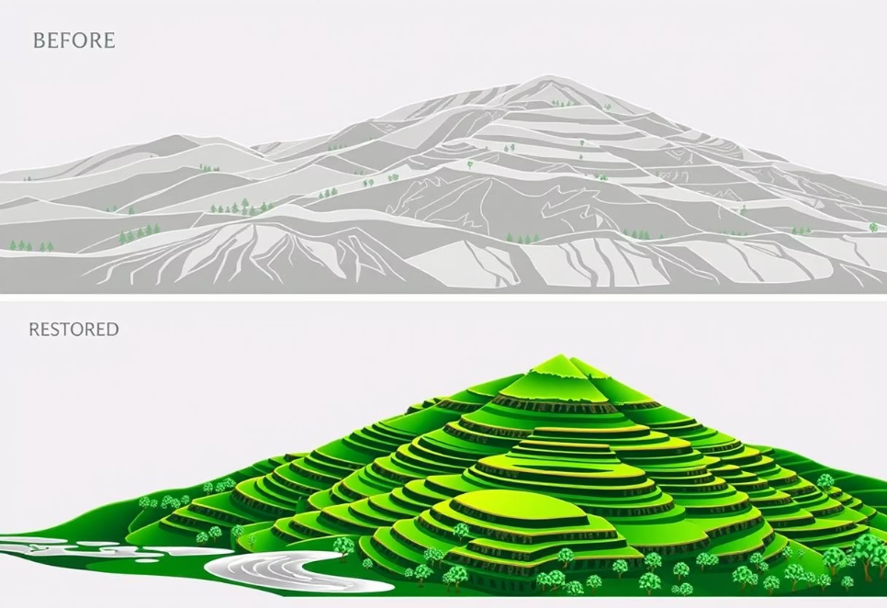
Global Success Stories
1
2
3
Rwanda
Great Green Wall (Africa)
China's Loess Plateau
Pioneering reforestation efforts have significantly increased forest cover and biodiversity.
An ambitious initiative to combat desertification across the Sahel region.
Large-scale ecological restoration transformed a degraded region into a fertile landscape.

