Slide 1
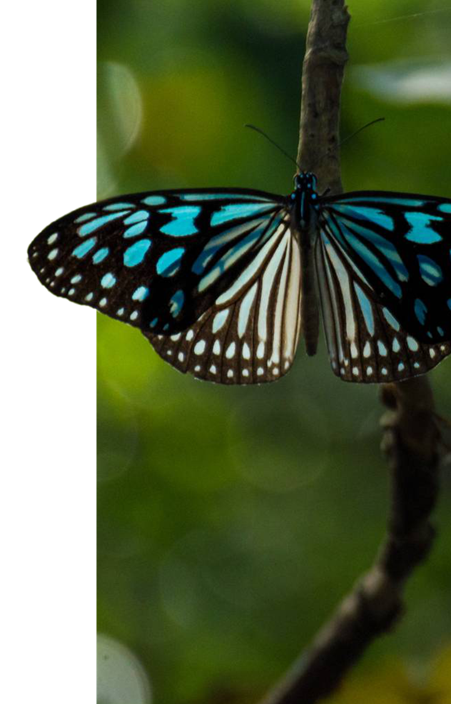

Slide 2
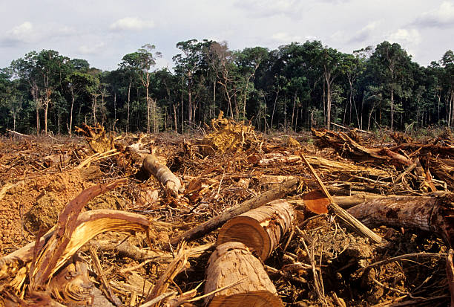
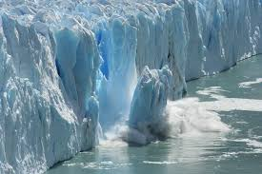
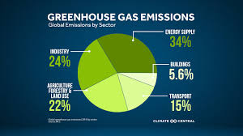
Climate Action Challenges
1.Deforestation and forest degradation
2. Excessive Greenhouse Gas Emissions
3.Melting and Rising Sea Levels
4. Lack of Climate Awareness and Education

Slide 3
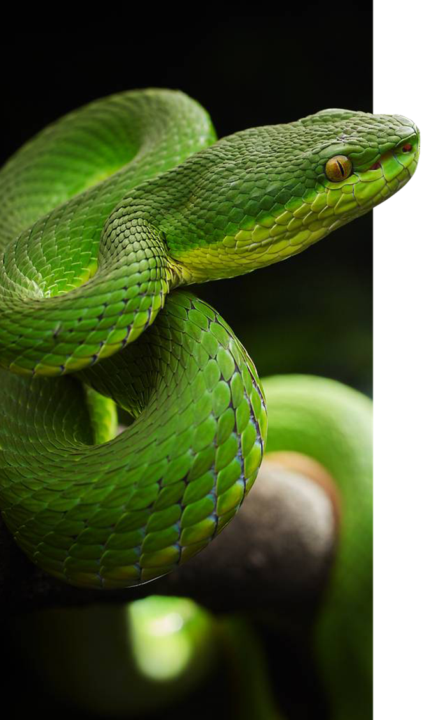
Innovative solutions

Slide 4
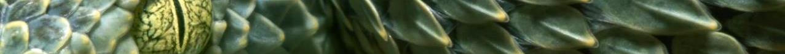

Slide 5
