Slide 1
Testing services
test automation enabling team

Slide 2
Our initiative
Modernize testing …..
test automation in Code instead of excel (C# . Net core, java, selenium, playwright)
Pipeline integration
Source control (git)
MOVE LEFT

Slide 3
Our current Collaborators
IFFS
GCOS
CSGC
APPLIWEB
LMIA
CPPE
YDG
NOC
JOB BANK
ECAS
ROE
HFIS
MEIIO
MSCA
CPP-SYS
EWCMS
IRS
AERS
RHRRP
CVA

Slide 4
Pipeline integration
lets move left

Slide 5
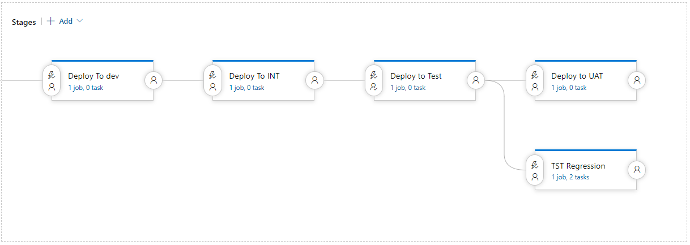
Notes:
Minimal viable product At minimum we want to be run after a deployment in test environments

Slide 6
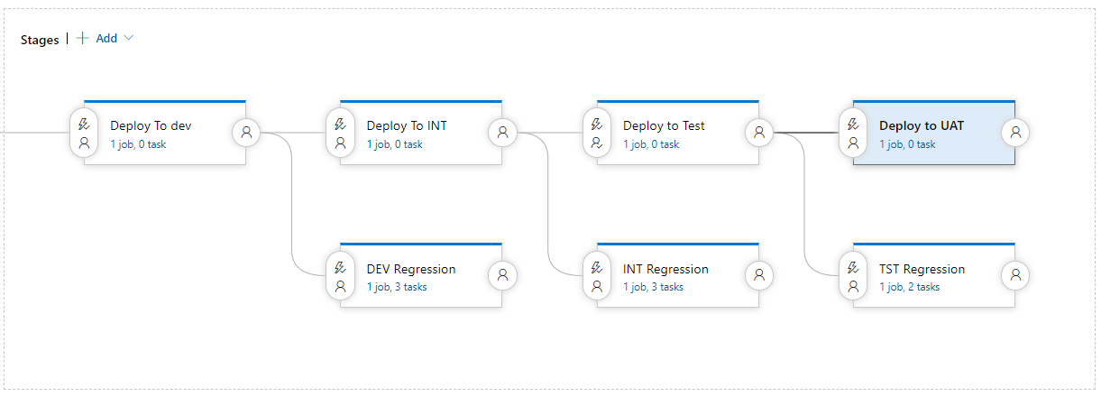
Notes:
ideally we would also run in your dev or int environment but we want to keep moving left

Slide 7
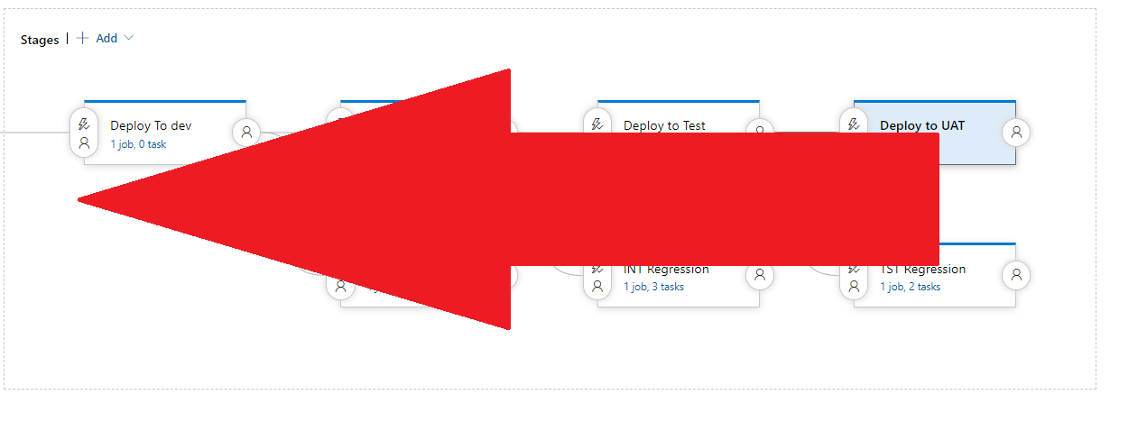
Notes:
Build process or check in process
Embedded tester GIT

Slide 8
resources
video
Day in the life of test automation engineer recording
Contact us
Me
pascal.desjardins@hrsdc-rhdcc.gc.ca
Test automaton enabling team
NC-SYS-TCOE-CEME-AUTOMATION-GD@hrsdc-rhdcc.gc.ca
ms team

