Slide 1
DevCoP React Showcase

Slide 2
Introduction
Developer with DTS for just over 2 years
Dev lead for Secure Client Hub team
2 years React experience

Slide 3
What is React?
React JS is a JavaScript library created by Facebook for building user interfaces. It lets you create reusable components so that your code is easy to read and maintain. The components usually consist of markup written in HTML, styling defined by CSS, and interactivity handled by JavaScript.

Slide 4
Why React?
Reusable components keep your code easy to read and maintain
Fast, efficient & easy to use
Tons of available support
Very popular so there are several available frameworks to suit specific tastes or needs (Next, Gatsby, Remix, etc.)

Slide 5

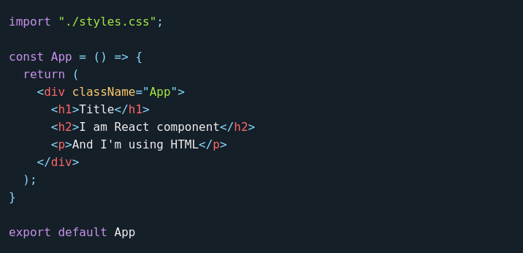
What is JSX?
JSX stands for JavaScript XML. JSX allows us to write HTML elements in JS and place them into the DOM. JSX converts these HTML elements into react elements. HTML code must be wrapped in a single parent element such as a div or a fragment.

Slide 6
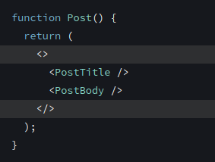
What is a fragment?
Makes it possible for components to return/render multiple elements without having a container element
By providing the ability to return multiple elements through JSX, fragments solved the issue of occasional invalid HTML markups inside react applications due to having the must-have constraints of only one element returning per component
Can use the shorthand version or <Fragment></Fragment>

Slide 7
React Demo
This demo will cover 4 basic concepts:
Reusable components
State management
Conditional rendering
React hooks (aside from those used for state management)
Built with Next.js, Tailwind, TypeScript
https://github.com/krischarbonneau/devcop-demo

Slide 8
Questions?

Slide 9

Thank you

