Slide 1
Introduction to VS Code
Dev CoP
June 2021

Slide 2
Agenda
Why visual studio code?
Installation
Interface
Extensions
Source Control
Tips and tricks

Slide 3
Why visual studio code?
Lightweight and fast
Customizable
Open source
Cross-platform
Notes:
Lightweight and fast
ships with the bare minimum, it installs with the less amount of things and you install packages as you go.
Customizable
Change theme, add more window, install extensions for icons, etc
Open Source
the source code is available on github, https://github.com/microsoft/vscode, MIT license
Cross platform
windows Debian, ubuntu, mac
Widely used in the industry, google
https://insights.stackoverflow.com/survey/2019#development-environments-and-tools

Slide 4
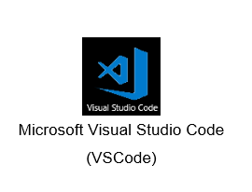
Installation
Available on the application catalogue
Commercial software
http://srmis-sigdi-iagent.prv/AppPortal/en/Home/Index/2
Notes:
http://srmis-sigdi-iagent.prv/AppPortal/en/Home/Index/2

Slide 5
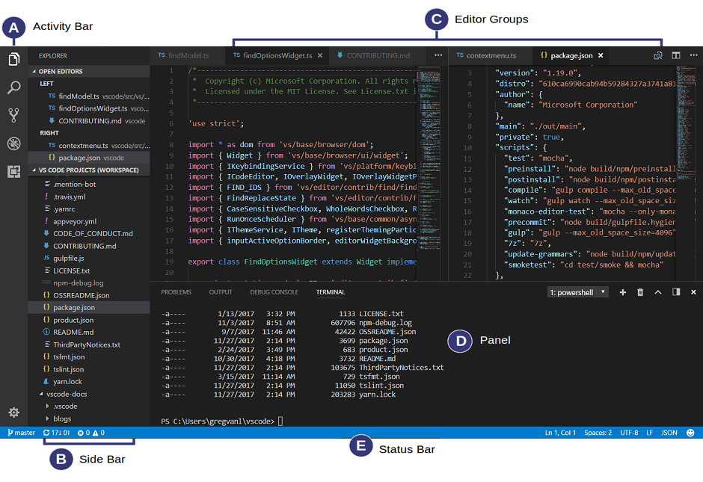
Interface
Notes:
Show icons
Search vs right click search
Open files, split view
View -> Editor Layout
Open Terminal, split

Slide 6
VS Code extensions
Java developers
Java Extension Pack
.NET Core developers
C# extension
Notes:
Material Icon Theme
Auto Rename Tag

Slide 7
Source control
VSCode includes git support
TFVC support deprecated since November 6, 2020.
Notes:
Show git available with interface and cmd

Slide 8
Tips and tricks
Command palette (ctrl+shift+p)
Quick file navigation (ctrl+p)
Multi cursor (alt + click, ctrl+alt+up arrow)
User snippets
Notes:
Command Palette (CTRL-Shift-P or View -> Command palette)
Join lines
Quick file navigation (ctrl+p or Go -> Go to file…)
Good with a deep hierarchy
Multi Cursor
JSON response
User snippets
tsrcc

Slide 9
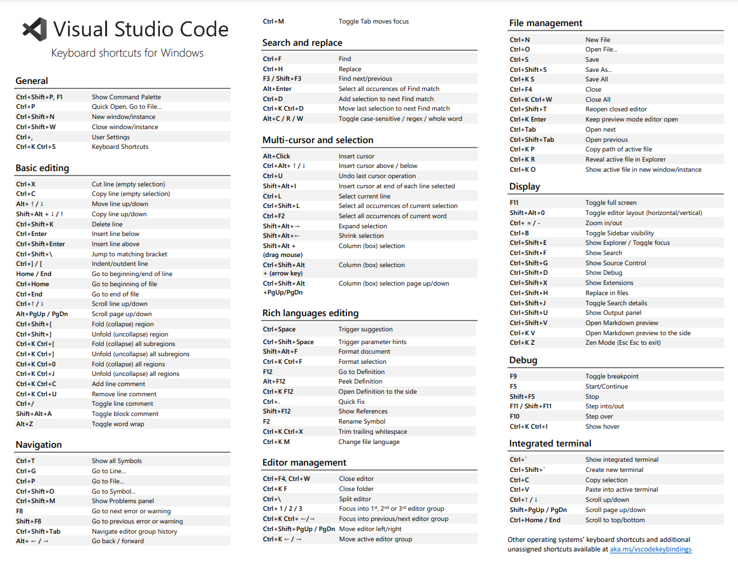
Keyboard shortcuts
https://code.visualstudio.com/shortcuts/keyboard-shortcuts-windows.pdf
Notes:
https://code.visualstudio.com/shortcuts/keyboard-shortcuts-windows.pdf

