Slide 1
DIGITAL DOJO
Digital Technology Solutions

Slide 2
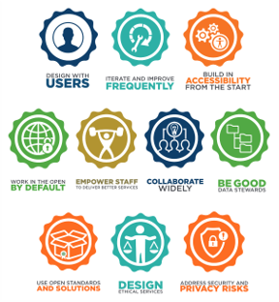
Modernizing and transforming is hard
Many teams in IITB have identified a desire to modernize how they deliver their products and services.​
We need these teams to follow TBS Digital Standards, which are closely aligned to a DevOps mindset.
After years of status quo, teams can feel overwhelmed, and unprepared to deliver in new ways.

Slide 3

We want to help
A Dojo is a Japanese word for a space for immersive learning or meditation.
The global DevOps community have embraced DevOps Dojos for learning and implementing organizational transformation.
Our Digital Dojo aims to provide an immersive virtual space where ESDC product teams learn new skills and new ways to solve common problems during service delivery.

Slide 4
What a Dojo isn’t vs. What a Dojo is
What a Dojo isn’t
What a Dojo is
Classroom training
A center of expertise
Abstract or high-level theoretical
Exercises with predefined answers
Practical & immersive experience
Experts work directly with your team
Work on your real product
Customized to your objectives
Notes:
52BAAD

Slide 5
THIS IS THE PART WHERE I AM SWEATING THINKING ABOUT THE VIDEO NOT WORKING

Slide 6



A bigger GC wide vision
Form mutually beneficial partnerships across the Government of Canada.
Seek out existing material and experts. Avoid reinventing the wheel.
Be a Dojo pathfinder. Share our findings and deliverables.
CSPS Digital Academy - Canadian Digital Service - GC DevOps League
GC Agile Community of Enablement - TBS OCIO - Interdepartmental Working Groups

Slide 7






Roadmap
Pathfinding
Soft launch
Grand opening
Building fundamentals
Planning the soft launch
Customer research
Test and adjust with our first client
Learn as we go
Validate our hypothesis
Accept requests from across ESDC
Continue to adjust and adapt with changing landscapes
JAN – JUN 2021
JULY 2021
AUG – OCT 2021
OCT – DEC 2021
JAN 2022
Identify first client
First client
Second client(s)

Slide 8

Get in touch, please!
"Next to trying and winning,
the best thing is trying and failing."
- L.M. Montgomery
EDSC.DGIIT.STNDojoDTSDojo.IITB.ESDC@hrdc-drhc.net
or contact Stephanie DeGuire

