Slide 1



Azure DevOps Estimation Poker

Slide 2
Intro
A “Poker Estimation” tool was added to ADO (Azure DevOps).
This add-on allows you to select work item(s) from an iteration, a query, or from your backlog and estimate the effort with your team.
All team members select from a predetermined relative effort scale, such Tee Shirt Sizes (XS, S, M, L, XL) or Numbers (0, 1, 2, 3, 4, 5)
Flipping at once should help to remove natural biases, such as selecting the same value as the team tech lead’s selection. After that, there’s a team discussion to normalize the value into an agreed selection, such as the average value.
Once consensus is reached, the work items “Story Points | Points du récit:” field will be updated.

Slide 3
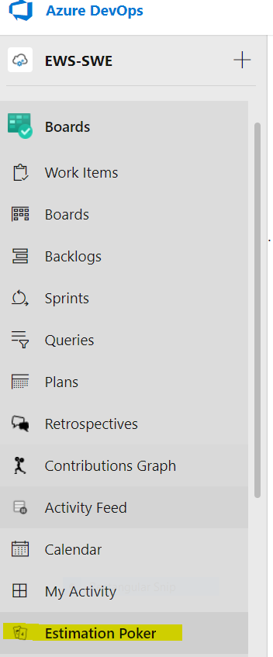
Quick steps to get started
STEP #1. Create a new Estimation Game
Option #1: from a board, click the “…” beside your work item, select “Estimate work item(s)”
Option #2: From the left menu, select “Boards/Estimation Poker”, and then “+Start your Game here”

Slide 4
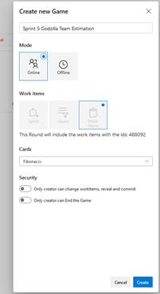
Step #2. Configure your Game
Enter a “Title” for your game
Select “Online” to view the estimations from your team real-time
Additional items may appear depending on how you started your game. Ex: select Team and sprint, select query…
Select the type of estimation you want to use (T-Shirt sizes, Fibonacci…) through the “Cards” field
Click “Create”
This will create a new game on the “Estimation Poker” hub

Slide 5
Step #3. Invite your team members to the game
From the left menu, select “Boards/Estimation Poker”, and then Select the game
Step #4. Estimate
Pick the Work Item to estimate from the “Pending Estimates” section
Have your team members vote by selecting a card under “Your Vote” section
Once all votes are in, click “Reveal”
Reach consensus on the estimation, you can re-vote if necessary
Step #5. Select the final estimation for your work item to be updated
Once consensus is reached, select the final card/estimation under “Actions” section
This will update the “Story Points | Points du récit:” field of your work item
Step #6. Repeat with your next work items

