Slide 1


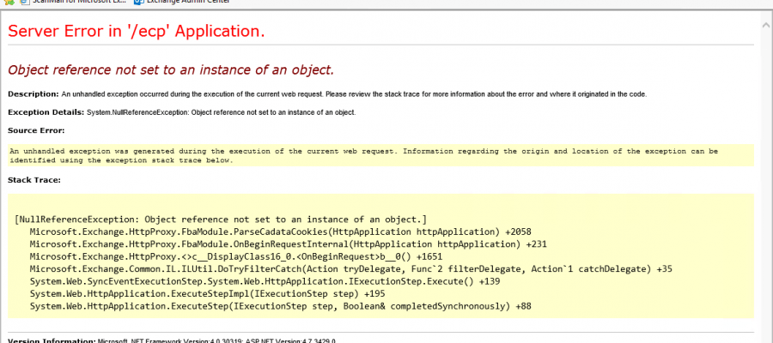

Troubleshooting

Slide 2

Debugging vs Troubleshooting
Troubleshooting and debugging are similar exercises
Debugging:
Developers spend most of their time debugging their code before its deployed.
Access to the code in debug mode (break points, stack trace, query variables at run time.)
Code is mostly executed on developers desktop
Troubleshooting:
No Access to the code in debug mode (break points, stack trace, query variables at run time.
Code isn’t executed on developers desktop(Web server, Database, Client desktop, etc.)
Refer to error codes, error messages, log files, steps to reproduce, etc.

Slide 3
Required to Troubleshoot
An error message accompanied by a stack trace is the starting point for most of all troubleshooting.*
When you are asked to troubleshoot or are troubleshooting yourself, always start with obtaining:
1. Error Message (worst case an Error Code, more details on next slide)
2. Environment name (URL if possible)
3. Steps to reproduce. I went to page "abc", I selected ID 1234 in the dashboard table, clicked on "Edit" button got a 500 error
* You might still have an error but without an error message in certain cases. Example: Web page presentation (css) is not displayed as intended.

Slide 4
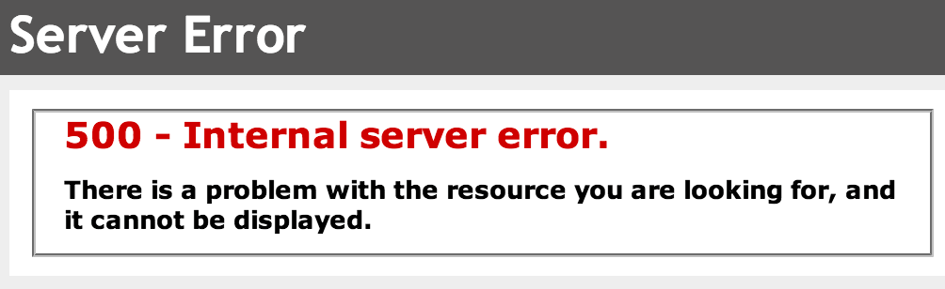
Error Codes from Web browsers
When an issue is raised from an end user using a web browser, there is a possibility that he will only see an error code on the web page instead of an error message with Stack Trace.
Status code meaning : https://en.wikipedia.org/wiki/List_of_HTTP_status_codes
Error codes be trimmed down to the following:
100: Information
200: Success* Even though the operation was successful might not mean it worked as intended
300: Redirection
400: Client Error *the error happens because of the data the client provided to the server, could also be the server that has a bug on their end (data passed by client is ok but server has a bug).
500: Server Error

Slide 5
Reproduce locally at run time
With an error message and stack trace in hand you can try and replicate the error while debugging and running the code locally.
If you cannot reproduce the problem make sure you have the following :
Is your source code the same version as the vertical in which the problem was reported ?
Point any dependencies to the vertical in question. Example: the solution depends on web services or API from another group. Point your local code to the same dependency on that same vertical from which the problem occurred. EX. Problem happens in SysTest environment, then point your local code to the dependencies on the same vertical.
Point your local code to the verticals database.
If your application is using access rights: set your access rights to be the same as the user that reported the error.
Keep in mind that you might not be able to reproduce 100% (load balancer on a desktop, DNS names vs localhost)

Slide 6
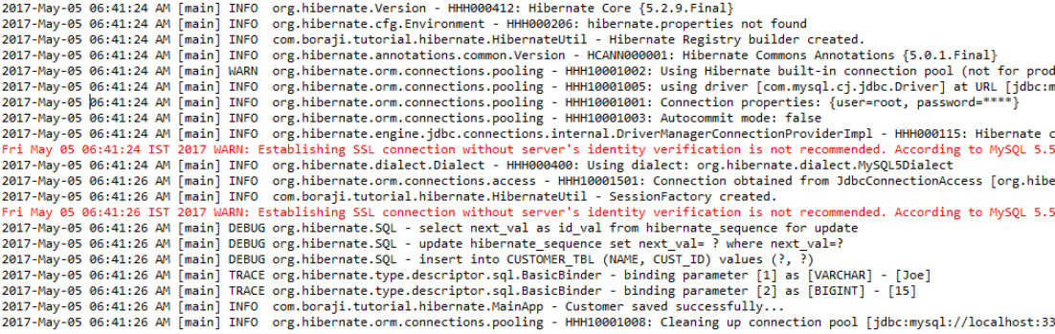
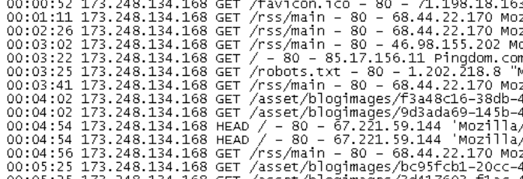
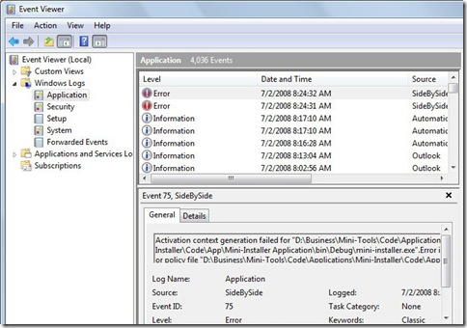
Error messages
An error message with a Stack trace will usually indicate where the error happens in the source code making it easy to find the source of the problem. If the Error Message and Stack trace doesn’t point to the problem then you should investigate at Log Files
Your application should handle exceptions and writes critical errors in a format that can be viewed and searched
Application logs (The ones you should have)
Web Server logs
Be mindful of load balanced environments, look at the logs of all the web servers)
Requires SSC intervention in production( NSD ticket with 1INet)
Operating System/Audit Logs

Slide 7
Add logging info in your exception/catch block
Since you cannot debug at run time on verticals; it is a must that logging be implemented in the solution (NLOG for Windows, Log4J for Java)
Identify all the functions that are consumed by the process that generates an error. Add proper debugging info (add variable information in your log files.)
Object reference not set to an instance of an object error. Multiple variables on one line, check all variables to find the one that isn’t instantiated

Slide 8
Look at configurations
If possible try and replicate the settings where the error happens.
For instance, a Senior advisor once noticed that a database had a default date format that was different from vertical to vertical.
Identify the differences, try all the different settings one by one. (Date format, Culture setting with server and client, timeout values, etc.)

Slide 9
Intermittent problems
What recently changed ?
Is your application load balanced, if so does the error happen when the "web server gets switched" (IIS Logs) ? Are all web servers configured the same ?
Was a new feature implemented ?
Was a dependency modified (SOAP or API service might change it's functions 'signature')
Was the web server configuration modified recently
Was the database modified recently
Has the architecture changed.
Are there any cache, Application level variables, session timeout values (Client & Server), database connection pool, or any value that have a "limit". If so make sure the values set are as desired and thread safety is implemented (one variable being changed by two processes).

Slide 10
Conclusion
Always do your own research before asking any help (gather as much information as possible)
When requesting assistance always provide the error message/Stack trace and the steps you did to solve the problem
If you are out of options ask for a "second pair of eyes" to look at your code.
Don't assume it cannot be done by simply reading other peoples input on the internet (Stack Overflow). Try it yourself and see for yourself if something is doable or not. There is no better assurance than having it done yourself.
There are options out there, try them !

Slide 11
? Questions /Comments?
Visit our GitHub pages
Welcome to the DevCoP! | ESDC Development Community (esdc-devcop.github.io)
Ask a question or request a specific topic
Issues · esdc-devcop/esdc-devcop.github.io
Have a question about a previous presentation, There is a milestone for each session
Milestones - esdc-devcop/esdc-devcop.github.io

