Slide 1

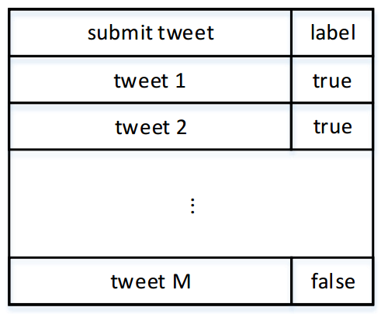
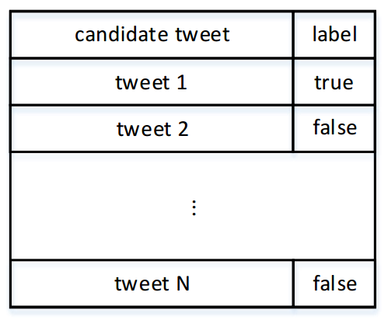
Twitter API
Filter Module
Submit Table
Judge Module
Scenario A
Non-English Filtering
Relevance Filtering
Non-ASCII Filtering
Novelty Filtering
Redundant Retweet Elimination
Submit Module
Stopword Filtering
Query
Expansion
Interest Profile
Submission Log
Poter Stemming
Word Overlap Filtering
Judge Module
Scenario B
Real-Time
Evaluation Broker
Pre-process Table
Relevance Filtering
Novelty Filtering
Sorting
Daily Summarization

