Slide 1

ITP74 - INFORMATION ASSURANCE AND SECURITY
PART FOUR:
IMPLEMENTATION

Slide 2
TOOLS/ASSESS ORGANIZATIONAL SECURITY

Slide 3
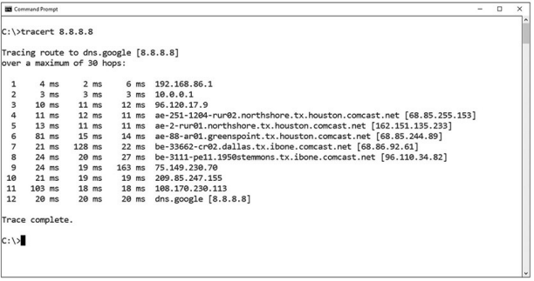
NETWORK RECONNAISSANCE AND DISCOVERY
tracert is a Windows command for tracing the route that packets take over the network. It provides a list of hosts, switches and routers in the order in which a packet passes through them, providing a trace of the network route from source to target. (traceroute for Linux and macOS)

Slide 4
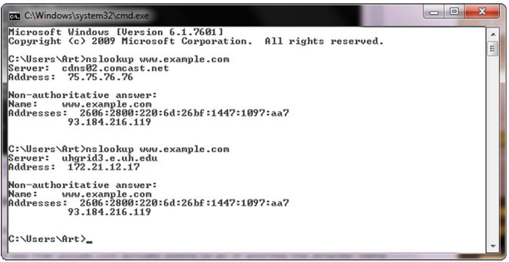
NETWORK RECONNAISSANCE AND DISCOVERY
nslookup/dig is a command that is used to examine a DNS query for a specific address
dig, is used for Linux systems, which stands for Domain Information Groper.

Slide 5
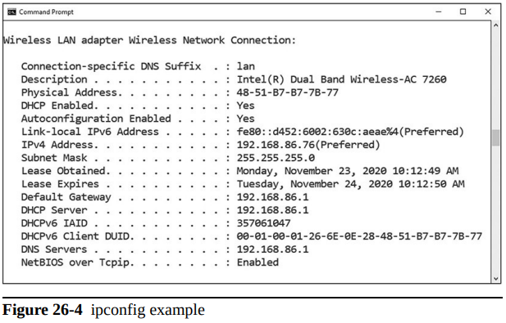
NETWORK RECONNAISSANCE AND DISCOVERY
ipconfig and ifconfig are command line tools to manipulate the network interfaces of the system

Slide 6
NETWORK RECONNAISSANCE AND DISCOVERY
Nmap is a free, open source port scanning tool developed by Gordon Lyon. It is used to discover what systems are on a network and the open ports and services on those systems.

Slide 7
NETWORK RECONNAISSANCE AND DISCOVERY
ping command sends echo requests to a designated machine to determine if communication is possible
pathping is a TCP/IP based utility that provides additional data beyond that of ping command. It will first display results as is you were using tracert

Slide 8
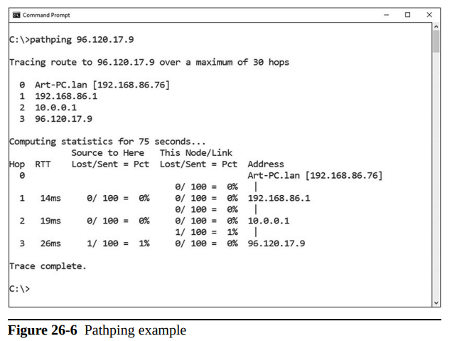
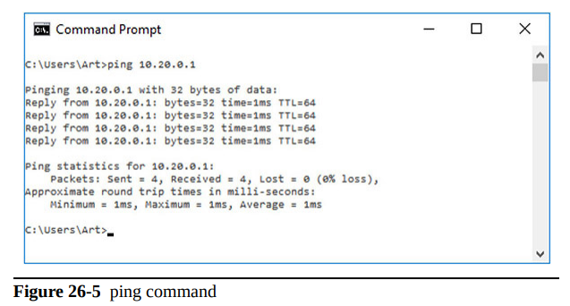
NETWORK RECONNAISSANCE AND DISCOVERY

Slide 9
NETWORK RECONNAISSANCE AND DISCOVERY
hping is a tool provides a means of
performing a wide range of network operations. This includes port scanning, crafting ICMP packets, host discovery, and more.

Slide 10
NETWORK RECONNAISSANCE AND DISCOVERY
netstat command is used to monitor network connections to and from a system
netstat –a Lists all active connections and listening ports
netstat –at Lists all active TCP connections
netstat –an Lists all active UDP connections

Slide 11
NETWORK RECONNAISSANCE AND DISCOVERY
netcat utility is the tool of choice in Linux for reading from and writing to network connections using TCP or UDP
nc –options –address

Slide 12
NETWORK RECONNAISSANCE AND DISCOVERY
IP scanners scan IP networks and can report on the status of IP addresses. There are a wide range of free and commercial scanning tools, and most come with significantly greater functionality than just reporting on address usage

Slide 13
NETWORK RECONNAISSANCE AND DISCOVERY
The arp command is designed to interface with the operating system’s Address Resolution Protocol (ARP) caches on a system
The route command works in Linux and Windows systems to provide information on current routing parameters and to manipulate these parameters

Slide 14
NETWORK RECONNAISSANCE AND DISCOVERY
curl is a tool designed to transfer data to or from a server, without user interaction. It support a long list of protocols (DICT, FILE, FTP, FTPS, Gopher, HTTP, HTTPS, IMAP, IMAPS, LDAP, LDAPS, MQTT, POP3, POP3S, RTMP, RTMPS, RTSP, SCP, SFTP, SMB, SMBS, SMTP, SMTPS, Telnet, and TFTP) and acts like a Swiss army knife for interacting with a server

Slide 15
NETWORK RECONNAISSANCE AND DISCOVERY
theHarvester is a Python-based program designed to assist penetration testers in the gathering of information during the reconnaissance portion of a penetration test. This is a useful tool for exploring what is publicly available about your organization on the Web, and it can provide information on employees, e-mails, and subdomains using different public sources

Slide 16
NETWORK RECONNAISSANCE AND DISCOVERY
sn1per is a Linux-based tool used by penetration testers. Sn1per is an automated scanner designed to collect a large amount of information while scanning for vulnerabilities. It runs a series of automated scripts to enumerate servers, open ports, and vulnerabilities, and it’s designed to integrate with the penetration testing tool Metasploit.

Slide 17
NETWORK RECONNAISSANCE AND DISCOVERY
scanless is a command-line utility to interface with websites that can perform port scans as part of a penetration test. When you use this tool, the source IP address for the scan is the website, not your testing machine.

Slide 18
NETWORK RECONNAISSANCE AND DISCOVERY
Dnsenum is a Perl script designed to enumerate DNS information. Dnsenum will enumerate DNS entries, including subdomains, MX records, and IP addresses.

Slide 19
NETWORK RECONNAISSANCE AND DISCOVERY
Nessus is one of the leading vulnerability scanners in the marketplace. It comes in a free version, with limited IP address capability, and fully functional commercial versions. Nessus is designed to perform a wide range of testing on a system, including the use of user credentials, patch level testing, common misconfigurations, password attacks, and more.

Slide 20
NETWORK RECONNAISSANCE AND DISCOVERY
Cuckoo is a sandbox used for malware analysis. Cuckoo is designed to allow a means of testing a suspicious file and determining what it does

Slide 21
FILE MANIPULATION
head is a utility designed to return the first lines of a file. A common option is the number of lines one wishes to return.
tail is a utility designed to return the last lines of a file. A common option is the number of lines one wishes to return

Slide 22
FILE MANIPULATION
cat is a Linux command, short for concatenate, that can be used to create and manipulate files. It can display the contents of a file, handle multiple files, and can be used to input data from stdin, which is a stream of input, to a file if the file does not exist
cat textfile.txt

Slide 23
FILE MANIPULATION
grep is a Linux utility that can perform pattern-matching searches on file contents. The name grep comes from “Globally search for Regular Expression and Print the matching lines
chmod is the Linux command used to change access permissions of a file.
chmod 754 <filename>

Slide 24
FILE MANIPULATION
The Linux command logger is how you can add log file information to /var/log/syslog. The logger command works from the command line, from scripts, or from other files, thus providing a versatile means of making log entries

Slide 25
SHELL AND SCRIPT ENVIRONMENTS
SSH (Secure Shell) is a cryptographically secured means of communicating and managing a network over an unsecured connection. It was originally designed as a replacement for the plaintext protocols of Telnet and other tools.

Slide 26
SHELL AND SCRIPT ENVIRONMENTS
PowerShell is a Microsoft Windows-based task automation and configuration management framework, consisting of a command-line shell and scripting language.
Python is a computer language commonly used for scripting and data analysis tasks facing system administrators and security personnel.

Slide 27
SHELL AND SCRIPT ENVIRONMENTS
OpenSSL is a general-purpose cryptography library that offers a wide range of cryptographic functions on Windows and Linux systems. Designed to be a full-featured toolkit for the Transport Layer Security (TLS) and Secure Sockets Layer (SSL) protocols, it provides so much more for real-world daily challenges.

Slide 28
PACKET CAPTURE AND REPLAY
Tcpreplay is the name for both a tool and a suite of tools. As a suite, tcpreplay is a group of free, open source utilities for editing and replaying previously captured network traffic. As a tool, it specifically replays a PCAP file on a network.

Slide 29
PACKET CAPTURE AND REPLAY
The tcpdump utility is designed to analyze network packets either from a network connection or a recorded file.
Wireshark is the gold standard for graphical analysis of network protocols. With dissectors that allow the analysis of virtually any network protocol, this tool can allow you to examine individual packets, monitor conversations, carve out files, and more.

Slide 30
FORENSICS
Digital forensics is the use of specific methods to determine who did what on a system at a specific time, or some variant of this question.
Data dump (dd) is a Linux command-line utility used to convert and copy files.

Slide 31
FORENSICS
FTK Imager is the company AccessData’s answer to dd. FTK Imager is a commercial program, free for use, and is designed to capture an image of a hard drive (or other device) in a forensic fashion.

Slide 32
FORENSICS
Autopsy is the open source answer for digital forensic tool suites. This suite, developed by Brian Carrier, has evolved over the past couple of decades into a community-supported open source project that can perform virtually all digital forensic functions.

Slide 33
EXPLOITATION FRAMEWORKS
Exploitation frameworks are toolsets designed to assist hackers in the tasks associated with exploiting vulnerabilities in a system. These frameworks are important because the exploitation path typically involves multiple steps, all done in precise order on a system to gain meaningful effect.

Slide 34
PASSWORD CRACKERS
Password crackers are used by hackers to find weak passwords.
Password crackers work using dictionary lists and brute force. On the dictionary lists, they make passwords by combining words with each other, with numbers and special symbols, and test those against the system. They also can perform brute force attacks

Slide 35
DATA SANITATION
Data sanitization tools are tools used to destroy, purge, or otherwise identify for destruction specific types of data on systems. Before a system can be retired and disposed of, you need to sanitize the data needs.

Slide 36
-- END OF PRESENTATION --

