Slide 1

ITP74 - INFORMATION ASSURANCE AND SECURITY
PART FOUR:
OPERATIONS AND INCIDENT RESPONSE

Slide 2
INCIDENT RESPONSE POLICIES, PROCESSES AND PROCEDURES

Slide 3
INCIDENT RESPONSE PLANS
An incident response plan describes the steps an organization performs in response to any situation determined to be abnormal in the operation of a computer system or network.

Slide 4
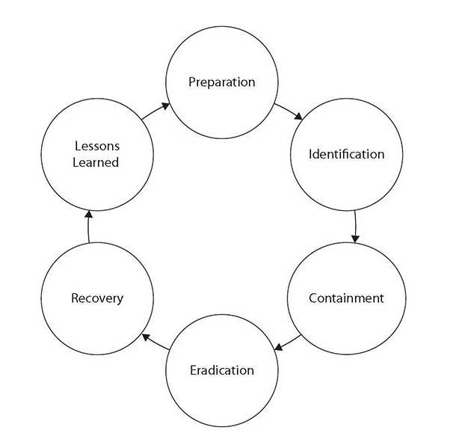
INCIDENT RESPONSE PROCESS
The incident response process is the set of actions security personnel perform in response to a wide range of triggering events.

Slide 5
INCIDENT RESPONSE PROCESS
Preparation is the phase of incident response that occurs before a specific incident.
Identification is the process where a team member suspects that a problem is bigger than an isolated incident and notifies the incident response team for further investigation.

Slide 6
INCIDENT RESPONSE PROCESS
Containment is the set of actions taken to constrain the incident to a minimal number of machines.
Eradication involves removing the problem, and in today’s complex system environment, this may mean rebuilding a clean machine.

Slide 7
INCIDENT RESPONSE PROCESS
Recovery is the process of returning the asset into the business function and restoring normal business operations.
A postmortem session should collect lessons learned and assign action items to correct weaknesses and to suggest ways to improve.

Slide 8
EXERCISES
Exercises come in many forms and functions, and doing a tabletop exercise where the planning and preparation steps are tested is an important final step in the planning process.

Slide 9
EXERCISES
A tabletop exercise is one that is designed for the participants to walk through all the steps of a process, ensuring all elements are covered and that the plan does not forget a key dataset or person.
Walkthroughs examine the actual steps that take place associated with a process, procedure, or event.

Slide 10
EXERCISES
A simulation is an approximation of the operation of a process or system that is designed to represent the actual system operations over a period of time.

Slide 11
ATTACK FRAMEWORKS
The Diamond Model of Intrusion Analysis is a cognitive model used by the threat intelligence community to describe a specific event. It is based on the notion that an event has four characteristics, each comprising a corner of the diamond

Slide 12
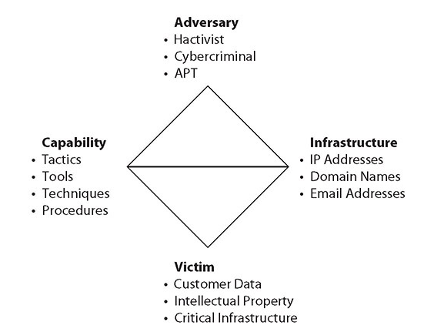
ATTACK FRAMEWORKS
Adversary - Whois is used to get an e-mail for the registrant—the possible attacker.
Infrastructure - The C2 domain name resolves to an IP address.
Capability - The response teams finds the C2 server domain name.
Victim - A victim discovers malware and launches an incident response.

Slide 13
ATTACK FRAMEWORKS
The Cyber Kill Chain is a model developed by Lockheed Martin as a military form of engagement framework. This model has a series of distinct steps that an attacker uses during a cyberattack—from the early reconnaissance stages to the exfiltration of data.

Slide 14
ATTACK FRAMEWORKS
Reconnaissance Research and identify targets.
Weaponization Exploit vulnerabilities to enter.
Delivery Deliver the payload (evil content).
Exploitation Begin the payload attack on the system and gain entry.
Installation Implement backdoors, persistent access, bots, and so on.

Slide 15
ATTACK FRAMEWORKS
6. Command and Control Communicate to outside servers for control purposes.
7. Action on Objective Obtain the objective of the attack (for example, steal intellectual property).

Slide 16
STAKEHOLDER MANAGEMENT
Stakeholders are the parties that have an interest in a process or the outcome
of a process. Stakeholders can be internal or external to an organization.
Having a stakeholder management process, including defined personnel roles and responsibilities, is essential for the management of the stakeholders and their relationships during incidents.

Slide 17
COMMUNICATION PLAN
A communication plan as part of the incident response effort that answers the preceding questions and defines responsibilities for communication is a key element to be developed during the preparation phase.

Slide 18
DISASTER RECOVERY PLAN
A disaster recovery plan (DRP) is critical for effective disaster recovery efforts. A DRP defines the data and resources necessary and the steps required to restore critical organizational processes.

Slide 19
BUSINESS CONTINUITY PLAN
The business continuity plan (BCP) represents the planning and advanced policy decisions to ensure the business continuity objectives are achieved during a time of obvious turmoil.

Slide 20
CONTINUITY OF OPERATION PLANNING (COOP)
The overall goal of continuity of operation planning (COOP) is to determine which subset of normal operations needs to be continued during periods of disruption. Continuity of operations planning involves developing a comprehensive plan to enact during a situation where normal operations are interrupted.

Slide 21
INCIDENT RESPONSE TEAM
The cyber incident response team (CIRT) is composed of the personnel who are designated to respond to an incident. The incident response plan should identify the membership and backup members, prior to an incident occurring. Once an incidence response begins, trying to find personnel to perform tasks only slows down the function, and in many cases would make it unmanageable.

Slide 22
RETENTION POLICIES
Data retention is the storage of data records. One of the first steps in understanding data retention in an organization is the determination of what records require storage and for how long

Slide 23
-- END OF PRESENTATION --

