Slide 1

ITP74 - INFORMATION ASSURANCE AND SECURITY
PART FOUR:
OPERATIONS AND INCIDENT RESPONSE

Slide 2
INVESTIGATIONS

Slide 3
VULNERABILITY SCAN OUTPUT
Vulnerability scan output provides information as to the systems that are running, any additional services that are listening on the network, and what the known vulnerabilities are against each of these.

Slide 4
SIEM DASHBOARDS
SIEM (security information and event management) dashboards are the windows into the SIEM datastore, a collection of information that can tell you where attacks are occurring and provide a trail of breadcrumbs to show how the attacker got into the network and moved to where they are now.

Slide 5
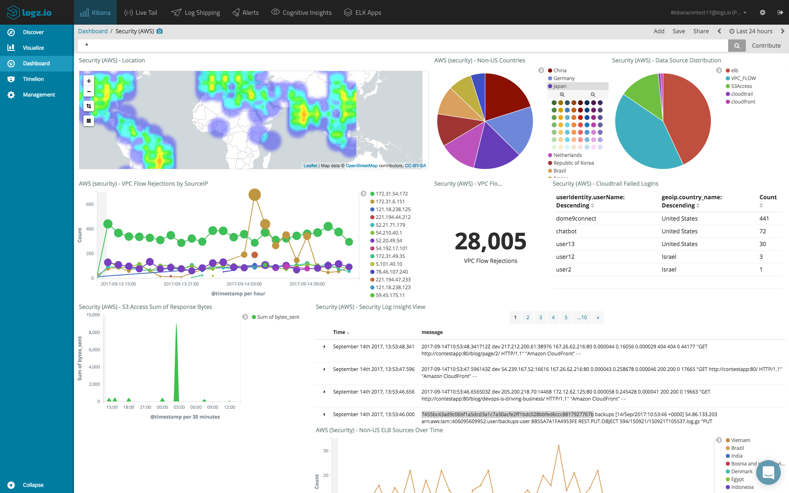
SIEM DASHBOARDS

Slide 6
SIEM DASHBOARDS
Sensors are the devices that provide security data into the security datastore.
Sensitivity is the quality of being quick to detect or respond to slight changes, signals, or influences.

Slide 7
SIEM DASHBOARDS
Trends are a series of data points that indicate a change over time. Trends can be increasing, decreasing, cyclical, or related to variability. What is important is that trends indicate some form of change.
Alerts are the primary method of communication between the SIEM system and operators.

Slide 8
SIEM DASHBOARDS
Correlation is the process of establishing a relationship between two variables. However, correlation is not causation, meaning that just because measurements trend together doesn’t mean one causes the other.

Slide 9
LOG FILES
Log files are a primary source of information during an investigation. Software can record in log files a wide range of information as it is operating. From self-health checks, to error-related data, to operational metadata supporting the events that are happening on a system, all this data ends up in log files.

Slide 10
LOG FILES
Network logs tend to have a duplication issue as packets can traverse several devices, giving multiple, nearly identical records.
Virtually every operating system creates system logs. These logs can provide a very detailed history of what actions were performed on a system

Slide 11
LOG FILES
Application logs are generated by the applications themselves as they run
Security logs are logs kept by the OS for metadata associated with security operations.
Web log files can help identify when attacks are happening in a web server

Slide 12
LOG FILES
DNS logs, when enabled, can contain a record for every query and response. This can be a treasure trove of information for an investigator because it can reveal malware calling out to its command-and-control server, or data transfers to non-company locations.

Slide 13
LOG FILES
Authentication logs contain information about successful and failed authentication attempts. The most common source of authentication log information comes from the system’s security logs, but additional sources exist as well.

Slide 14
LOG FILES
Dump files are copies of what was in memory at a point in time—typically a point when some failure occurred. Dump files can be created by the operating system (OS) when the OS crashes, and these files can be analyzed to determine the cause of the crash.

Slide 15
LOG FILES
Voice over IP (VoIP) solutions and call manager applications enable a wide range of audio and video communication services over the Internet. These systems can log a variety of data, including call information such as the number called (to and from), time of the call, and duration of the call.

Slide 16
LOG FILES
The Session Initiation Protocol (SIP) is a text-based protocol used for signaling voice, video, and messaging applications over IP. SIP provides information for initiating, maintaining, and terminating real-time sessions. SIP traffic logs are typically in the SIP Common Log Format (CLF), which mimics web server logs and captures the details associated with a communication (such as to and from).

Slide 17
SYSLOG/RSYSLOG/ SYSLOG-NG
Syslog stands for System Logging Protocol and is a standard protocol used in Linux systems to send system log or event messages to a specific server, called a syslog server.

Slide 18
SYSLOG/RSYSLOG/ SYSLOG-NG
Rsyslog is an open source variant of syslog that follows the syslog specifications but also provides additional features such as content-based filtering
Syslog-ng is another open source implementation of the syslog standard.

Slide 19
JOURNALCTL
On Linux systems, the initial daemon that launches the system is called systemd. When systemd creates log files, it does so through the systemdjournald service. Journalctl is the command that is used to view these logs.

Slide 20
NXLOG
NXLog is a multiplatform log management tool designed to assist in the use of log data during investigations. This tool suite is capable of handling syslog-type data as well as other log formats, including Microsoft Windows

Slide 21
BANDWIDTH MONITORS
Bandwidth monitors are utilities designed to measure network bandwidth utilization over time. Bandwidth monitors can provide information as to how much bandwidth is being utilized, by service type, and how much remains.

Slide 22
METADATA
Metadata is data about data. A file entry on a storage system has the file contents plus metadata, including the filename, creation, access, and update timestamps, size, and more.
Email
Mobile
Web
File

Slide 23
NetFlow/sFlow
NetFlow is a proprietary standard from Cisco. Flow data is generated by the network devices themselves, including routers and switches. The data that is collected and shipped off to data collectors is a simple set of metadata—source and destination IP addresses, source and destination ports, if any (ICMP, for example, doesn’t use ports), and the protocol. NetFlow does this for all packets, while sFlow (sampled flow) does a statistical sampling.

Slide 24
NetFlow/sFlow
Internet Protocol Flow Information Export (IPFIX) is an IETF protocol that’s the answer to the proprietary Cisco NetFlow standard.

Slide 25
PROTOCOL ANALYZER OUTPUT
A protocol analyzer (also known as a packet sniffer, network analyzer, or network sniffer) is a piece of software or an integrated software/hardware system that can capture and decode network traffic.

Slide 26
-- END OF PRESENTATION --

