Slide 1
What is the difference between functional and non-functional requirements?
What is a use case?
What is the difference between evolutionary vs. throw-away prototyping?

Slide 2
ESE
Project Kick Off

Slide 3
teamwork

Slide 4
You are not alone

Slide 5
customer
coach

Slide 6
customer
coach

Slide 7
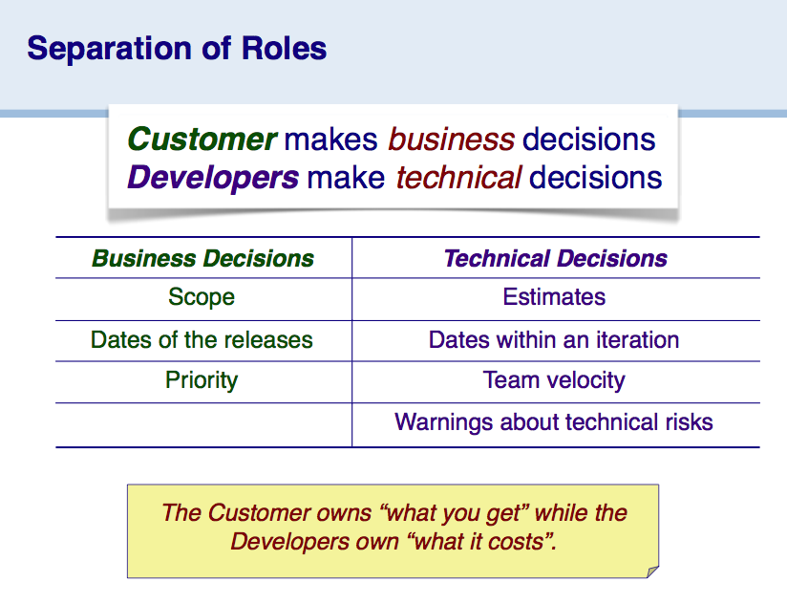

Slide 8
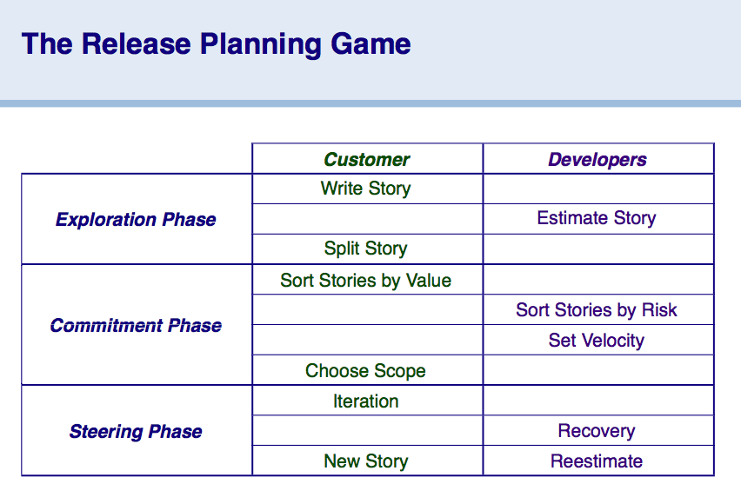

Slide 9
iterations
1 week

Slide 10
Backlog with user stories
As a [role] I can [function] so that [rationale]
“As a buyer, I can add an item to my wish list so that I can share it with others.”

Slide 11
Granularity
too big
spike
too risky
prototype

Slide 12
Organization

Slide 13
Each team has…
… a repository github.com/ese-unibe-ch/ese2012-teamX
… a wiki github.com/ese-unibe-ch/ese2012-teamX/wiki
… a mailing list ese-teamX@iam.unibe.ch
… a backlog shared spreadsheet
… a name what you want ☺
check settings
Notes:
Team building: get in touch with each other
Pick a team name
Pick a dev strategy: tools, coding convention, who does what

Slide 14
Schedule
Technology adoption
1st cycle
Intermezzo
2nd cycle
Intermezzo
Release & demo
2 weeks
4 weeks
2 weeks
4 weeks
1 week

Slide 15
Evaluation
Customer = 12 points
Stories (9), installation (1), Overall Feeling (2)
Coach = 12 points
Design (4), Unit Tests (4), Doc (2), Coding Style (2)
24 points in total
Notes:
Unit test → test covarage

Slide 16
Meet your customer
planning game
each week

Slide 17
Meet your coach
design / CRC sessions
each week

Slide 18
It is the interest of the team for all members to participate
Tell us if something goes wrong

Slide 19
Some of you are better at some things, some at others
Try to get involved in all activities, don’t try to do everything

Slide 20
More hints
Write meeting minutes
Use CRC cards
Organize work items in github issue tracker
Commit frequently
Incremental integration and test
Test coverage > 50%
Notes:
Few tips for the organisation

