Slide 1
Sentry Gun
ESE350 - Tom Ly and Max Guo

Slide 2
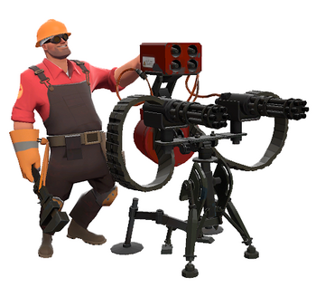

Slide 3
Equipment
LIDAR
mbed
Nerf Gun
Servo Motor controlled frame

Slide 4
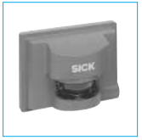
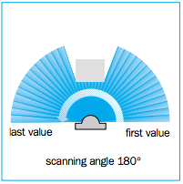
Lidar: SICK LMS221
data sent through RS422 serial port
180 measurements sent every time, one for each viewing angle degree.
data is a distance and an angle
10mm resolution, accurate up to 80m

Slide 5
Lidar: Object Detection
used to track objects in the field
placed alongside the Nerf Gun to detect incoming objects
Nerf Gun and Lidar form a baseline/endzone, think of it as a game, cannot pass this line
set a distance threshold, track objects after a certain line
track closest object first
closest object determined by closest perpendicular distance to baseline

Slide 6
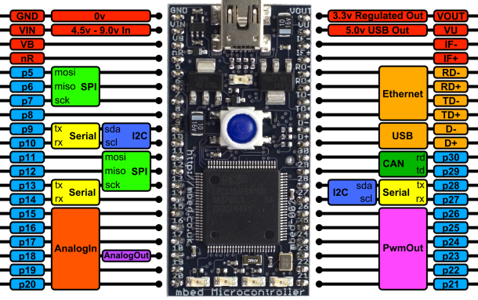
mbed NXP LPC1768
wide range of useful tools: Ethernet port, SPI Accelerometer, USB ports, Controller Area Network (CAN) ports, PWM, Serial ports, etc.
Lidar utilizes Serial. FTDI cable to convert to USB.
USB pins to capture data stream.
PWMout pins to control
frame servos

Slide 7
mbed: Processing the Data
after capturing data, calculates perpendicular distance to the baseline
if an object is seen (object passed the threshold line) send out PWM signals to servos and aim the nerf gun.
send pwm signal to fire.
ensure that no data is lost when processing captured data

Slide 8
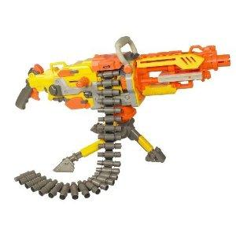
Nerf Gun
Shoots things
Rotates left and right as well as up and down
Servo control
Aim: X and Y plane
Fire: pulls trigger
Airsoft/paintball gun = dangerous, pierce skin
Nerf gun = shoots foam, weak....
Nerf gun it is (Vulcan EBF-25)
-fully automatic
-internal electronic trigger
could be directly controlled by mbed.

Slide 9
Servos
controlled by PWM signals from mbed
180-servo to rotate left and right
180-servo to rotate the gun up and down
servo to pull the trigger:
ideally simple 180-servo
depending on trigger action of gun

Slide 10
Tripod Frame
holds lidar, guns, servos as well as any other necessary attachments
Should be sturdy (LIDAR is 20 lbs. alone)
Allow quick rotation of servos without falling over
1. modify camera tripod
2. build it from scratch (wood)

Slide 11
Setup
Lidar connected to mbed at the USB pins
mBed hooked up to all the servos on the PWM pins
servos linked to the Nerf Gun through mechanical means (screws)
LIDAR has separate power supply
mBed can be powered by battery
Indoors, normal room conditions

Slide 12
Timeline
3/31:
-LIDAR: communicating with the mbed
-Have parts ordered by then
Tripod : Flush out an initial design based on order parts
4/7:
-LIDAR: Algorithm to identify a stationary single object + get started with a moving object
-Gun: Open up the gun and modify internals to interface with mbed
-Frame: Install servos and interface with mbed
4/14:
-LIDAR: Track multiple objects algorithm.
-Gun + Frame: Finish whatever from last week + attach LIDAR
-Calibration: Start debugging algorithm and test gun response
4/21:
-LIDAR: Debug debug debug + timing issues
-Calibration: test + test + test
-Extras: Twitter

Slide 13
Extras
- Post a Twitter message to indicate an intruder
- Panic mode:
if (out of ammo || target is at baseline){
swing nerf gun wildly like a bat }
- Voice commands: "FIRE!"

Slide 14
Backup: Ping Sensors
If LIDAR is too overkill => use Ping sensors
Calculating distance would be different
REALLY different
have to manually calculate distance to object and then to convert that into perpendicular distance
Calibration is a pain and not as accurate.

Slide 15
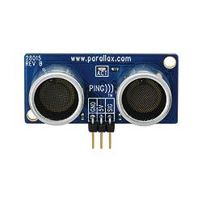
Sensor
Parrallex PING))) Ultrasonic Distance Sensor
3m range
+5 VDC, I/O pin, GRN
40 kHz pulse
Travels through
burst travels 1150 feet/second

Slide 16
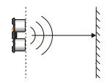
Array of ping sensors
Speed of Sound = 1150 ft /second
time of return signal = t
time to object = t/2
~ distance to object = SoS * t/2
Form a vector using distances from each sensor that "sees" the object
Trig Magic = Degree and Distance

