Slide 1
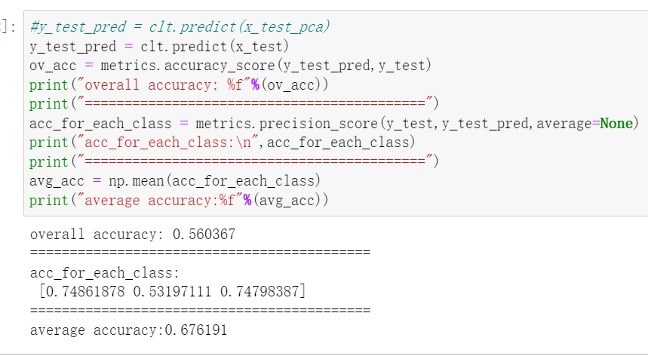
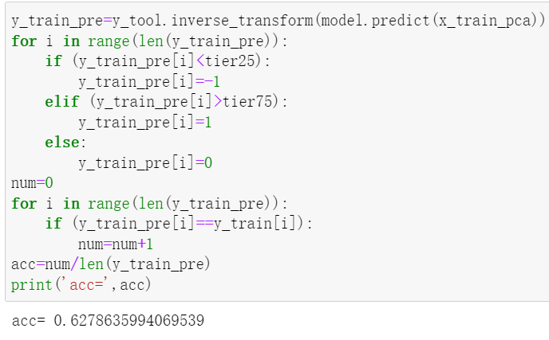
Stock Selection Model Based on Advanced Random Forest and Natural Language Processing Algorithms 2022/03/30
Project Authors | Hao Qin, Run Zhang
Industrial Area of Application | Financial Engineering
Status | On target
Project Description / Deliverables
The stock market is a very complex nonlinear system. The traditional quantitative stock selection model is always based on data and does not select varieties, which has limitations that cannot be ignored. And in the financial services and banking industries, vast resources are poured into, analysing, and trying to quantify qualitative data from news and company reports. The problem is compounded as news cycles shorten and reporting requirements on public companies become more onerous. In this project, we leverage two state-of-the-art machine learning based frameworks to select better performing stocks. One is mainly based on the advanced random forest framework, and the other relies on natural language processing (NLP) methods. Finally, we compare the two methods using stock dates from 2016.1 to 2021.12 on yahoo finance. In a word, the overall objective of our project is to compare the performance of advanced random forest and natural language processing algorithms in selecting the superior stock.
Decisions Impacted
Weekly Progress
we compare the prediction results obtained by the Random Forest + LSTM model with the monthly increase rate of sp500. Use the data from 2016 to 2021 to carry out a real-life-based portfolio construction, and give the final performance on return. Compare the prediction results obtained by the PCA + SVM model with the quarterly increase rate of SP500. Also use the data from 2016 to 2021, and do the same comparison with SP500. Apply a new model of PCA+LSTM, and RF+SVM. Get the following result. For RF+SVM, the good stock prediction accuracy is 0.74798387, the bad stock prediction accuracy is 0.7486187. (previously around 69%) However, for PCA+LSTM, the overall prediction accuracy is decreased to 0.6278635994069539 (previously around 71%). Therefore, we can see that the RF+SVM and RF+LSTM are better choices among the 4 options. Use Python to obtain the details of public companies, the news from authority institutions and the price information of stocks by using yahoo finance API. The link of github:https://github.com/ese527team/ese527_third_status_report.git The link also includes the discussion of the problems proposed in the midterm presentation.
The importance of features
The result of PCA and random forest
The value of future EPS
The accuracy of the prediction
Expected Business Value
By simulating the process of the dynamic portfolio, we will have an evaluation of how the selection based on our model will go beyond the performance of SP500. In real life, we only need to plug in the recent quarter of a year’s data of different stocks, and then add the best predicted superior stocks into our portfolio to help us make more profit than the SP500.

