Slide 1
Simple MRP
Customer Order
Item Demand Forecast
Generate MPS
Confirm MPS
Approve PR
Release Job
Inventory

Slide 2
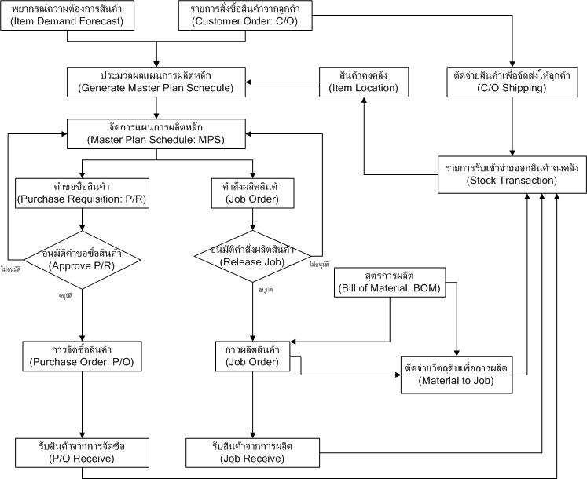

Slide 3
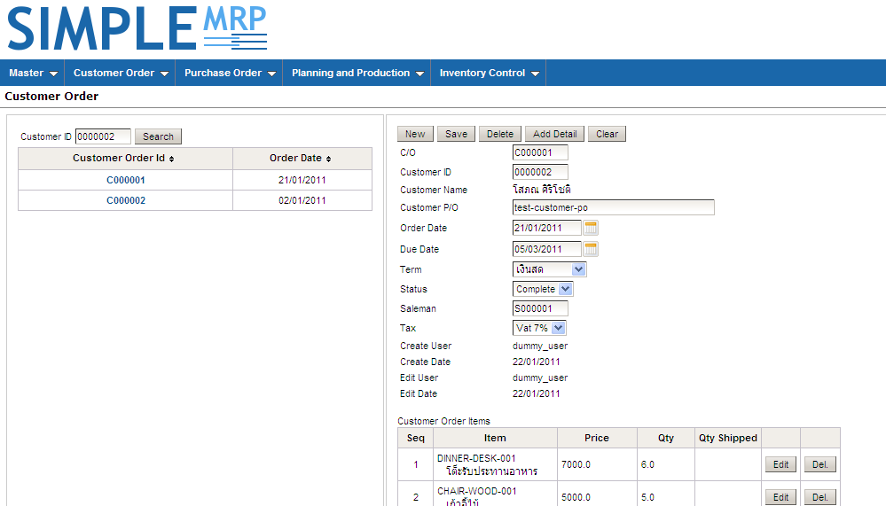
Customer Order

Slide 4
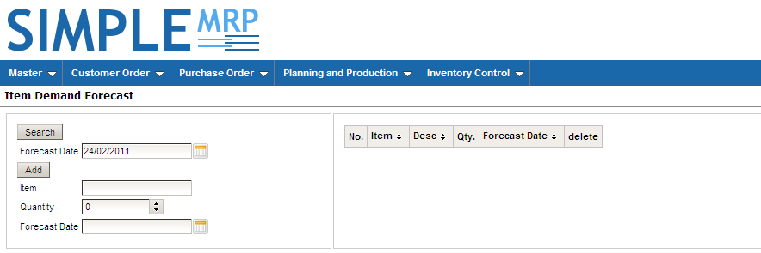
Item Demand Forecast

Slide 5
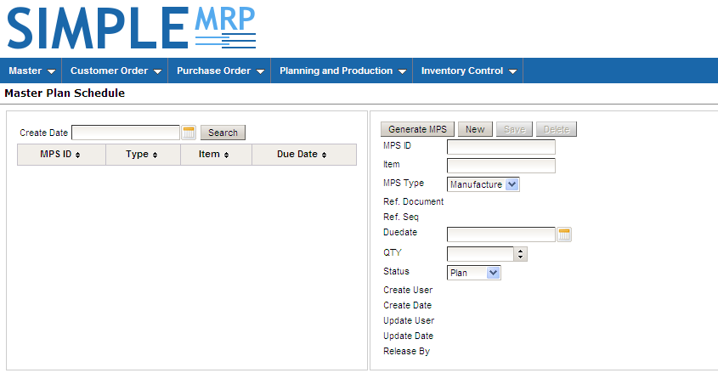
Master Plan Schedule

Slide 6
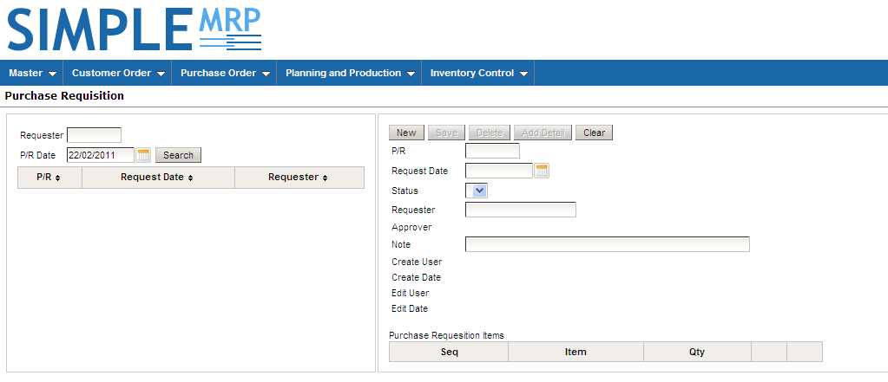
Purchase Requisition

Slide 7
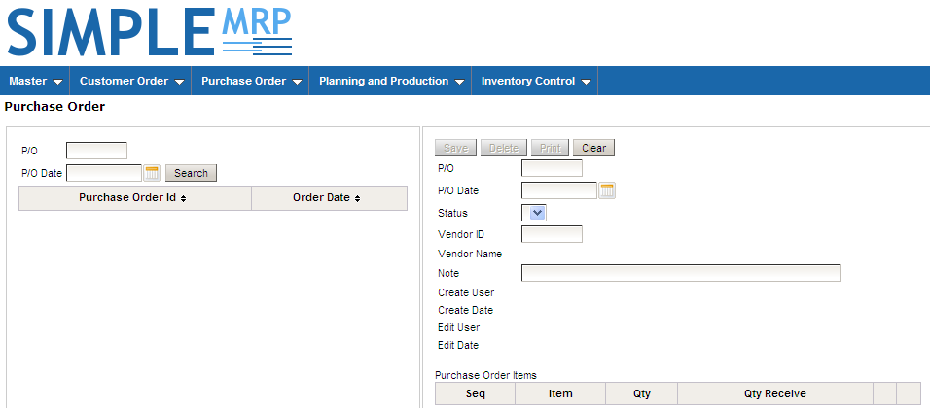
Purchase Order

Slide 8
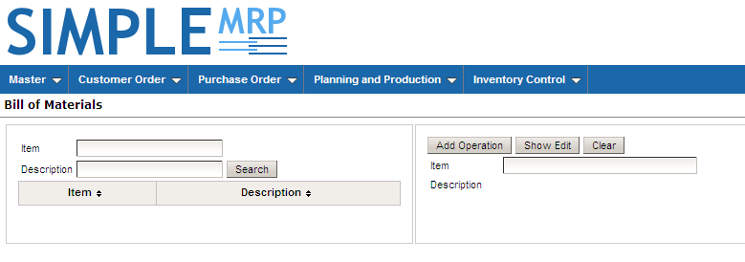
Bill of Meterial

Slide 9
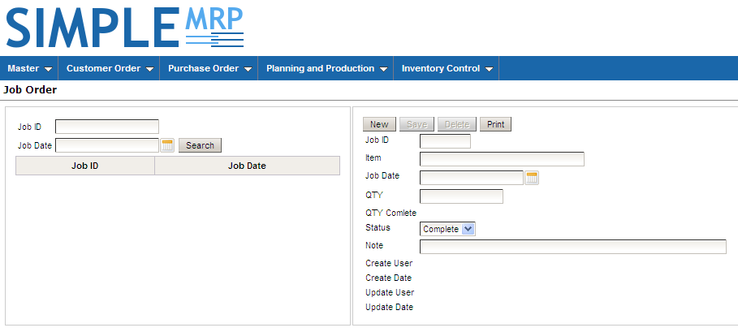
Job Order

Slide 10
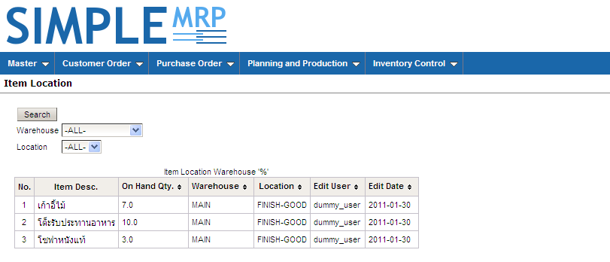
Item Location

Slide 11
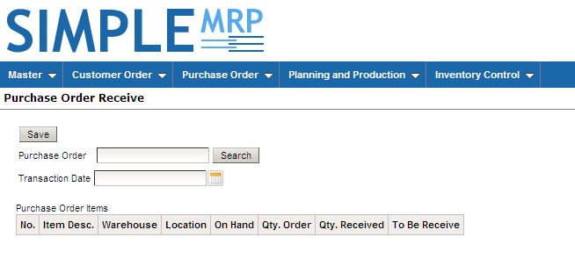
Purchase Order Receive

Slide 12
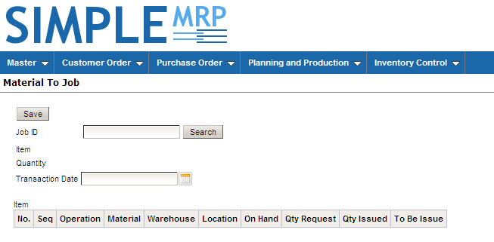
Material To Job

Slide 13
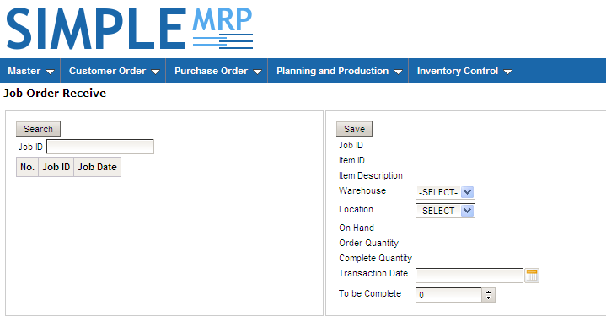
Job Order Receive

Slide 14
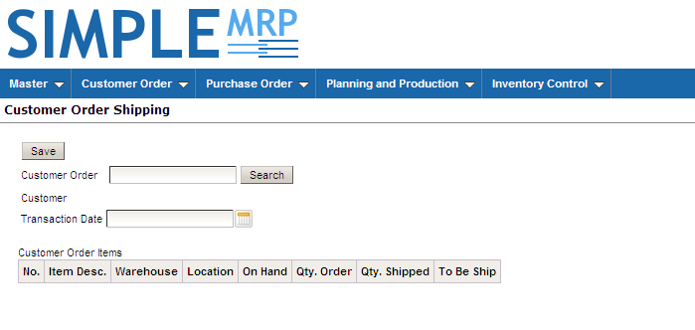
Customer Order Shipping

Slide 15
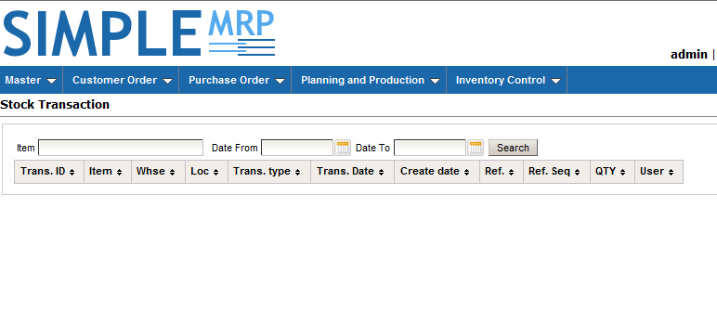
Stock Transaction

