Slide 1
Introduction to Optimization for Analytics
IDS 435
Instructor: Selva Nadarajah

Slide 2
Discussion Plan
What is optimization?
Overview of optimization and course topics via examples
What can optimization (this course) to do help?

Slide 3
What is Optimization?
What is it? Optimization consists of two key components:
Formulation: Mathematical language to formalize the process of choosing between “feasible” alternatives that can be ranked according to an “objective”
Solution Method: Techniques to efficiently search across “feasible” alternatives to find the best solution according to the “objective”
What does it rely on?
Data and human input
Mathematics & programming
Computing power and technology
What are its benefits?
Helps achieve better outcomes in practice
Transparent

Slide 4
NBA Analytics
Teams in the National Basketball Association (NBA) are split into two conferences: Eastern and western
The season is split into regular and playoff games
In the 2021-22 regular season, our Chicago Bulls were 26-10 (Win-Loss tally) and were ranked first in the eastern conference!
Chicagoans are excited and let’s assume they want to predict the point scored at the end of the game based on half time statistics
Historical data is available at basketball-reference.com

Slide 5
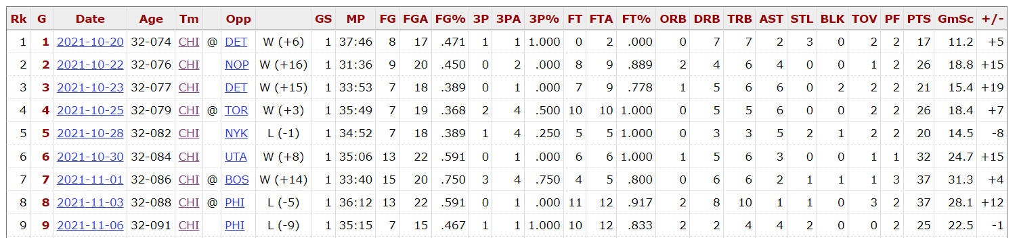

Historical Data
Suppose we have data for each regular season game at half time
Stats of top players at half time
Half-time score for each game
Final score for each game
source: baseketball-reference.com

Slide 6

Independent and dependent variables
Dependent variable $(y)$: Final score
Independent variables $z_{1},z_{2},…, z_{m}$ (a.k.a. features)
FG, FGA, 3P, 3PA, …..
$\text{F}{\text{G}}^{2}$, FGx3P, ….
All evaluated at half time
Game | Final score | FG | FGA | FG% | 3P | 3PA | 3P% | ….
1 | 94 | 37 | 86 | 0.43 | 7 | 23 | 0.304 | ….
2 | 128 | 47 | 89 | 0.528 | 14 | 28 | 0.5 | ….
3 | 97 | 35 | 84 | 0.417 | 11 | 26 | 0.423 | ….
4 | 108 | 39 | 81 | 0.481 | 12 | 27 | 0.444 | ….

Slide 7
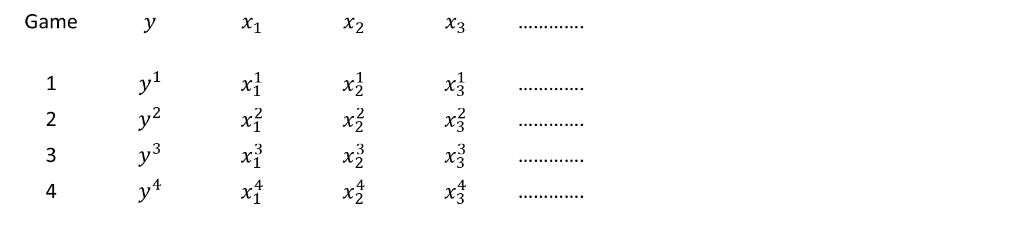
Independent and dependent variables
Dependent variable $(y)$: Final score
Independent variables $z_{1},z_{2},…, z_{m}$ (a.k.a. features)
FG, FGA, 3P, 3PA, …..
$\text{F}{\text{G}}^{2}$, FGx3P, ….
All evaluated at half time
Game | $$y$$ | $$x_{1}$$ | $$x_{2}$$ | $$x_{3}$$ | …………. |  |  | ….
1 | $$y^{1}$$ | $$x_{1}^{1}$$ | $$x_{2}^{1}$$ | $$x_{3}^{1}$$ | ………….
2 | $$y^{2}$$ | $$x_{1}^{2}$$ | $$x_{2}^{2}$$ | $$x_{3}^{2}$$ | ………….
3 | $$y^{3}$$ | $$x_{1}^{3}$$ | $$x_{2}^{3}$$ | $$x_{3}^{3}$$ | ………….
4 | $$y^{4}$$ | $$x_{1}^{4}$$ | $$x_{2}^{4}$$ | $$x_{3}^{4}$$ | ………….

Slide 8


Least-squares Linear Regression Formulation
Linear regression: Use a linear function of half-time features and error to explain final game score
Optimization formulation to compute the parameter vector $β=(β_{1},β_{2},…,β_{m})$
$\min_{β∈R^{m}}{{\sum_{n=1}^{N}{\left(y^{n}−β_{0}−\sum_{m=1}^{M}{β_{m}}z_{m}^{n}\right)}}^{2}}$
$$y=β_{0}+\sum_{m=1}^{M}{β_{m}}z_{m}+error$$
Minimize
squared error
(least-squares)
Final score of n-th game
Final score prediction for n-th game using half-time feature

Slide 9
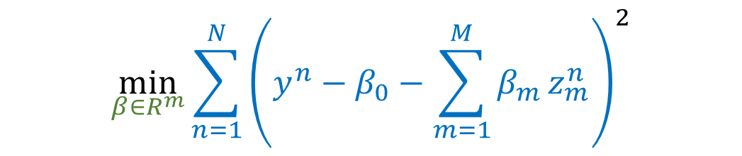
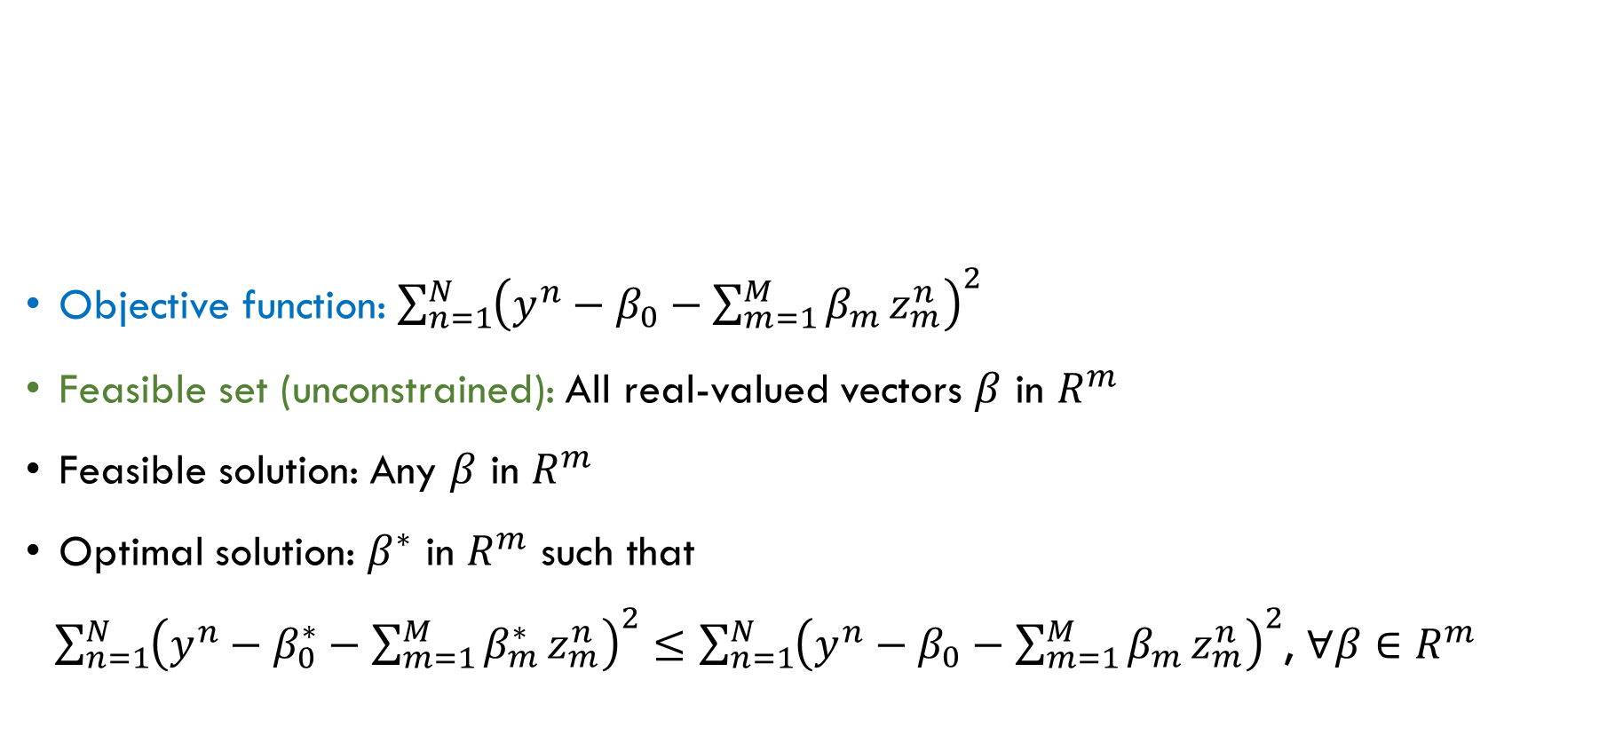
Breaking Down the Optimization Formulation
Objective function: ${\sum_{n=1}^{N}{\left(y^{n}−β_{0}−\sum_{m=1}^{M}{β_{m}}z_{m}^{n}\right)}}^{2}$
Feasible set (unconstrained): All real-valued vectors $β$ in $R^{m}$
Feasible solution: Any $β$ in $R^{m}$
Optimal solution: $β^{∗}$ in $R^{m}$ such that
${\sum_{n=1}^{N}{\left(y^{n}−β_{0}^{∗}−\sum_{m=1}^{M}{β_{m}^{∗}}z_{m}^{n}\right)}}^{2}≤{\sum_{n=1}^{N}{\left(y^{n}−β_{0}−\sum_{m=1}^{M}{β_{m}}z_{m}^{n}\right)}}^{2}$, $∀β∈R^{m}$
$$\min_{β∈R^{m}}{{\sum_{n=1}^{N}{\left(y^{n}−β_{0}−\sum_{m=1}^{M}{β_{m}}z_{m}^{n}\right)}}^{2}}$$

Slide 10


Breaking Down the Optimization Formulation
Objective function: ${\sum_{n=1}^{N}{\left(y^{n}−β_{0}−\sum_{m=1}^{M}{β_{m}}z_{m}^{n}\right)}}^{2}$
Feasible set (unconstrained): All real-valued vector $β$ in $R^{m}$
Feasible solution: Any $β$ in $R^{m}$
Optimal solution: $β^{∗}$ in $R^{m}$ such that
${\sum_{n=1}^{N}{\left(y^{n}−β_{0}^{∗}−\sum_{m=1}^{M}{β_{m}^{∗}}z_{m}^{n}\right)}}^{2}≤{\sum_{n=1}^{N}{\left(y^{n}−β_{0}−\sum_{m=1}^{M}{β_{m}}z_{m}^{n}\right)}}^{2}$, $∀β∈R^{m}$
$$\min_{β∈R^{m}}{{\sum_{n=1}^{N}{\left(y^{n}−β_{0}−\sum_{m=1}^{M}{β_{m}}z_{m}^{n}\right)}}^{2}}$$
Solve:
Why!?

Slide 11
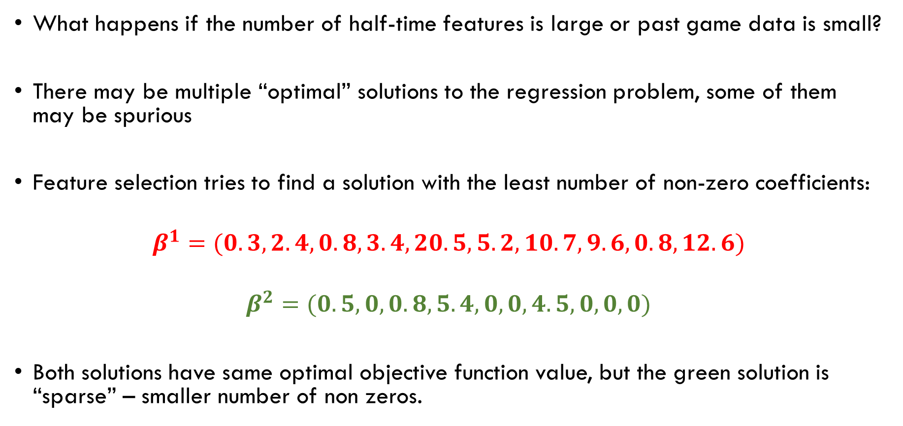
Feature Selection
What happens if the number of half-time features is large or past game data is small?
There may be multiple “optimal” solutions to the regression problem, some of them may be spurious
Feature selection tries to find a solution with the least number of non-zero coefficients:
$$β^{1}=(0.3, 2.4, 0.8, 3.4, 20.5, 5.2, 10.7, 9.6, 0.8, 12.6)$$
$$β^{2}=(0.5,0, 0.8, 5.4, 0, 0,4.5, 0, 0, 0)$$
Both solutions have same optimal objective function value, but the green solution is “sparse” – smaller number of non zeros.

Slide 12
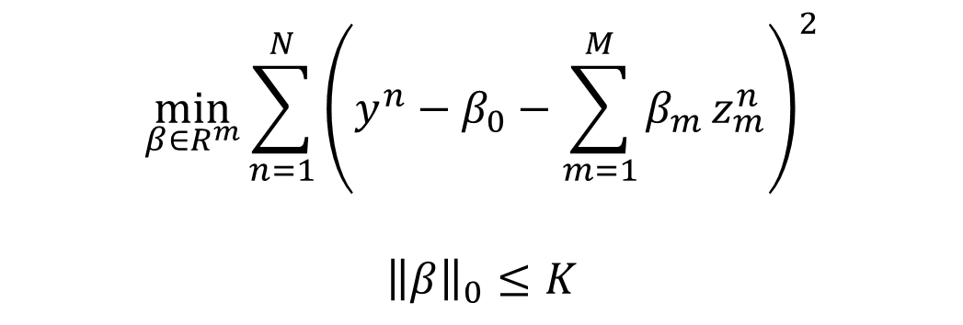


Ideal Feature Selection Formulation
Zero norm ${\left\|β\right\|}_{0}$: Counts the number of non-zero elements in the vector $β$
${\left\|β^{1}\right\|}_{0}=10$ and ${\left\|β^{2}\right\|}_{0}=$ 4
Objective function: ${\sum_{n=1}^{N}{\left(y^{n}−β_{0}−\sum_{m=1}^{M}{β_{m}}z_{m}^{n}\right)}}^{2}$
Feasible set: All $β$ in $R^{m}$ satisfying ${\left\|β\right\|}_{0}≤K$
Feasible solution: Any $β$ in $R^{m}$ such that ${\left\|β\right\|}_{0}≤K$
Optimal solution: $β^{∗}$ in $R^{m}$ and ${\left\|β\right\|}_{0}≤K$ such that
$${\sum_{n=1}^{N}{\left(y^{n}−β_{0}^{∗}−\sum_{m=1}^{M}{β_{m}^{∗}}z_{m}^{n}\right)}}^{2}$$
$$≤$$
$${\sum_{n=1}^{N}{\left(y^{n}−β_{0}^{}−\sum_{m=1}^{M}{β_{m}^{}}z_{m}^{n}\right)}}^{2}$$
$$\min_{β∈R^{m}}{{\sum_{n=1}^{N}{\left(y^{n}−β_{0}−\sum_{m=1}^{M}{β_{m}}z_{m}^{n}\right)}}^{2}}$$
$${\left\|β\right\|}_{0}≤K$$
Constraint imposing that the number of nonzeros is less than K

Slide 13

Ideal Feature Selection Formulation
Zero norm ${\left\|β\right\|}_{0}$: Counts the number of non-zero elements in the vector $β$
${\left\|β^{1}\right\|}_{0}=10$ and ${\left\|β^{2}\right\|}_{0}=$ 4
Objective function: ${\sum_{n=1}^{N}{\left(y^{n}−β_{0}−\sum_{m=1}^{M}{β_{m}}z_{m}^{n}\right)}}^{2}$
Feasible set: All $β$ in $R^{m}$ satisfying ${\left\|β\right\|}_{0}≤K$
Feasible solution: Any $β$ in $R^{m}$ such that ${\left\|β\right\|}_{0}≤K$
Optimal solution: $β^{∗}$ in $R^{m}$ and ${\left\|β\right\|}_{0}≤K$ such that
$${\sum_{n=1}^{N}{\left(y^{n}−β_{0}^{∗}−\sum_{m=1}^{M}{β_{m}^{∗}}z_{m}^{n}\right)}}^{2}$$
$$≤$$
$${\sum_{n=1}^{N}{\left(y^{n}−β_{0}^{}−\sum_{m=1}^{M}{β_{m}^{}}z_{m}^{n}\right)}}^{2}$$
Solve:
$$\min_{β∈R^{m}}{{\sum_{n=1}^{N}{\left(y^{n}−β_{0}−\sum_{m=1}^{M}{β_{m}}z_{m}^{n}\right)}}^{2}}$$
$${\left\|β\right\|}_{0}≤K$$
Why!?
Constraint imposing that the number of nonzeros is less than K

Slide 14
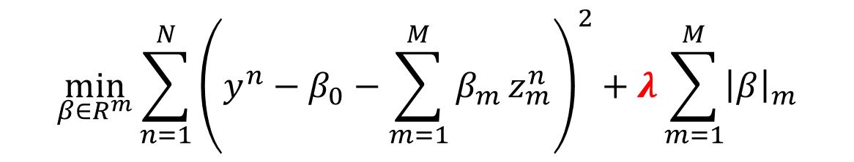

Practical Feature Selection: Lasso
Lasso replaces the zero-norm constraint by a 1-norm penalty term in the objective
1-norm of $β$ = ${\left\|β\right\|}_{1}=\sum_{m=1}^{M}{{\left|β\right|}_{m}}$
Lasso regression: Minimize the sum of squares error plus a 1-norm penalty
$λ$ is a parameter
$$\min_{β∈R^{m}}{{\sum_{n=1}^{N}{\left(y^{n}−β_{0}−\sum_{m=1}^{M}{β_{m}}z_{m}^{n}\right)}}^{2}+λ\sum_{m=1}^{M}{{\left|β\right|}_{m}}}$$

Slide 15
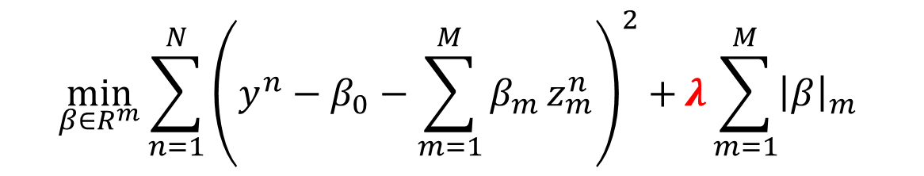
Practical Feature Selection: Lasso
Lasso replaces the zero-norm constraint by a 1-norm penalty term in the objective
1-norm of $β$ = ${\left\|β\right\|}_{1}=\sum_{m=1}^{M}{{\left|β\right|}_{m}}$
Lasso regression: Minimize the sum of squares error plus a 1-norm penalty
$λ$ is a parameter
Solve:
$$\min_{β∈R^{m}}{{\sum_{n=1}^{N}{\left(y^{n}−β_{0}−\sum_{m=1}^{M}{β_{m}}z_{m}^{n}\right)}}^{2}+}λ\sum_{m=1}^{M}{{\left|β\right|}_{m}}$$
Why!?

Slide 16

Optimization Formulation
$$\min_{x∈X}{f(x)}$$
Variables: Vector $x$
Objective function: $f(x)$
Constraints: Represented by set X
Feasible solution: Any $x∈X$
Optimal solution: An $x^{∗}∈X$ such that $f\left(x^{∗}\right)≤f\left(x\right), ∀x∈X$

Slide 17
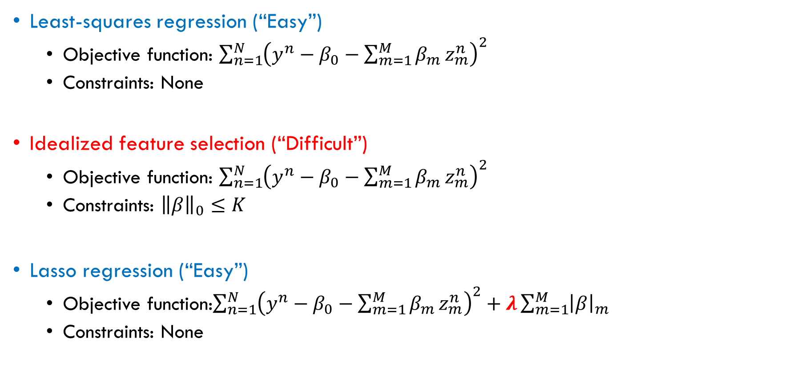
Mapping Examples to General Formulation
Least-squares regression (“Easy”)
Objective function: ${\sum_{n=1}^{N}{\left(y^{n}−β_{0}−\sum_{m=1}^{M}{β_{m}}z_{m}^{n}\right)}}^{2}$
Constraints: None
Idealized feature selection (“Difficult”)
Objective function: ${\sum_{n=1}^{N}{\left(y^{n}−β_{0}−\sum_{m=1}^{M}{β_{m}}z_{m}^{n}\right)}}^{2}$
Constraints: ${\left\|β\right\|}_{0}≤K$
Lasso regression (“Easy”)
Objective function:${\sum_{n=1}^{N}{\left(y^{n}−β_{0}−\sum_{m=1}^{M}{β_{m}}z_{m}^{n}\right)}}^{2}+λ\sum_{m=1}^{M}{{\left|β\right|}_{m}}$
Constraints: None
Takeaway 1:
From our examples it seems the nature of the objective function and constraints determine the difficulty of optimizing a task!

Slide 18
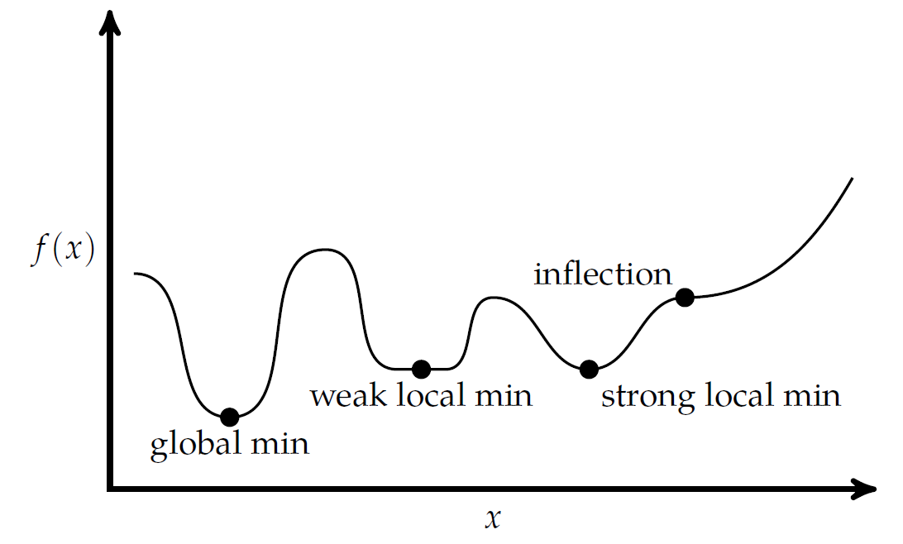
Graphical Intuition: Optimization Landscape
Convex: Minimum reached via local reasoning (a.k.a. local min) is a global minimum
Nonconvex: Local minimum may not be a global minimum
Convex
Nonconvex
local min = global min

Slide 19
Formulation Implications
Convex optimization formulations can be solved more efficiently using algorithms that exploit local information (e.g., gradients)
Non-convex formulations are more challenging to solve to optimality, and algorithms based on local information can only guarantee a local minimum
Takeaway 2: Knowledge of optimization helps you understand the difficulty of formulations as well as guide the design of potential approximations that are easier to solve (e.g., LASSO as an approximation of zero-norm constrained regression)

Slide 20
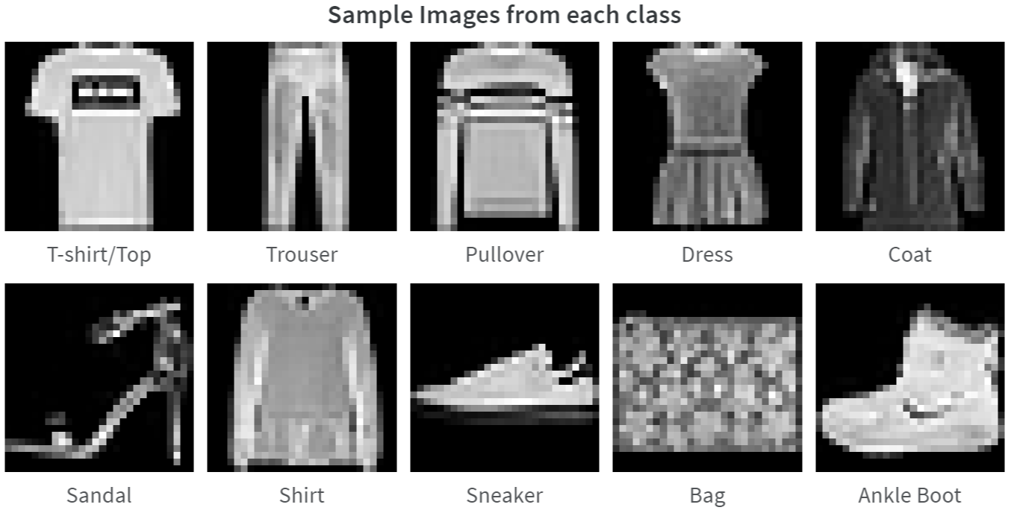

Image Classification
The Fashion-MNIST dataset is a collection of small greyscale images of ten different types of clothing.
Given a new image, we would like to classify it in one of the following classes: T-shirt, Trouser, Pullover, Dress, Coat, Sandal, Shirt, Sneaker, Bag, and Ankle Boot.
Which class does this image belong to?

Slide 21
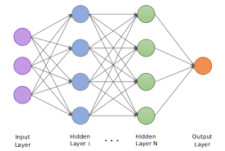
Neural Network for Image Classification
A neural network in this example is a function that translates an image to probability distribution over types of clothing
Probabilities of clothing types
T-shirt
Ankle boot
Sneaker
Sandal

Slide 22


Neural Network for Image Classification
A neural network in this example is a function that translates an image to probability distribution over types of clothing
Algorithms to train this neural network (i.e., find $β$) use local information and find locally optimal solutions – but can be made to work well.
g$(image, β)$
Probabilities of clothing types
T-shirt
Ankle boot
Sneaker
Sandal

Slide 23
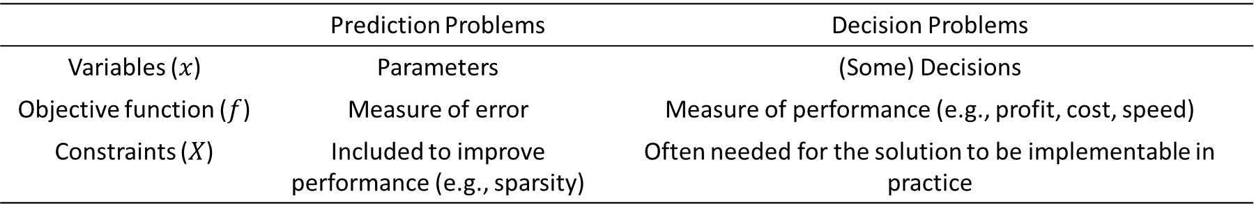
Decision Optimization Problems
$$\min_{x∈X}{f(x)}$$
 | Prediction Problems | Decision Problems
Variables ($x$) | Parameters | (Some) Decisions
Objective function ($f$) | Measure of error | Measure of performance (e.g., profit, cost, speed)
Constraints ($X$) | Included to improve performance (e.g., sparsity) | Often needed for the solution to be implementable in practice

Slide 24

Operating Room Scheduling
Hospitals have limited number of ORs
Each OR is staffed in 8-hour blocks
Departments set their own targets for allocation hours
Departments also have requirements
Gynecology needs at least 1 OR per day
Ophthalmology needs at least 2 ORs per week
The oral surgeon is only available on Tuesdays and Thursdays

Slide 25
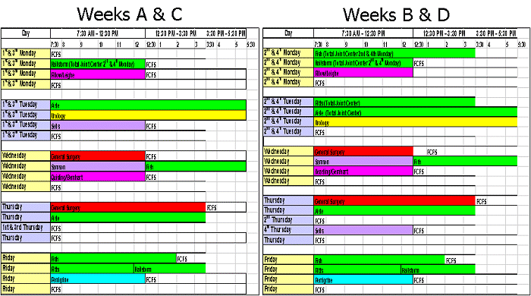
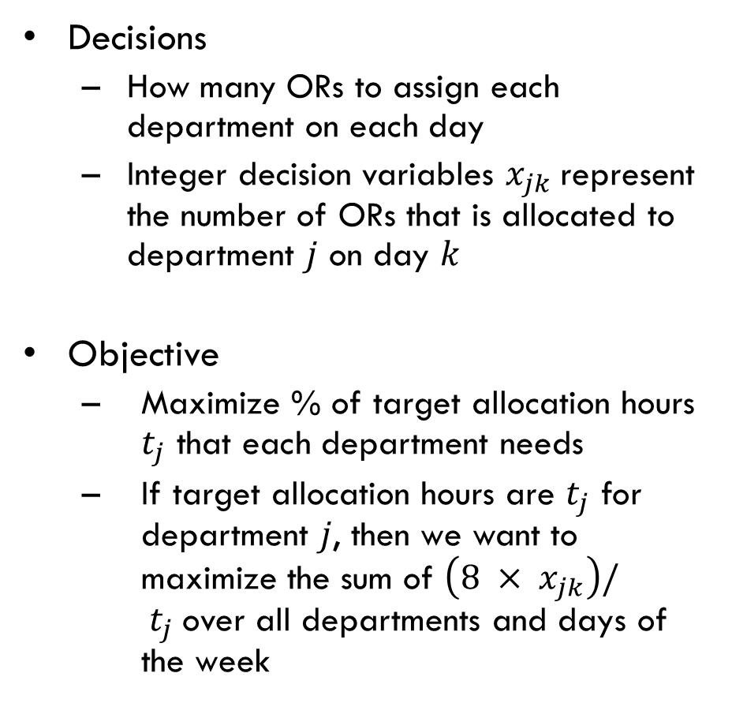
Optimization Formulation
Decisions
How many ORs to assign each department on each day
Integer decision variables $x_{jk}$represent the number of ORs that is allocated to department $j$ on day $k$
Objective
Maximize % of target allocation hours $t_{j}$ that each department needs
If target allocation hours are $t_{j}$ for department $j$, then we want to maximize the sum of $\left(8 × x_{jk}\right)/ t_{j}$over all departments and days of the week

Slide 26
Easy or Difficult to Solve?
Is the related optimization problem convex or nonconvex?
The OR allocation decisions in the problem are integer valued: 0, 1, 2, 3, … (fractions are not allowed)
This makes the problem nonconvex but ….
Integer and mixed integer programs are a class of nonconvex optimization problems that we know to solve to global optimality well via specialized solvers

Slide 27
Nature of Data in Decision Making Problems
In the OR scheduling problem, data consists of targets from the different departments and other scheduling information
This data is “static” or fixed over time and so are the objective and constraints
In other applications, we have data streams that change over time in an uncertain manner, and we need to make decisions in the face of such changes!

Slide 28
What Can Optimization (This Course) Do to Help?

Slide 29
What Can Optimization (This Course) Do to Help? Step 1: Help Formulate Real World Problems
Formalize real world prediction and decision tasks via optimization formulations
Recognize if the formulation is easy or difficult to solve
Convex is easier than non-convex
Unconstrained is easier than constrained
Size of the formulation also matters (i.e., number of variables and constraints)
Create approximations of the original formulation that are easier to solve
A good way to address a “solve” issue is to avoid it at the formulation stage!

Slide 30
What Can Optimization (This Course) Do to Help? Step 2: Help Effectively Use Tools to Solve Optimization Formulations
Help understand how commercial and state-of-the-art solvers work (e.g., ski-kit learn, Pytorch, and Gurobi)
Help use these solvers using Python
Help navigate how to configure solvers and solve problems effectively

Slide 31
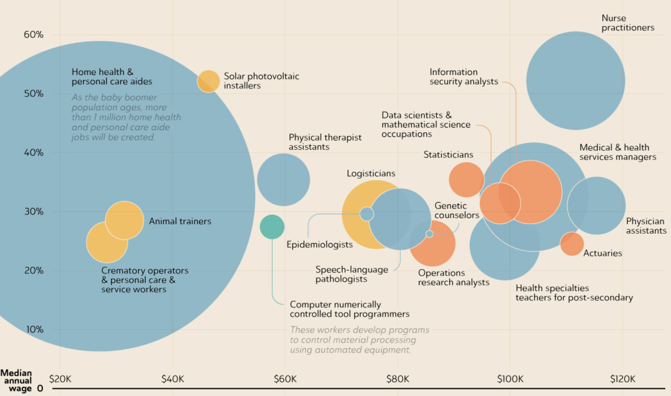
What Can Optimization (This Course) Do to Help? Step 3: Help You Add an Important Skill to be a Data Scientist
Source: Forbes September 2021

