Slide 1

Predicting Individual Physiological Responses to Pollution Using Transformer–Based Time-Series Models
Davide Baino
05.09.2025

Slide 2
Agenda
Aim – why?
Dataset – what?
Model – how?
Results
Conclusions
Q&A

Slide 3
Aim
Air pollution contributes to an estimated seven million deaths annually and globally.
Most of research does not show how predicted pollution affect individuals.
The aim is then to predict individual health responses to pollution exposure (population model), facilitating early warnings and personalised health recommendations (personalised model).
Why?

Slide 4

The Inhale Dataset
Merged respiratory and personally experienced level of pollution on patient id and timestamp.
Added personal levels of inhalation rate by multiplying tidal volume of air inhaled per patient to pollution levels in the air inhaled
What?
Copyright: Imperial Inhale project https://www.imperial.ac.uk/earth-science/research/research-projects/inhale/
Notes:
Tidal volume (TV) is the amount of air that moves in and out of the lungs with each normal, relaxed breath.
Physiological response is mostly useful because → As an example, consider two individuals who are both in the same place at the same time, but one is driving while the others jogging. Every individual belonging to a different group reacts differently to the same level of pollution.
Open weather → Basically tells you air quality and pollution level (up to 200 metres precise). Could I measure it as a distance from a station? It has to be up to a meter or what’s the calculation behind it?

Slide 5
Datasets
Merged on longitude, latitude, timestamp
OpenWeather Dataset (including pollution measures like pm2.5)
Inhale Dataset (including breath rate avg standard, activity level etc.)
What?
Notes:
Data was normalised and successfully filtered

Slide 6
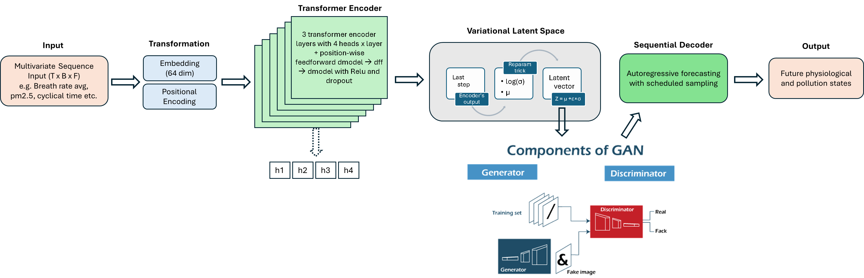
Model
How?
Notes:
Query → “What do I want?”
Key → “What do I have?”
Value → “What do I deliver if you attend to me?”
self.linear1 = nn.Linear(d_model, dim_feedforward)
self.dropout = nn.Dropout(dropout)
self.linear2 = nn.Linear(dim_feedforward, d_model)
## Layernorm and dropouts
self.norm1 = nn.LayerNorm(d_model)
self.norm2 = nn.LayerNorm(d_model)
self.dropout1 = nn.Dropout(dropout)
self.dropout2 = nn.Dropout(dropout)
self.activation = F.relu
attn_output, attn_weights = self.self_attn(
src, src, src,
attn_mask=src_mask,
key_padding_mask=src_key_padding_mask,
need_weights=True,
average_attn_weights=False
)
src2 = self.dropout1(attn_output)
src = self.norm1(src + src2)
src2 = self.linear2(self.dropout(self.activation(self.linear1(src))))
src = self.norm2(src + self.dropout2(src2))
return src, attn_weights

Slide 7
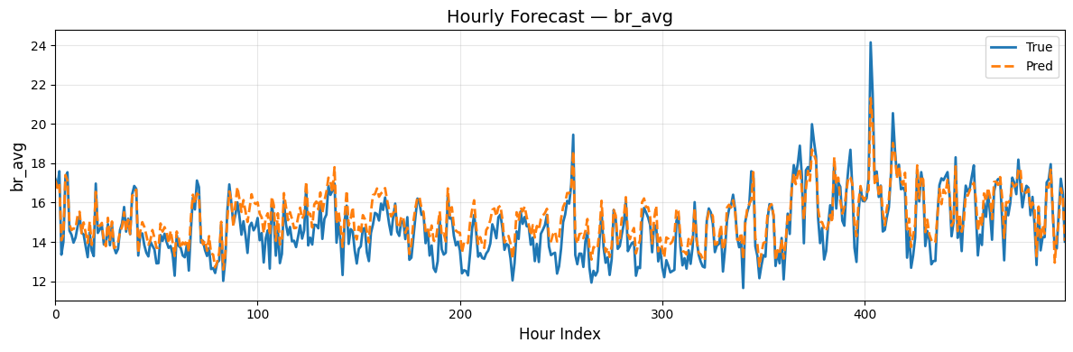
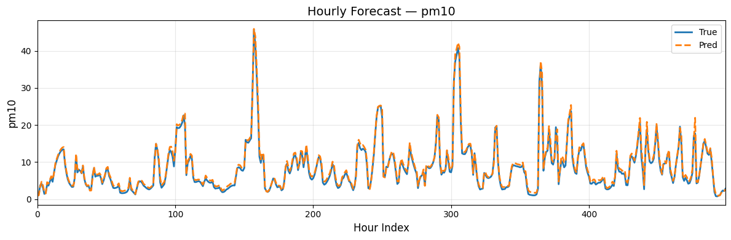
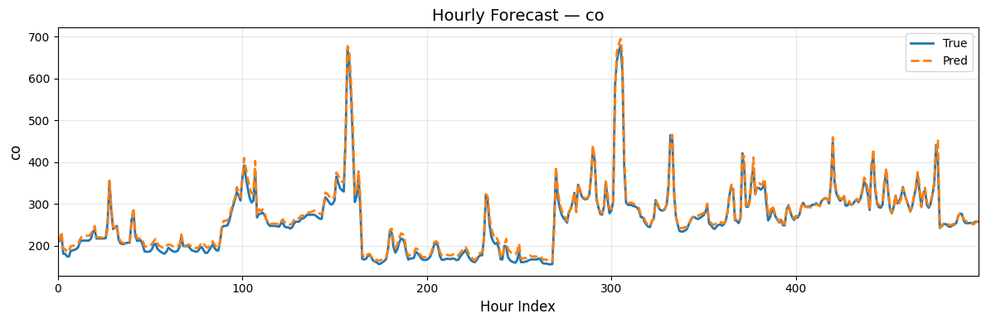
Results – population wide model
Predicting hourly physiological measures more challenging than pollution measures

Slide 8
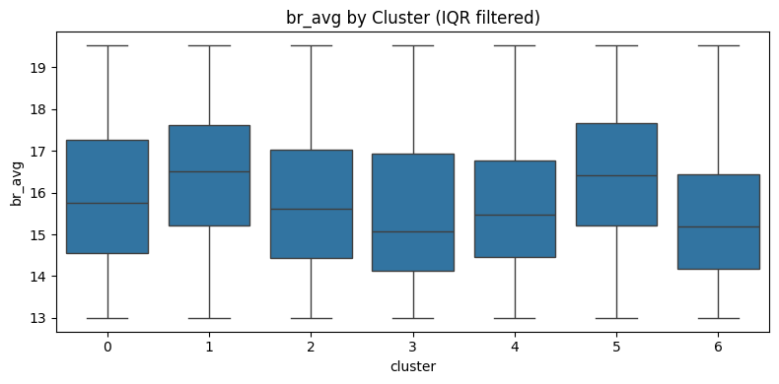
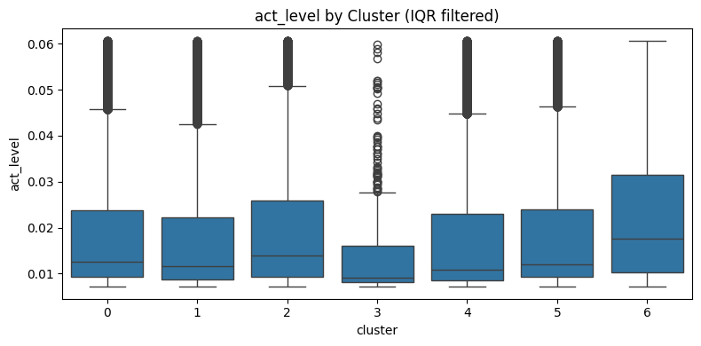
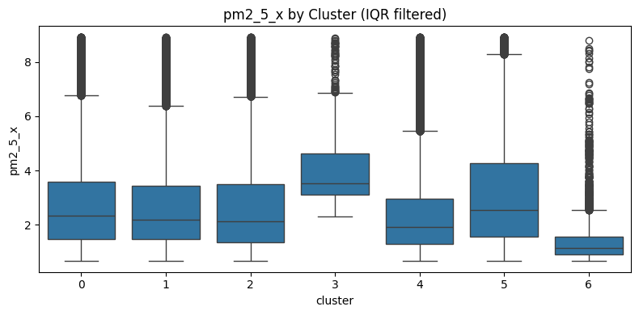
Reaction to pollution by clusters
Cluster 3 - highest levels of PM2.5 and PM10 levels and shows one of the largest increases in average breathing rate.
Cluster 4 - lower PM2.5 and PM10, higher activity levels are associated with the strongest breathing-rate response.
Cluster 0 - has modest PM2.5 but elevated O3 and SO2 relative to other clusters, consistent with vehicles and indoor pollution influences.
Notes:
Found the clusters with the latent vectors then I reassigned them to meta_df

Slide 9
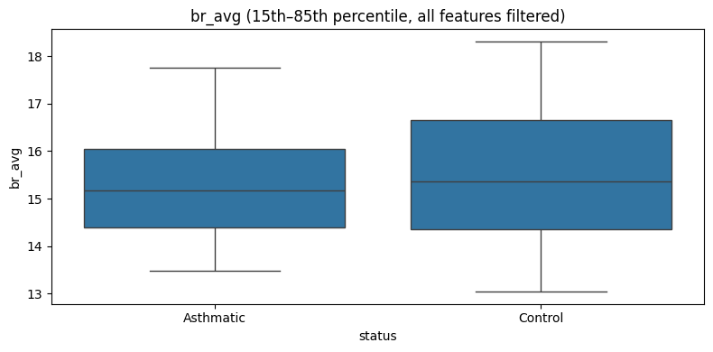
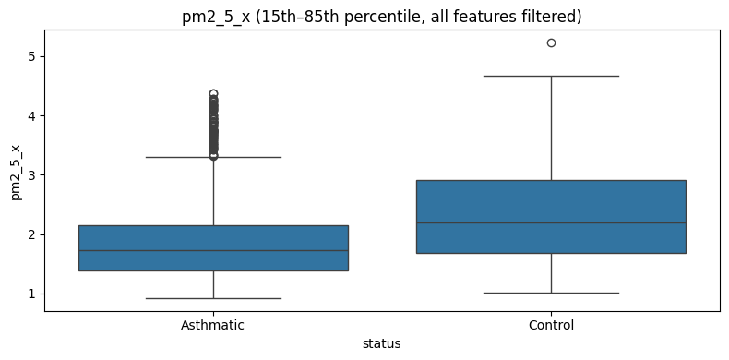
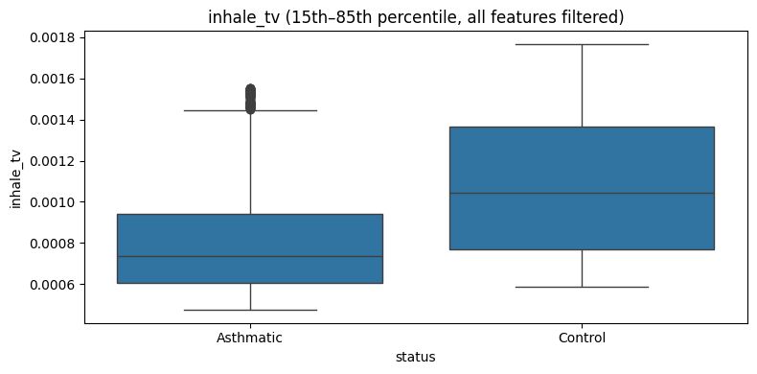
Reaction to pollution by health group
Control (healthy group) is reacting more to pollution than asthmatic
Control has higher level of pm2.5, pm10 . Greater inhalation and they have greater level of activity
Control inhale more polluted air than healthy

Slide 10
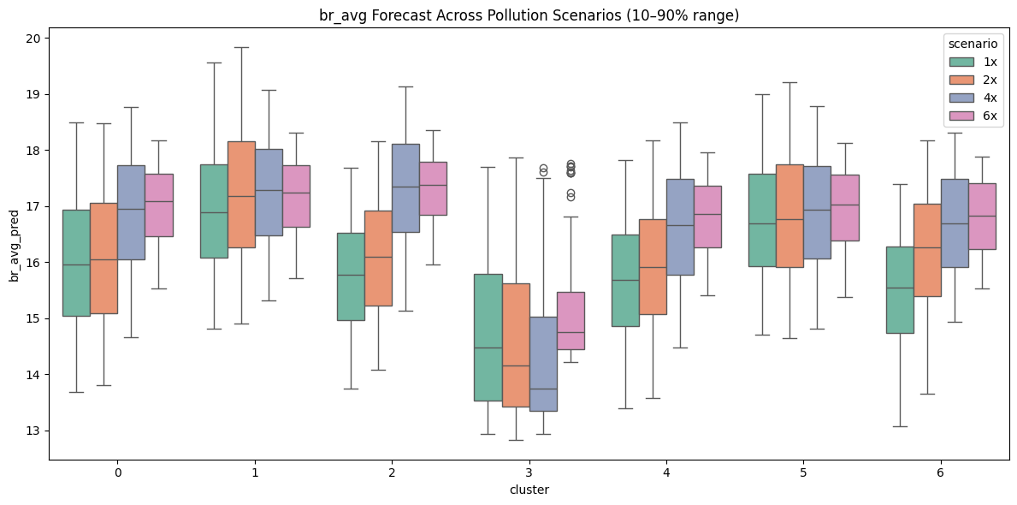
Perturbation multiplied by 1, 2, 4, 6 times of pollution measures
Greater levels of pollution suggest higher volatility within breathing rate, meaning more unstable breathing.
Clusters 0, 2, 4 and 6 seem to show the strongest reactivity, with breath rate rising by up to 10%.
Clusters 1 and 5 display only mild changes in average breath rate but reflect more erratic standard deviations, indicating spikier breathing patterns.

Slide 11
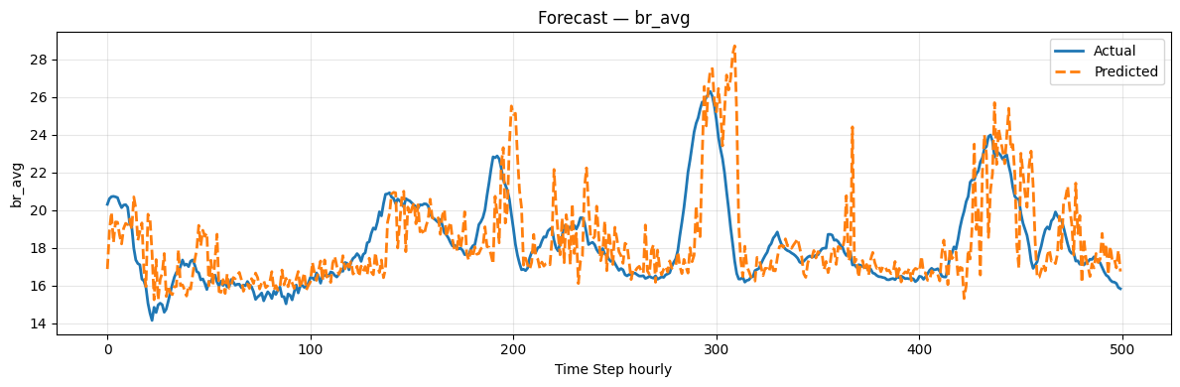
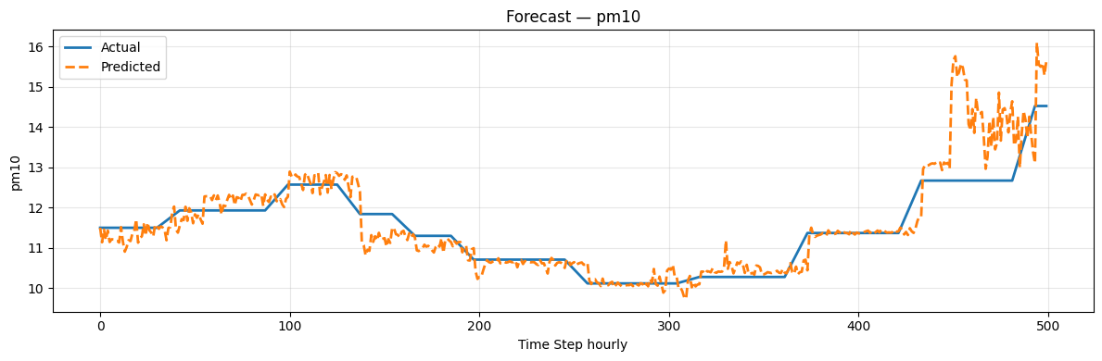
Fine tuned model can predict next hours for unseen data
Model successfully predicted next hour breath rate average so it learns from population and apply to unseen data
Fine-tuned model is also able to predict next few hours of pollution level, so it understands the relationship between the twp.

Slide 12
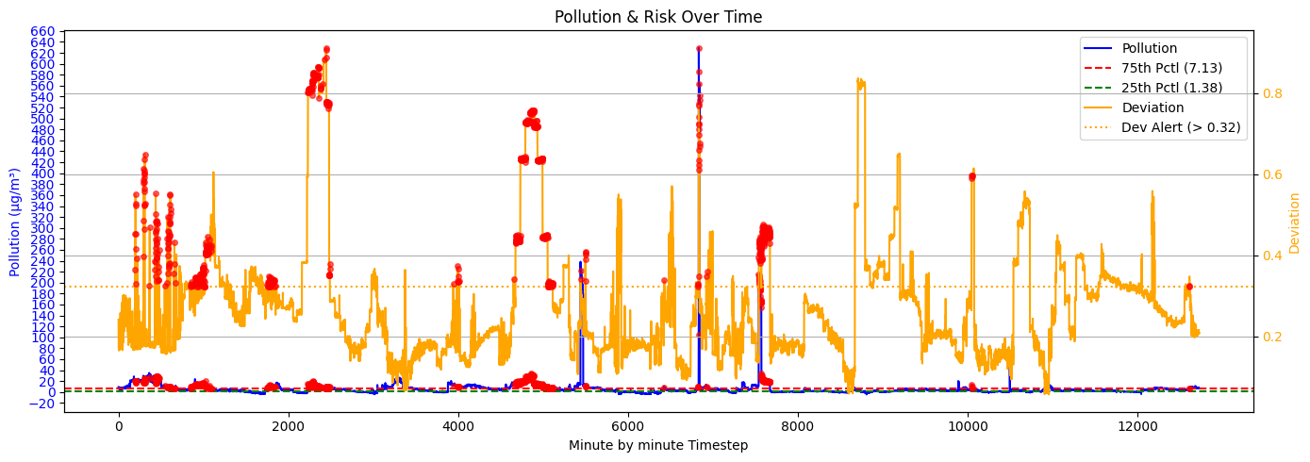
Alert system
There is a personalised baseline of expected physiology for individuals and deviations from it at every new timestep
Pollution exposure and physiological deviation are assessed against individualised thresholds. High risk is greater than 75%
An alert is triggered only when both thresholds are exceeded, so that we can infer that pollution and physiological are driven by one another

Slide 13
Conclusions
A Transformer VAE-GAN was trained on cleaned data to forecast future physiological and pollution measures, showing strong accuracy for both population trends and unseen individuals.
Clustering of latent spaces revealed groups with different sensitivities to pollution, with some clusters showing strong physiological reactions under high exposure (10% increase)
A threshold-based alert system was developed to warn individuals of likely adverse reactions, supporting behaviour changes to reduce exposure.

Slide 14
Main Notebook altogether
Sampling_interval = 60, history_hours = 1, forecast_hours = 12, block_minutes = 60
Window_size = 1* 60 // 60 = 1, block_size = 1, num_blocks = 12. This means I divide the 12 forecast_blocks In 12 parts, where each time I predict one block
Batch_size is a training sample where each sampe as input and targets defined by SlidingWindowDataset
Part 1
Notes:
Tidal volume (TV) is the amount of air that moves in and out of the lungs with each normal, relaxed breath.
Physiological response is mostly useful because → As an example, consider two individuals who are both in the same place at the same time, but one is driving while the others jogging. Every individual belonging to a different group reacts differently to the same level of pollution.
Open weather → Basically tells you air quality and pollution level (up to 200 metres precise). Could I measure it as a distance from a station? It has to be up to a meter or what’s the calculation behind it?

Slide 15
Main Notebook altogether
Sampling_interval = 60, history_hours = 1, forecast_hours = 12, block_minutes = 60
Window_size = 1, block_size = 1, num_blocks = 12. This means I divide the 12 forecast_blocks In 12 parts, where each time I predict one block
Batch_size is a training sample where each sample as input and targets defined by SlidingWindowDataset
So for the data loader I am using window_size of 1 to predict 12 and in the dataloader I concatenate all of this altogether in 64 samples of this 1 past (input) to predict 12 steps but block size of 1.
Part 1
Notes:
Tidal volume (TV) is the amount of air that moves in and out of the lungs with each normal, relaxed breath.
Physiological response is mostly useful because → As an example, consider two individuals who are both in the same place at the same time, but one is driving while the others jogging. Every individual belonging to a different group reacts differently to the same level of pollution.
Open weather → Basically tells you air quality and pollution level (up to 200 metres precise). Could I measure it as a distance from a station? It has to be up to a meter or what’s the calculation behind it?

Slide 16
Main Notebook altogether
Sampling_interval = 60, history_hours = 1, forecast_hours = 12, block_minutes = 60
Window_size = 1* 60 // 60 = 1, block_size = 1, num_blocks = 12. This means I divide the 12 forecast_blocks In 12 parts, where each time I predict one block
Batch_size is a training sample where each sampe as input and targets defined by SlidingWindowDataset
Notes:
Tidal volume (TV) is the amount of air that moves in and out of the lungs with each normal, relaxed breath.
Physiological response is mostly useful because → As an example, consider two individuals who are both in the same place at the same time, but one is driving while the others jogging. Every individual belonging to a different group reacts differently to the same level of pollution.
Open weather → Basically tells you air quality and pollution level (up to 200 metres precise). Could I measure it as a distance from a station? It has to be up to a meter or what’s the calculation behind it?

Slide 17
Dataset Summary
Respiratory data I dropped ["INH016", "INH019","INH026", "INH126", "INH136"] because missing values of br_avg and br_std
Merged respiratory and pollution on patient id and timestamp
When filtering I:
Define the time difference between current point and previous one
Instantiate new segment if difference is greater than 1min (non continuous)
Keeping only segments which have at least 30rows of 1 minute data
Notes:
Tidal volume (TV) is the amount of air that moves in and out of the lungs with each normal, relaxed breath.
Physiological response is mostly useful because → As an example, consider two individuals who are both in the same place at the same time, but one is driving while the others jogging. Every individual belonging to a different group reacts differently to the same level of pollution.
Open weather → Basically tells you air quality and pollution level (up to 200 metres precise). Could I measure it as a distance from a station? It has to be up to a meter or what’s the calculation behind it?

Slide 18
Sliding Window Dataset
n_samples = rows while n_features = features or columns
How many valid windows can I extract from the sequence (goal is input and target) → num_windows = (n_samples - window_size - forecast_steps) // step + 1
How many sliding windows can you extract given the window length, forecast length, and stride?
The for loop:
start = i * step → step is my stride (needed it cause took me too much to train at the start)
window = data[start:start + window_size] (past values [8]) first goes from 0 to 8
target = data[start + window_size:start + window_size + forecast_steps] (goes from 8 to * + forecast_steps
Notes:
class SlidingWindowDataset(Dataset):
def __init__(self, data, window_size=8, forecast_steps=1, step=1):
## Storing parameters
self.window_size = window_size
self.forecast_steps = forecast_steps
self.step = step
# Create sliding windows - how many sliding windows can be extracted?
n_samples, n_features = data.shape
num_windows = (n_samples - window_size - forecast_steps) // step + 1
self.windows = []
self.targets = []
## Looping to generate all possible windows
## Iterate through each window and select window as input
## target as what to predict
for i in range(num_windows):
start = i * step
window = data[start:start + window_size]
target = data[start + window_size:start + window_size + forecast_steps]
self.windows.append(window)
self.targets.append(target)
def __len__(self):
return len(self.windows)
def __getitem__(self, idx):
window = torch.FloatTensor(self.windows[idx])
target = torch.FloatTensor(self.targets[idx])
# For single step prediction, squeeze the target
## This is because at the start I was doing single step prediction
if self.forecast_steps == 1:
target = target.squeeze(0)
return window, target

Slide 19
Model.py – Positional Encoding
div_term = torch.exp( torch.arange(0, d_model, 2, dtype=torch.float) * (-math.log(10000.0) / d_model)):
This is the denominator term as per paper formula
Div_term div decides the “speed” of sine/cosine oscillations in each embedding dimension
https://medium.com/@manindersingh120996/hands-on-with-transformers-recreating-attention-is-all-you-need-in-pytorch-step-by-step-ecfbf3e1985b
Let’s not foroget we created an empty matrix. We are then adding in each row but colum 0,2,4 sine and 1,3, 5 cosine
pe[:, 0::2] = torch.sin(position * div_term)
pe[:, 1::2] = torch.cos(position * div_term)
Adding a batch dimension with unsqueeze and register_buffer, save pe which is the positional encoding matrix on the same device as the model so can be trained on GPUs
Notes:
class PositionalEncoding(nn.Module):
def __init__(self, d_model, max_len=1000):
super().__init__()
# Creating empty encoding matrix
pe = torch.zeros(max_len, d_model)
# Checking how many positions to add
position = torch.arange(0, max_len, dtype=torch.float).unsqueeze(1)
# Building the frequency scale for the positional encoding!
div_term = torch.exp(
torch.arange(0, d_model, 2, dtype=torch.float) *
(-math.log(10000.0) / d_model))
# Apply sine to even indices, cosine to odd indices
pe[:, 0::2] = torch.sin(position * div_term)
pe[:, 1::2] = torch.cos(position * div_term)
pe = pe.unsqueeze(1) # (max_len, 1, d_model)
self.register_buffer('pe', pe)
def forward(self, x: torch.Tensor) -> torch.Tensor:
"""
Here adding the positional encoding
"""
x = x + self.pe[:x.size(0)]
return x

Slide 20
Model.py – Custom Transformer Encoder
MultiheadAttention:
multihead_attn = nn.MultiheadAttention(embed_dim, num_heads)
attn_output, attn_output_weights = multihead_attn(query, key, value)
attn_output → encoded representation of the input in term of attention (seq_len, batch, d_model)
The it goes through the dropout.
Then I basically add together the original embeddings with attention outputs that have been going through multiread self-attention
Position wise feedforward network:
src2 = self.linear2(self.dropout(self.activation(self.linear1(src))))
The result is then passed through a linear transformation – where I go from d_model 64 to dim_feedforward which is 512 (hidden size of feedforward layers)
Then a relu activation ( I need to introduce nonlinear transformation) ReLU keeps positive inputs unchanged and zeroes negatives → gradient is either 1 or 0 → avoids vanishing gradients in practice.
LayerNorm is basically normalization ensuring each feature belong to the same scale
Notes:
class CustomTransformerEncoderLayer(nn.Module):
"""
Custom Transformer encoder layer with:
- Multihead self-attention
- Position-wise feedforward network
- Dropout + LayerNorm
Parameters
----------
d_model : int
Dimensionality of embeddings.
nhead : int
Number of attention heads.
dim_feedforward : int, default=512
Hidden size in the feedforward sub-layer.
dropout : float, default=0.1
Dropout probability.
"""
def __init__(self, d_model, nhead, dim_feedforward=512, dropout=0.1):
super().__init__()
## Multihead self-attention
self.self_attn = nn.MultiheadAttention(d_model, nhead, dropout=dropout, batch_first=False)
## Feedforward netowrk
self.linear1 = nn.Linear(d_model, dim_feedforward)
self.dropout = nn.Dropout(dropout)
self.linear2 = nn.Linear(dim_feedforward, d_model)
## Layernorm and dropouts
self.norm1 = nn.LayerNorm(d_model)
self.norm2 = nn.LayerNorm(d_model)
self.dropout1 = nn.Dropout(dropout)
self.dropout2 = nn.Dropout(dropout)
self.activation = F.relu
def forward(self, src, src_mask=None, src_key_padding_mask=None):
"""
Transformer encoder forward pass useful to implement multihead self-attention,
feedforward network, dropout and layer norm to input
Parameters
----------
src : torch.Tensor
Input of shape (seq_len, batch, d_model).
src_mask : torch.Tensor, optional
Attention mask.
src_key_padding_mask : torch.Tensor, optional
Padding mask.
Returns
-------
src : torch.Tensor
Encoded output (seq_len, batch, d_model).
attn_weights : torch.Tensor
Attention weights (batch, nhead, seq_len, seq_len).
"""
## This was useful at the start to store attention weights!
attn_output, attn_weights = self.self_attn(
src, src, src,
attn_mask=src_mask,
key_padding_mask=src_key_padding_mask,
need_weights=True,
average_attn_weights=False
)
src2 = self.dropout1(attn_output)
src = self.norm1(src + src2)
src2 = self.linear2(self.dropout(self.activation(self.linear1(src))))
src = self.norm2(src + self.dropout2(src2))
return src, attn_weights

Slide 21
Model.py – Variational TimeSeriesTransformer
We start with transforming input features = feature cols to d_model with a linear transformation → we want to improve expressiveness
To the d_model we add positional encoding!
We are then implementing Custom Transformer Encoder Later! It was custom because we started by storing attention weights but then we didn’t implement it. Dim_feedforward = 512 (hidden size of the FFN inside each encoder layer)
We instantiate self.mean_layers and self.logvar_layer. They take the encoder output and spit out two different vectors. They are just two simple vectors but through reparametisation and training, they will learn to be those
Then let’s take last step of encoder layer that really summarises the dataset and instantiate two linear layers (mu and logvar) Reparameterization ensures we can still train the model with backprop despite randomness.
Notes:
self.input_proj = nn.Linear(input_features, d_model)
self.pos_encoder = PositionalEncoding(d_model)
## Encoder layers implementing customer encoder structure
self.encoder_layers = nn.ModuleList([
CustomTransformerEncoderLayer(
d_model=d_model,
nhead=nhead,
dim_feedforward=dim_feedforward,
dropout=dropout
) for _ in range(num_layers)
])
# Latent mean and log variance projection
self.mean_layer = nn.Linear(d_model, latent_dim)
self.logvar_layer = nn.Linear(d_model, latent_dim)
# Sequential Decoder maps from latent space → forecast
self.decoder = nn.Sequential(
nn.Linear(latent_dim, dim_feedforward), ## first linear layer
nn.ReLU(), ## adding non linearity
nn.Linear(dim_feedforward, output_features * forecast_steps), ## second linear layer
)
self.d_model = d_model
self.latent_dim = latent_dim
self.forecast_steps = forecast_steps
self.output_features = output_features

Slide 22
Model.py – Latent Discriminator
LatentDiscriminator is a binary classifier that judges whether a latent vector comes from the true Gaussian prior or from the encoder. It’s used to align the encoder’s latent distribution with 𝑁(0,𝐼)

Slide 23
Train – how does training the model work?
Doing 3 epochs. After putting model in training mode.
Using the train_loader with the same logic as SlidingWindowDataset so I create an input and a target
targets = full_targets.view(B, num_blocks, block_size, F_in) --. This is key because I am splitting the full_targets into blocks. So that the model can implement rollout training
1. model discriminator and generator
Creating z_fake → model.reparameterize (mu, logvar) It’s fake because it’s model-generated latent codes, not guaranteed to follow Gaussian.
Creating z_real → Then we sample a real latent vector from a standard Gaussian prior (same shape as z_fake).
Then make a tensor full of 0 and a tensor full of ones
The discriminator is then trained
Notes:
def train_model_aae_rollout(model,train_loader,val_loader,optimizer,discriminator,disc_optimizer, device,epochs=3,patience=5,min_delta=1e-4,
adv_weight=0.01, scheduled_sampling_start=1.0, scheduled_sampling_end=0.0, scheduled_sampling_decay=0.95,
block_size=None, num_blocks=None
):
# Reduce LR when validation loss plateaus
scheduler = torch.optim.lr_scheduler.ReduceLROnPlateau(
optimizer, mode='min', patience=3, factor=0.5
)
## the below is useful to mantain the best loss
adversarial_loss = BCELoss()
best_val_loss = float('inf')
patience_cnt = 0
# initialise teacher-forcing probability:
sampling_prob = scheduled_sampling_start
for epoch in range(1, epochs + 1):
## putting model and discriminator in training mode
model.train()
discriminator.train()
total_train_loss = 0.0
## Here I am looping over training batches and extracting past context and targets
## Reshaping to be able to compare prediction with ground truth
for inputs, full_targets in train_loader:
inputs = inputs.to(device) # [B, win, F]
full_targets= full_targets.to(device) # [B, blk*#blks, F]
B, _, F_in = inputs.shape
targets = full_targets.view(B, num_blocks, block_size, F_in)
# 1st Phase of training --> Trainining discriminator
## Rearranging input shape for transformer
inputs_enc = inputs.permute(1,0,2) # [win, B, F]
with torch.no_grad():
# Below I am running the encoder, get latent distribution parameters (mu, logvar).
# Then we sample from this latent distribution to create z_fake.
# It’s fake because it’s model-generated latent codes, not guaranteed to follow Gaussian
_, mu, logvar, _ = model(inputs_enc)
z_fake = model.reparameterize(mu, logvar).detach()
# Then we sample a real latent vector from a standard Gaussian prior (same shape as z_fake).
# This is the ideal distribution we want the encoder to match. rand_like creates
# random numbers drawn from a Gaussian 𝒩(0, 1).
z_real = torch.randn_like(z_fake)
real_lbls = torch.ones(z_real.size(0),1, device=device)
fake_lbls = torch.zeros(z_fake.size(0),1, device=device)
# Then we pass z_real and z_fake through the discriminator
# and we calculate disc_loss
disc_optimizer.zero_grad()
d_real = discriminator(z_real) ## output a prob of close to 1 if it thinks it's real
d_fake = discriminator(z_fake) ## output close to 0 if it thinks its fake
# total loss encourage 1 for real latent and 0 for fake ones
disc_loss = adversarial_loss(d_real, real_lbls) \
+ adversarial_loss(d_fake, fake_lbls)
disc_loss.backward()
disc_optimizer.step()
# 2nd Phase of training --> Block-wise rollout + Adversarial regularisation
optimizer.zero_grad()
# input sequence
current_win = inputs_enc.clone() # [win, B, F]
total_rec_loss = 0.0
for b in range(num_blocks):
# 1) Predicting next time block from current window
frc_block, mu, logvar, _ = model(current_win)
# ensure shape [B, blk, F]
if frc_block.dim()==2:
frc_block = frc_block.unsqueeze(1)
# 2) Getting the true block so that I can compare
true_block = targets[:, b] # [B, blk, F]
if true_block.dim()==2:
true_block = true_block.unsqueeze(1)
# 3) Computing reconstruction loss
rec_loss = F.mse_loss(frc_block, true_block, reduction='mean')
total_rec_loss += rec_loss
# 4) Picking next input via scheduled sampling:
# With probability of sampling_prob, feed the ground truth as next input.
# Otherwise, feed the model’s own prediction.
if torch.rand(1).item() < sampling_prob:
next_block = true_block
else:
next_block = frc_block.detach()
# 5) Sliding the window and going to the next block
# convert [B, blk, F] → [blk, B, F]
next_block = next_block.permute(1,0,2)
current_win = torch.cat([current_win[block_size:], next_block], dim=0)
# 6) Adversarial loss on the final latent z
# Forcing the encoder’s latent distribution to mimic the true Gaussian prior
# So the latent space is variational
z_gen = model.reparameterize(mu, logvar)
pred_lbls= torch.ones(z_gen.size(0),1, device=device)
adv_loss = adversarial_loss(discriminator(z_gen), pred_lbls)
# 7) Total loss & backward
# total_rec_loss → measures how well the model forecasts blocks.
# adv_loss → measures how realistic the latent space looks to the discriminator.
# adv_weight → controls how much adversarial regularisation matters relative to frc.
loss = total_rec_loss + adv_weight * adv_loss
loss.backward()
optimizer.step()
total_train_loss += loss.item()
avg_train = total_train_loss / len(train_loader)
# Validation
model.eval(); discriminator.eval()
total_val_loss = 0.0
with torch.no_grad():
for inputs, full_targets in val_loader:
inputs, full_targets = inputs.to(device), full_targets.to(device)
inp = inputs.permute(1,0,2)
frc_blk, _, _, _ = model(inp)
if frc_blk.dim()==2:
frc_blk = frc_blk.unsqueeze(1)
true_blk = full_targets[:, :block_size, :]
if true_blk.dim()==2:
true_blk = true_blk.unsqueeze(1)
# Here we are computing the loss between what we want to predict and ground truth
total_val_loss += F.mse_loss(frc_blk, true_blk, reduction='mean').item()
avg_val = total_val_loss / len(val_loader)
scheduler.step(avg_val)
print(
f"[Epoch {epoch:02d}] "
f"Train={avg_train:.6f} | Val={avg_val:.6f} | "
f"Disc={disc_loss.item():.4f} | Adv={adv_loss.item():.4f} | "
f"SampProb={sampling_prob:.3f}"
)
# If validation loss improves by more than min_delta, reset patience counter.
# Otherwise, increase patience counter. If counter reaches patience, we will stop training early.
if best_val_loss - avg_val > min_delta:
best_val_loss = avg_val
patience_cnt = 0
else:
patience_cnt += 1
if patience_cnt >= patience:
print(f"→ Early stopping at epoch {epoch}")
break
# Gradually makes the model rely less on ground truth, more on its own predictions.
sampling_prob = max(scheduled_sampling_end,
sampling_prob * scheduled_sampling_decay)
return model

Slide 24
Visualisation
# Inverse transforming back to original
I don’t actually need it anymore but at the start I was not predicting them all.
If that’s the case, when I inverse transform the scaler is expecting all the columns
if scaler is not None:
Create zero-filled arrays with the full original number of columns the scaler expects.
dummy_cols = scaler.n_features_in_
preds_full = np.zeros((len(preds), dummy_cols))
trues_full = np.zeros((len(trues), dummy_cols))
# Fill first columns with predicted/true features
preds_full[:, :preds.shape[1]] = preds
trues_full[:, :trues.shape[1]] = trues
# Inverse transforming then slice back to feature dimension
preds = scaler.inverse_transform(preds_full)[:, :preds.shape[1]]
trues = scaler.inverse_transform(trues_full)[:, :trues.shape[1]]

Slide 25
Utils
def extract_latents_by_condition(model, dataloader, device):
def normalize_risk_vector(vec, risk_indices, scaler):
def get_risk_from_prediction(pred_vector, baseline_vector, risk_indices, scaler, method="euclidean", green_thresh=0.3, yellow_thresh=1.0, return_distance=False):
def predict_with_model(model, dataloader, device):
def scan_individual_risk(model,dataset,scaler,baseline_vector,risk_indices, device,):
def scan_risk(model,dataset,scaler,baseline_vector,risk_indices,pollution_index,device):
def compute_reactivity_score(deviations, pollution_vals):
def predict_pollution_level(combined: pd.DataFrame, multiplier: float, model, feature_cols: list, scaler, window_size: int, forecast_steps: int, pollution_cols: list, physiological_cols: list, device, PatientLatentDataset
def get_baseline_prediction_vector(model, dataloader, device, scaler, risk_indices)

Slide 26
Utils – extract_latents_by_condition
Extracting both the latent vector z and the metadata coming with it.
This is because of the patientlatentdataset
Z = sampled latent vector, it encodes the past context upto that window
Metadata does not come from the model, but it comes from the dataset and it is aligned with z. Metadata comes from the dataset stoered future row (GT at forecast horizon).
It is basically telling me how does the current latent vector going to impact the next future statest (not a prediction for now but in the dataset).
I then reformat the metadata batch to turn it into a Pandas DataFrame.
for x, meta_batch in dataloader:
# Reformat for transformer (seq_len, batch, features) and move to device
x = x.permute(1, 0, 2).to(device)
# Forward pass: only need latent mean and variance
_, mu, logvar, _ = model(x)
# Sample latent vector z using reparameterization trick
z = model.reparameterize(mu, logvar).cpu().numpy()
z_list.append(z)
# Converting to store the data in dataloader
# k is f.i. patient_id
# v is the context of the data where every row is raw physiological and pollution form of the data
clean_meta = {}
for k, v in meta_batch.items():
clean_meta[k] = np.array(v).tolist()
Notes:
def extract_latents_by_condition(model, dataloader, device):
"""
Run the model in evaluation mode to extract latent representations
and aligned metadata from a dataset.
Args:
model: Trained variational time-series model with a reparameterize method.
dataloader: PyTorch DataLoader yielding (window, metadata) pairs.
device: Torch device ("cpu" or "cuda") for inference.
Returns:
z_df (pd.DataFrame): DataFrame of latent vectors (N x latent_dim).
meta_df (pd.DataFrame): DataFrame of metadata aligned row-by-row with z_df.
"""
## Putting the model in evaluation mode
model.eval()
## This will store the latent vectors
z_list = []
## This will store additional data
meta_list = []
## Turning off gradients - I don't need to keep them
with torch.no_grad():
## In dataloader from PatientLatentDataset I get:
## a tensor of shape (batch, window_size and n_features)
## Metadata including patient_id, pm_2_5 etc
for x, meta_batch in dataloader:
# Reformat for transformer (seq_len, batch, features) and move to device
x = x.permute(1, 0, 2).to(device)
# Forward pass: only need latent mean and variance
_, mu, logvar, _ = model(x)
# Sample latent vector z using reparameterization trick
z = model.reparameterize(mu, logvar).cpu().numpy()
z_list.append(z)
# Converting to store the data in dataloader
# k is f.i. patient_id
# v is the context of the data where every row is raw physiological and pollution form of the data
clean_meta = {}
for k, v in meta_batch.items():
clean_meta[k] = np.array(v).tolist()
# Building DataFrame for this batch and append
meta_df_batch = pd.DataFrame(clean_meta)
meta_list.append(meta_df_batch)
# Concatenate all batches
z_all = np.concatenate(z_list, axis=0)
meta_df = pd.concat(meta_list, ignore_index=True)
# Return two aligned DataFrames
z_df = pd.DataFrame(z_all)
return z_df, meta_df

Slide 27
Utils – Normalize risk vector
Create a dummy dataset with same number of features as original dataset. We inverse transform with the same number of features that the scaler was trained on so that the scaler does not throw us an error
Notes:
def extract_latents_by_condition(model, dataloader, device):
"""
Run the model in evaluation mode to extract latent representations
and aligned metadata from a dataset.
Args:
model: Trained variational time-series model with a reparameterize method.
dataloader: PyTorch DataLoader yielding (window, metadata) pairs.
device: Torch device ("cpu" or "cuda") for inference.
Returns:
z_df (pd.DataFrame): DataFrame of latent vectors (N x latent_dim).
meta_df (pd.DataFrame): DataFrame of metadata aligned row-by-row with z_df.
"""
## Putting the model in evaluation mode
model.eval()
## This will store the latent vectors
z_list = []
## This will store additional data
meta_list = []
## Turning off gradients - I don't need to keep them
with torch.no_grad():
## In dataloader from PatientLatentDataset I get:
## a tensor of shape (batch, window_size and n_features)
## Metadata including patient_id, pm_2_5 etc
for x, meta_batch in dataloader:
# Reformat for transformer (seq_len, batch, features) and move to device
x = x.permute(1, 0, 2).to(device)
# Forward pass: only need latent mean and variance
_, mu, logvar, _ = model(x)
# Sample latent vector z using reparameterization trick
z = model.reparameterize(mu, logvar).cpu().numpy()
z_list.append(z)
# Converting to store the data in dataloader
# k is f.i. patient_id
# v is the context of the data where every row is raw physiological and pollution form of the data
clean_meta = {}
for k, v in meta_batch.items():
clean_meta[k] = np.array(v).tolist()
# Building DataFrame for this batch and append
meta_df_batch = pd.DataFrame(clean_meta)
meta_list.append(meta_df_batch)
# Concatenate all batches
z_all = np.concatenate(z_list, axis=0)
meta_df = pd.concat(meta_list, ignore_index=True)
# Return two aligned DataFrames
z_df = pd.DataFrame(z_all)
return z_df, meta_df

Slide 28
Utils – get_risk_from_prediction
Comparing predicted with baseline vector
If distance is less than threshold then green etc

Slide 29
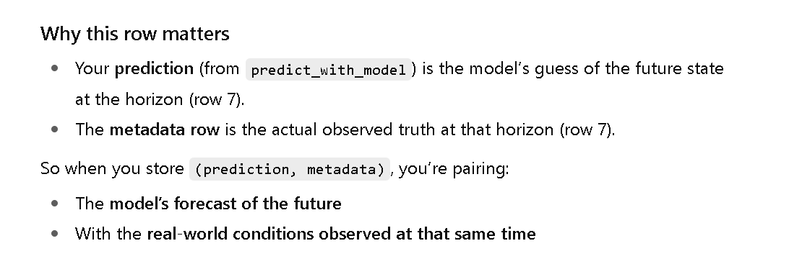
Utils – Predict with model
Create a dummy dataset with same number of features as original dataset. We inverse transform with the same number of features that the scaler was trained on so that the scaler does not throw us an error
predict_with_model
Notes:
def predict_with_model(model, dataloader, device):
"""
Run the model in evaluation mode and extract predictions aligned with metadata.
Handles both 2D and 3D outputs from the model.
Args:
model: Trained model (e.g. VAE, Transformer-based predictor).
dataloader: PyTorch DataLoader yielding (window, metadata) pairs.
device: Torch device ("cpu" or "cuda") for inference.
Returns:
y_pred (np.ndarray): Array of predictions, shape [N, F].
meta_df (pd.DataFrame): DataFrame of metadata aligned row-by-row with predictions.
"""
model.eval()
preds, metas = [], []
with torch.no_grad():
for x, meta_batch in dataloader:
## Needed for what the transformer wants
x = x.permute(1,0,2).to(device)
# Forward pass → forecast
frc, mu, logvar, _ = model(x)
# If frc is 3-D, grab the last time-step;
# if it’s 2-D, it is the that last step.
if frc.dim() == 3:
final = frc[:, -1, :] # shape [B, F]
elif frc.dim() == 2:
final = frc # shape [B, F]
else:
raise ValueError(f"Unexpected recon shape {frc.shape}")
preds.append(final.cpu().numpy())
metas.append(pd.DataFrame(meta_batch))
y_pred = np.vstack(preds)
meta_df = pd.concat(metas, ignore_index=True)
return y_pred, meta_df

Slide 30
Utils – get_baseline_prediction_vector
I predict the first horizon step for every window, collect those vectors, inverse-scale, keep only risk-related features, and then average them
The resulting mean vector is my baseline profile for the individual. But I am not using the full horizon forecasts (steps 2…N are ignored).

Slide 31
Utils – Scan_individual_risk
It’s taking the normal state of an individual with get_baseline_prediction_vector
Then I compute the Eucldiean distance between the prediction and the normal. If the threshold is greater than 0.3 then green, red or yellow
Notes:
def predict_with_model(model, dataloader, device):
"""
Run the model in evaluation mode and extract predictions aligned with metadata.
Handles both 2D and 3D outputs from the model.
Args:
model: Trained model (e.g. VAE, Transformer-based predictor).
dataloader: PyTorch DataLoader yielding (window, metadata) pairs.
device: Torch device ("cpu" or "cuda") for inference.
Returns:
y_pred (np.ndarray): Array of predictions, shape [N, F].
meta_df (pd.DataFrame): DataFrame of metadata aligned row-by-row with predictions.
"""
model.eval()
preds, metas = [], []
with torch.no_grad():
for x, meta_batch in dataloader:
## Needed for what the transformer wants
x = x.permute(1,0,2).to(device)
# Forward pass → forecast
frc, mu, logvar, _ = model(x)
# If frc is 3-D, grab the last time-step;
# if it’s 2-D, it is the that last step.
if frc.dim() == 3:
final = frc[:, -1, :] # shape [B, F]
elif frc.dim() == 2:
final = frc # shape [B, F]
else:
raise ValueError(f"Unexpected recon shape {frc.shape}")
preds.append(final.cpu().numpy())
metas.append(pd.DataFrame(meta_batch))
y_pred = np.vstack(preds)
meta_df = pd.concat(metas, ignore_index=True)
return y_pred, meta_df

Slide 32
Utils – Scan_risk
It’s taking the normal state of an individual with get_baseline_prediction_vector
Then I compute the Eucldiean distance between the prediction and the normal. If the threshold is greater than 0.3 then green, red or yellow
Notes:
def predict_with_model(model, dataloader, device):
"""
Run the model in evaluation mode and extract predictions aligned with metadata.
Handles both 2D and 3D outputs from the model.
Args:
model: Trained model (e.g. VAE, Transformer-based predictor).
dataloader: PyTorch DataLoader yielding (window, metadata) pairs.
device: Torch device ("cpu" or "cuda") for inference.
Returns:
y_pred (np.ndarray): Array of predictions, shape [N, F].
meta_df (pd.DataFrame): DataFrame of metadata aligned row-by-row with predictions.
"""
model.eval()
preds, metas = [], []
with torch.no_grad():
for x, meta_batch in dataloader:
## Needed for what the transformer wants
x = x.permute(1,0,2).to(device)
# Forward pass → forecast
frc, mu, logvar, _ = model(x)
# If frc is 3-D, grab the last time-step;
# if it’s 2-D, it is the that last step.
if frc.dim() == 3:
final = frc[:, -1, :] # shape [B, F]
elif frc.dim() == 2:
final = frc # shape [B, F]
else:
raise ValueError(f"Unexpected recon shape {frc.shape}")
preds.append(final.cpu().numpy())
metas.append(pd.DataFrame(meta_batch))
y_pred = np.vstack(preds)
meta_df = pd.concat(metas, ignore_index=True)
return y_pred, meta_df

Slide 33
Compute_reactivity_score
Find IQR pollution values
Then I am collecting deviations when pollution_vals are lower than p (low_exposure or high_exposure)
The last row is saying take the mean if list is empty, if not 0.0

Slide 34
Predict_pollution_level
It’s the multiplier

