Slide 1
MIS 376: Knowledge Mapping and Data Visualization Final Project
Arif ESEN

Slide 2
Outline
COVID-19 pandemic
England's pandemic response and precautions to COVID-19
Cases in UK
Survey about Covid-19’s economic impacts and its results
Some countries’ total reliefs
Vaccination rates of UK
Expected impact of Covid-19 on some industries
References

Slide 3
COVID-19 pandemic
The Covid-19 virus was first identified in December 2019 in Wuhan, China. The World Health Organization (WHO) declared a Public Health Emergency of International Concern about COVID-19 on 30 January 2020, and later declared a pandemic on 11 March 2020.

Slide 4
England's pandemic response to COVID-19
In the beginnig of pandemic, hundreds of countries took precautions but England government did not take serious the Covid-19 and they did not take many precautions.
Citizens protest to government for their attitude to Covid-19 but England Government was still doing nothing despite the increase in Covid-19 cases.
While Covid-19 cases keeping increase every day in whole world, England government realized their mistake and they accepted it.
After this, government took some precautions and they tried to reduce number of people who have Covid virus. England Government closed the businessess, airports, terminals etc to to prevent people from relocating.

Slide 5
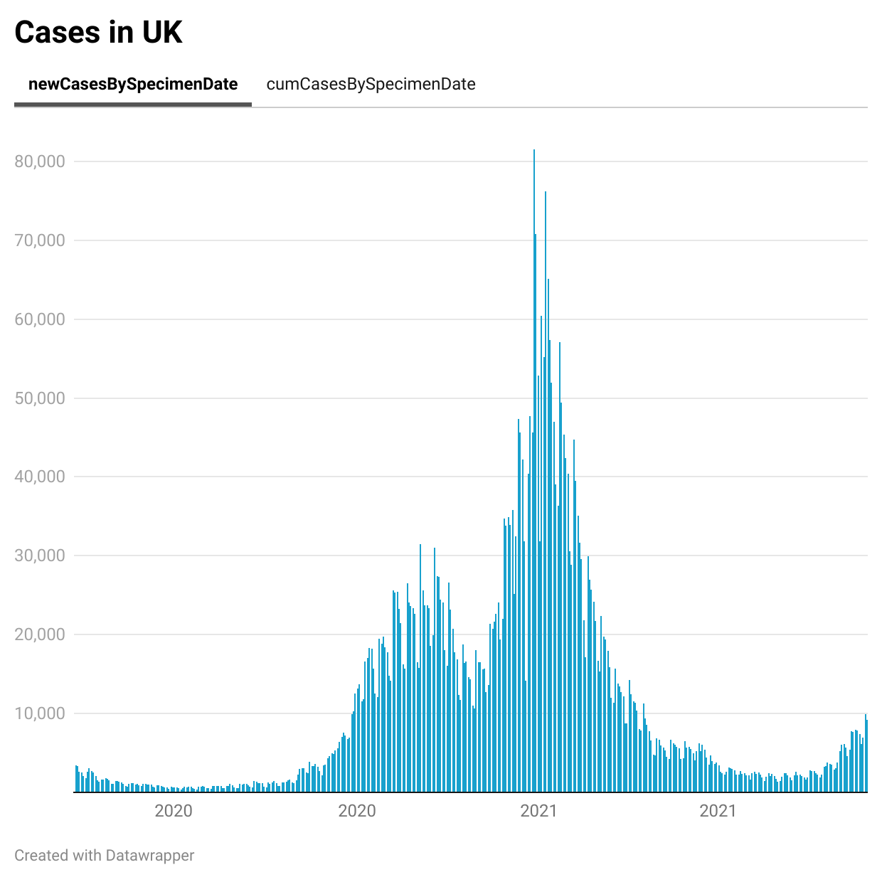
Cases in UK
2 peak
Lockdown
Businesses

Slide 6

Cases in UK
In the beginning of the Covid pandemic, business owners attended to a survey about Covid-19’s economic impacts. The survey results can be seen from the graphs.

Slide 7
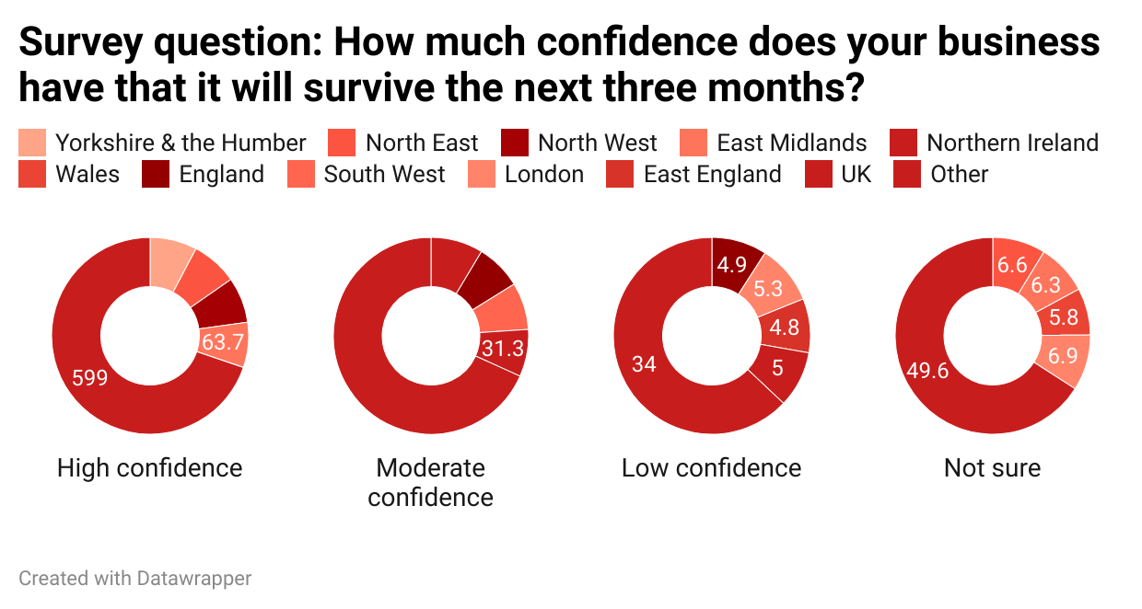
Survey about Covid-19’s economic impacts

Slide 8
Survey about Covid-19’s economic impacts
As it can be seen in the result of survey, business owners has high confidence about their business’ next three monts because England Government made public a financial support package for business - like a hundreds countries -
Also, England Government were a wide raft of support measures in place to assist businesses affected by the pandemic. Some of these are:
Business rates relief
Bounce Back Loans for small and micro-businesses
The Coronavirus Job Retention Scheme
Tax deferraling
Restart Grants to support High Street businesses to reopen

Slide 9
Expected impact of Covid-19 on some industries
Despite of all these measures and support, most industries negatively affected from lockdowns. According to financial experts, most industries will downsize.
The downsize can be seen in the next slide.

Slide 10
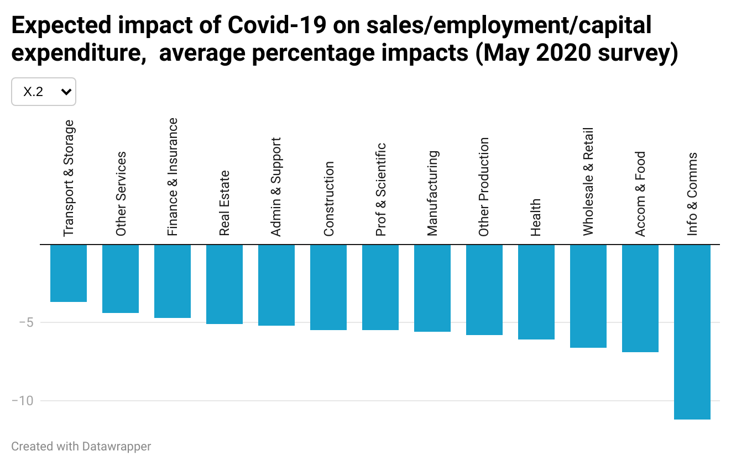
Expected impact of Covid-19 on some industries

Slide 11
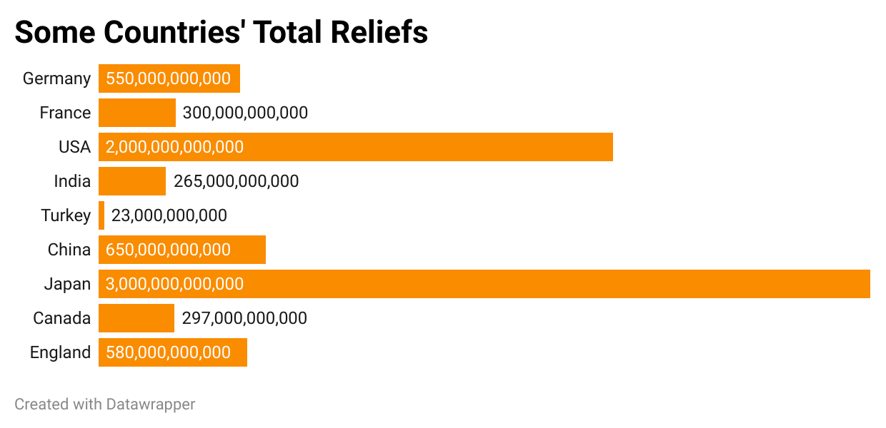
Some countries’ total reliefs
There is a graph for some countries’ reliefs for their citizens. In this graph, European countires’ reliefs are in terms of Euro and others are in terms of Dollar.
As we can see in the graph, The UK is one of the country which supported people most in the world.

Slide 12
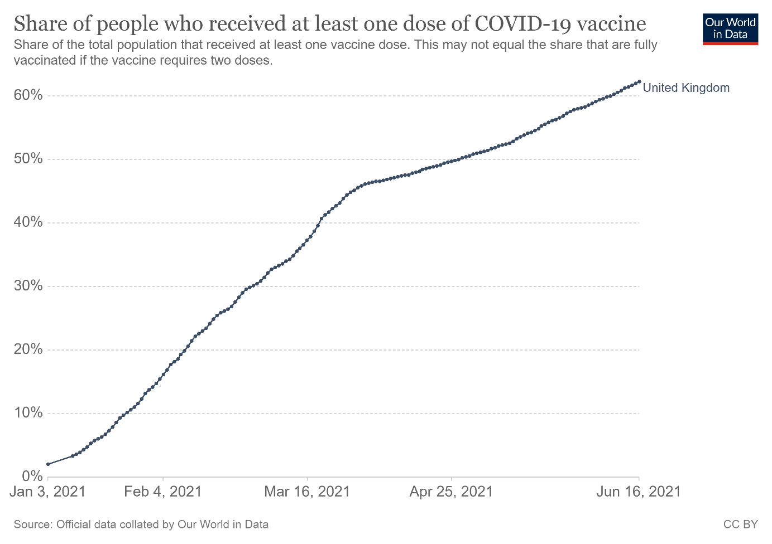
Vaccination rates of UK
UK has a very strong vaccination capacity. So, government made an agreement with Pfizer-BionTech for vaccine and they still vaccinate the citizens.

Slide 13
Vaccination rates of UK
UK has a very strong vaccination capacity. So, government made an agreement with Pfizer-BionTech for vaccine and they still vaccinate the citizens.

Slide 14
References
https://www.investopedia.com/government-stimulus-and-relief-efforts-to-fight-the-covid-19-crisis-5113980
https://www.ons.gov.uk/economy/economicoutputandproductivity/output/datasets/businessimpactofcovid19surveybicsresults
https://coronavirus.data.gov.uk/details/cases
https://ourworldindata.org/covid-vaccinations
https://github.com/owid/covid-19-data/tree/master/public/data/vaccinations
https://github.com/owid/covid-19-data/blob/master/public/data/vaccinations/locations.csv
https://www.england.nhs.uk/statistics/statistical-work-areas/covid-19-vaccinations/
https://www.ons.gov.uk/economy/economicoutputandproductivity/output/articles/firmsandindustrieswhereturnoverwasresilientduringthecoronaviruscovid19pandemic/2021-04-26
https://www.economicsobservatory.com/update-which-firms-and-industries-have-been-most-affected-by-covid-19
http://www.salihlitso.org.tr/uploaded/dosyalar/YENİNORMALEGÖREİNGİLTERE.pdf
https://www.bridgend.gov.uk/media/10951/economic-resilience-fund-guidance-notes.pdf
https://www.local.gov.uk/our-support/coronavirus-information-councils/covid-19-service-information/covid-19-business-support

