Slide 1
EDA - Top 5 European Leagues
Ali Taşbaş

Slide 2
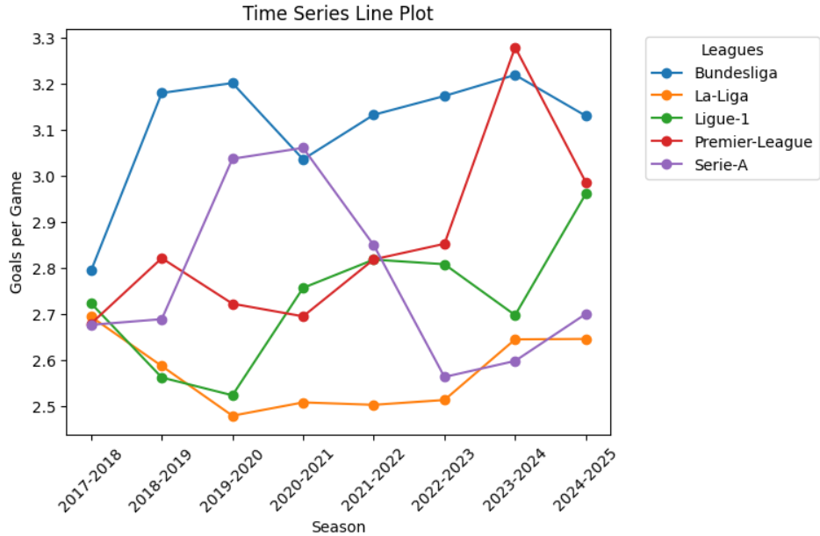
Are there less goals conceded in the Spanish League
Notes:
Compare home and away goals separately. line plot shot counts over the years
foul counts, yellow red cards

Slide 3
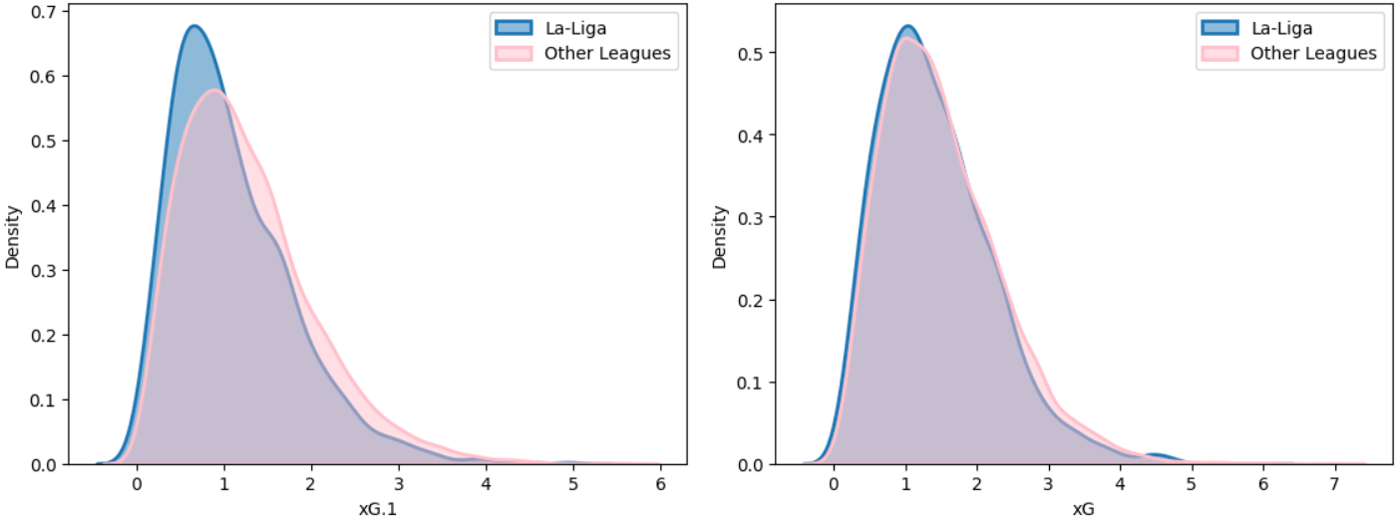
xG
Away
Home
Is the home turf advantage greater in the Spanish League

Slide 4
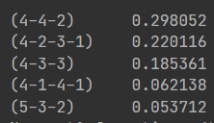
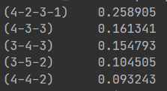
La Liga and the Rest of the World
Formation
La-Liga
Rest

Slide 5
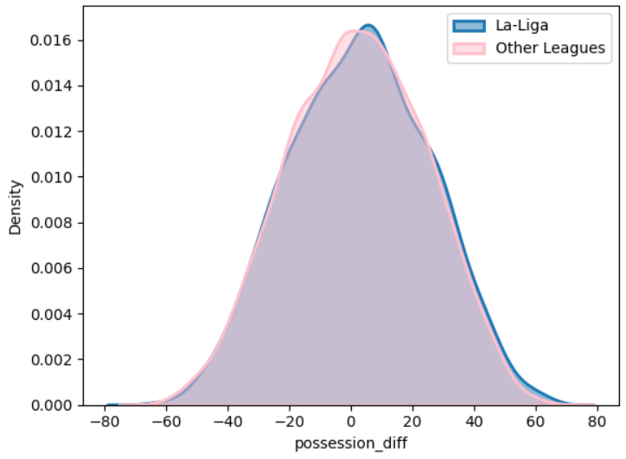
Possession Diff

Slide 6
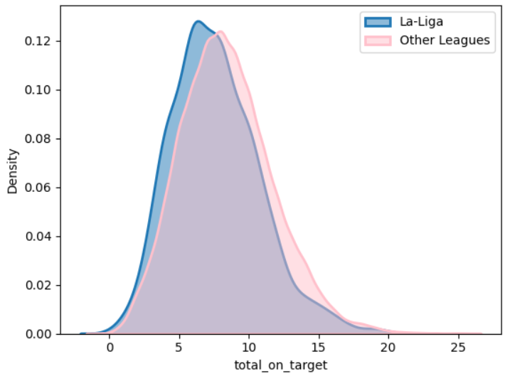
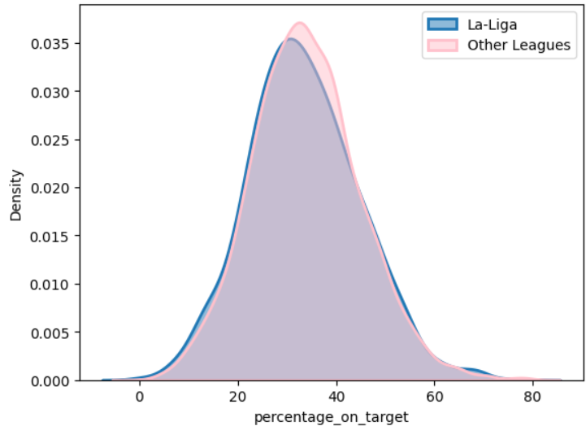
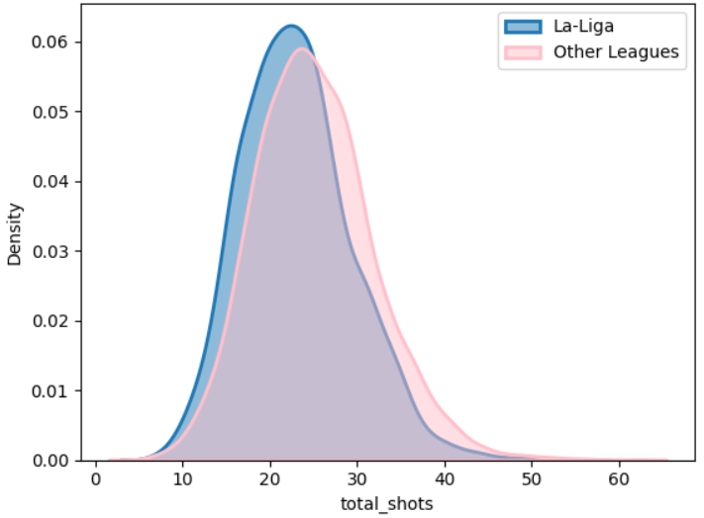
Shots

Slide 7
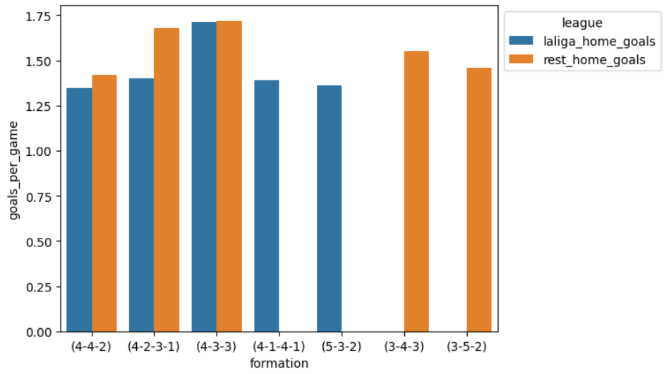
Home Goals per Game ~ Formation
 | laliga_home_goals | rest_home_goals
formation
(4-4-2) | 1.346290 | 1.418502
(4-2-3-1) | 1.401914 | 1.679058
(4-3-3) | 1.710227 | 1.718802
(4-1-4-1) | 1.389831 | 0.000000
(5-3-2) | 1.362745 | 0.000000
(3-4-3) | 0.000000 | 1.553229
(3-5-2) | 0.000000 | 1.457847

Slide 8
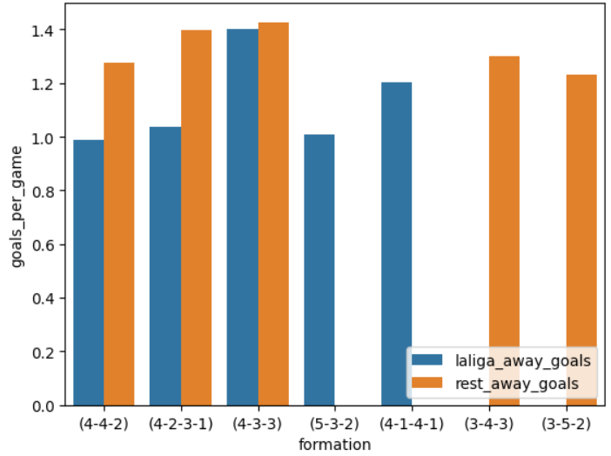
Descriptive Statistics / Results
 | laliga_away_goals | rest_away_goals
formation
(4-4-2) | 0.986355 | 1.275974
(4-2-3-1) | 1.035129 | 1.399890
(4-3-3) | 1.400000 | 1.427481
(5-3-2) | 1.007407 | 0.000000
(4-1-4-1) | 1.201493 | 0.000000
(3-4-3) | 0.000000 | 1.301439
(3-5-2) | 0.000000 | 1.233668

Slide 9
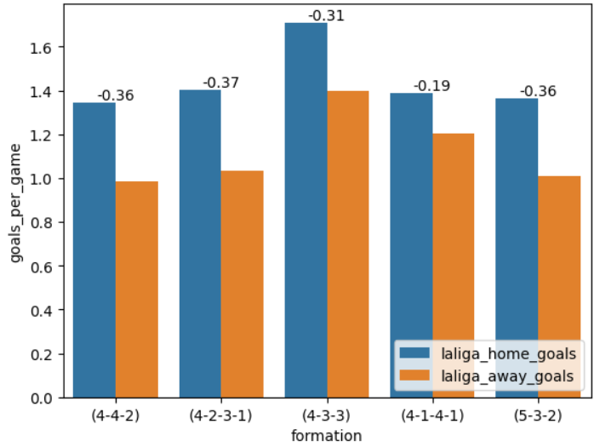
La-Liga Goal Difference
 | laliga_home_goals | laliga_away_goals | Diff
formation
(4-4-2) | 1.346290 | 0.986355 | -0.359935
(4-2-3-1) | 1.401914 | 1.035129 | -0.366785
(4-3-3) | 1.710227 | 1.400000 | -0.310227
(4-1-4-1) | 1.389831 | 1.201493 | -0.188338
(5-3-2) | 1.362745 | 1.007407 | -0.355338

Slide 10
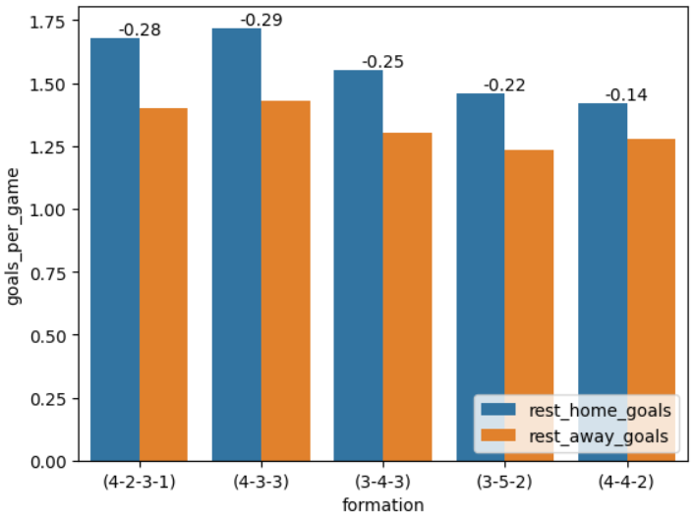
ROW Goal Difference
 | rest_home_goals | rest_away_goals | Diff
formation
(4-2-3-1) | 1.679058 | 1.399890 | -0.279167
(4-3-3) | 1.718802 | 1.427481 | -0.291321
(3-4-3) | 1.553229 | 1.301439 | -0.251789
(3-5-2) | 1.457847 | 1.233668 | -0.224179
(4-4-2) | 1.418502 | 1.275974 | -0.142528

Slide 11
THOUGHTS?

Slide 12


