Slide 1

Status of the AWAKE eBPMs studies
E. Senes, M. Krupa, L. Soby, M. Wendt
With many thanks to: A.M. Bachmann, P. Muggli, M. Martyanov, M. Huther F.M. Velotti, G. Papotti, C. Perry, P.N. Burrows

Slide 2
Outline
Proton spectrum
Ideal case
Streak camera measurements
Run2 parameters
Review of the data of November
Some notes on the beam pipe aperture and the two BPM models
EM simulation of the present BPM
VNA measurements in the lab on a spare
Measurement proposal for the summer run

Slide 3
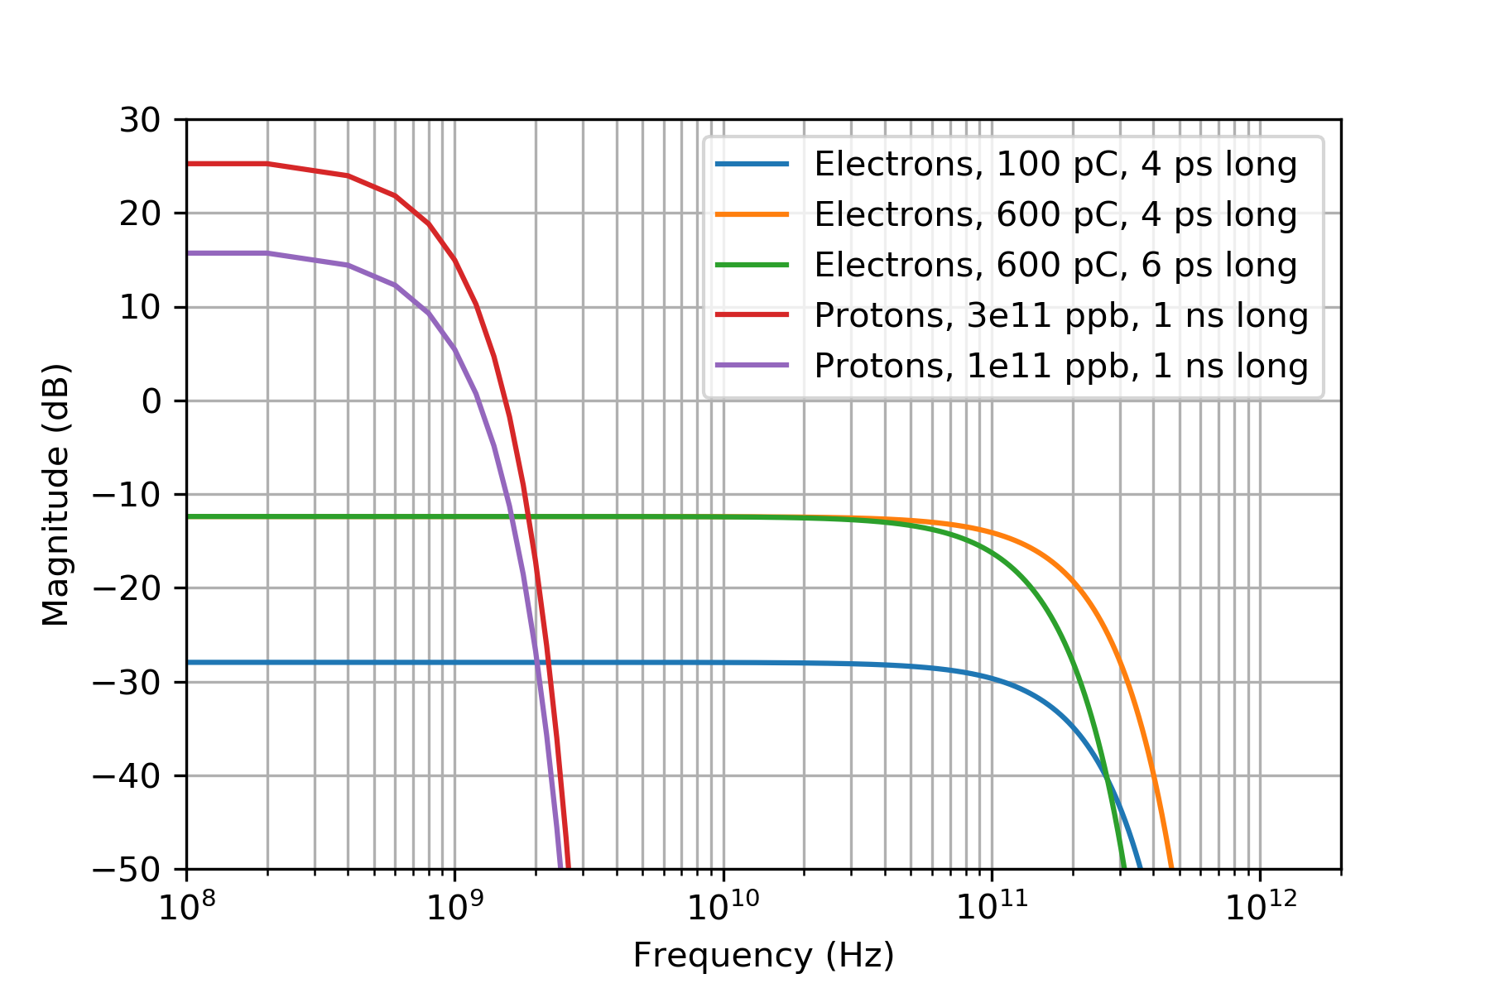
Proton spectrum: gaussian beams case
Gaussian case:
For the present setup:
3e11 protons
600 pC electrons
Expected 35-38 dB difference at zero frequency

Slide 4
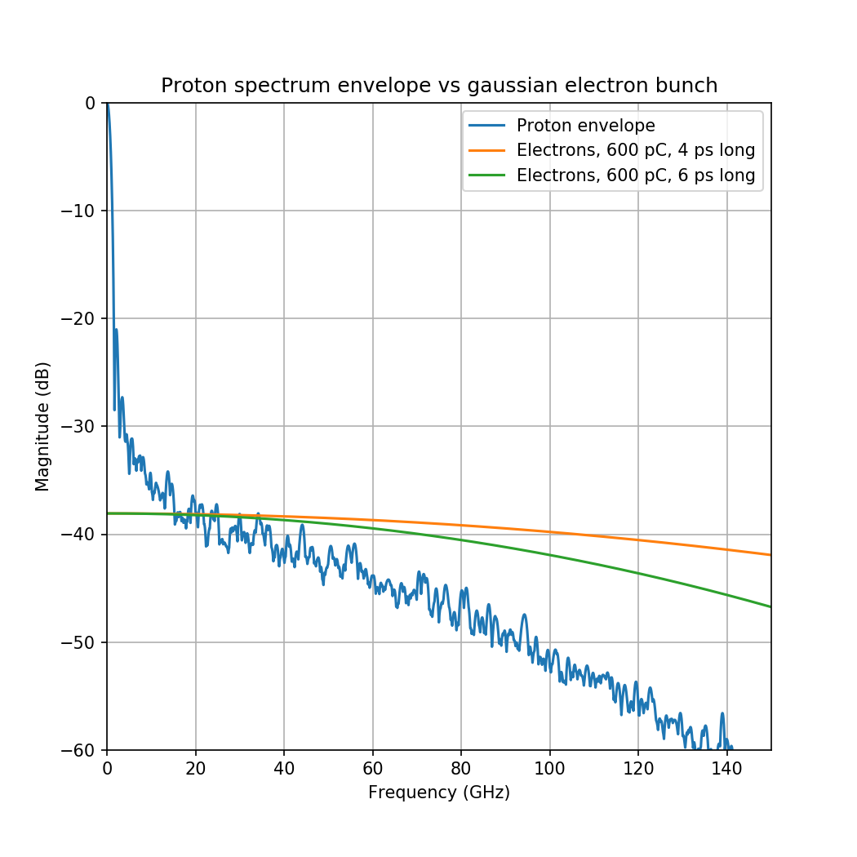
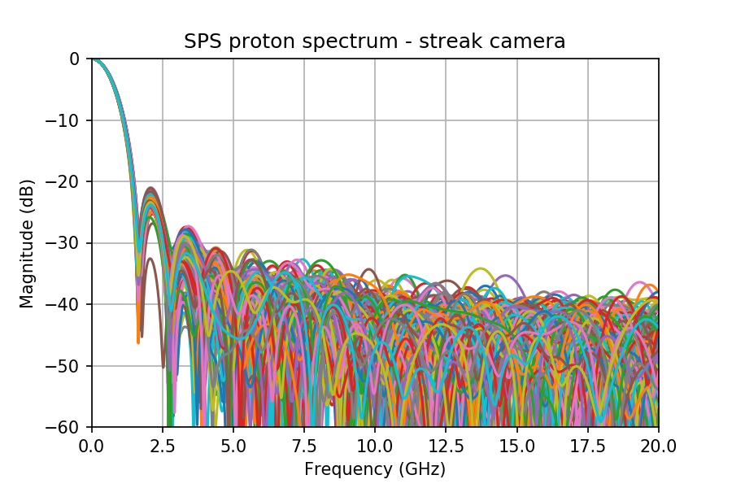
Streak camera measurements
Key question: how long does the proton spectrum extends in the frequency range ?

Slide 5
Streak camera reliability
The presence of a fine structure in the proton bunch is interesting for AWAKE as it might be the trigger for seeded instability
The streak camera has been well characterised in a master thesis work
K. Rieger, Streak cameras and optical transition radiation as a diagnostic for self-modulation of charged particle beams in plasmas, MSc. Thesis, TUM, Munich, Germany, January 2015
K. Rieger et al, GHz modulation detection using a streak camera: Suitablilty of streak cameras in the AWAKE experiment, Rev. of Scientific Instr. 88, 025110, 2017, corrected Jan. 2018
It concludes that the streak camera looks behaving well up to ~300 GHz !

Slide 6
Streak camera reliability
The presence of a fine structure in the proton bunch is interesting for AWAKE as it might be the trigger for seeded instability
No suitable instrumentation is installed in the SPS to investigate in the tens of GHz regime.
WCM -3dB cutoff frequency is 2.2 GHz, and it is believed that it behaves well up to ~3.5 GHz ... Definitely not enough
The validation of the reliability of the streak camera is pending. Hamamatsu experts have been pulled in the loop.
High frequency noise can be introduced by the nature of the streak camera measurement itself. Shot by shot use could be problematic. Normally a very low light is employed and the profiles are averaged in order to resolve the bunch length by fitting (chat with Stefano).
Does being able to resolve 300 GHz keep us safe from these HF components ?

Slide 7
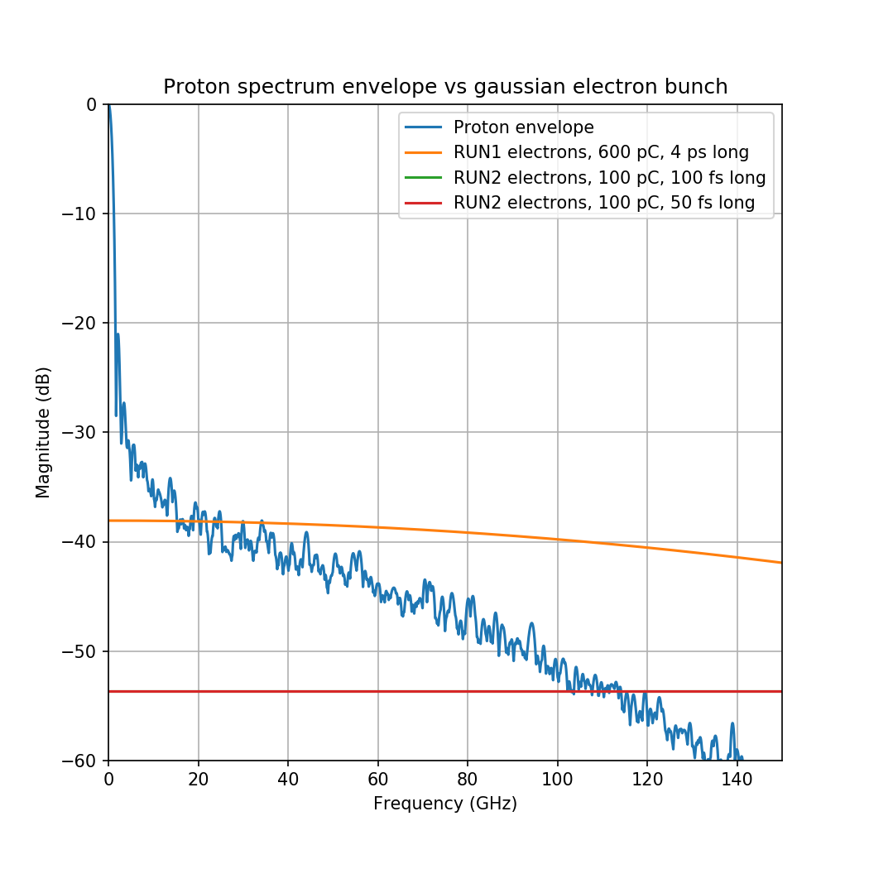
AWAKE run 2 parameters
The usual design parameter frequent variation problem with AWAKE persists. Assuming
Protons as today
3e11 ppb
1ns bunch length (4σ)
Electrons (worst case):
100 pC charge
50-100 fs bunch length(4σ)
At such parameters, the difference between protons and electrons (gaussian case) is ~55 dB !!

Slide 8
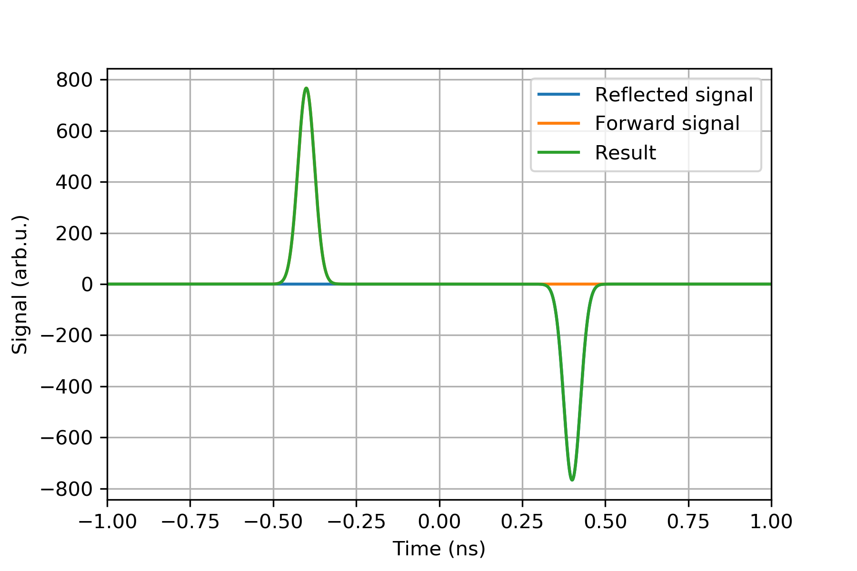
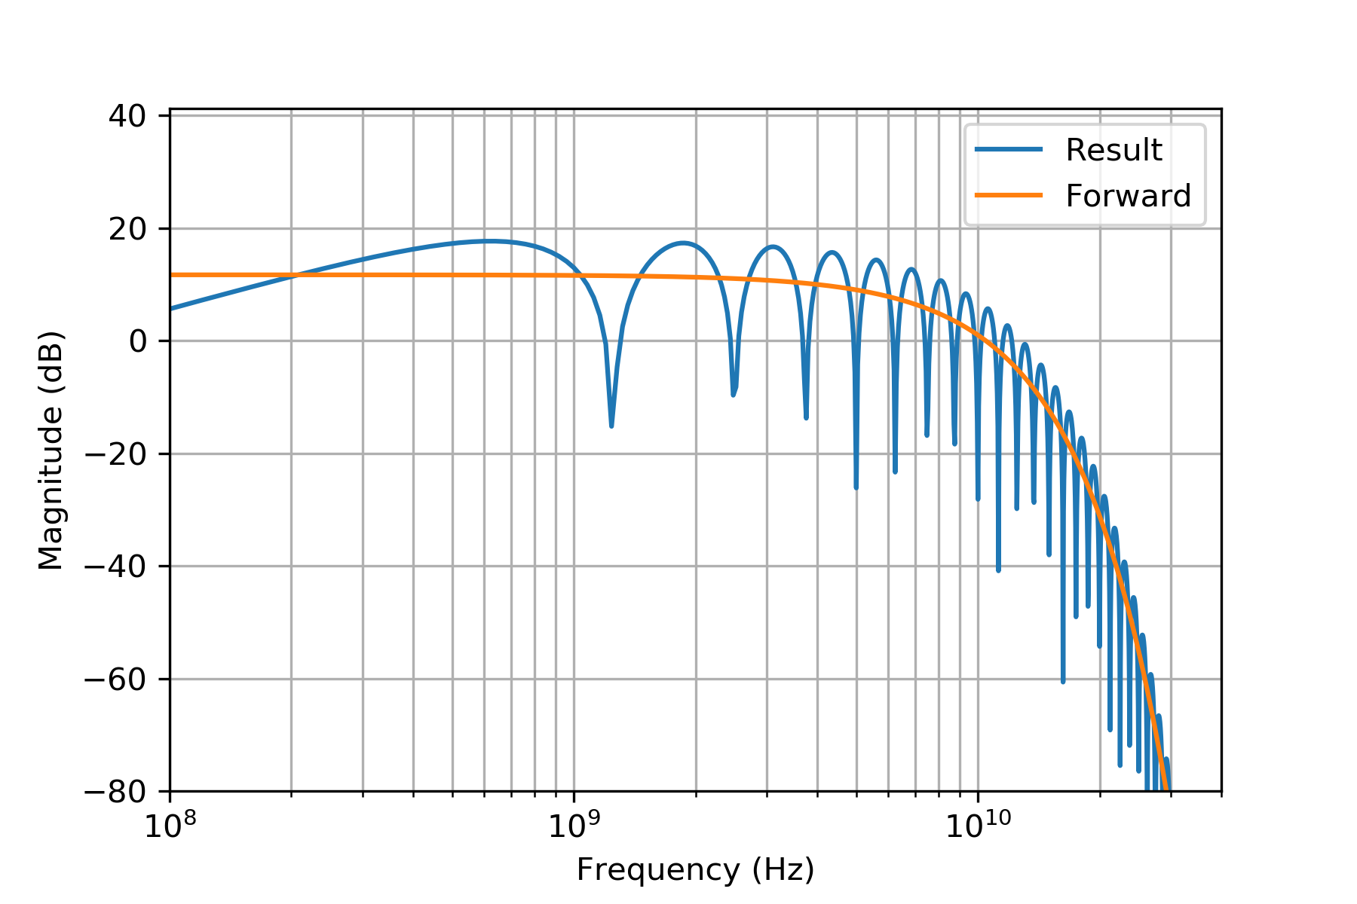
Review of the data of November
After the video meeting of the 12th of February, many thanks to C. Perry for the numerous comments !
Note on the beam pipe size: every measurement is contaminated by reflections from the environment above the beam pipe cutoff frequency. For the current design:
Type | Stripline length | Beam pipe f_{cutoff} | Reflection distance | Lobe frequency
40 mm | 120 mm | 4.40 GHz | 800 ps | 1.25 GHz
60 mm | 126 mm | 2.93 GHz | 840 ps | 1.19 GHz

Slide 10
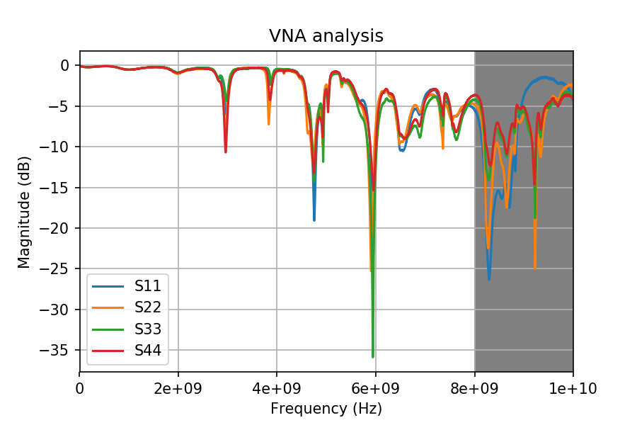
VNA measurements on a prototype
A 60 mm type eBPM protoype was tested in the lab
Installed in the tunnel before the AWAKE operation started
Then removed and brought to the lab
Absorptive foam in the beam pipe
One of the feedthrough seems to be bad (very sensible to mechanical stress)

Slide 11
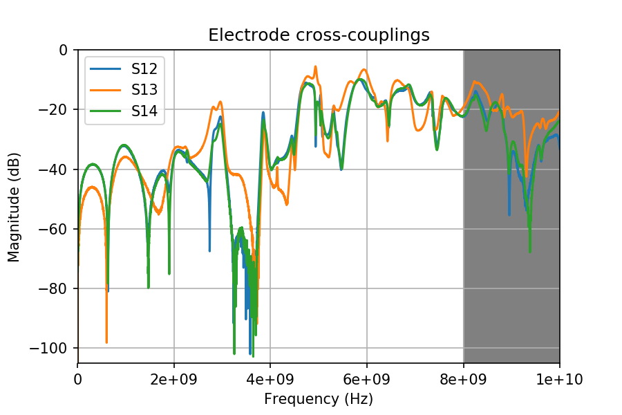
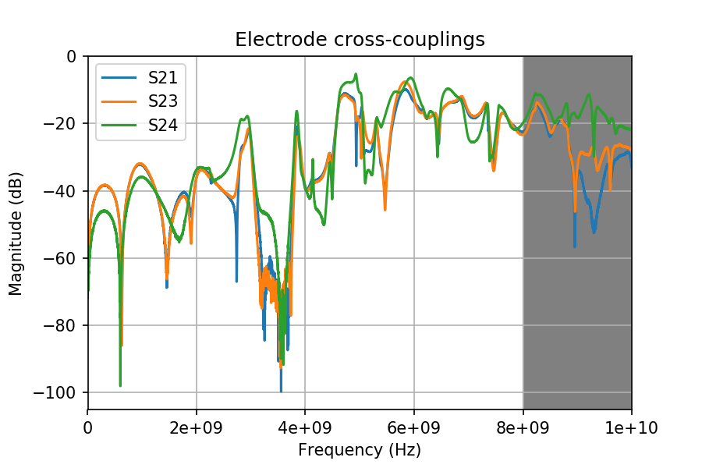
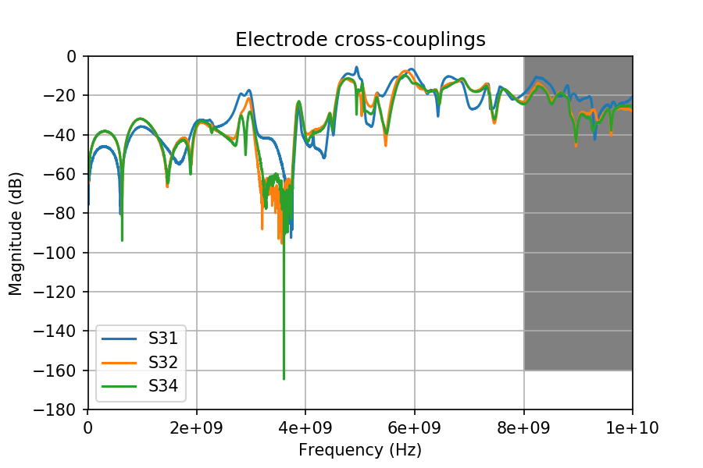
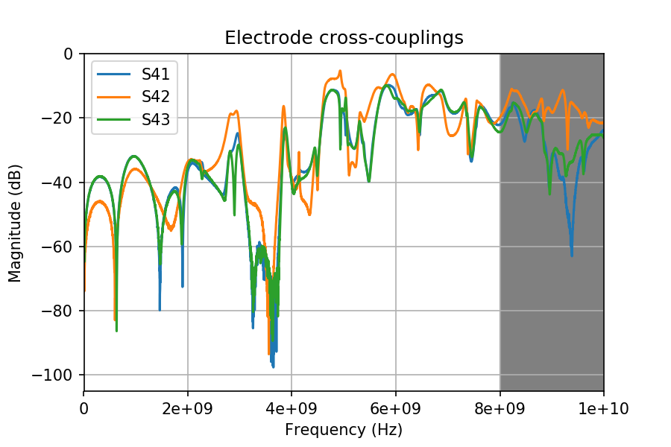
Electrodes cross-couplings

Slide 12
EM simulation of the present 60 mm design

