Slide 2
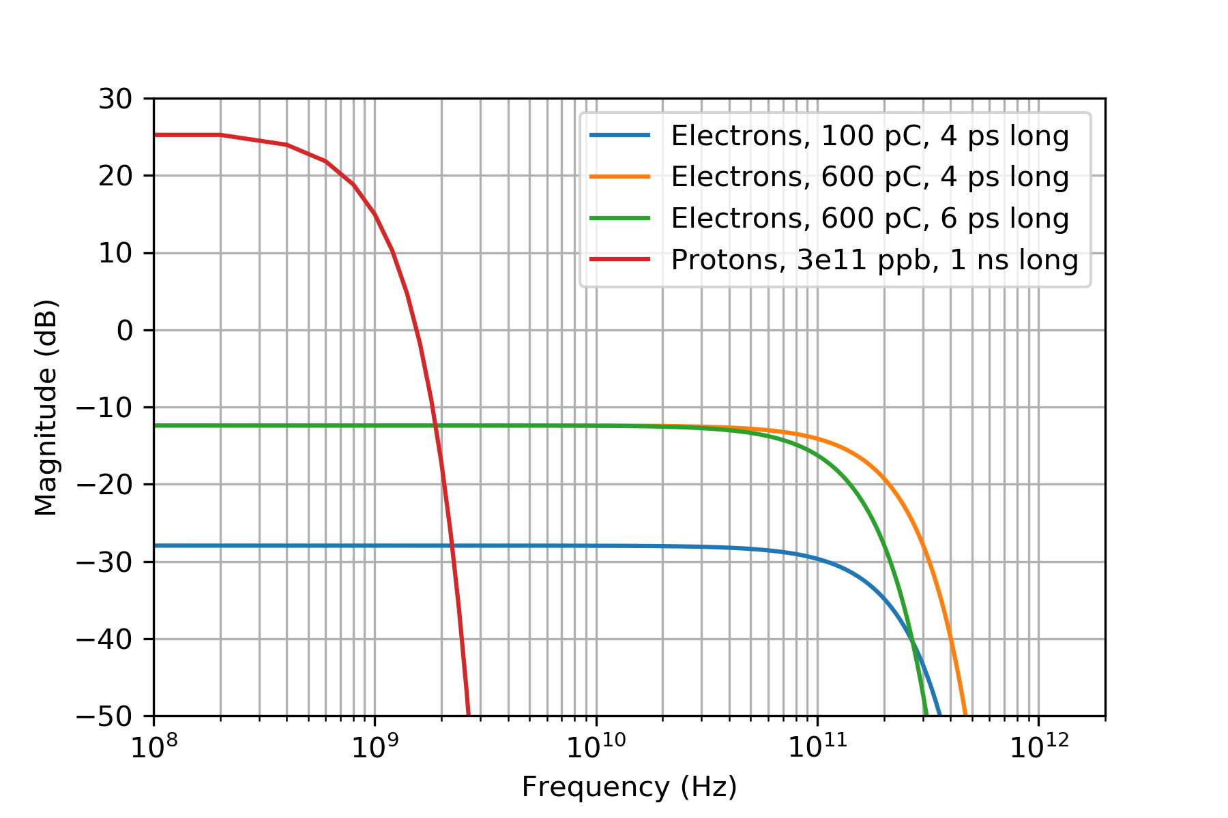
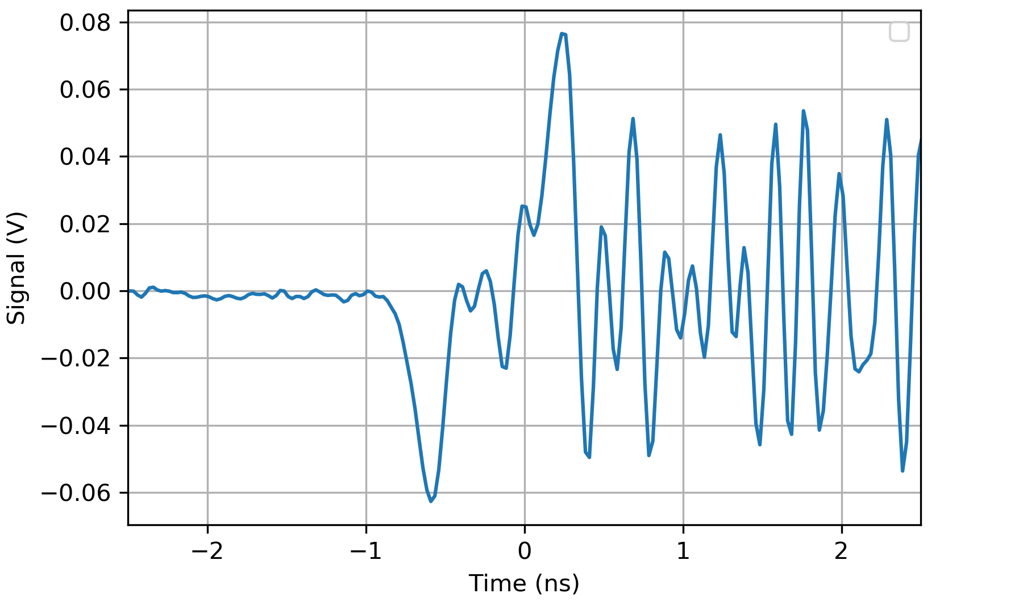
AWAKE electron BPM system limitations
E. Senes, M. Krupa, M. Wendt
Same magnitude
at ~2 GHz
In the final beamline two bunches of protons and electrons run overlapped
The electron bunch is sensibly shorter than the proton
p⁺ spectrum component drops after 2GHz
e⁻ electron component constant for tens of GHz
Measuring using the present system is problematic due to pickup resonances in the GHz range excited by the beam
Electron bunch signal
Resonance pattern

