Slide 1

Status of the AWAKE eBPMs studies
E. Senes, M. Krupa, L. Soby, M. Wendt
With many thanks to: A.M. Bachmann, P. Muggli, M. Martyanov, M. Huther F.M. Velotti, G. Papotti, C. Perry, P.N. Burrows

Slide 2
Outline
Proton spectrum
Ideal case
Streak camera measurements
Run2 parameters
Simulations and measurements
Note on the beam pipe cutoff frequency
VNA simulations on a 60mm spare
Future measurements plan
Additional work

Slide 3
Proton bunch spectrum

Slide 4
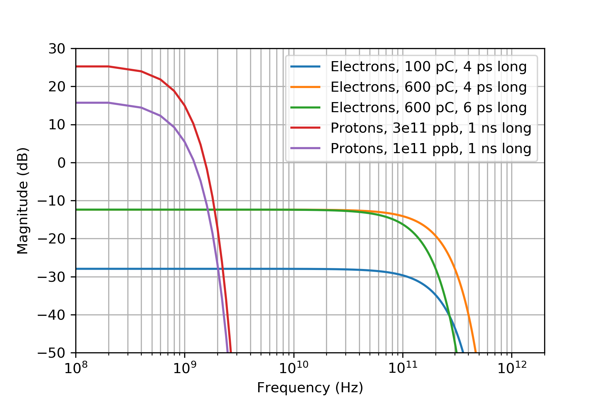
Proton spectrum: gaussian beams case
Gaussian case:
For the present setup:
3e11 protons
600 pC electrons
Expected 35-38 dB difference at zero frequency

Slide 5
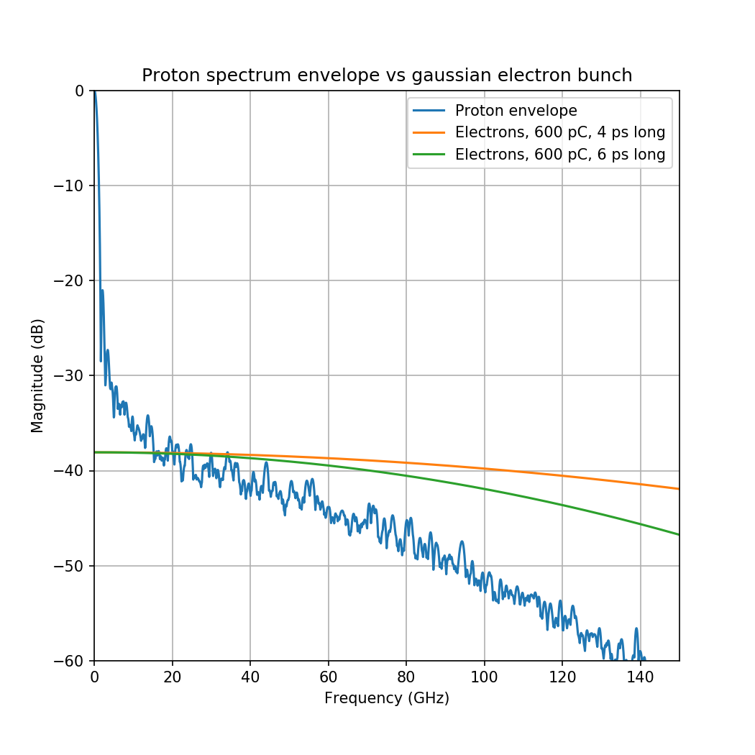
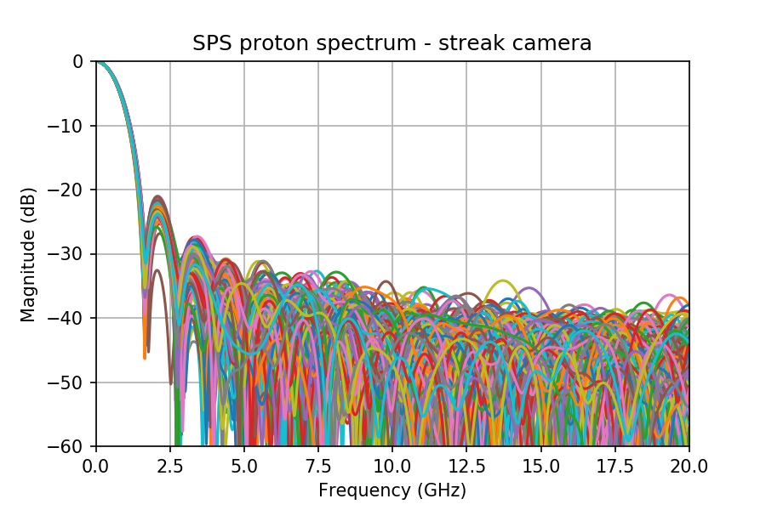
Streak camera measurements
Key question: how long does the proton spectrum extends in the frequency range ?

Slide 6
Streak camera reliability
The presence of a fine structure in the proton bunch is interesting for AWAKE as it might be the trigger for seeded instability
The streak camera has been well characterised in a master thesis work
K. Rieger, Streak cameras and optical transition radiation as a diagnostic for self-modulation of charged particle beams in plasmas, MSc. Thesis, TUM, Munich, Germany, January 2015
K. Rieger et al, GHz modulation detection using a streak camera: Suitablilty of streak cameras in the AWAKE experiment, Rev. of Scientific Instr. 88, 025110, 2017, corrected Jan. 2018
It concludes that the streak camera is capable of resolving light peaks up to ~300 GHz !
I will use the FFT of dark images to understand the effect of the instrument on the spectrum (frames from M.Huther)

Slide 7
Streak camera reliability
No suitable instrumentation is installed in the SPS to investigate in the tens of GHz regime.
WCM -3dB cutoff frequency is 2.2 GHz, and it is believed that it behaves well up to ~3.5 GHz ... Definitely not enough
Other instrumentation at AWAKE ? E.g. heterodyne system could be potentially used, but no protons anymore …
This analysis was never done before, investigating if something was done for the electrons …
The validation of the reliability of the streak camera is pending. Hamamatsu experts have been pulled in the loop.
High frequency noise can be introduced by the nature of the streak camera measurement itself. Shot by shot use could be problematic. Normally a very low light is employed and the profiles are averaged in order to resolve the bunch length by fitting (chat with Stefano).
Does being able to resolve 300 GHz keep us safe from these HF components ?

Slide 8
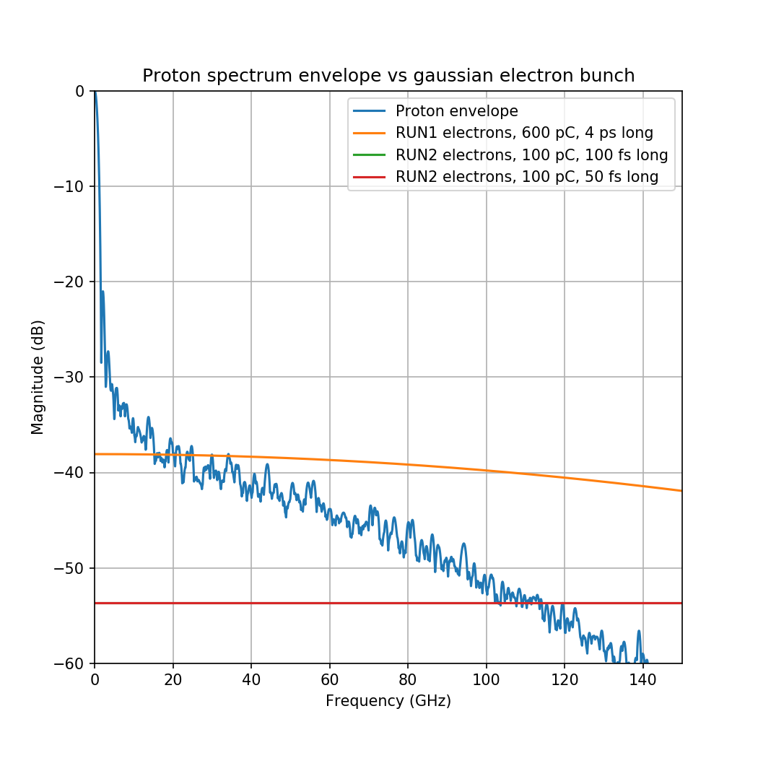
AWAKE run 2 parameters
The usual design parameter frequent variation problem with AWAKE persists. Assuming [1]:
Protons as today
3e11 ppb
1ns bunch length (4σ)
Electrons (worst case):
100 pC charge
50-100 fs bunch length(4σ)
At such parameters, the difference between protons and electrons (gaussian case) is ~55 dB !!
[1] K. Pipitone et al., The electron accelerators for the AWAKE experiment at CERN – Baseline and future developments, Nucl. Inst. and Methods A, 909 (2018) 102-106

Slide 9
Simulations and measurements

Slide 10
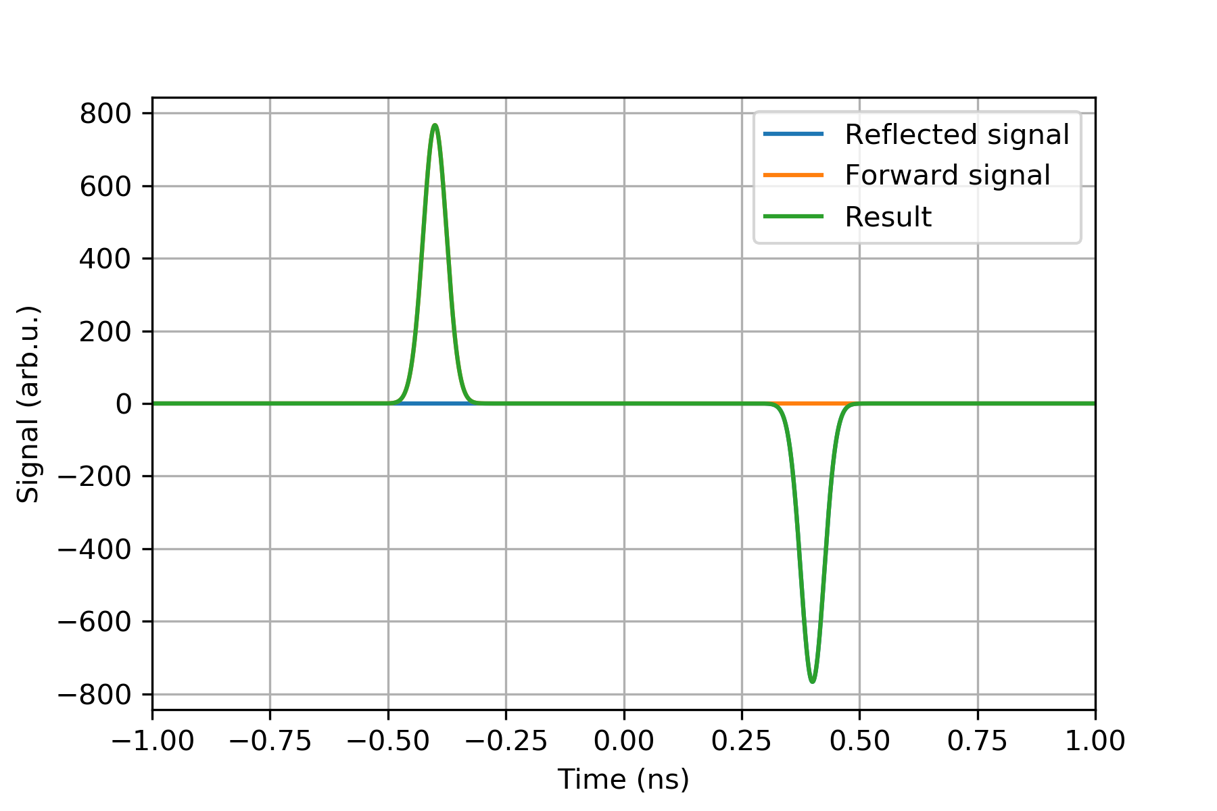
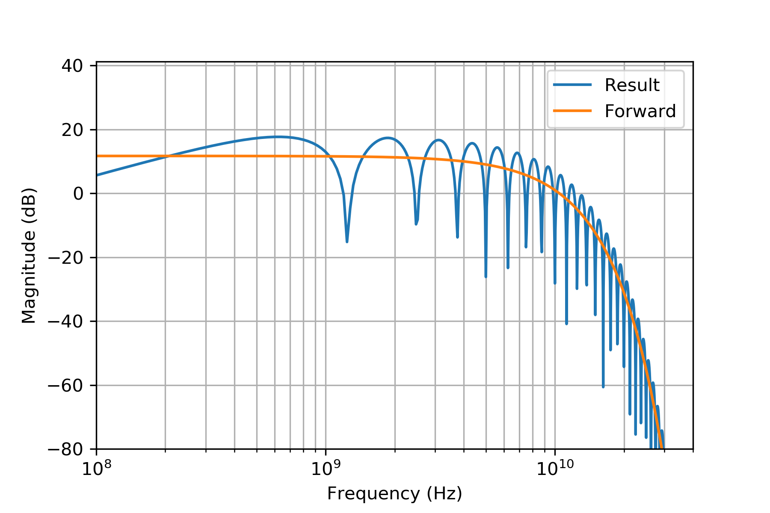
Beam pipe cutoff frequency
Many thanks to C. Perry for the numerous comments after the video meeting !
Note on the beam pipe size: every measurement is contaminated by reflections from the environment above the beam pipe cutoff frequency. For the current design:
Type | Stripline length | Beam pipe f_{cutoff} | Reflection distance | Lobe frequency
40 mm | 120 mm | 4.40 GHz | 800 ps | 1.25 GHz
60 mm | 126 mm | 2.93 GHz | 840 ps | 1.19 GHz

Slide 11
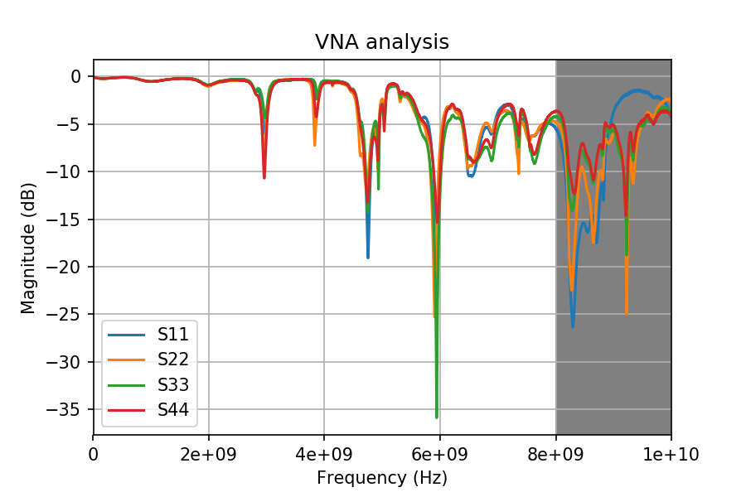
VNA measurements on a prototype
A 60 mm type eBPM protoype was tested in the lab
Installed in the tunnel before the AWAKE operation started
Then removed and brought to the lab
Absorptive foam in the beam pipe
One of the feedthrough seems to be bad (very sensible to mechanical stress)
Clockwise port numbering
Above 8 GHz, the measurement is sensitive to stress, cable positions

Slide 12
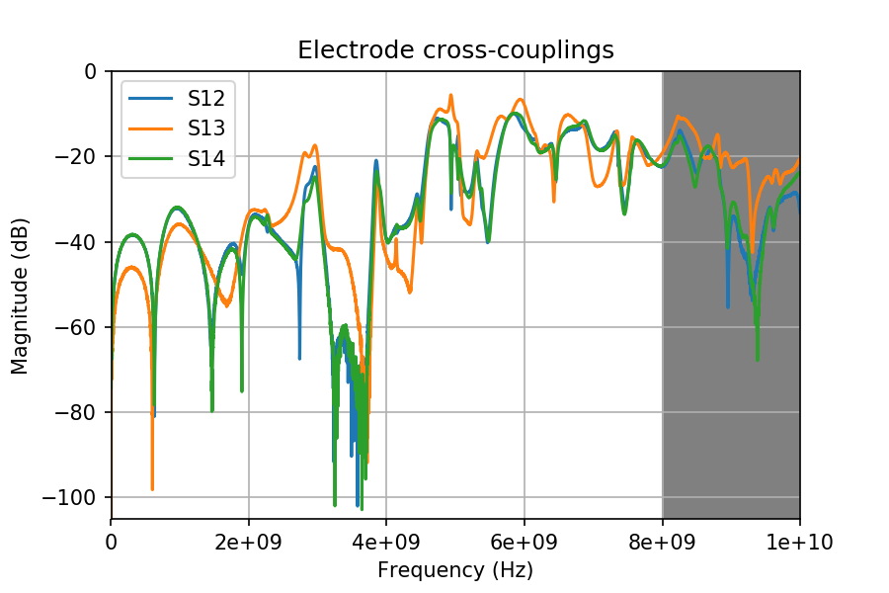
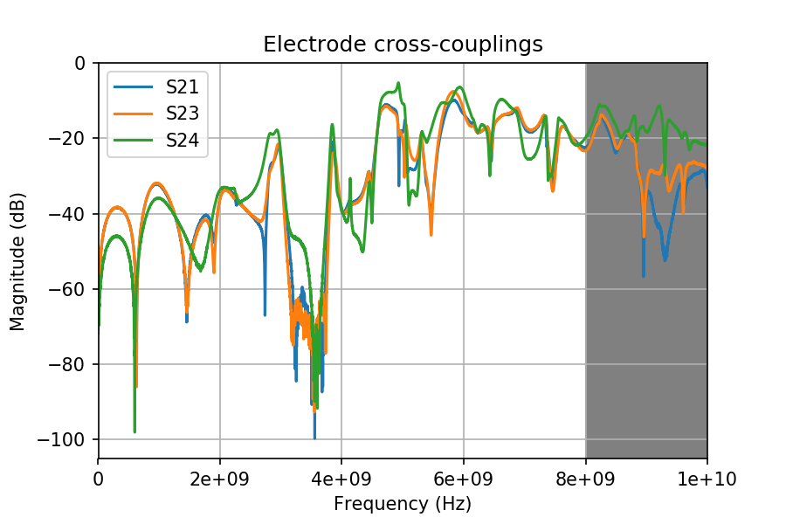
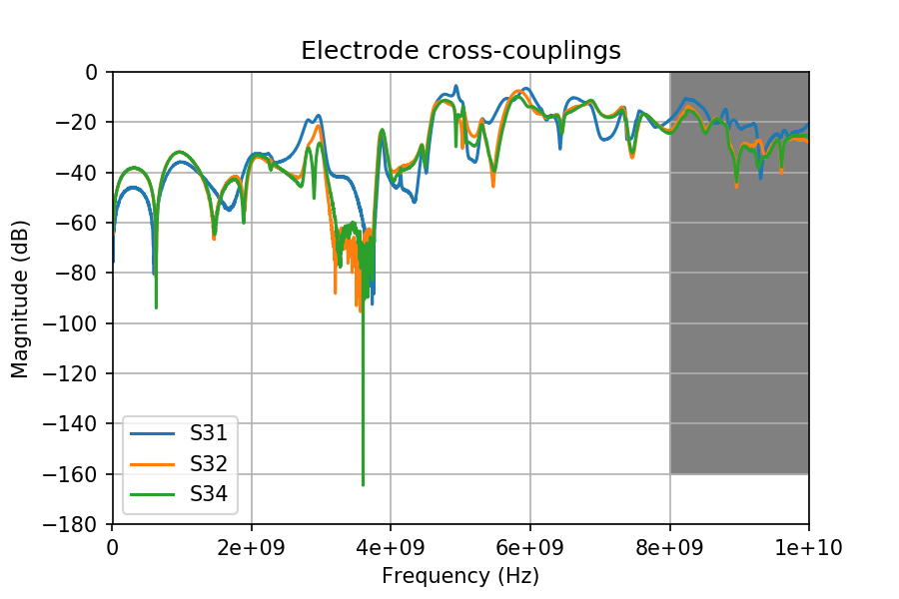
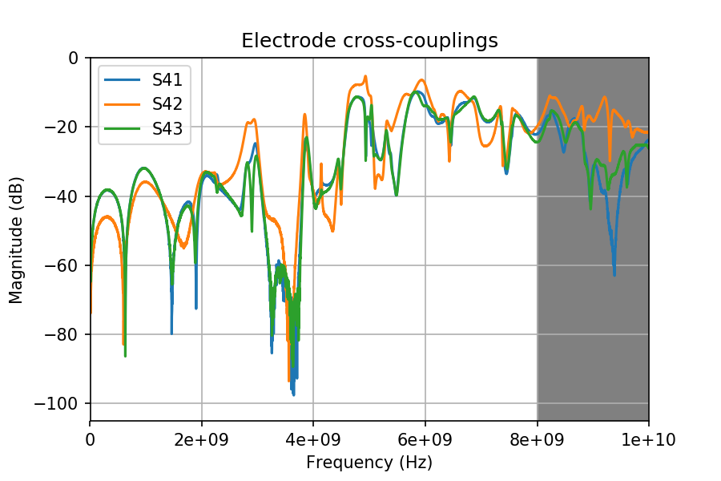
Electrodes cross-couplings

Slide 13
Comparison to CST simulation
The CST simulation of both the 60 mm and 40 mm version is running on the cluster right now
10 cells per wavelength, also for background

Slide 14
On the menu
Tunnel measurements (April?):
VNA measurement of a 60 mm pickup
VNA measurement of a 40 mm pickup
Tunnel measurements (Summer run):
Scope measurements of the same 60 mm pickup
Electrons only (with steering)
Electrons + laser
Electrons + Rb vapour
Electrons + laser + Rb plasma
Eventual scope measurement of the 40 mm pickup (requires cabling work !, under discussion a.t.m.)

Slide 15
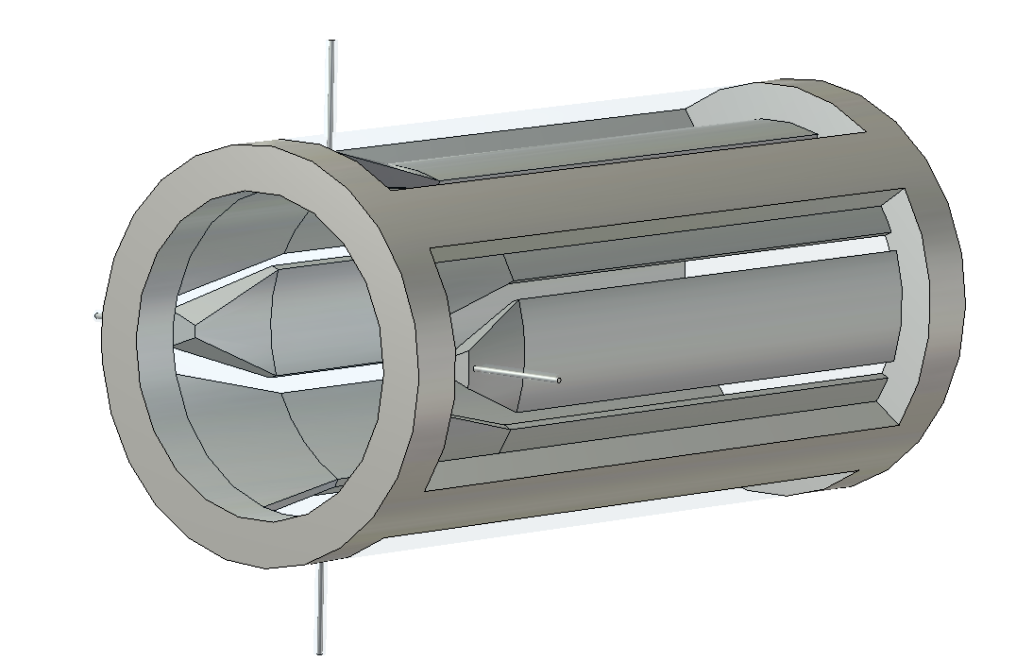
EM simulation of the present 60 mm design
3D model of the BPM was developed
Fully parametric
Simulated:
TDR
Wakefield
S parameters (running …)

Slide 16
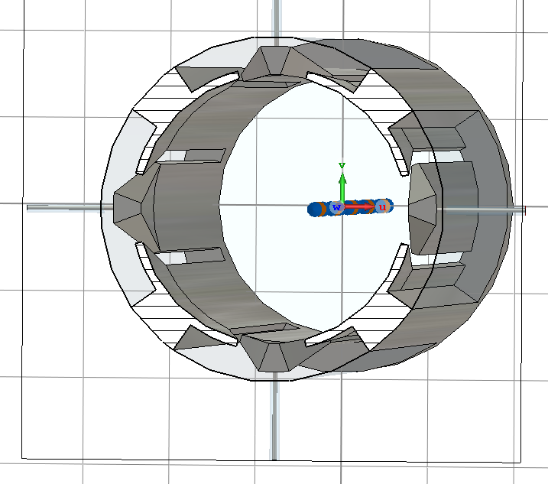
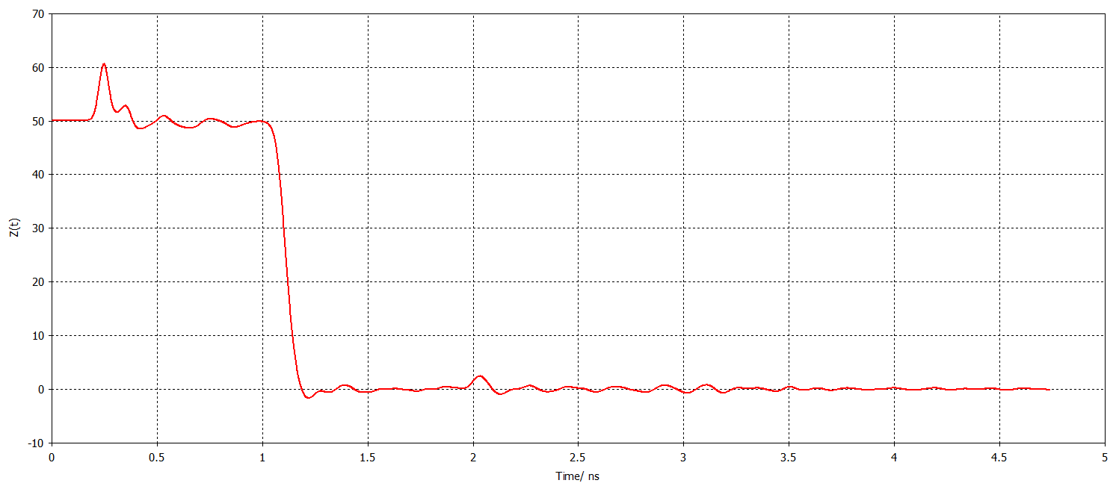
TDR simulations
This design was never simulated before realisation
The end of the stripline is generally problematic. A not careful design can lead to resonances due to the impedance mismatch
TDR analysis done (generally up to 15 GHz) and parameter sweep
No sensible variation of the wakefield simulation using optimised parameters

Slide 17
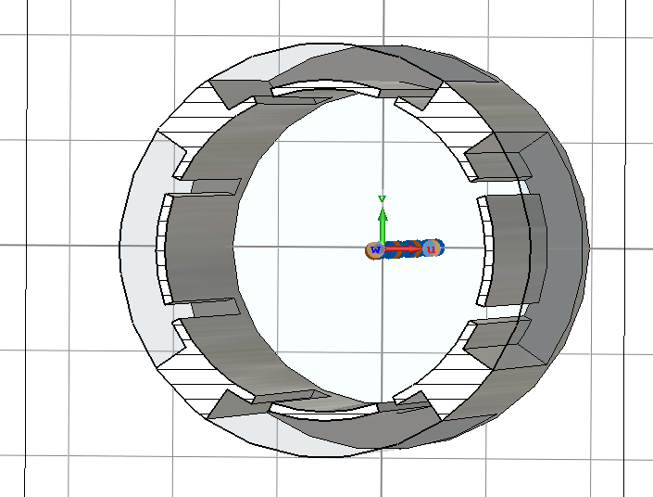
Impact of the cavity behind the stripline
This design was never simulated before realisation
The cavity behind the stripline can be resonating
After optimisation (wakefield sim.), the smaller the better
The slot size can be changed also
Every optimisation changes the capacitive coupling of the stripline
Still, no sensible variation of the wakefield simulation using optimised parameters

Slide 18
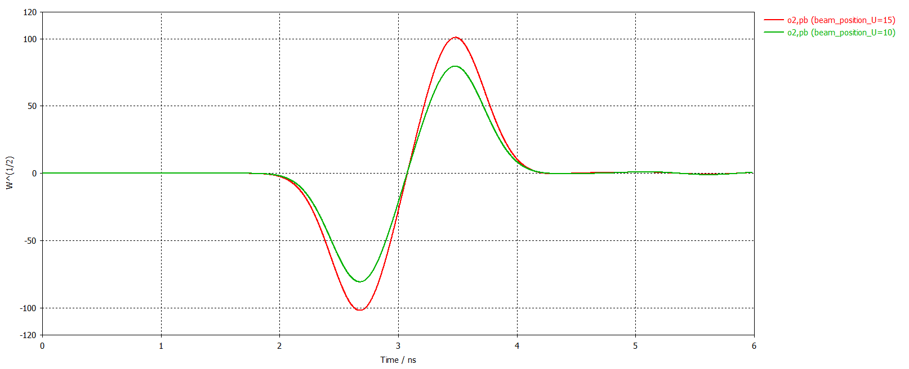
Wakefield simulations
Simulate the beam effect
Only gaussian beams
Only one beam at the time
Parameters explored
Nominal protons
3e11 ppb
75 mm sigma
Nominal protons/10
Nominal protons/100

Slide 19
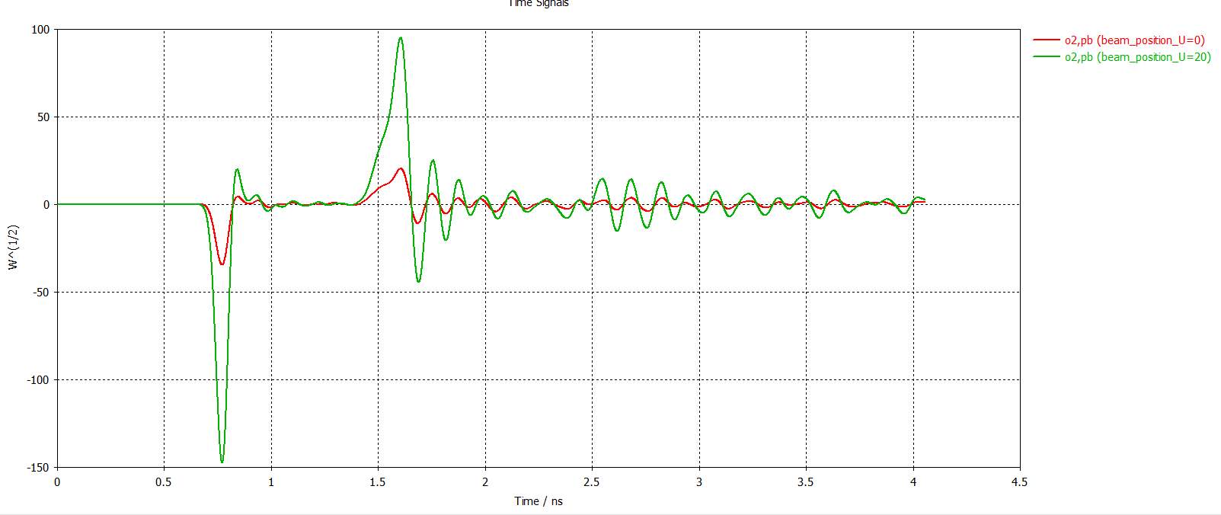
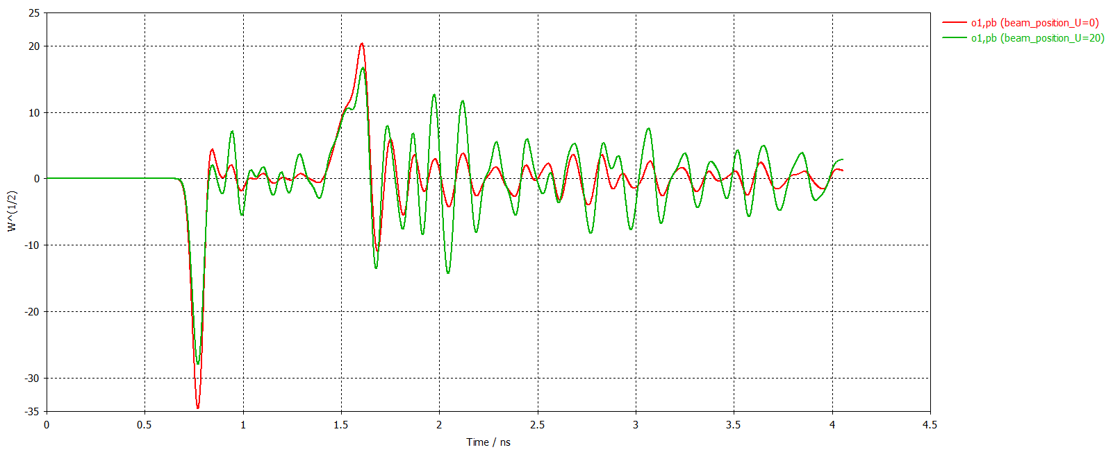
Wakefield simulations
Troubles start at already protons/10
Will submit the electron simulation soon with real parameters
The resonance pattern starts to be visible, and we are in open z-bundaries
Signal still dependent on the position

Slide 20
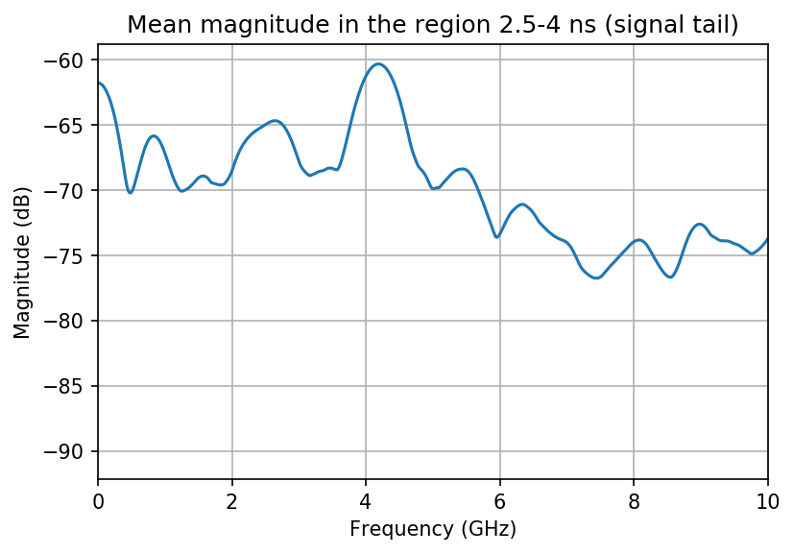
November data review
I am reviewing the data on the basis of Colin’s numerous comments
Looking back at the proton signal tail, it looks that there might be something around 4.2 GHz (averaging in f domain)
Electron signals processing optimisation is still ongoing

Slide 21
Additional headaches
CST simulations of the Cherenkov radiators
Idea: optimise a design to be tested at CLEAR
Hitting VERY hard the limitations of the code and of the CERN computing facilities
Limited to 2^31 =~ 2.3 billion cells (and trying to go to 400 GHz …)
Going higher requires MPI, that the IT plans to make available at some point on the cluster, unclear when. I don’t count on that.
The code struggles a lot with big field monitors. Even just saving the field in a cutting plane is 40 GB
VERY time consuming, simulations on the cluster ~18h, plus setup time, copy back and forth, and additional complication of a program running on windows locally and processing on linux in the cluster
The various file systems at CERN do not help at all
Next attempt using GDFIDL
No time to explore it yet
IPAC paper on the PS side is still taking time (mostly overnight)

Slide 22
Spare

Slide 23
