Slide 1

Status of the AWAKE eBPMs studies
2 April 2019
E. Senes, M. Krupa, L. Soby, M. Wendt
With many thanks to: A.M. Bachmann, P. Muggli, M. Martyanov, M. Huther F.M. Velotti, G. Papotti, C. Perry, P.N. Burrows

Slide 2
Outline
Recap of 2018 measurements
Protons
Electrons
Proton spectrum
Ideal case
Streak camera measurements
Run2 parameters
Simulations and measurements
Note on the beam pipe cutoff frequency
VNA simulations on a 60mm spare
Future measurements plan

Slide 3
Recap of 2018 measurements

Slide 4
eBPM measurements
Two plates of BPM51 were disconnected from the electronics and connected to a Lecroy SDA18000 oscilloscope.
The signals were attenuated to protect the scope from the proton signal
All the measurement are single shot (no averaging)
The measurements results are presented for discussions. Drawing final conclusions requires a more broad work, including simulations.
 | Single channel | Dual channel (CH1 – CH2)
Bandwidth | 18 GHz | 12 GHz – 6 GHz
Sampling rate | 60 GSa/s | 40 GSa/s – 20 Gsa/s
Resolution | 8 bits | 8 bits

Slide 5
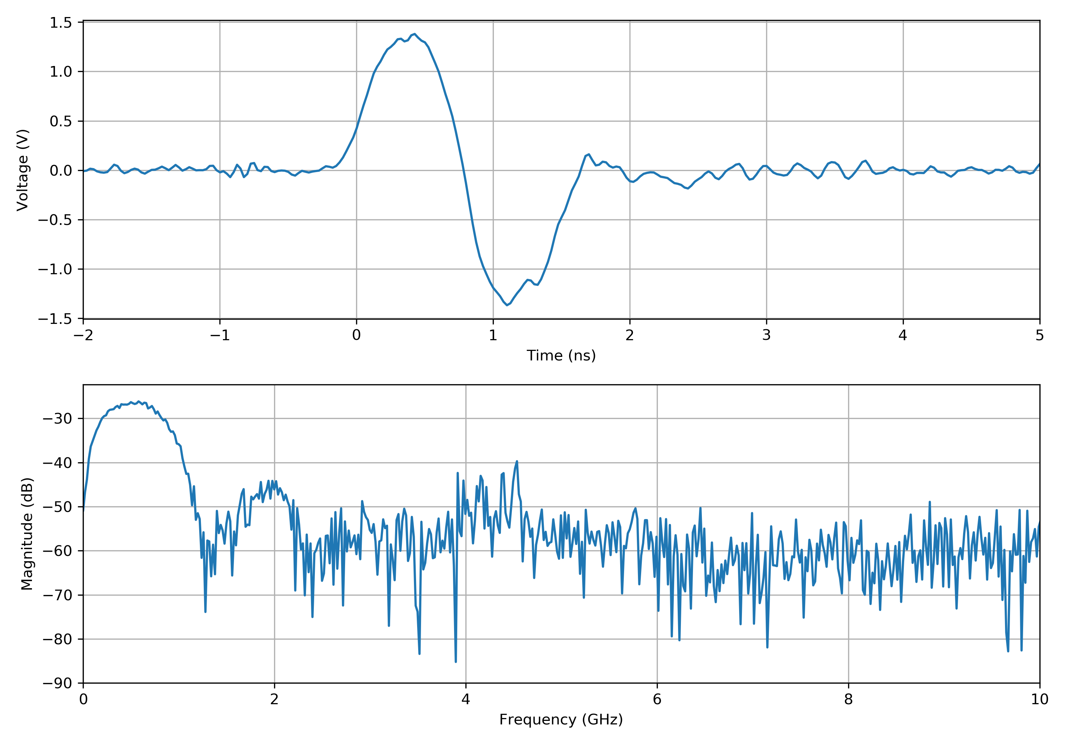
Proton beam measurements
Proton beam:
2e11 ppb
1 ns bunch length (4σ)
Most of the signal below the GHz

Slide 6
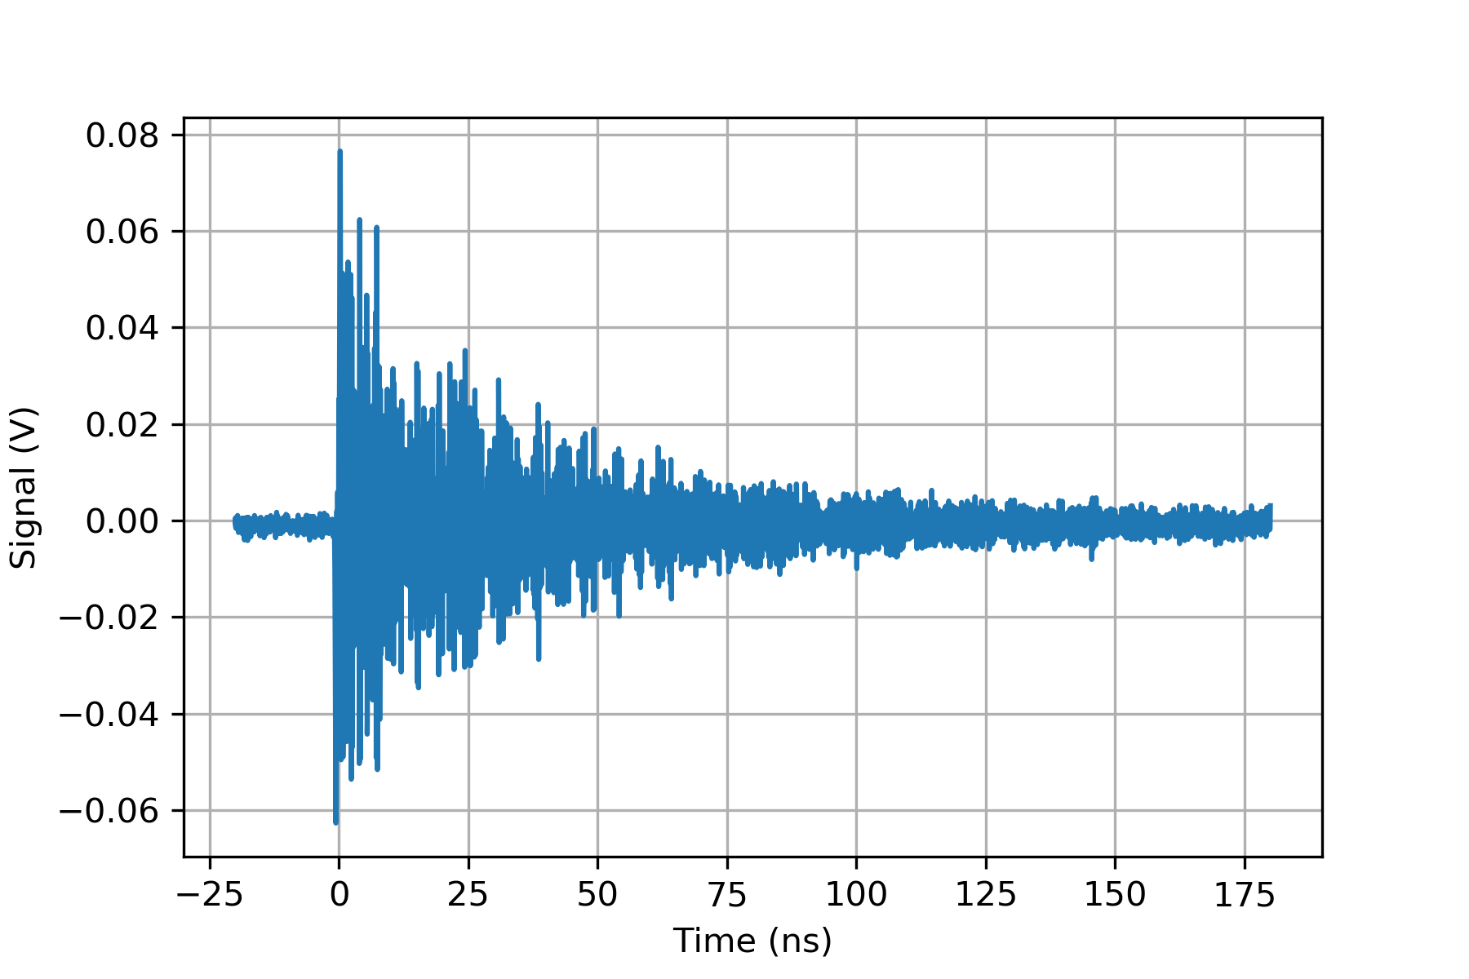
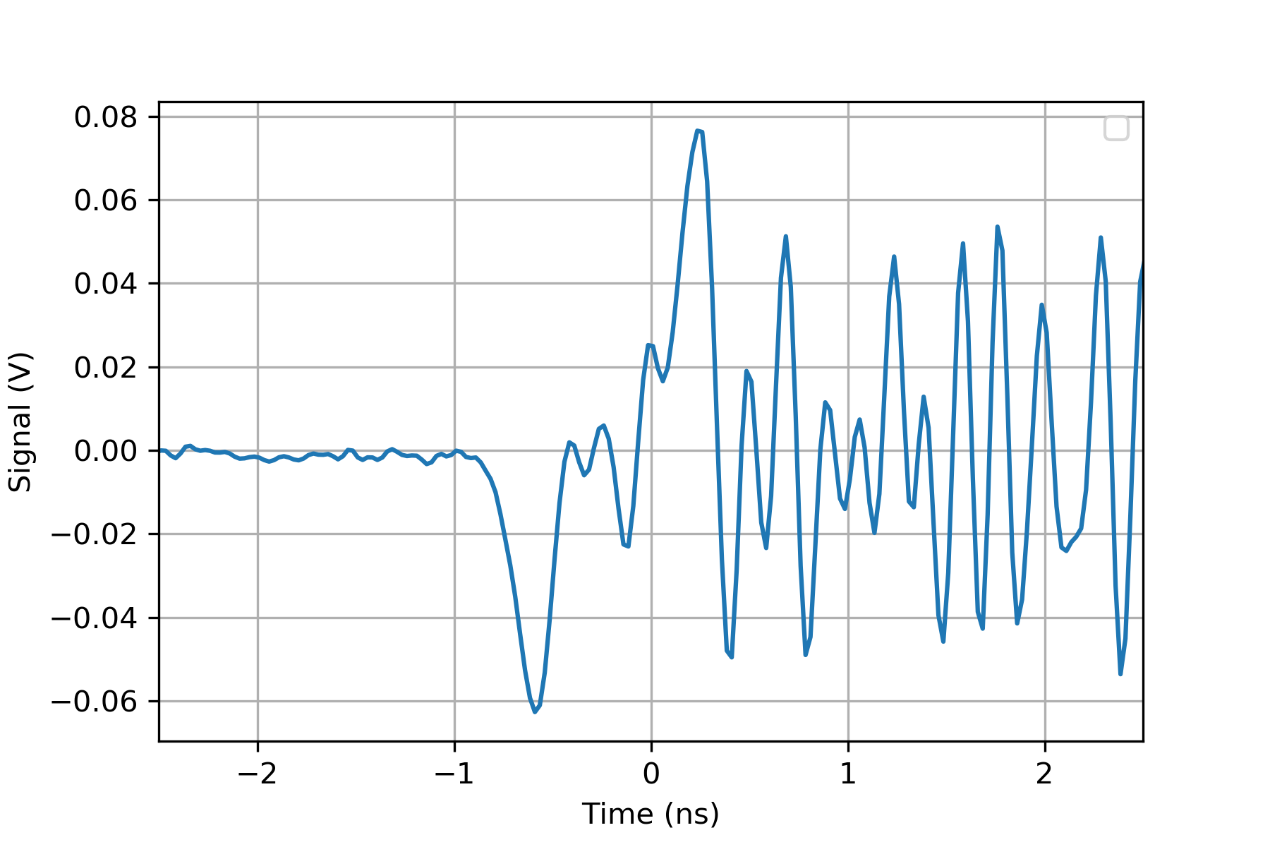
Electron beam measurements
Nominal electron beam:
600 pC bunch charge
4-6 ps bunch length (4σ)
The signal is visible, but followed by a resonance around 4-5 GHz

Slide 7
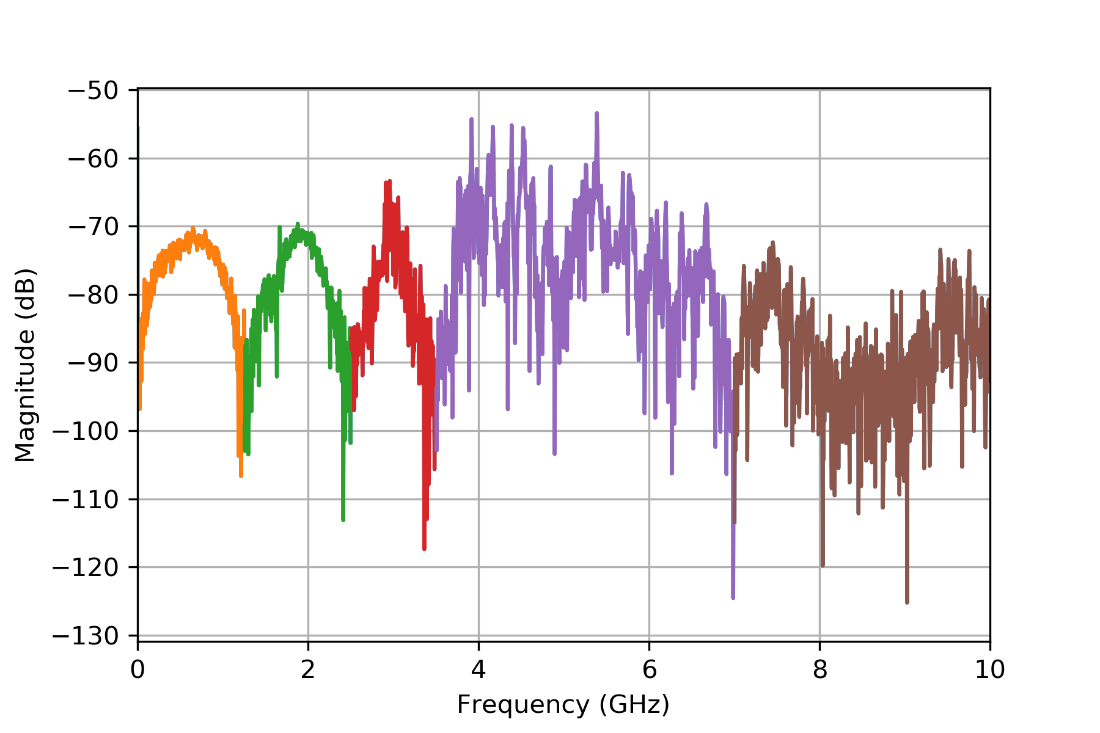
Electron beam measurements
Nominal electron beam:
As the beam component is constant up to 10s of GHz, the signal can be observed on the longer scale including the reflections
The dips in the spectrum are compatible with the pickup length
Three frequency intervals look interesting
0 – 1.25 GHz
1.25 – 2.5 GHz
2.5 – 3.5 GHz
Above 3.5 GHz mostly noise

Slide 8
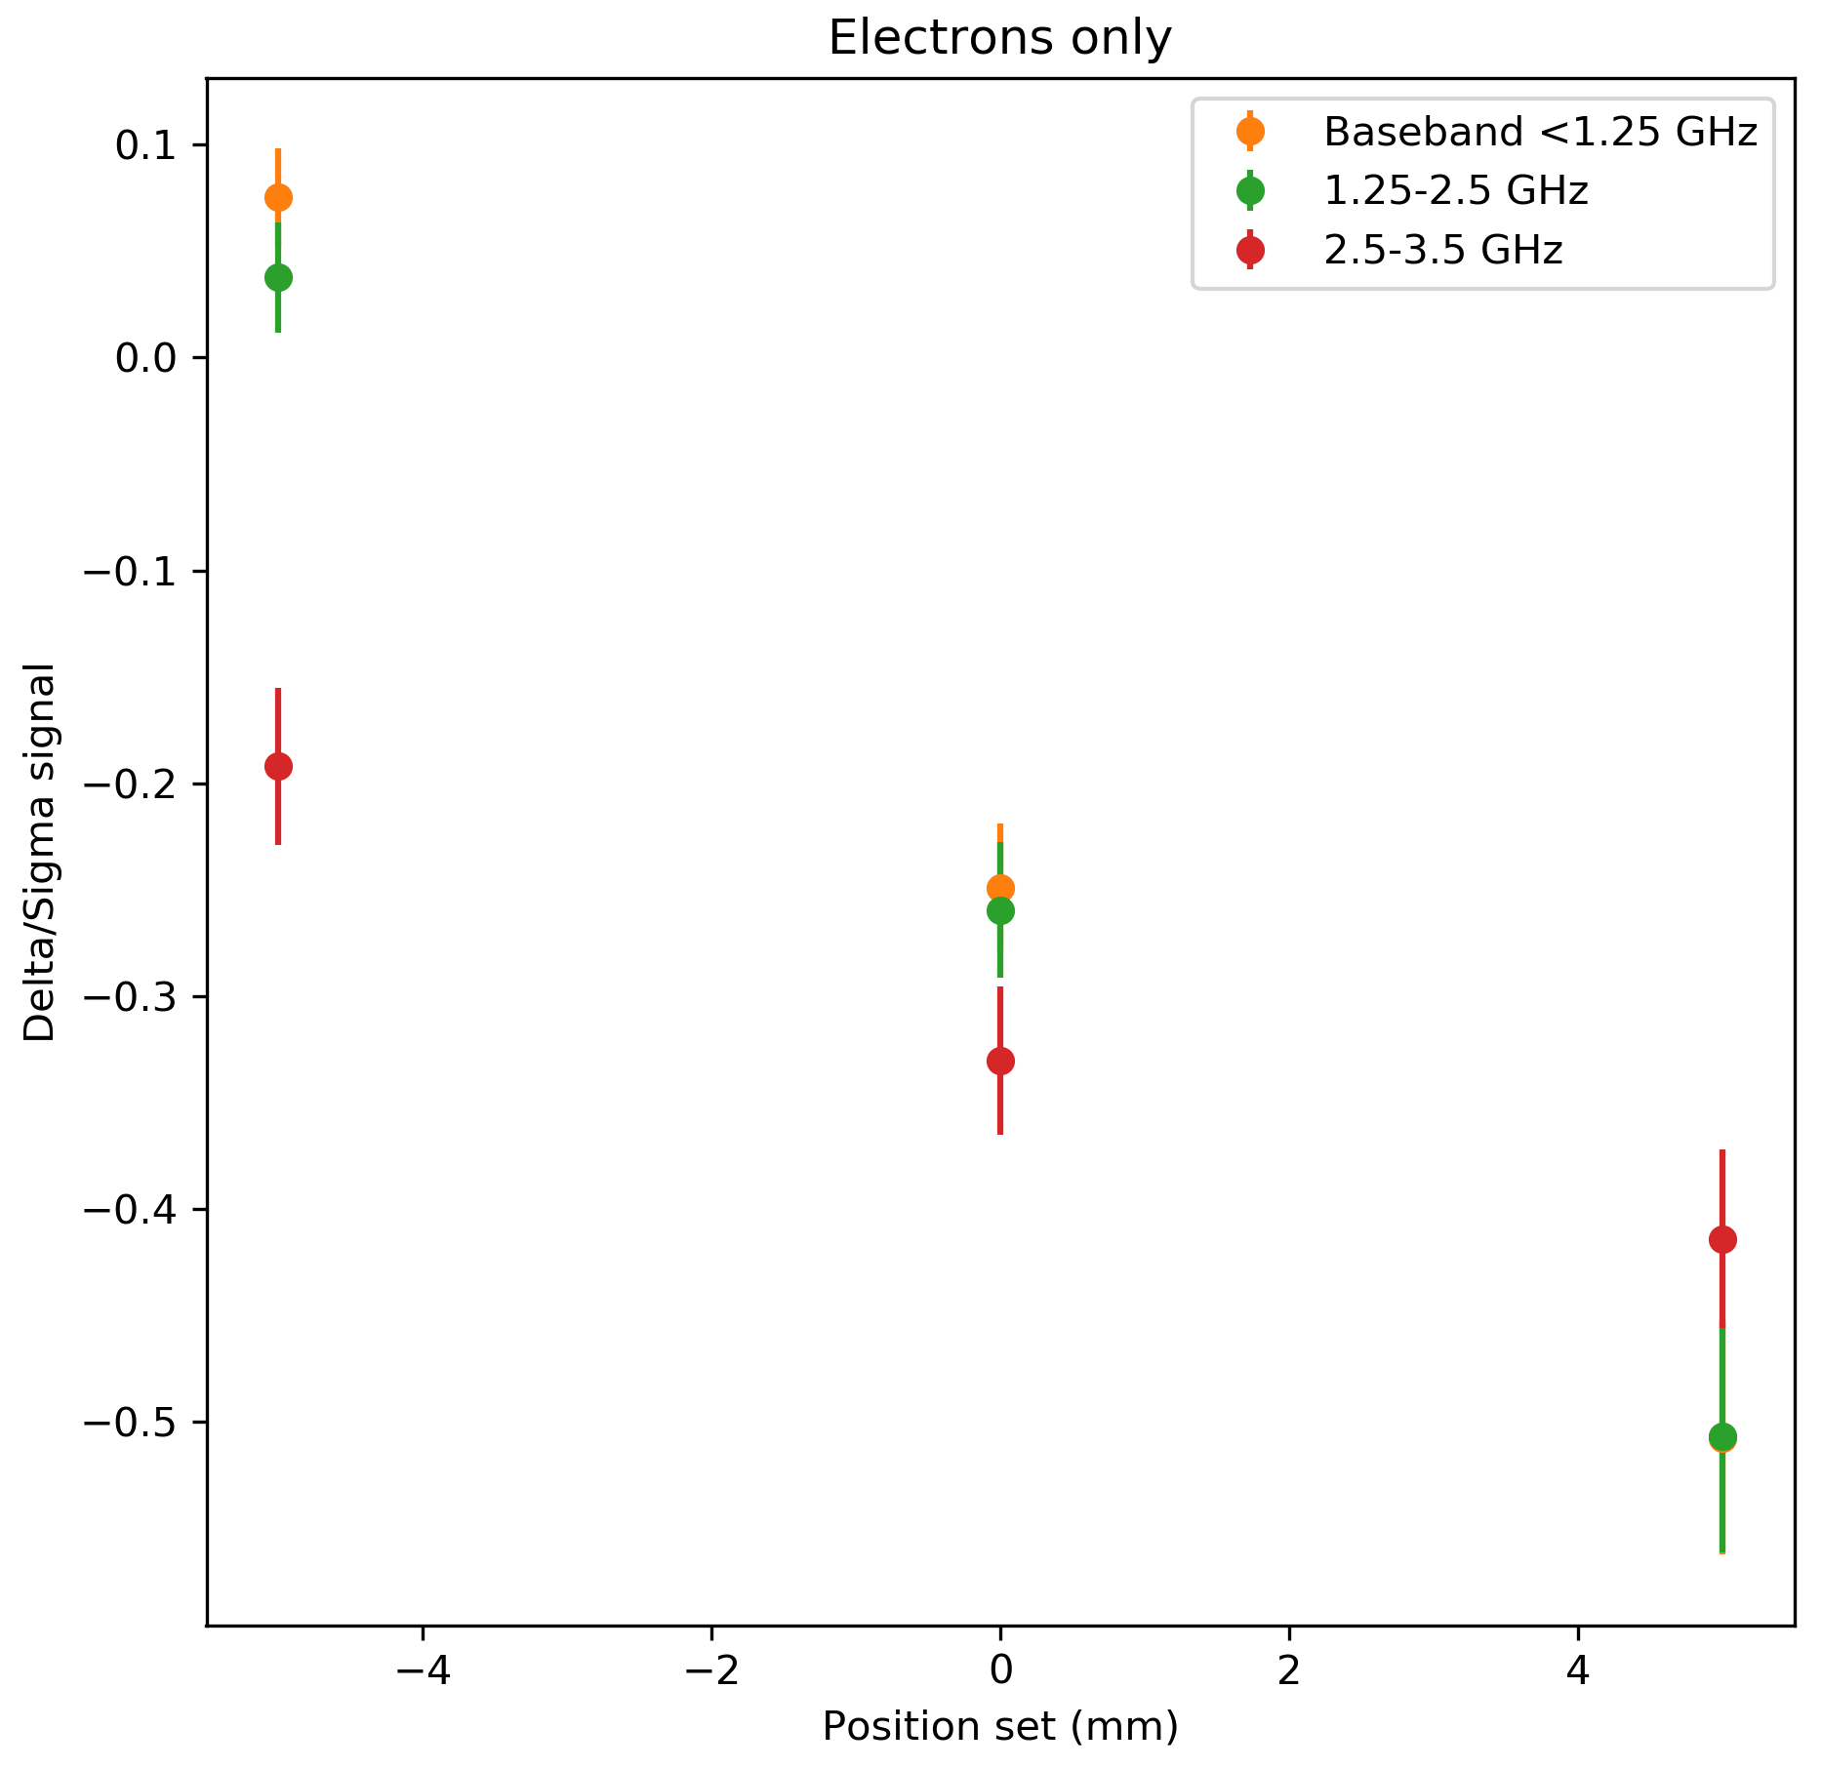
Electron beam measurements
Electron beam steering:
The electron beam was steered via YASP in the +/- 5 mm range
The first two frequency regions show clear dependency on the position of the Δ/Σ signal. The third one in a reduced scale.
Above the 3.5 GHz the position information is lost

Slide 9
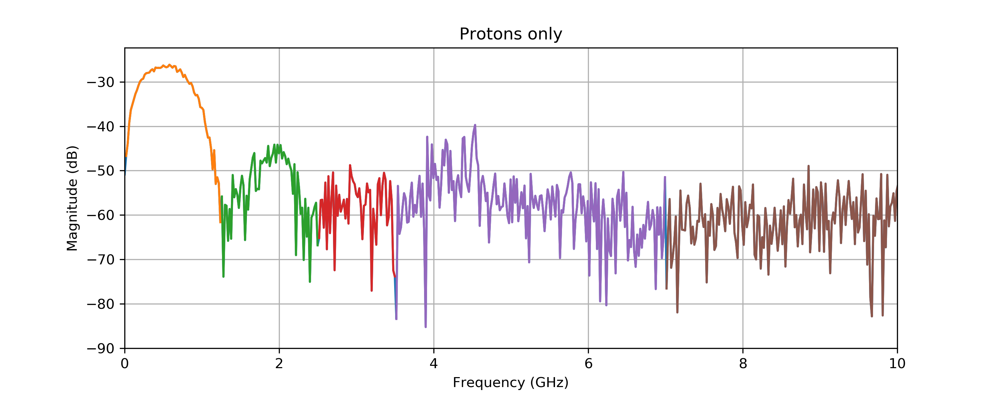
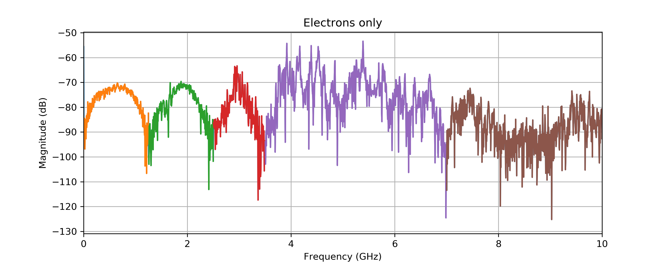
e⁻-p⁺ spectra comparison
Notes:
Cut at 10 GHz
Check if the data of the protons are ok or is it reduced sampling

Slide 10
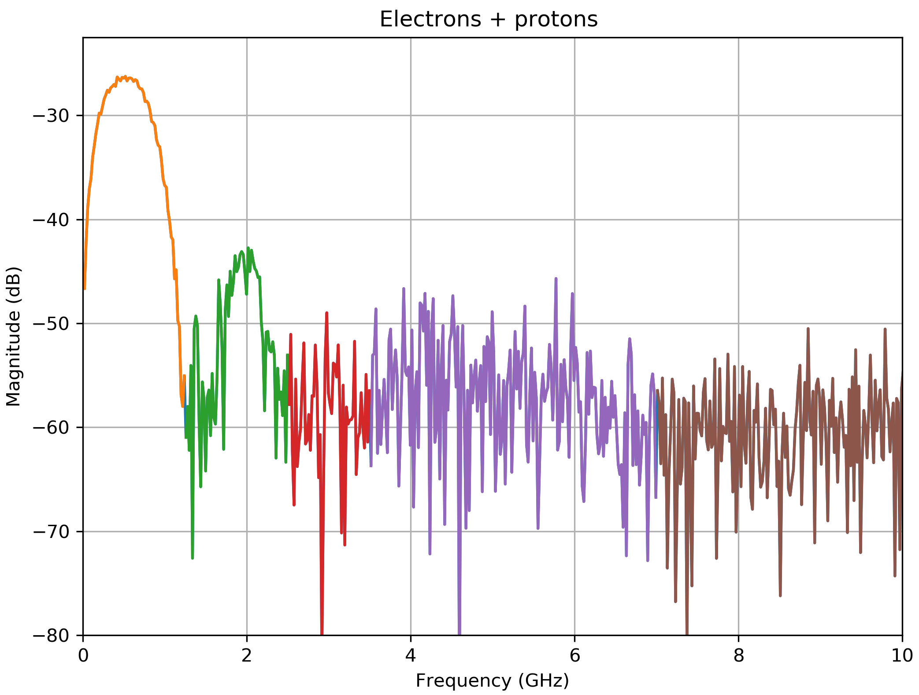
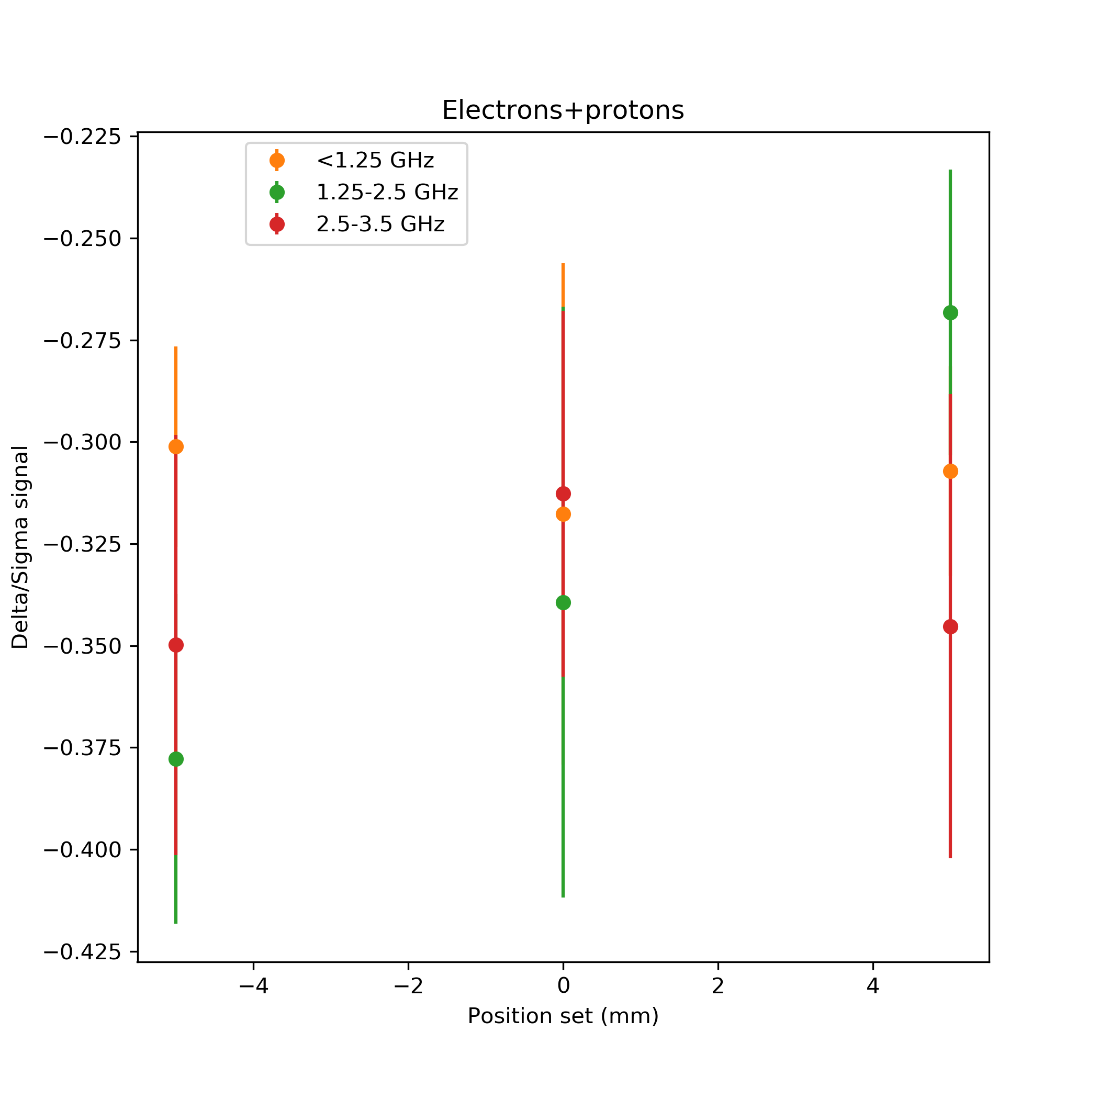
e⁻ and p⁺ together
Electron beam steering with proton presence:
The electron beam was steered via YASP in the +/- 5 mm range
Proton beam stayed in the centre due to the reduced time
In the orange region the signal of the protons dominates
Some dependence in the green band
Measurement limited by the dynamic range of the scope

Slide 11
Proton bunch spectrum

Slide 12
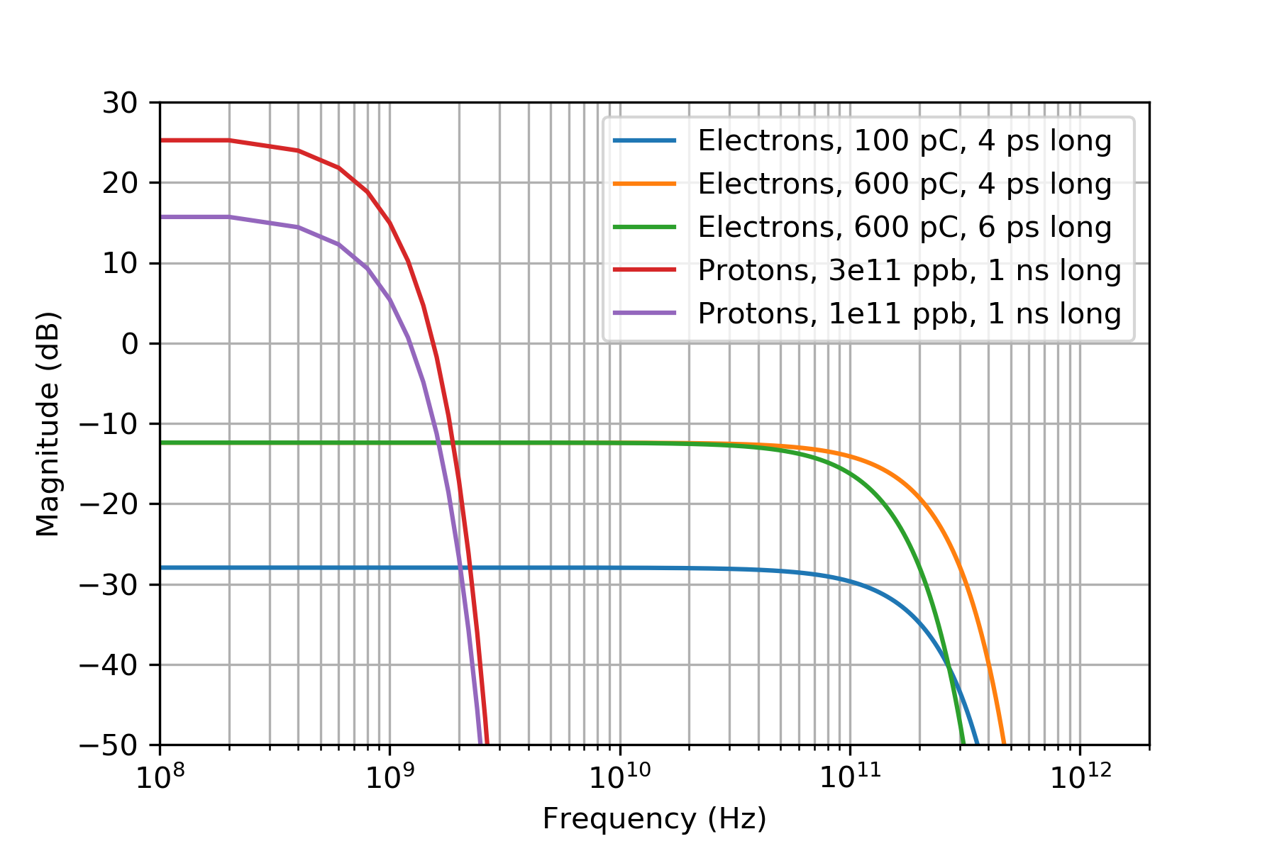
Proton spectrum: gaussian beams case
Gaussian case:
For the present setup:
3e11 protons
600 pC electrons
Expected 35-38 dB difference at zero frequency

Slide 13
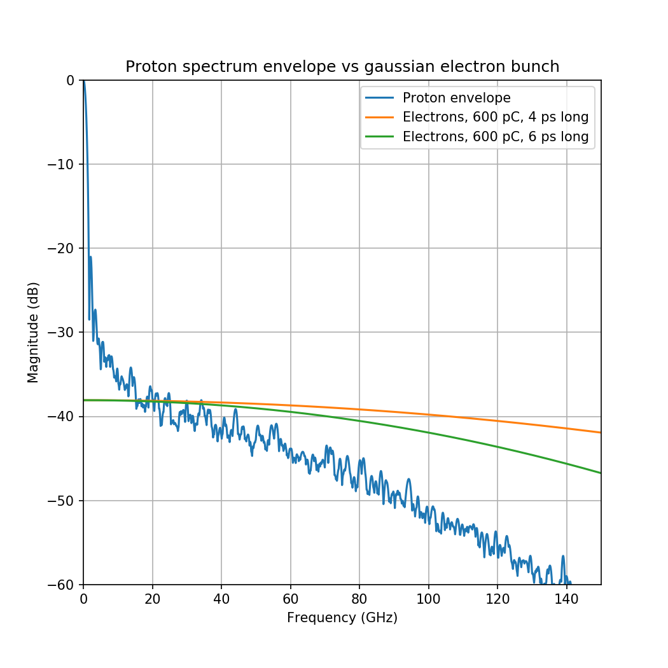
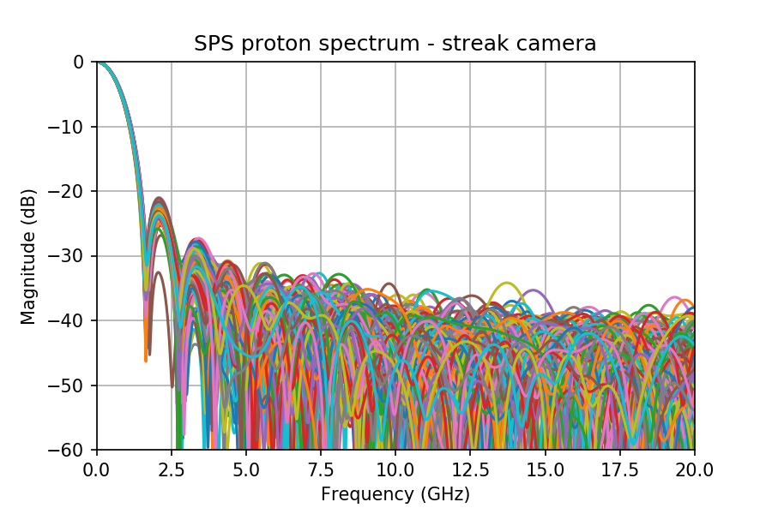
Streak camera measurements
Key question: how long does the proton spectrum extends in the frequency range ?

Slide 14
Streak camera reliability
The presence of a fine structure in the proton bunch is interesting for AWAKE as it might be the trigger for seeded instability
The streak camera has been well characterised in a master thesis work
K. Rieger, Streak cameras and optical transition radiation as a diagnostic for self-modulation of charged particle beams in plasmas, MSc. Thesis, TUM, Munich, Germany, January 2015
K. Rieger et al, GHz modulation detection using a streak camera: Suitablilty of streak cameras in the AWAKE experiment, Rev. of Scientific Instr. 88, 025110, 2017, corrected Jan. 2018
It concludes that the streak camera is capable of resolving light peaks up to ~300 GHz !
I will use the FFT of dark images to understand the effect of the instrument on the spectrum (frames from M.Huther)

Slide 15
Streak camera reliability
No suitable instrumentation is installed in the SPS to investigate in the tens of GHz regime.
WCM -3dB cutoff frequency is 2.2 GHz, and it is believed that it behaves well up to ~3.5 GHz ... Definitely not enough
Other instrumentation at AWAKE ? E.g. heterodyne system could be potentially used, but no protons anymore …
The validation of the reliability of the streak camera is pending. Hamamatsu experts have been pulled in the loop.
High frequency noise can be introduced by the nature of the streak camera measurement itself. Shot by shot use could be problematic. Normally a very low light is employed and the profiles are averaged in order to resolve the bunch length by fitting (chat with Stefano).
Does being able to resolve 300 GHz keep us safe from these HF components ?

Slide 16
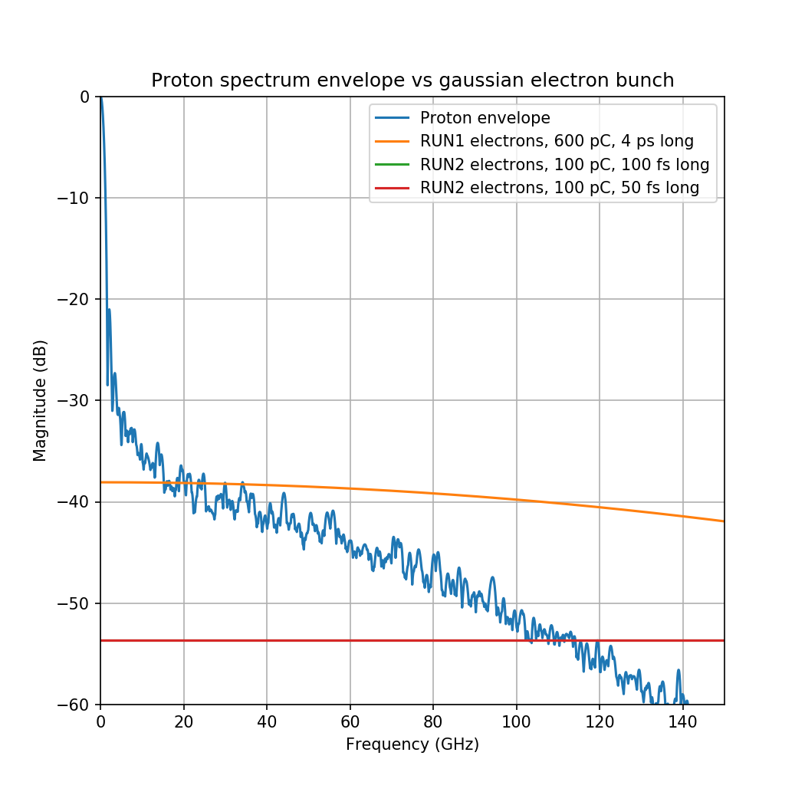
AWAKE run 2 parameters
The usual design parameter frequent variation problem with AWAKE persists. Assuming [1]:
Protons as today
3e11 ppb
1ns bunch length (4σ)
Electrons (worst case):
100 pC charge
50-100 fs bunch length(4σ)
At such parameters, the difference between protons and electrons (gaussian case) is ~55 dB !!
[1] K. Pipitone et al., The electron accelerators for the AWAKE experiment at CERN – Baseline and future developments, Nucl. Inst. and Methods A, 909 (2018) 102-106

Slide 17
Simulations and measurements

Slide 18
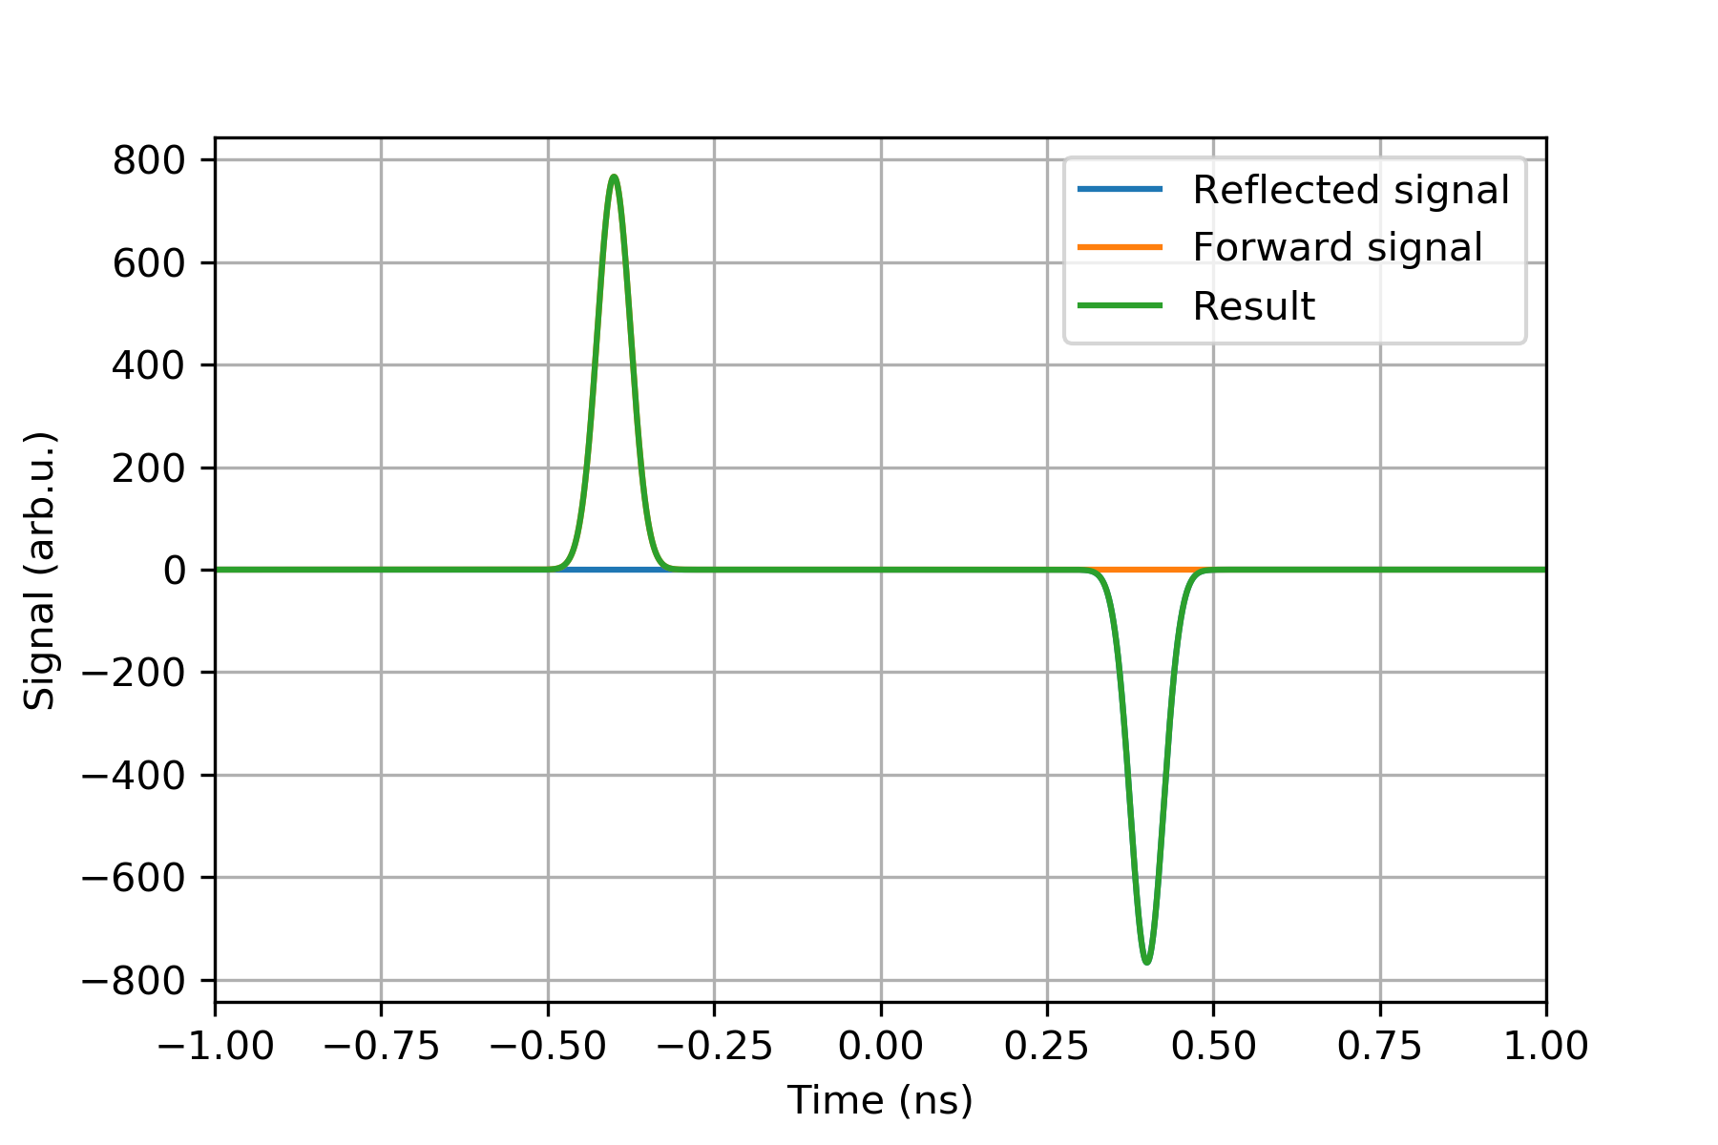
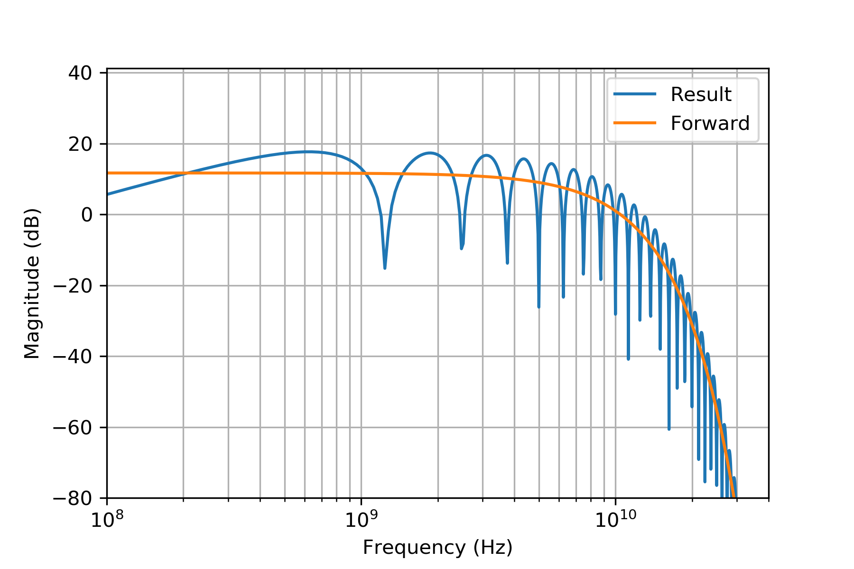
Beam pipe cutoff frequency
Many thanks to C. Perry for the numerous comments after the video meeting !
Note on the beam pipe size: every measurement is contaminated by reflections from the environment above the beam pipe cutoff frequency. For the current design:
Type | Stripline length | Beam pipe f_{cutoff} | Reflection distance | Lobe frequency
40 mm | 120 mm | 4.40 GHz | 800 ps | 1.25 GHz
60 mm | 126 mm | 2.93 GHz | 840 ps | 1.19 GHz

Slide 19
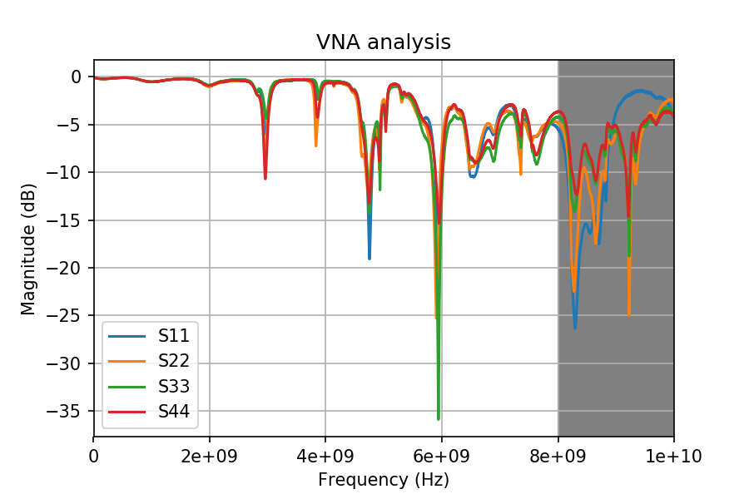
VNA measurements on a prototype
A 60 mm type eBPM protoype was tested in the lab
Installed in the tunnel before the AWAKE operation started
Then removed and brought to the lab
Absorptive foam in the beam pipe
One of the feedthrough seems to be bad (very sensible to mechanical stress)
Clockwise port numbering
Above 8 GHz, the measurement is sensitive to stress, cable positions

Slide 20
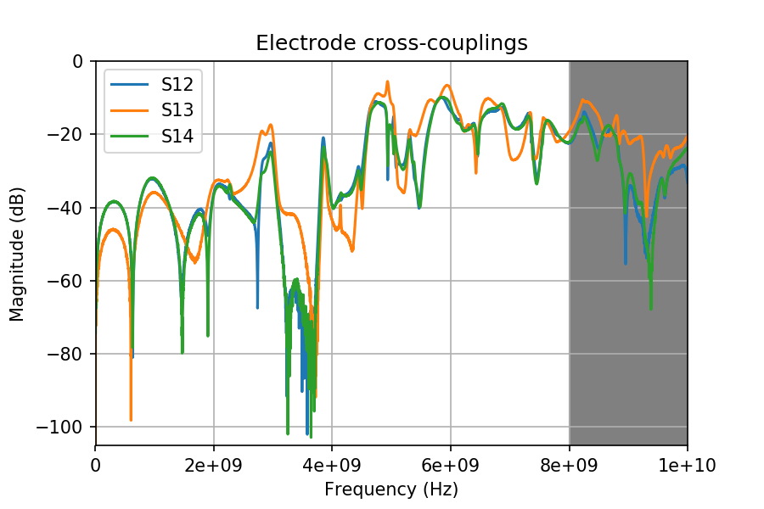
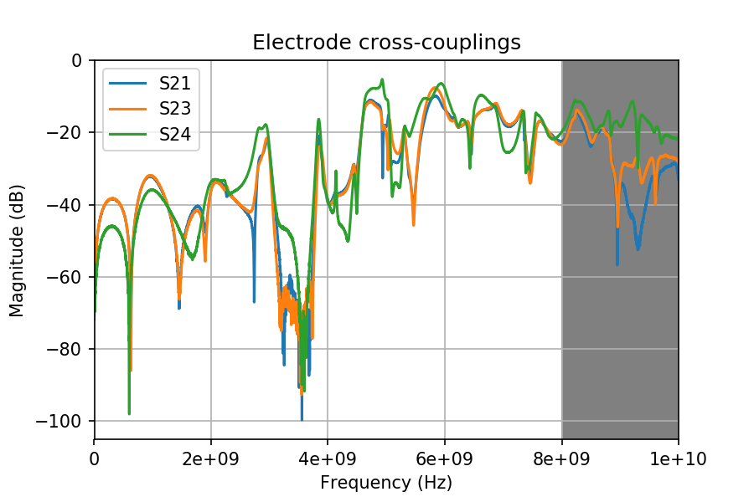
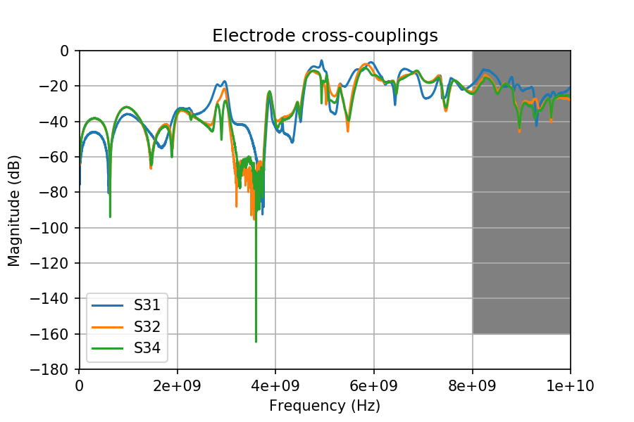
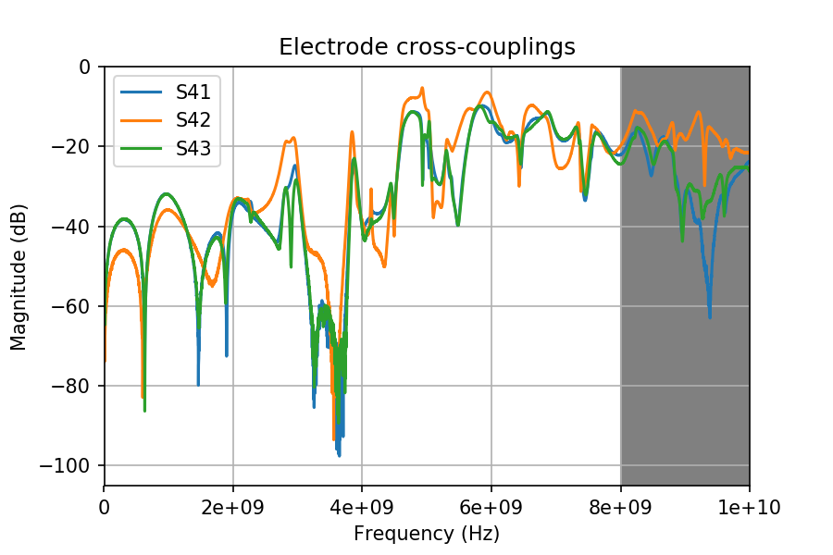
Electrodes cross-couplings

Slide 21
Comparison to CST simulation
The CST simulation of both the 60 mm and 40 mm version is running on the cluster right now
10 cells per wavelength, also for background
Keeps being a trouble for the meshing. Resubmitted again…

Slide 22
On the menu
Tunnel measurements (5th or 11th of April):
VNA measurement of a 60 mm pickup
VNA measurement of a 40 mm pickup
Streak camera with the LED system
Tunnel measurements (Summer run):
Scope measurements of the same 60 mm pickup
Electrons only (with steering)
Electrons + laser
Electrons + Rb vapour
Electrons + laser + Rb plasma
Eventual scope measurement of the 40 mm pickup (requires cabling work !, under discussion a.t.m.)

Slide 23
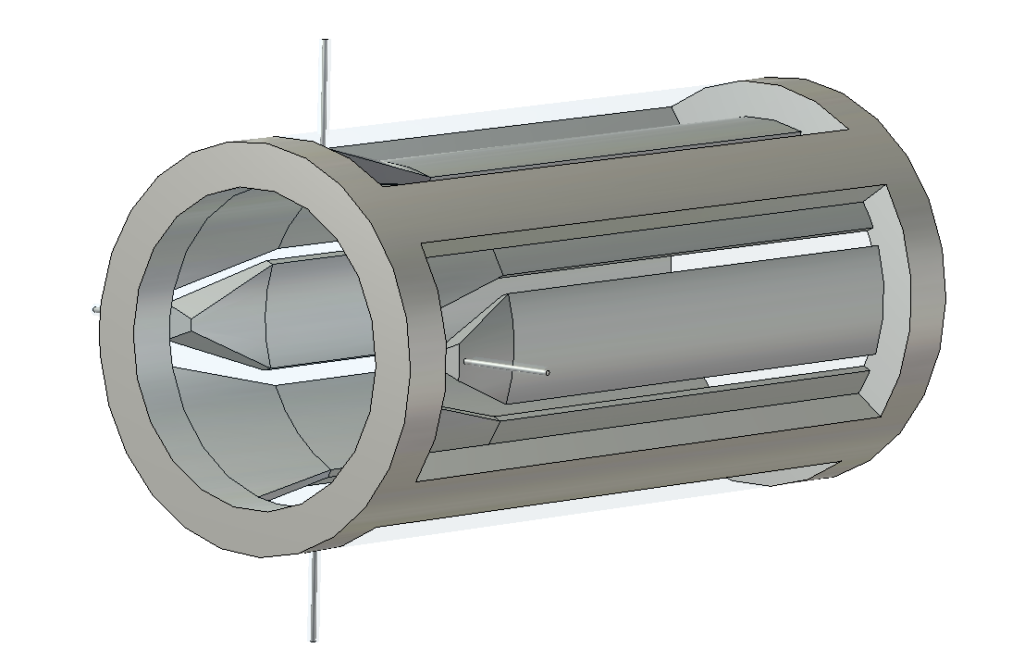
EM simulation of the present 60 mm design
3D model of the BPM was developed
Fully parametric
Simulated:
Wakefield
TDR
S parameters (running …)

Slide 24
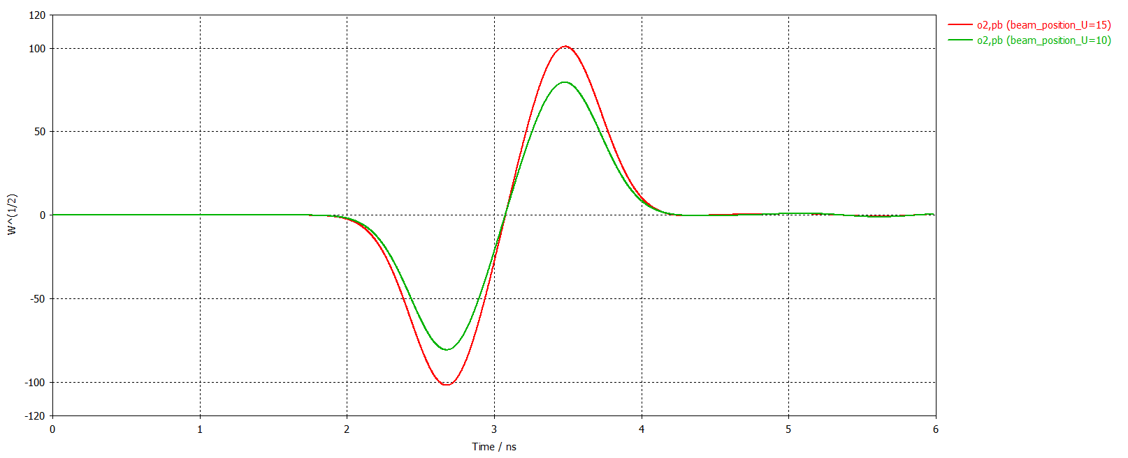
Wakefield simulations
Simulate the beam effect
Only gaussian beams
Only one beam at the time
Parameters explored
Nominal protons
3e11 ppb
75 mm sigma
Nominal protons/10
Nominal protons/100
Electrons 600 pC, 4 ps

Slide 25
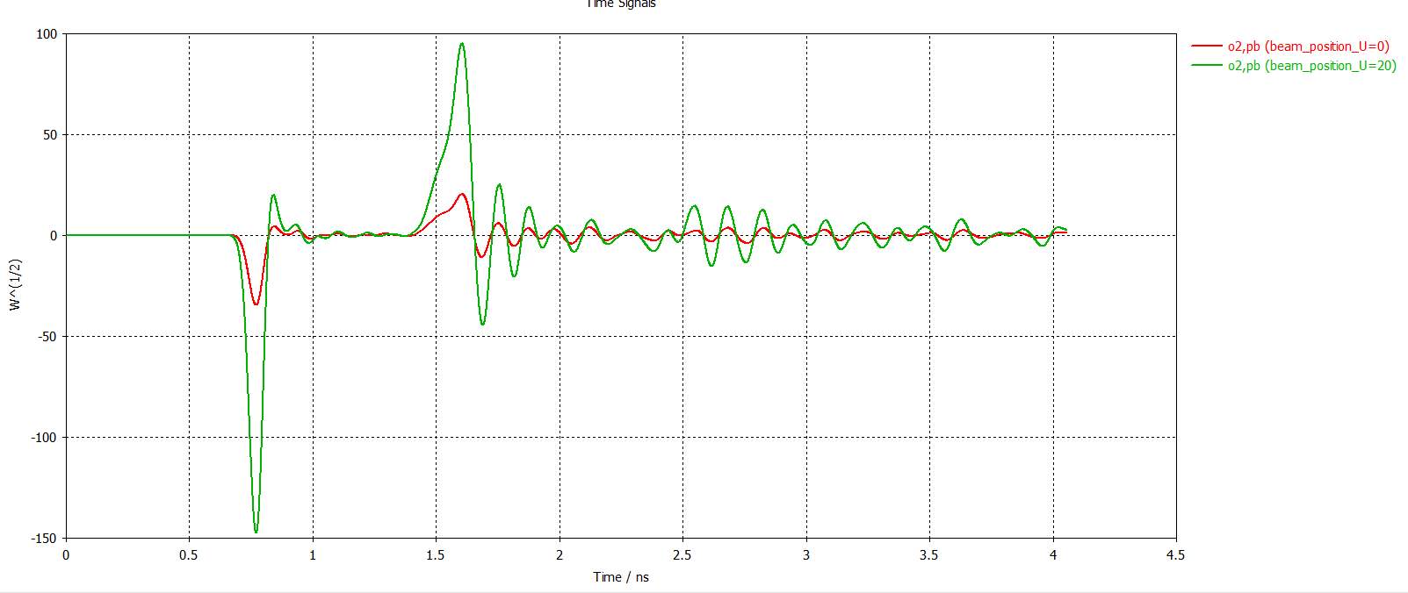
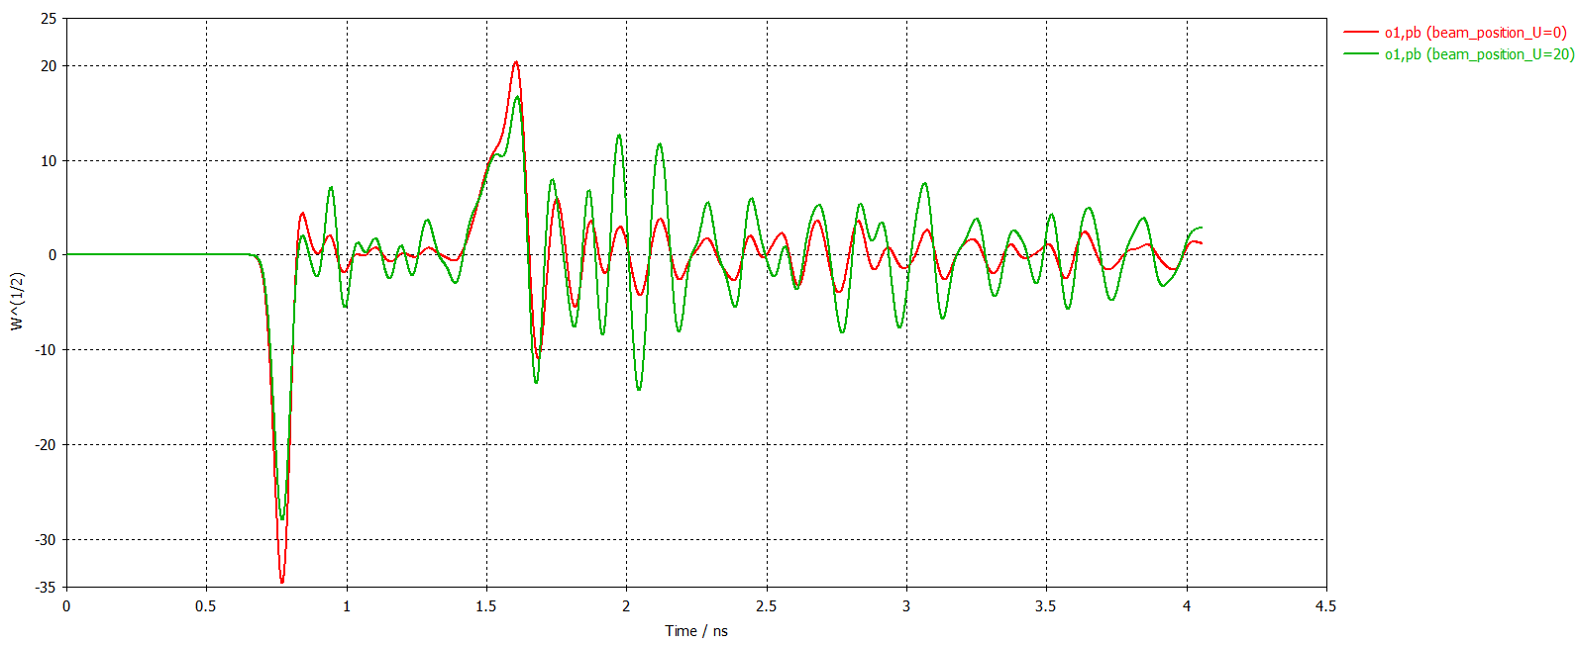
Wakefield simulations
Troubles start at already protons/10
Will submit the electron simulation soon with real parameters
The resonance pattern starts to be visible, and we are in open z-bundaries
Signal still dependent on the position

Slide 26
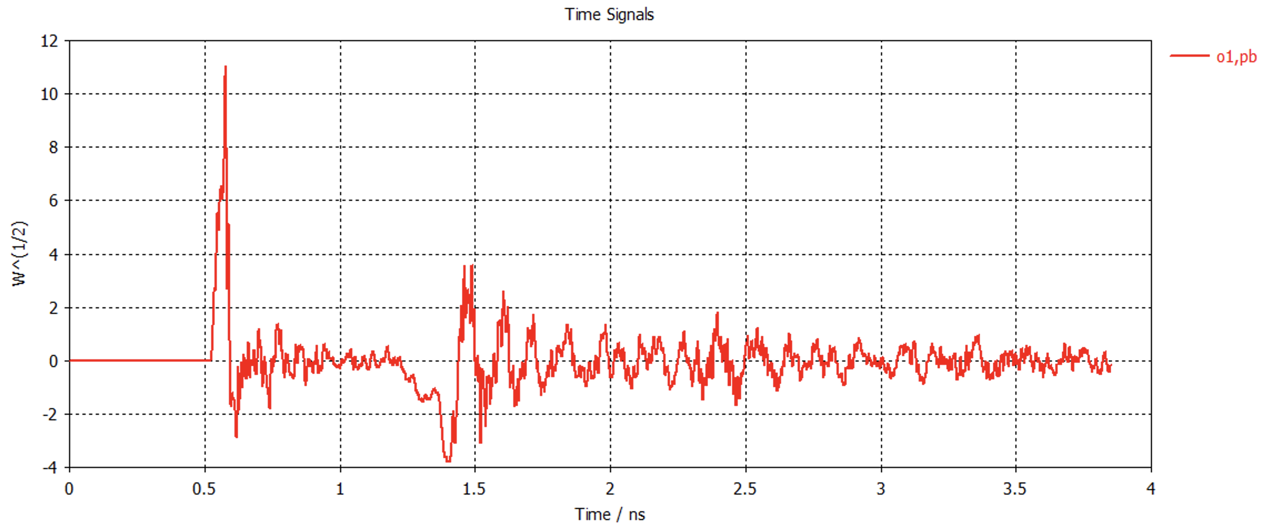
Real electron beam parameters
SIMULATION
MEASUREMENT
Wakefield simulation
5 cell/wavelength (10 cells submitted)
600 pC
4 ps bunch length

Slide 27
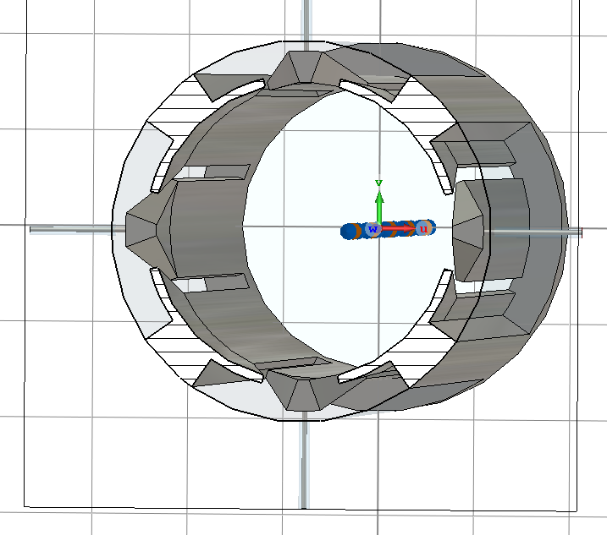
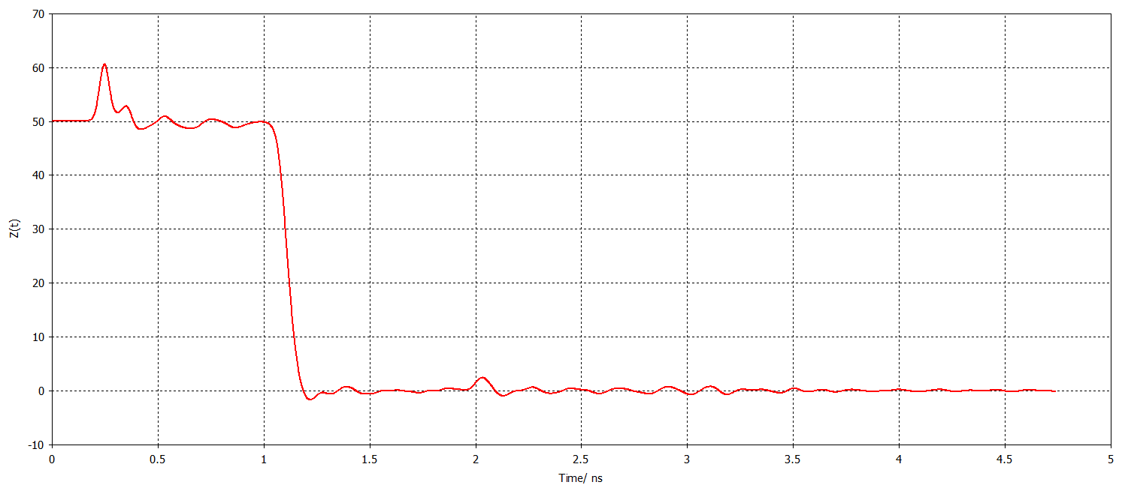
TDR simulations
Was the design simulated before the realisation ?
The end of the stripline is generally problematic. A not careful design can lead to resonances due to the impedance mismatch
TDR analysis done (generally up to 15 GHz) and parameter sweep
No sensible variation of the wakefield simulation using optimised parameters

Slide 28
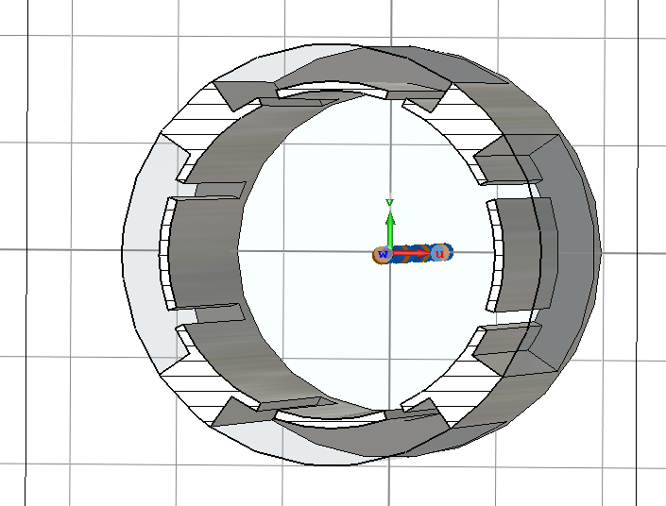
Impact of the cavity behind the stripline
This design was never simulated before realisation
The cavity behind the stripline can be resonating
After optimisation (wakefield sim.), the smaller the better
The slot size can be changed also
Every optimisation changes the capacitive coupling of the stripline
Still, no sensible variation of the wakefield simulation using optimised parameters

Slide 29
Spare

