Slide 1

Status of the AWAKE eBPMs studies
-
Streak camera reference measurement
July 2019
E. Senes, A.M. Bachmann, I. Gorgisyan, M. Krupa,
S. Mazzoni, J. Moody, M. Wendt
With many thanks to: E. Granados, H. Panuganti

Slide 2
Outline
Recap - motivation
Streak camera reference measurements
  Asynchronous
  Simultaneous

Slide 3
Recap

Slide 4
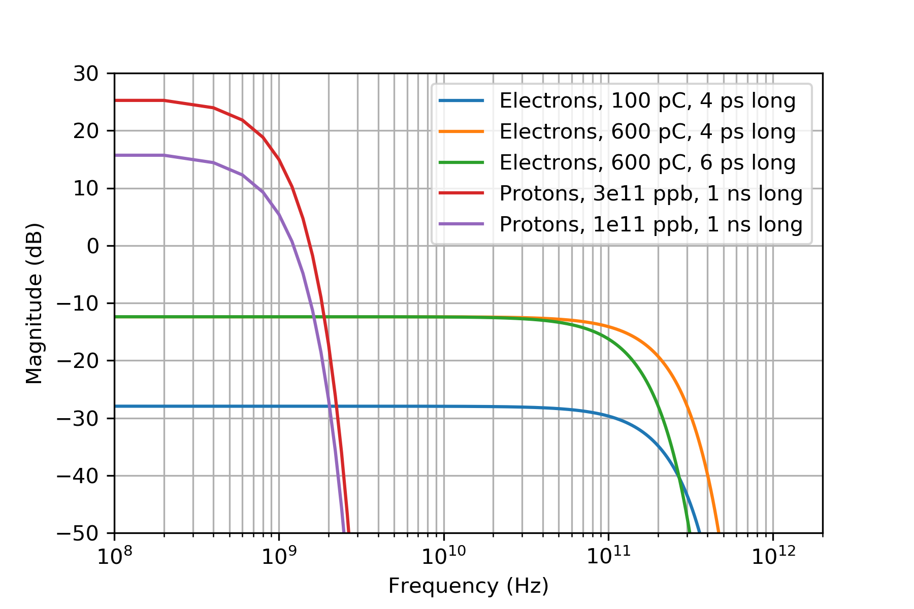
Proton spectrum: gaussian beams case
Gaussian case:
For the present setup:
3e11 protons
600 pC electrons
Expected 35-38 dB difference at zero frequency

Slide 5
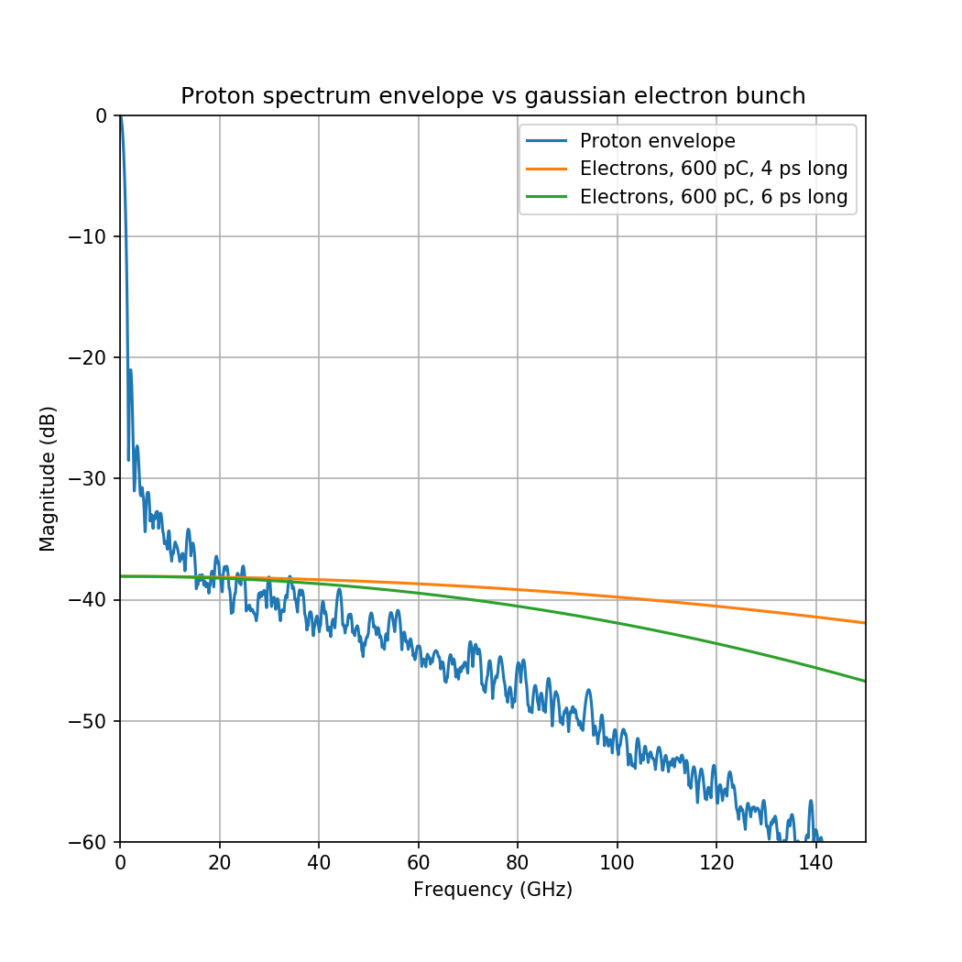
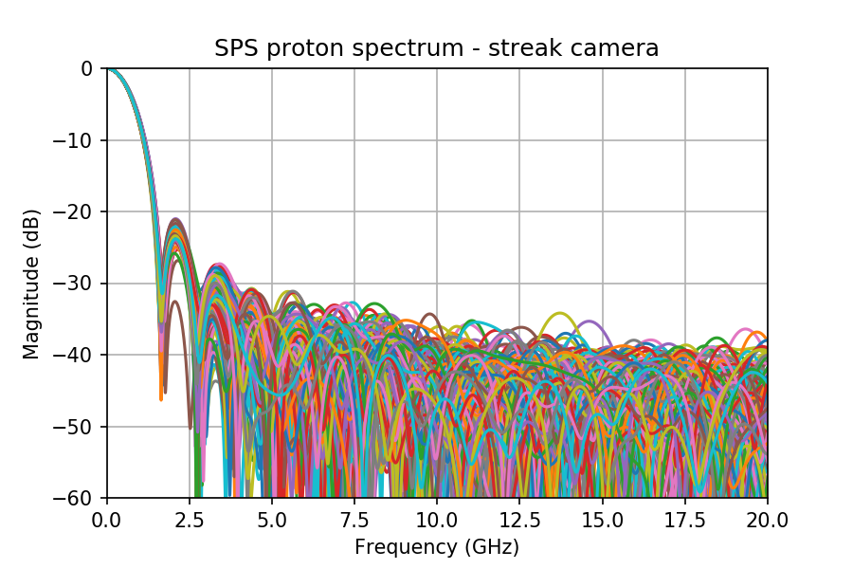
Streak camera measurements
Key question: how long does the proton spectrum extends in the frequency range ?

Slide 6
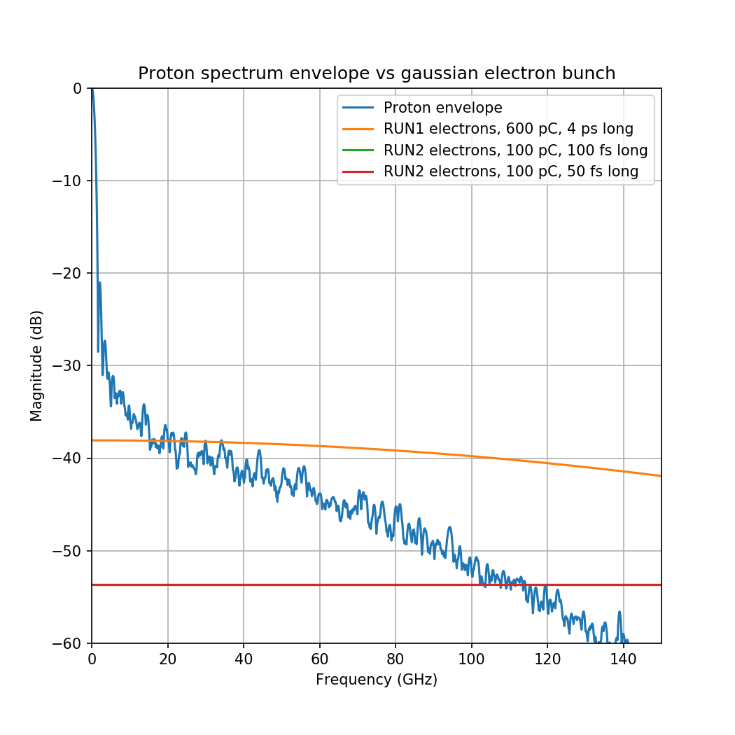
AWAKE run 2 parameters
Assuming the scenario in [1]:
  Protons as today
    3e11 ppb
    1ns bunch length (4σ)
  Electrons (worst case):
    100 pC charge
    50-100 fs bunch length(4σ)
At such parameters, the difference between protons and electrons (gaussian case) is ~55 dB !!
[1] K. Pipitone et al., The electron accelerators for the AWAKE experiment at CERN – Baseline and future developments, Nucl. Inst. and Methods A, 909 (2018) 102-106

Slide 7
Streak camera reliability
No suitable instrumentation is installed in the SPS to investigate in the tens of GHz regime.
  WCM -3dB cutoff frequency is 2.2 GHz, and it is believed that it behaves well up to ~3.5 GHz ... Definitely not enough
The validation of the reliability of the streak camera is pending.
  No luck from the Hamamatsu experts contribution
  High frequency noise can be introduced by the nature of the streak camera measurement itself.
  Shot by shot use could be problematic. Normally a very low light is employed and the profiles are averaged in order to resolve the bunch length by fitting.
  Does being able to resolve 300 GHz keep us safe from these HF components ?

Slide 8
Streak camera reference measurements

Slide 9
Setup
Laser system
10 Hz
TTL
%10 freq divider
Stanford delay box
Laser beam 780 ns extracted before the compressor
  Pulse FWHM 250 ps
  Transported at full power to the streak room optical table
Simultaneous measurement of the profile via
  Streak camera
  Ultrafast photodiode (>7 GHz BW)
Laser
beamline
~30-40 m
Beam
splitter
OD5.1
filter
Beam
splitter
8%
92%
Streak camera
92%
8%
x
IRIS
OD1
filter
Laser
dump
Ultrafast photodiode
Oscilloscope

Slide 10
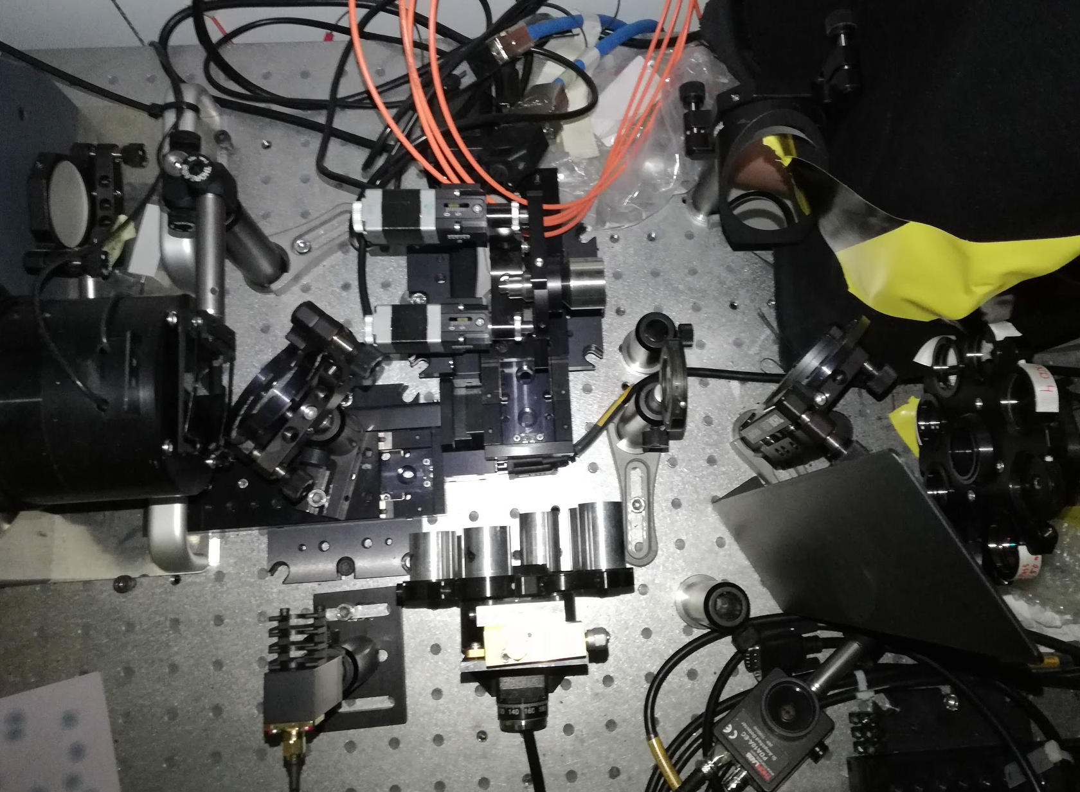
Setup (2)
Laser from
the marker beamline
Streak
filter
Beam
splitter
Streak
camera
Iris
Beam
splitter
Ultrafast
photodiode

Slide 13
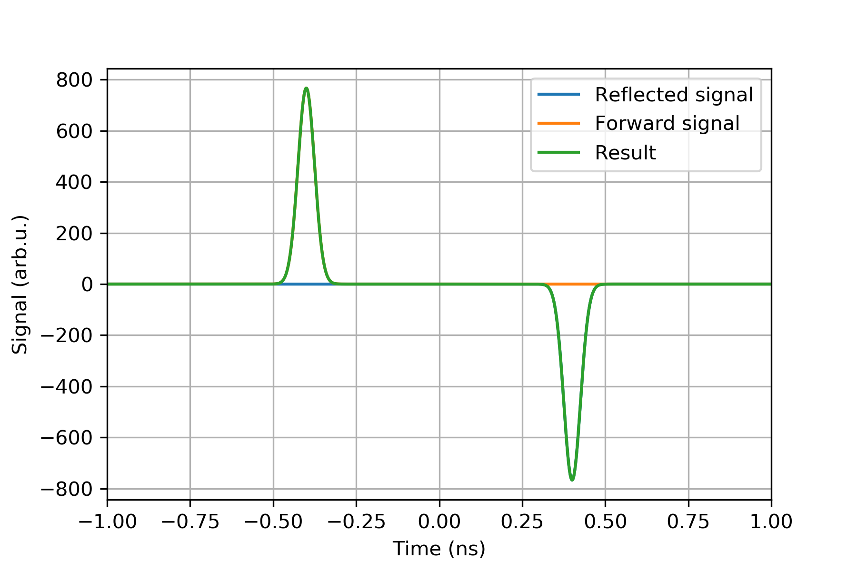
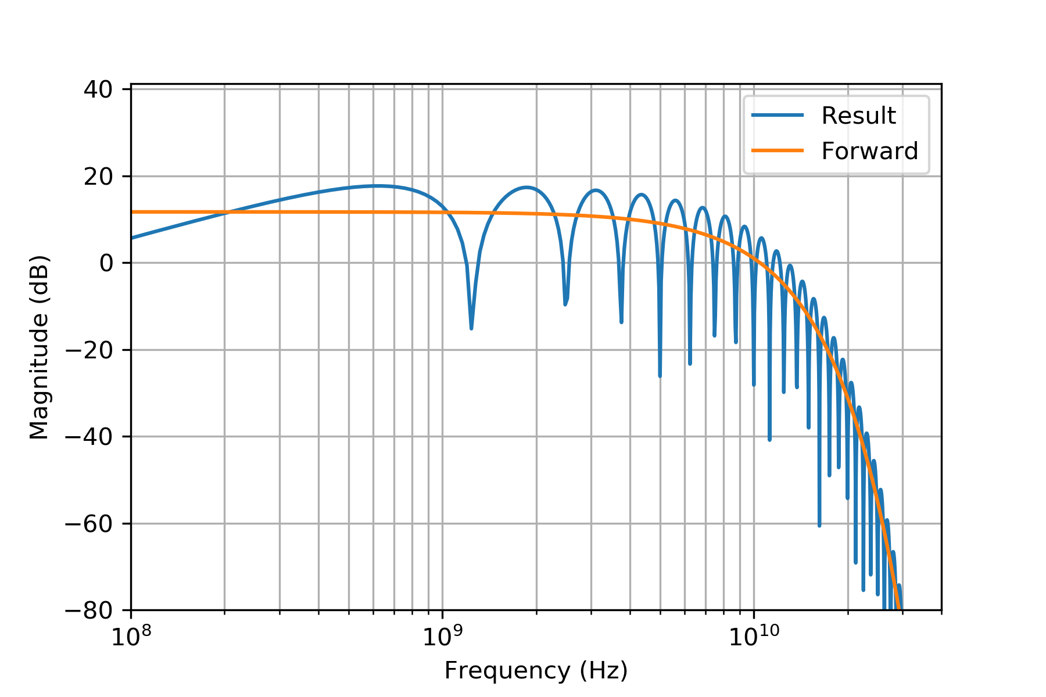
Beam pipe cutoff frequency
Many thanks to C. Perry for the numerous comments after the video meeting !
Note on the beam pipe size: every measurement is contaminated by reflections from the environment above the beam pipe cutoff frequency. For the current design:
Type | Stripline length | Beam pipe f_{cutoff} | Reflection distance | Lobe frequency
40 mm | 120 mm | 4.40 GHz | 800 ps | 1.25 GHz
60 mm | 126 mm | 2.93 GHz | 840 ps | 1.19 GHz

Slide 14
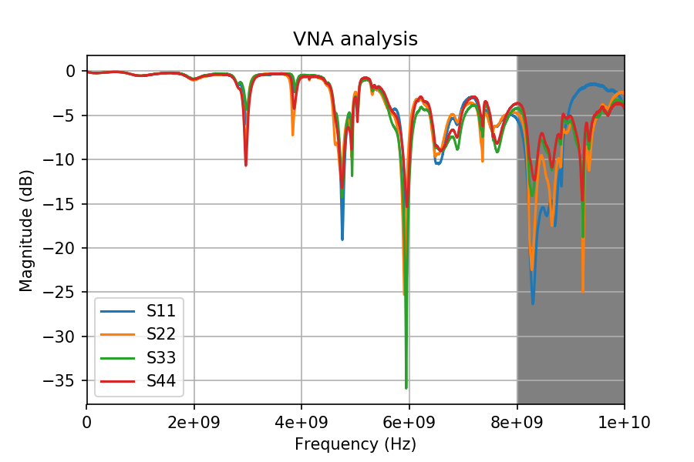
VNA measurements on a prototype
A 60 mm type eBPM protoype was tested in the lab
  Installed in the tunnel before the AWAKE operation started
  Then removed and brought to the lab
Absorptive foam in the beam pipe
One of the feedthrough
seems to be bad (very
sensible to mechanical
stress)
Clockwise port
numbering
Above 8 GHz, the
measurement is
sensitive to stress,
cable positions

Slide 15
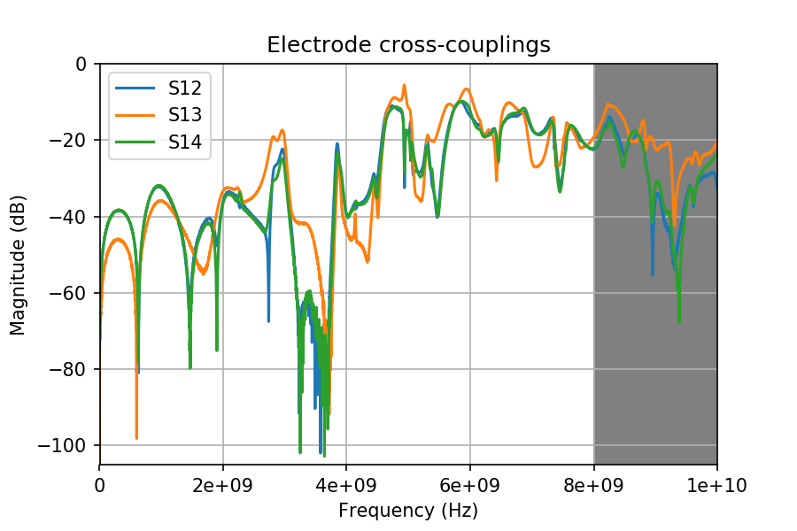
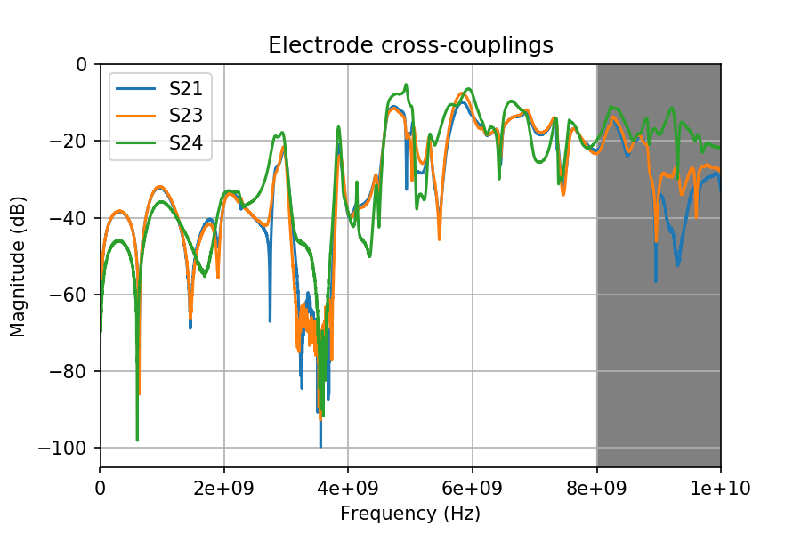
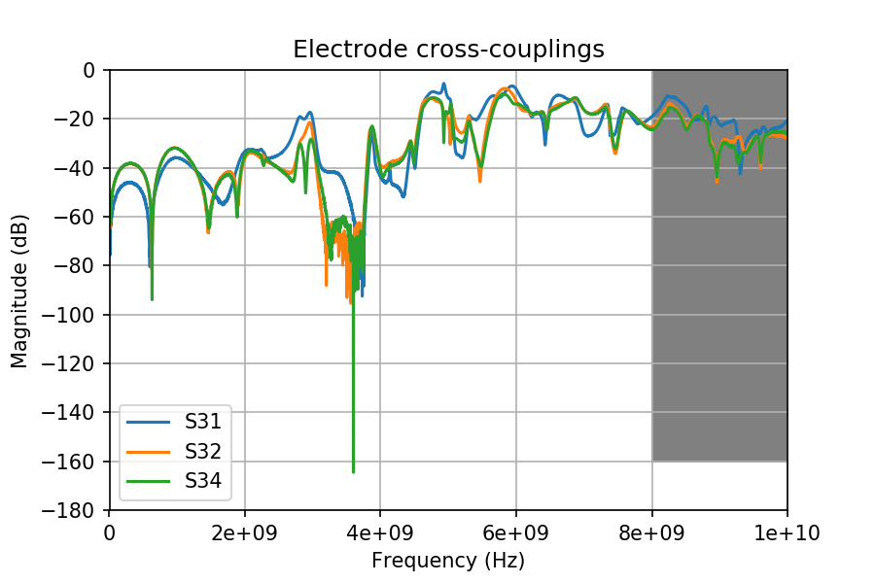
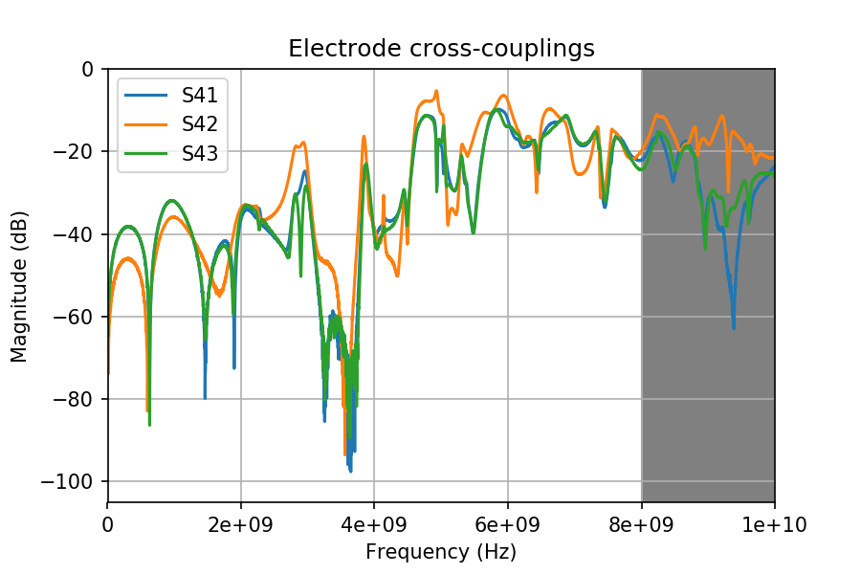
Electrodes cross-couplings

Slide 16
Comparison to CST simulation
The CST simulation of both the 60 mm and 40 mm version is running on the cluster right now
  10 cells per wavelength, also for background
    Keeps being a trouble for the meshing. Resubmitted again…

Slide 17
On the menu
Tunnel measurements (5th or 11th of April):
VNA measurement of a 60 mm pickup
VNA measurement of a 40 mm pickup
Streak camera with the LED system
Tunnel measurements (Summer run):
Scope measurements of the same 60 mm pickup
  Electrons only (with steering)
  Electrons + laser
  Electrons + Rb vapour
  Electrons + laser + Rb plasma
Eventual scope measurement of the 40 mm pickup (requires cabling work !, under discussion a.t.m.)

Slide 18
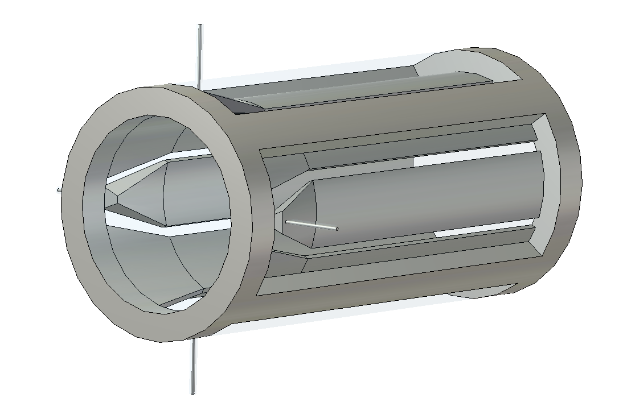
EM simulation of the present 60 mm design
3D model of the BPM was developed
Fully parametric
Simulated:
Wakefield
TDR
S parameters (running …)

Slide 19
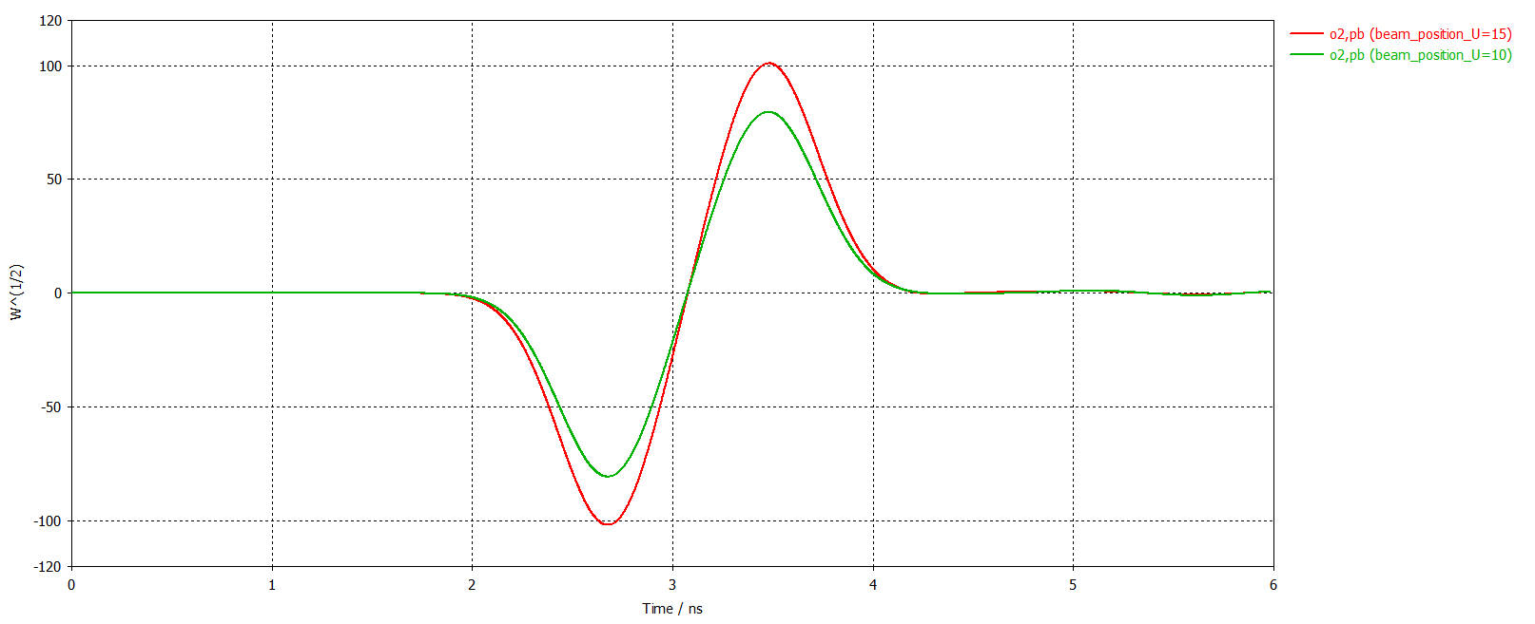
Wakefield simulations
Simulate the beam effect
  Only gaussian beams
  Only one beam at the time
Parameters explored
  Nominal protons
    3e11 ppb
    75 mm sigma
  Nominal protons/10
  Nominal protons/100
  Electrons 600 pC, 4 ps

Slide 20
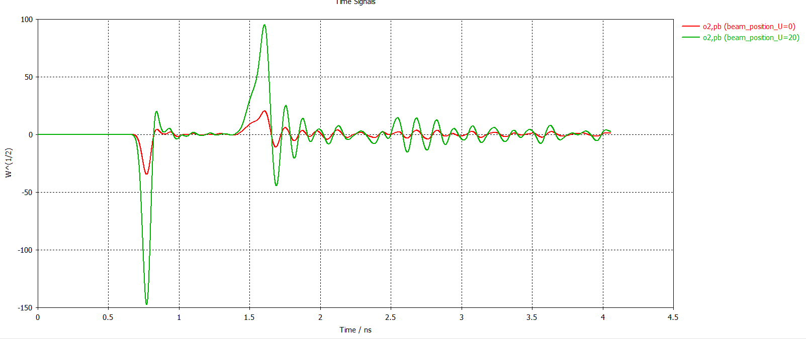
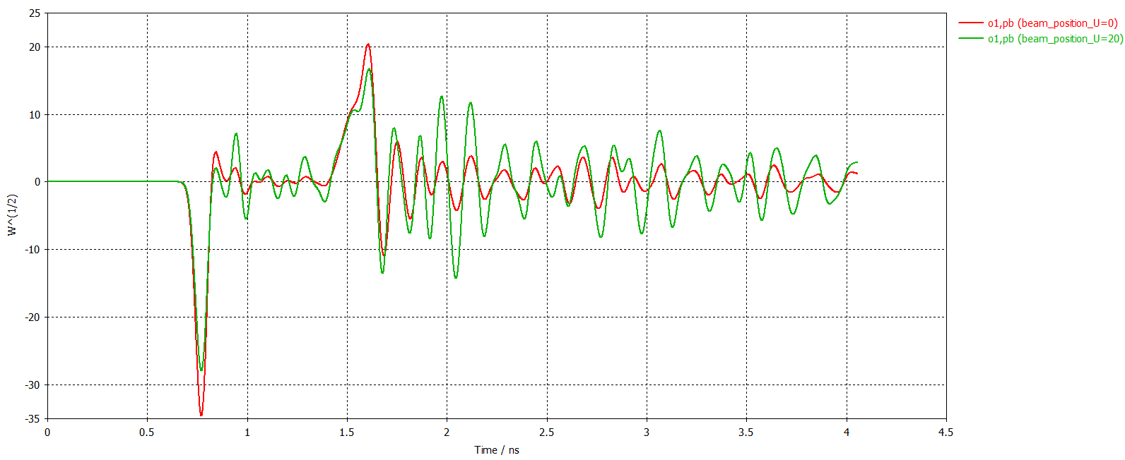
Wakefield simulations
Troubles start at already protons/10
Will submit the electron simulation soon with real parameters
The resonance pattern starts to be visible, and we are in open z-bundaries
Signal still dependent on
the position

Slide 21
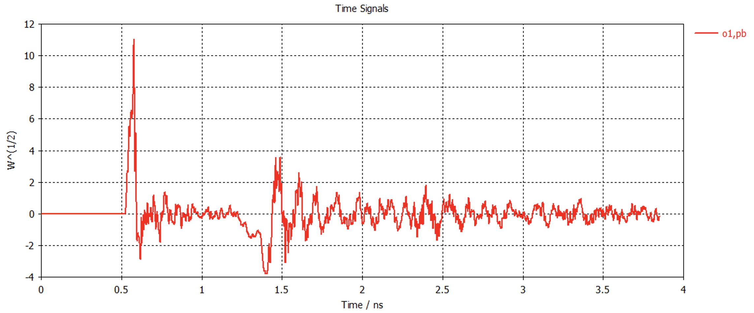
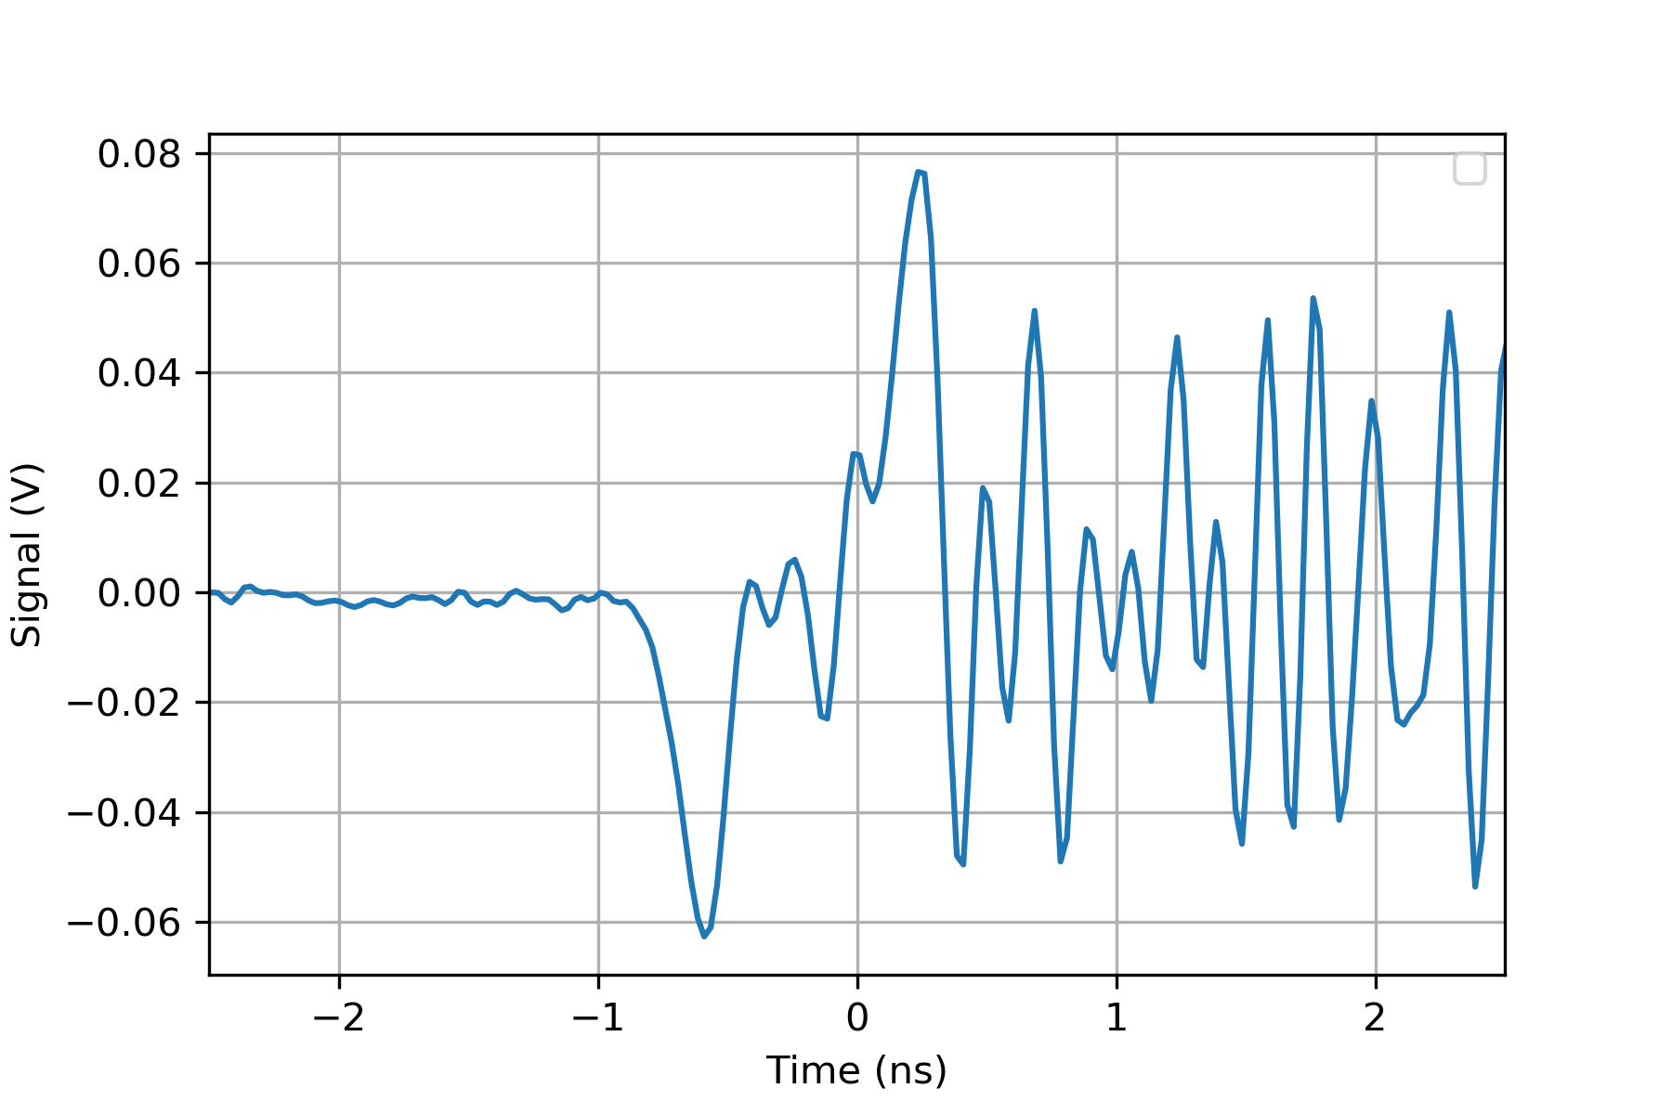
Real electron beam parameters
SIMULATION
MEASUREMENT
Wakefield simulation
  5 cell/wavelength
  (10 cells submitted)
  600 pC
  4 ps bunch length

Slide 22
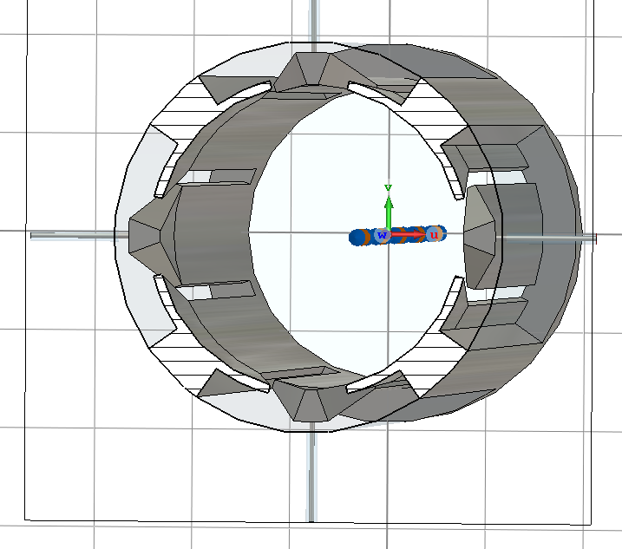
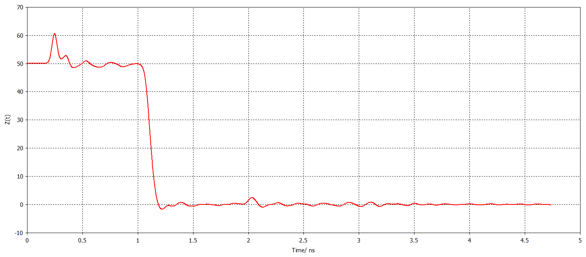
TDR simulations
Was the design simulated before the realisation ?
The end of the stripline is generally problematic. A not careful design can lead to resonances due to the impedance mismatch
TDR analysis done (generally up to 15 GHz) and parameter sweep
No sensible variation of the wakefield simulation using optimised parameters

Slide 23
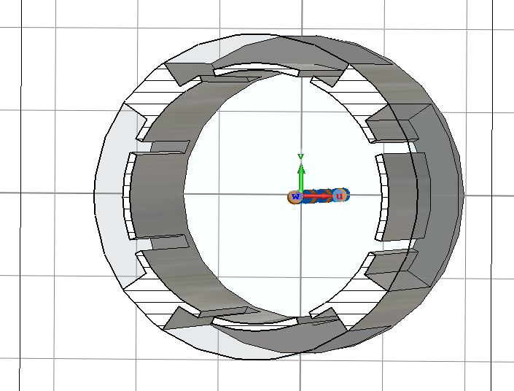
Impact of the cavity behind the stripline
This design was never simulated before realisation
The cavity behind the stripline can be resonating
  After optimisation (wakefield sim.), the smaller the better
  The slot size can be changed also
Every optimisation changes the capacitive coupling of the stripline
Still, no sensible variation of the wakefield simulation using optimised parameters

Slide 24
Spare

