Slide 1
Simulation parameters
I rerun the model for the prism with a 1 cm bore
1.5 ns sigma 100 pC electron beam
Field probe as Konstantin
Beam position x=0 at the pipe center
Delta/sigma calculated as in the experiment:
Delta = E²_{abs_right} – E²_{abs_left}
Sigma= E²_{abs_right} + E²_{abs_left}

Slide 2
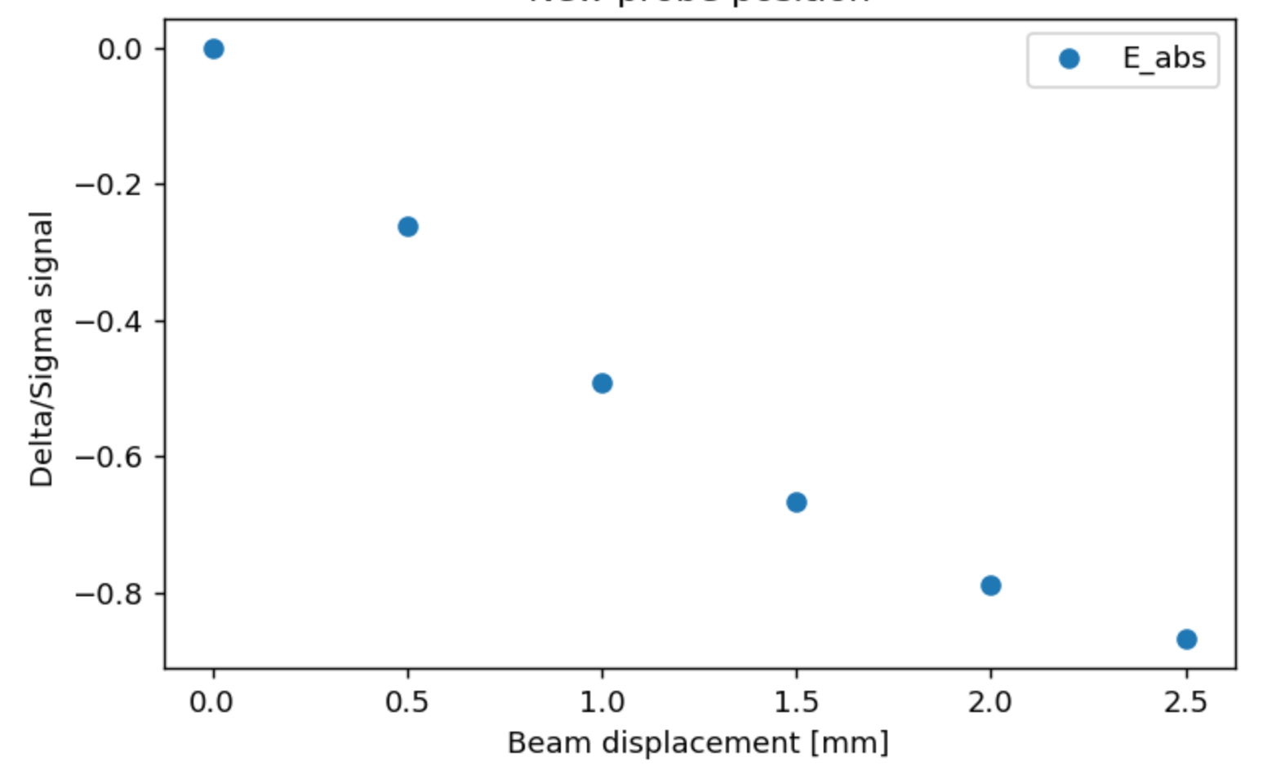
Beam_position_mm = [0. , 0.5, 1. , 1.5, 2. , 2.5]
Delta_sigma = [ 2.75802803e-05, -2.62488492e-01, -4.90373815e-01, -6.65479220e-01, -7.87680393e-01, -8.67708763e-01]

