Slide 1

CST tests status for the Cherenkov electron BPMs
E. Senes
With many for the useful discussions and support to: M. Bergamaschi, A. Curcio, S. Sandovich,
T. Lefevre, M. Harrach (CST support)

Slide 2
Outline
Diffraction Cherenkov simulations with CST
Generalities and limitations
Effect of the vacuum volume
Beam steering
Comparison to Kostantin
Next steps

Slide 3
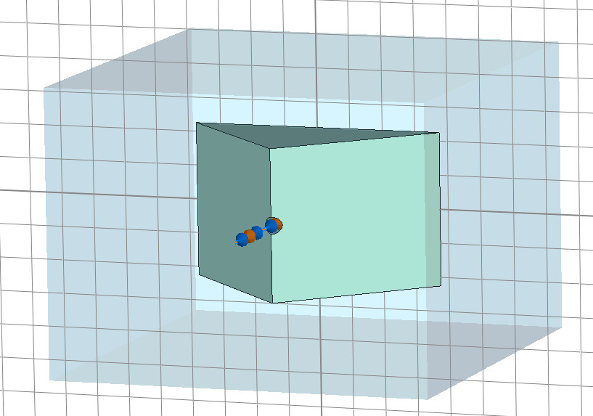
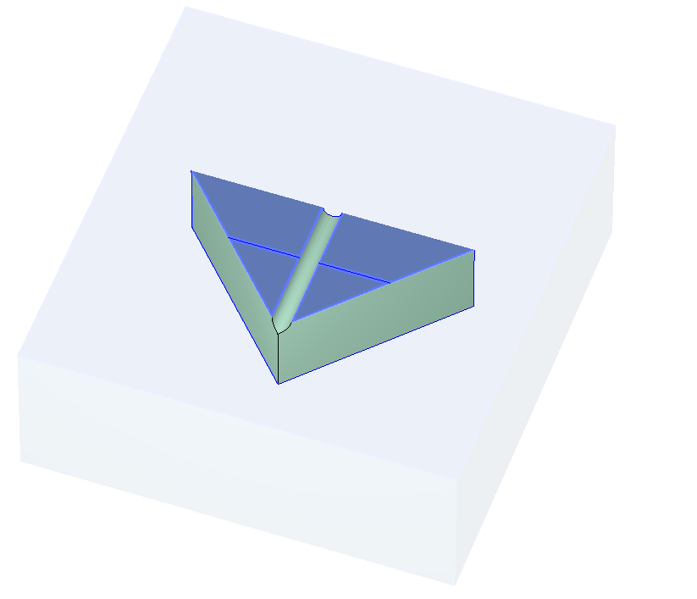
Generalities and limitations
Simple CST 3D model of a triangular prism
Dimensions
70x40x45 mm
Bore diameter 5 mm
400 GHz bandwidth simulation
Wakefield simulation
Beam sigma 1 ps, 100 nC
Electric boundaries in x,y
Open boundaries in z

Slide 4
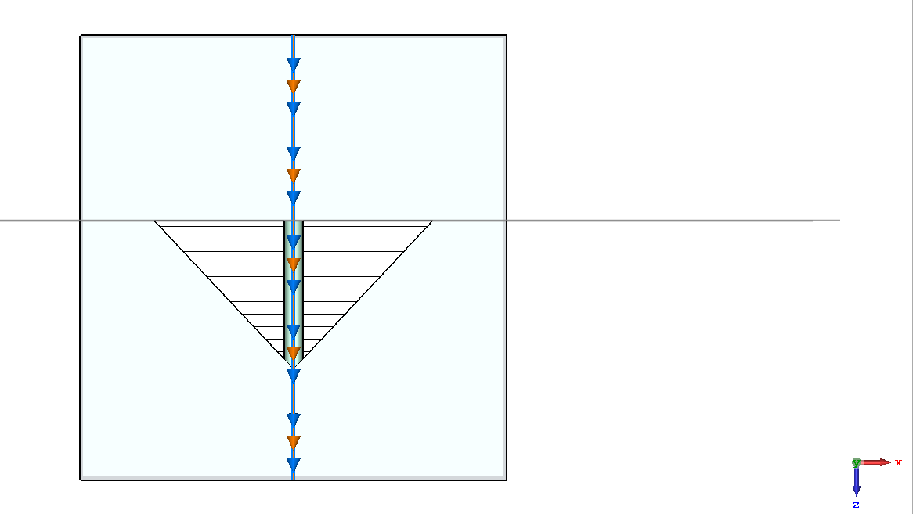
Generalities and limitations
Limitations
MPI not available on CERN clusters → max 2^31 cells
3D field monitor produce huge output. Saving the y=0 plane only is 40 GB. Broken frames from CST error. Support is taking care of it.
No GPU acceleration for wakefield simulations. Max 8 cores and 96 threads. Anyway in general ~18h run time

Slide 5
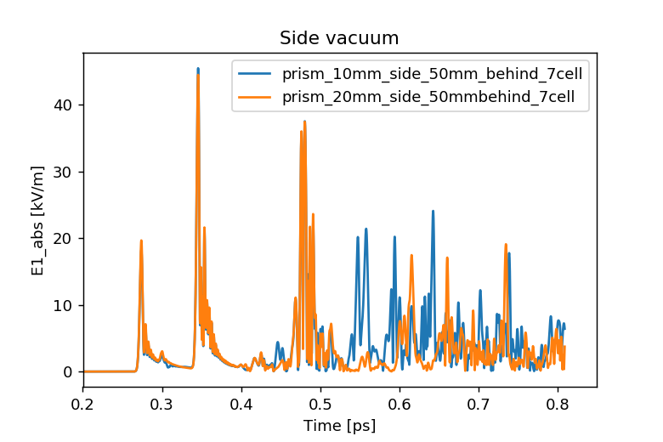
Effect of vacuum around the radiator
Side vacuum
10 or 20 mm

Slide 6
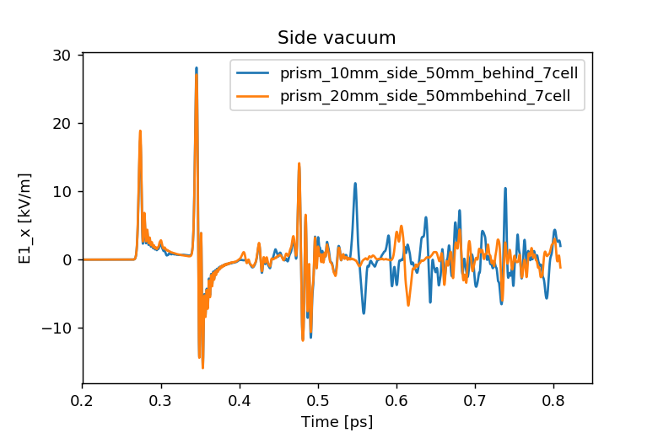
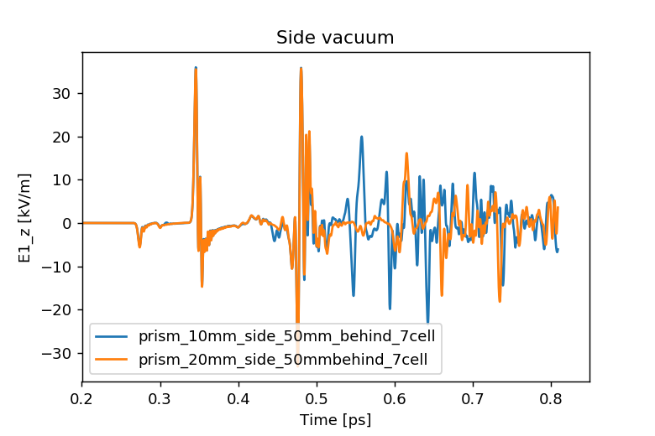
Effect of vacuum around the radiator
Side vacuum
10 or 20 mm

Slide 7
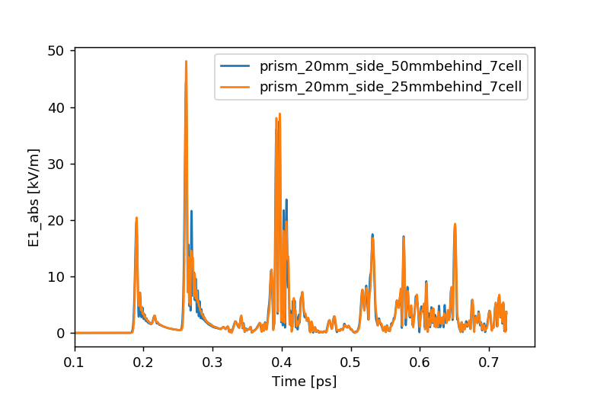
Effect of vacuum around the radiator
Vacuum before the radiator
25 or 50mm

Slide 8
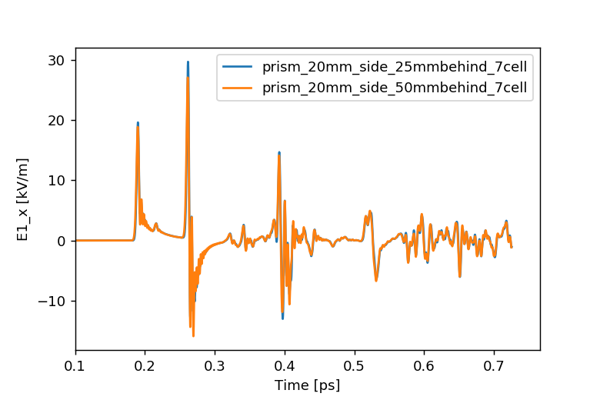
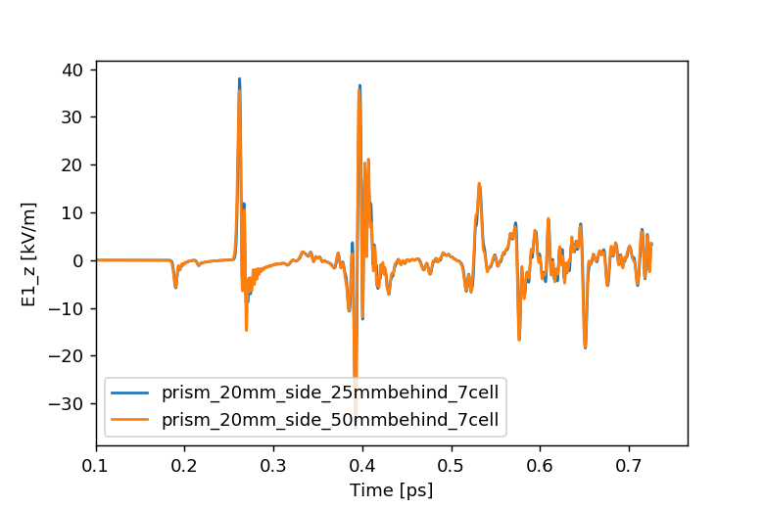
Effect of vacuum around the radiator
Vacuum before the radiator
25 or 50mm

Slide 9
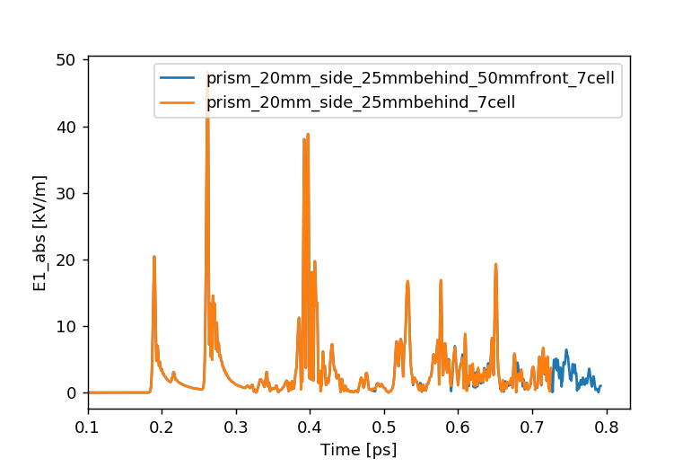
Effect of vacuum around the radiator
Vacuum after the radiator
30 or 50mm

Slide 10
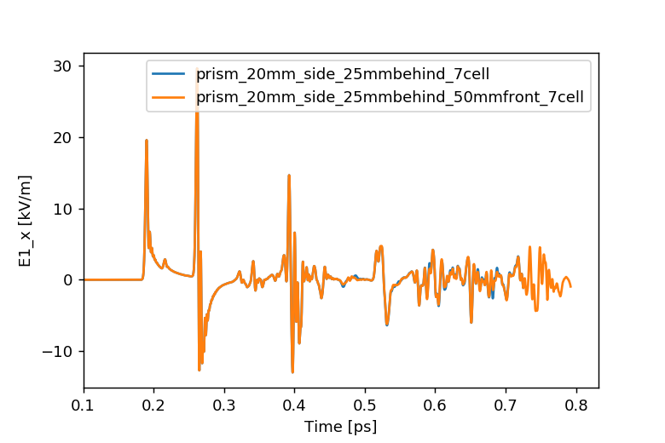
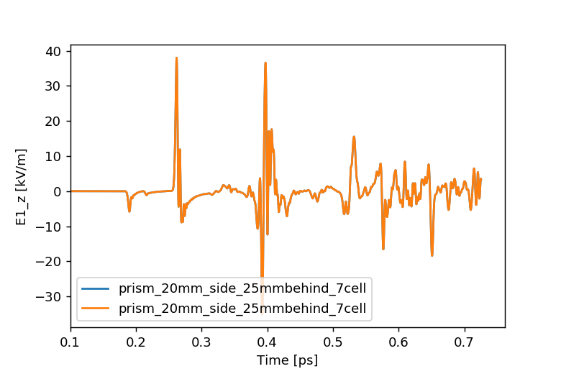
Effect of vacuum around the radiator
Vacuum before the radiator
25 or 50mm

Slide 11
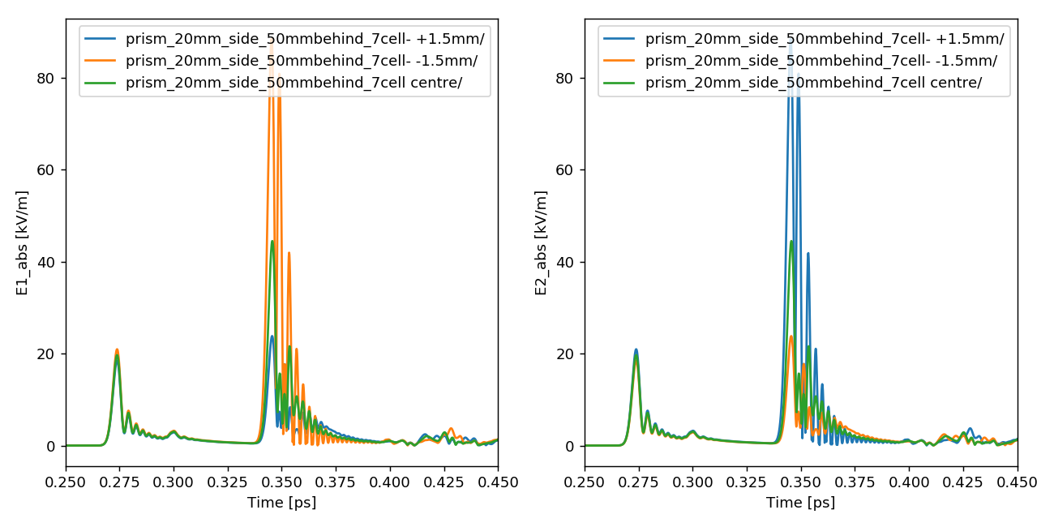
Beam steering

Slide 12
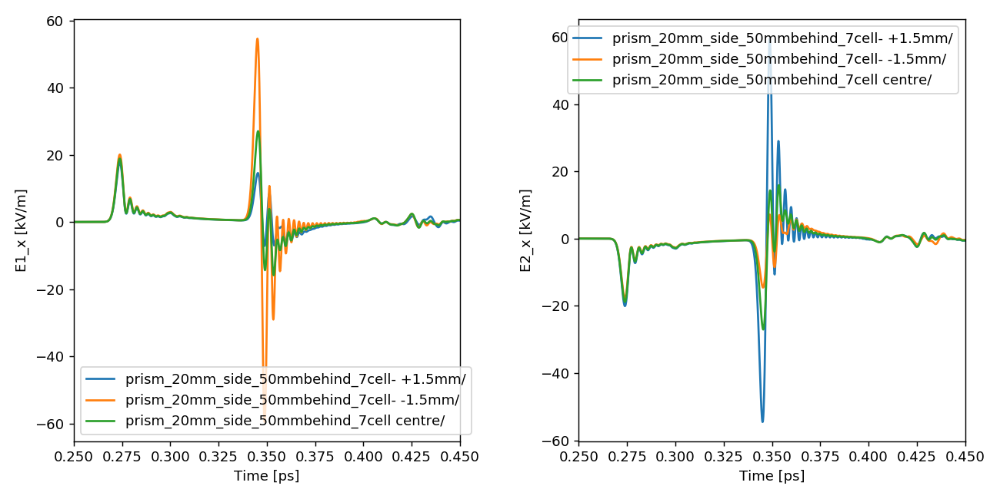
Beam steering

Slide 13
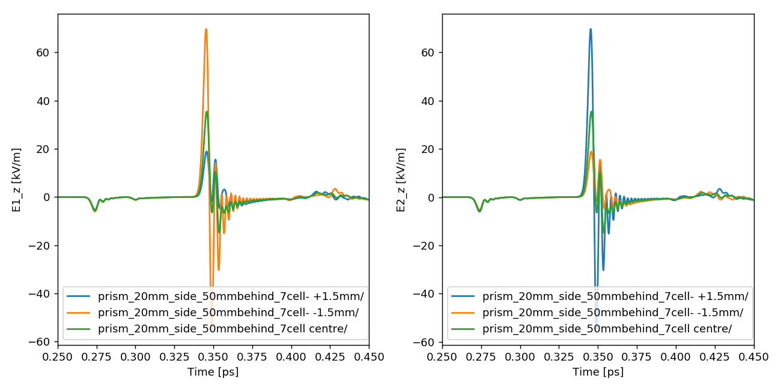
Beam steering

Slide 14
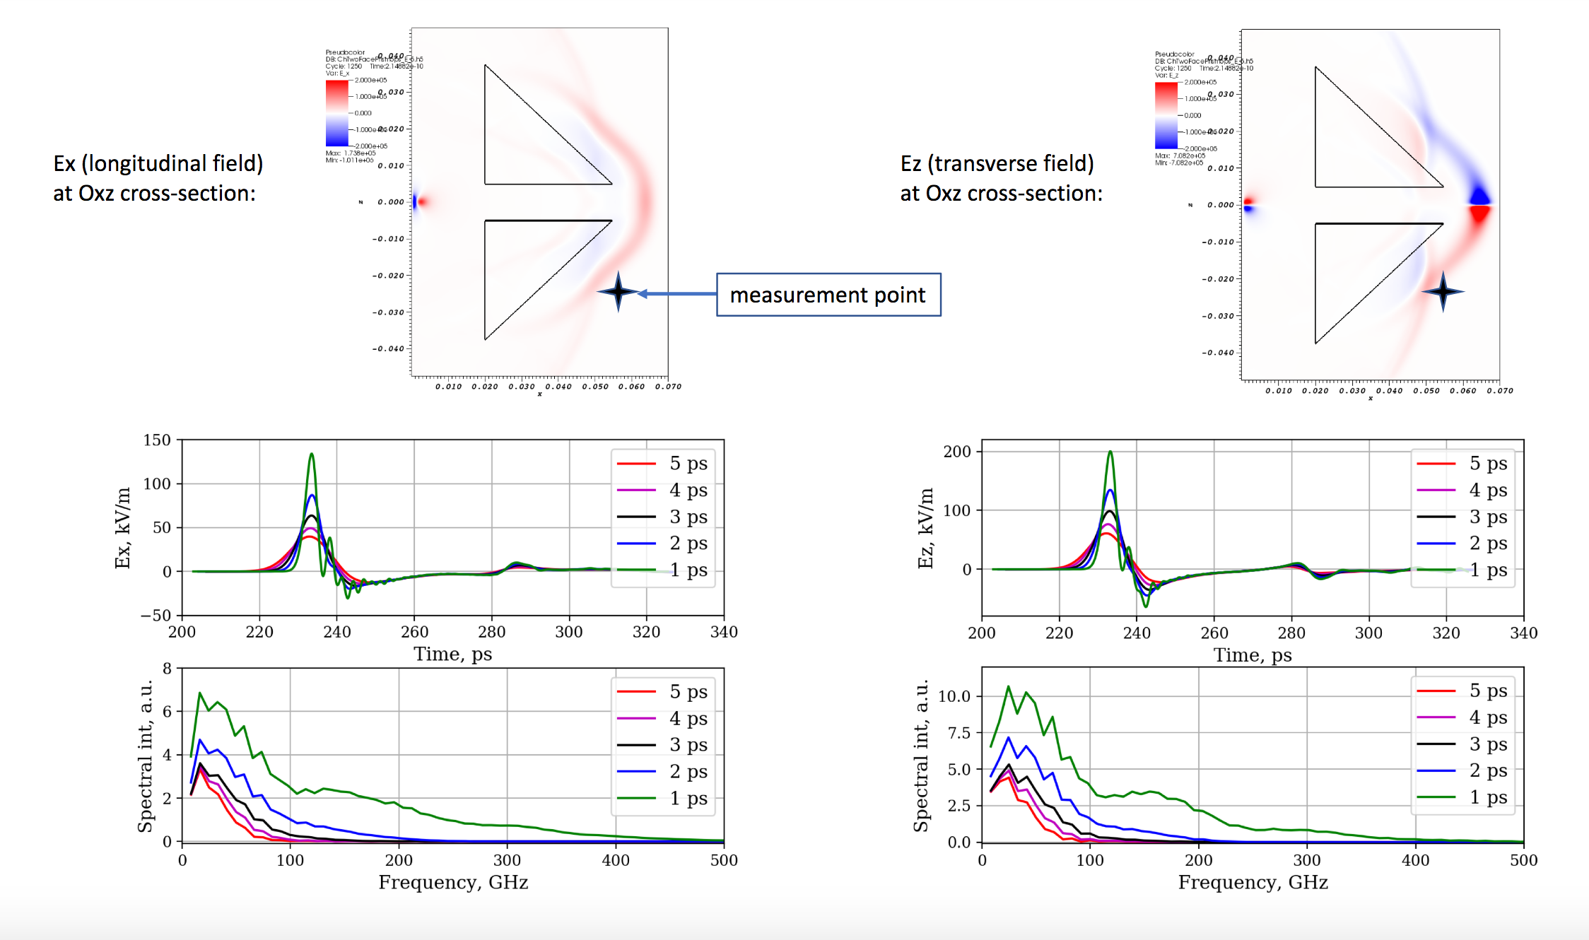
Results of Konstantin

Slide 15
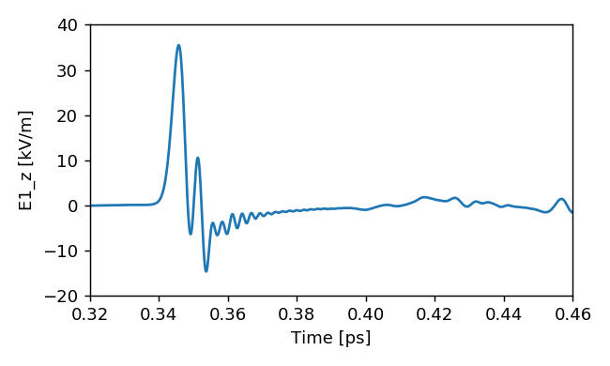
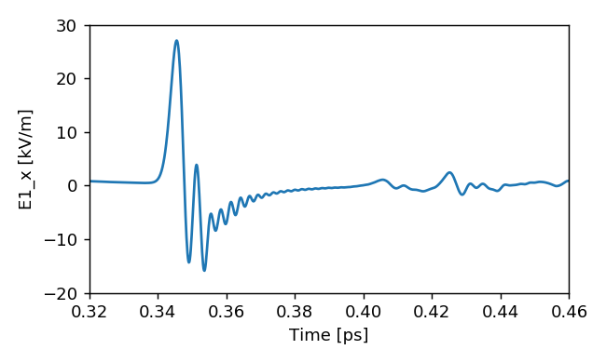
vSIM
CST

Slide 16
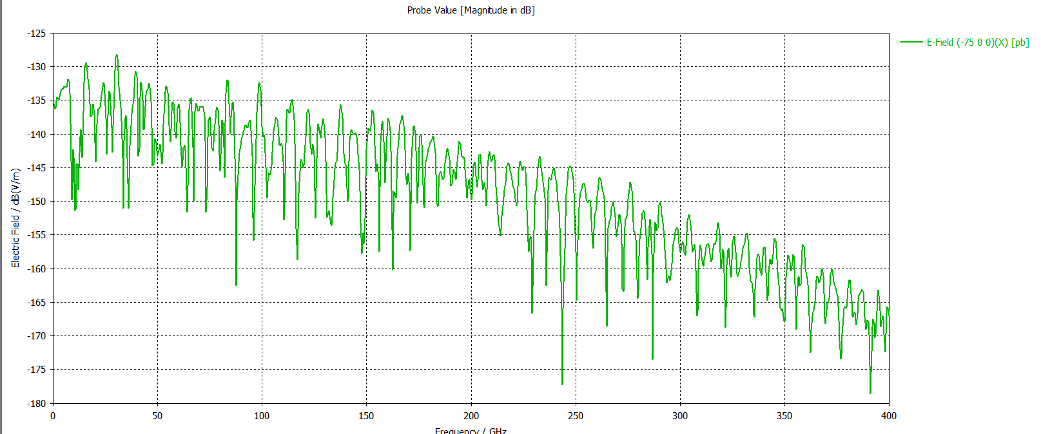
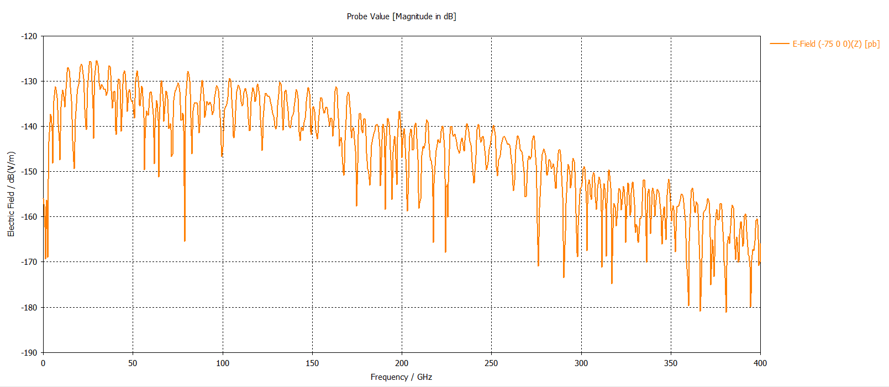
vSIM
CST

Slide 17
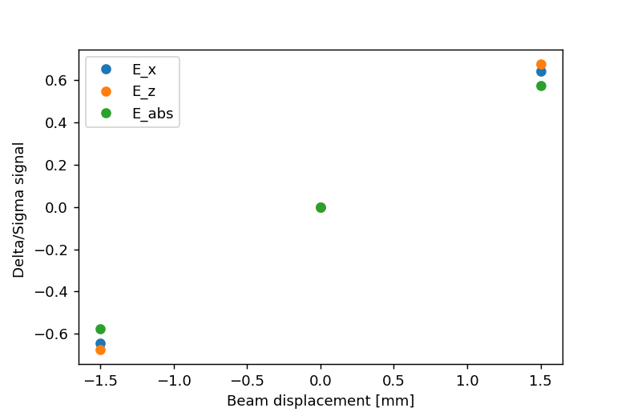
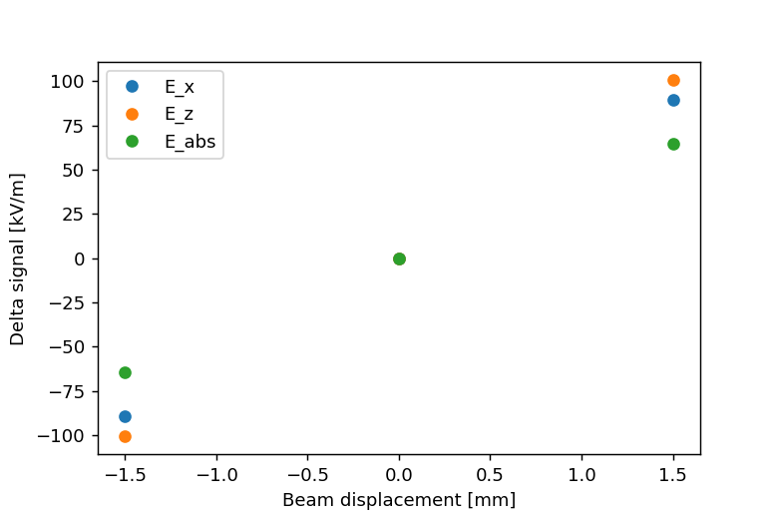
Delta/sigma
From the peak to peak voltage at the field probes

Slide 18
Summary
The region of interest goes up to ~450 ps with the present geometry. Konstatin was looking at ~150 ps. The region of interest is the peak around 270 ps.
No field pictures due to CST fail in handling big files
The vacuum around the prism seems to not to influence the region of interest. What comes after are reflections (?)
When steering the beam, the signal depends on the position as expected
The differences with vSIM come from ?
Same beam and same geometry
Material properties ?
Slight difference in the field probe position ?

Slide 19
What comes next ?
We can attempt GDFIDL instead
Still 3D simulation to be compared to the 2D vSIM
If we reduce the vacuum, we could keep using CST
But we have the field monitor problem …

Slide 20
Spare

Slide 21
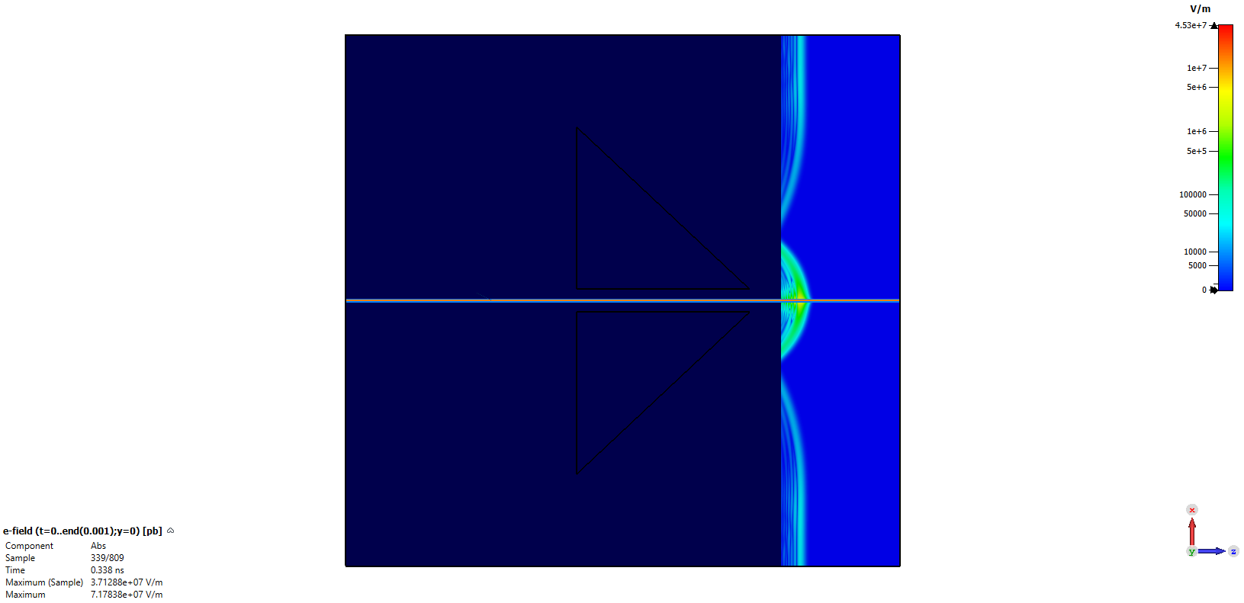
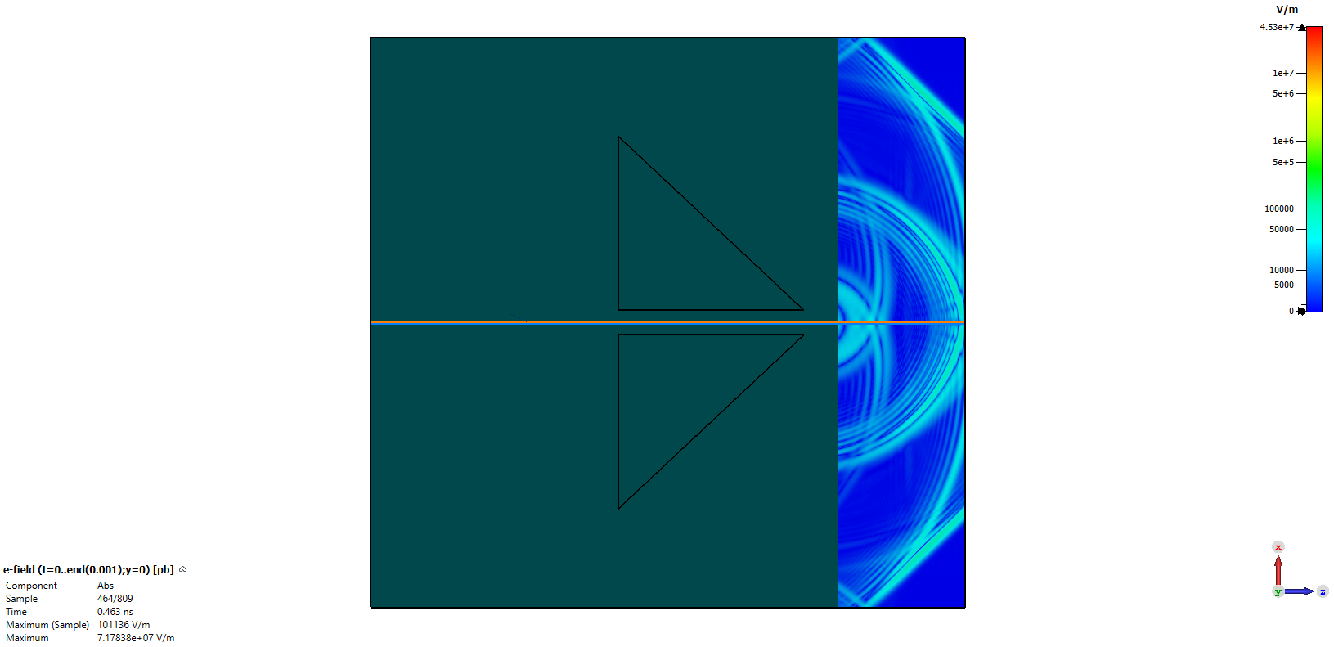
Field monitor crash problem

Slide 22
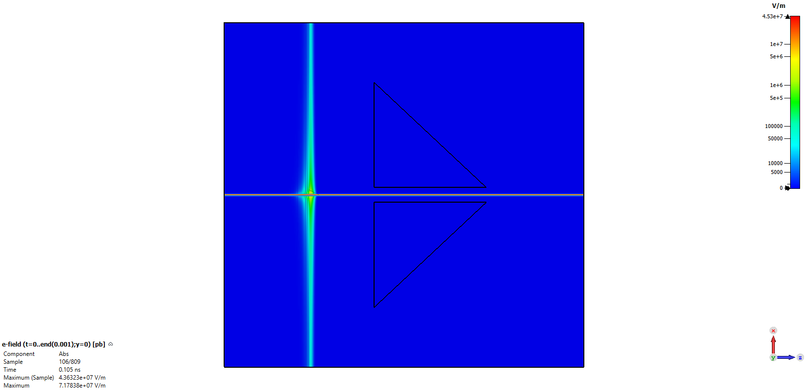
The only successful frame over ~800 …

