Slide 1

CST tests status for the Cherenkov electron BPMs
E. Senes
With many for the useful discussions and support to: M. Bergamaschi, A. Curcio, S. Sandovich,
T. Lefevre, M. Harrach (CST support)

Slide 2
Summary
I rerun the model for the prism with a 1 cm bore this time as you requested
1 ns sigma 100 pC electron beam, the 5 ns is still running (needed rerun due to an error)
I put two field probes, one stayed where it was last time, the other at the position of the simulations of konstantin

Slide 3
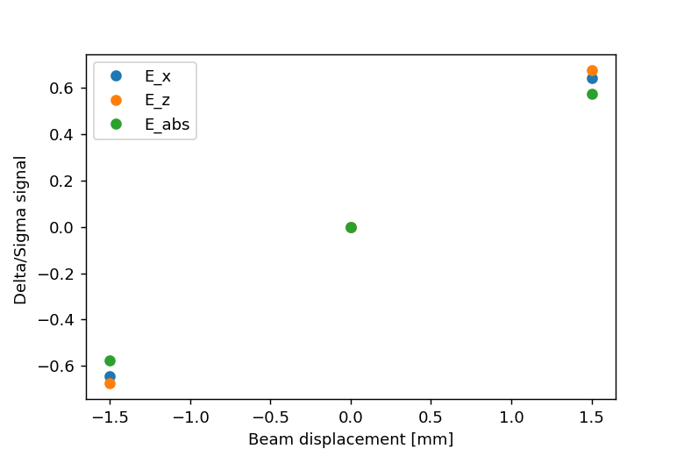
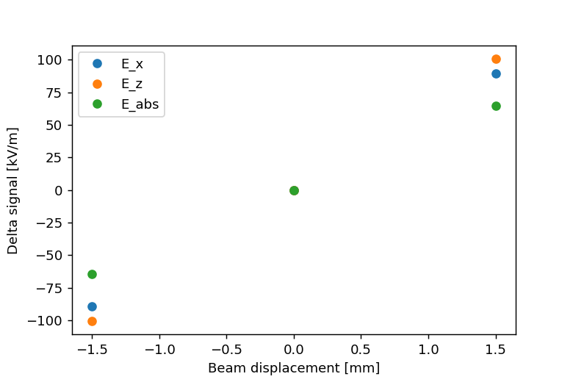
Delta/sigma signal – 5mm bore diameter
What was showed last time

Slide 4
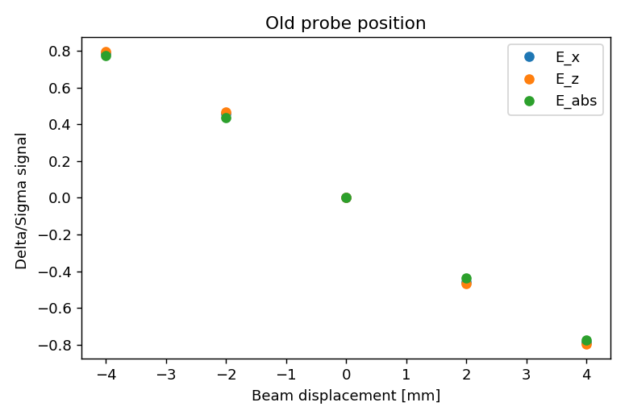
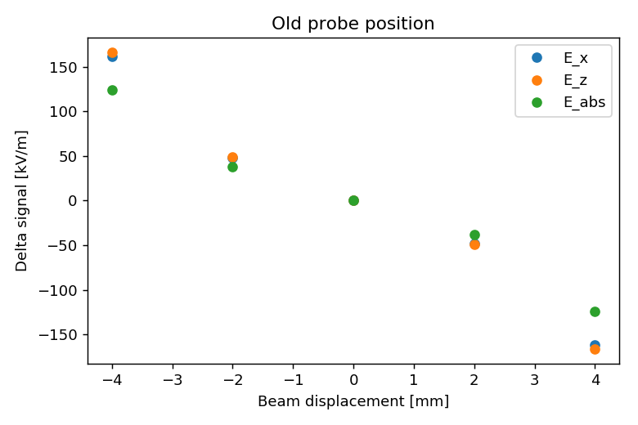
Delta/sigma signal – 10mm bore diameter
Old probe position --> for comparison with the former slide.
Sensitivity is reduced as effect of the bigger hole in the prism

Slide 5
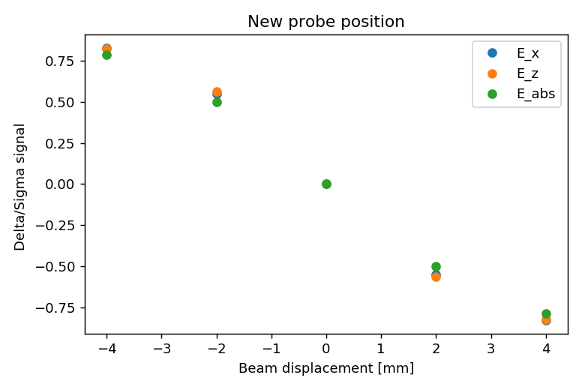
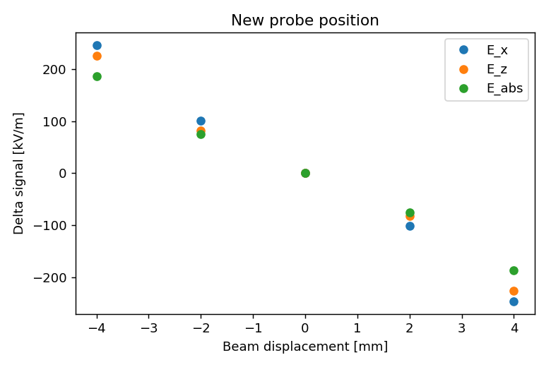
Delta/sigma signal – 10mm bore diameter
Different probe position --> same as simulations of Konstantin
A sensitivity dependence on the probe position is present.

Slide 6
What comes next ?
I started playing with GDFIDL
Incredibly time consuming as it runs on the cluster only, so I have to wait every time before getting an error back during the debug …
Not as user friendly as CST

