Slide 1

CST tests status for the Cherenkov electron BPMs - Update
E. Senes
With many for the useful discussions and support to: M. Bergamaschi, A. Curcio, S. Sandovich,
T. Lefevre, M. Harrach (CST support)

Slide 2
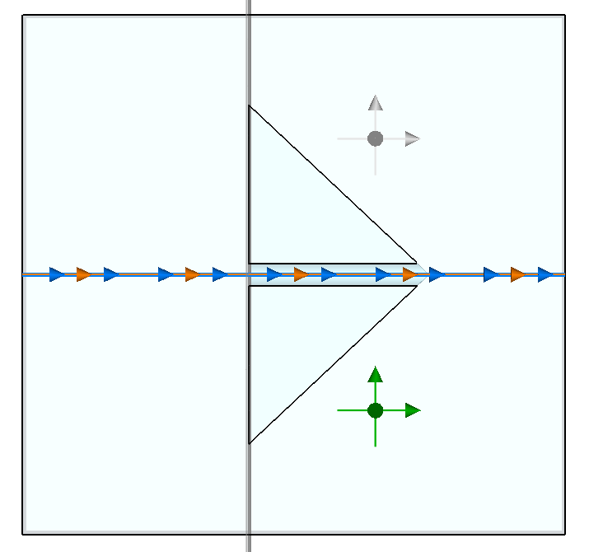
What’s new
The CST support produced a video for me tweaking a lot
A bug report has been opened
Maybe we have a glimpse on what we see in time domain plots !
Mind the probe position →
… and look at the video ! https://cernbox.cern.ch/index.php/s/7fr0ks3opPQsUsP

Slide 3
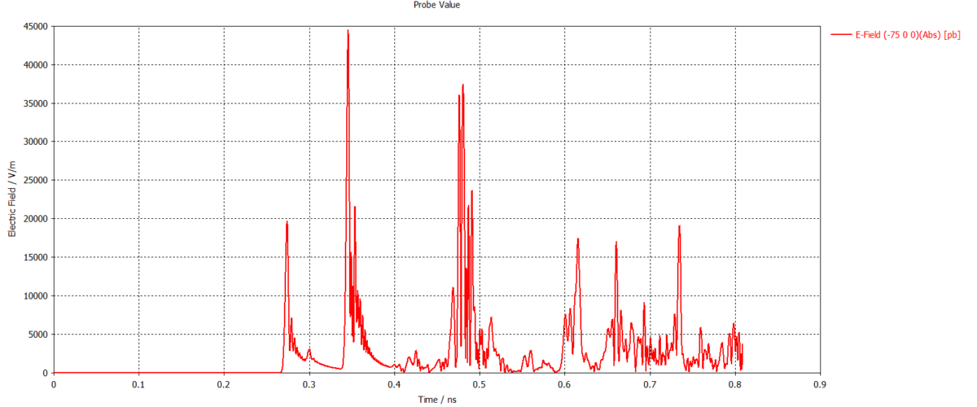
Ideas ?
Bunch field
Cherenkov emission

Slide 4
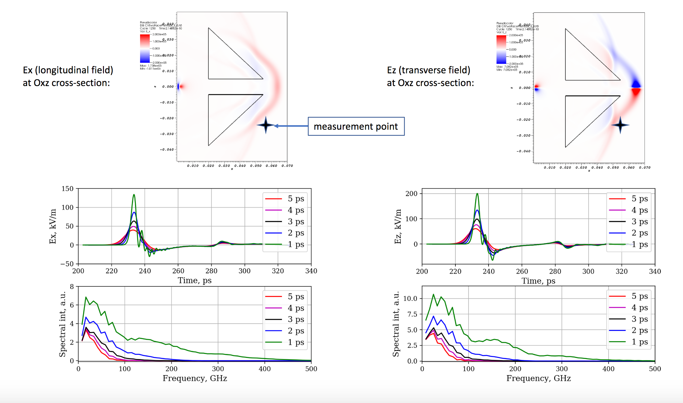
Probe position difference

