Slide 1
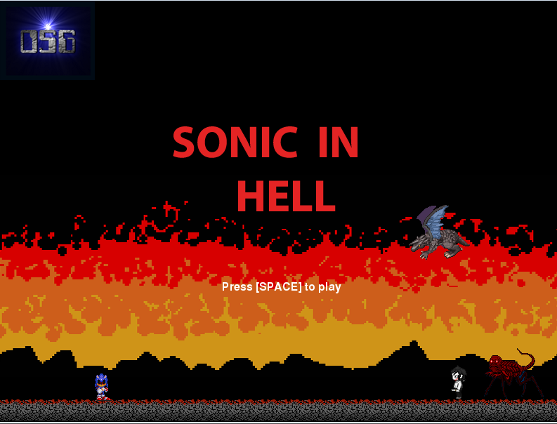
Notes:
Ahoy there!!!

Slide 2
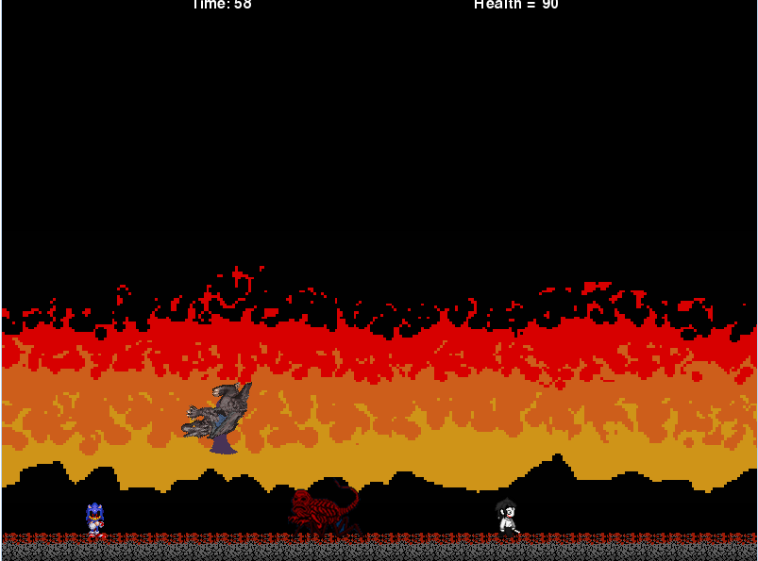
Notes:
Meet sonic, your hero. Everyone else is your enemy

Slide 3
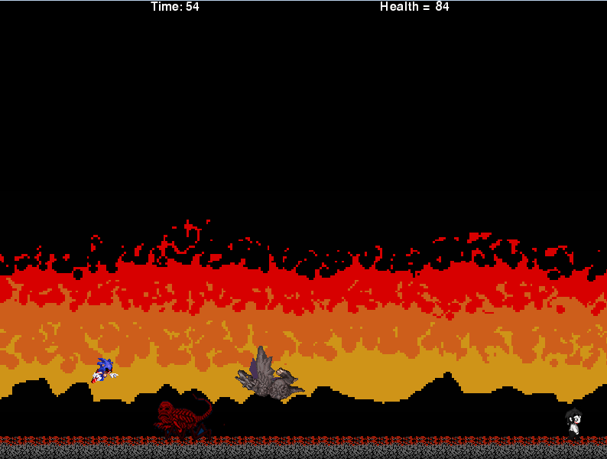
Notes:
Your objective is to run away from your enemy, its not about if you survive, its how long you can survive.

Slide 4
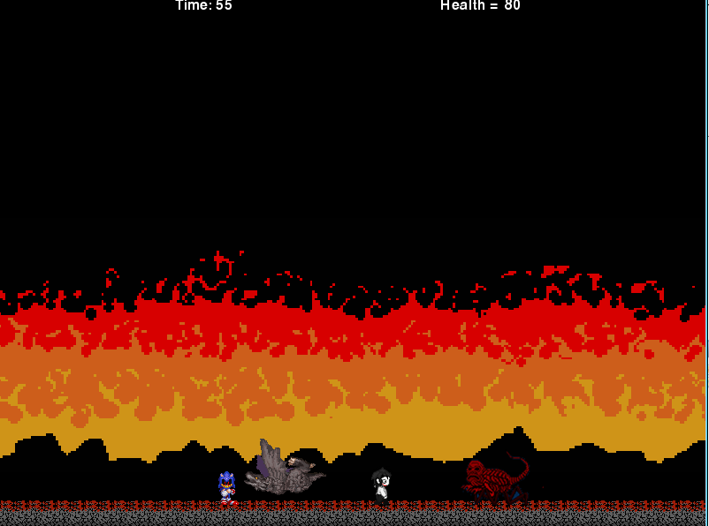
Notes:
On top of the screen is your timing and health bar

Slide 5
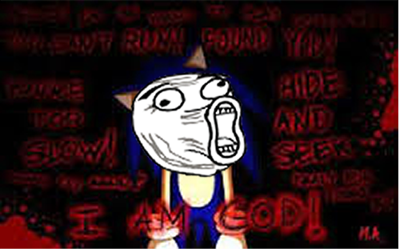
Notes:
Well there you have it, Good luck Soldier.

