Slide 1

6/15/2021
twitter_analyis_classification_v1.ipynb - Colaboratory
#Mount google drive
from google.colab import drive drive.mount('/content/drive')
Drive already mounted at /content/drive; to attempt to forcibly remount, call drive.mou
Tweets Classification
Contents:
Problem Statement About the dataset Exploratory Data Analysis

Slide 2
6/15/2021
twitter_analyis_classification_v1.ipynb - Colaboratory
Data Analysis
Data Preprocessing ML Model
Why BERT Model Create the Model Model Training Model Prediction
Logisitic Regression Model AutoML Model
Conclusion
Problem Statement:
The goal is to predict whether the given tweet is a about a real disaster or not. If it is real disaster then the prediction should be 1 and if not not then 0.
About the dataset:
The features in the dataset are as follows
id - an identifier for each tweet
keyword - a particular keyword from the tweet location - the location the tweet was sent from text - the text of the tweet
target - the output that tells if a tweet is about a real disaster (1) or not (0)
random - this column contains random numbers and again all values are unique.

Slide 3
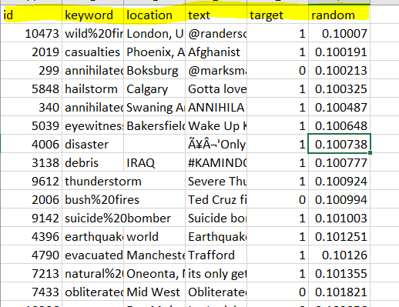

6/15/2021
twitter_analyis_classification_v1.ipynb - Colaboratory
PIP Install all the required libraries

Slide 4
6/15/2021
twitter_analyis_classification_v1.ipynb - Colaboratory
#PIP Install all the required libraries
!pip install tokenization wordcloud tqdm transformers nltk tensorflow_hub
Requirement already satisfied: tokenization in /usr/local/lib/python3.7/dist-packages ( Requirement already satisfied: wordcloud in /usr/local/lib/python3.7/dist-packages (1.5 Requirement already satisfied: tqdm in /usr/local/lib/python3.7/dist-packages (4.41.1) Requirement already satisfied: transformers in /usr/local/lib/python3.7/dist-packages ( Requirement already satisfied: nltk in /usr/local/lib/python3.7/dist-packages (3.2.5) Requirement already satisfied: tensorflow_hub in /usr/local/lib/python3.7/dist-packages Requirement already satisfied: regex in /usr/local/lib/python3.7/dist-packages (from to Requirement already satisfied: pillow in /usr/local/lib/python3.7/dist-packages (from w Requirement already satisfied: numpy>=1.6.1 in /usr/local/lib/python3.7/dist-packages ( Requirement already satisfied: packaging in /usr/local/lib/python3.7/dist-packages (fro Requirement already satisfied: huggingface-hub==0.0.8 in /usr/local/lib/python3.7/dist- Requirement already satisfied: tokenizers<0.11,>=0.10.1 in /usr/local/lib/python3.7/dis Requirement already satisfied: importlib-metadata; python_version < "3.8" in /usr/local Requirement already satisfied: filelock in /usr/local/lib/python3.7/dist-packages (from Requirement already satisfied: sacremoses in /usr/local/lib/python3.7/dist-packages (fr Requirement already satisfied: requests in /usr/local/lib/python3.7/dist-packages (from Requirement already satisfied: six in /usr/local/lib/python3.7/dist-packages (from nltk Requirement already satisfied: protobuf>=3.8.0 in /usr/local/lib/python3.7/dist-package Requirement already satisfied: pyparsing>=2.0.2 in /usr/local/lib/python3.7/dist-packag Requirement already satisfied: typing-extensions>=3.6.4; python_version < "3.8" in /usr Requirement already satisfied: zipp>=0.5 in /usr/local/lib/python3.7/dist-packages (fro Requirement already satisfied: click in /usr/local/lib/python3.7/dist-packages (from sa Requirement already satisfied: joblib in /usr/local/lib/python3.7/dist-packages (from s Requirement already satisfied: chardet<4,>=3.0.2 in /usr/local/lib/python3.7/dist-packa Requirement already satisfied: idna<3,>=2.5 in /usr/local/lib/python3.7/dist-packages ( Requirement already satisfied: certifi>=2017.4.17 in /usr/local/lib/python3.7/dist-pack Requirement already satisfied: urllib3!=1.25.0,!=1.25.1,<1.26,>=1.21.1 in /usr/local/li Requirement already satisfied: setuptools in /usr/local/lib/python3.7/dist-packages (fr
import nltk nltk.download('stopwords')
[nltk_data] Downloading package stopwords to /root/nltk_data... [nltk_data] Package stopwords is already up-to-date!
True
Import all the required libraries
#Import all the libraries import numpy as np
import pandas as pd pd.set_option('display.max_rows', 500)
pd.set_option('display.max_columns', 500)
pd.set_option('display.width', 1000) import matplotlib.pyplot as plt import seaborn as sns

Slide 5
6/15/2021 twitter_analyis_classification_v1.ipynb - Colaboratory
import tokenization
from wordcloud import STOPWORDS
from sklearn.model_selection import StratifiedKFold, StratifiedShuffleSplit from sklearn.metrics import precision_score, recall_score, f1_score
import tensorflow as tf import tensorflow_hub as hub from tensorflow import keras
from tensorflow.keras.optimizers import SGD, Adam
from tensorflow.keras.layers import Dense, Input, Dropout, GlobalAveragePooling1D from tensorflow.keras.models import Model, Sequential
from tensorflow.keras.callbacks import ModelCheckpoint, EarlyStopping, Callback from wordcloud import WordCloud
from collections import defaultdict from nltk.corpus import stopwords from nltk.util import ngrams stop=set(stopwords.words('english'))
plt.rcParams["figure.figsize"] = (20,10)
from sklearn.feature_extraction.text import CountVectorizer import spacy
import nltk
from nltk.tokenize import word_tokenize from nltk.corpus import stopwords import regex as re
import string
import tensorflow as tf
from tensorflow.keras.layers import Dense, Input from tensorflow.keras.optimizers import Adam from tensorflow.keras.models import Model
from tensorflow.keras.callbacks import ModelCheckpoint, EarlyStopping, ReduceLROnPlateau, Lea
import transformers
from tqdm.notebook import tqdm
from tokenizers import BertWordPieceTokenizer from transformers import BertTokenizer
import warnings warnings.filterwarnings('ignore')
Load the training data set: Load the traning CSV file into pandas dataframe.
#Load the file.
tweets = pd.read_csv('/content/drive/MyDrive/train_set.csv', dtype={'id': np.int16, 'target': df_test = pd.read_csv('/content/drive/MyDrive/test01.csv')

Slide 6
6/15/2021
twitter_analyis_classification_v1.ipynb - Colaboratory
Describe the pandas dataframe
#Analyze the dataframe tweets.describe
<bound method NDFrame.describe of
id
keyword
location
0 | 10473 | wild%20fires | London, |  | UK | @randerson62 Watching news of wild fires and
1 | 2019 | casualties | Phoenix, |  | AZ | Afghanistan: U.N. Reports 'Record-High Level
2 | 299 | annihilated | Boksburg |  |  | @marksmaponyane Hey!Sundowns were annihilate
3 | 5848 | hailstorm | Calgary |  |  | Gotta love #summer in #Calgary. #yyc #hailst
4 | 340 | annihilated | Swaning | Around |  | ANNIHILATED | IN DAMASCUS: SYRIAN ARMY GRINDS
... | ... | ... |  | ...
6872 | 6376 | hostages |  | NaN |  | One Year on | from the Sinjar Massacre #Yazidi
6873 | 10290 | weapon |  | NaN |  | Fur Leather | Coats sprite &amp; weapon of cho
6874 | 3115 | debris | NaN |  |  | RÌ©union Debris Is Almost Surely From |  | Flight
6875 | 9472 | terrorism | Riyadh |  |  | In #islam saving a person is equal in |  | reward
6876 | 3534 | derailment | Mumbai |  |  | Latest : Trains derailment: 'It's the |  | freaki
[6877 rows x 6 columns]>
Check the header and tail
tweets.head(10)
id
keyword
location
text
target
random
0 10473 | wild%20fires | London, UK
1 2019 | casualties | Phoenix, AZ
2 299 | annihilated | Boksburg
@randerson62 Watching news of wild
fires and h...
Afghanistan: U.N. Reports 'Record-
High Levels'...
@marksmaponyane Hey!Sundowns
were annihilated ...
1 | 0.100070
1 | 0.100191
0 | 0.100213
1 | 0.100325
1 | 0.100487
1 | 0.100648
3 5848 | hailstorm
4 340 | annihilated
5 5039 | eyewitness
Calgary
Gotta love #summer in #Calgary. #yyc
#hailstor...
Swaning Around
ANNIHILATED IN DAMASCUS: SYRIAN ARMY GRINDS □Û...
Bakersfield, California
Wake Up Kern County Eyewitness
News Mornings a...
å¬'Only the sea knows how many are
tweets.tail(10)

Slide 7
6/15/2021
twitter_analyis_classification_v1.ipynb - Colaboratory
 | id | keyword | location
6867 | 1143 | blight | Central Illinois ^{@todd_calfee so} wa
6868 | 3879 | detonation | New York ^{Detona}
text
@mattburgener nted to see th...
tion fashionable mountaineering electron...
target | random
1 | 0.997934
1 | 0.998323
1 | 0.998513
1 | 0.998857
0 | 0.999126
1 | 0.999180
6869 10677
wounds
Earth: Senseless
nonsense
Explosion in Gaza Strip kills four
wounds 30; ...
6870 9723
tragedy
India
Railways caught unawares by MP
tragedy; Accide...
6871 6009 hazardous
Muntinlupa City,
Philippines
@HearItFromPatty Also pls help
us w/ our campa...
6872 6376 hostages
NaN
One Year on from the Sinjar Massacre #Yazidis ...
Exploratory Data Anaysis(EDA)
Fur Leather Coats sprite &amp;
#Basic Exploratory Data Anaysis(EDA)
print('There are {} rows and {} columns in train'.format(tweets.shape[0],tweets.shape[1]))
There are 6877 rows and 6 columns in train
#First check the class distribution x=tweets.target.value_counts() sns.barplot(x.index,x) plt.gca().set_ylabel('Tweets')

Slide 8
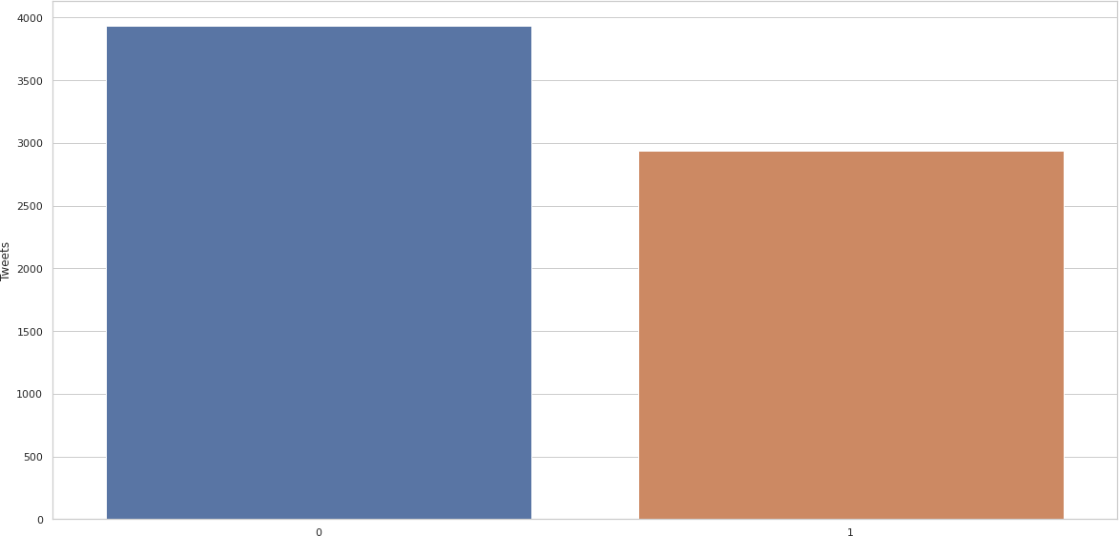
6/15/2021
twitter_analyis_classification_v1.ipynb - Colaboratory
Text(0, 0.5, 'Tweets')
neg, pos = np.bincount(tweets['target']) total = neg + pos
print('Examples:\n Total: {}\n Positive: {} ({:.2f}% of total)\n
Examples:
Total: 6877
Positive: 2940 (42.75% of total)
Negative: 3937 (57.25% of total)
Negative: {} ({:.2f
There is definitely imbalance in the dataset . Total: 6877 Positive: 2940 (42.75% of total) Negative: 3937 (57.25% of total)
The disaster tweets are 42.75% of the total tweets. The non disaster tweets are 57.25% of the toal. Still it is not a very bad imbalanced dataset.
# creating a new dataframe for missing values percentage
missing_values = dict(zip([col+"_missing_percent" for col in tweets.columns if col != "target [round(100*tweets[col].isnull().sum()/len(tweets), 2) for col in tw if col != "target"]))
missing_values_df = pd.DataFrame(missing_values, index=[0])
missing_values_df = missing_values_df.melt(var_name= "columns", value_name= "percentage")
# plotting missing values chart plt.figure(figsize=(15, 8)) sns.set(style="whitegrid", color_codes=True)
seaborn_plot = sns.barplot(x="columns", y="percentage", data=missing_values_df) for p in seaborn_plot.patches:
seaborn_plot.annotate(format(p.get_height(), '.2f'), (p.get_x() + p.get_width() / 2., p.g va = 'center', xytext = (0, 9), textcoords = 'offset points')
plt.title("Percentage of Missing Values in Columns", size=20, weight="bold") plt.xlabel("Columns", size=14, weight="bold")
plt.ylabel("Percentage", size=14, weight="bold") plt.show()

Slide 9
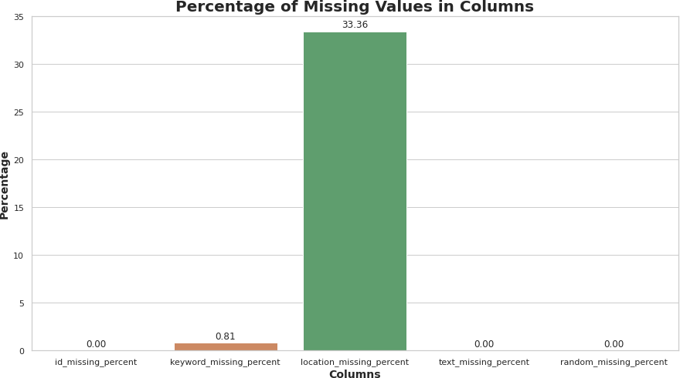
6/15/2021
twitter_analyis_classification_v1.ipynb - Colaboratory
# creating a new dataframe for unique value cound
unique_values = dict(zip([col+"_unique_values" for col in tweets.columns if col != "target"], [tweets[col].nunique() for col in tweets.columns if col != "target"
unique_values_df = pd.DataFrame(unique_values, index=[0])
unique_values_df = unique_values_df.melt(var_name= "columns", value_name= "counts")
# plotting unique values chart plt.figure(figsize=(15, 8)) sns.set(style="whitegrid", color_codes=True)
seaborn_plot = sns.barplot(x="columns", y="counts", data=unique_values_df) for p in seaborn_plot.patches:
seaborn_plot.annotate(format(p.get_height(), '.2f'), (p.get_x() + p.get_width() / 2., p.g va = 'center', xytext = (0, 9), textcoords = 'offset points')
plt.title("Number of Unique Values in Columns", size=20, weight="bold") plt.xlabel("Columns", size=14, weight="bold")
plt.ylabel("Counts", size=14, weight="bold") plt.show()

Slide 10
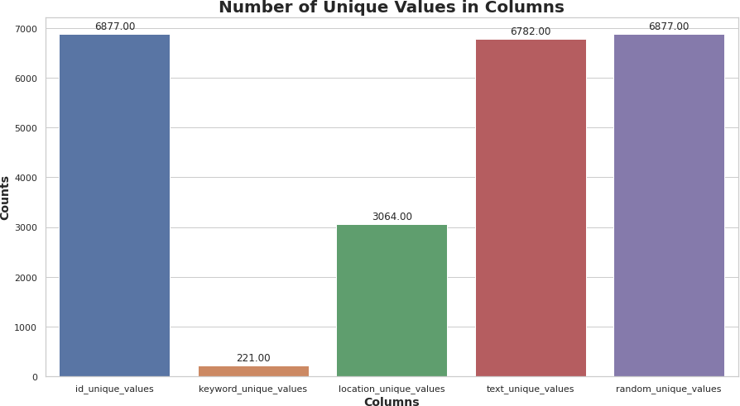
6/15/2021
twitter_analyis_classification_v1.ipynb - Colaboratory
No of characters in a tweets
#No of characters in a tweets fig,(ax1,ax2)=plt.subplots(1,2,figsize=(14,8)) tweet_len=tweets[tweets['target']==1]['text'].str.len() ax1.hist(tweet_len,color='orange') ax1.set_title('disaster tweets') tweet_len=tweets[tweets['target']==0]['text'].str.len() ax2.hist(tweet_len,color='blue')
ax2.set_title('Not disaster tweets') fig.suptitle('Characters in tweets') plt.show()

Slide 11
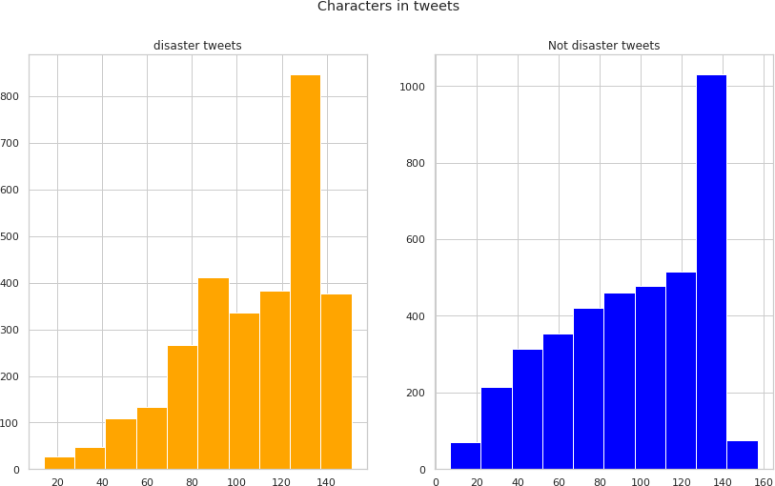
6/15/2021
twitter_analyis_classification_v1.ipynb - Colaboratory
The no of characters for disaster tweets are 120-140 approximately. The no of characters for normal tweets are 140-160 approximately. The distribution looks almost same and not much difference.
No of words in a tweet
#No of words in a tweet fig,(ax1,ax2)=plt.subplots(1,2,figsize=(14,8))
tweet_len=tweets[tweets['target']==1]['text'].str.split().map(lambda x: len(x)) ax1.hist(tweet_len,color='orange')
ax1.set_title('disaster tweets') tweet_len=tweets[tweets['target']==0]['text'].str.split().map(lambda x: len(x)) ax2.hist(tweet_len,color='blue')
ax2.set_title('Not disaster tweets') fig.suptitle('Words in a tweet') plt.show()

Slide 12
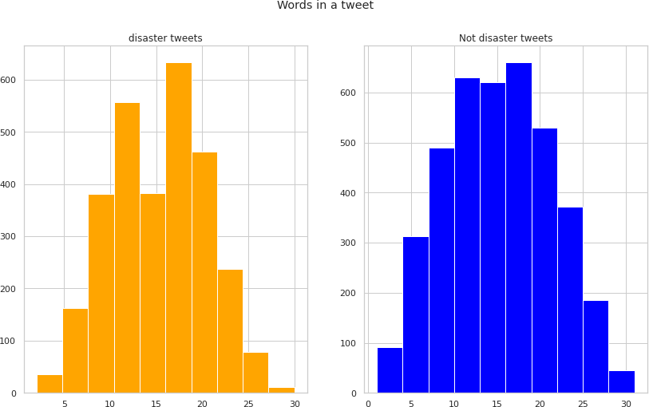
6/15/2021
twitter_analyis_classification_v1.ipynb - Colaboratory
Again the distribution normal tweets and disaster tweets are the same.
Location break-up analysis
There are lot of NaN values . The majority of the tweets are from USA.
#Location break-up analysis tweets.location.value_counts()[:10].to_frame()
 | location
USA | 82
New York | 66
United States | 43
London | 41
Nigeria | 26
UK | 24
Los Angeles, CA | 23
India | 23
Mumbai | 21
Canada | 20
Most common Words
#Most common Words common_keywords=tweets["keyword"].value_counts()[:20].to_frame() fig=plt.figure(figsize=(15,6))
sns.barplot(data=common_keywords,x=common_keywords.index,y="keyword",palette="magma") plt.title("Most common keywords",size=16)
plt.xticks(rotation=70,size=12);

Slide 13
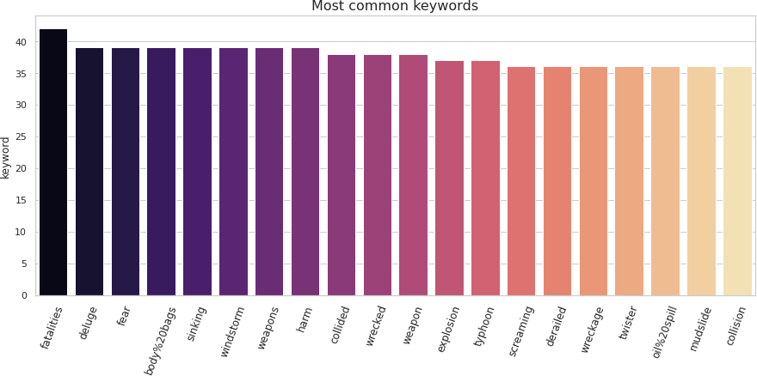
6/15/2021
twitter_analyis_classification_v1.ipynb - Colaboratory
common_keywords.head(20)

Slide 14
6/15/2021
twitter_analyis_classification_v1.ipynb - Colaboratory
keyword
fatalities
42
deluge
39
fear 39
disaster_tweets = tweets[tweets['target']==1]['text'] non_disaster_tweets = tweets[tweets['target']==0]['text']
# keyword to target counts
keyword_count_df = pd.DataFrame(tweets.groupby(["keyword", "target"])["text"].count()).rename keyword_count_df.head(50)
body%20bags 39
sinking 39
windstorm 39
weapons 39
harm 39
collided 38
wrecked 38
weapon 38
explosion 37
typhoon 37
screaming 36
derailed 36
wreckage 36
twister 36
oil%20spill 36
mudslide 36

Slide 15
6/15/2021
keyword | target | twitter_analyis_classification_v1.ipynb - Colaboratory count
ablaze | 0 | 19
 | 1 | 12
accident | 0 | 11
 | 1 | 21
aftershock | 0 | 31
airplane%20accident | 0 | 5
 | 1 | 28
ambulance | 0 | 16
 | 1 | 19
annihilated | 0 | 21
 | 1 | 11
annihilation | 0 | 16
 | 1 | 8
apocalypse | 0 | 19
 | 1 | 9
armageddon | 0 | 28
 | 1 | 5
army | 0 | 28
 | 1 | 3
arson | 0 | 9
 | 1 | 17
arsonist | 0 | 23
 | 1 | 8
attack | 0 | 9
 | 1 | 22
attacked 0 12
1 19
avalanche 0 23
1 4
Word Cloud
Google says a word cloud is “an image composed of words used in a particular text or subject, in which the size of each word indicates its frequency or importance.”So, the more often a specific word appears in your text, the bigger and bolder it appears in your word cloud. Wordcloud is used in

Slide 16
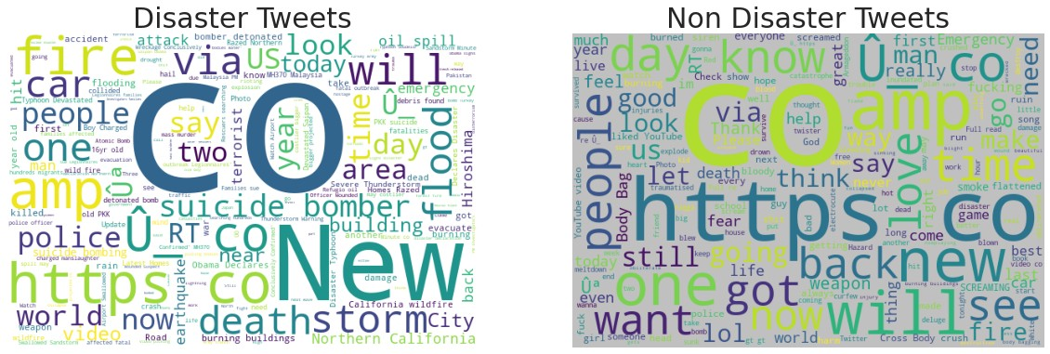
6/15/2021 twitter_analyis_classification_v1.ipynb - Colaboratory
a lot of applications like in the company website, try to extract from the customer feedback, employee feedback, etc.
battle 0 21
1 4
bioterror 0 13
1 21
bioterrorism 0 8
1 20
blaze 0 31
1 4
blazing 0 33
1 1
bleeding 0 26
1 5
blew%20up 0 28
1 1
blight 0 25
1 2
blizzard 0 30
1 4
blood 0 26
fig, (ax1, ax2) = plt.subplots(1, 2, figsize=[20, 10]) wordcloud1 = WordCloud( background_color='white',
width=600,
height=400).generate(" ".join(disaster_tweets))
ax1.imshow(wordcloud1) ax1.axis('off')
ax1.set_title('Disaster Tweets',fontsize=30);
wordcloud2 = WordCloud( background_color='silver',
width=600,
height=400).generate(" ".join(non_disaster_tweets))
ax2.imshow(wordcloud2) ax2.axis('off')
ax2.set_title('Non Disaster Tweets',fontsize=30);
def create_corpus(target): corpus=[]
for x in tweets[tweets['target']==target]['text'].str.split(): for i in x:
corpus.append(i) return corpus
corpus=create_corpus(0)

Slide 17
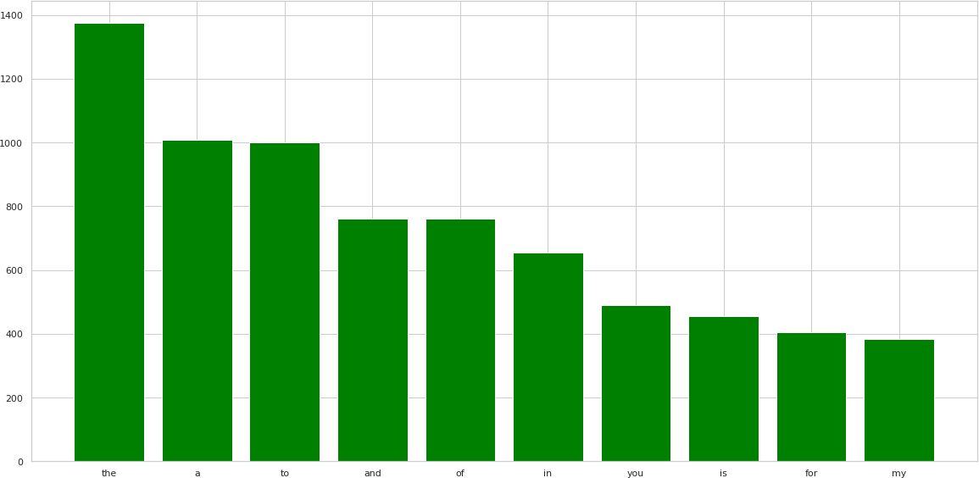
6/15/2021
twitter_analyis_classification_v1.ipynb - Colaboratory
dic=defaultdict(int) for word in corpus:
if word in stop: dic[word]+=1
top=sorted(dic.items(), key=lambda x:x[1],reverse=True)[:10]
Common Stop Words used in the Tweets:
#
x,y=zip(*top) plt.bar(x,y,color='green')
<BarContainer object of 10 artists>
corpus=create_corpus(1)
dic=defaultdict(int) for word in corpus:
if word in stop:

Slide 18
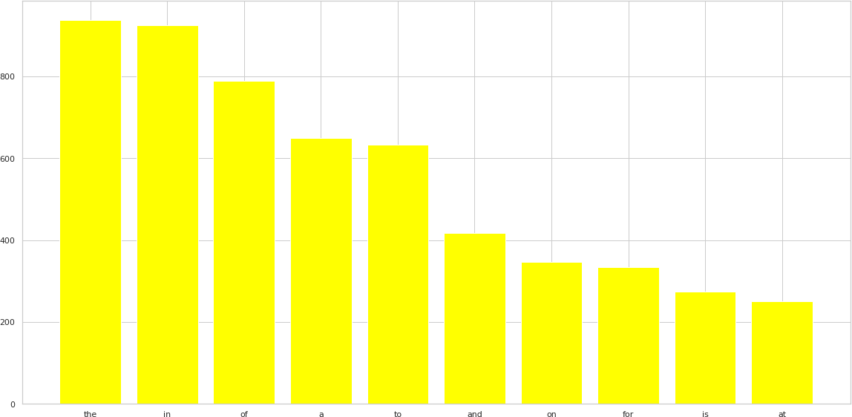
6/15/2021
twitter_analyis_classification_v1.ipynb - Colaboratory
dic[word]+=1
top=sorted(dic.items(), key=lambda x:x[1],reverse=True)[:10]
x,y=zip(*top) plt.bar(x,y,color='yellow')
<BarContainer object of 10 artists>
N Grams Analysis: Bi grams Tri grams
Unigrams are single words, bigrams are two words, trigrams are three words, 4-grams are four words, 5-grams are five words, etc.N-gram is simply a sequence of N words.
Some of the applications where N-grams used in NLP AutoComplete
Auto Spell Check Check Grammar

Slide 19
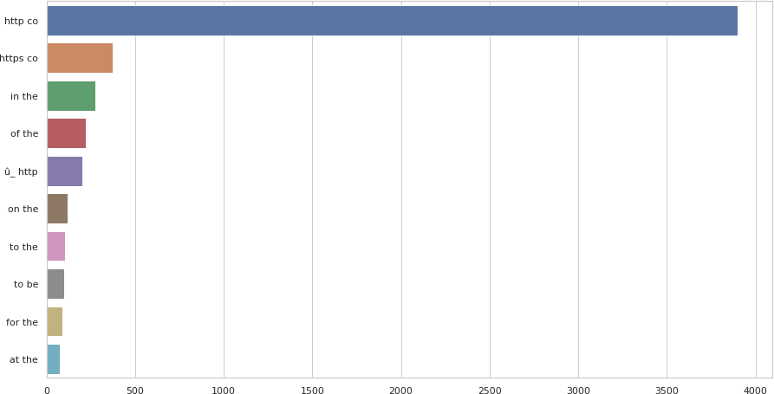
6/15/2021
twitter_analyis_classification_v1.ipynb - Colaboratory
Virtual Assistant — Bots
#Bi grams and tri grams analysis
def get_top_tweet_bigrams(corpus, n=None):
vec = CountVectorizer(ngram_range=(2, 2)).fit(corpus) bag_of_words = vec.transform(corpus)
sum_words = bag_of_words.sum(axis=0)
words_freq = [(word, sum_words[0, idx]) for word, idx in vec.vocabulary_.items()] words_freq =sorted(words_freq, key = lambda x: x[1], reverse=True)
return words_freq[:n]
plt.figure(figsize=(15,8)) top_tweet_bigrams=get_top_tweet_bigrams(tweets['text'])[:10] x,y=map(list,zip(*top_tweet_bigrams))
sns.barplot(x=y,y=x)
<matplotlib.axes._subplots.AxesSubplot at 0x7fc1a8d10e90>
def get_top_tweet_trigrams(corpus, n=None):
vec = CountVectorizer(ngram_range=(3, 3)).fit(corpus) bag_of_words = vec.transform(corpus)
sum_words = bag_of_words.sum(axis=0)
words_freq = [(word, sum_words[0, idx]) for word, idx in vec.vocabulary_.items()] words_freq =sorted(words_freq, key = lambda x: x[1], reverse=True)

Slide 20
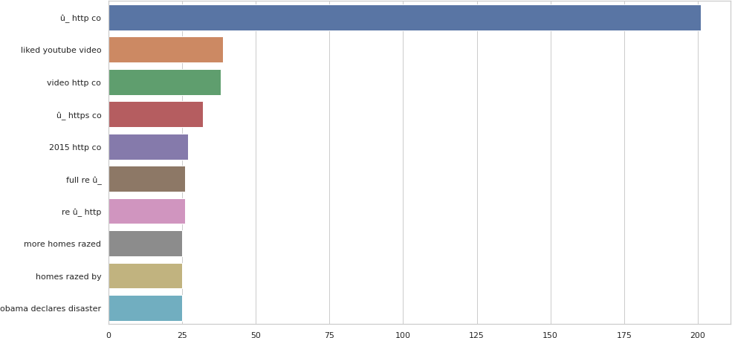
6/15/2021
twitter_analyis_classification_v1.ipynb - Colaboratory
return words_freq[:n]
plt.figure(figsize=(15,8)) top_tweet_trigrams=get_top_tweet_trigrams(tweets['text'])[:10] x,y=map(list,zip(*top_tweet_trigrams))
sns.barplot(x=y,y=x)
<matplotlib.axes._subplots.AxesSubplot at 0x7fc1a8e84810>
Feature Engineering
ID
keyword Location text target random
ID is not needed. It is unique and can be dropped.It won't help with the prediction.The same with random column. All values are unique and can be dropped.
There are lot of missing values for location and it won't help with the prediction. Hence the location can be dropped.

Slide 21
6/15/2021 twitter_analyis_classification_v1.ipynb - Colaboratory
The only feature needed is text and the target column.
# check missing values tweets.isnull().sum()
id | 0
keyword | 56
location | 2294
text | 0
target | 0
random | 0
dtype: int64
# all duplicate tweets
duplicated_df = tweets[tweets["text"].duplicated()]
print(f"Number of Duplicated Tweets in Train: {len(duplicated_df)}\n\
Number of Duplicated Tweets in Train: {duplicated_df['target'].notna().sum()}")
Number of Duplicated Tweets in Train: 95 Number of Duplicated Tweets in Train: 95
# add all the tweets with duplicates
train_duplicates = tweets[tweets["text"].duplicated()].groupby(["text"])[["target"]].agg(list
diff_label_idx = []
for idx, val in enumerate(train_duplicates["target"]): for ele in val:
if ele != val[0]: diff_label_idx.append(idx)
print(f"Number of Duplicated Tweets with different target labels in train: {len(diff_label_id Number of Duplicated Tweets with different target labels in train: 8
# tweets with different labels train_duplicates.iloc[diff_label_idx]

Slide 22
6/15/2021
twitter_analyis_classification_v1.ipynb - Colaboratory
target
text
#foodscare #offers2go #NestleIndia slips into loss after #Magginoodle #ban unsafe and
[1, 0]
hazardous for #humanconsumption
CLEARED:incident with injury:I-495 inner loop Exit 31 - MD 97/Georgia Ave Silver Spring [0, 1]
He came to a land which was engulfed in tribal war and turned it into a land of peace i.e. [1, 0, 1,
Madinah. #ProphetMuhammad #islam 0]
#Drop the columns
tweets.drop(columns = ['location', 'keyword', 'id', 'random'], inplace = True) #tweets.drop(columns = ['location', 'keyword', 'id'], inplace = True)
He came to a land which was engulfed in tribal war and turned it into a land of peace i.e. [1, 0, 1,
Madinah. #ProphetMuhammad #islam 0]
Hellfire is surrounded by desires so be careful and don□Ûªt let your desires control you!
#Afterlife ^{[0, 1]}
The Prophet (peace be upon him) said 'Save yourself from Hellfire even if it is by giving [0, 0, 0,
tweets.head(5)
text | target
0 @randerson62 Watching news of wild fires and h... | 1
1 Afghanistan: U.N. Reports 'Record-High Levels'... | 1
2 @marksmaponyane Hey!Sundowns were annihilated ... | 0
3 Gotta love #summer in #Calgary. #yyc #hailstor... | 1
4 ANNIHILATED IN DAMASCUS: SYRIAN ARMY GRINDS □Û... | 1
tweets.shape[0]
6877
#tweets.drop_duplicates() tweets.sort_values("text", inplace=True) tweets.drop_duplicates(keep=False,inplace=True)
tweets.shape[0] 6738
def text_clear(data):
tx = data.apply(lambda x: re.sub("http\S+", '', str(x)))
tx = tx.apply(lambda x: re.sub(u'[^a-zA-Z0-9áéíóúÁÉÍÓÚâêîôÂÊÎÔãõÃÕçÇ: ]', '',x)) tx = tx.apply(lambda x: re.sub(' +', ' ', x))
tx = tx.apply(lambda x: re.sub('(#[A-Za-z]+[A-Za-z0-9-_]+)', '', x))
tx = tx.apply(lambda x: re.sub('(@[A-Za-z]+[A-za-z0-9-_]+)', '', x)) tx = tx.apply(lambda x: re.sub('rt', '', x))
tx = tx.apply(lambda x: ''.join([i for i in x if i not in string.punctuation])) return tx
clean_tweets=tweets
clean_tweets['text'] = text_clear(clean_tweets['text'])

Slide 23
6/15/2021
clean_tweets.head()
twitter_analyis_classification_v1.ipynb - Colaboratory
 | text | target
2243 | Residents Return To Destroyed Homes As Washin... | 1
4203 | 360WiseNews Chinas Stock Market Crash Are The... | 1
1711 | 360WiseNews Chinas Stock Market Crash Are The... | 1
2555 | 360WiseNews Chinas Stock Market Crash Are The... | 0
2239 | 3 TITAN WarriorCord 100 Feet Authentic Militar... | 0
test_tweets=df_test
test_tweets['text'] = text_clear(test_tweets['text']) test_tweets.head()
text
Indian coast need to be prepared disaster read...
Unimaginable loss of lives and propey due to m...
2
For people living with disabilities preparing ...
3 When you go to make an iced coffee and realise...
Model
I used the following frameworks
Sci Kit Learn - Logistic Regression Tensorflow - Transfer Learning - BERT Model GCP - AutoMl
BERT
BERT stands for Bidirectional Encoder Representations from Transformers
BERT stands for Bidirectional Encoder Representations from Transformers. It is designed to pre- train deep bidirectional representations from unlabeled text by jointly conditioning on both left and right context. As a result, the pre-trained BERT model can be fine-tuned with just one additional output layer to create state-of-the-art models for a wide range of NLP tasks.”
BERT is pre-trained on a large corpus of unlabelled text including the entire Wikipedia(that’s 2,500 million words!) and Book Corpus (800 million words).
BERT is a “deeply bidirectional” model. Bidirectional means that BERT learns information from both the left and the right side of a token’s context during the training phase.

Slide 24

6/15/2021
twitter_analyis_classification_v1.ipynb - Colaboratory
tokenizer = BertTokenizer.from_pretrained('bert-large-uncased')
def bert_encode(data, maximum_length) : input_ids = []
attention_masks = []
for text in data:
encoded = tokenizer.encode_plus( text, add_special_tokens=True, max_length=maximum_length, pad_to_max_length=True, truncation=True, return_attention_mask=True
)
input_ids.append(encoded['input_ids']) attention_masks.append(encoded['attention_mask'])
return np.array(input_ids),np.array(attention_masks)
texts = clean_tweets['text'] target = clean_tweets['target']
train_input_ids, train_attention_masks = bert_encode(texts,90)
test_texts = df_test['text']
test input ids, test attention masks = bert encode(test texts,90)

Slide 25
6/15/2021
twitter_analyis_classification_v1.ipynb - Colaboratory
from transformers import TFBertModel
bert_model = TFBertModel.from_pretrained('bert-base-uncased')
Some layers from the model checkpoint at bert-base-uncased were not used when initializ
This IS expected if you are initializing TFBertModel from the checkpoint of a model t
This IS NOT expected if you are initializing TFBertModel from the checkpoint of a mod All the layers of TFBertModel were initialized from the model checkpoint at bert-base-u If your task is similar to the task the model of the checkpoint was trained on, you can
Keras Sequential Model:
2 Dense layer Introduce dropout - 0.2
Loss: binary crossentropy because of binary classfication
import tensorflow as tf
from tensorflow.keras.optimizers import Adam
def create_model(bert_model):
input_ids = tf.keras.Input(shape=(90,),dtype='int32') attention_masks = tf.keras.Input(shape=(90,),dtype='int32')
output = bert_model([input_ids,attention_masks]) output = output[1]
output = tf.keras.layers.Dense(32,activation='relu')(output) output = tf.keras.layers.Dropout(0.2)(output)
output = tf.keras.layers.Dense(1,activation='sigmoid')(output)
model = tf.keras.models.Model(inputs = [input_ids,attention_masks],outputs = output) model.compile(Adam(lr=1e-5), loss='binary_crossentropy', metrics=['accuracy']) return model
Loss function
Since this is a binary classification problem and the model outputs a probability (a single-unit layer), I will use BinaryCrossentropy loss function.
model = create_model(bert_model)
WARNING:tensorflow:The parameters `output_attentions`, `output_hidden_states` and `use_ WARNING:tensorflow:The parameters `output_attentions`, `output_hidden_states` and `use_ WARNING:tensorflow:The parameter `return_dict` cannot be set in graph mode and will alw WARNING:tensorflow:The parameter `return_dict` cannot be set in graph mode and will alw

Slide 26

6/15/2021
twitter_analyis_classification_v1.ipynb - Colaboratory
tf.keras.utils.plot_model(bert_model)
EarlyStopping: Stop training when a monitored metric has stopped improving.
ReduceLROnPlateau :Reduce learning rate when a metric has stopped improving.
stoped = EarlyStopping(monitor='val_loss', patience=5, min_delta=0.0001)
redutor = ReduceLROnPlateau(monitor='val_accuracy', patience=3, verbose=1, factor=0.5, min_lr
history = model.fit([train_input_ids, train_attention_masks],
target, validation_split=0.2, epochs=50, batch_size=32, callbacks=[stoped, redutor])
Epoch 1/50
WARNING:tensorflow:The parameters `output_attentions`, `output_hidden_states` and `use_ WARNING:tensorflow:The parameters `output_attentions`, `output_hidden_states` and `use_ WARNING:tensorflow:The parameter `return_dict` cannot be set in graph mode and will alw WARNING:tensorflow:The parameter `return_dict` cannot be set in graph mode and will alw WARNING:tensorflow:The parameters `output_attentions`, `output_hidden_states` and `use_ WARNING:tensorflow:The parameters `output_attentions`, `output_hidden_states` and `use_ WARNING:tensorflow:The parameter `return_dict` cannot be set in graph mode and will alw WARNING:tensorflow:The parameter `return_dict` cannot be set in graph mode and will alw 169/169 [==============================] - ETA: 0s - loss: 0.5148 - accuracy: 0.7601WAR
WARNING:tensorflow:The parameters `output_attentions`, `output_hidden_states` and `use_ WARNING:tensorflow:The parameter `return_dict` cannot be set in graph mode and will alw WARNING:tensorflow:The parameter `return_dict` cannot be set in graph mode and will alw
169/169 [==============================] | - 81s | 392ms/step | - loss: | 0.5148 | - accuracy: | 0.
Epoch 2/50
169/169 [==============================] | - 64s | 377ms/step | - loss: | 0.3871 | - accuracy: | 0.
Epoch 3/50
169/169 [==============================] | - 64s | 377ms/step | - loss: | 0.3333 | - accuracy: | 0.
Epoch 4/50
169/169 [==============================] | - 64s | 377ms/step | - loss: | 0.2633 | - accuracy: | 0.
Epoch 5/50
169/169 [==============================] | - 64s | 377ms/step | - loss: | 0.2127 | - accuracy: | 0.
Epoch 6/50
169/169 [==============================] | - 64s | 377ms/step | - loss: | 0.1746 | - accuracy: | 0.
Epoch 7/50
169/169 [==============================] | - 64s | 377ms/step | - loss: | 0.1405 | - accuracy: | 0.
import matplotlib.pyplot as plt import seaborn as sns
fig, axes = plt.subplots(1, 2, figsize=(15,5)) axes[0].plot(history.history['accuracy']) axes[0].plot(history.history['val accuracy'])

Slide 27
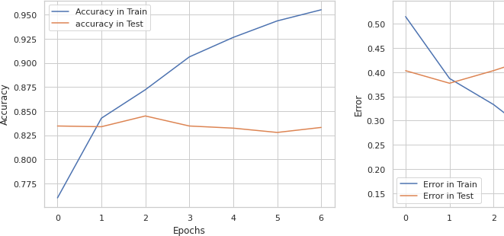
6/15/2021 twitter_analyis_classification_v1.ipynb - Colaboratory
axes[0].set_xlabel('Epochs') axes[0].set_ylabel('Accuracy') axes[0].legend(['Accuracy in Train','accuracy in Test']) axes[0].grid(True)
axes[1].plot(history.history['loss']) axes[1].plot(history.history['val_loss']) axes[1].set_xlabel('Epochs') axes[1].set_ylabel('Error')
axes[1].legend(['Error in Train','Error in Test']) axes[1].grid(True)

Slide 28

6/15/2021
twitter_analyis_classification_v1.ipynb - Colaboratory
predictions = model.predict([test_input_ids, test_attention_masks])
WARNING:tensorflow:The parameters `output_attentions`, `output_hidden_states` and `use_ WARNING:tensorflow:The parameters `output_attentions`, `output_hidden_states` and `use_ WARNING:tensorflow:The parameter `return_dict` cannot be set in graph mode and will alw WARNING:tensorflow:The parameter `return_dict` cannot be set in graph mode and will alw
#probs = model.predict(test_df["text"]) threshold = 0.5
preds = np.where(predictions[:,] > threshold, 1, 0)
print(preds)
[[1]
[1]
[1]
[0]]
#!mkdir -p saved_model export_dir='/content/saved_model'

Slide 29
6/15/2021 twitter_analyis_classification_v1.ipynb - Colaboratory
tf.saved_model.save(bert_model, export_dir=export_dir)
WARNING:tensorflow:The parameters `output_attentions`, `output_hidden_states` and `use_ WARNING:tensorflow:The parameters `output_attentions`, `output_hidden_states` and `use_ WARNING:tensorflow:The parameter `return_dict` cannot be set in graph mode and will alw WARNING:tensorflow:The parameter `return_dict` cannot be set in graph mode and will alw WARNING:tensorflow:The parameters `output_attentions`, `output_hidden_states` and `use_ WARNING:tensorflow:The parameters `output_attentions`, `output_hidden_states` and `use_ WARNING:tensorflow:The parameter `return_dict` cannot be set in graph mode and will alw WARNING:tensorflow:The parameter `return_dict` cannot be set in graph mode and will alw WARNING:tensorflow:The parameters `output_attentions`, `output_hidden_states` and `use_ WARNING:tensorflow:The parameters `output_attentions`, `output_hidden_states` and `use_ WARNING:tensorflow:The parameter `return_dict` cannot be set in graph mode and will alw WARNING:tensorflow:The parameter `return_dict` cannot be set in graph mode and will alw WARNING:tensorflow:The parameters `output_attentions`, `output_hidden_states` and `use_ WARNING:tensorflow:The parameters `output_attentions`, `output_hidden_states` and `use_ WARNING:tensorflow:The parameter `return_dict` cannot be set in graph mode and will alw WARNING:tensorflow:The parameter `return_dict` cannot be set in graph mode and will alw WARNING:tensorflow:The parameters `output_attentions`, `output_hidden_states` and `use_ WARNING:tensorflow:The parameters `output_attentions`, `output_hidden_states` and `use_ WARNING:tensorflow:The parameter `return_dict` cannot be set in graph mode and will alw WARNING:tensorflow:The parameter `return_dict` cannot be set in graph mode and will alw WARNING:tensorflow:The parameters `output_attentions`, `output_hidden_states` and `use_ WARNING:tensorflow:The parameters `output_attentions`, `output_hidden_states` and `use_ WARNING:tensorflow:The parameter `return_dict` cannot be set in graph mode and will alw WARNING:tensorflow:The parameter `return_dict` cannot be set in graph mode and will alw WARNING:tensorflow:The parameters `output_attentions`, `output_hidden_states` and `use_ WARNING:tensorflow:The parameters `output_attentions`, `output_hidden_states` and `use_ WARNING:tensorflow:The parameter `return_dict` cannot be set in graph mode and will alw WARNING:tensorflow:The parameter `return_dict` cannot be set in graph mode and will alw WARNING:tensorflow:The parameters `output_attentions`, `output_hidden_states` and `use_ WARNING:tensorflow:The parameters `output_attentions`, `output_hidden_states` and `use_ WARNING:tensorflow:The parameter `return_dict` cannot be set in graph mode and will alw WARNING:tensorflow:The parameter `return_dict` cannot be set in graph mode and will alw WARNING:absl:Found untraced functions such as embeddings_layer_call_and_return_conditio WARNING:tensorflow:FOR KERAS USERS: The object that you are saving contains one or more
FOR DEVS: If you are overwriting _tracking_metadata in your class, this property has be WARNING:tensorflow:FOR KERAS USERS: The object that you are saving contains one or more
FOR DEVS: If you are overwriting _tracking_metadata in your class, this property has be INFO:tensorflow:Assets written to: /content/saved_model/assets
INFO:tensorflow:Assets written to: /content/saved_model/assets
reloaded = tf.saved_model.load(export_dir)
print(list(reloaded.signatures.keys())) # ["serving_default"] ['serving_default']
infer = reloaded.signatures["serving_default"] print(infer.structured_outputs)

Slide 30
6/15/2021
twitter_analyis_classification_v1.ipynb - Colaboratory
{'last_hidden_state': TensorSpec(shape=(None, 5, 768), dtype=tf.float32, name='last_hid
import pandas as pd
from sklearn.naive_bayes import MultinomialNB
from sklearn.metrics import classification_report, confusion_matrix, accuracy_score from sklearn.model_selection import train_test_split
from sklearn.feature_extraction.text import TfidfVectorizer from sklearn.feature_extraction.text import CountVectorizer from sklearn.feature_extraction.text import TfidfTransformer
X_train, X_test, Y_train, Y_test = train_test_split(clean_tweets['text'],
clean_tweets['target'], test_size = 0.2,
random_state = 10)
# Convert a collection of text documents to a matrix of token counts tfidf = TfidfVectorizer(encoding='utf-8',
ngram_range=(1,1), max_features=5000, norm='l2', sublinear_tf=True)
train_features = tfidf.fit_transform(X_train).toarray()
print(train_features[1]) print(train_features.shape)
[0. 0. 0. ... 0. 0. 0.]
(5390, 5000)
test_features = tfidf.transform(X_test).toarray() print(test_features.shape)
(1348, 5000)
train_labels = Y_train test_labels = Y_test
mnb_classifier = MultinomialNB() mnb_classifier.fit(train_features,train_labels)
MultinomialNB(alpha=1.0, class_prior=None, fit_prior=True)

Slide 31
6/15/2021
twitter_analyis_classification_v1.ipynb - Colaboratory
training_accuracy = accuracy_score(train_labels, mnb_classifier.predict(train_features)) print(training_accuracy)
0.862708719851577
mnb_prediction = mnb_classifier.predict(test_features) print(mnb_prediction)
[0 1 1 ... 0 0 0]
testing_accuracy = accuracy_score(test_labels, mnb_prediction) print(testing_accuracy)
0.7856083086053413
print(classification_report(test_labels, mnb_prediction))
 | precision | recall | f1-score | support
0 | 0.76 | 0.92 | 0.83 | 777
1 | 0.84 | 0.61 | 0.71 | 571
accuracy |  |  | 0.79 | 1348
macro avg | 0.80 | 0.76 | 0.77 | 1348
weighted avg | 0.80 | 0.79 | 0.78 | 1348
AutoML AutoML enables developers with limited machine learning expertise to train high-quality models specific to their business needs. Build your own custom machine learning model in minutes.
AutoML Natural Language enables you to build and deploy custom machine learning models that analyze documents, categorizing them, identify entities within them, or assessing attitudes within them.
Auto ML Steps:
Import the file and store it in a GCP bucket Verfy the file contents
Train the model Evaluate the model
Test and deploy the model

Slide 32
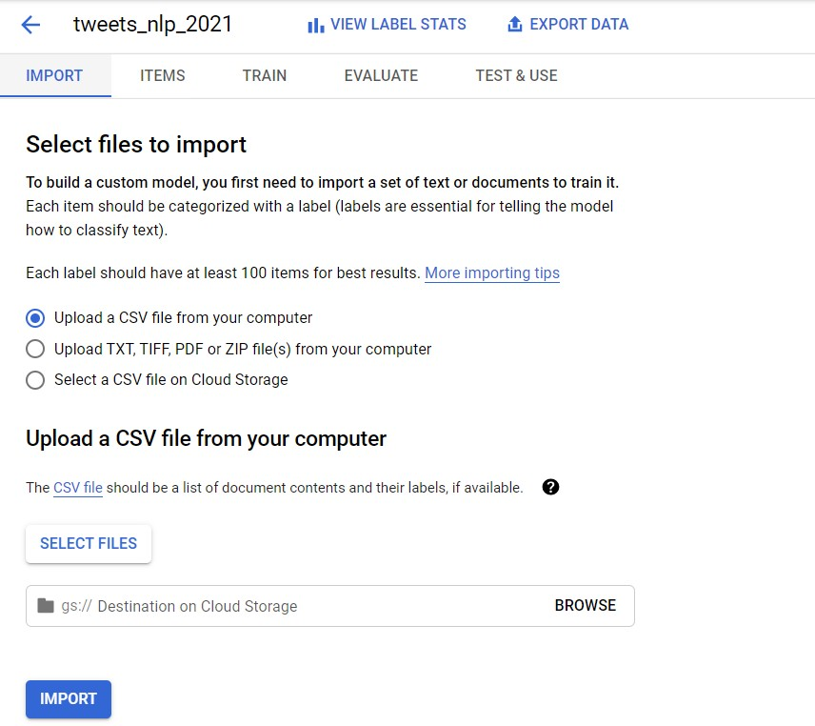
6/15/2021
twitter_analyis_classification_v1.ipynb - Colaboratory

Slide 33
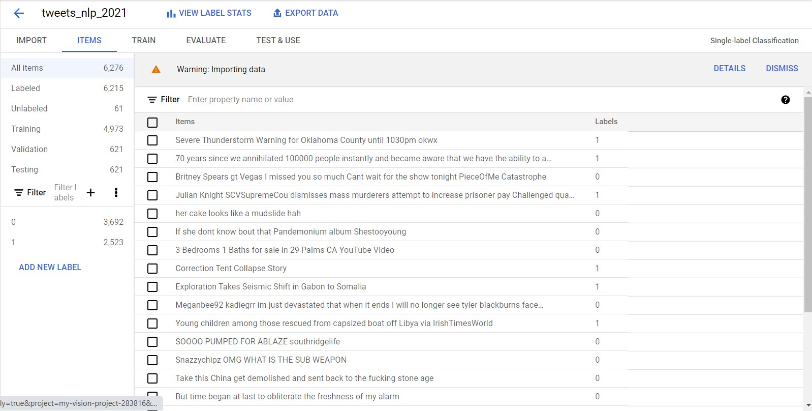
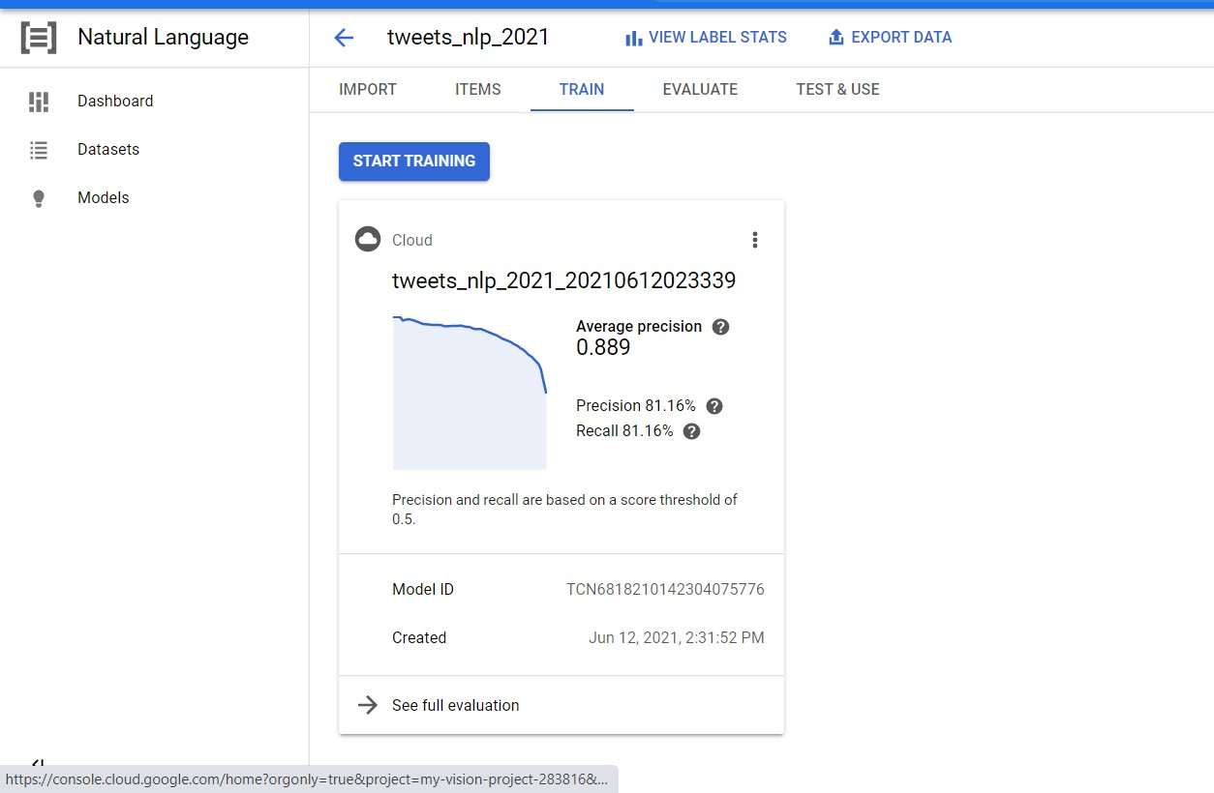
6/15/2021
twitter_analyis_classification_v1.ipynb - Colaboratory

Slide 34
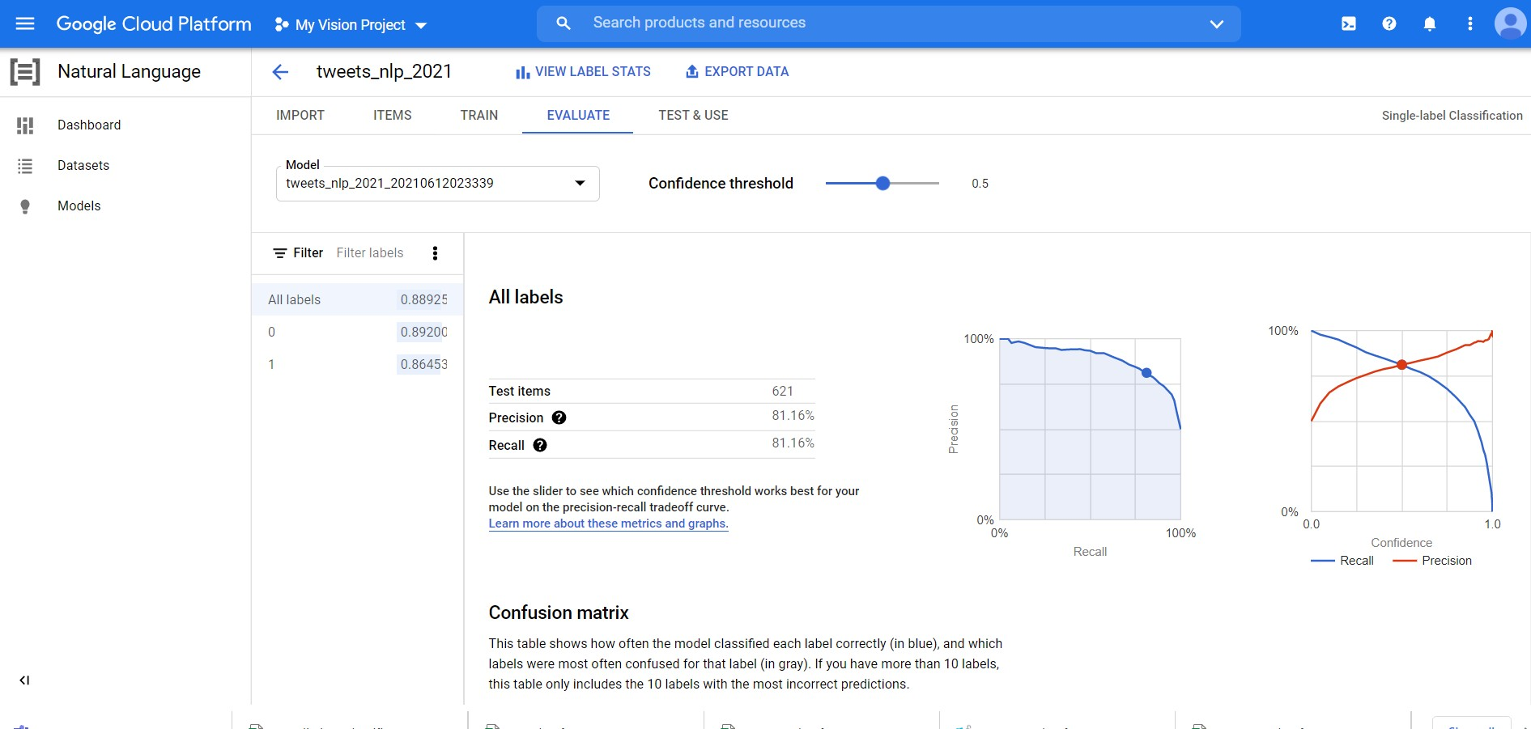
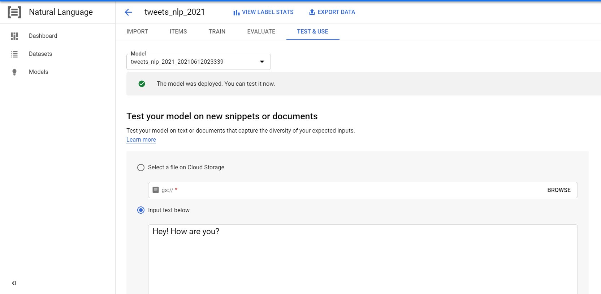
6/15/2021
twitter_analyis_classification_v1.ipynb - Colaboratory

Slide 35
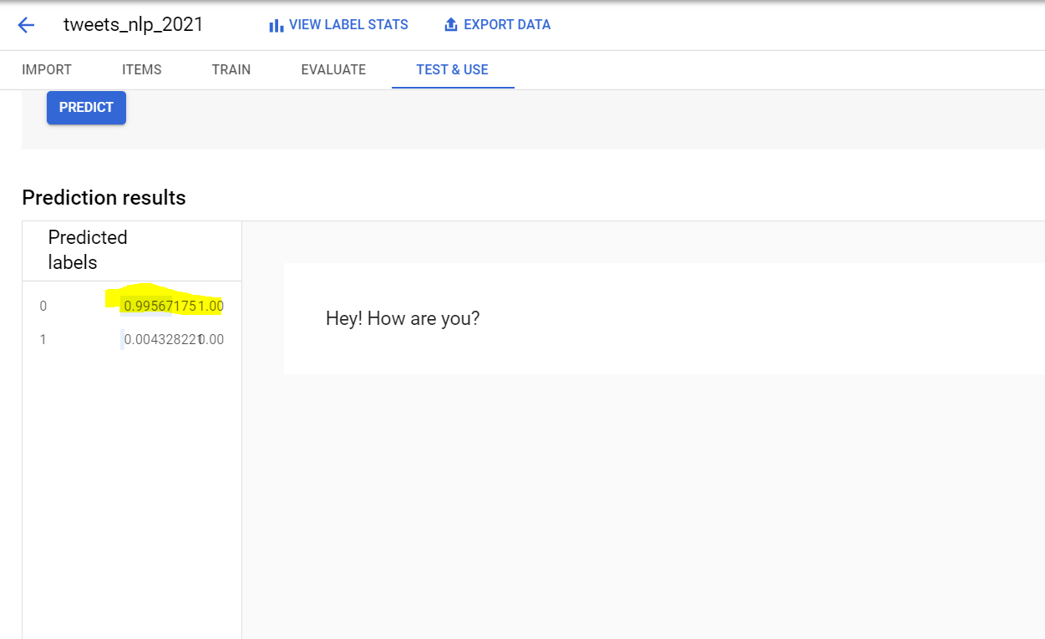
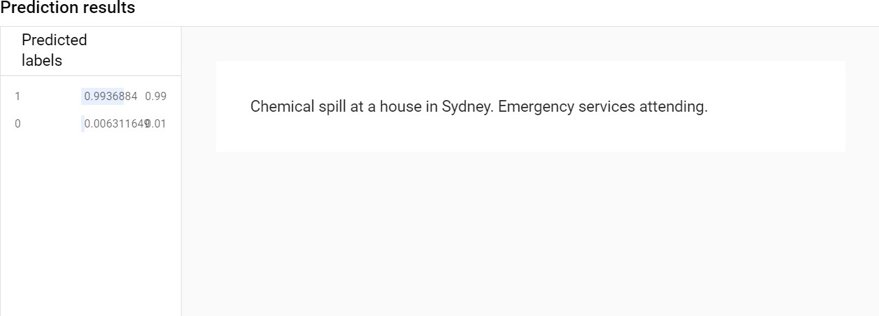
6/15/2021
twitter_analyis_classification_v1.ipynb - Colaboratory

Slide 36
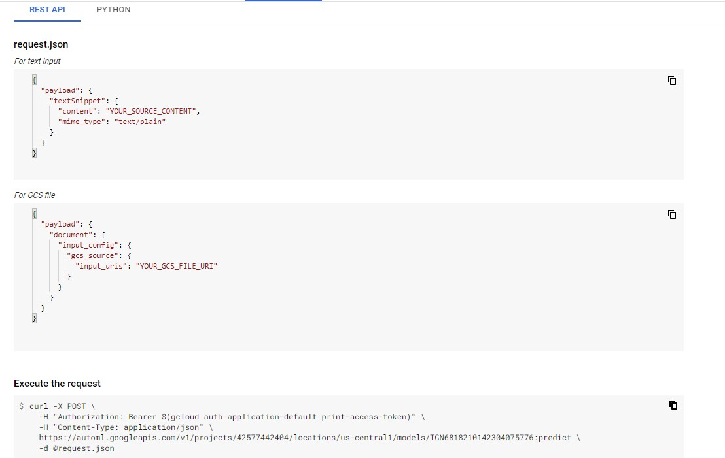
6/15/2021
twitter_analyis_classification_v1.ipynb - Colaboratory
Conclusion:
The Bert tensorflow model gave an accuracy of around 82%, the logictic regression gave around 78% and the automl model around 82%.
Again scope for improvements. try with multiple algorithms do hyper parameter tuning
Increase the training set size.
References:
BERT Explained
Tensorflow - classify with BERT 3.BERT Visual Guide
4.Google AutoML - NLP API

Slide 37
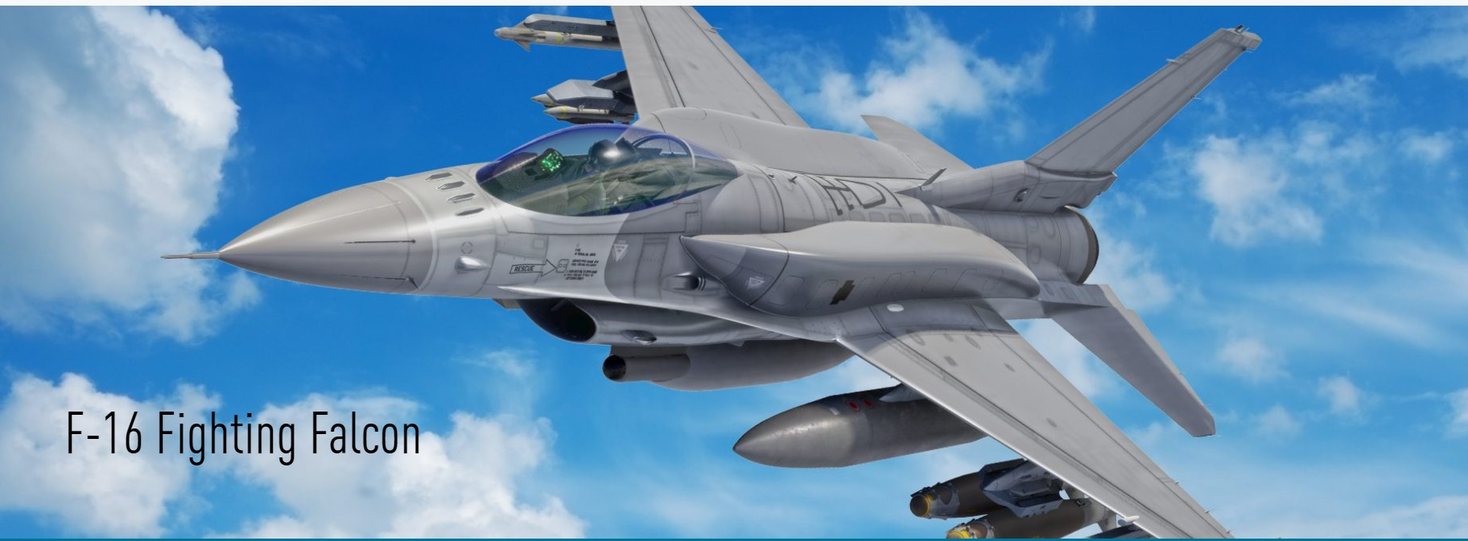
6/15/2021
5.BERT used in all English Queries
twitter_analyis_classification_v1.ipynb - Colaboratory
Thank you for your time.
Questions Session

0s completed at 7:41 PM

