Slide 1
Credit Card customers - Predict Churning customers

Slide 2
Contents
Problem statement-why is it useful to answer the question
Clients and intended audience
Dataset used for the investigation
Data cleaning and wrangling
Data visualization
Exploratory data analysis (EDA)
Machine learning algorithms
Conclusions

Slide 3
Problem Statement
A manager at the bank is disturbed with more and more customers leaving their credit card services.
They would really appreciate if one could predict for them who is gonna get churned so they can proactively go to the customer to provide them better services and turn customers' decisions in the opposite direction.
I got this dataset from a website with the URL as https://leaps.analyttica.com/home.
Now, this dataset consists of 10,000 customers mentioning their age, salary, marital_status, credit card limit, credit card category, etc. There are nearly 18 features.
We have only 16.07% of customers who have churned. Thus, it's a bit difficult to train our model to predict churning customers.

Slide 4
Motivation
The reason for picking up this problem is to find out the reason for customers leaving credit card services.
To avoid these scenarios we need to provide services based on customer needs and usage.
It is important that credit card companies are able to recognize the pulse of customer usage in credit card services.

Slide 5
Clients/ Intended audience
The model can be used by the banks in identifying the customer going to leave credit card services.
In turn Banks can take an alternate action to keep the customers.

Slide 6
Dataset
The dataset used for this analysis is from Kaggle website and the data source is listed below:
https://leaps.analyttica.com/home
The dataset contains information about the credit card services.

Slide 7
Data cleaning and wrangling
Finding the shape of the data using data.shape method and the shape is (10127, 21)
No Duplicates and No null values found in this data.
This dataset has 21 features.
(data['Class'].value_counts(dropna=False))

Slide 8
Data Visualization
Existing Customer - 8500
Attrited Customer - 1627

Slide 9
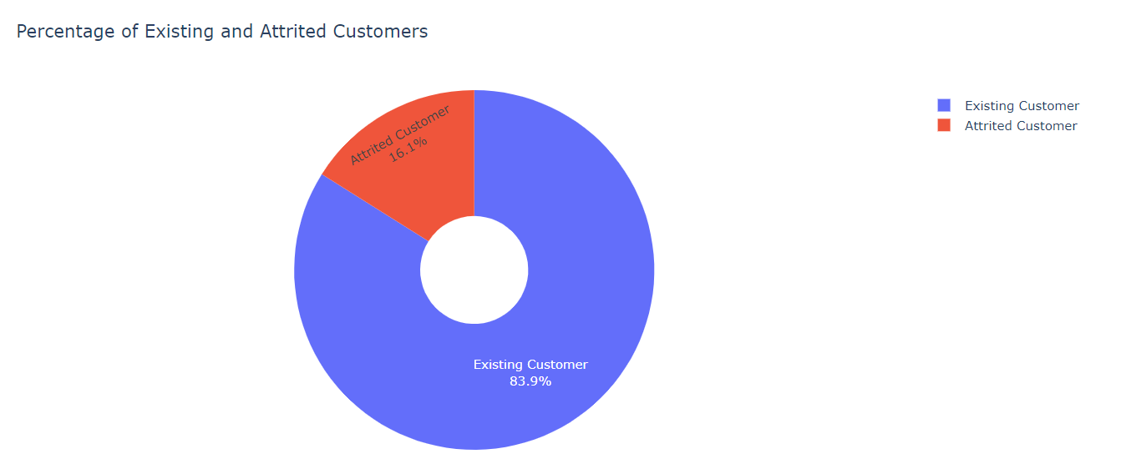
EDA

Slide 10
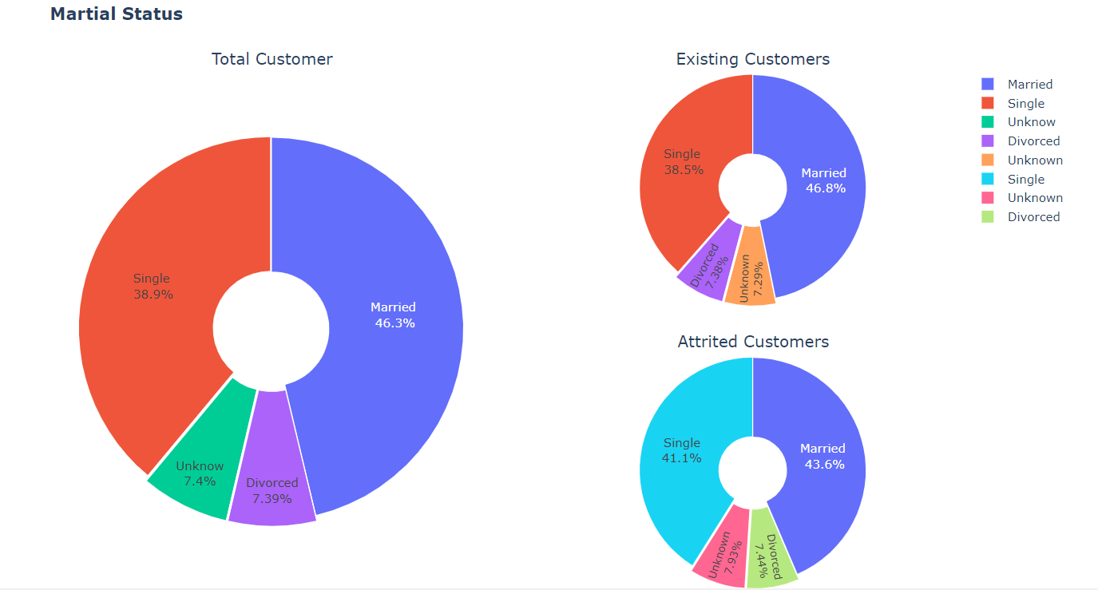

Slide 11
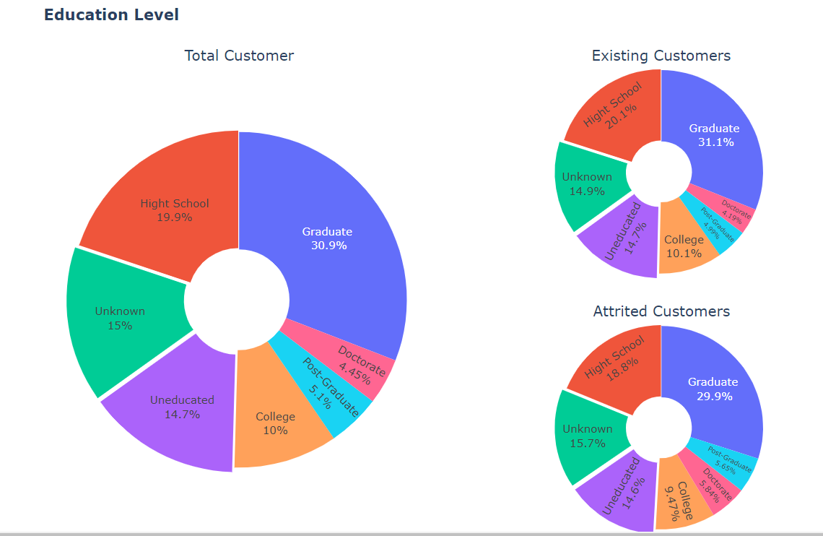

Slide 12
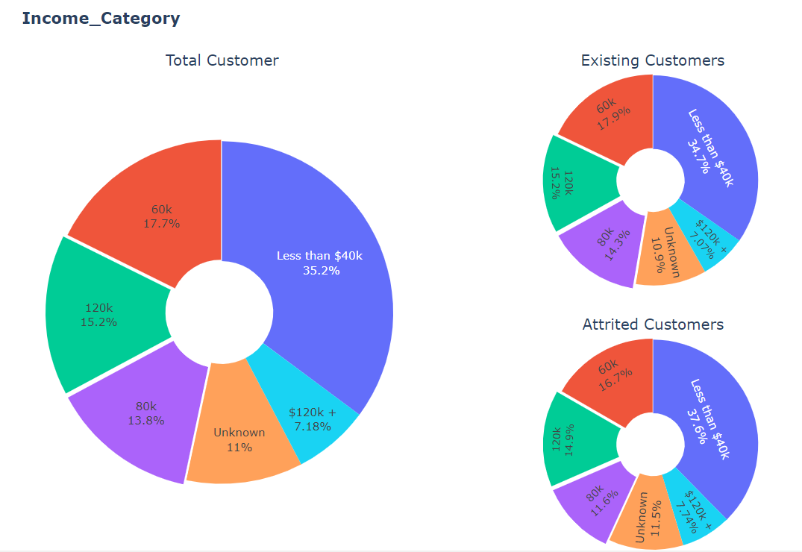

Slide 13
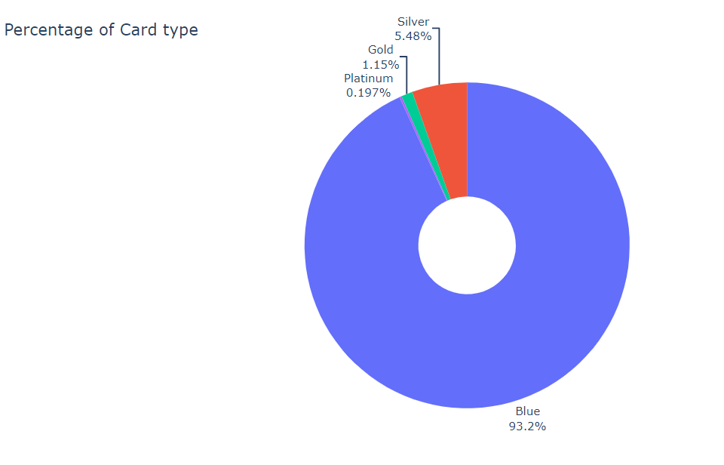

Slide 14
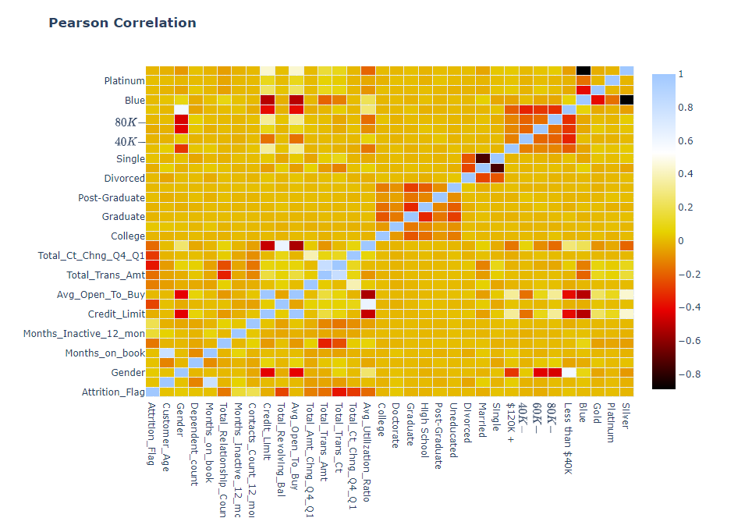

Slide 15
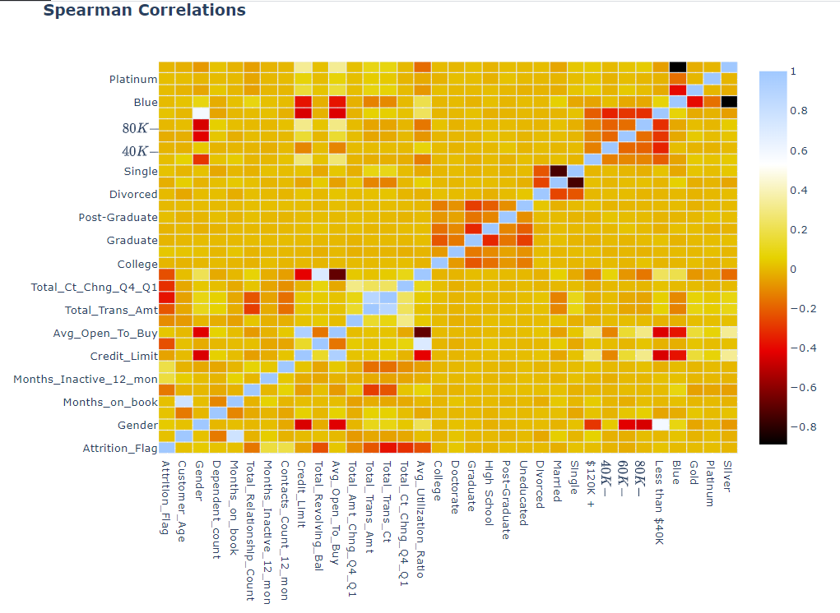

Slide 16
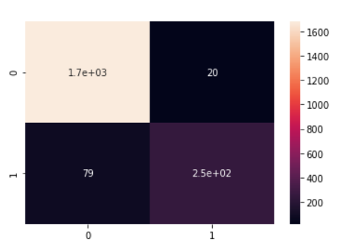
Confusion Matrix – Random Forest

Slide 17
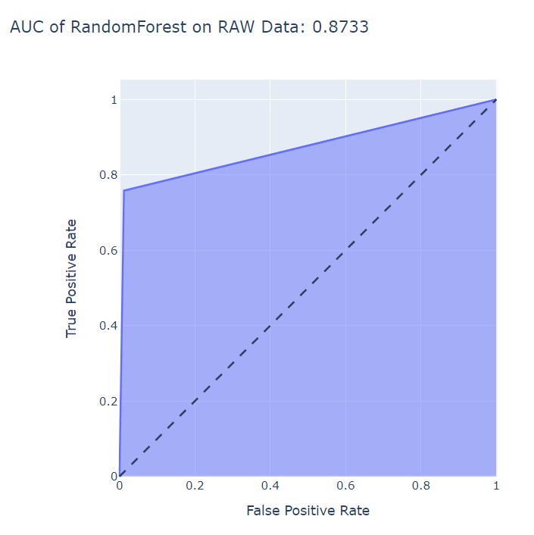

Slide 18
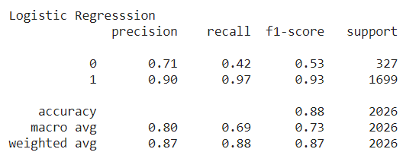
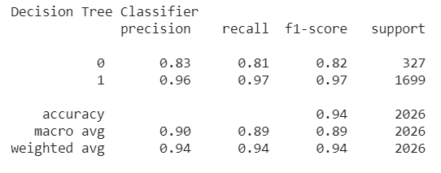
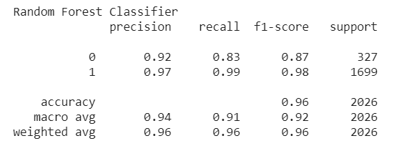
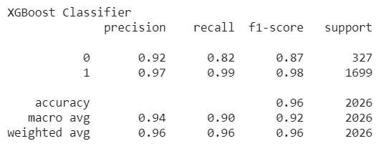
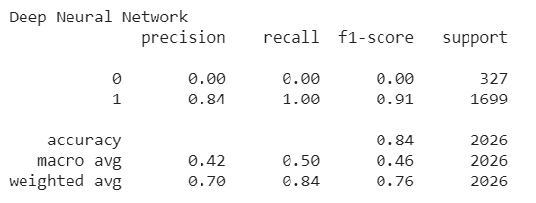
Machine Learning Algorithms

Slide 19
Conclusions
We had very successful results with Decision Tree, Random Forest and XGBOOST up to %96 accuracy.
I have used regression, random forest, decision tree and neural network approaches with this dataset.
I was able to achieve %96 accuracy with xgboost which is pretty good.
Overall, every model performed good but some of them were more suitable for this problem.

Slide 20
Future Work
Will try implementing some more models to improve the accuracy even more.

