Slide 1
Credit Card Fraud Detection

Slide 2
Contents
Problem statement-why is it useful to answer the question
Clients and intended audience
Dataset used for the investigation
Data cleaning and wrangling
Data visualization
Exploratory data analysis (EDA)
Machine learning algorithms
Conclusions

Slide 3
Problem Statement
The dataset contains transactions made by credit cards in September 2013 by European cardholders.
This dataset presents transactions that occurred in two days, where we have 492 frauds out of 284,807 transactions.
The dataset is highly unbalanced, the positive class (frauds) account for 0.172% of all transactions.
It contains only numerical input variables which are the result of a PCA transformation.
Unfortunately, due to confidentiality issues, we cannot provide the original features and more background information about the data.
Features V1, V2, … V28 are the principal components obtained with PCA, the only features which have not been transformed with PCA are 'Time' and 'Amount'.
Feature 'Time' contains the seconds elapsed between each transaction and the first transaction in the dataset.
The feature 'Amount' is the transaction Amount, this feature can be used for example-dependent cost-sensitive learning.
Feature 'Class' is the response variable and it takes value 1 in case of fraud and 0 otherwise.
Given the class imbalance ratio, we recommend measuring the accuracy using the Area Under the Precision-Recall Curve (AUPRC).

Slide 4
Motivation
The reason for choosing this problem is that in daily life there are more number of fraudulent intruders interacting like customers and using their money.
To avoid these scenarios we need some system to be developed in identifying the fraudulent behaviors.
It is important that credit card companies are able to recognize fraudulent credit card transactions so that customers are not charged for items that they did not purchase.

Slide 5
Clients/ Intended audience
The model can be used by the banks in identifying the fraudulent users of credit card.
This can also be used for the banks in avoiding the illegal usage of credit cards.

Slide 6
Dataset
The dataset used for this analysis is from Kaggle website and the data source is listed below:
https://www.kaggle.com/mlg-ulb/creditcardfraud
The dataset contains information about the credit card information as it is highly confidential they have not provided the column names of the data.

Slide 7
Data cleaning and wrangling
Finding the shape of the data using data.shape method and the shape is (284807, 31)
No Duplicates and No null values found in this data.
This dataset has 31 features.
With this method, we found there are
284315 - Non-fraudulent
492 - Fraudulent
(data['Class'].value_counts(dropna=False))

Slide 8
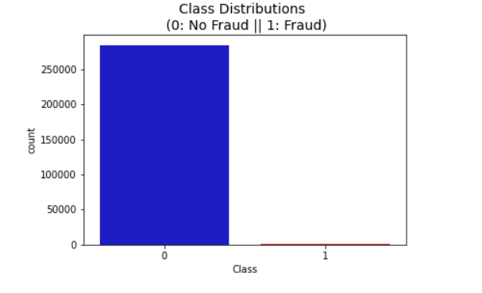
Data Visualization
Percent of Non-Fraudulent Transactions = 99.827%
Percent of Fraudulent Transactions = 0.173%

Slide 9
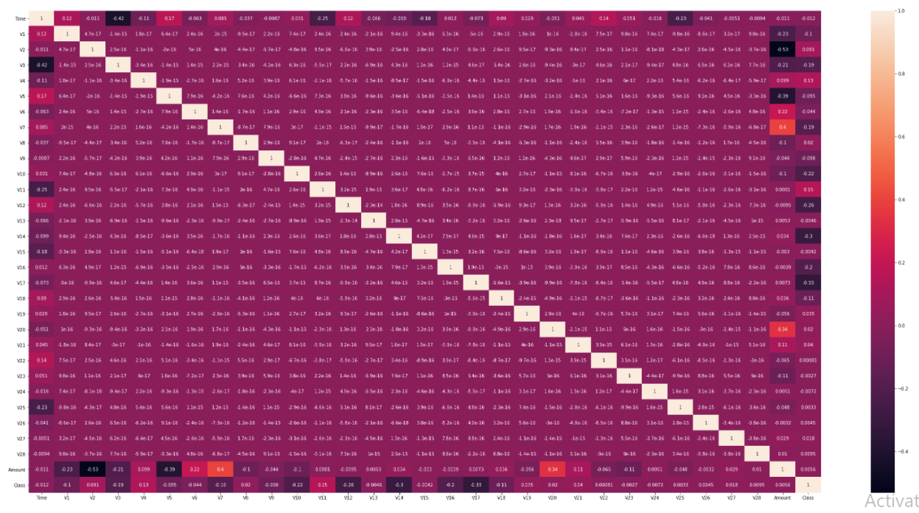
EDA – Correlation matrix

Slide 10
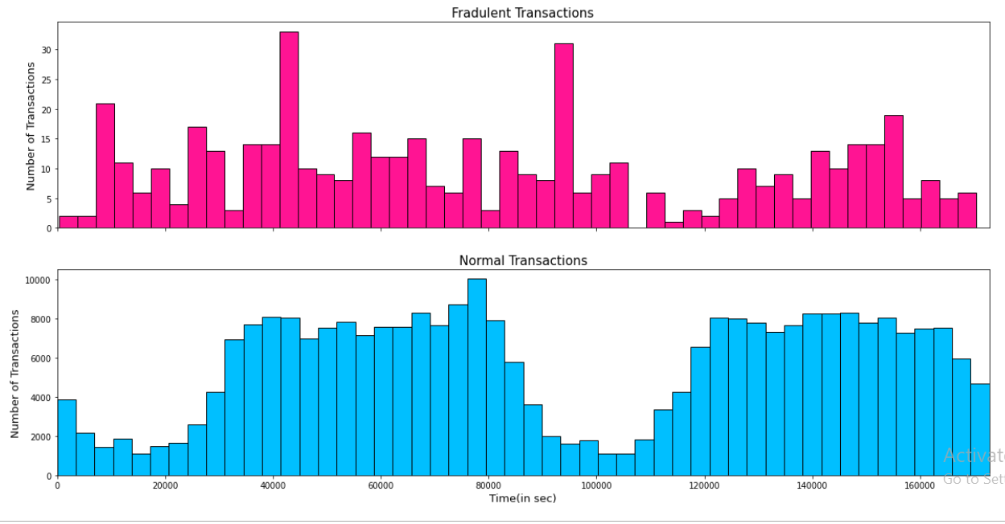
EDA

Slide 11
Machine Learning Algorithms
Two different techniques used:
Logistic Regression (Test Data)
Accuracy: 95.35%
Precision: 0.07
Recall: 0.91
f1 Score: 0.12
Random Forest Classifier (Test Data)
Accuracy :0.99943
AUC : 0.82778
Precision : 1.00000
Recall : 0.65556
F1 : 0.79195

Slide 12
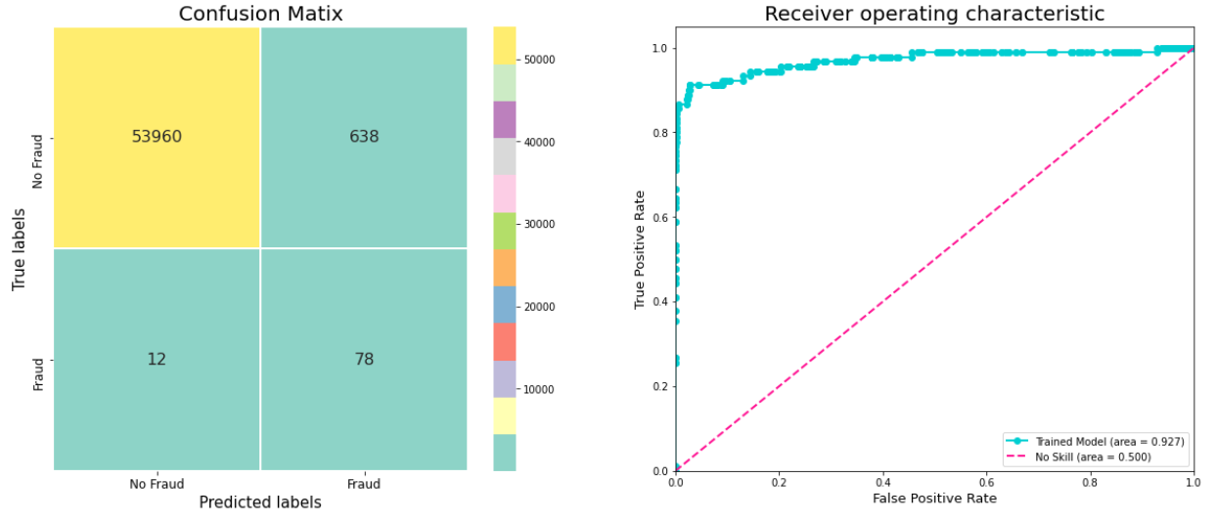
Logistic Regression – Confusion Matrix & ROC Curve

Slide 13
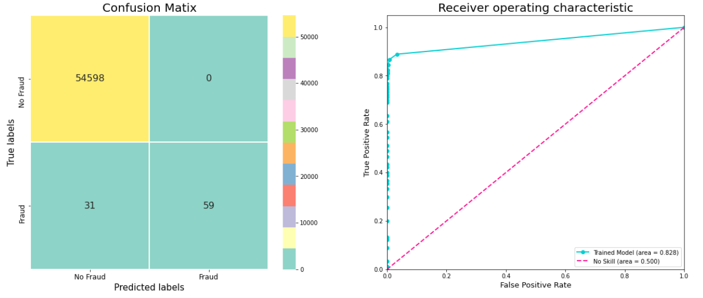
Random Forest Classifier – Confusion Matrix & ROC Curve

Slide 14
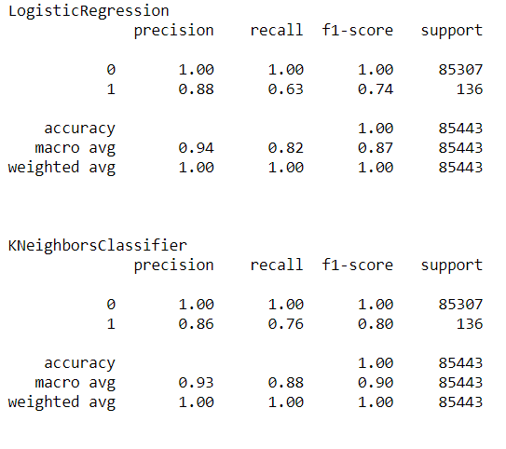
Results of ML Algorithms Used

Slide 15
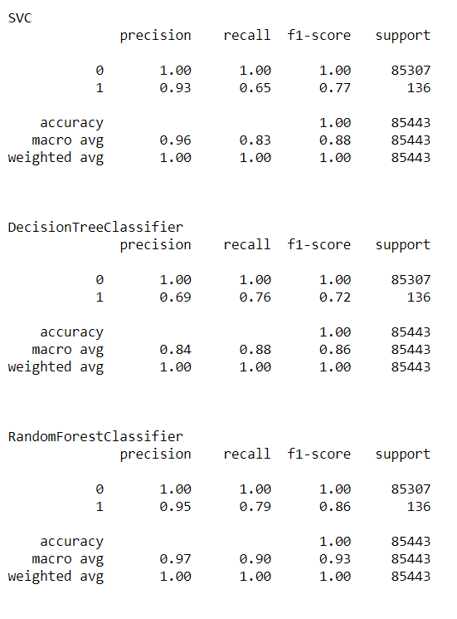

Slide 16
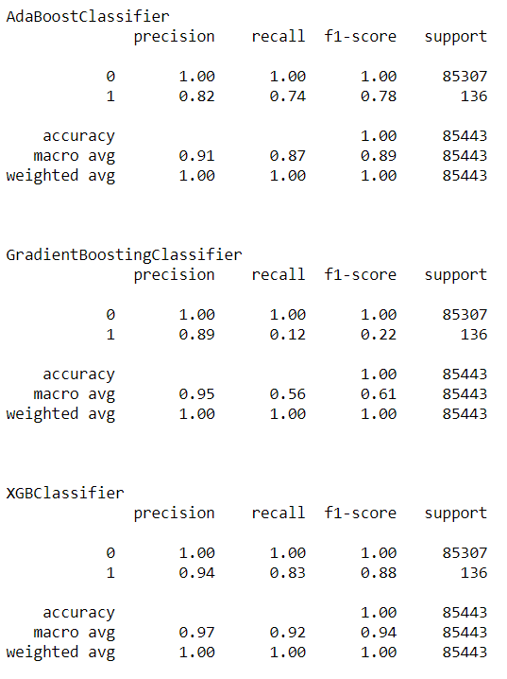

Slide 17
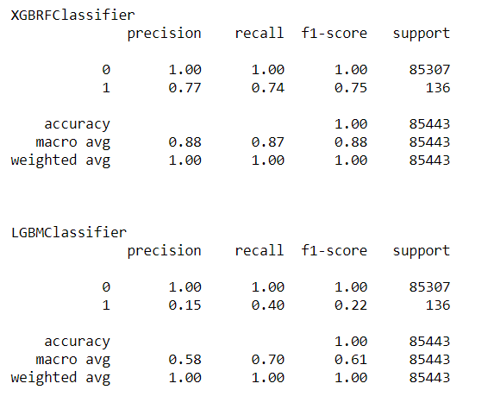
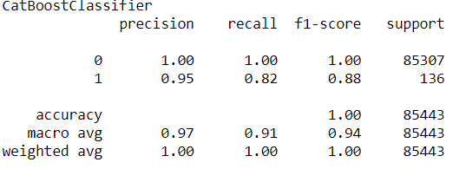

Slide 18
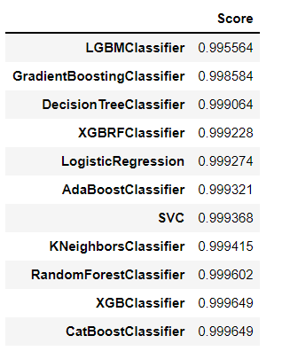
Scores of Different Algorithms Used

Slide 19
Result Analysis
From the Scores, we are concluding that XGB and CatBoost Classifiers has higher score.
So we are going with XGB Classifier for further analysis.

Slide 20
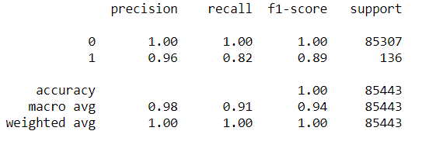
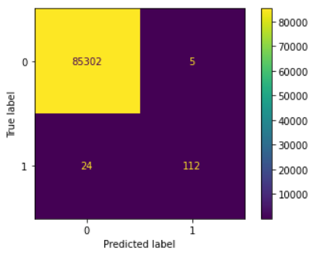
XGB Scores & Confusion Matrix

Slide 21

CV Score

Slide 22
Conclusions
ML algorithms considered: Logistic Regression, Random Forest and more.
From all the data, XGB performed better with precision score.
CV Score has good Accuracy, Better Precision whereas Recall and f1 scores are pretty low.
Hyper parameter tuning is done to minimize overfitting using Grid Search CV

Slide 23
Future Work
As the recall is bit lower will be working on various ML methods to improve the recall and f1 scores.

