Slide 1
REST Web Services
By Malak Kays
20/01/2016

Slide 2
Content
Web services definition
Web services types
REST web services definition
REST web services characteristics
REST resources
REST methods
REST representation

Slide 3
Web Services Definition

Slide 4
Web Services
Services exposed to the internet
For a programmatic access
→Online APIs
Web Service

Slide 5

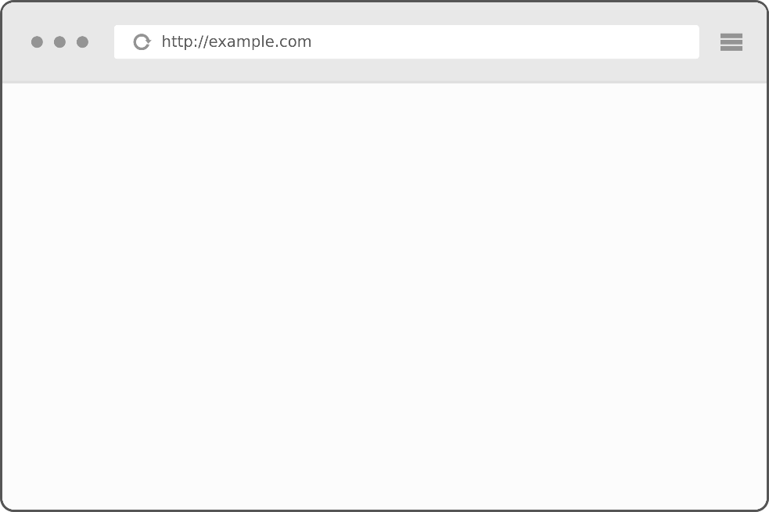
Web Applications vs. Web Services
Application server
)
Application server
getProducts()
application
jar
Jar file
getProducts
MVC
URL
Product1..
Product2..
….
Web application
client

Slide 6
Web Applications vs. Web Services
Application server
Application server
getProducts()
application
Web services

Slide 7
Local API
Add libraries to the class path
Inside a single machine
Client App
Library
Library
Library

Slide 8
Web Services
Code deployed on different machine
Heterogeneous applications
Distributed environment
Called through the network
Based on HTTP
Allow companies to
communicate
Client
Web Service
Web Service
JAVA
C++
.NET

Slide 9


Example
Apps
Calling online APIs
Games

Slide 10

Example
Publish web services
Other applications consume these services

Slide 11


Example
HTML
XML or JSON
http://www.twitter.com
http://api.twitter.com
Human
consumption
Code
consumption

Slide 12
Web Service Types
SOAP web services
REST web services

Slide 13
SOAP Web Service
Simple Object Access Protocol
Based on XML
standard for encoding messages in XML that invoke functions in other applications.
analogous to Remote Procedure Calls (RPC)
SOAP enables applications to call functions from other applications

Slide 14
REST Web Service

Slide 15
REST Web Service
REpresentational State Transfer
defined in the thesis of Roy Fielding in 2000
can use protocols other than HTTP
Resource based

Slide 16
REST Web Service
REST web service is not
A Protocol
A Format
A Standard
It is
An architecture
An approach to build an application

Slide 17
Where we use REST
ROA (Resource Oriented Application)
DOA (Data Oriented Application)
Application that respects REST architecture
→RESTFul web services

Slide 18





REST Web Service Providers

Slide 19
Utilization Example in AMAZON

Slide 20
REST characteristics
Code on demand
Client-server
Layered system
Stateless
Uniform interface
cache

Slide 21
REST characteristics: Stateless
Server contains no client state
Each request contains enough context to process the message
Self descriptive messages
Any session state is held on the client

Slide 22
REST characteristics: Uniform Interface
Defines the interface between the client and the server
this means:
HTTP verbs (get, put, post, delete)
URIs (resources’ names)
HTTP response(status, body)

Slide 23




REST characteristics: Cache
Proxy
server
Query
Query
Response
Server
Client
Response
Response
Cache

Slide 24
REST constraints
Roy Fielding identified four constraints of REST:
Identification of resources
resources representations
Self-descriptive messages
HATEOAS

Slide 25
HATEOAS
Hypermedia As The Engine Of Application State
/messages
Client
Server
[{
“id” : “1”,
“message” : “Hello Word”,
“date” : “01Jan2016”,
“author” : “Malak Kays”
}, {
“id” : “2”,
“message” : “Hello Word”,
“date” : “01Jan2016”,
“author” : “Malak Kays”
}]
1
/messages/

Slide 26
HATEOAS
/messages
Client
Server
[{
“id” : “1”,
“message” : “Hello Word”,
“date” : “01Jan2016”,
“author” : “Malak Kays”,
“href” : “/messages/1”
}, {
“id” : “2”,
“message” : “Hello Word”,
“date” : “01Jan2016”,
“author” : “Malak Kays”,
“href” : “/messages/2”
}]
{
“id” : “1”,
“message” : “Hello Word”,
“date” : “01Jan2016”,
“author” : “Malak Kays”,
“href” : “/messages/1”,
“comments-href” : “/messages/1/comments”,
“likes-href” : “/messages/1/likes”,
“profile-href” : “/messages/1/profile”
}
You should remember every field name!!

Slide 27
HATEOAS
/messages
Client
{
“id” : “1”,
“message” : “Hello Word”,
“date” : “01Jan2016”,
“author” : “Malak Kays”,
“links” : [
{
“link”: “/messages/1”,
“rel”: “self”
},
{
“link”: “/messages/1/comments”,
“rel”: “self”
}
]
}
Server

Slide 28
REST over the Web
Data exchange over the web
Web
HTTP

Slide 29
HTTP

Slide 30
HTTP
Hyper Text Transfer Protocol
exchange information between a client and a server
Using TCP as the transport layer

Slide 31



HTTP
Client
Web service
Hyper Text
Written by HTML
LINK
Hyper Links

Slide 32
HTTP Query
Resource/document
Image, HTML, JSON, XML…
Protocol’s version
1.0 or 1.1
Query method
GET, POST, PUT
<Method>
<URI>
HTTP/
<version>
[<header field> : <value>]
Information about the HTTP client
(cookies, location)
Blank line separates header and body
Query body
Data sent to the server, necessary for POST or PUT requests

Slide 33
HTTP Response
Protocol’s version
1.0 or 1.1
Response status characterized by the predefined codes http: 200/404/500
Descriptive information on the status
Information on the MIME type of the content: XML / html / JSON
HTTP/
<version>
<status>
<comments>
Content type: <MIME content type>
Information about the server
[<header field> : <value>]
Blank line separates header and body
content

Slide 34
HTTP Exchange
Client
HTTP request
Server
HTTP response
<html..>
…
</html>

Slide 35
REST Exchange
Client
HTTP request
Web service
Data
<html..>
…
</html>

Slide 36
Protocol
Client
Web service
Message format
Client
SOAP web service
SOAP protocol
Client
REST web service
XML
JSON
Text → Web protocols

Slide 37
REST Elements
Resource identifier
Ex: URI
Representation
Ex: JSON
Methods
Ex: HTTP

Slide 38
REST METHODS

Slide 39
REST Methods
Client
REST web service
HTTP request
(Method ?)

Slide 40
Methods
4 bases operations
Corresponding to the 4 types of HTTP requests
C
R
U
D
CREATE
RETRIEVE
UPDATE
DELETE
POST
GET
PUT
DELETE

Slide 41
POST Method
Create new resource on the server.
POST:http://address/className/methodName
The query core is a representation: XML, JSON, HTML..
Server
Client
Status : 201, 204
Message : Create, No content
header : …..

Slide 42
GET Method
Send the resource representation existing on the server.
GET:http://address/className/methodName
The query core is a representation: XML, JSON, HTML..
Server
Client
Status : 200
Message : OK
header : …..
Representation: XML, JSON, HTML,….

Slide 43
PUT Method
Update a resource on the server.
GET:http://address/className/methodName/resource identifier
Header: …
core: XML, JSON, HTML..
Server
Client
Status : 200
Message : OK
header : …..

Slide 44
DELETE Method
Delete a resource on the server.
GET:http://address/className/methodName/resource identifier
Server
Client
Status : 200
Message : OK
header : …..
44

Slide 45
Idempotent methods
Safely repeatable
GET
PUT
DELETE
Non idempotent: cannot be repeated safely
POST
Notes:
Because every time you made a replication of the method you change something
Read only, non read only

Slide 46
Wikipedia definition for Idempotence
‘Idempotence is the property of certain operations in mathematics and computer science, that can be applied multiple times without changing the result beyond the initial application.’
HTTP requires that: GET, PUT and DELETE to be always idempotent
Notes:
If the client makes a request with one of these methods they don’t have to worry about making duplicate request
But if they’re making a post request, they cannot safely make a duplicate request wihout any effect on the server

Slide 47
Resources
A resource is an identifiable object on the system.
Identified with an URI
Contains nouns NOT verbs!
Nouns are the resource names
http://serverAddress:8484/applicationContext/resource

Slide 48


Resources Example
http://ntdp.miage.fr/bookstore/fetchBooks
http://ntdp.miage.fr/bookstore/books
http://ntdp.miage.fr/bookstore/books/book/1

Slide 49
Representation
designates exchanged resource data between the client and the server.
It might be:
XML
JSON
XHTML
Text/plain
….

Slide 50
JSON

Slide 51
JSON
JavaScript Object Notation
Data exchange format
Based on JavaScript
independent of programming languages

Slide 52
JSON
Two structures:
A collection of key / values → object
An ordered collection of objects → array

Slide 53
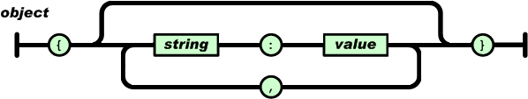
JSON Object
Starts with "{"
Ends with "}"
Composed of an unordered list of pair keys / values.
A key is followed by ":"
The key / value pairs are separated by ","

Slide 54
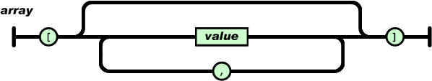
JSON Array
Ordered list of objects
Beginning with "["
Ending with "]“
The objects are separated from each other by “,".

Slide 55
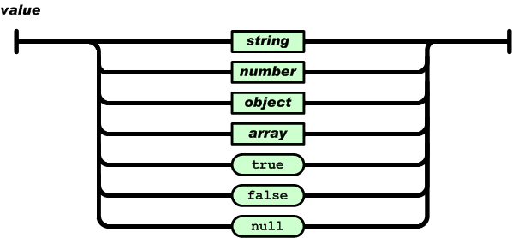
JSON Value
An object can be
String between " "
Number (integer, decimal)
Boolean (true, false)
Null
Object.

Slide 56
JSON Example
This JSON syntax defines an employees object, with an array of 3 employees records
{“employees”:[
{“firstName”:”John”, “lastName”:”Doe”},
{“firstName”:”Anna”, “lastName”:”Smith”},
{“firstName”:”Peter”, “lastName”:”Jones”}
]}

Slide 57
JSON Example
This XML syntax also defines an employees object with 3 employees records
<employees>
<employee>
<firstName>John</firstName><lastName>Doe</lastName>
</ employee>
<employee>
<firstName>Anna</firstName><lastName>Smith</lastName>
</ employee>
<employee>
<firstName>Peter</firstName><lastName>Jones</lastName>
</ employee>
</ employees>

Slide 58

Web Service Definition
What the web service does?
What are the operations?
Input arguments?
Arguments types?
Outputs?
…..

Slide 59

SOAP Web Service Definition
All the details of the SOAP web service
WSDL
WSDL

Slide 60
REST Web Service Definition
All the details of the SOAP web service
WADL
Web Application Definition Language
Describes the REST service in a XML format.
provides service informations that allow building client applications using REST services.
automatically generated by the API
WADL

Slide 61
JAX-RS
REST specification

Slide 62
SOAP specification
JAX-WS
Java API for XML Web Services
represents remote procedure calls or messages using XML-based protocols
Notes:
such as SOAP
Clients of the JAX-WS Web- Service need a WSDL file to generate executable code that the clients can use to call Web- Service.
REST architectures often use JSON to send and receive data. JAX-WS uses XML.
It's not that JSON is so significantly smaller than XML by itself. It's mostly that JAX-WS specification includes lots overhead in how it communicates.
With REST you will still need to provide some documentation to other users about how the REST service is organized and what data and HTTP commands need to be sent.

Slide 63
JAX-RS
Acronym for RESTFul web services’ Java API.
Based on POJO (Plain Old Java Object) using specific JAX-RS annotations
forms an integral part of Java EE specification.
Describes the implementation of client side of REST web services.
Its architecture is based on the use of classes and annotations to develop web services.

Slide 64
JAX-RS
JAX-RS is a specification
around this specification are developed several implementations:
JERSEY : reference implementation provided by Oracle( http://jersey.java.net )
CXF : provided by Apache ( http://cfx.apache.org )
RESTEasy : provided by JBOSS
RESTLET : One of the first implementing REST framework for Java

Slide 65
JAX-RS
Jersey
JAX-RS
Implementation classes
(javax.ws.rs.*)
JAX-RS
Interfaces and
annotations
JAX-RS
Interfaces and
annotations
JAX-RS
Interfaces and
annotations
RESTEasy
Implementation classes

Slide 66
JAX-RS
Jersey
JAX-RS
Interfaces and
annotations
Implementation classes
(javax.ws.rs.*)
REST API application
Application code

Slide 67
JAX-RS Annotations
to expose a Java class as a web service.
JAX-RS has an annotation set:
@Path
@GET, @POST, @PUT, @DELETE
@Produces, @Consumes

Slide 68
JAX-RS: @PATH
Make the class accessible via an HTTP request.
Defines the resources’ root.
The data value is the relative URL of the resource
@Path(“category")
public class Category {
……
}
http://localhost:8080/Bibliotheque/webresources/category

Slide 69
JAX-RS: @PATH
The annotation can be used to note a method
resulting URI is the concatenation between the Path value of the class and the path value of the method
The value set in the Path annotation is not necessarily a constant, it can vary.
Ability to define more complex expressions, called Template Parameters
The complex contents are delimited by "{}"

Slide 70
JAX-RS: @GET, @POST, @PUT, @DELETE
for mapping a method accessible via HTTP request
used only for methods
The method name does not matter, JAX determines the method to execute based on the request

Slide 71
@Consumes, @Produces
@Consumes: to specify MIME types that a resource’s method can accept.
@Produces: specifies the type of output this method (or web service) will produce.
the list of constants of various MIME types is available in the class MediaType.

Slide 72
Query Parameters
JAX-RS provides mechanisms to extract parameters from the query
Used on the parameters of resource methods to perform injections of content

Slide 73
Query Parameters
@PathParam:
Binds the parameter passed to method to a value in path.
@QueryParam:
Binds the parameter passed to method to a query parameter in path.
@FormParam:
Binds the parameter passed to method to a form value.
@HeaderParam:
Binds the parameter passed to method to a HTTP header.
@CookieParam:
Binds the parameter passed to method to a Cookie.

Slide 74
Example
@Path("livre")
public class LivreFacadeREST {
@POST
@Consumes({"application/xml", "application/json"})
public void create(Livre entity) {
super.create(entity);
}
@PUT
@Consumes({"application/xml", "application/json"})
public void edit(Livre entity) {
super.edit(entity);
}
@DELETE @Path("{id}")
public void remove(@PathParam("id") Long id) {
super.remove(super.find(id));
}

Slide 75
Example
@GET @Path("{id}")
@Produces({"application/xml", "application/json"})
public Livre find(@PathParam("id") Long id) {
return super.find(id);
}
@GET @Override
@Produces({"application/xml", "application/json"})
public List<Livre> findAll() {
return super.findAll();
}
@GET @Path("{from}/{to}")
@Produces({"application/xml","application/json"})
public List<Livre> findRange(@PathParam("from") Integer from, @PathParam("to") Integer to) {
return super.findRange(new int[]{from, to});
} }

Slide 76
JERSY
integrated into Glassfish
Integrated in Java EE implementation (6.7)
Supported in NetBeans

Slide 77
Customize Response
More control on the response that the rest web service send?
Status code?
Header’s values?
New resource’s URL?
…
@POST
Public Message addMessage(Message message){
return messageSercice.addMessage(message);
}
Response class
Notes:
When you create a resource you want to get the url for this resource
If you have a method that creates a new message, this metod return the added message
In order to control the response what we can do? What we can return from this method?
It’s a separate instance (class) called Response

Slide 78
Customize Response
More control on the response that the rest web service send?
Status code?
Header’s values?
New resource’s URL?
…
You can use predefined status (200, 201..)
Example: 201 -> created
Response.status(status.CREATED)
@POST
Public Response addMessage(Message message){
//return messageSercice.addMessage(message);
Message message = messageSercice.addMessage(message);
return Response.status(201).entity(message).build();
}
Or return Response.created(new resource’s URL).entity(message).build();
Notes:
This method won’t return the created message, it should return a response instance
How do you create this response?
To create this response we user the response builder and that lets you modify the status code, the header and all that stuff;

Slide 79
REST vs. SOAP

Slide 80
SOAP
Advantages
Standardized
Security
Disadvantages
Performance
Complexity
Notes:
While SOAP supports SSL (just like REST) it also supports WS-Security which adds some enterprise security features. Supports identity through intermediaries, not just point to point (SSL). It also provides a standard implementation of data integrity and data privacy. Calling it “Enterprise” isn’t to say it’s more secure, it simply supports some security tools that typical internet services have no need for, in fact they are really only needed in a few “enterprise” scenarios.
Need ACID Transactions over a service, you’re going to need SOAP. While REST supports transactions, it isn’t as comprehensive and isn’t ACID compliant. Fortunately ACID transactions almost never make sense over the internet. REST is limited by HTTP itself which can’t provide two-phase commit across distributed transactional resources, but SOAP can. Internet apps generally don’t need this level of transactional reliability, enterprise apps sometimes do.

Slide 81
REST
Advantages
Easiness of implementation
Readability by a human
Scalability
Multiple representations (XML, JSON, ...)
Disadvantages
Security restricted by the use of HTTP methods
Consume bandwidth less than SOAP

Slide 82
REST vs. SOAP
<?xml version="1.0" encoding="UTF-8"?>
<S:Envelope xmlns:S="http://schemas.xmlsoap.org/soap/envelope/" xmlns:SOAP-ENV="http://schemas.xmlsoap.org/soap/envelope/">
<SOAP-ENV:Header/>
<S:Body> <ns2:hello xmlns:ns2="http://services.bibliotheque.ntdp.miage.unice.fr/">
<name>Miage NTDP</name>
</ns2:hello>
</S:Body>
</S:Envelope>
Client
Server
http://localhost:8080/Bibliotheque/webresources/category/Miage%20NTDP
Client
Server

Slide 83
Summary
When you want to design a REST API
Have resources based URIs
Choose the right HTTP methods
Return the right HTTP status code
Header contains the content type

Slide 84
THANK YOU!
Questions?

