Slide 1
REST Web Services
By Malak Kays

Slide 2
Content
Web services definition

Slide 3
Web Service Definition

Slide 4
Web Services
Services exposed to the internet
For a programmatic access
→Online APIs
Web Service

Slide 5
Local API
Add libraries to the class path
Inside a single machine
Client App
Library
Library
Library

Slide 6
Web Service
Code deployed on different machine
Heterogeneous applications
Distributed environment
Called through the network
Allow companies to
communicate
Client
Web Service
Web Service

Slide 7


Example
Apps
Calling online APIs
Games

Slide 8

Example
Publish web services
Other applications consume these services

Slide 9


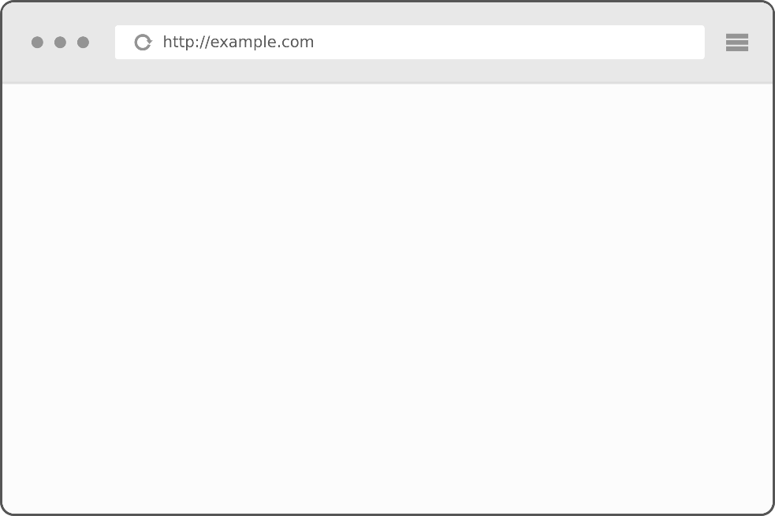
Example
HTML
XML or JSON
http://www.twitter.com
http://api.twitter.com

Slide 10
Web Service Types

Slide 11
Web Service Types
REST web service
SOAP web service

Slide 12
REST Web Service
REpresentational State Transfer
defined in the thesis of Roy Fielding in 2000
Based on HTTP
But can use protocols other than HTTP

Slide 13
REST Web Service
REST web service is not
Protocol
Format
Standard
It is
An architecture
An approach to build an application

Slide 14
Questions & Comments

