Slide 1
REST Web Services
By Malak Kays

Slide 2
Content
Web services definition
Web service types

Slide 3
Web Service Definition

Slide 4
Web Services
Services exposed to the internet
For a programmatic access
→Online APIs
Web Service

Slide 5
Local API
Add libraries to the class path
Inside a single machine
Client App
Library
Library
Library

Slide 6
Web Service
Code deployed on different machine
Heterogeneous applications
Distributed environment
Called through the network
Allow companies to
communicate
Client
Web Service
Web Service

Slide 7


Example
Apps
Calling online APIs
Games

Slide 8

Example
Publish web services
Other applications consume these services

Slide 9


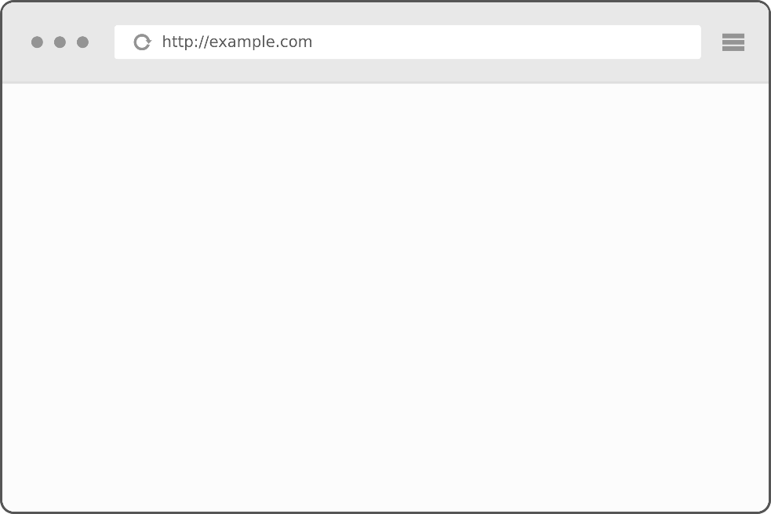
Example
HTML
XML or JSON
http://www.twitter.com
http://api.twitter.com

Slide 10
Web Service Types
SOAP web service
REST web service

Slide 11
REST Web Service

Slide 12
REST Web Service
REpresentational State Transfer
defined in the thesis of Roy Fielding in 2000
Based on HTTP
can use protocols other than HTTP

Slide 13
REST Web Service
REST web service is not
A Protocol
A Format
A Standard
It is
An architecture
An approach to build an application

Slide 14
Where we use REST
ROA (Resource Oriented Application)
DOA (Data Oriented Application)
Application that respects REST architecture
→RESTFul web services

Slide 15





REST Web Service Providers

Slide 16
Utilization Example in AMAZON

Slide 17
REST characteristics
Stateless
Based on HTTP methods
RESTful architectures are built only from resources identified by URI (s)

Slide 18
Resources
Methods
representation

Slide 19
Resources
Identified with an URI

Slide 20
Methods
4 bases operations
Corresponding to the 4 types of HTTP requests
C
R
U
D
CREATE
RETRIEVE
UPDATE
DELETE
POST
GET
PUT
DELETE

Slide 21


POST Method
Create new resource on the server.
POST:http://address/className/methodName
The query core is a representation: XML, JSON, HTML..
Server
Client
Status : 201, 204
Message : Create, No content
header : …..

Slide 22
GET Method
Send the resource representation existing on the server.
GET:http://address/className/methodName
The query core is a representation: XML, JSON, HTML..
Server
Client
Status : 200
Message : OK
header : …..
Representation: XML, JSON, HTML,….

Slide 23
PUT Method
Update a resource on the server.
GET:http://address/className/methodName/resource identifier
Header: …
core: XML, JSON, HTML..
Server
Client
Status : 200
Message : OK
header : …..

Slide 24
DELETE Method
Delete a resource on the server.
GET:http://address/className/methodName/resource identifier
Server
Client
Status : 200
Message : OK
header : …..
24

Slide 25
Representation
The representation designates exchanged resource data between the client and the server.
It might be:
XML
JSON
XHTML
Text/plain
….

Slide 26
Questions & Comments

