Slide 1
REST Web Services
By Malak Kays

Slide 2
Content
Web services definition
Web service types
REST web service definition
REST web service characteristics
REST resources
REST methods
REST representation
JAX-RS definition
JAX-RS annotations
REST vs. SOAP

Slide 3
Web Service Definition

Slide 4
Web Services
Services exposed to the internet
For a programmatic access
→Online APIs
Web Service

Slide 5

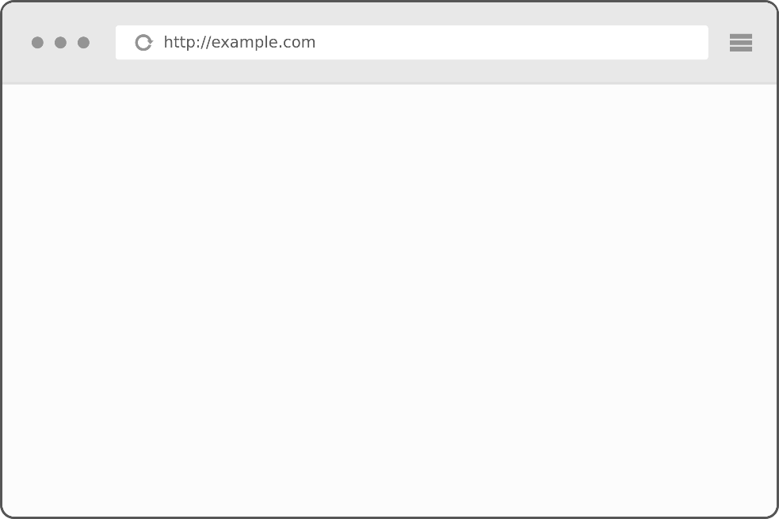
Application server
)
Application server
getProducts()
application
jar
Jar file
getProducts
MVC
URL
Product1..
Product2..
….
Web application
client

Slide 6
Application server
Application server
getProducts()
application
Web service
MVC

Slide 7
Local API
Add libraries to the class path
Inside a single machine
Client App
Library
Library
Library

Slide 8
Web Service
Code deployed on different machine
Heterogeneous applications
Distributed environment
Called through the network
Allow companies to
communicate
Client
Web Service
Web Service
JAVA
C++
.NET

Slide 9


Example
Apps
Calling online APIs
Games

Slide 10

Example
Publish web services
Other applications consume these services

Slide 11


Example
HTML
XML or JSON
http://www.twitter.com
http://api.twitter.com
Human
consumption
Code
consumption
Notes:
The difference is that this is made for human consumption
But this is for code consumption

Slide 12
Web Service Types
SOAP web service
REST web service
Notes:
There are mainly 2 types
The oldest is SOAP
The newest is REST
The 2 types are used and popular

Slide 13
SOAP Web Service
Simple Object Access Protocol
Systems communicate over HTTP
Based on XML
SOAP is analogous to Remote Procedure Calls (RPC)
standard for encoding messages in XML that invoke functions in other applications.

Slide 14
REST Web Service

Slide 15
REST Web Service
REpresentational State Transfer
defined in the thesis of Roy Fielding in 2000
Based on HTTP
can use protocols other than HTTP

Slide 16
REST Web Service
REST web service is not
A Protocol
A Format
A Standard
It is
An architecture
An approach to build an application

Slide 17
Where we use REST
ROA (Resource Oriented Application)
DOA (Data Oriented Application)
Application that respects REST architecture
→RESTFul web services

Slide 18





REST Web Service Providers

Slide 19
Utilization Example in AMAZON

Slide 20
REST characteristics
Stateless
Based on HTTP methods
RESTful architectures are built only from resources identified by URI (s)

Slide 21
Data exchange over the web
Web
HTTP

Slide 22
HTTP

Slide 23
HTTP
Hyper Text Transfer Protocol
exchange information between a client and a server
Using TCP as the transport layer

Slide 24



HTTP
Client
Web service
Hyper Text
Written by HTML
LINK
Hyper Links

Slide 25
HTTP Query
Resource/document
Image, HTML, JSON, XML…
Protocol’s version
1.0 or 1.1
Query method
GET, POST, PUT
<Method>
<URI>
HTTP/
<version>
[<header field> : <value>]
Information about the HTTP client
(cookies, location)
Blank line separates header and body
Query body
Data sent to the server, necessary for POST or PUT requests

Slide 26
HTTP Response
Protocol’s version
1.0 or 1.1
Response status characterized by the predefined codes http: 200/404/500
Descriptive information on the status
Information on the MIME type of the content: XML / html / JSON
HTTP/
<version>
<status>
<comments>
Content type: <MIME content type>
Information about the server
[<header field> : <value>]
Blank line separates header and body
content

Slide 27
HTTP Exchange
Client
HTTP request
Server
HTTP response
<html..>
…
</html>

Slide 28
REST Exchange
Client
HTTP request
Web service
Data
<html..>
…
</html>

Slide 29
Protocol
Client
Web service
Message format
Client
SOAP web service
SOAP protocol
Client
REST web service
XML
JSON
Text → Web protocols

Slide 30
Resources
Methods
representation

Slide 31
Representation
The representation designates exchanged resource data between the client and the server.
It might be:
XML
JSON
XHTML
Text/plain
….

Slide 32
JSON
JavaScript Object Notation
Data exchange format
Based on JavaScript
independent of programming languages

Slide 33
JSON
Two structures:
A collection of key / values → object
An ordered collection of objects → array

Slide 34
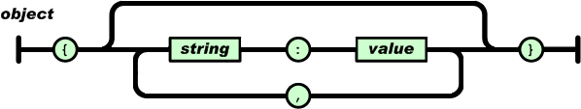
JSON Object
Starts with "{"
Ends with "}"
Composed of an unordered list of pair keys / values.
A key is followed by ":"
The key / value pairs are separated by ","

Slide 35
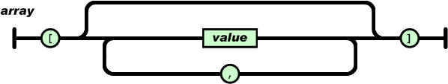
JSON Array
Ordered list of objects
Beginning with "["
Ending with "]“
The objects are separated from each other by “,".

Slide 36
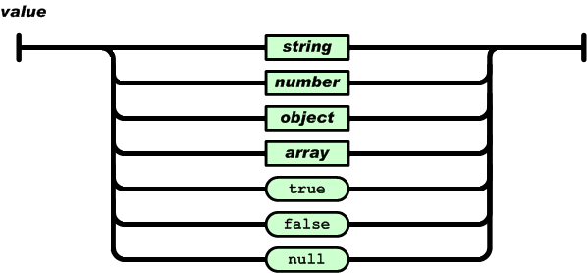
JSON Value
An object can be
String between " "
Number (integer, decimal)
Boolean (true, false)
Null
Object.

Slide 37
JSON vs. XML Example
This JSON syntax defines an employees object, with an array of 3 employees records
{“employees”:[
{“firstName”:”John”, “lastName”:”Doe”},
{“firstName”:”Anna”, “lastName”:”Smith”},
{“firstName”:”Peter”, “lastName”:”Jones”}
]}

Slide 38
JSON vs. XML Example
This XML syntax also defines an employees object with 3 employees records
<employees>
<employee>
<firstName>John</firstName><lastName>Doe</lastName>
</ employee>
<employee>
<firstName>Anna</firstName><lastName>Smith</lastName>
</ employee>
<employee>
<firstName>Peter</firstName><lastName>Jones</lastName>
</ employee>
</ employees>

Slide 39
Client
REST web service
HTTP request
(Method ?)

Slide 40
Methods
4 bases operations
Corresponding to the 4 types of HTTP requests
C
R
U
D
CREATE
RETRIEVE
UPDATE
DELETE
POST
GET
PUT
DELETE

Slide 41


POST Method
Create new resource on the server.
POST:http://address/className/methodName
The query core is a representation: XML, JSON, HTML..
Server
Client
Status : 201, 204
Message : Create, No content
header : …..

Slide 42
GET Method
Send the resource representation existing on the server.
GET:http://address/className/methodName
The query core is a representation: XML, JSON, HTML..
Server
Client
Status : 200
Message : OK
header : …..
Representation: XML, JSON, HTML,….

Slide 43
PUT Method
Update a resource on the server.
GET:http://address/className/methodName/resource identifier
Header: …
core: XML, JSON, HTML..
Server
Client
Status : 200
Message : OK
header : …..

Slide 44
DELETE Method
Delete a resource on the server.
GET:http://address/className/methodName/resource identifier
Server
Client
Status : 200
Message : OK
header : …..
44

Slide 45
Resources
A resource is an identifiable object on the system.
Identified with an URI
Contains nouns NOT verbs!
Nouns are the resource names

Slide 46
Questions & Comments

