Slide 1
REST Web Services
By Malak Kays

Slide 2
Content
Web services definition
Web service types
REST web service definition
REST web service characteristics
REST resources
REST methods
REST representation
JAX-RS definition
JAX-RS annotations
REST vs. SOAP

Slide 3
Web Service Definition

Slide 4
Web Services
Services exposed to the internet
For a programmatic access
→Online APIs
Web Service

Slide 5

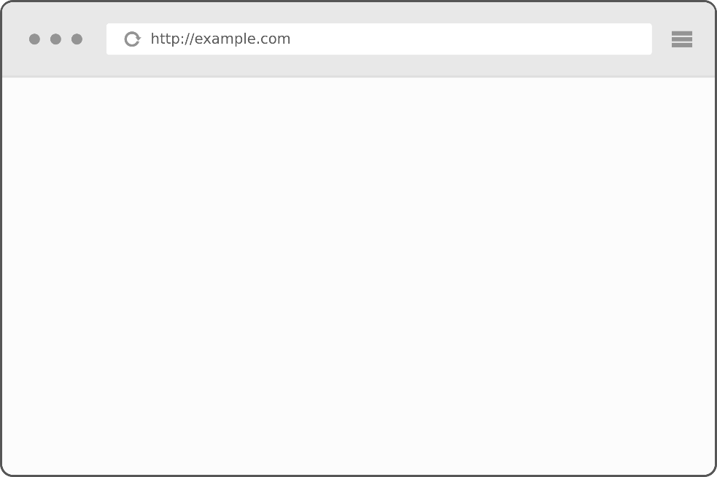
Application server
)
Application server
getProducts()
application
jar
Jar file
getProducts
MVC
URL
Product1..
Product2..
….
Web application
client

Slide 6
Application server
Application server
getProducts()
application
Web service
MVC

Slide 7
Local API
Add libraries to the class path
Inside a single machine
Client App
Library
Library
Library

Slide 8
Web Service
Code deployed on different machine
Heterogeneous applications
Distributed environment
Called through the network
Allow companies to
communicate
Client
Web Service
Web Service
JAVA
C++
.NET

Slide 9


Example
Apps
Calling online APIs
Games

Slide 10

Example
Publish web services
Other applications consume these services

Slide 11


Example
HTML
XML or JSON
http://www.twitter.com
http://api.twitter.com
Human
consumption
Code
consumption
Notes:
The difference is that this is made for human consumption
But this is for code consumption

Slide 12
Web Service Types
SOAP web service
REST web service
Notes:
There are mainly 2 types
The oldest is SOAP
The newest is REST
The 2 types are used and popular

Slide 13
SOAP Web Service
Simple Object Access Protocol
Systems communicate over HTTP
Based on XML
SOAP is analogous to Remote Procedure Calls (RPC)
standard for encoding messages in XML that invoke functions in other applications.

Slide 14
REST Web Service

Slide 15
REST Web Service
REpresentational State Transfer
defined in the thesis of Roy Fielding in 2000
Based on HTTP
can use protocols other than HTTP

Slide 16
REST Web Service
REST web service is not
A Protocol
A Format
A Standard
It is
An architecture
An approach to build an application

Slide 17
Where we use REST
ROA (Resource Oriented Application)
DOA (Data Oriented Application)
Application that respects REST architecture
→RESTFul web services

Slide 18





REST Web Service Providers

Slide 19
Utilization Example in AMAZON

Slide 20
REST characteristics
Stateless
Based on HTTP methods
RESTful architectures are built only from resources identified by URI (s)

Slide 21
Data exchange over the web
Web
HTTP

Slide 22
HTTP

Slide 23
HTTP
Hyper Text Transfer Protocol
exchange information between a client and a server
Using TCP as the transport layer

Slide 24



HTTP
Client
Web service
Hyper Text
Written by HTML
LINK
Hyper Links

Slide 25
Resources
Methods
representation

Slide 26
Representation
The representation designates exchanged resource data between the client and the server.
It might be:
XML
JSON
XHTML
Text/plain
….

Slide 27
Client
REST web service
HTTP request
(Method ?)

Slide 28
Methods
4 bases operations
Corresponding to the 4 types of HTTP requests
C
R
U
D
CREATE
RETRIEVE
UPDATE
DELETE
POST
GET
PUT
DELETE

Slide 29


POST Method
Create new resource on the server.
POST:http://address/className/methodName
The query core is a representation: XML, JSON, HTML..
Server
Client
Status : 201, 204
Message : Create, No content
header : …..

Slide 30
GET Method
Send the resource representation existing on the server.
GET:http://address/className/methodName
The query core is a representation: XML, JSON, HTML..
Server
Client
Status : 200
Message : OK
header : …..
Representation: XML, JSON, HTML,….

Slide 31
PUT Method
Update a resource on the server.
GET:http://address/className/methodName/resource identifier
Header: …
core: XML, JSON, HTML..
Server
Client
Status : 200
Message : OK
header : …..

Slide 32
DELETE Method
Delete a resource on the server.
GET:http://address/className/methodName/resource identifier
Server
Client
Status : 200
Message : OK
header : …..
32

Slide 33
Resources
A resource is an identifiable object on the system.
Identified with an URI
Contains nouns NOT verbs!
Nouns are the resource names

Slide 34
Questions & Comments

