Slide 1
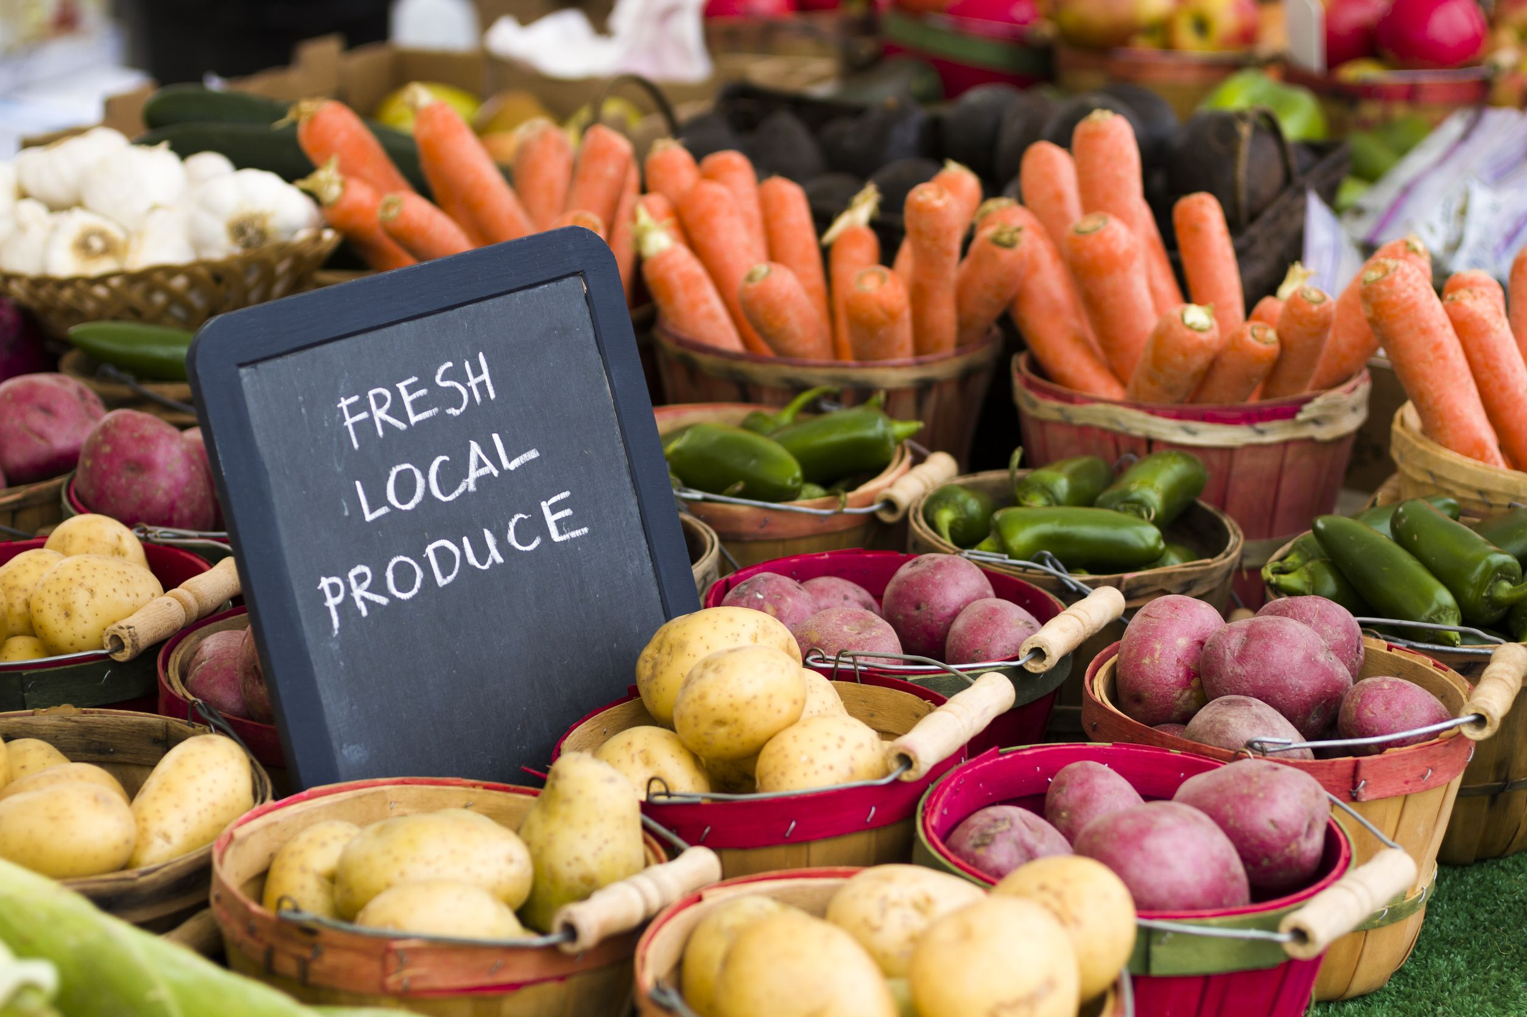


Ensuring that locally sourced food is truly local
Member names: Carlos Lovera, Cristina Gravel, Nick Murray, Raymond Chavez, Yi Zu
Challenges: CoinDesk, AlphaPoint, Microsoft
Problem: Ensuring the quality and local legitimacy of food supplied to restaurant customers across New York City.

Slide 2
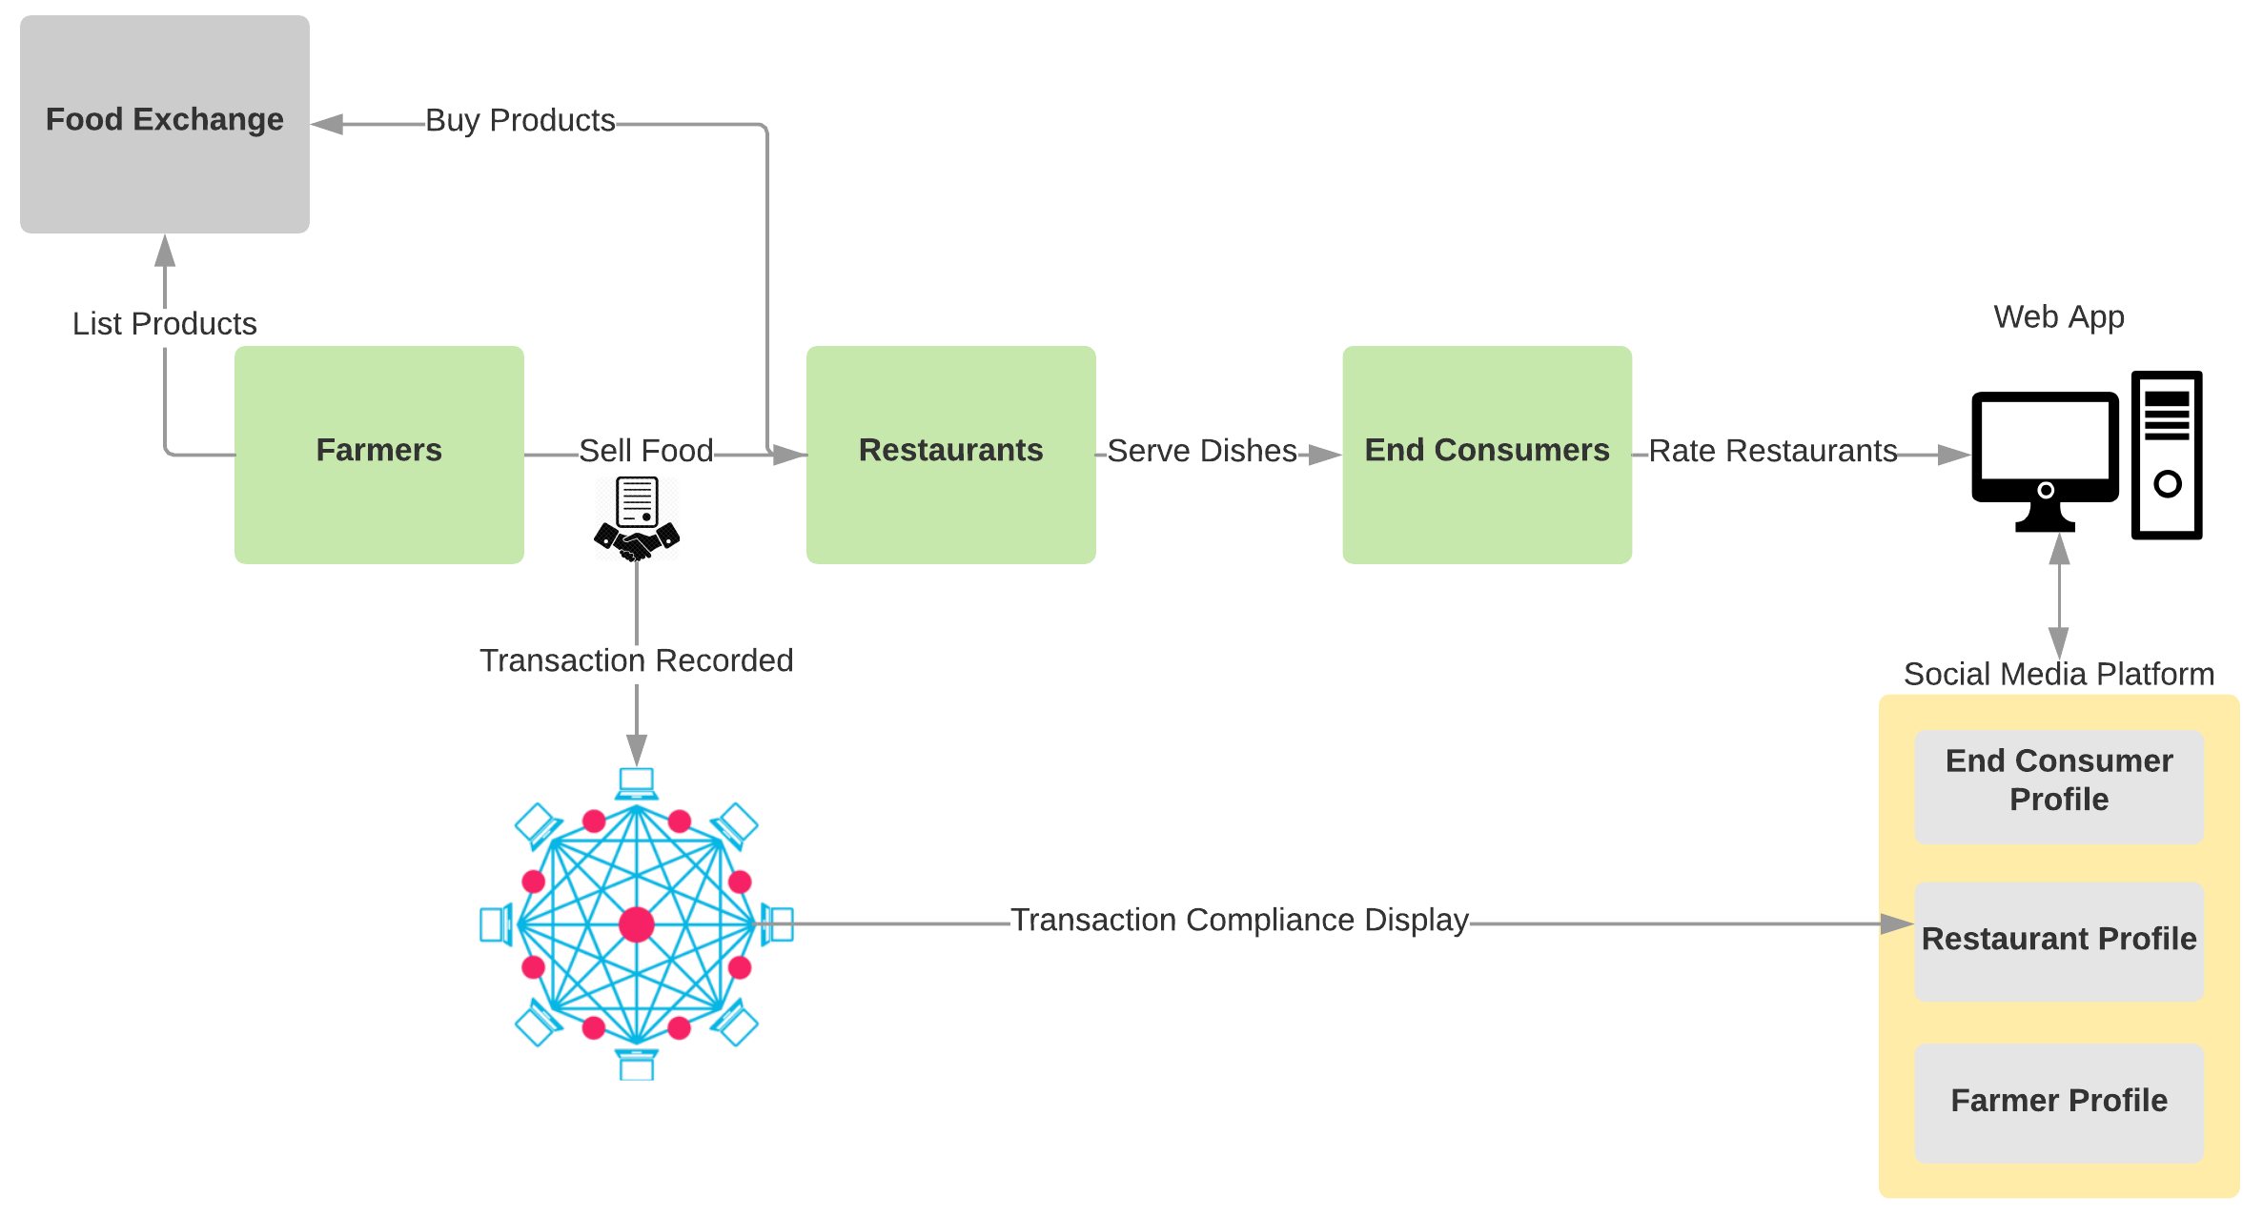
VeriFood Ecosystem
“Leveraging the power of blockchain to ensure the origin of locally produced food and increase the transparency of the food supply chain” – VeriFood Mission Statement

