Slide 1

Vibration-based SHM
Department of Civil and Environmental Engineering
Esmaeil Ghorbani, Ph.D., P.Eng.

Slide 2
Why do we need model-based SHM?
SHM: The process of monitoring the conditions of and identifying damage in civil, mechanical, and aerospace engineering structures in order to evaluate the system’s remaining life span.
Every damage identification problem includes three steps:
damage detection
damage localization
damage quantification
The model-free methods are able to detect the damage and hardly localize the damage.
They are unable to quantify the level of damage.
The question is why do we need to quantify the level of damage?

Slide 3
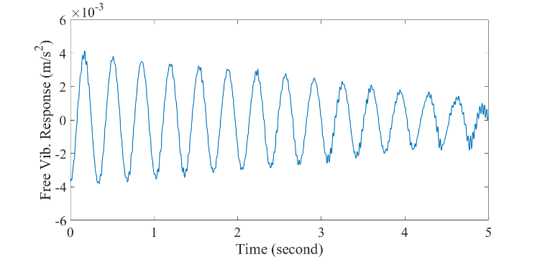
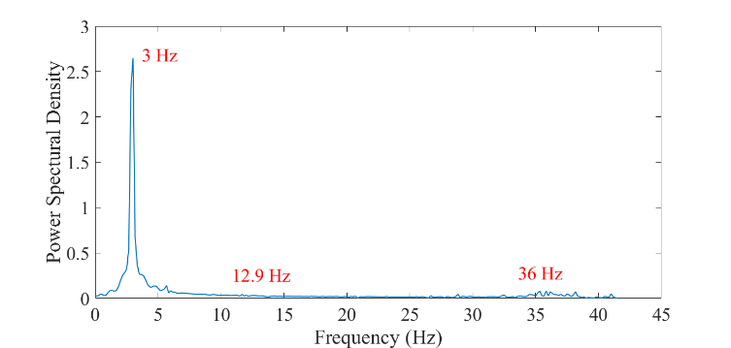
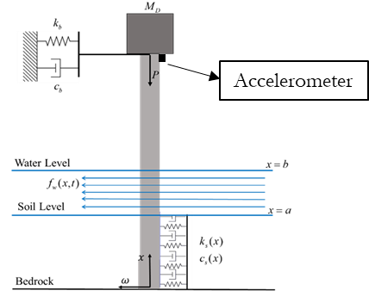
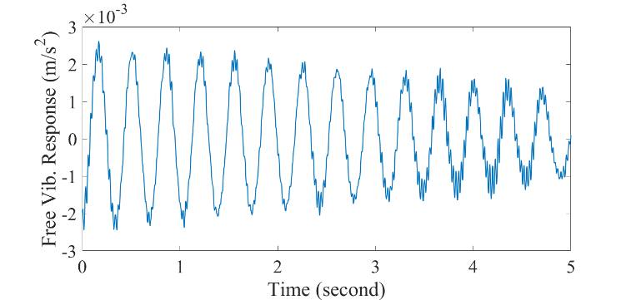
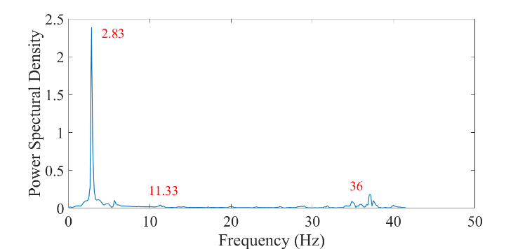
Lets start with an example
We simulated a bridge pier with different type of forces, and measured the acceleration of vibration at the tip of pier close to the bearing.
Time domain signal
Frequency domain signal
Original model
20% change in stiffness
Here, you can ask many questions, which I am going to answer through the lecture!

Slide 4
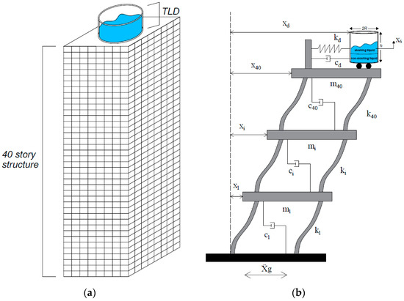
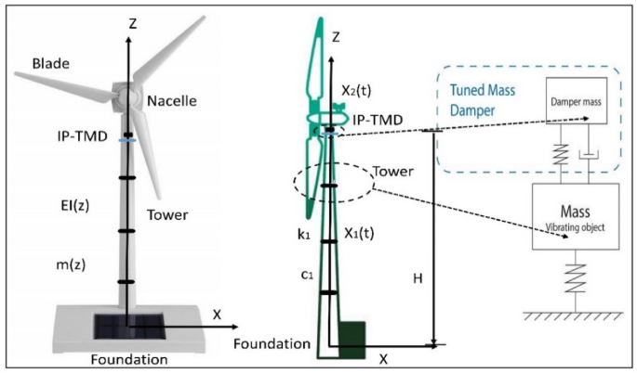
How can we define a model?
Amer, Y. A., A. T. El-Sayed, and M. M. Agwa. "Controlling wind turbine tower vibration under external force by applying control systems combination." Scientific Reports 14.1 (2024): 18597.
Ocak, Ayla, et al. "Optimization of tuned liquid damper including different liquids for lateral displacement control of single and multi-story structures." Buildings 12.3 (2022): 377.

Slide 5



How can we define a discrete model?
In every dynamical system we have three main physical components:
The mass (m) which resists acceleration according to Newton’s second law.
$$F=m\ddot{x}$$
The damper (c) which produces a force proportional to velocity
$$F_{d}=c\dot{x}$$
The spring (k) which produces a force proportional to displacement (Hooke’s law).
$$F_{s}=kx$$

Slide 6
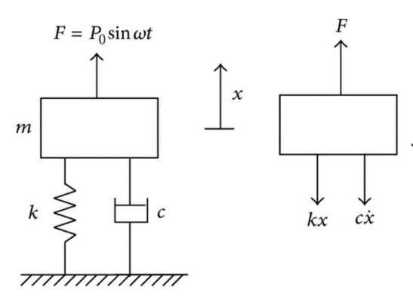
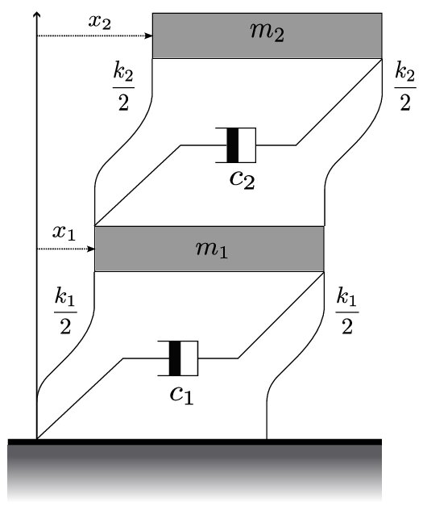
one degree of freedom system
F(t)

Slide 7
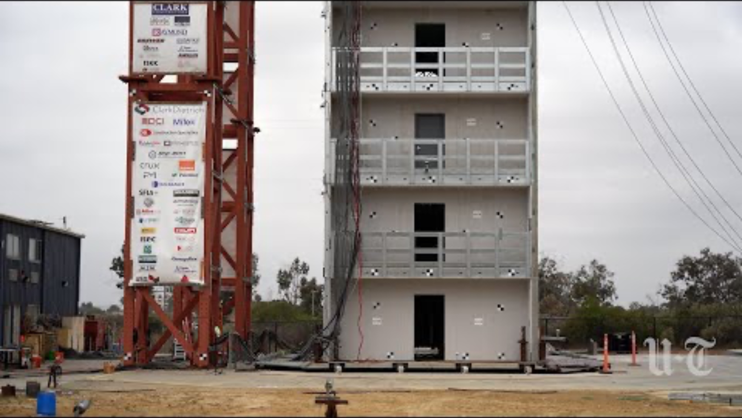
10 story building at UCSD

Slide 8



















What about multi-DoF systems
$$x_{3}$$
$m_{3}$, $c_{3} ,k_{3}$
$$F(t)$$
$$x_{2}$$
$$F(t)$$
$$F(t)$$
$$k_{1}$$
$$k_{2}$$
$$k_{3}$$
$$m_{1}$$
$$m_{2}$$
$$m_{3}$$
$m_{2}$, $c_{2} ,k_{2}$
$$c_{1}$$
$$c_{2}$$
$$c_{3}$$
$$x_{1}$$
$m_{1}$, $c_{1} ,k_{1}$
$$a_{g}$$

Slide 9










Governing equation for a 3-DoF system
$$F(t)$$
$$F(t)$$
$$F(t)$$
$$k_{1}$$
$$k_{2}$$
$$k_{3}$$
$$m_{1}$$
$$m_{2}$$
$$m_{3}$$
$$c_{1}$$
$$c_{2}$$
$$c_{3}$$

Slide 10
Simulation practice.
I provided different codes, to play with equations and get a sense about how an vibrating system behaves under different loading conditions and different parameters.
The codes are for both one and three degree of freedom systems.
You will see the behaviour of the system under resonance,
You will see the behaviour of vibrating systems in underdamped, critical damped and overdamped conditions.
More details in the provided code.

Slide 11
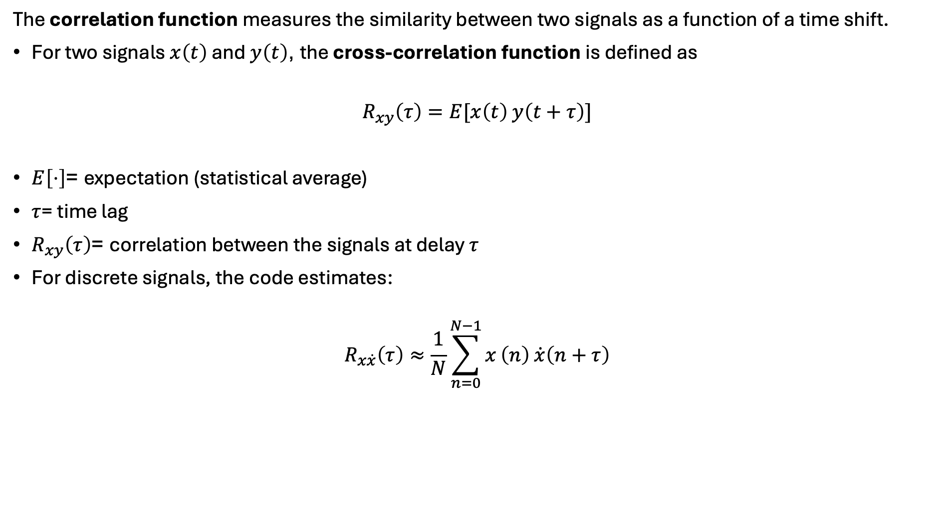
What is correlation function?
The correlation function measures the similarity between two signals as a function of a time shift.
For two signals $x\left(t\right)$ and $y\left(t\right)$, the cross-correlation function is defined as
$$R_{xy}\left(τ\right)=E[x\left(t\right) y\left(t+τ\right)]$$
$E\left[⋅\right]$= expectation (statistical average)
$τ$= time lag
$R_{xy}\left(τ\right)$= correlation between the signals at delay $τ$
For discrete signals, the code estimates:
$$R_{x\dot{x}}\left(τ\right)≈\frac{1}{N}\sum_{n=0}^{N−1}{x}\left(n\right) \dot{x}\left(n+τ\right)$$

Slide 12
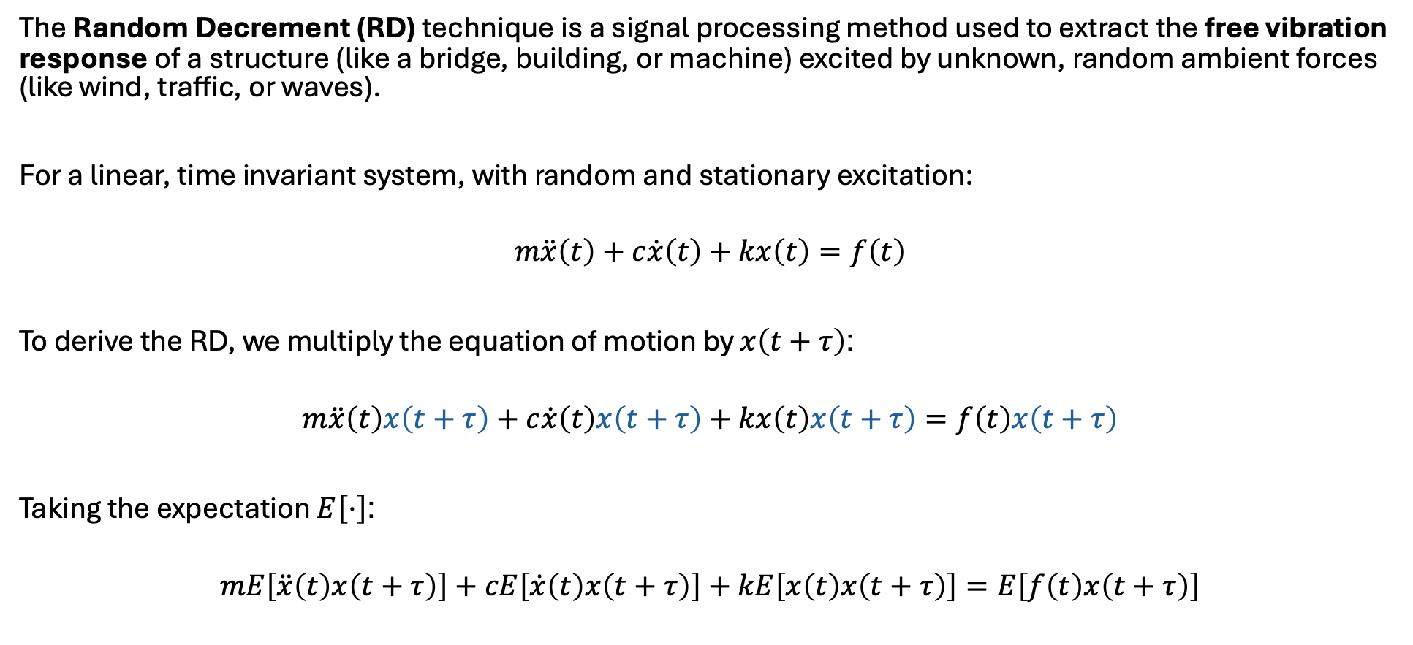
Random Decrement
The Random Decrement (RD) technique is a signal processing method used to extract the free vibration response of a structure (like a bridge, building, or machine) excited by unknown, random ambient forces (like wind, traffic, or waves).
For a linear, time invariant system, with random and stationary excitation:
$$m\ddot{x}\left(t\right)+c\dot{x}\left(t\right)+kx\left(t\right)=f\left(t\right)$$
To derive the RD, we multiply the equation of motion by $x\left(t+τ\right)$:
$$m\ddot{x}\left(t\right)x\left(t+τ\right)+c\dot{x}\left(t\right)x\left(t+τ\right)+kx\left(t\right)x\left(t+τ\right)=f\left(t\right)x\left(t+τ\right)$$
Taking the expectation $E\left[⋅\right]$:
$$mE\left[\ddot{x}\left(t\right)x\left(t+τ\right)\right]+cE\left[\dot{x}\left(t\right)x\left(t+τ\right)\right]+kE\left[x\left(t\right)x\left(t+τ\right)\right]=E\left[f\left(t\right)x\left(t+τ\right)\right]$$

Slide 13
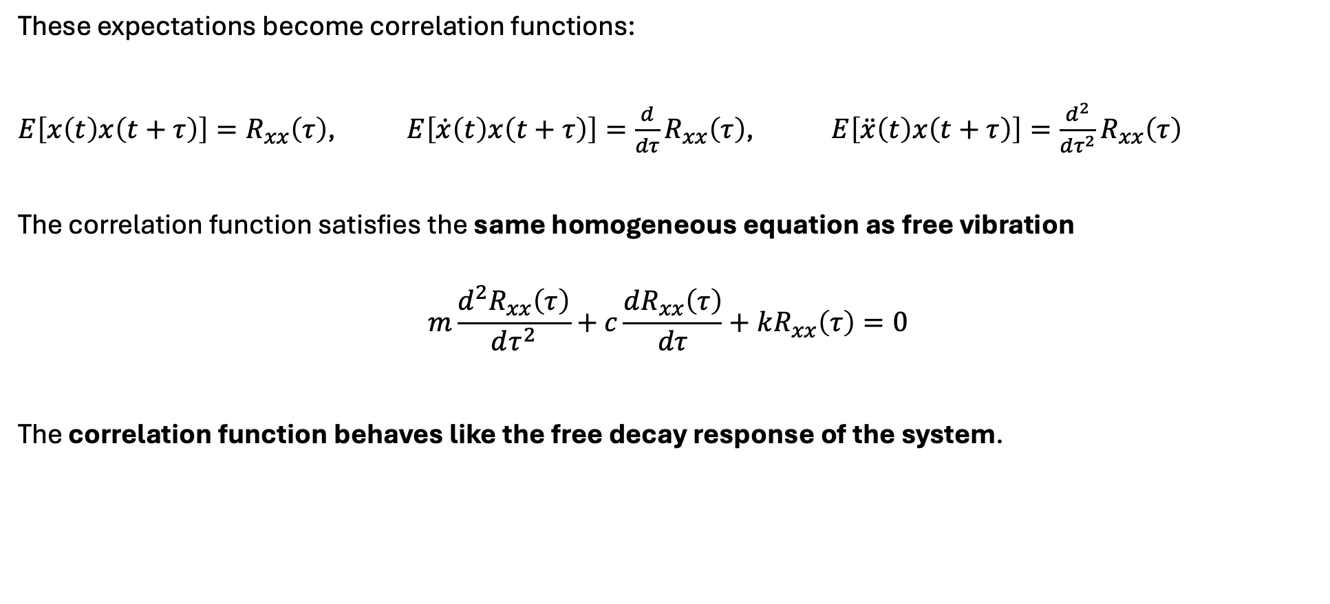
Random Decrement
These expectations become correlation functions:
$E\left[x\left(t\right)x\left(t+τ\right)\right]=R_{xx}\left(τ\right)$, $E\left[\dot{x}\left(t\right)x\left(t+τ\right)\right]=\frac{d}{dτ}R_{xx}\left(τ\right)$, $E\left[\ddot{x}\left(t\right)x\left(t+τ\right)\right]=\frac{d^{2}}{dτ^{2}}R_{xx}\left(τ\right)$
The correlation function satisfies the same homogeneous equation as free vibration
$$m\frac{d^{2}R_{xx}\left(τ\right)}{dτ^{2}}+c\frac{dR_{xx}\left(τ\right)}{dτ}+kR_{xx}\left(τ\right)=0$$
The correlation function behaves like the free decay response of the system.

Slide 14
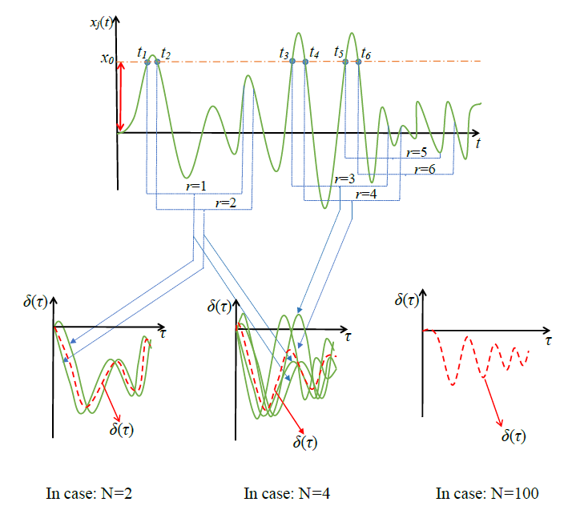
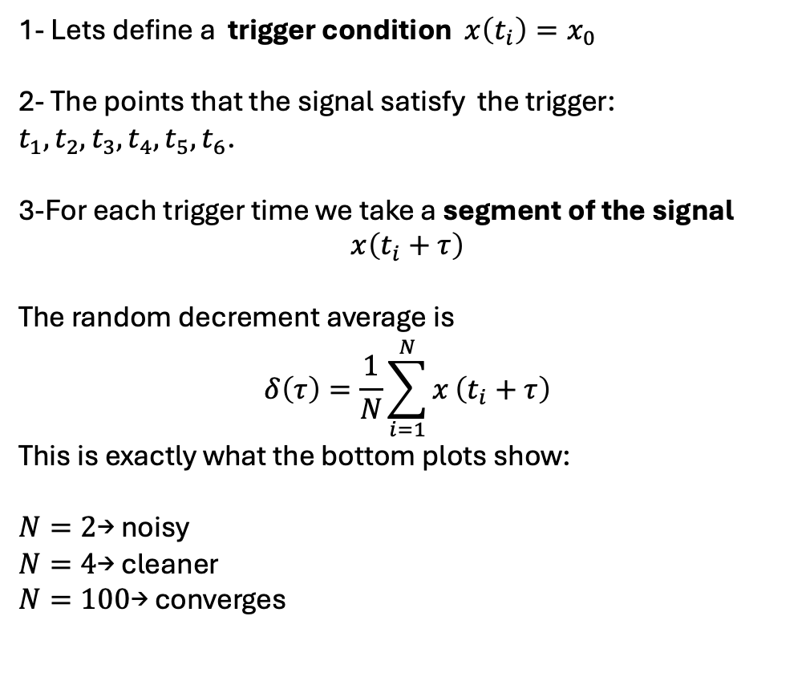
How to implement Random Decrement
1- Lets define a trigger condition $x\left(t_{i}\right)=x_{0}$
2- The points that the signal satisfy the trigger: $t_{1},t_{2},t_{3},t_{4},t_{5},t_{6}$.
3-For each trigger time we take a segment of the signal
$$x\left(t_{i}+τ\right)$$
The random decrement average is
$$δ\left(τ\right)=\frac{1}{N}\sum_{i=1}^{N}{x}\left(t_{i}+τ\right)$$
This is exactly what the bottom plots show:
$N=2$→ noisy
$N=4$→ cleaner
$N=100$→ converges

Slide 15
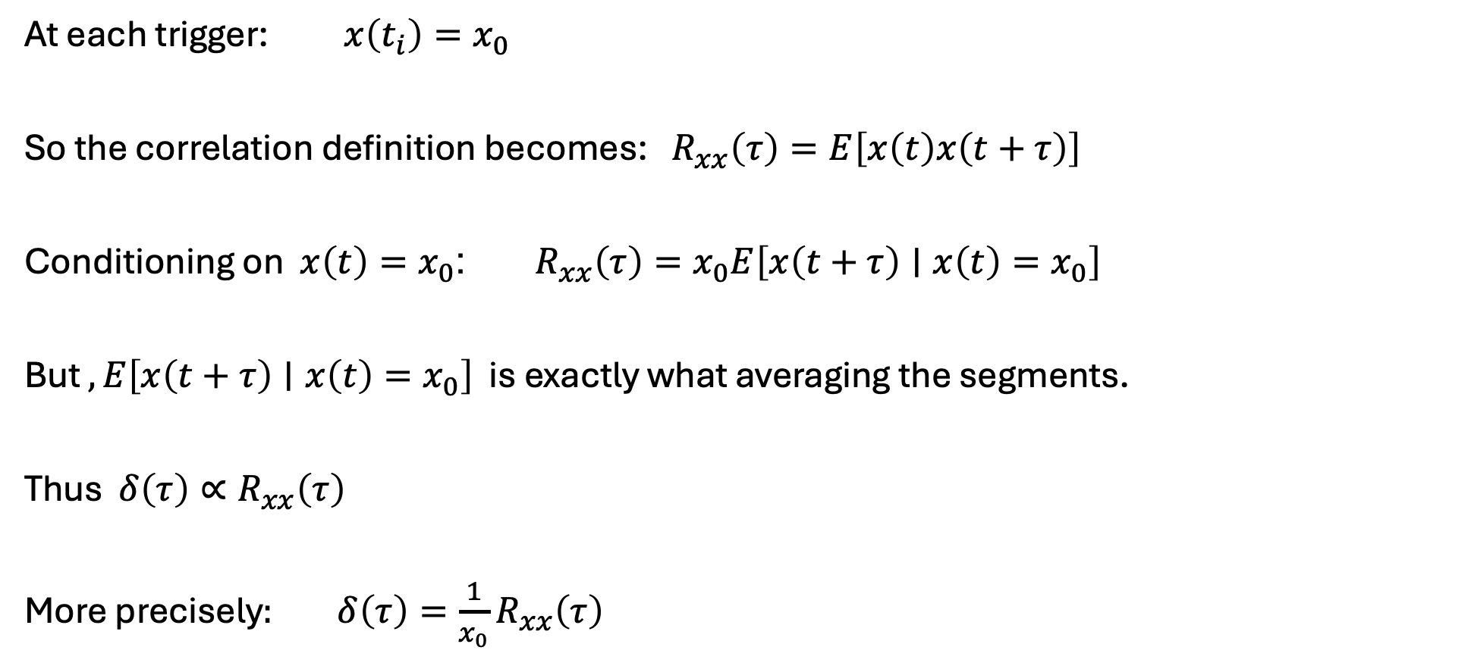
Relation between correlation and averaging segments
At each trigger:$x\left(t_{i}\right)=x_{0}$
So the correlation definition becomes: $R_{xx}\left(τ\right)=E\left[x\left(t\right)x\left(t+τ\right)\right]$
Conditioning on $x\left(t\right)=x_{0}$: $R_{xx}\left(τ\right)=x_{0}E\left[x\left(t+τ\right)∣x\left(t\right)=x_{0}\right]$
But $, E\left[x\left(t+τ\right)∣x\left(t\right)=x_{0}\right]$ is exactly what averaging the segments.
Thus $δ\left(τ\right)∝R_{xx}\left(τ\right)$
More precisely$: δ\left(τ\right)=\frac{1}{x_{0}}R_{xx}\left(τ\right)$
Self-study

Slide 16
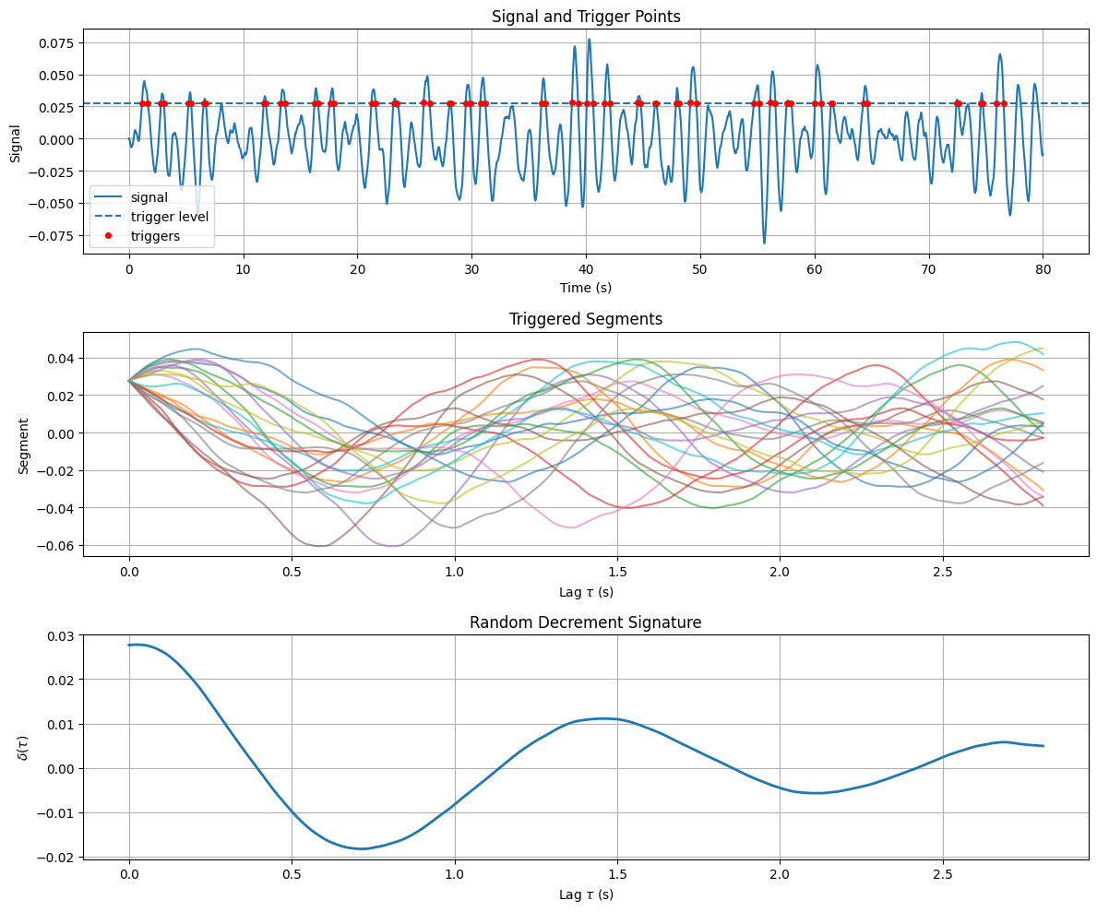
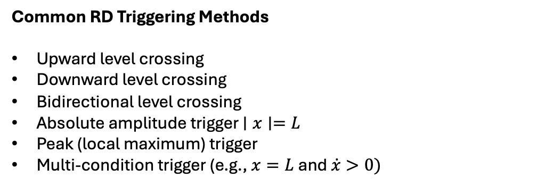
Simulation results for Random Decrement
Common RD Triggering Methods
Upward level crossing
Downward level crossing
Bidirectional level crossing
Absolute amplitude trigger $∣x∣=L$
Peak (local maximum) trigger
Multi-condition trigger (e.g., $x=L$and $\dot{x}>0)$
Vesterholm, Karsten Krautwald. "Random Decrement Based Vibration Analysis of Nonlinear Systems." (2021).

Slide 17
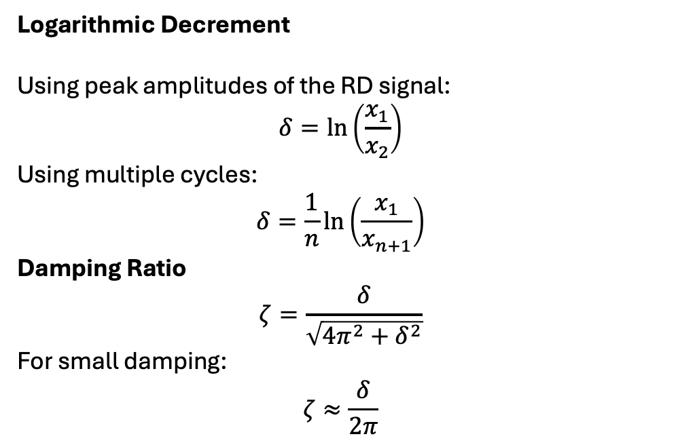
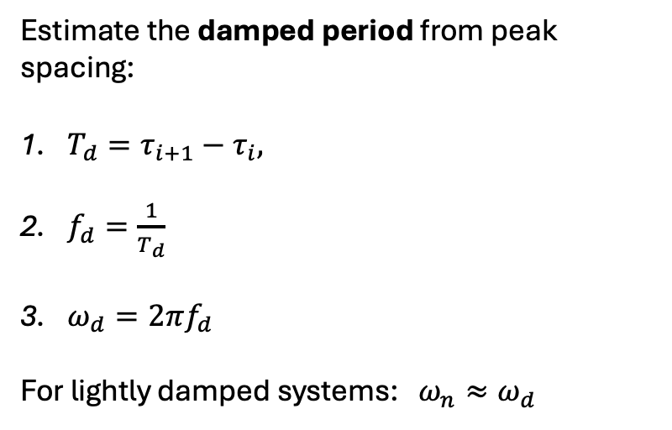
How to use RD signatures?
Natural Frequency
Damping Ratio
Estimate the damped period from peak spacing:
$T_{d}=τ_{i+1}−τ_{i},$
$f_{d}=\frac{1}{T_{d}}$
$ω_{d}=2πf_{d}$
For lightly damped systems: $ω_{n}≈ω_{d}$
Logarithmic Decrement
Using peak amplitudes of the RD signal:
$$δ=\ln\left(\frac{x_{1}}{x_{2}}\right)$$
Using multiple cycles:
$$δ=\frac{1}{n}\ln\left(\frac{x_{1}}{x_{n+1}}\right)$$
Damping Ratio
$$ζ=\frac{δ}{\sqrt{4π^{2}+δ^{2}}}$$
For small damping:
$$ζ≈\frac{δ}{2π}$$

Slide 18
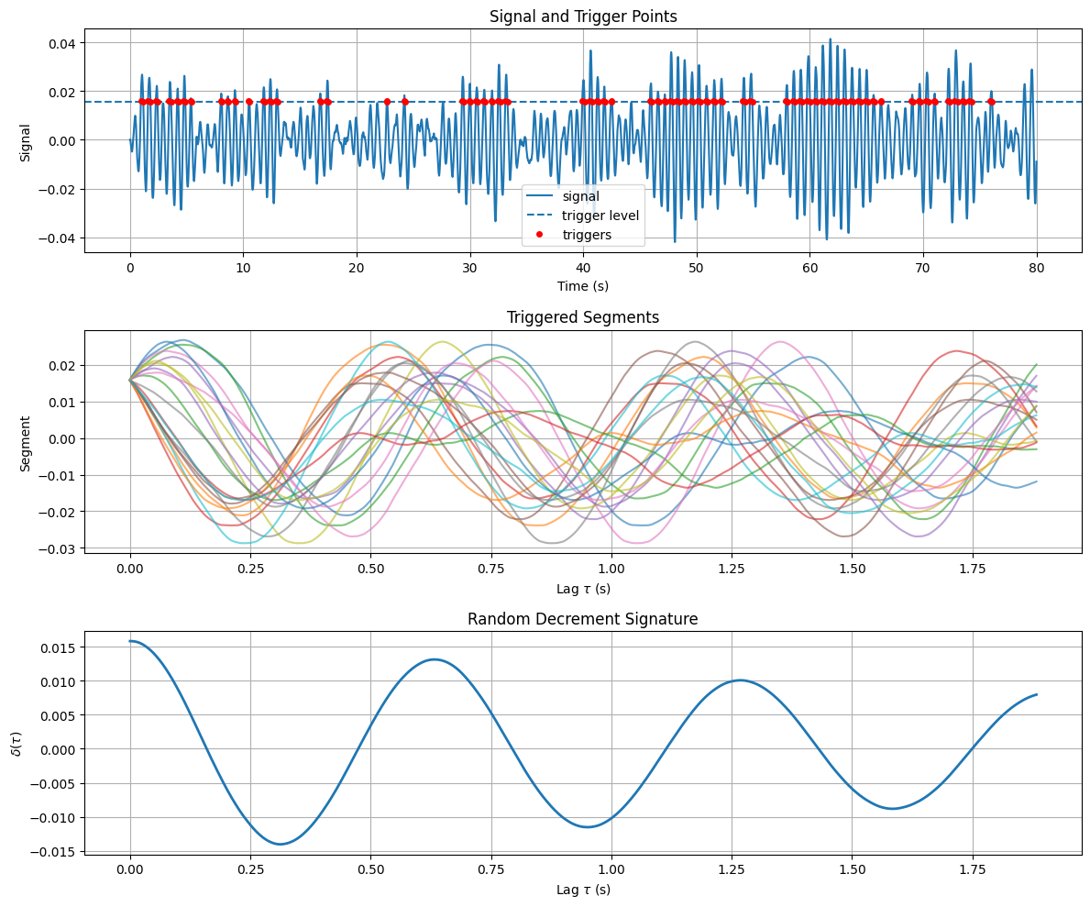
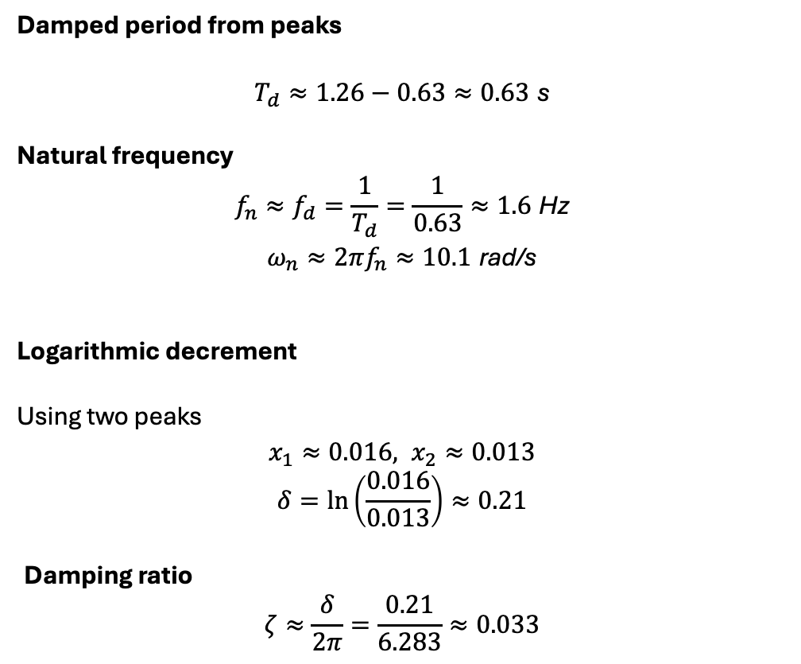
Simulation results for Random Decrement
m = 1.0 kg, c = 0.8 N.s/m, k = 100 N/m
Damped period from peaks
$$T_{d}≈1.26−0.63≈0.63 \text{s}$$
Natural frequency
$$f_{n}≈f_{d}=\frac{1}{T_{d}}=\frac{1}{0.63}≈1.6 \text{Hz}$$
$$ω_{n}≈2πf_{n}≈10.1 \text{rad}\text{/}\text{s}$$
Logarithmic decrement
Using two peaks $$x_{1}≈0.016, x_{2}≈0.013$$
$$δ=\ln\left(\frac{0.016}{0.013}\right)≈0.21$$
Damping ratio
$$ζ≈\frac{δ}{2π}=\frac{0.21}{6.283}≈0.033$$

Slide 19


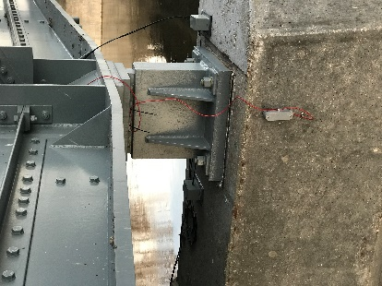
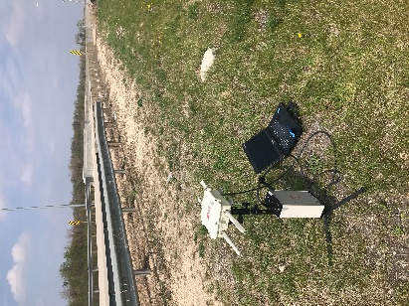
Vibration response of a 5-span bridge
Morris bridge, 5-span, 300 meter long bridge located in Morris city, Manitoba, Canada, 2019-2021
Ghorbani, Esmaeil, et al. "Bridge pier scour level quantification based on output-only Kalman filtering." Structural Health Monitoring 21.5 (2022): 2116-2135.

Slide 20
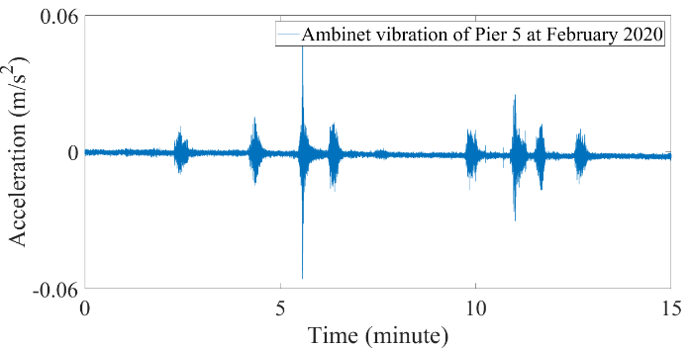
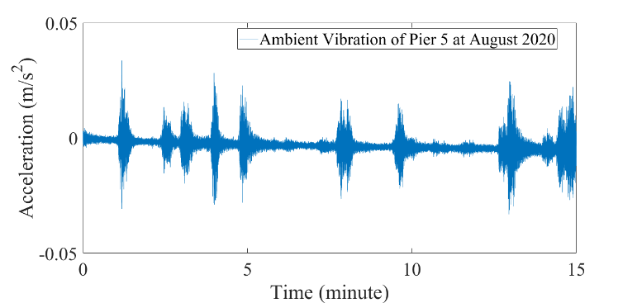
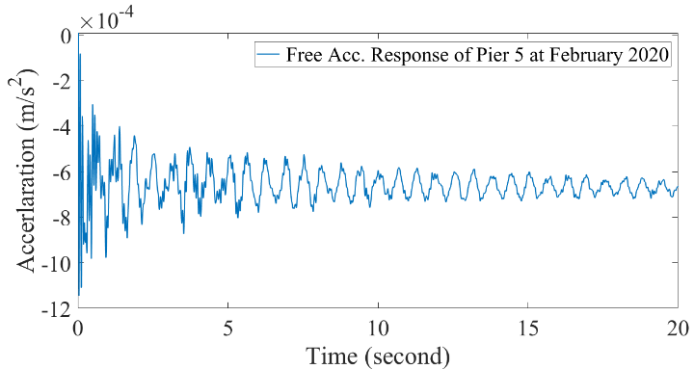
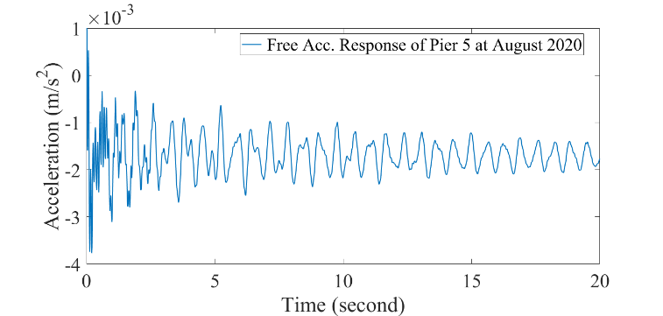
Vibration response of a 5-span bridge
There are many frequency involved in the response. It is not a simple solo-frequency free vibration response.
Raw vibration data
Free vibration response

Slide 21
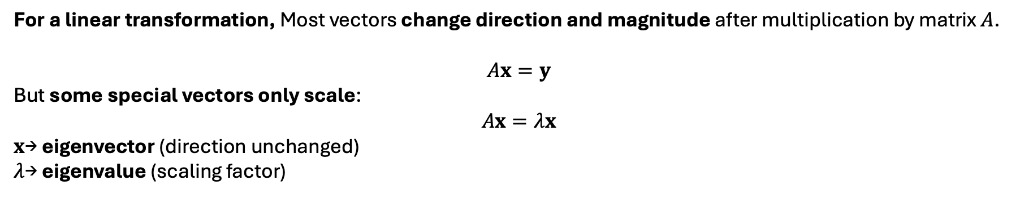
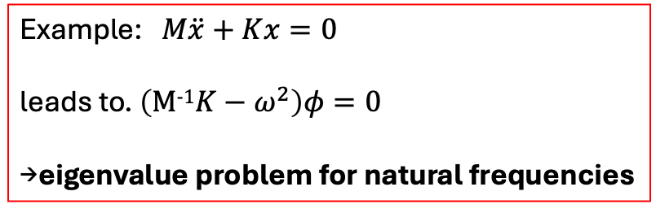
Eigenvalue Problem
For a linear transformation, Most vectors change direction and magnitude after multiplication by matrix $A$.
$$Ax=y$$
But some special vectors only scale:
$$Ax=λx$$
$x$→ eigenvector (direction unchanged)
$λ$→ eigenvalue (scaling factor)
To solve the eigenvalue problem: $\left(A−λI\right)x=0, and det⁡\left(A−λI\right)=0$ is the characteristic equation.
Eigenvalues tell us the intrinsic behavior of a system, independent of forcing.
Eigenvalues determine fundamental system properties:
Vibration: natural frequencies
Dynamics: stability of systems
Control systems: poles of the system
PDEs: modal decomposition
Example: $M\ddot{x}+Kx=0$
leads to. $\left(M-1K−ω^{2}\right)φ=0$
→eigenvalue problem for natural frequencies

