Slide 1
Cognitive Search Lab – Knowledge Mining on Business Documents
LearnAI Team
Cloud & AI

Slide 2
Training goals
What Azure Cognitive Search is
How to implement a Cognitive Search Solution
Why this technology can be useful for any company
When to use this solution for demos, POCs and other business scenarios
Notes:
This slide is required. Do NOT delete. This should be the first slide after your Title Slide.
This slide should describe what your goals are for this session. This information lets your audience know what you are trying to accomplish with your talk or tutorial—ie, what value will attendees get by investing 25 minutes or 2 hours of their time listening to you.
You should not spend more than 1 minute presenting this slide.
General examples of session goals could be (you will have to create your own specific goals):
Introduce a new technique or approach to solve a customer problem
Compare two approaches and explain why one is superior
Describe a project and the learnings that audience members can apply from it
Teach audience members how to use a specific technology

Slide 3
Quick Poll
Do you know what Azure Search is?
Do you know what Cognitive Search is?
Did you do the pre-requisites?
Top 1 AI Service on Azure!!
Notes:
This slide is required. Do NOT delete. This should be the first slide after your Title Slide.
This slide should describe what your goals are for this session. This information lets your audience know what you are trying to accomplish with your talk or tutorial—ie, what value will attendees get by investing 25 minutes or 2 hours of their time listening to you.
You should not spend more than 1 minute presenting this slide.
General examples of session goals could be (you will have to create your own specific goals):
Introduce a new technique or approach to solve a customer problem
Compare two approaches and explain why one is superior
Describe a project and the learnings that audience members can apply from it
Teach audience members how to use a specific technology

Slide 4
LearnAI – Knowledge Mining Bootcamp (NEW!)
KMB
16 Hours
Azure Search
Cognitive Search
Intro
Text Skills
Image Skills
Custom Skills
Azure Functions
Content Moderator API
Bots
8 Hours
Cognitive Search
Intro
Text Skills
Image Skills
Custom Skills
Azure Functions
Translator API
CSW

Slide 5
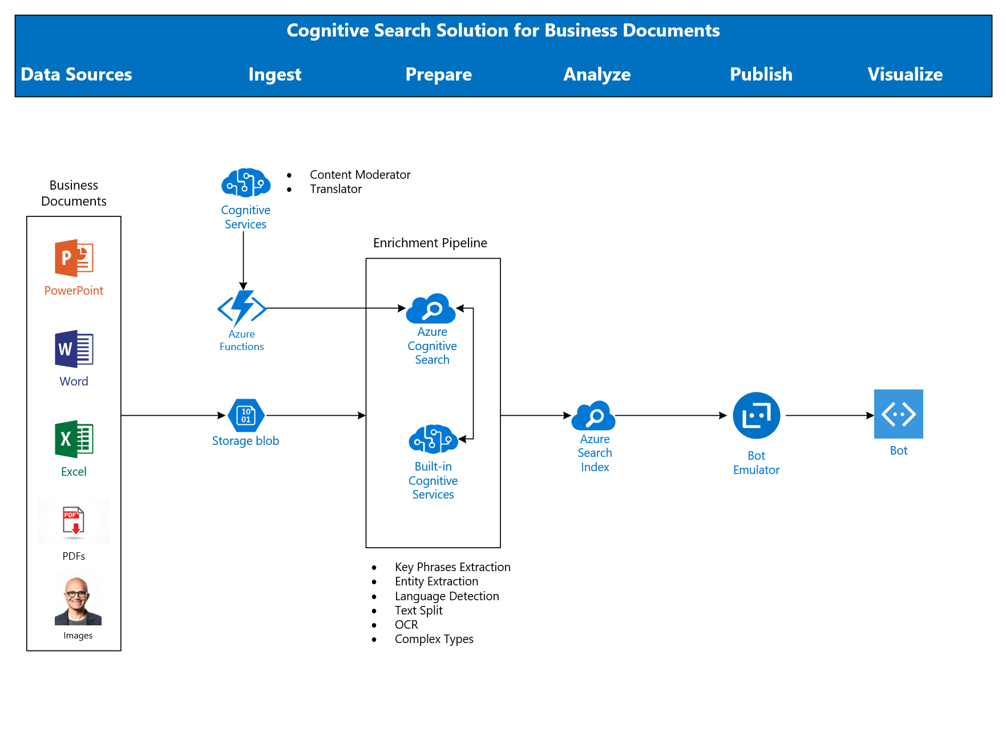
KMB - Architecture

Slide 6
Quick Requests
Azure Search Deployments
50% West Europe
50% South Central US
Patience with Postman, It's worth it
Patience with us, today is the 1st delivery of this training
Be careful with field names (JSON files, URLs). Azure Search is case sensitive.
Notes:
This slide is required. Do NOT delete. This should be the first slide after your Title Slide.
This slide should describe what your goals are for this session. This information lets your audience know what you are trying to accomplish with your talk or tutorial—ie, what value will attendees get by investing 25 minutes or 2 hours of their time listening to you.
You should not spend more than 1 minute presenting this slide.
General examples of session goals could be (you will have to create your own specific goals):
Introduce a new technique or approach to solve a customer problem
Compare two approaches and explain why one is superior
Describe a project and the learnings that audience members can apply from it
Teach audience members how to use a specific technology

Slide 7
KMB - Agenda
Day 1
Introduction, Architecture: 9 AM – 10 AM
Break
Lab 1 - Environment Creation: 10 AM – 11 PM
Lab 2 - Azure Search: 11 AM – 12 PM
Lunch
Lab 3 - Cognitive Search – Text Skills: 1 PM – 2 PM
Break
Lab 4 - Cognitive Search – Image Skills: 2 AM – 4 AM
Day 2
Lab 5 - Cognitive Search – Custom Skills: 9 AM – 11 PM
Lab 6 – Bot: 11 AM – 1 PM
Lunch
Feedback session – Products and Training: 12 PM – 1 PM
Lab 7 - Architecture Design Session: 1:30 PM – 2:30 PM

Slide 8
AI Breaking News
Container support in Azure Cognitive Services
https://docs.microsoft.com/en-us/azure/cognitive-services/cognitive-services-container-support
Power BI delivers AI power
https://www.zdnet.com/article/power-bi-delivers-ai-power/
New Certifications! Beta for a limited time!
Azure Data Engineer
Azure AI Engineer
Azure Data Scientist
https://www.microsoft.com/en-us/learning/browse-new-certification.aspx

Slide 9
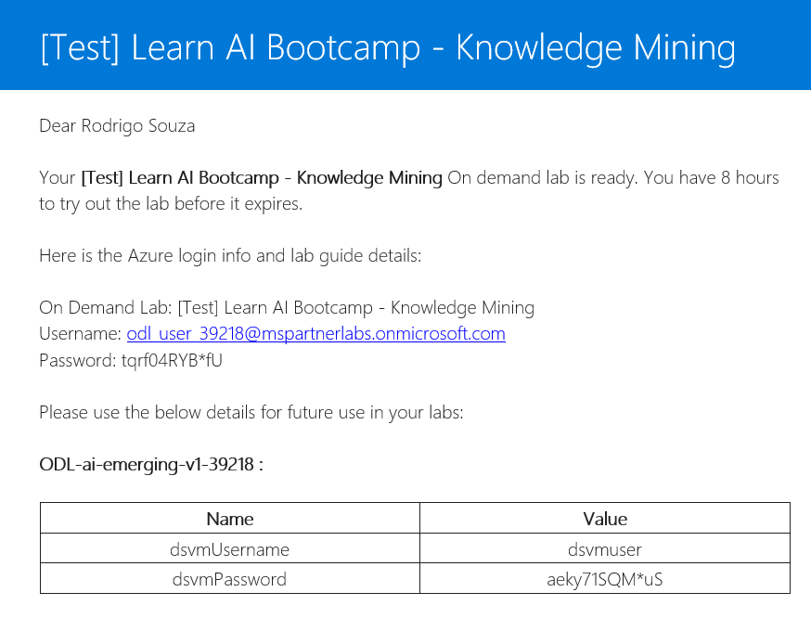
Spektra Environment
http://bit.ly/2zF4bJA
Training Environment
Azure Account
DSVM
Confirmation email from noreply@cloudlabs.ai

Slide 10
LearnAI – Knowledge Mining Bootcamp
https://aka.ms/kmb

Slide 11
LearnAI – Knowledge Mining Bootcamp
Announcements!!!!
1) Lunch will be in the Commons
2) Restart at 1 PM

Slide 12
Quick Orientations – Day 2
Custom Skills Lab - Create the moderated text field as Boolean and filterable
Search for moderated documents using:
$select=blob_uri,ModeratedText&$filter=ModeratedText eq true
Run the Bot Emulator as Administrator
The other Azure Search solution
https://github.com/Rodrigossz/AzureCognitiveSkill
Notes:
This slide is required. Do NOT delete. This should be the first slide after your Title Slide.
This slide should describe what your goals are for this session. This information lets your audience know what you are trying to accomplish with your talk or tutorial—ie, what value will attendees get by investing 25 minutes or 2 hours of their time listening to you.
You should not spend more than 1 minute presenting this slide.
General examples of session goals could be (you will have to create your own specific goals):
Introduce a new technique or approach to solve a customer problem
Compare two approaches and explain why one is superior
Describe a project and the learnings that audience members can apply from it
Teach audience members how to use a specific technology

Slide 13
LearnAI – KMB - Closing
KMB: https://www.surveymonkey.com/r/XGYCF6M
Survey
<enter the URL here

