Slide 1
Internal loops in RNA secondary structure prediction
Lyngsø, Zuker, and Pedersen (1999)
Andrew Hendriks
CMPT 889
Selected Topics in Bioinformatics

Slide 2
Overview
RNA Biochemistry
RNA roles
Structure Prediction Overview
Nussinov’s Algorithm

Slide 3
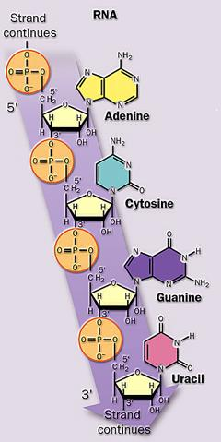
RNA Defined
Sugar (Ribose)
Phosphate
Nucleic Acid Bases
Image Source: Nelson & Cox (2000) “Understand! Biochemistry” Leninger Principles of Biochemistry, Third Edition
Notes:
Both DNA and RNA are composed of repeating units of nucleotides. Each nucleotide consists of a sugar, a phosphate and a nucleic acid base.
The sugar in DNA is deoxyribose. The sugar in RNA is ribose, the same as deoxyribose but with one more OH (oxygen-hydrogen atom combination called a hydroxyl). This is the biggest difference between DNA and RNA. Another difference is that RNA molecules can have a much greater variety of nucleic acid bases. DNA has mostly just 4 different bases with a few extra occasionally. The difference in these bases (between DNA and RNA) allows RNA molecules to assume a wide variety of shapes and also many different functions. DNA, on the other hand, serves as a set of directions and that's about all

Slide 4
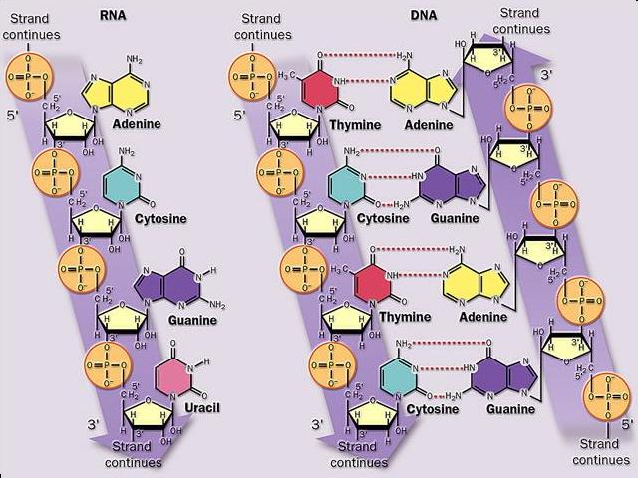
How is RNA different from DNA?
Single-stranded
Uracil replaces Thymine
Sugar is Ribose instead of Deoxyribose
Image Source: Nelson & Cox (2000) “Understand! Biochemistry” Leninger Principles of Biochemistry, Third Edition
Notes:
RNA is almost exclusively found in single-stranded form
The sugar in RNA is ribose
RNA replaces the DNA base thymine with uracil

Slide 5
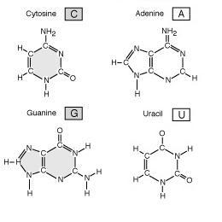
RNA Bases
Pyrimidines
(one ring)
Purines (two rings)
Notes:
Bases are divided into two categories based on the structure of their molecules
purines : two ring structures (adenine and guanine)
pyrimidines have one (cytosine and uracil).

Slide 6
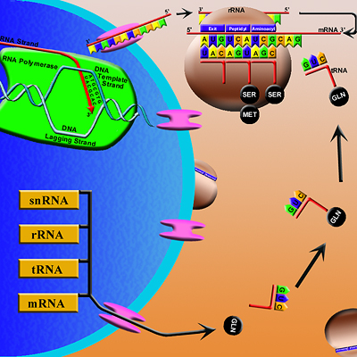
Central Dogma of Molecular Biology
RNA is central in several stages of protein synthesis
Image source: Regents of New Mexico State Univ./SWBIC (2001), http://www.swbic.org/education/ttexter1.php
Notes:
RNA is central in several stages of protein synthesis.
the production of a protein begins with the information in DNA. That information is copied, or transcribed, into the form of RNA.
The message contained in the RNA is then translated into a protein

Slide 7
Types of RNA
small nuclear RNA (snRNA)
  RNA splicing (removal of introns)
ribosomal RNA (rRNA)
  combine with proteins to make ribosomes
transfer RNA (tRNA)
  combines with amino acids as the first step in protein synthesis
messenger RNA, (mRNA)
  transcribed from DNA, encodes proteins
Notes:
Messenger RNA, abbreviated mRNA, is transcribed directly from a gene's DNA and is used to encode proteins
Messenger RNA carries the genetic message from the chromosomes to the ribosomes
Transfer RNA (tRNA) – functioning as adaptor molecules that decode the genetic code
class of RNA molecules, each of which combines covalently with a specific amino acid as the first step in protein synthesis
Ribosomal RNA (rRNA) – RNA serving as components of ribosomes, combined with proteins as the site of protein synthesis
Small nuclear RNA (snRNA) - small RNA molecules in the nucleus of eukaryotic cells.
- most involved RNA splicing (removal of introns from mRNA, tRNA, and rRNA)
always associated with specific proteins, and the complexes are referred to as small nuclear ribonucleoproteins (snRNP) or sometimes as snurps.
Signal Recognition Particle - translocating proteins across plasma membrane
small nucleolar RNA (snoRNA) - required for ribosomal RNA processing and modification
The RNA structure (especially in 5’ and 3’ untranslated regions) used in many ways to effect post-transcriptional genetic regulation

Slide 8


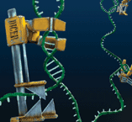
Why ELSE is RNA Important?
discovery of catalytic RNA by Cech & Bass (1986)
structural and catalytic RNAs are important in molecular biology of organisms
Notes:
More than just DNA-Protein intermediaries
“small RNAs” operate many controls within a cell
Shut down genes or alter expression levels
Some species can shape genomes
May even switch genes on or off during cell development
For decades, RNA molecules were dismissed as little more than drones, taking orders from DNA and converting genetic information into proteins. But a string of recent discoveries indicates that a class of RNA molecules called small RNAs operate many of the cell's controls. They can turn the tables on DNA, shutting down genes or altering their levels of expression. Remarkably, in some species, truncated RNA molecules literally shape genomes, carving out chunks to keep and discarding others. There are even hints that certain small RNAs might help chart a cell's destiny by directing genes to turn on or off during development, which could have profound implications for coaxing cells to form one type of tissue or another.
(Whew!) And if that wasn’t good enough for you…

Slide 9
RNA World Hypothesis
hypothesis that ancient RNA molecules served as the starting point for life (Gilbert 1986)
i.e. RNA genomes were replicated by RNA catalysts
seems to be hotly debated
Notes:
first life on earth may have been RNA-based:
RNA's can carry genetic information like DNA and catalyze biochemical reactions like enzymes.
some viruses, such as retroviruses, still use RNA as their only genetic material.
less stable than DNA,
less efficient catalyst than most protein enzymes.
may have led to selection for reduced use of RNA in cells, and greater use of DNA and proteins.

Slide 10
Why Predict Structure?
knowing a biomolecule’s shape is invaluable in endeavors such as creating new drugs and understanding genetic diseases
current physical methods (Nuclear Magnetic Resonance and X-Ray Crystallography) are too expensive and time consuming
we wish to predict shape of biopolymers from sequence of bases
Notes:
Since a biomolecule’s function follows from its shape, knowing that shape is invaluable in endeavors such as creating new drugs and understanding genetic diseases
Our current physical methods (X-Ray Crystallography and Nuclear Magnetic Resonance) are too expensive and too time consuming
So a hot topic in bioinformatics is structure prediction.
The idea is we take the sequences of bases which make up a biomolecule such as RNA, and try to determine how that sequence folds to form the final shape or tertiary structure

Slide 11
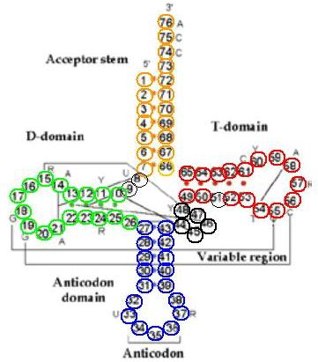
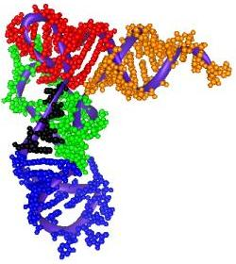
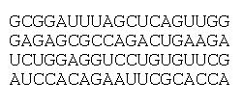
Secondary and Tertiary Structure
Primary Structure
Tertiary Structure
Secondary Structure
Image Source: Designed Universe http://www.designeduniverse.com/articles/Nobel_Prize/Nobel_DNA2.htm
Notes:
1. The primary structure is the sequence of nucleoside monophosphates (usually written as the sequence of bases they contain).
2. The secondary structure refers to stable arrangements of bases which give rise to recurring structural patterns.
3. Tertiary structure refers to large-scale folding in a linear polymer that is at a higher order than secondary structure. The tertiary structure is the specific three-dimensional shape into which an entire chain is folded.

Slide 12
Why RNA Secondary Structure?
simply put, secondary structure prediction is more straightforward
four basic structures: helices, loops, bulges and junctions
energies involved in secondary structures are greater than tertiary, making them more stable (Tinoco & Bustamante, 1999)
Notes:
Also, the secondary structure of RNA essentially dominates its tertiary structure

Slide 13
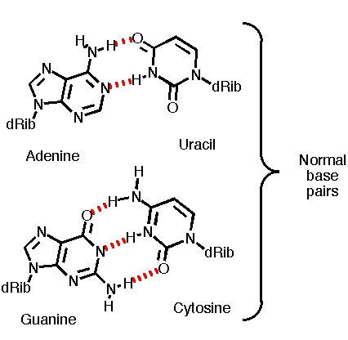
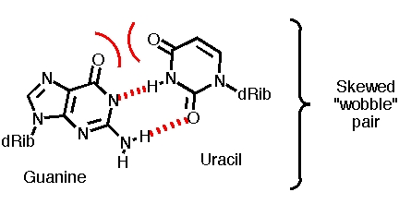
Base Pairs in RNA
2 Hydrogen Bonds (less stable)
“Non-canonical” base pair
3 Hydrogen Bonds (most stable)
Image Source: “BC 5254/GCS 719, Computer Applications in Biomedical Research” http://www.finchcms.edu/cms/biochem/Walters/rna_folding.html

Slide 14
RNA Folding
bonds form between “canonical base pairs” (GC, AU, GU and their mirrors)
G
C
A
G
C
U
A
A
G
U
G
U
U
C
A
A
these bonds “fold” the sequence back on itself to form secondary structure (helices)
U
A
G
C
A
G
C
A
A
A
C
U
U
G
G
U
Notes:
In our model, RNA secondary structure occurs as a consequence of chemical (hydrogen) bonds that form between specific pairs of base (nucleotides), (i.e. GC, AU, GU,)
and their mirrors which are collectively known as the canonical base pairs.
These form secondary structures known as helices.
Searching a sequence of bases for all possible base pairs is rapid and straightforward; the challenge comes from attempting to predict which specific pairs form bonds in the real structure.

Slide 15
Secondary Structure Elements
Internal Loop
External Base
Multi-loop
Bulge
Hairpin Loop
Note: the same sequence may produce many different, overlapping helices
Notes:
These represent the basic secondary structures in RNA.
It’s important to note that the same sequence can produce many different secondary structures depending on which base pair bonds form.

Slide 16
Pseudoknots
A
G
C
A
U
A
C
5′
U
U
C
C
G
A
A
G
G
G
C
A
A
C
U
C
G
A
A
G
C
A
U
G
A
G
C
U
3′
C
G
A
A
C
G
U
G
U
A
3′
A
A
A
U
G
A
G
C
U
5′
bases pairs between a loop and positions outside the enclosing stem
two stems can stack coaxially and mimic a contiguous A-form helix
Image Source: Durbin et al. (2002) “Biological Sequence Analysis”
Notes:
Pseudoknot: Base pairs between a loop and positions outside the enclosing stem
Artificially selected RNA inhibitor of the human immunodeficiency virus reverse transcriptase [Turek, MacDougal & Gold 1992]
Very challenging to deal with them; however, the total number of pseudoknotted base pairs is relatively small
i.e. in E. coli SSU rRNA, 447 base pairs, only 8 are in pseudoknot structures
NOTE: no thermodynamic data on pseudoknots

Slide 17
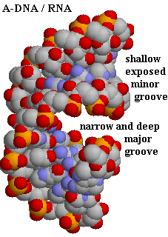
RNA A-Form Helix
Image source: Oehler, U. (2002) “Chem*730 Proteins and Nucleic acids” http://www.chembio.uoguelph.ca/educmat/chm730/h730.htm
Notes:
Image source: Oehler, U. (2002) “Chem*730 Proteins and Nucleic acids” http://www.chembio.uoguelph.ca/educmat/chm730/h730.htm

Slide 18
Methods of Secondary Structure Prediction
Comparative Sequence Analysis
Dynamic Programming
Notes:
Comparative Methods
Dynamic Programming
Kinetic Folding – emulate kinetic folding algorithm has been developed in order to study the dynamics of RNA folding on such an energy landscape.
Genetic Algorithms – emulate folding via crossover operators

Slide 19
Comparative Sequence Analysis
during evolution, secondary structure of functional RNA conserved better than primary
align sets of phylogenetically-ordered homologous sequences
invariance in certain sections identifies them as being important to structure and function

Slide 20
Comparative Sequence Analysis
seq1 G C C U U C G G G C
U
C
U
G
seq2 G A C U U C G G U C
C
C
N
N′
G
G
seq3 G C C U U C G G G C
highlighted sections covary, maintaining Watson-Crick complementarity
Image Source: Durbin et al. (2002) “Biological Sequence Analysis”
Notes:
We see a covariation at a specific point, implying a base pair, which leads to a consensus secondary structure prediction.

Slide 21
Dynamic Programming
recursive computation
i.e. maximizes base pairs or minimizes free energy
focus on algorithms by Nussinov and Zuker

Slide 22
First DP Algorithm: Nussinov
one possible technique: base pair maximization
Algorithms for Loop Matching
(Nussinov et al., 1978)
too simple for accurate prediction, but stepping-stone for later algorithms

Slide 23
Initial Concepts
only consider base pairs
folding of an N nucleotide sequence can be specified by a symmetric N × N matrix
M_{ij}=1 if bases form a pair
M_{ij}=0 otherwise
C
G
A
U
G
U

Slide 24
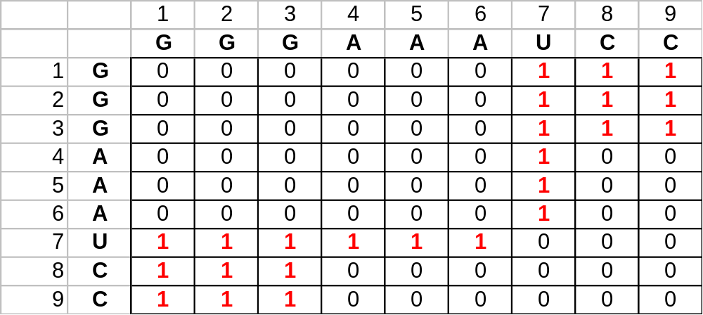
Naïve Example 1
G
G
G
A
A
A
U
C
C
1
2
3
4
5
6
7
8
9

Slide 25
Matching “blocks”
visually inspect matrices for diagonal lines of 1’s
manually piece them together into an optimal folded shape

Slide 26
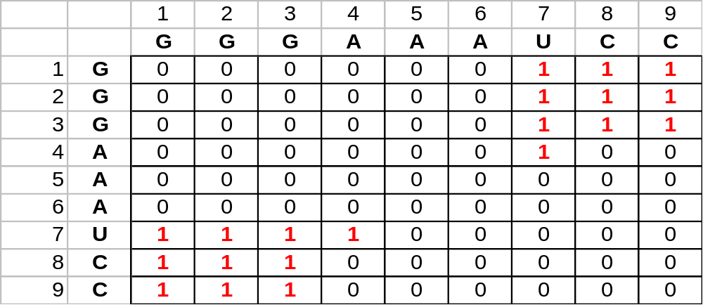
Naïve Example 1
G
G
G
A
A
A
U
C
C
1
2
3
4
5
6
7
8
9

Slide 27
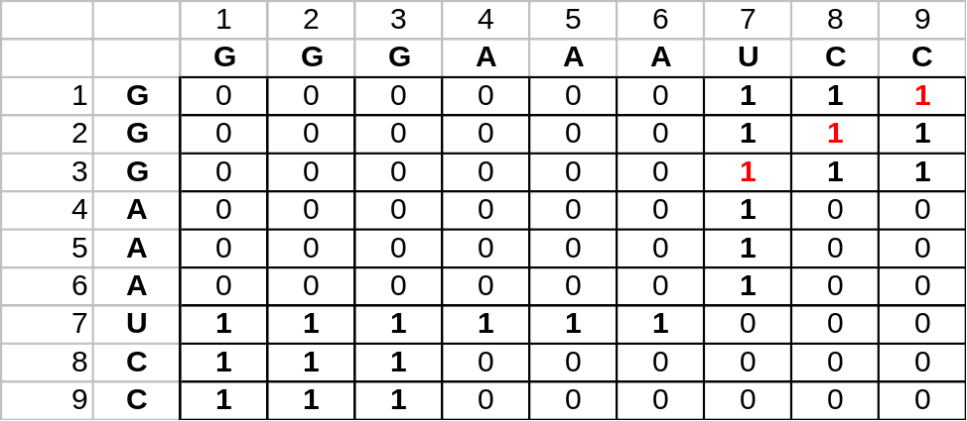
Naïve Example 1
G
G
G
A
A
A
U
C
C
1
2
3
4
5
6
7
8
9

Slide 28
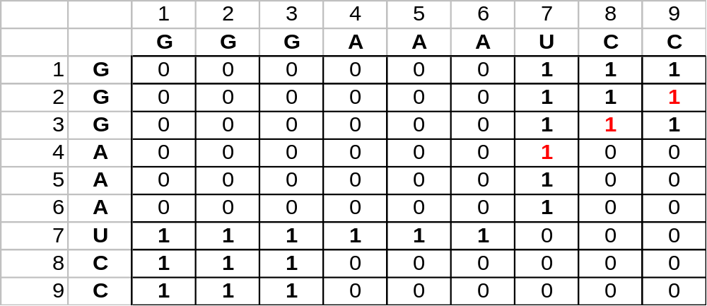
Naïve Example 1
G
G
G
A
A
A
U
C
C
1
2
3
4
5
6
7
8
9

Slide 29
Refinement
unfortunately, this finds chemically infeasible structures
i.e. insufficient space, inflexibility of paired base regions
next step is to specify better constraints
solution: a dynamic programming algorithm [Nussinov et al., 1978]
Notes:
rapidly found to be impractical for sequences of N > ~100
also ignored the impact of adjacent bases (base stacking)

Slide 30
Structure Representation
secondary structure described as a graph
base pairs are described via pairs of indices
(i, j), indicating links between base vertices
S={(1,13), (2,12), (3,11), (4,10)}
U
C
A
U
G
C
G
U
A
A
U
G
A
U
C
U
C
U
A
G
G
A
U
C
G
C
1
2
3
4
5
6
7
8
9
10
11
12
13

Slide 31
Basic Constraints
Each edge contains vertices (bases) linking compatible base pairs
No vertex can be in more than one edge
Edges must be drawn without crossing
Edges (g, h) and (i, j)
if i < g < j < h or g < i < h < j, both edges cannot belong to the same “matching.”
G
G
G
A
A
A
U
C
C
i
g
j
h

Slide 32
Basic Constraints
Each edge contains vertices (bases) linking compatible base pairs
No vertex can be in more than one edge
Edges must be drawn without crossing
Edges (g, h) and (i, j)
if i < g < j < h or g < i < h < j, both edges cannot belong to the same “matching.”
G
G
G
A
A
A
U
C
C
g
i
h
j

Slide 33
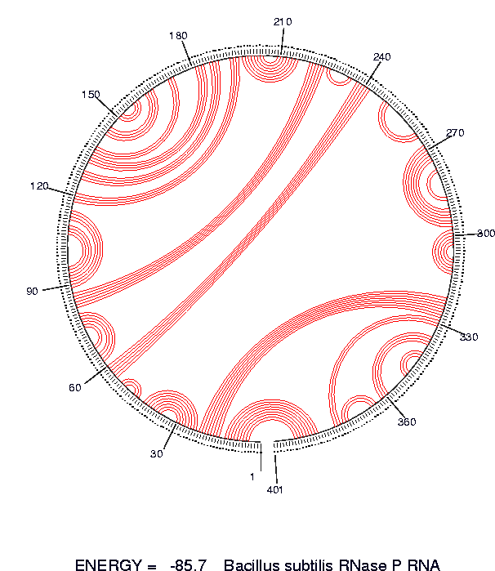
Circular Representation
Image source: Zuker, M. (2002) “Lectures on RNA Secondary Structure Prediction” http://www.bioinfo.rpi.edu/~zukerm/lectures/RNAfold-html/node1.html

Slide 34
Energy Minimization
objective is a folded shape for a given nucleotide chain such that the energy is minimized
E_{ij} = 1 for each possible compatible base pair, E_{ij} = 0 otherwise

Slide 35
Algorithm Behaviour
recursive computation, finding the best structure for small subsequences
works outward to larger subsequences
four possible ways to get the best RNA structure:

Slide 36


Case 1: Adding unpaired base i
Add unpaired position i onto best structure for subsequence i+1, j
i+1
j
i
Image Source: Durbin et al. (2002) “Biological Sequence Analysis”
Notes:
Adding an unpaired base I to the best structure

Slide 37
Case 2: Adding unpaired base j
Add unpaired position i onto best structure for subsequence i+1, j
i
j-1
j
Image Source: Durbin et al. (2002) “Biological Sequence Analysis”
Notes:
Adding unpaired base j to the best structure

Slide 38
Case 3: Adding (i, j) pair
Add base pair (i, j) onto best structure found for subsequence i+1, j-1
i+1
j-1
i
j
Image Source: Durbin et al. (2002) “Biological Sequence Analysis”
Notes:
Stacking another base pair (I,j) onto the structure

Slide 39
Case 4: Bifurcation
combining two optimal substructures i, k and k+1, j
i
j
k
k+1
Image Source: Durbin et al. (2002) “Biological Sequence Analysis”
Notes:
Bifurcation, or combining two optimal substructures ranging from i <k < j

Slide 40
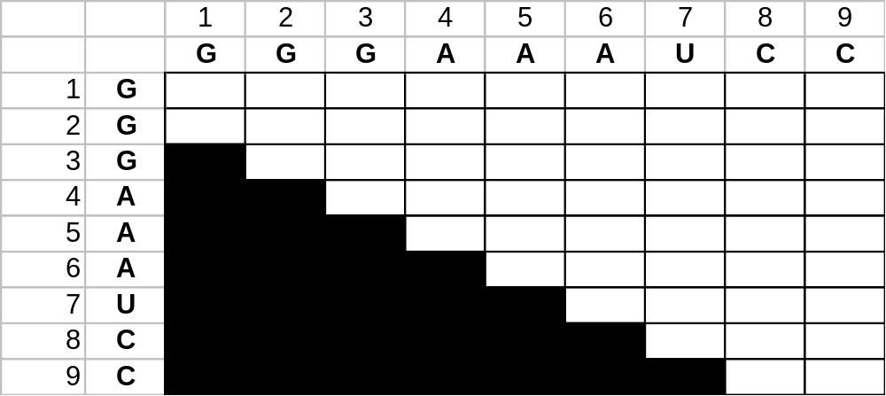
Nussinov RNA Folding Algorithm
Initialization:
  γ(i, i-1) = 0 for I = 2 to L;
  γ(i, i) = 0 for I = 2 to L.
j
i
Image Source: Durbin et al. (2002) “Biological Sequence Analysis”

Slide 41

Nussinov RNA Folding Algorithm
Initialization:
  γ(i, i-1) = 0 for I = 2 to L;
  γ(i, i) = 0 for I = 2 to L.
j
i
Image Source: Durbin et al. (2002) “Biological Sequence Analysis”

Slide 42

Nussinov RNA Folding Algorithm
Initialization:
  γ(i, i-1) = 0 for I = 2 to L;
  γ(i, i) = 0 for I = 2 to L.
j
i
Image Source: Durbin et al. (2002) “Biological Sequence Analysis”

Slide 43
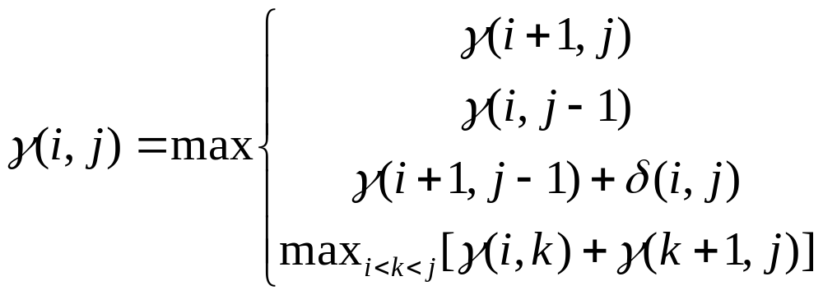
Nussinov RNA Folding Algorithm
Recursive Relation:
For all subsequences from length 2 to length L:
Case 1
Case 2
Case 3
Case 4

Slide 44

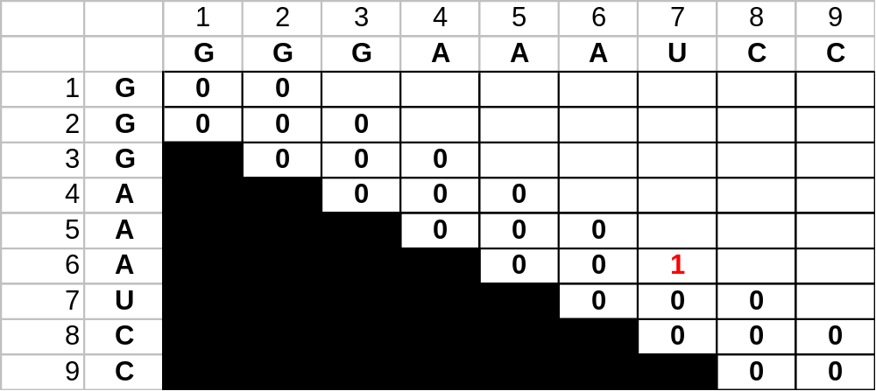
Nussinov RNA Folding Algorithm
j
i
Image Source: Durbin et al. (2002) “Biological Sequence Analysis”

Slide 45
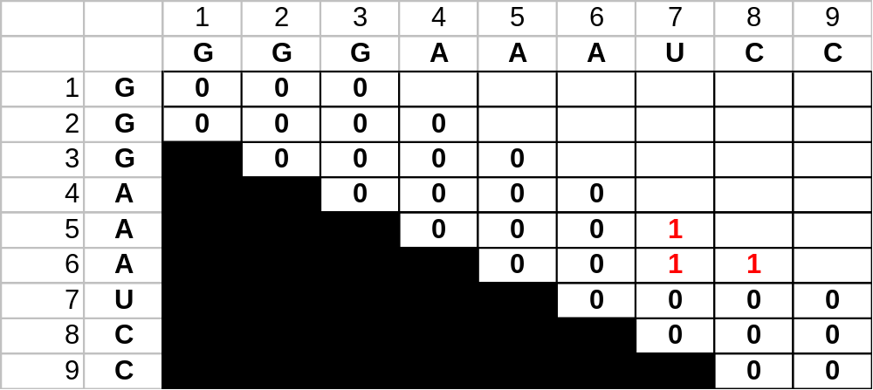
Nussinov RNA Folding Algorithm
j
i
Image Source: Durbin et al. (2002) “Biological Sequence Analysis”

Slide 46
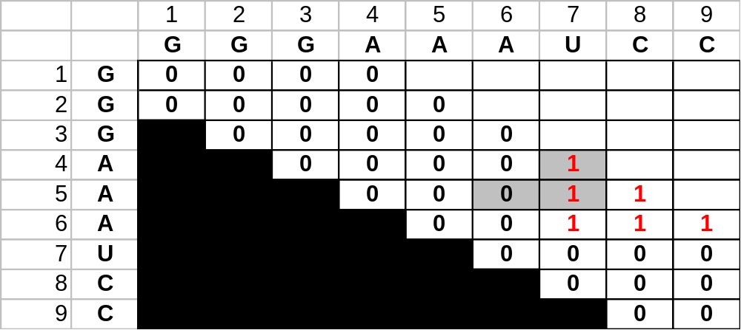
Nussinov RNA Folding Algorithm
j
i
Image Source: Durbin et al. (2002) “Biological Sequence Analysis”

Slide 47
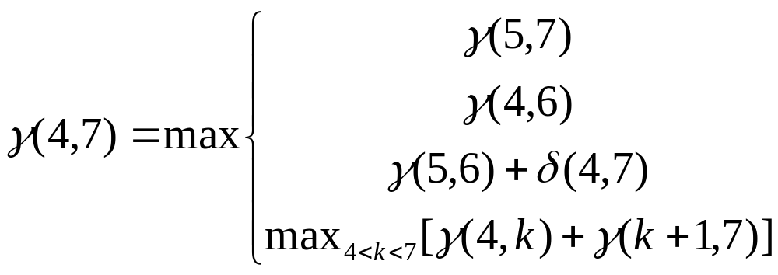
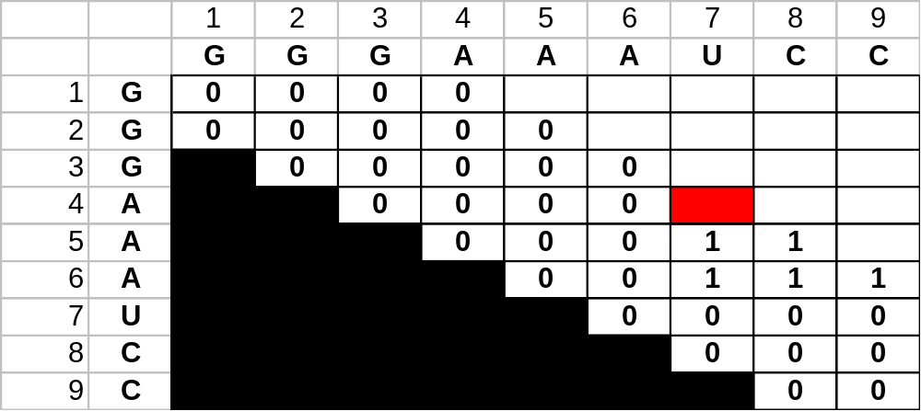
Example Computation
j
i
Image Source: Durbin et al. (2002) “Biological Sequence Analysis”

Slide 48
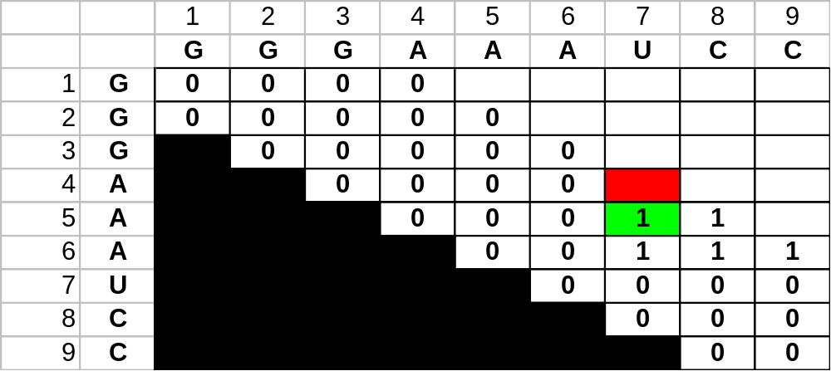
Example Computation
A
i+1
A
U
j
i
A
j
i
Image Source: Durbin et al. (2002) “Biological Sequence Analysis”

Slide 49
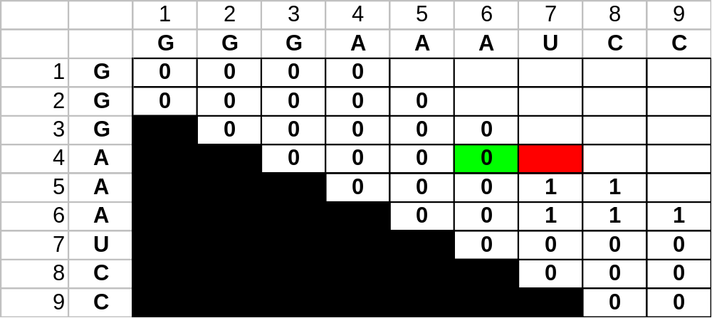
Example Computation
j
i
Image Source: Durbin et al. (2002) “Biological Sequence Analysis”

Slide 50
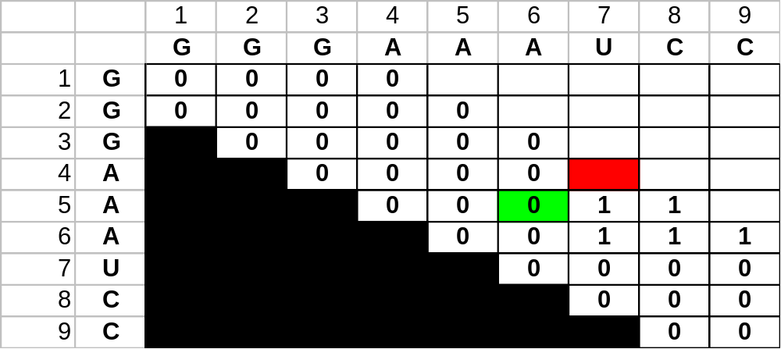
Example Computation
i+1
j-1
A
A
A
U
i
j
j
i
Image Source: Durbin et al. (2002) “Biological Sequence Analysis”

Slide 51
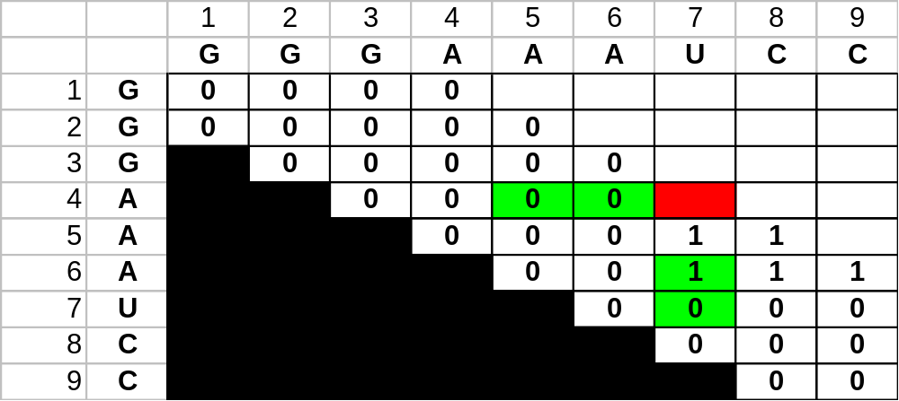
Example Computation
j
i
Image Source: Durbin et al. (2002) “Biological Sequence Analysis”

Slide 52
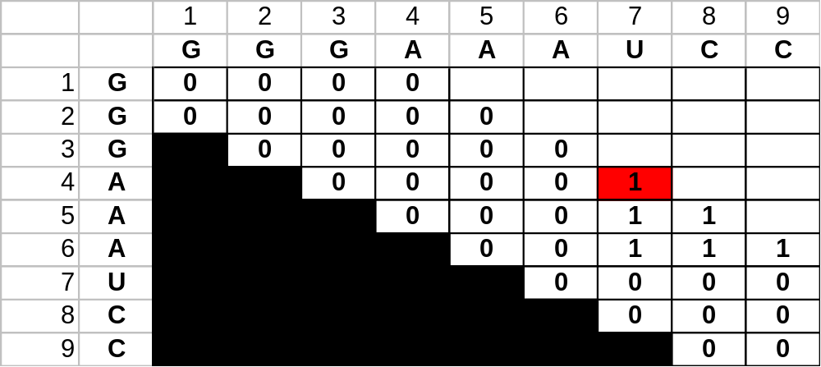
Example Computation
j
i
Image Source: Durbin et al. (2002) “Biological Sequence Analysis”

Slide 53
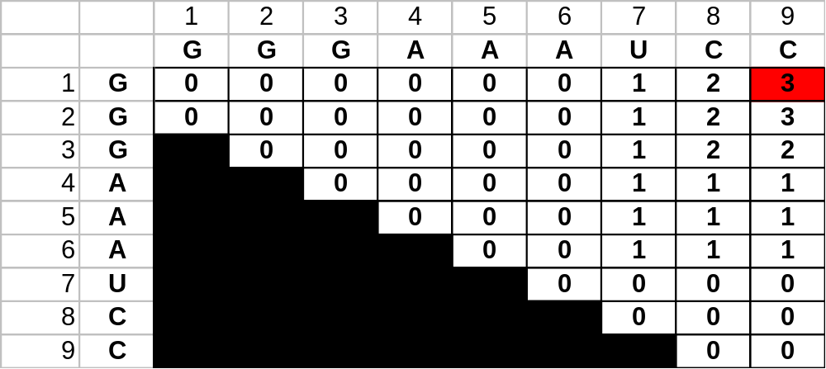
Completed Matrix
j
i
Image Source: Durbin et al. (2002) “Biological Sequence Analysis”

Slide 54
Traceback
value at γ(1, L) is the total base pair count in the maximally base-paired structure
as in other DP, traceback from γ(1, L) is necessary to recover the final secondary structure
pushdown stack is used to deal with bifurcated structures

Slide 55
Traceback Pseudocode
Initialization: Push (1,L) onto stack
Recursion: Repeat until stack is empty:
pop (i, j).
If i >= j continue; // hit diagonal
  else if γ(i+1,j) = γ(i, j) push (i+1,j); // case 1
  else if γ(i, j-1) = γ(i, j) push (i,j-1); // case 2
  else if γ(i+1,j-1)+δ_{i,j} = γ(i, j): // case 3
    record i, j base pair
    push (i+1,j-1);
  else for k=i+1 to j-1:if γ(i, k)+γ(k+1,j)=γ(i, j): // case 4
    push (k+1, j).
    push (i, k).
    break

Slide 56
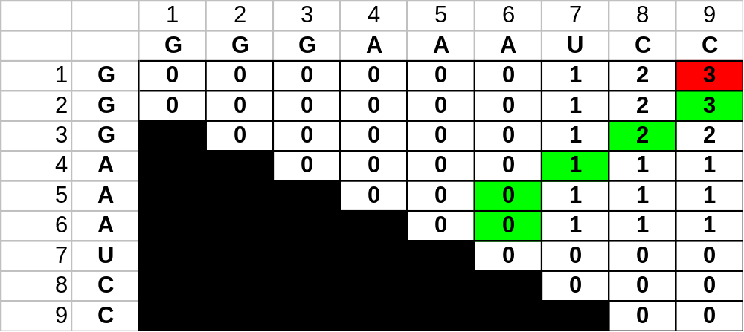
Retrieving the Structure
PAIRS
STACK
(1,9)
CURRENT
j
i
Image Source: Durbin et al. (2002) “Biological Sequence Analysis”

Slide 57
Retrieving the Structure
PAIRS
STACK
(2,9)
CURRENT
(1,9)
j
i
Image Source: Durbin et al. (2002) “Biological Sequence Analysis”

Slide 58
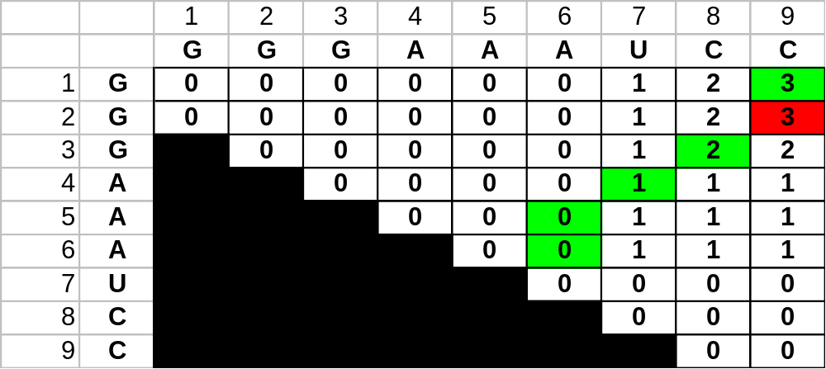
Retrieving the Structure
PAIRS
(2,9)
STACK
(3,8)
CURRENT
(2,9)
G
C
G
j
i
Image Source: Durbin et al. (2002) “Biological Sequence Analysis”

Slide 59
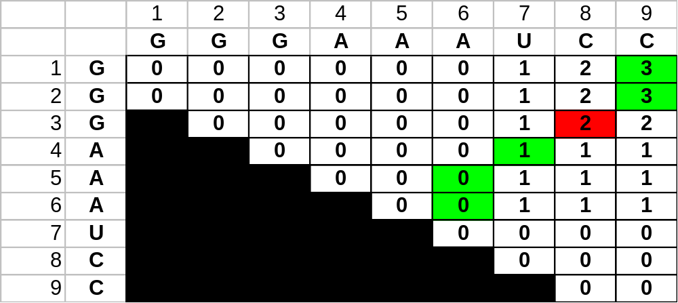
Retrieving the Structure
PAIRS
(2,9)
(3,8)
STACK
(4,7)
CURRENT
(3,8)
G
C
G
C
G
j
i
Image Source: Durbin et al. (2002) “Biological Sequence Analysis”

Slide 60
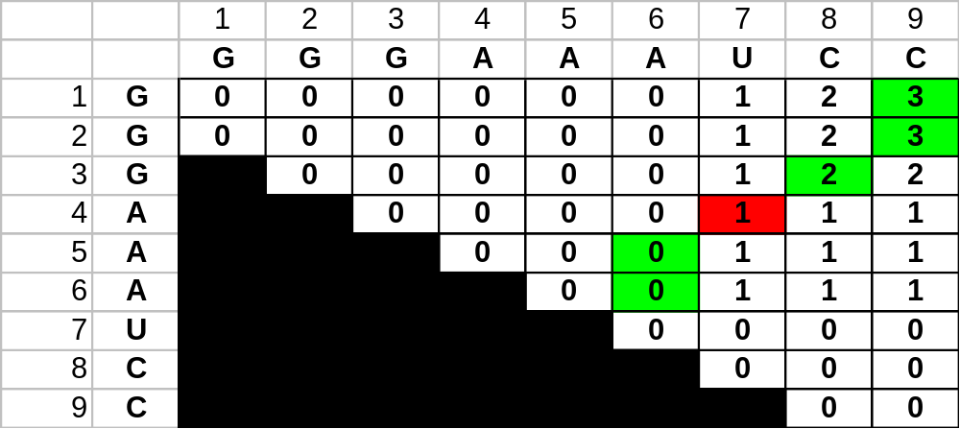
Retrieving the Structure
PAIRS
(2,9)
(3,8)
(4,7)
STACK
(5,6)
CURRENT
(4,7)
A
U
G
C
G
C
G
j
i
Image Source: Durbin et al. (2002) “Biological Sequence Analysis”

Slide 61
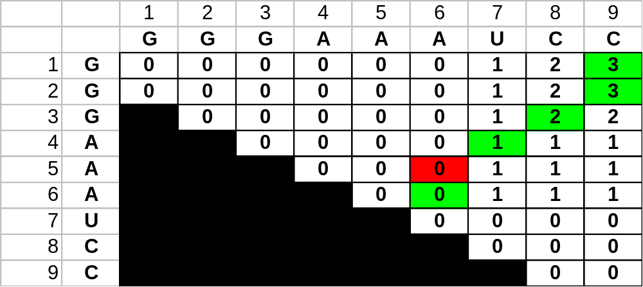
Retrieving the Structure
A
PAIRS
(2,9)
(3,8)
(4,7)
STACK
(6,6)
CURRENT
(5,6)
A
U
G
C
G
C
G
j
i
Image Source: Durbin et al. (2002) “Biological Sequence Analysis”

Slide 62
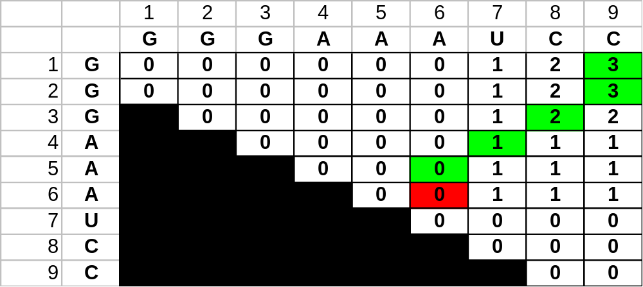
Retrieving the Structure
A
A
PAIRS
(2,9)
(3,8)
(4,7)
STACK
-
CURRENT
(6,6)
A
U
G
C
G
C
G
j
i
Image Source: Durbin et al. (2002) “Biological Sequence Analysis”

Slide 63
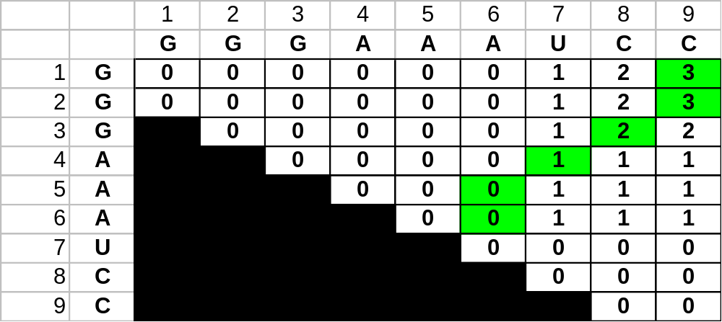
Retrieving the Structure
A
A
A
U
G
C
G
C
G
j
i
Image Source: Durbin et al. (2002) “Biological Sequence Analysis”

Slide 64
Evaluation of Nussinov
unfortunately, while this does maximize the base pairs, it does not create viable secondary structures
in Zuker’s algorithm, the correct structure is assumed to have the lowest equilibrium free energy (ΔG) (Zuker and Stiegler, 1981; Zuker 1989a)

Slide 65
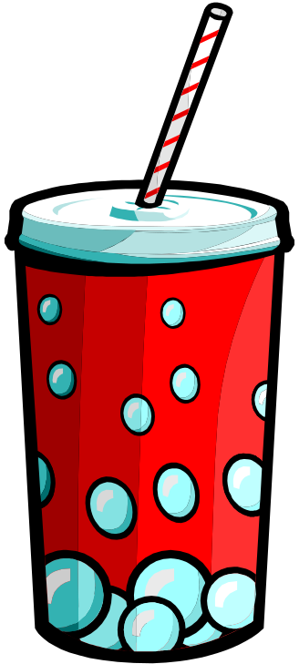


Break Time!

Slide 66
Free Energy (ΔG)
ΔG approximated as the sum of contributions from loops, base pairs and other secondary structures
4 nt loop +5.9
U
U
A
A
-1.1 terminal mismatch of hairpin
G
C
-2.9 stack
G
C
1nt bulge +3.3
A
-2.9 stack (special case of 1 nt bulge)
G
C
-1.8 stack
U
A
-0.9 stack
A
U
-1.8 stack
C
G
-2.1 stack
A
U
5′ dangle -0.3
A
unstructured single strand 0.0
A
3′
5′
Image Source: Durbin et al. (2002) “Biological Sequence Analysis”
Notes:
Important difference from Nussinov is that energies of stems are calculated by adding stacking contributions for the interface between neighboring base pairs
Results of thermodynamic studies [Freier et al., 1986; Turner et al. 1987]

Slide 67
Basic Notation
secondary structure of sequence s is a set S of base pairs i • j, 1 ≤ i < j ≤ |s|
we assume:
  each base is only in one base pair
  no pseudoknots
  sharp “U-turns” prohibited; a hairpin loop must contain at least 3 bases

Slide 68
Secondary Structure Representation
can view a structure S as a collection of loops together with some external unpaired bases

Slide 69
Accessible Bases
Let i < k < j with i•j ∈ S
k is accessible from i•j if for all i′•j′ ∈ S if it is not the case that i<i′<k<j′<j
i’’
j’’
i’
j’
i
k
j

Slide 70
Exterior Base Pairs
base pair i•j is the exterior base pair of (or closing) the loop consisting of i•j and all bases accessible from it
i
j

Slide 71
Interior Base Pairs
if i′ and j′ are accessible from i•j
and i′•j′ ∈ S
then i′•j′ is an interior base pair, and is accessible from i•j
i’
j’
i
j

Slide 72
Hairpin Loop
if there are no interior base pairs in a loop, it is a hairpin loop
i’
j’
i
j

Slide 73
Stacked Pair
a loop with one interior base pair is a stacked pair if i′ = i+1 and j′ = j-1
i’ = i+1
j’ = j+1
i
j

Slide 74
Internal Loop
if it is not true that the interior base pair i•j that
i′ = i+1 and j′ = j-1, it is an internal loop
i’
i
j
j’
Notes:
Mention that bulges are the same as internal loops, except that either base I’ or j’ is directed adjacant to I or j (but not both)

Slide 75
Multibranch Loops
loops with more than one interior base pair are multibranched loops

Slide 76
External Bases and Base Pairs
any bases or base pairs not accessible from any base pair are called external

Slide 77
Assumptions
structure prediction determines the most stable structure for a given sequence
stability of a structure is based on free energy
energy of secondary structures is the sum of independent loop energies
Notes:
stability of a structure is based on free energy; an optimal structure has minimal free energy

Slide 78
Recursion Relation
four arrays are used to hold the minimal free energy of specific structures of subsequences of s
arrays are computed interdependently
calculated recursively using pre-specified free energy functions for each type of loop

Slide 79
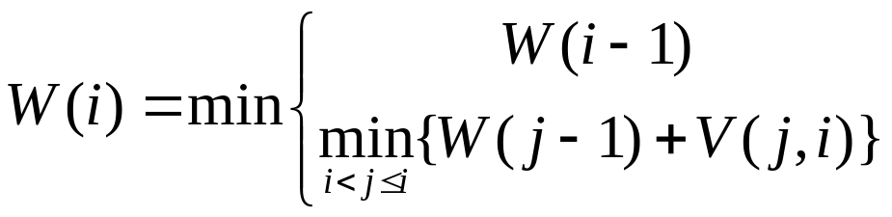
W(i)
energy of an optimal structure of subsequence 1 through i:

Slide 80
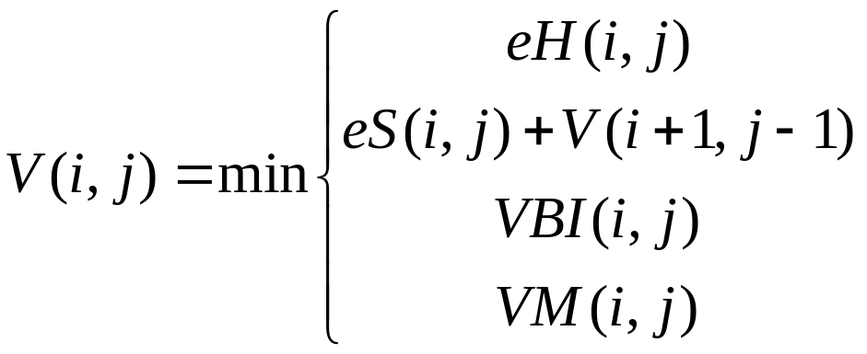
V(i,j)
energy of an optimal structure of subsequence i through j closed by i•j:

Slide 81

eH(i,j)
energy of hairpin loop closed by i•j
computed with:
R = universal gas constant (1.9872 cal/mol/K).
T = absolute temperature
l_{s} = total single-stranded (unpaired) bases in loop

Slide 82
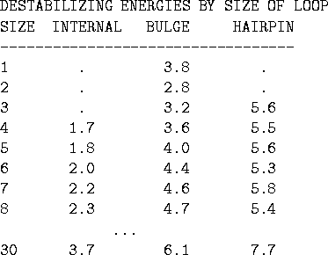
Loop Energy Table

Slide 83
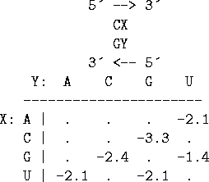
eS(i,j)
energy of stacking base pair i•j with i+1•j-1
sample free energies in kcal/mole for CG base pairs stacked over all possible base pairs, XY
‘.’ entries are undefined, and can be assumed as ∞

Slide 84
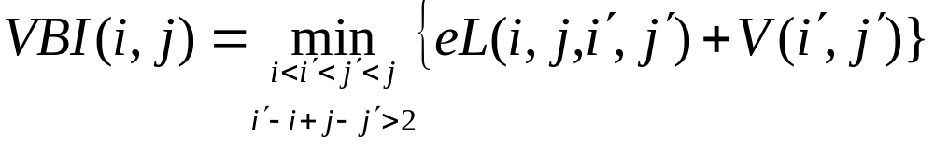
VBI(i,j)
energy of an optimal structure of the subsequence from i through j, where i•j closes a bulge or an internal loop

Slide 85
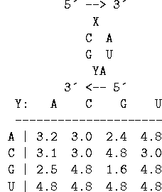
eL(i,j,i′,j′)
energy of a bulge or internal loop with exterior base pair i•j and interior base pair i′•j′
free energies for all 1 x 2 interior loops in RNA closed by a CG and an AU base pair, with a single stranded U 3' to the double stranded U.

Slide 86
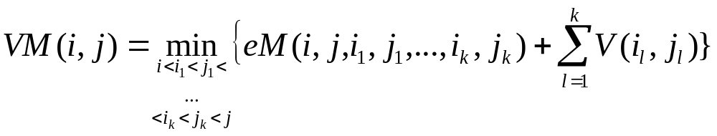
VM(i,j)
energy of an optimal structure of the subsequence from i through j, where i•j closes a multibranched loop

Slide 87

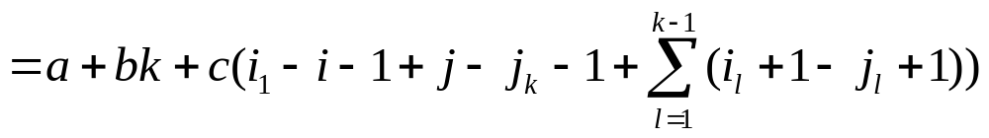
eM(i,j,i₁,j₁,…,i_{k},j_{k})
energy of a multibranched loop with exterior base pair i•j and interior base pairs i₁•j₁,…,i_{k}•j_{k}
simplification: linear contributions from number of unpaired bases in loop, number of branches and a constant
Notes:
little is known about the effects of multi-branch loops on RNA stability, we assign free energies in a way that makes the computations easy

Slide 88
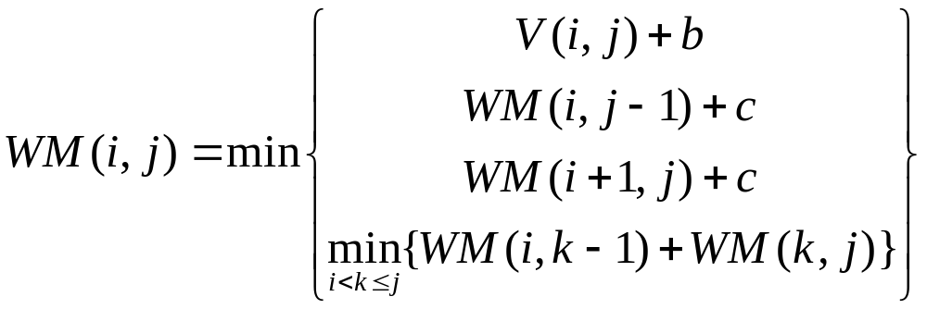
eM refactored as VM(i,j)
energy of an optimal structure of subsequence i – j constituting part of a multibranched loop structure
unpaired bases and external base pairs are penalized as per the previous equation:
Notes:
It is known that the stability of a multibranched loop also depends on the stacking effects of the base pairs in the loop and their neighboring unpaired bases.
These effects can also be handled efficiently, but for simplificity we have omitted the details here.

Slide 89

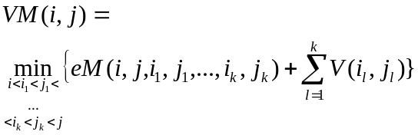


Assembling the Pieces
Internal Loop
External Base
Multi-loop
Hairpin Loop
Bulge
Stacking Base Pairs

Slide 90
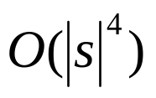
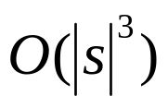
The Trouble with Internal Loops
objective of this paper is to reduce the computational complexity from to
the most computationally complex element of the four different secondary structure types is VBI(i,j), or bulge or internal loops
Notes:
hairpin loops [eH(i,j)], stacked base pairs [eS(i,j)], multiloops [VM(i,j)], and bulge or internal loops [VBI(i,j)], is VBI(i,j)

Slide 91
Internal Loops Revisited
computational complexity: all possible base pairs accessible to i and j are considered for all i and j computed in VBI
also add destabilizing loop energy and energy of optimal substructure closed by (i′• j′), the complexity is

Slide 92
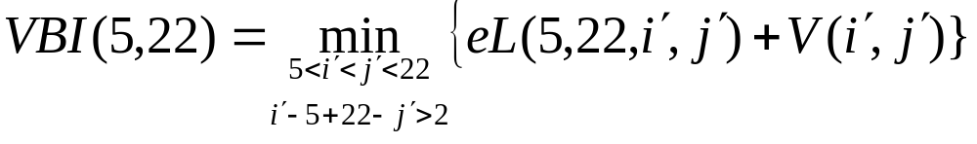
Example Internal Loop
13
12
14
11
15
16
10
17
18
9
19
internal base pair (i′•j′)
8
7
20
6
21
external base pair (i•j)
5
22
4
23
3
24
2
25
1
26

Slide 93


Simplifying the Energy Computation
the energy function eL for internal loops can be split into three components:
entropic term depending on size of the loop
asymmetric penalty for asymmetric loops
stacking energies of interior and exterior base pairs with the nearest unpaired bases
(1)
(2)
(3)

Slide 94



Example eL(i,j,i′,j′) Computation
13
12
14
11
15
16
10
17
18
9
19
internal base pair (i′•j′)
8
7
20
6
21
external base pair (i•j)
5
22
4
23
3
24
2
25
1
26

Slide 95

Dealing with Asymmetry Penalty
we assume that lopsidedness and size dependence of asymmetry can be separated out:
main idea: if we fix lopsidedness, asymmetry penalty doesn’t change with size
Notes:
N = n1-n2
M = min(n1,n2,c)
Emax = max penalty
C = constant=1 = thermodynamic penalty

Slide 96
The Payoff
for internal loops of size l and shortest length of unpaired bases c, if we know:
  the optimal interior base pair (i′• j′)
  the exterior base pair (i• j)
we can find the optimal interior base pair for loop size l+2 with exterior base pair (i+1• j+1) in constant time

Slide 97




Lopsided Illustration
i′
i′
S′
S′
shift closing pair from (i, j) to (i′,j′)
j′
j′
i
j
i-1
j+1
lopsided to straight
Change in size +
stacking(i-1, j-1) - stacking(i, j)
S′′
S′′
i′′
j′′
i′′
j′′
i
j
i-1
j+1
Notes:
The difference in destabilizing energy when extending a loop from being closed by (i,j) to (i-1, j+1) is determined solely by the size of the loop and the change in stacking stability of the closing base pair.
Thus comparisons between different choices of interior base pairs (i.e. i’j’ and i’’j’’) can be reused.

Slide 98
The Algorithm
compare structure with interior base pair (i′• j′) with the two structures with an interior base pair that gives a shortest length of c unpaired bases
algorithm evaluates internal loops of size 2l + a with exterior base pair i-l•j+l+a and shortest length of at least c unpaired bases
Notes:
c is a constant set to 1 based on loop thermodynamic data

Slide 99
Algorithm Pseudocode
Require: i, j with i < j
  For a = 0 to 1 do // a=0 for even, a=1 for odd sized loops
    E=∞ // energy of optimal loop excepting size and external stacking
    For l = c + 1 to min{i-1,|s|-j-a} do
      E = min {E,
        V(i-l+c+1,j-l+c+1)+
        asymmetry(c,2l+a-c-2)+
        stacking(i-l+c+1,j-l+c+1), // Examine two new
        V(i+a+l-c-1,j+a+l-c-1)+ // candidate base pairs
        asymmetry(2l+a-c-2,c)+ // i.e. interior base pairs next to
        stacking(i-l+c+1,j-l+c+1)} // current exterior base pair
        VBI(i-l,j+a+l)=
        min{VBI(i-l,j+a+l),
        E+size(2l+a-2)+stacking(i-l,j+a+l)} // update VBI for current
    end for // exterior base pair
  end for

Slide 100
Algorithm Walkthrough (5,22)
V(5,22) + asymmetry(1,1) + stacking(5,22)
VBI(3,24)
1
2
3
4
5
6
7
8
9
10
11
12
13
14
15
16
17
18
19
20
21
22
23
24
25
26

Slide 101
Algorithm Walkthrough (5,22)
V(4,21) + asymmetry(1,3) + stacking(4,21)
V(6,23) + asymmetry(3,1) + stacking(6,23)
VBI(2,25)
1
2
3
4
5
6
7
8
9
10
11
12
13
14
15
16
17
18
19
20
21
22
23
24
25
26

Slide 102
Algorithm Walkthrough (5,22)
V(3,20) + asymmetry(1,5) + stacking(3,20)
V(7,24) + asymmetry(5,1) + stacking(7,24)
VBI(1,26)
1
2
3
4
5
6
7
8
9
10
11
12
13
14
15
16
17
18
19
20
21
22
23
24
25
26

Slide 103
Algorithm Walkthrough (5,22)
V(5,22) + asymmetry(1,2) + stacking(5,22)
V(6,23) + asymmetry(2,1) + stacking(6,23)
VBI(3,25)
1
2
3
4
5
6
7
8
9
10
11
12
13
14
15
16
17
18
19
20
21
22
23
24
25
26

Slide 104
Algorithm Walkthrough (5,22)
V(4,21) + asymmetry(1,4) + stacking(4,21)
V(7,24) + asymmetry(4,1) + stacking(7,24)
VBI(2,26)
1
2
3
4
5
6
7
8
9
10
11
12
13
14
15
16
17
18
19
20
21
22
23
24
25
26

Slide 105
End Result
O(|s|³) algorithm for internal loops with shortest stretch of unpaired bases c
O(c|s|³) needed to consider all internal loops (evaluate these individually)
experiments performed on artificial sequence, Qβ, and Thermococcus celer

Slide 106
Experimental Results
artificial sequence: resolves double-bulge problem
Coliphage Qβ RNA: unable to find any structures found by Jacobson (1991)
Thermococcus celer: found some key elements

Slide 107
Conclusion
tried predicting structures at high temperatures to generate large (~30) loops
energy parameters extrapolated for high temperatures do not support long range base pairing
Notes:
Not wildly successful

Slide 108
References
Durbin, R., Eddy, S., Krogh, A, & Mitchison, G. (1998) Biological Sequence Analysis (Cambridge University Press, Cambridge).
R. B. Lyngsø, M. Zuker, and C. N. S. Pedersen. (1999) Internal loops in RNA secondary structure prediction. In Proceedings of the 3rd Annual International Conference on Computational Molecular Biology (RECOMB),
R. Nussinov, G. Piecznik, J. R. Grigg and D. J. Kleitman, (1978) Algorithms for loop matchings, SIAM Journal on Applied Mathematics 35, 68-82.
M. Zuker and P. Stiegler, (1981) Optimal computer folding of large RNA sequences using thermodynamics and auxiliary information, Nucleic Acid Res. 9, 133-148. 12
R.B. Lyngsø, M. Zuker, and C.N.S. Pedersen. (1999) An Improved Algorithm for RNA Secondary Structure Prediction. Tech-report BRICS RS-99-15.

