Slide 1
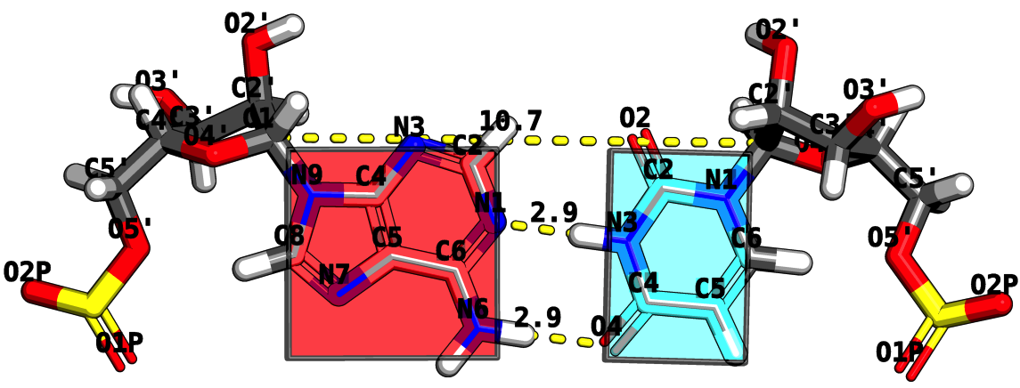
RNA Structure Analysis via the Rigid Block Model
Mauricio Esguerra
October 5th, 2010
PhD Program

Slide 2
Playbill
Motivation.
Act I. look at others.
Act II. Base pairs in RNA helical regions.
Act IIIFrom local to global properties in RNA with the aid of rigid-blocks.
RNA structural motifs identification using rigid-blocks.
Notes:
Change it to Act I, Act II, etc. → Intermezzo.

Slide 3
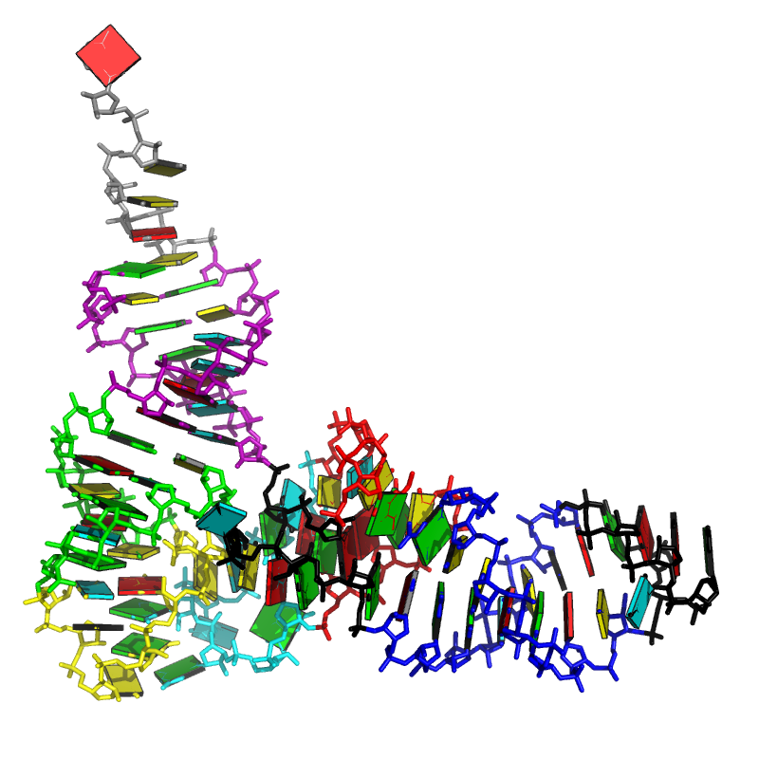
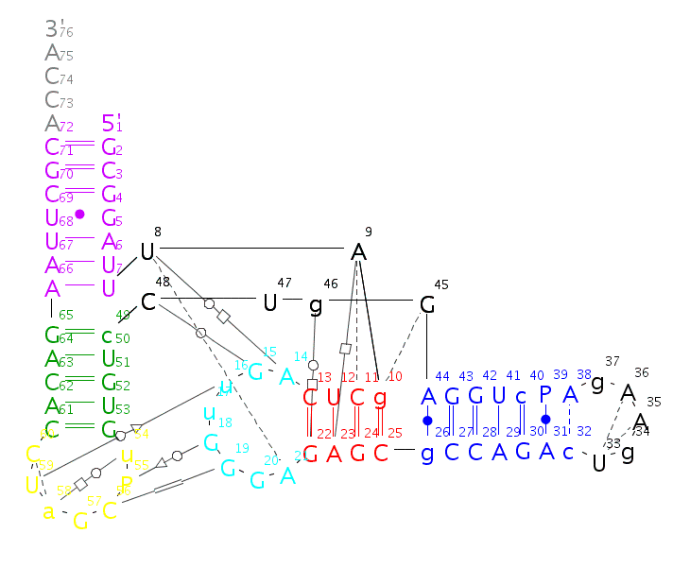
How does RNA Fold?
GCGGAUUUAGCUCAGUUGGGAGAGCGCCAGACUGAAGAUCUGGAGGUCCUGUGUUCGAUCCACAGAAUUCGCACCA

Slide 4
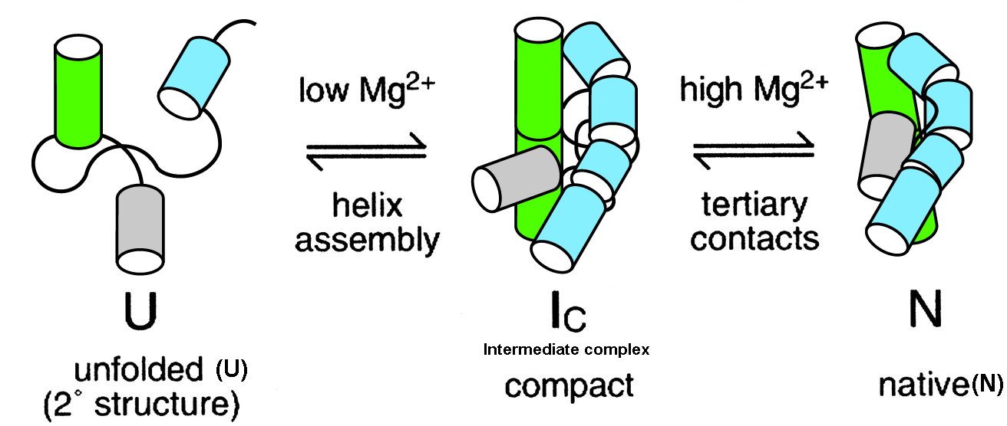
Easy or Hard?
Notes:
Too long.
Have the CHALLENGE IN ALL TO CONNECT TO OUTLINE!

Slide 5
RNA Conformations and Classification
Backbone (Reijmers2001)
Backbone, sugar, base (Sykes-Levitt2005)
Atom perspective
Bond perspective
Rigid body perspective
Covalent bonds (Reijmers2001, Schneider2004,
Hershkovitz 2003,2006)
Hydrogen bonds (Leontis-Weshof1998-2006)
Pseudobonds (Duarte-Pyle1998, 2003, 2007, Reijmers2001)
Stacking
Pairing/hbonds (Xin2005)
Notes:
Sentence in thesis. Three ways to look.

Slide 6
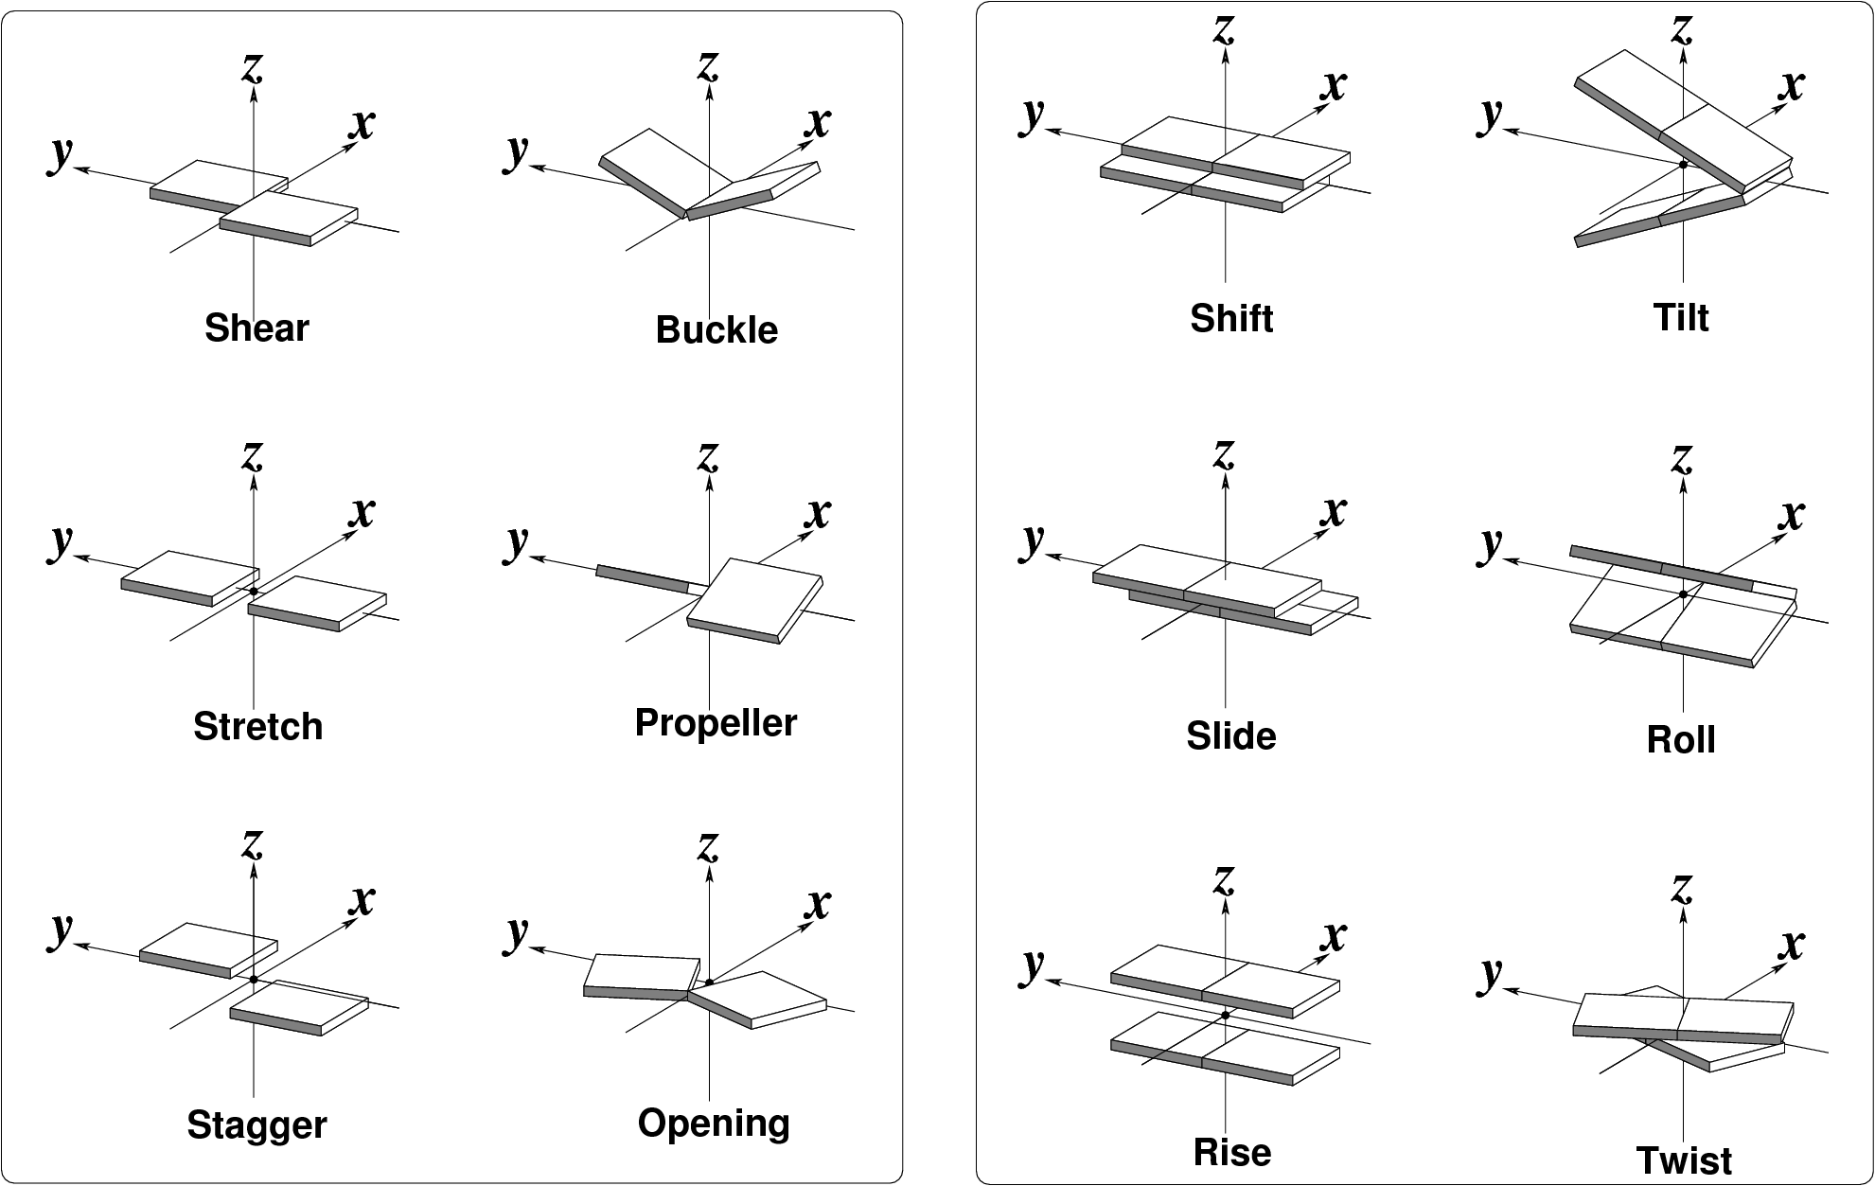
Rigid Block Perspective
Message here.
Notes:
Put message larger in titles

Slide 7
ACT I
Dinucleotide step classification using single-stranded base step parameters
Notes:
Look at what is before ACT, to give it a name as motivation.

Slide 8
monotonous Helen structures with her numbers in their display type.kindly provided.

Slide 9
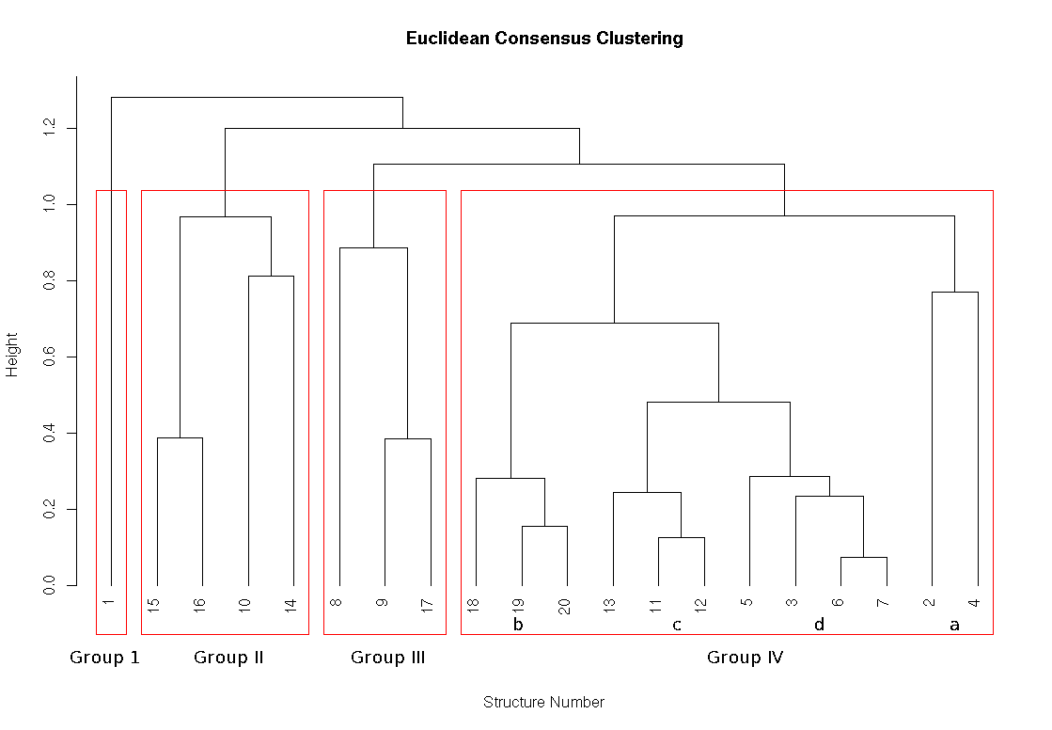
Consensus Clustering message here_x0013_

Slide 10
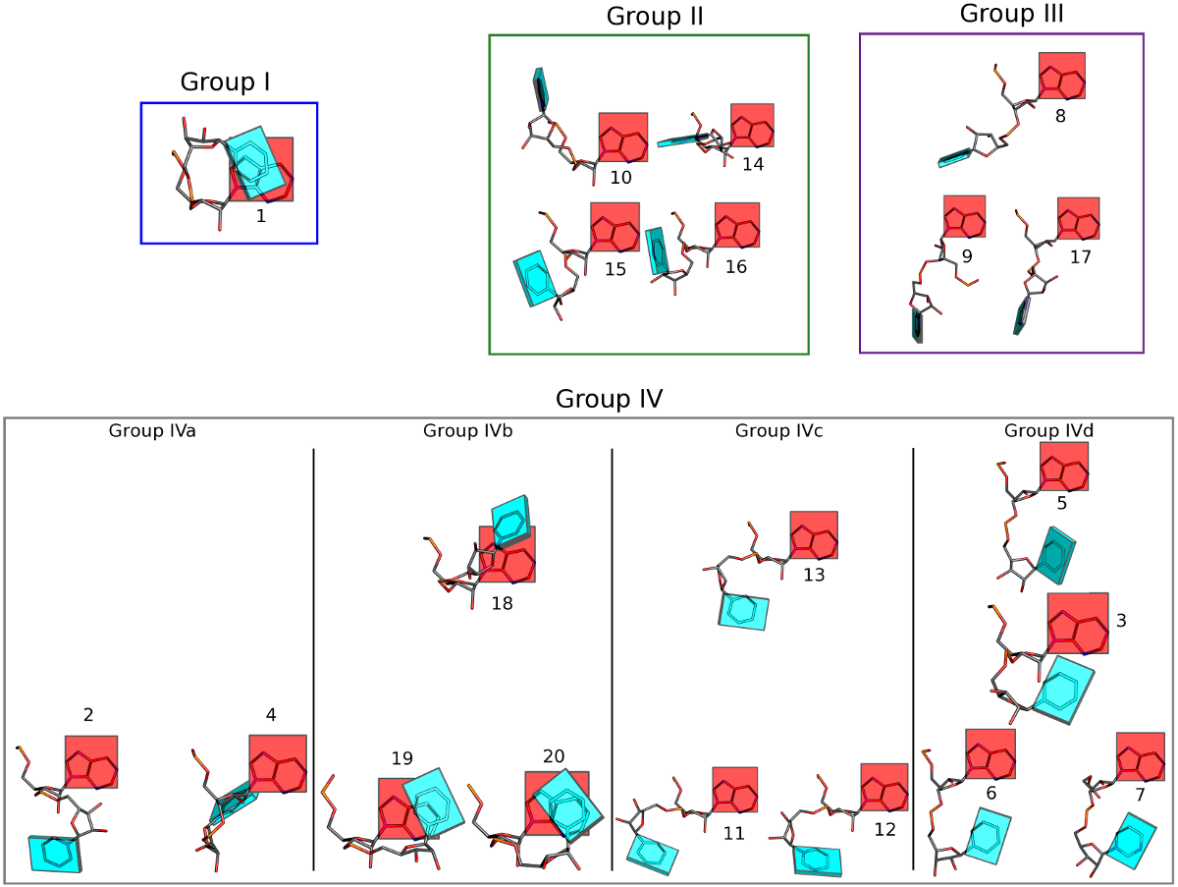

Slide 11
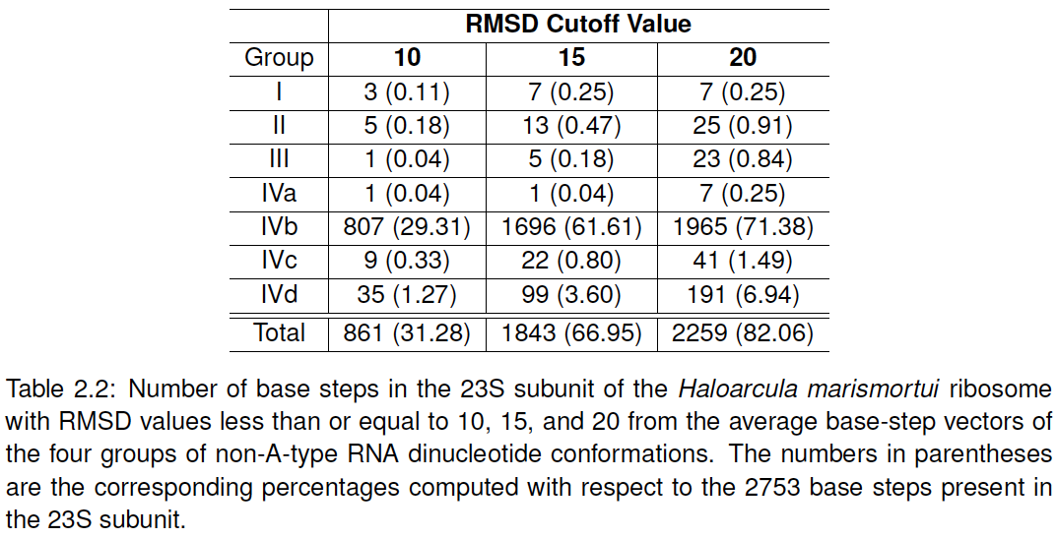
Only small fraction bla 23S -message- rRNA
Picture here of cutoff 10
Notes:
Subscript what’s in parentheses.

Slide 12
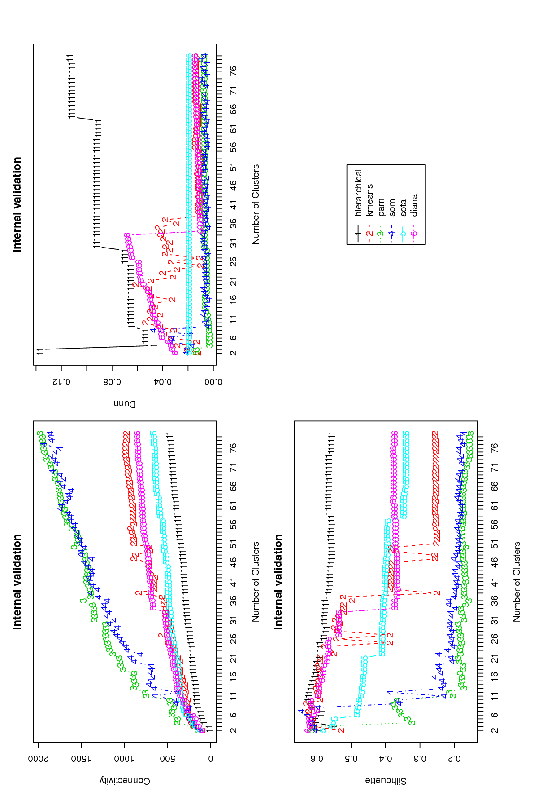
Message rather than just any clustering take advantage from software
Label these
Connectivity is best smaller etc

Slide 13
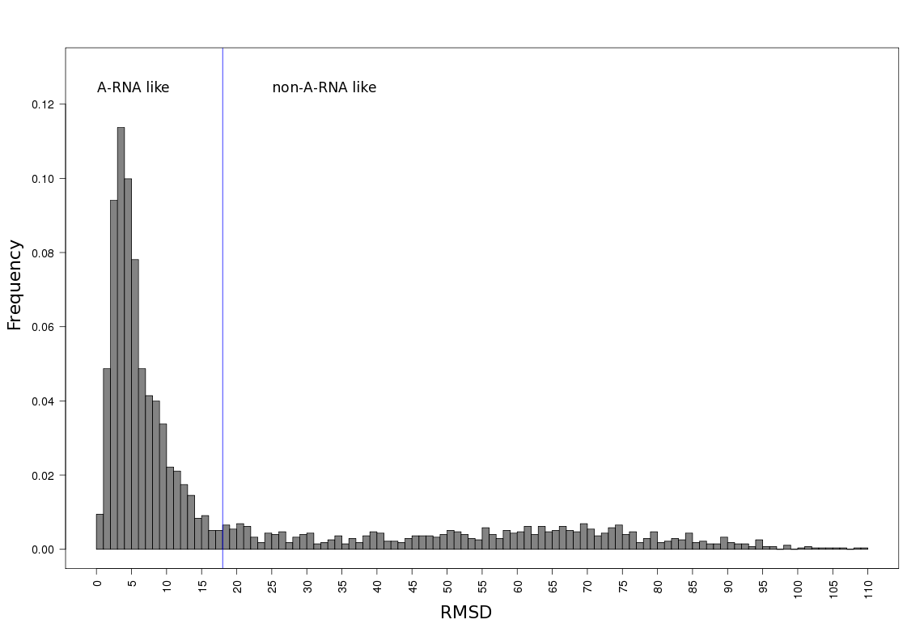
Message comparing with A-RNA
How many in each?

Slide 14
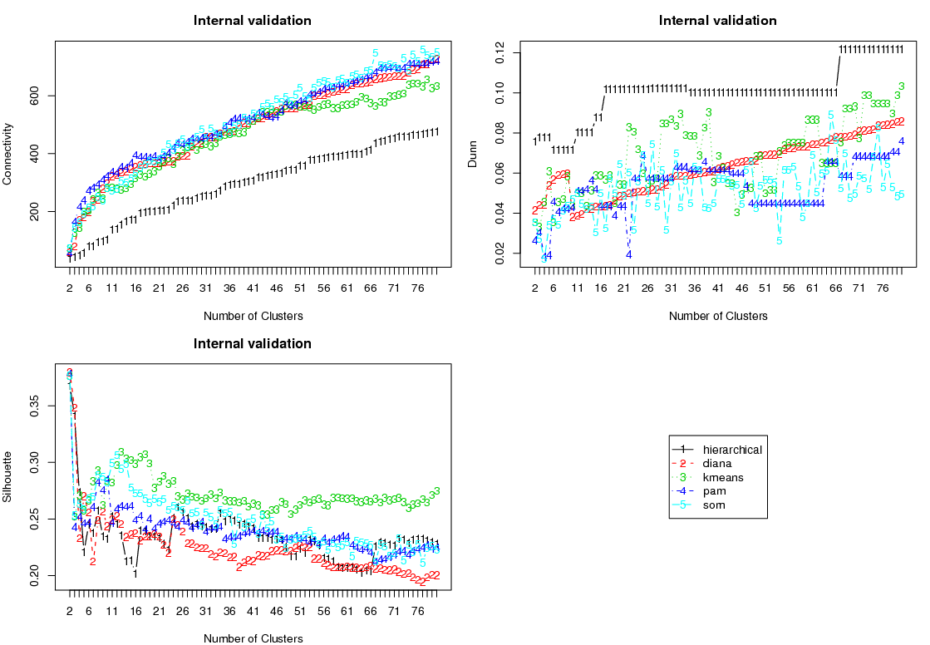
Message here -Non-ARNA-Like Validation
labels
Score better if
67 groups

Slide 15
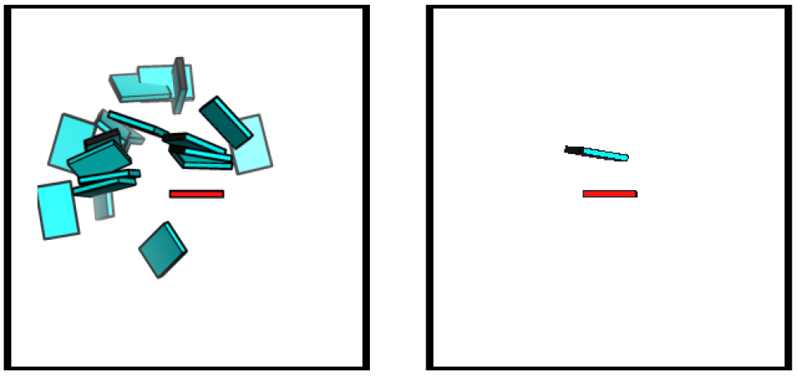
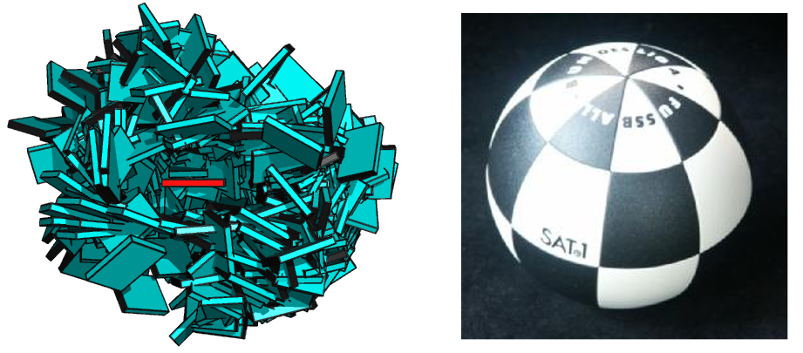
Message here
What are these?
The 67
Helens’
all
No-ball
How many ?

Slide 16
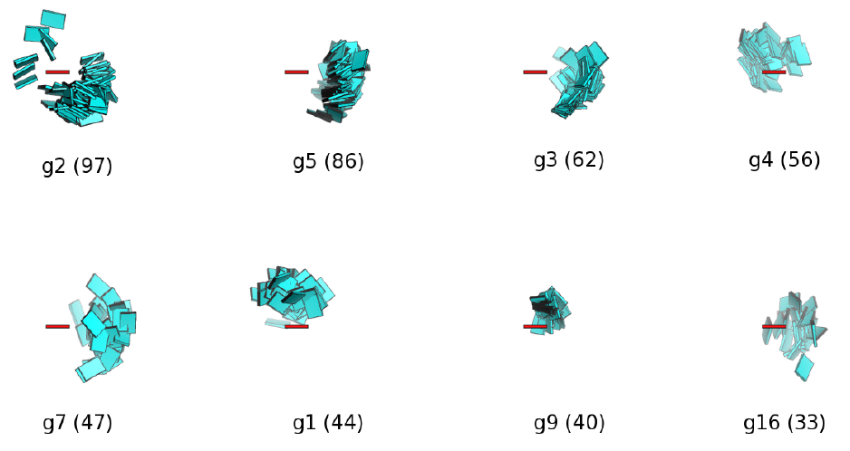
17 Main Non-ARNA-Like Clusters
Percentages of this, better than just how many
What are the missing groups?

Slide 17
ACT II
Base-pairs in RNA helical regions

Slide 18
Picture of helical regions describe.
Quasi-continuous show pictures.
Base-pairing preferences, base-sequence preferences, in helical regiosn which can be linked to tertiary interactions.

Slide 19
Partially Non-redundant RNA Dataset message here
Add line saying is percent
Notes:
MESSAGE HERE THAT ITS GC RICH

Slide 20
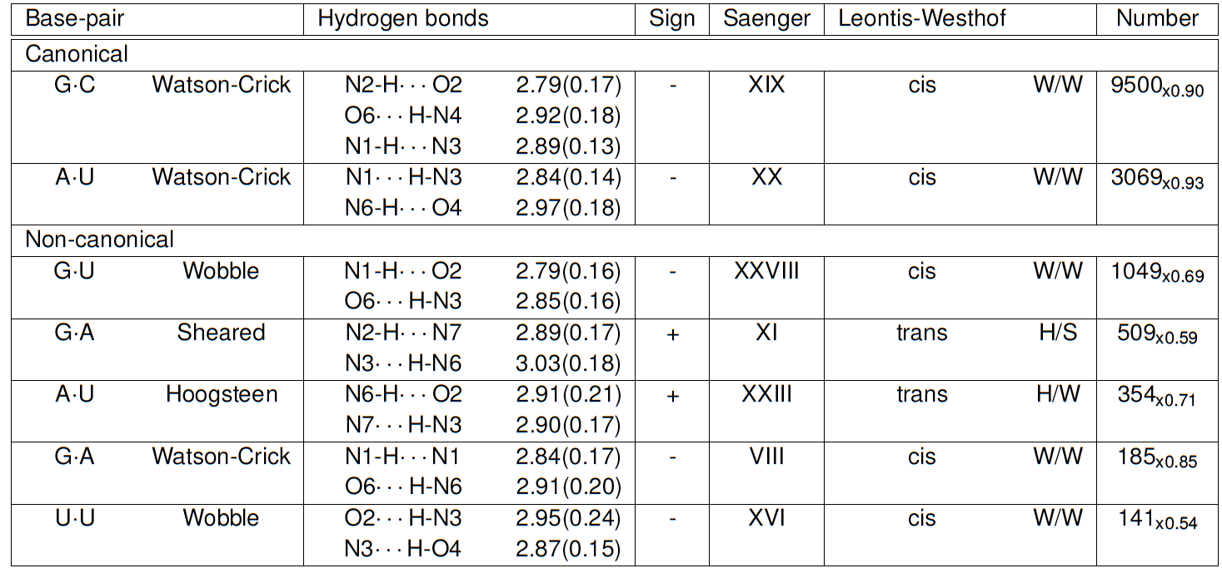
Seven Prominent Base-Pairs phrase in paper

Slide 21
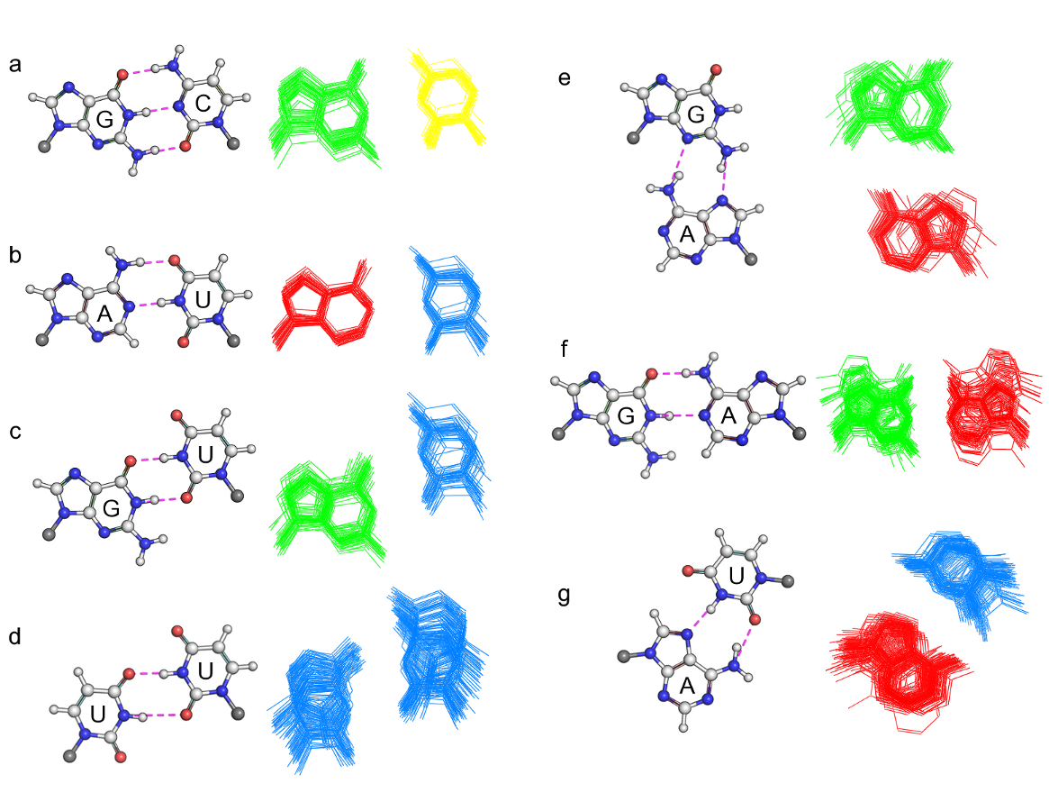
Non-canonical are more deformable. message
Notes:
Add NAMES to them.

Slide 22
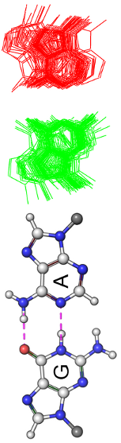
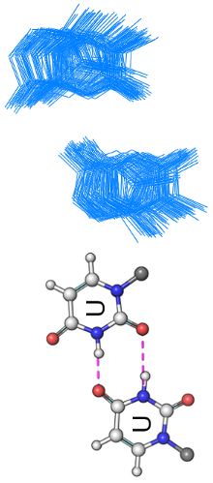
Average Base-Pair Parameters for the Seven.
Talk about analogy

Slide 23
ACT III
Base-pair-steps in RNA helical regions and RNA global properties

Slide 24
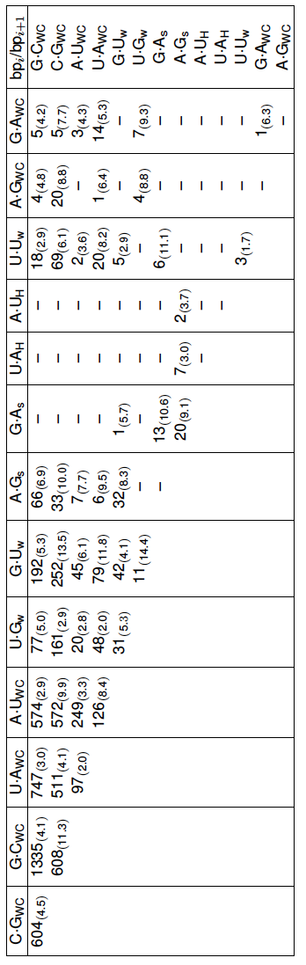
RNA Base-Pairs Steps so Far
Message here: not all possible combinations are seen
Point to examples that stand out.

Slide 25
Just hyperlink to slide
And then go to the site.
Show how it works.
http://rnasteps.rutgers.edu

Slide 26
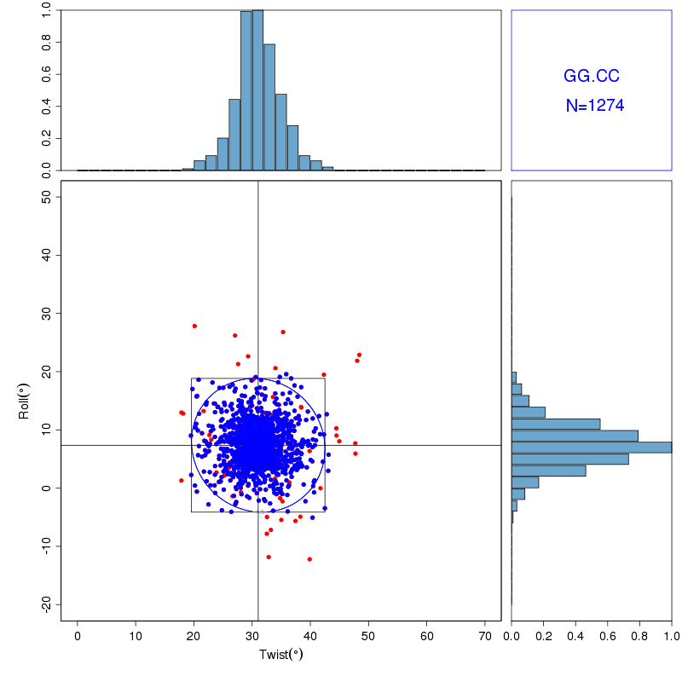
Energy Contours on Culled Data_x0013_
Notes:
This will just go from going into the website.

Slide 27
Intermezzo

Slide 28
jump to global properties.
Knowledge of adjacent makes it possible to make larger polymer.
Picture with four–five steps, just to illustrate principle

Slide 29
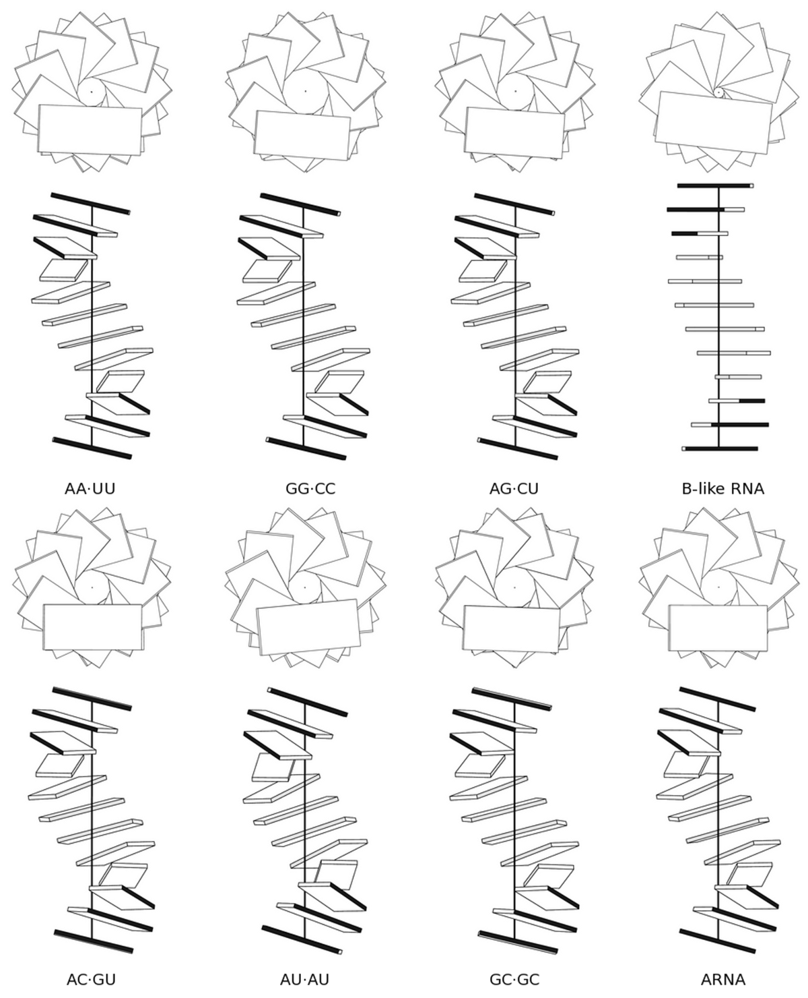
Homopolymers and Block Copolymers
Sequence has suttle effects on
Structure of RNA.

Slide 30
Movie or graph to explain persistence length
Talk about flexibility.
Table of different polymers and their persistence lengths

Slide 31
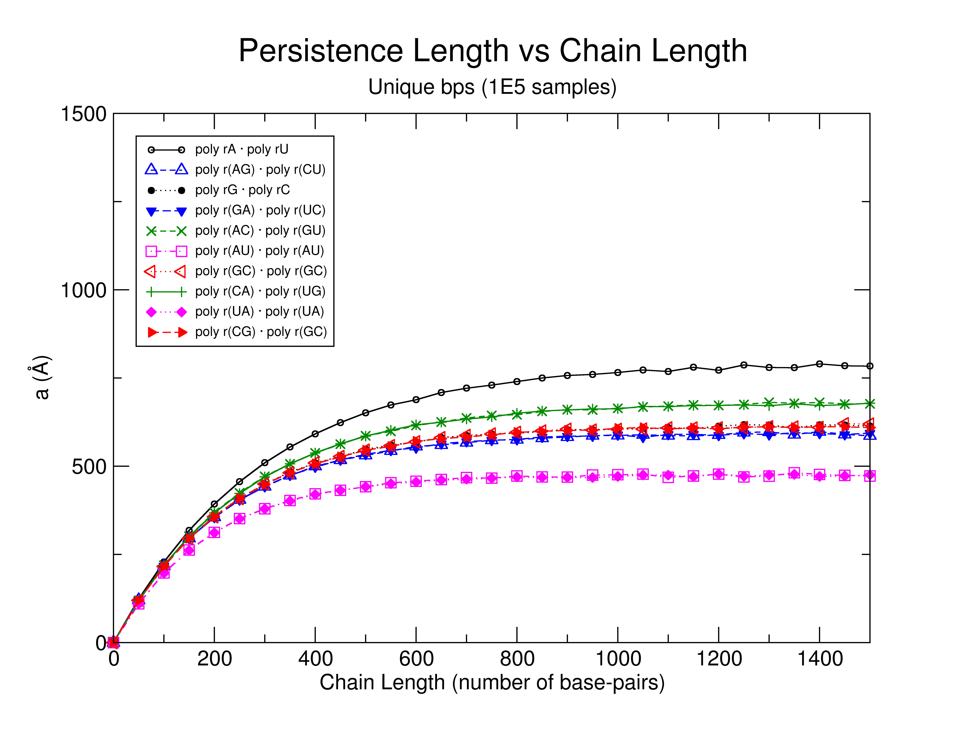
RNA Persistence Length
Message here
Suggest possible sequence
dependence

Slide 32
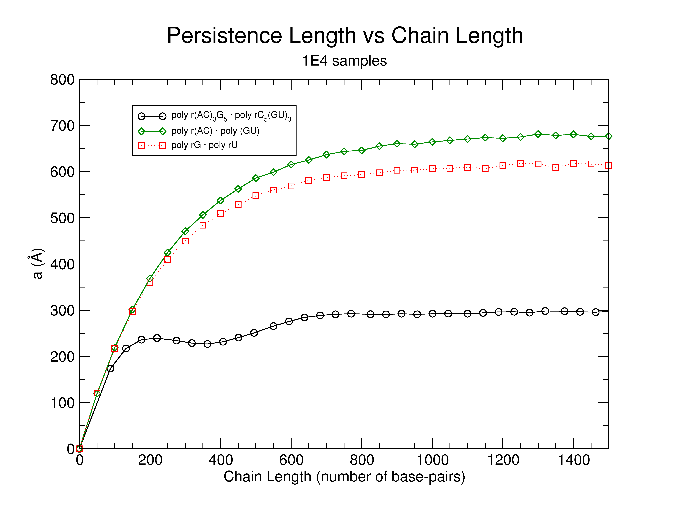
Message her of surprisingly some RNA messages appera to be curved RNA Chains
Notes:
FIX GRAPH_x0013_

Slide 33
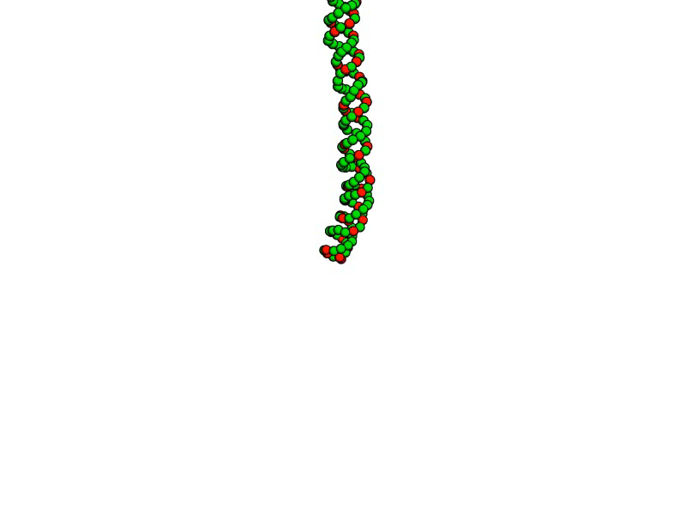
poly r(AC)₃ • poly r(GU)₃

Slide 34
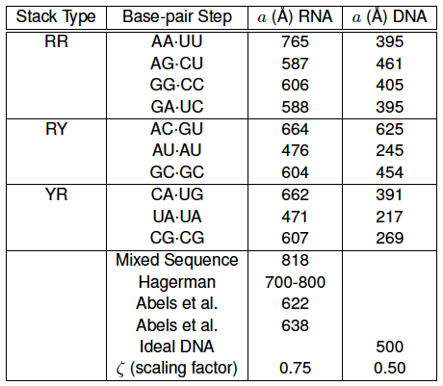
Modelled vs. Experimental a
Just what’s experimental what’s modelled
From x-ray strucutre analysis suggests that RNA is stiffer to

Slide 35
ACT IV
Finding RNA motifs using base step parameters.

Slide 36
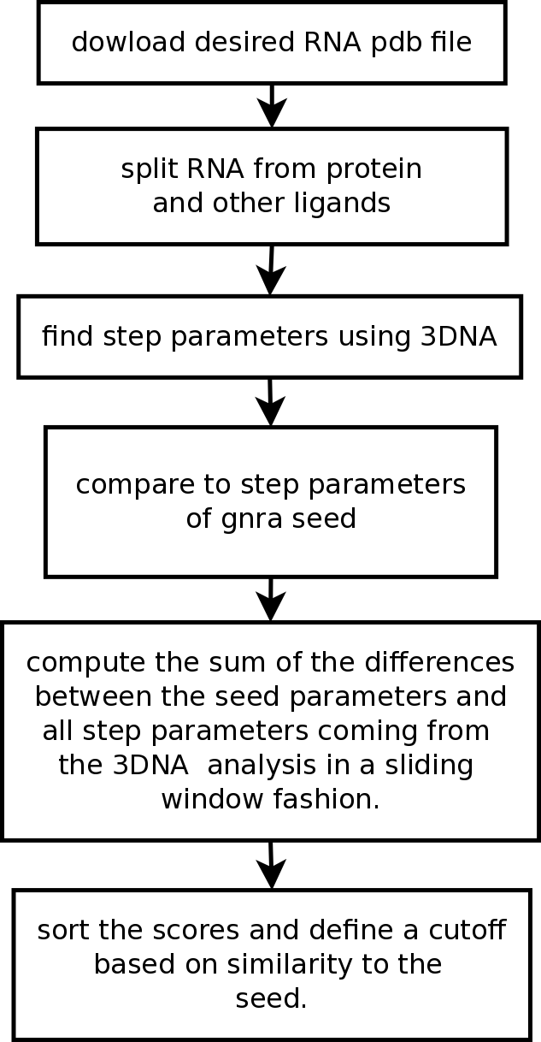
getMotif
Message
Description of software

Slide 37
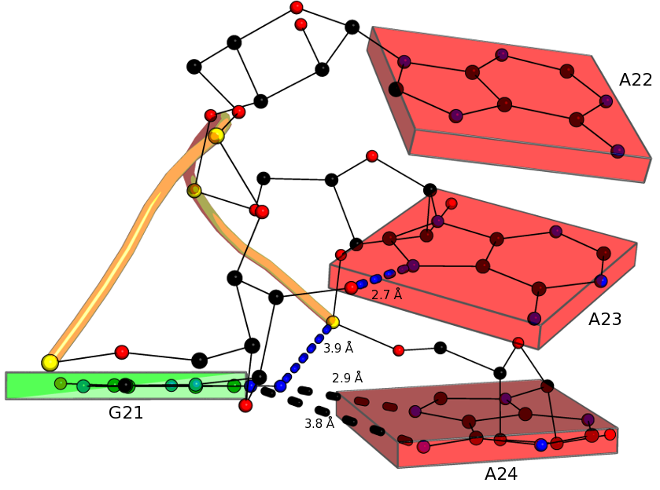
Test GNRA Tetraloop Motif
GNRA Tetraloop provides
Good “toy” model

Slide 38
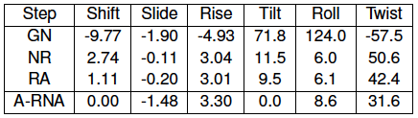

GNRA Steps in PDB_ID:1FFK
What do rigid body parameters
Tell you?

Slide 39
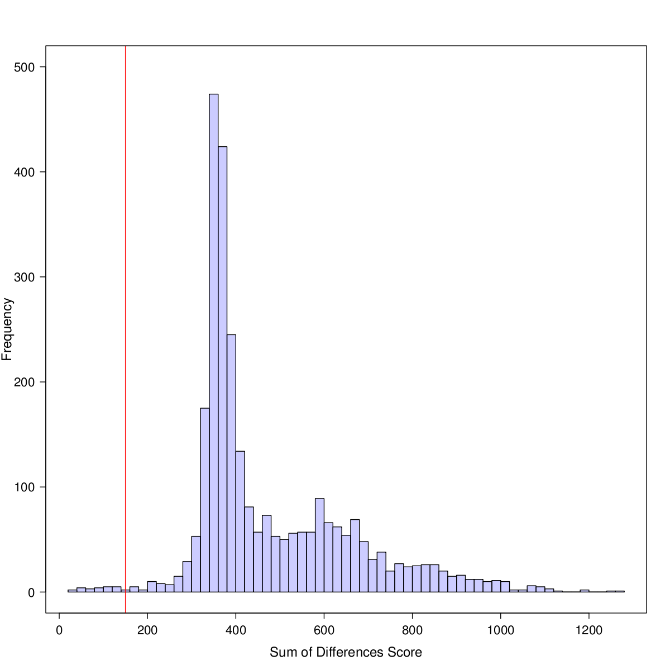
No acronym Score Cutoff
This is for 1FFK
Sliding windows image
Image with matrices in color
Boxes
e.g.
--- ---- ----
---- ---- -----
--- ---- ----

Slide 40
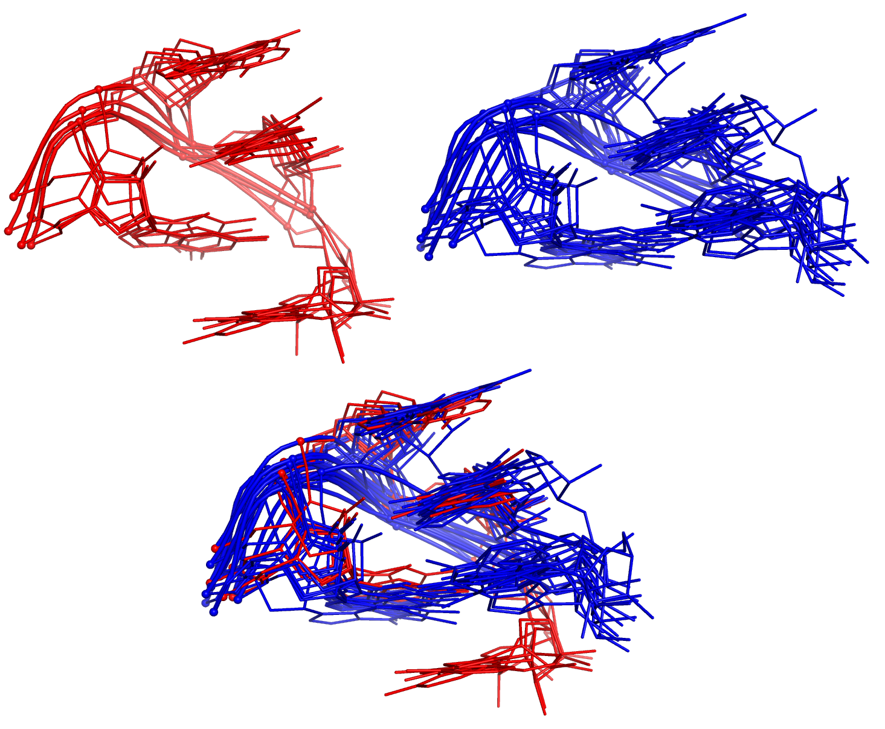
More informations
Software recognixes this motifs
Add base in pentaloops and
Tell how many in other slide

Slide 41
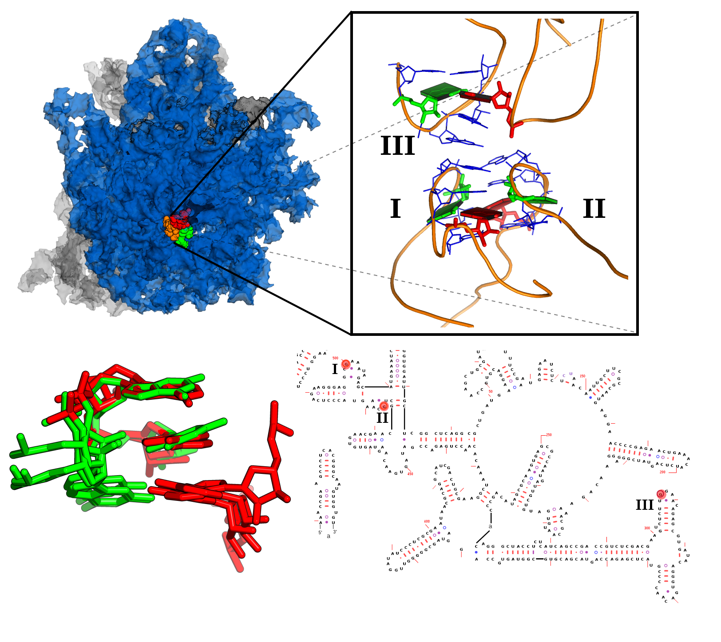
Group II Candidate is Lone-Pair Triloop
This loops
Are ocurring
In such
Just use right side
If figure
In additional ribosome
In left.

Slide 42
Finale
Each act conlcusion or message
Future, open questions. Coming attractions

Slide 43
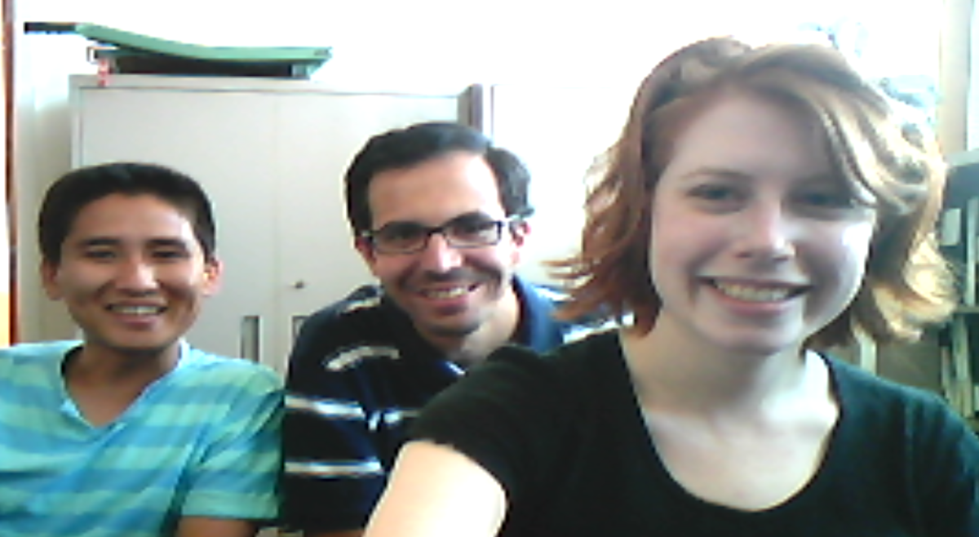
Thanks for yout attention
Thsnk comitte,
Visit us at: http://dnaserver.rutgers.edu
Special thanks to all members of the Olson Lab,
past and present.

Slide 44
